Slide 1
WHERE SHOULD THE NEXT
COMPLIANCE DOLLAR GO?
A data-driven case across service quality, accessibility and operations
17,663 approved education & care services, analysed nationally
[Your Name] · Prepared for ACECQA & State Governments
Notes:
Hi, I'm [YOUR NAME], and I work for government to improve education and care services across Australia. Here's the problem I'm solving: ACECQA and state governments have a limited budget for lifting service quality and funding new services, across seventeen thousand approved services nationally. Spent well, that budget closes real gaps for families. Spent on the wrong thing, it doesn't move the needle. So today, three questions with data: where is quality actually failing and why, where are families genuinely cut off from services, and — just as important — what should we stop assuming matters, so we don't waste money chasing it.

Slide 2
THE DATA
The national register of every approved service
17,663
10
17,653
Services in the national register, with quality ratings and transport-access fields for each
Services dropped — no address at all, every one geocoded to the same placeholder point in Myanmar
Services checked and kept — the working dataset for every chart that follows
02
Notes:
Quickly on the data: this is the national register of every approved service, with quality ratings and transport-access data. Before trusting it, I checked it — ten services had no address at all and had all been geocoded to the same point in Myanmar. I dropped those rather than guess. Everything else checked out.

Slide 3
1
PROBLEM 1
Is quality failing consistently, or is it a specific, fixable issue?
All eight states and territories apply the same National Law.
03
Notes:
First problem: all eight states and territories apply the same National Law. If quality outcomes are wildly inconsistent anyway, that's either a resourcing gap or an enforcement gap — and knowing which one matters, because they need completely different fixes.

Slide 4
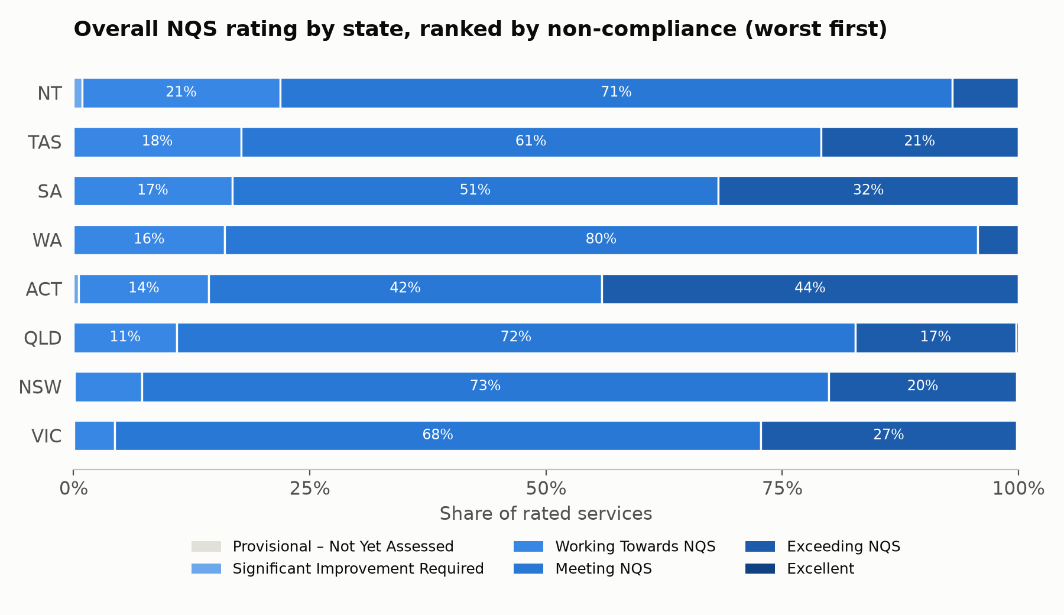
PROBLEM 1 · CHART 1
Same law, a 5x compliance gap between states
04
Notes:
They are wildly inconsistent — and I'm ranking this by who's actually failing the legal minimum, not who's excelling. The Northern Territory is worst: twenty-two percent of its services rated Working Towards NQS or Significant Improvement Required. Victoria is best, at four percent. Same law, five-times difference. That's not noise — that's a finding that should already be uncomfortable for a national regulator.

Slide 5
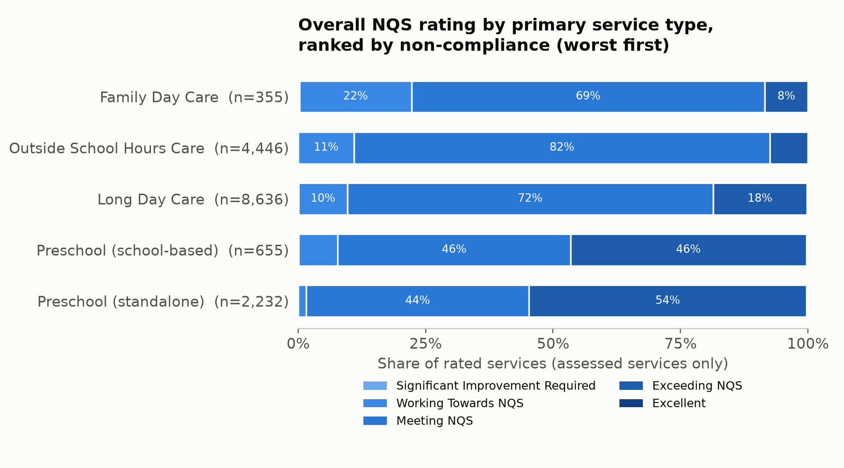
PROBLEM 1 · CHART 2
Family Day Care is the weakest performer nationally
05
Notes:
It's not just geography, either. Ranked the same way as Chart 1 — worst compliance first — Family Day Care is the clear outlier: twenty-two percent non-compliant, roughly double Long Day Care and Outside School Hours Care, and miles behind standalone preschools at under two percent. Family Day Care is a small slice of the sector by numbers, but it's the single worst-performing service type in the country.

Slide 6
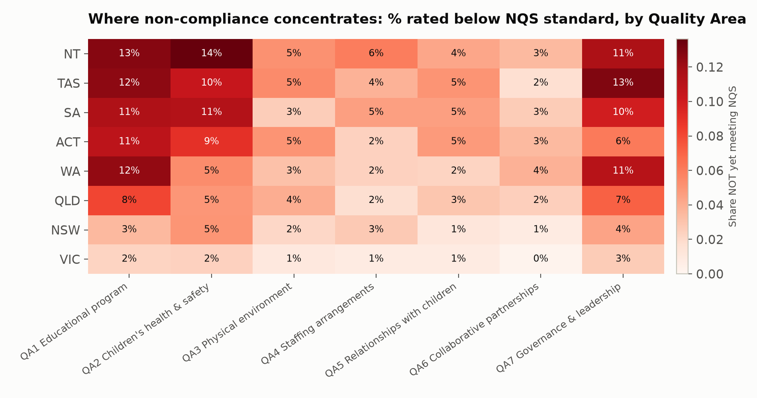
PROBLEM 1 · CHART 3
State averages hide component-level problems
06
Notes:
This chart zooms from the overall number into which specific component drives it. The Northern Territory and Tasmania still lead — but by this component-level measure, Western Australia and South Australia join them near the top, up to fourteen percent non-compliant in a single quality area, even though WA ranked only fourth on the overall measure in Chart 1. A state's overall rating isn't a simple average of its seven components, so a state can look mid-table overall while hiding a real problem in one specific area — concentrated here in Quality Area 1, educational program, and Quality Area 7, governance.

Slide 7
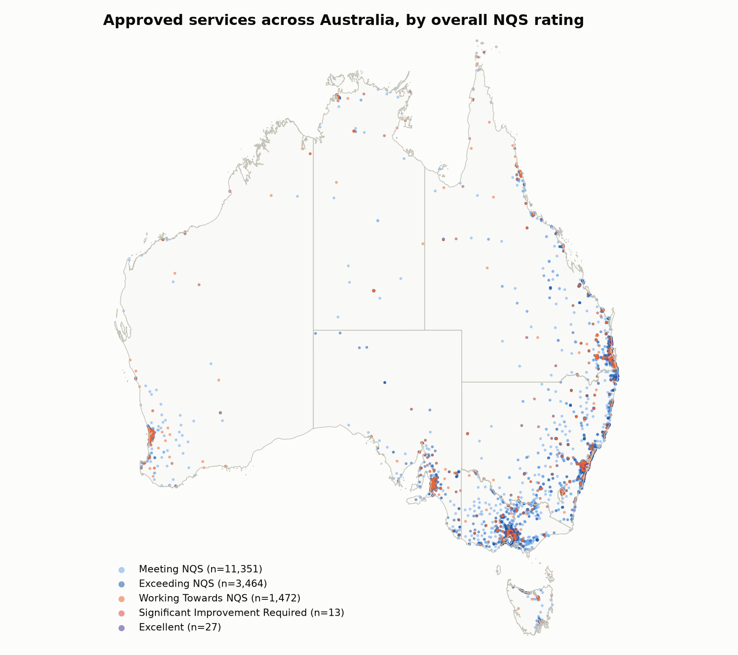
PROBLEM 1 · CHART 4
Underperformance clusters around Perth and Adelaide
07
Notes:
And it's local enough to act on directly — you can see clusters of underperforming services around Perth and Adelaide specifically, which means a support team could be deployed to a cluster, not spread across an entire state.

Slide 8
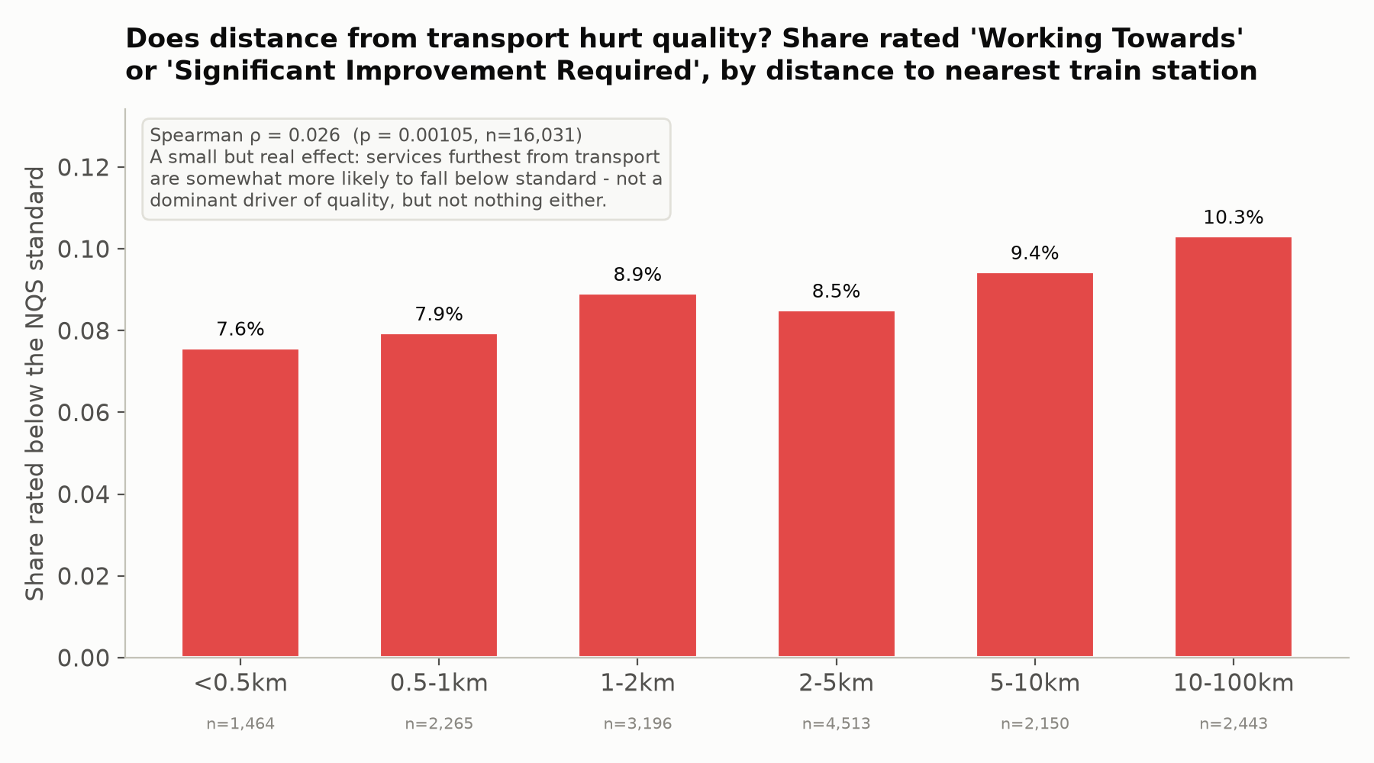
PROBLEM 1 · CHART 5
Transport hurts quality — but only slightly
08
Notes:
Before recommending a fix, I need to test the obvious hypothesis: does poor transport access damage quality? I looked at the share of services rated below the NQS standard by distance to the nearest train station. It rises from seven-point-six percent for the closest services to ten-point-three for the furthest — real and significant, but small. A transport upgrade might nudge quality slightly; it won't close a ten-times state-level gap. A minor risk factor beside much bigger drivers.

Slide 9
2
PROBLEM 2
Are families structurally cut off from services — and where worst?
Four assignment requirements, four charts built to prove a claim — plus one gut-check chart.
09
Notes:
Second problem, and the assignment sets four specific questions here. I'm answering each one directly, with a chart built to prove a claim, not just describe a distribution.

Slide 10
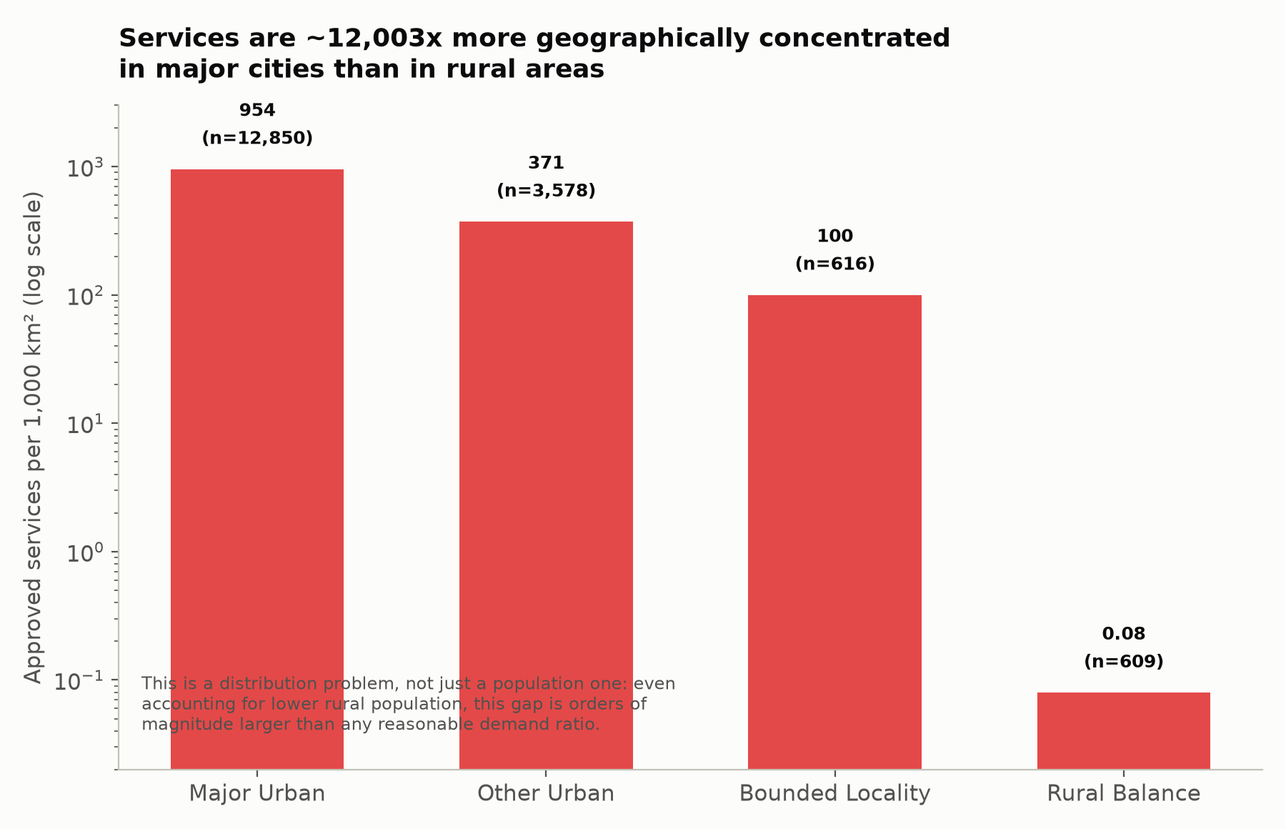
PROBLEM 2 · CHART 6
Services are 12,000x denser in cities than the country
10
Notes:
First: the geographic disparity itself. Measuring services per square kilometre by ABS area type, Major Urban areas have about twelve thousand times the density of Rural Balance areas. That's not just 'cities have more people' — it's an order of magnitude beyond any population ratio you could justify. Provision is structurally concentrated, not just naturally uneven.

Slide 11
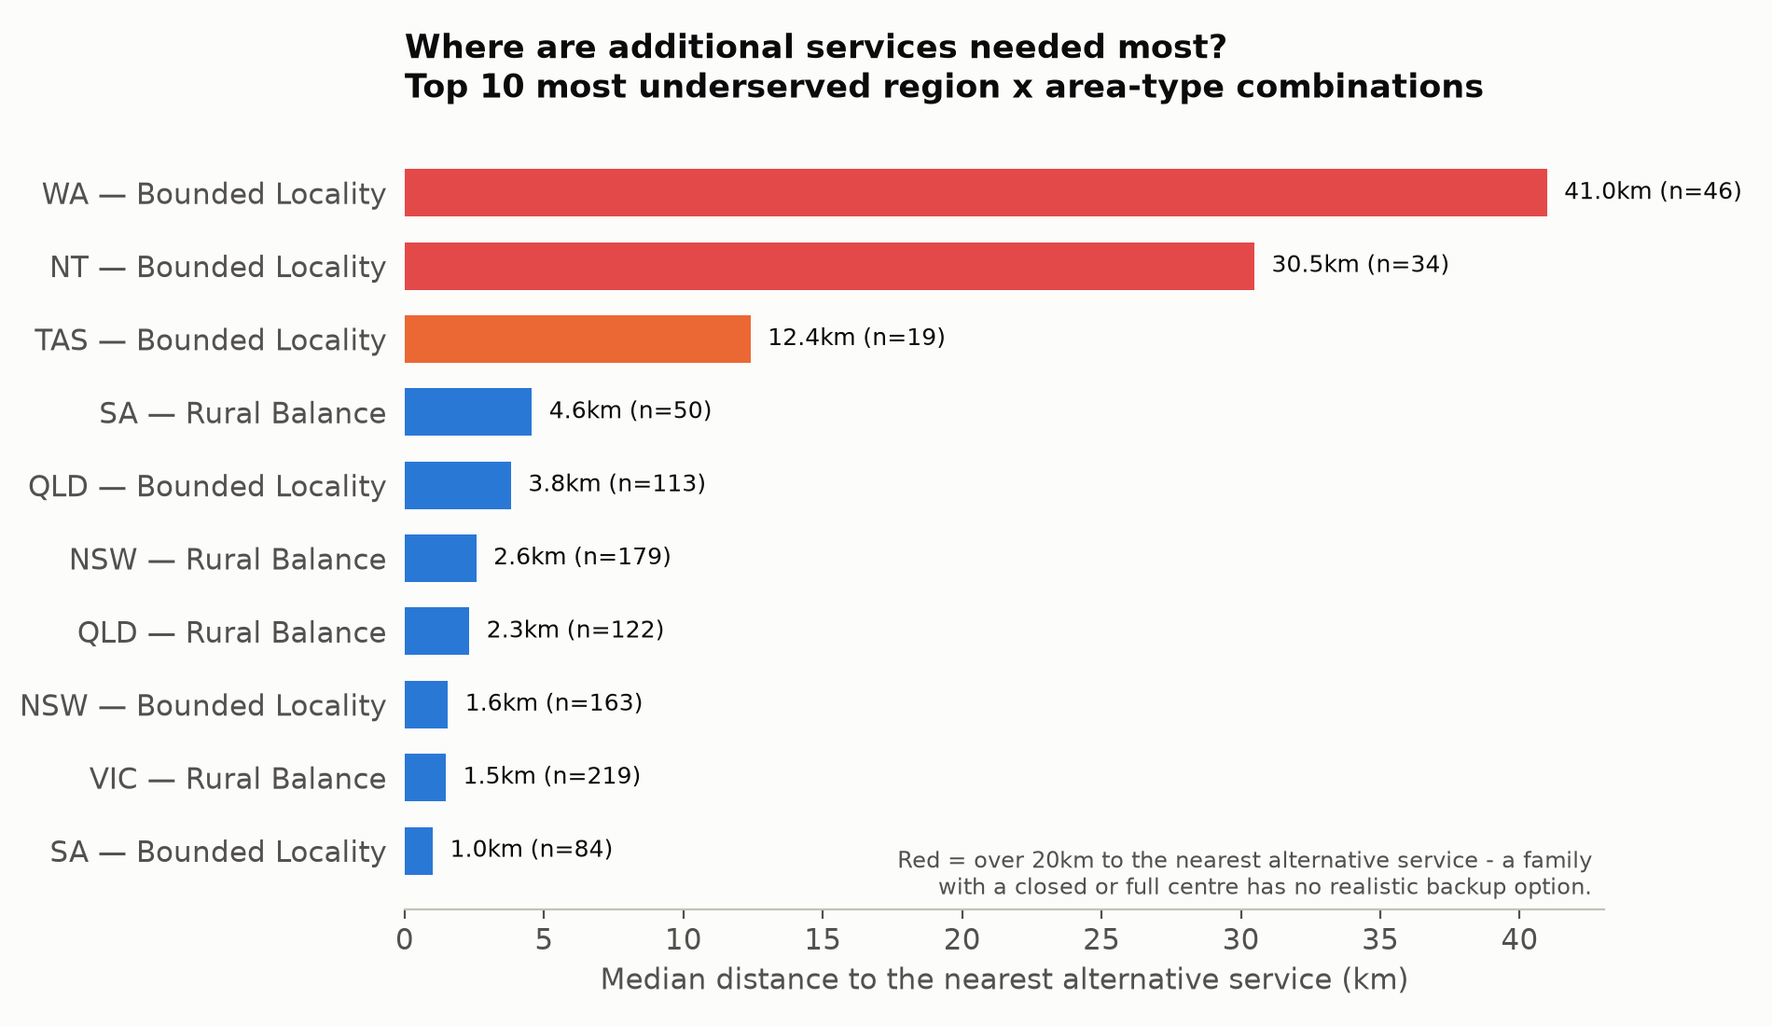
PROBLEM 2 · CHART 7
WA's Bounded Localities: the biggest coverage gap nationally
11
Notes:
Second: where specifically should ACECQA add capacity? I measured, for every service, the distance to its nearest alternative — the real question a family asks when their usual centre is full or closed. Ranked worst first: Western Australia's Bounded Localities are the single worst case in the country, a median forty-one kilometres to a backup option. The Northern Territory's Bounded Localities are second, at thirty kilometres. These are the two places a new-service dollar should go first — not a general 'rural funding' line, a named list.

Slide 12
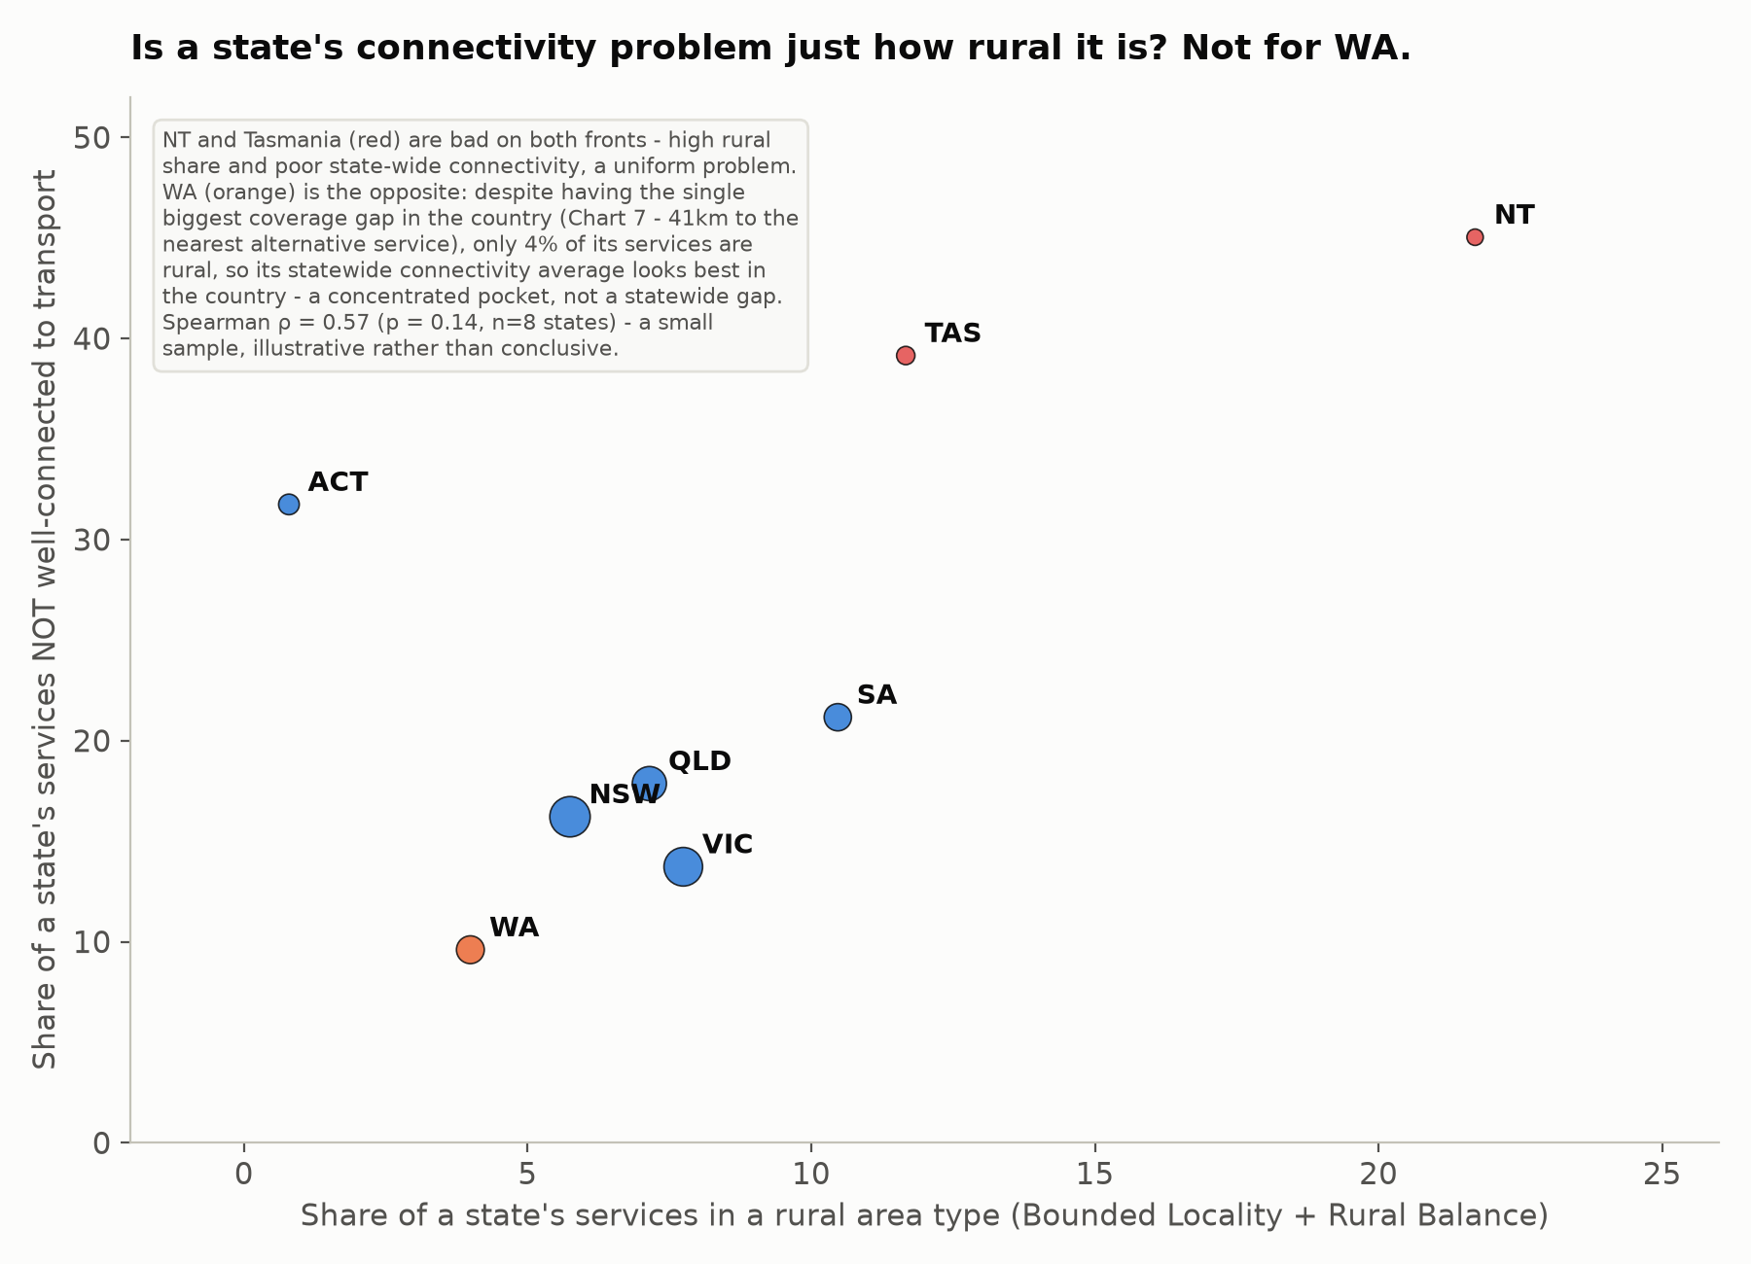
PROBLEM 2 · CHART 8 (BRIDGE)
WA's gap is a pocket problem — not a statewide one
12
Notes:
One gut check: are NT and Tasmania — already flagged worst on compliance — just showing up again here because they're the most rural? Plotting rural share against statewide connectivity: yes for them, a genuinely statewide problem. But Western Australia breaks the pattern — despite the country's biggest coverage gap, from Chart 7, only four percent of its services are rural, so its statewide connectivity average is actually the best in the country. Same state, two different problems.

Slide 13
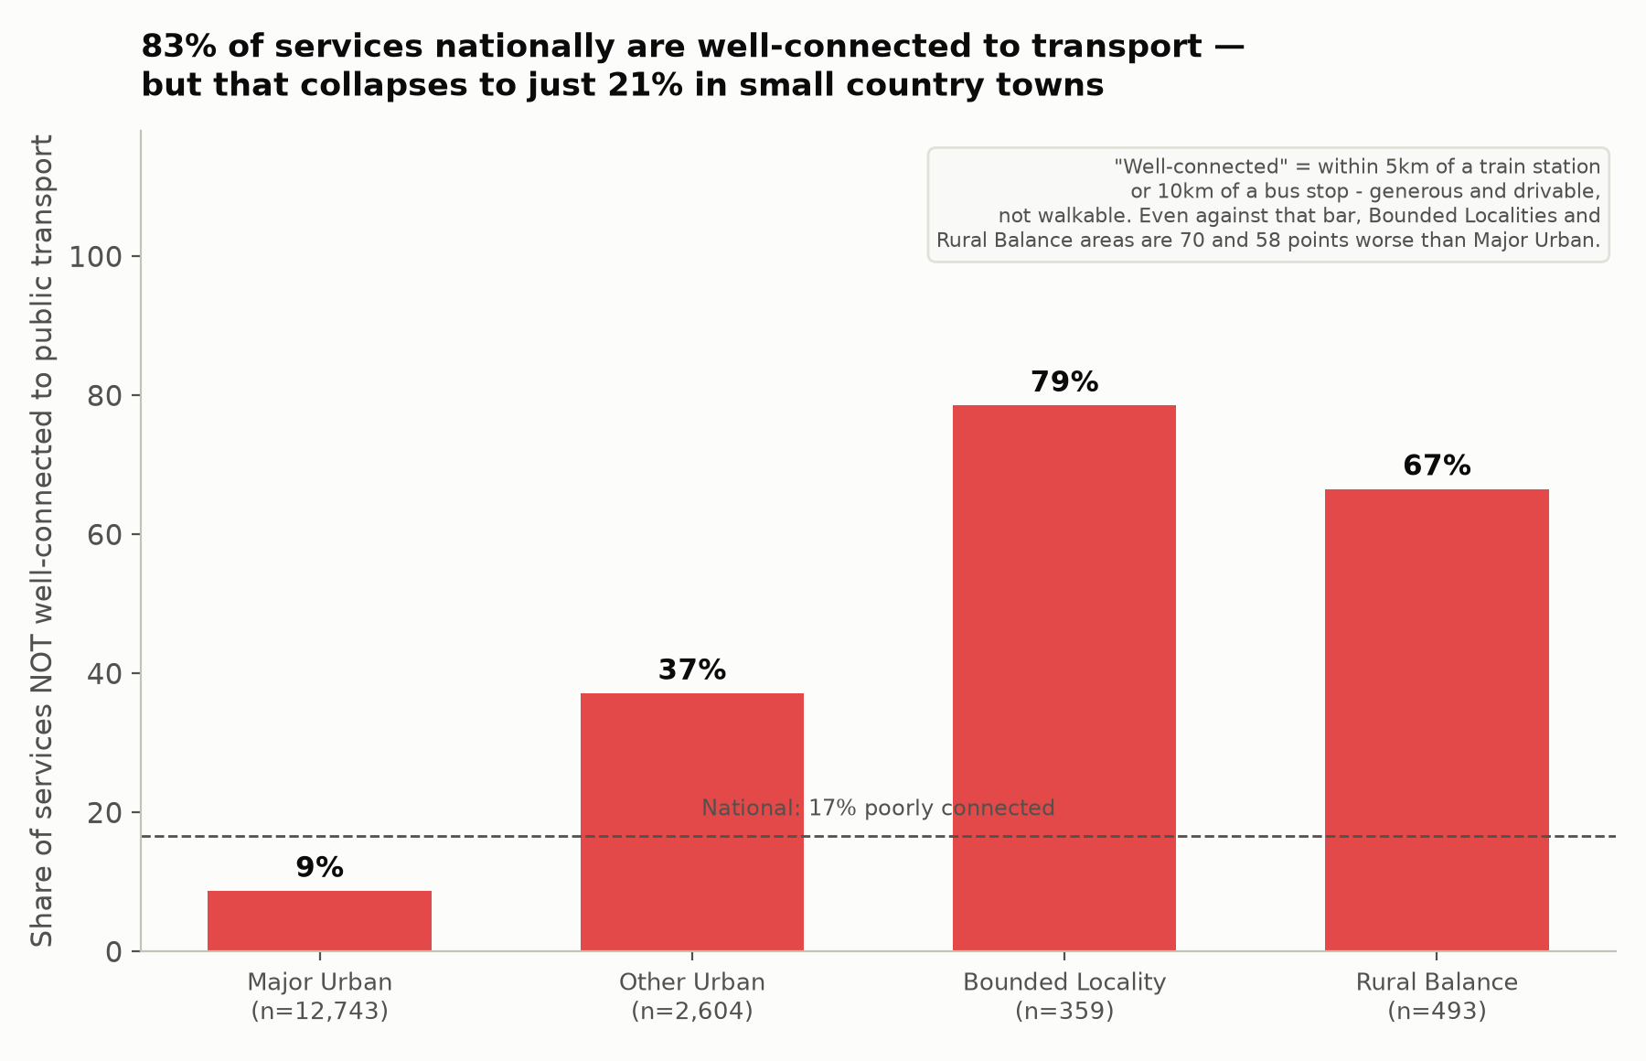
PROBLEM 2 · CHART 9
83% well-connected nationally, just 21% in country towns
13
Notes:
Third requirement: transport connectivity, using the actual distance-to-station and distance-to-bus-stop fields — with a deliberately generous bar, five kilometres to a train station or ten to a bus stop, a short drive, not a walk. Even so, eighty-three percent of services nationally clear it. But that collapses to twenty-one percent in small country towns and thirty-four in the most rural areas — a seventy-point gap against major cities, on a generous bar. A real rural transport gap, not a threshold artefact.

Slide 14
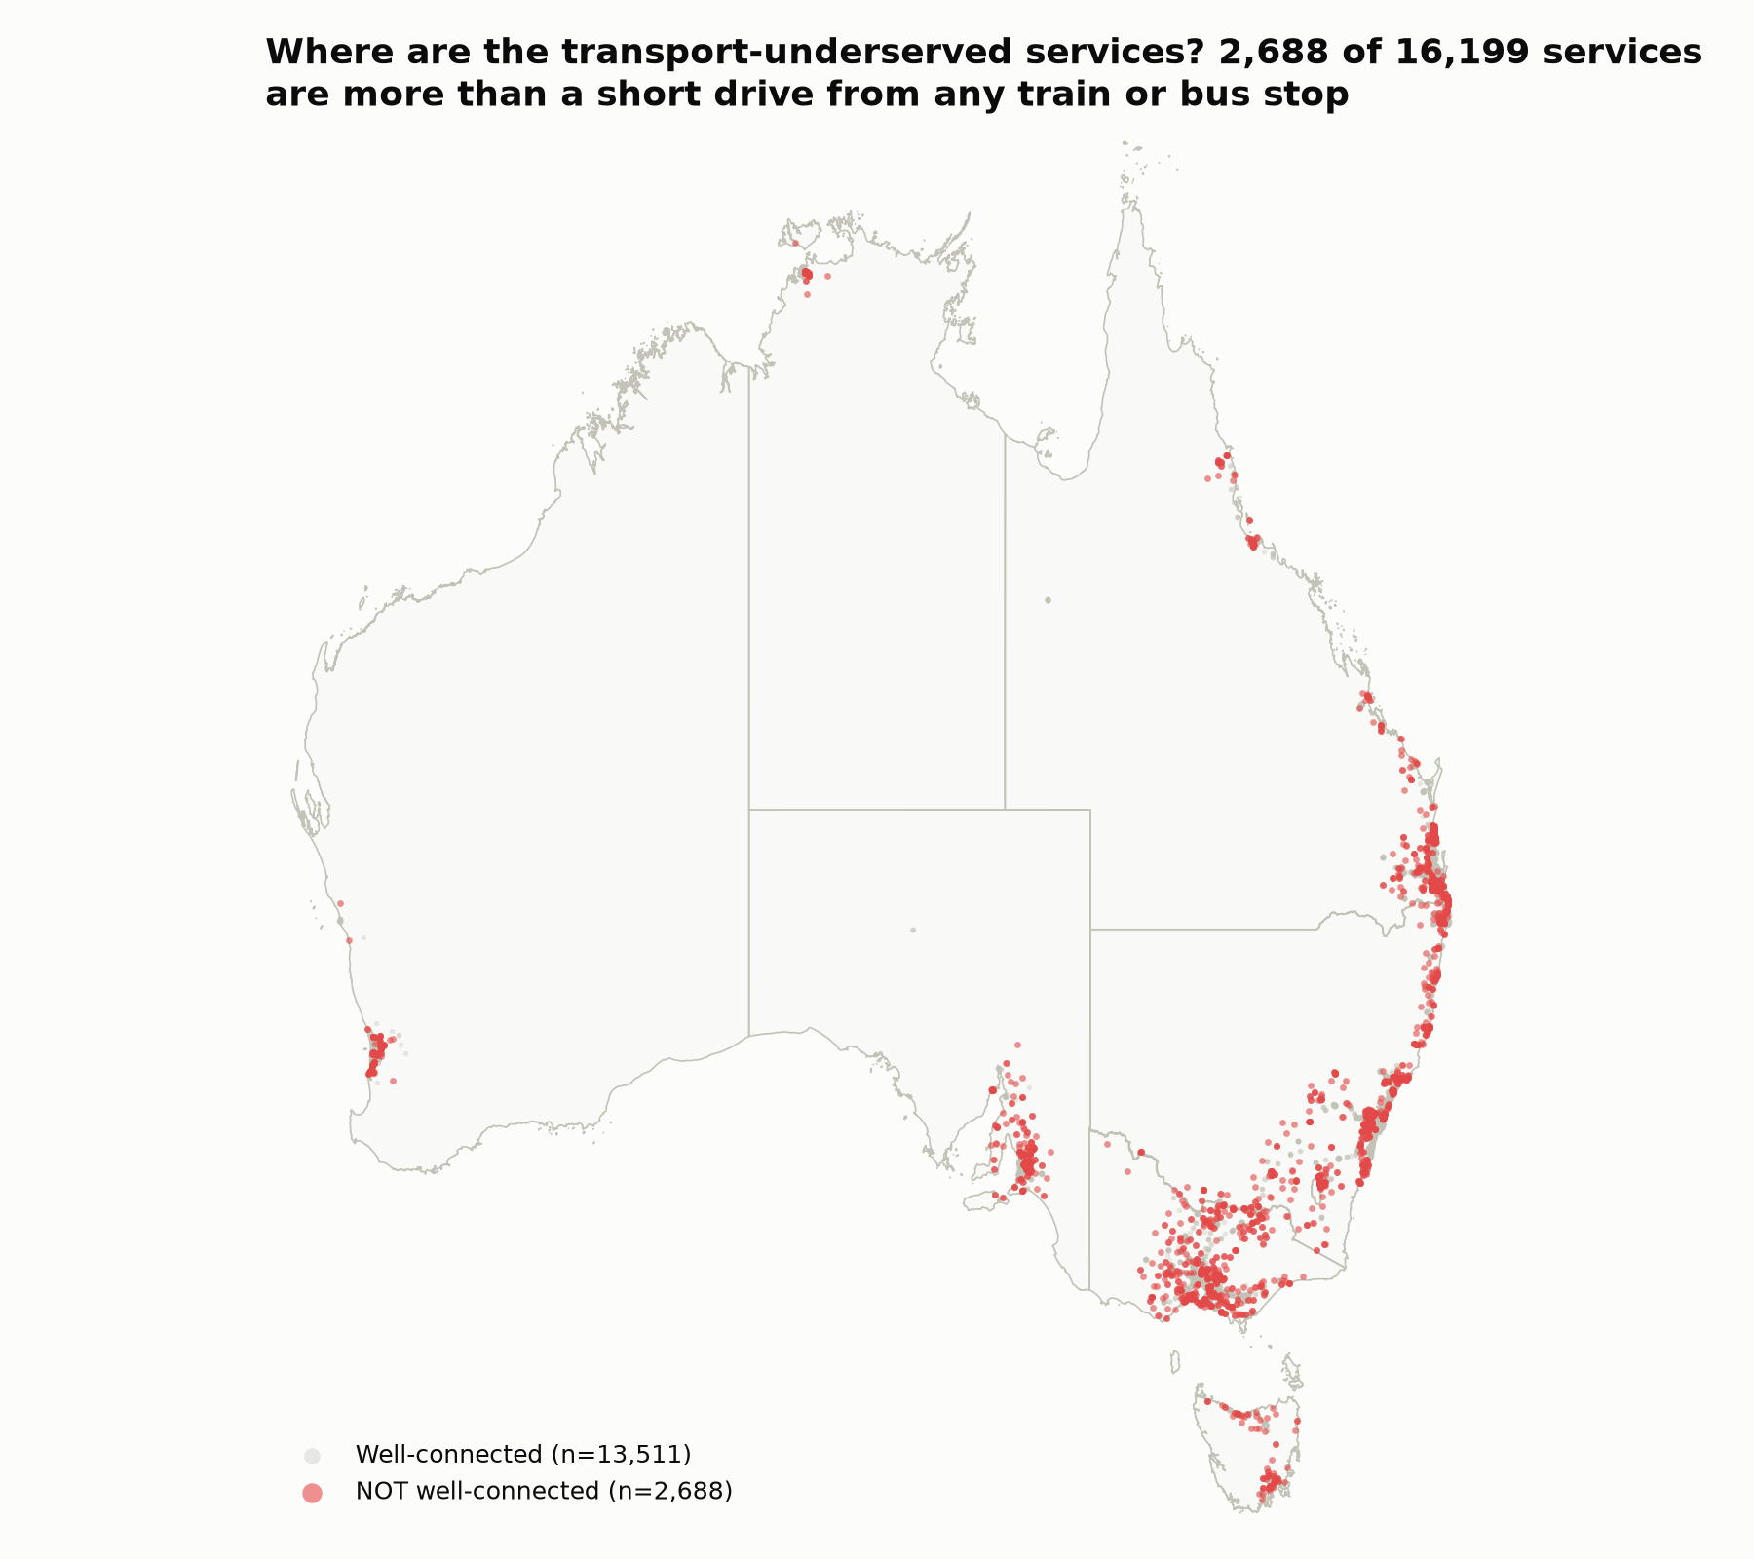
PROBLEM 2 · CHART 10
The transport gap is concentrated, not scattered
14
Notes:
Fourth: mapping every poorly-connected service directly, rather than just a state or area-type average. Roughly twenty-seven hundred services, in red, more than a short drive from any train or bus stop — concentrated in small towns and rural stretches away from the main rail corridors, not scattered randomly. That confirms Chart 9's area breakdown directly: this is a genuine, geographically concentrated rural access gap.

Slide 15
3
PROBLEM 3
Which operational factors actually push a service below the standard?
Three levers tested directly. Two matter. One doesn't.
15
Notes:
Third problem, and it's a different kind of test. ACECQA could point to three operational levers — size, opening hours, how old a service is — and assume any of them explains non-compliance. I tested all three directly. Two matter. One doesn't.

Slide 16
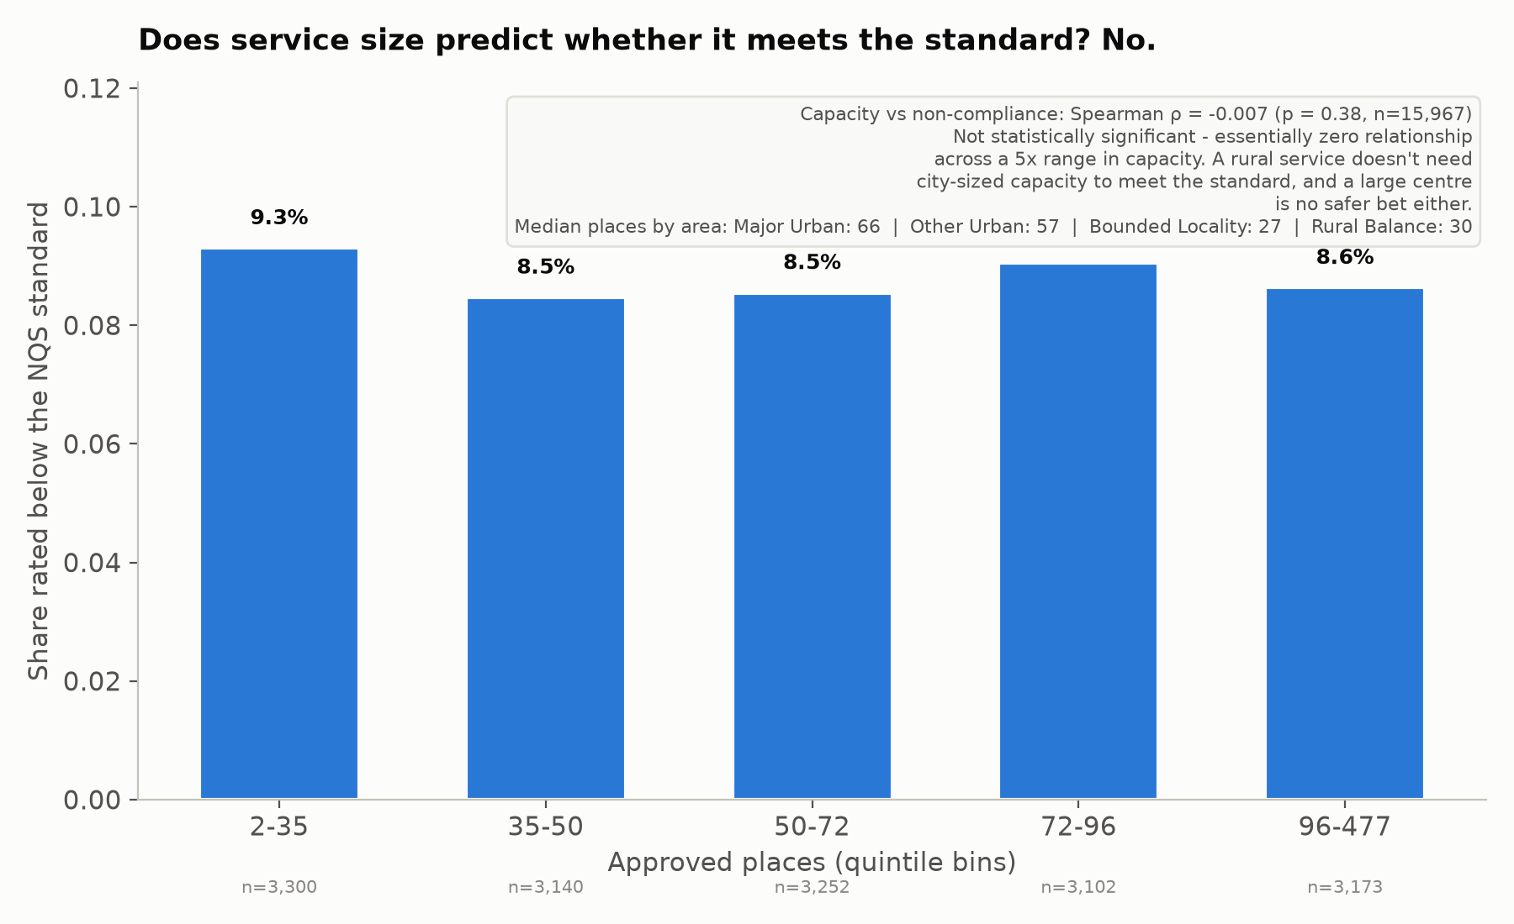
PROBLEM 3 · CHART 11
Bigger centres are no safer bet
16
Notes:
Capacity varies a lot by type and by area — sixty-six places typical in major cities, twenty-seven in small country towns. But tested directly against non-compliance in capacity bands, the smallest services sit at nine-point-three percent, the largest at eight-point-six — not even statistically significant. A bigger centre is no safer bet — a new rural service doesn't need city-sized capacity to meet the standard.

Slide 17
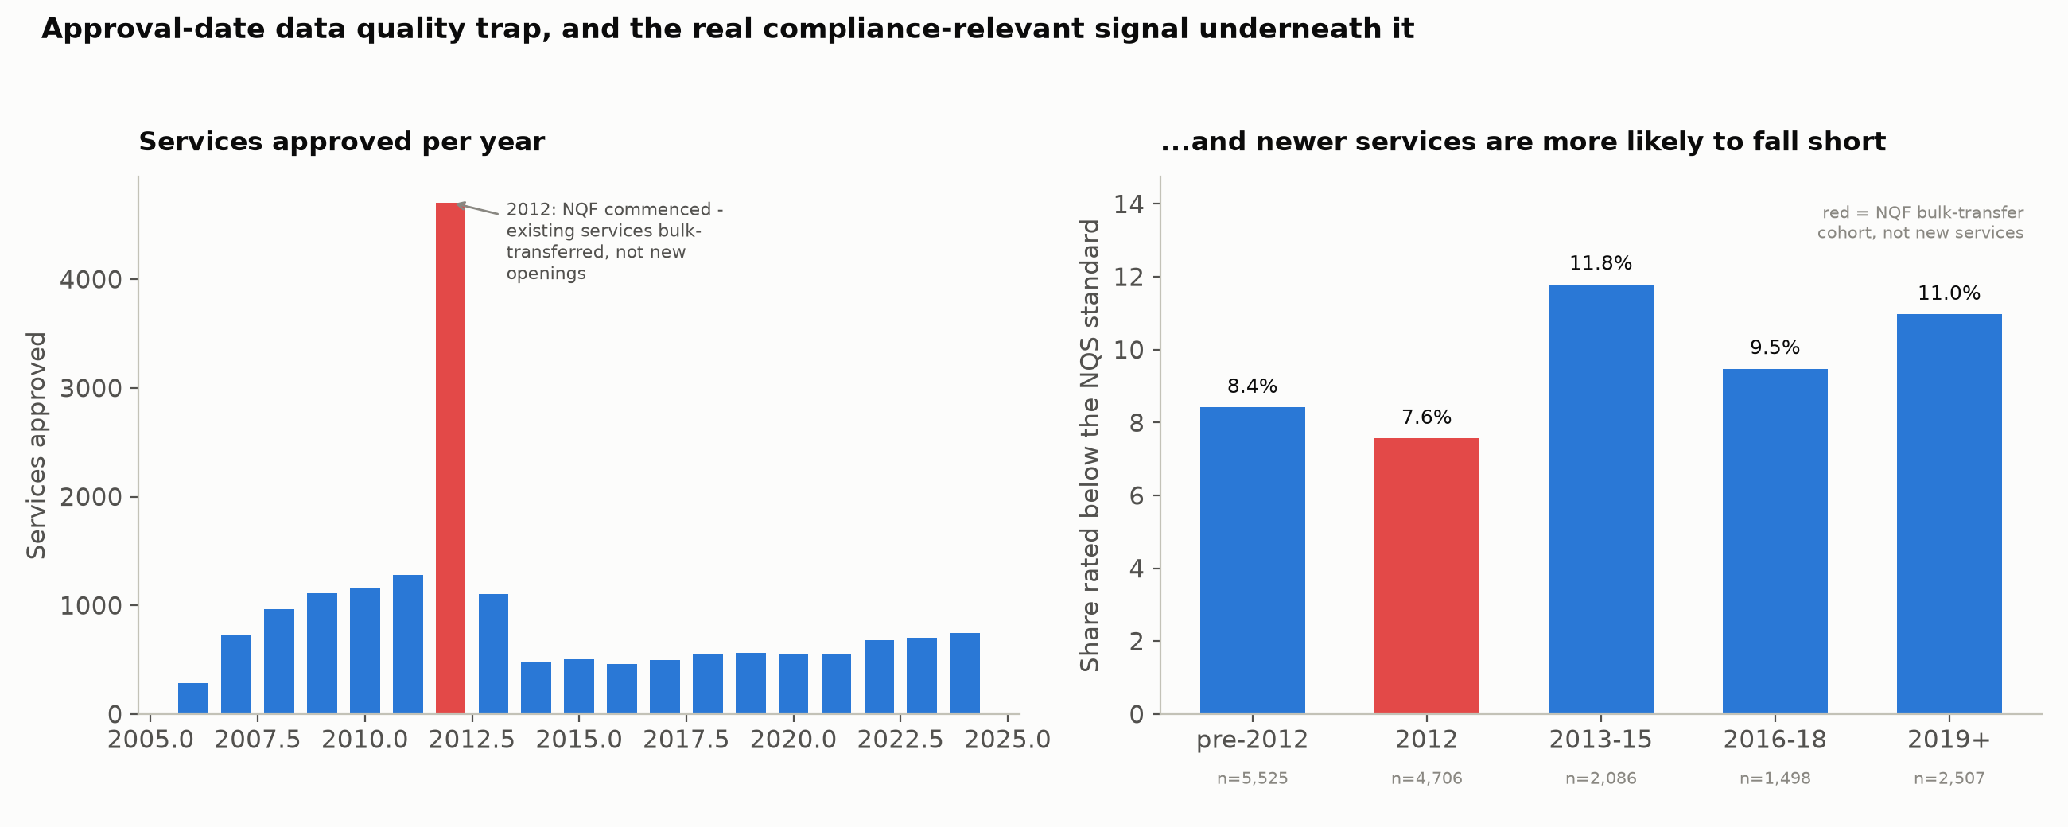
PROBLEM 3 · CHART 12
Newer services haven't had time to embed practice
17
Notes:
A data trap first: approvals-per-year spikes in 2012 — over four thousand in one year. Read naively, that's explosive growth. It isn't — the National Quality Framework commenced that January and bulk-transferred every already-operating service onto new numbers, not newly opened ones. The right-hand panel is the real story: grouped by when they were actually approved, services from 2019 onward sit at eleven percent non-compliant, against eight-point-four percent for pre-2012, long-established services. Newer services simply haven't had the years to embed practice yet. That's the strongest operational signal in this whole analysis.

Slide 18
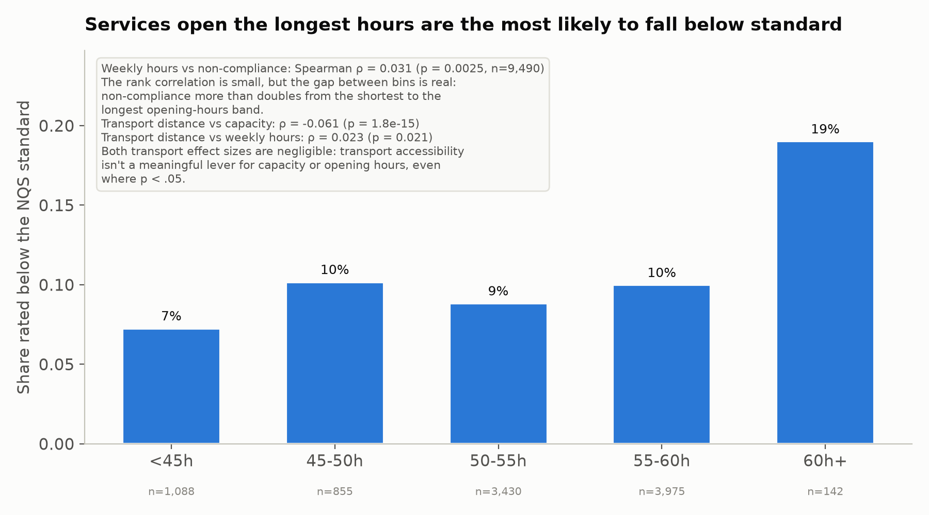
PROBLEM 3 · CHART 13
Longer hours, sharply higher non-compliance
18
Notes:
Opening hours shows the clearest relationship of the three — seven percent non-compliant under forty-five hours a week, rising to nineteen percent for the longest-opening services, more than double. And closing the loop on Problem 1: transport still doesn't move capacity or hours in any meaningful way — its small compliance effect from Chart 5 stands on its own. Two of three operational levers actually predict whether a service meets the standard; one is noise dressed up as insight.

Slide 19
THE DECISION
Four budget lines, four reasons
1
Urgent compliance intervention in the NT
2
New-service funding, named destinations
Educational program & governance — a legal-minimum problem, not a generic audit. Tasmania, SA and WA aren't far behind.
WA's and the NT's Bounded Localities — 41km and 30km to a family's nearest backup option.
3
Transport as a rural equity investment
4
A support pathway for newly-approved services
Real but small as a quality lever — fund it for equity, not as a compliance play.
Not a compliance one — they just haven't had the years yet.
A budget with a reason behind every line.
19
Notes:
Back to the budget question. One: the Northern Territory is the clearest case for urgent, statewide compliance intervention in educational program and governance — a legal-minimum problem, not a generic audit. Tasmania, South Australia and WA aren't far behind. Two: new-service funding has a named destination — WA's and the NT's Bounded Localities, forty-one and thirty kilometres from a family's nearest backup option. Three: transport connectivity is a rural investment priority, real but small as a quality lever — fund it for equity, don't oversell it. And four: give newly-approved services a support pathway, not a compliance one — they just haven't had the years yet. A budget with a reason behind every line. Thank you.

