Slide 1
Simple toy / numerical examples
Group: 30
TDT 17 - Visual Intelligence - 2019
NE1: Convolution and Max Pooling
NE2: Metrics for Object Detection
NE3: Value Iteration
NE4: Q-learning
NE5: ANN, forward pass
Participants:
Vold, Martin
Ødegaard, Ole Håkon Kløvrud
Examples

Slide 2
Numerical Example 1:
Convolution and Max Pooling
Metrics for Object Detection
Value Iteration
Q-learning
ANN, forward pass

Slide 3
Convolution
Stride length of 2
.5 | .7 | .8 | .5 | .2
.6 | .5 | .5 | .4 | .1
.3 | .0 | .0 | .6 | .0
.4 | .5 | .6 | .0 | .0
.1 | .1 | .2 | .3 | .1
.1 | .0 | .1
.2 | .3 | .2
.2 | .0 | .2
⊛
=

Slide 4
Convolution
Stride length of 2
.5 | .7 | .8 | .5 | .2
.6 | .5 | .5 | .4 | .1
.3 | .0 | .0 | .6 | .0
.4 | .5 | .6 | .0 | .0
.1 | .1 | .2 | .3 | .1
.1 | .0 | .1
.2 | .3 | .2
.2 | .0 | .2
.56
⊛
=

Slide 5
Convolution
Stride length of 2
.5 | .7 | .8 | .5 | .2
.6 | .5 | .5 | .4 | .1
.3 | .0 | .0 | .6 | .0
.4 | .5 | .6 | .0 | .0
.1 | .1 | .2 | .3 | .1
.1 | .0 | .1
.2 | .3 | .2
.2 | .0 | .2
.56 | .34
⊛
=

Slide 6
Convolution
Stride length of 2
.5 | .7 | .8 | .5 | .2
.6 | .5 | .5 | .4 | .1
.3 | .0 | .0 | .6 | .0
.4 | .5 | .6 | .0 | .0
.1 | .1 | .2 | .3 | .1
.1 | .0 | .1
.2 | .3 | .2
.2 | .0 | .2
.56 | .34
.44
⊛
=

Slide 7
Convolution
Stride length of 2
.5 | .7 | .8 | .5 | .2
.6 | .5 | .5 | .4 | .1
.3 | .0 | .0 | .6 | .0
.4 | .5 | .6 | .0 | .0
.1 | .1 | .2 | .3 | .1
.1 | .0 | .1
.2 | .3 | .2
.2 | .0 | .2
.56 | .34
.44 | .18
⊛
=

Slide 8
Max Pooling
One of many (Average Pooling, Sum Pooling…)
Filter of size 2x2 and stride length of 2
.5 | .6 | .9 | .8
.2 | .4 | .3 | .3
.7 | .1 | .1 | .1
.4 | .6 | .2 | .3
Max Pooling

Slide 9
Max Pooling
One of many (Average Pooling, Sum Pooling…)
Filter of size 2x2 and stride length of 2
.5 | .6 | .9 | .8
.2 | .4 | .3 | .3
.7 | .1 | .1 | .1
.4 | .6 | .2 | .3
Max Pooling
.6

Slide 10
Max Pooling
One of many (Average Pooling, Sum Pooling…)
Filter of size 2x2 and stride length of 2
.5 | .6 | .9 | .8
.2 | .4 | .3 | .3
.7 | .1 | .1 | .1
.4 | .6 | .2 | .3
Max Pooling
.6 | .9

Slide 11
Max Pooling
One of many (Average Pooling, Sum Pooling…)
Filter of size 2x2 and stride length of 2
.5 | .6 | .9 | .8
.2 | .4 | .3 | .3
.7 | .1 | .1 | .1
.4 | .6 | .2 | .3
Max Pooling
.6 | .9
.7

Slide 12
Max Pooling
One of many (Average Pooling, Sum Pooling…)
Filter of size 2x2 and stride length of 2
.5 | .6 | .9 | .8
.2 | .4 | .3 | .3
.7 | .1 | .1 | .1
.4 | .6 | .2 | .3
Max Pooling
.6 | .9
.7 | .3

Slide 13
Numerical Example 2:
Convolution and Max Pooling
Metrics for Object Detection
Value Iteration
Q-learning
ANN, forward pass

Slide 14
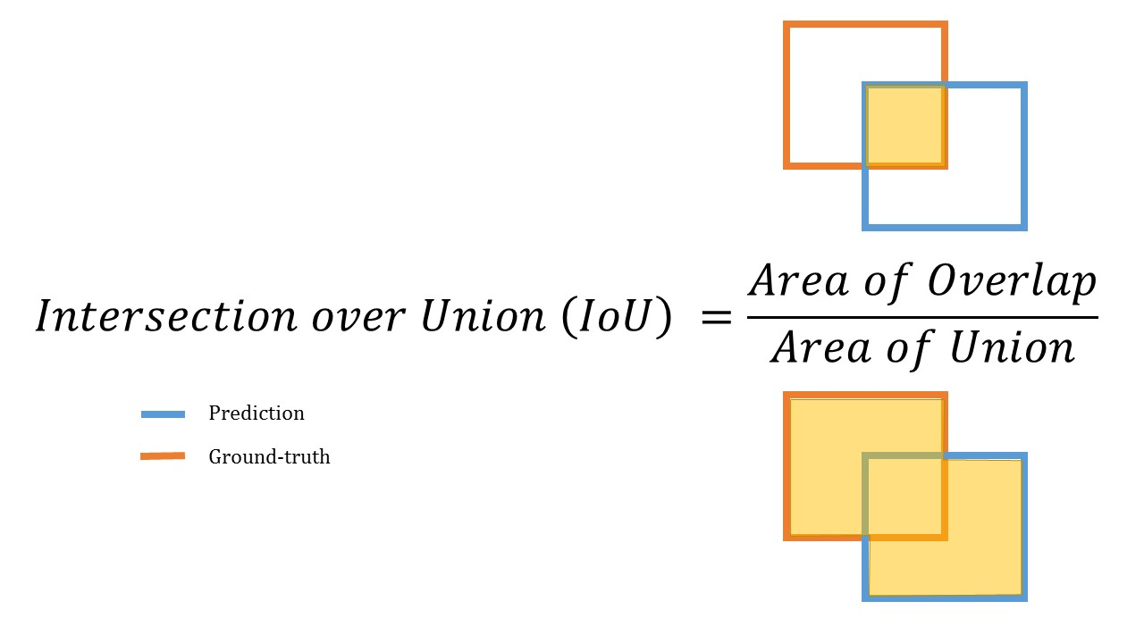
IoU - Intersection over Union
Evaluation metric used to to measure the accuracy of an object detector
IoU > 0.5 is normally considered a “good” prediction

Slide 15
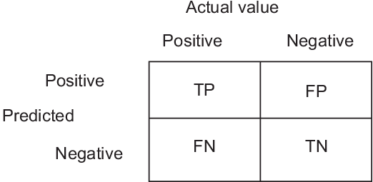
Prediction outcomes

Slide 16
Prediction outcomes
True Positive: IoU > 0.5
False Positive:
IoU <= 0.5
Duplicated Bounding Boxes
No IoU
False Negative: Iou > 0.5 but the bounding box has the wrong classification
True Negative: Usually there are not true negatives as the images are expected to contain at least one object
Notes:
fewer false positives (we make fewer mistakes)
more false negatives (we miss more objects)

Slide 17
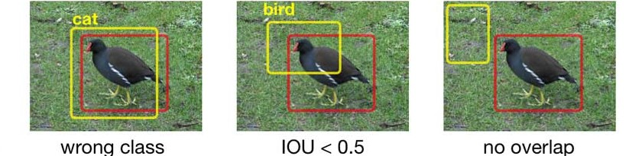
Examples
FN FP FP

Slide 18
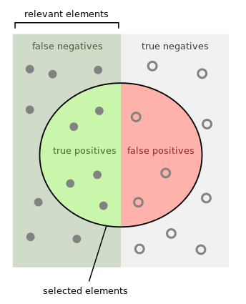
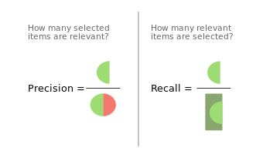
Precision and Recall
Notes:
Precision measures how accurate is your predictions. i.e. the percentage of your predictions are correct.
Recall measures how good you find all the positives. For example, we can find 80% of the possible positive cases in our top K predictions.

Slide 19
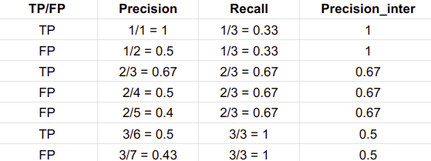
Precision and Recall

Slide 20
Precision and Recall

Slide 21
Precision and Recall

Slide 22
Precision and Recall

Slide 23
Precision and Recall

Slide 24
Precision and Recall

Slide 25
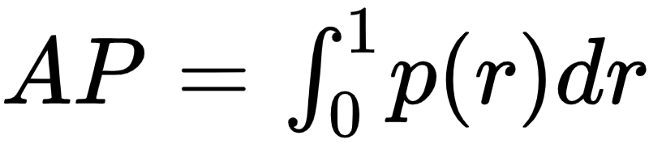
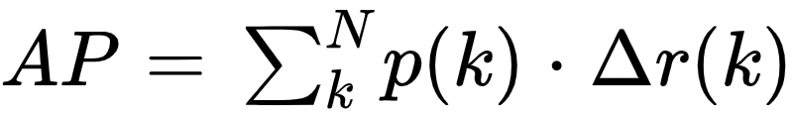
AP - Average Precision
Precision averaged across all values of recall between 0 and 1
Equal to taking the area under the precision/recall curve
This integral can be approximated by a sum over the precisions at every possible threshold value, multiplied by the change in recall, N is the total number of images in the collection, p(k) is the precision at a cutoff of k images, and delta r(k) is the change in recall that happened between cutoff k-1 and cutoff k.
Notes:
The general definition for the Average Precision (AP) is finding the area under the precision-recall curve above.
Precision and recall are always between 0 and 1. Therefore, AP falls within 0 and 1 also. Before calculating AP for the object detection, we often smooth out the zigzag pattern first.

Slide 26
Approximated Average Precision
(1 * 0.33) + (0.5 * 0) + (0.67 * 0.33) + (0.5 * 0) + (0.4 * 0) + (0.5 * 0.33) + (0.43 * 0) = 0.7161

Slide 27
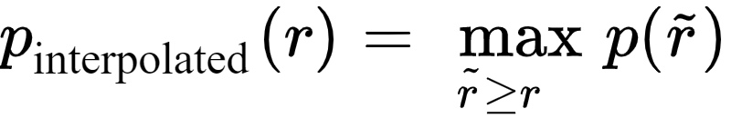
Interpolated AP
Interpolated AP: replace each precision value with the maximum precision value to the right of that recall level to reduce the impact of the “wiggles” in the precision/recall curve.

Slide 28
Interpolated AP
Interpolated AP: replace each precision value with the maximum precision value to the right of that recall level to reduce the impact of the “wiggles” in the precision/recall curve.

Slide 29
Interpolated AP
Interpolated AP: replace each precision value with the maximum precision value to the right of that recall level to reduce the impact of the “wiggles” in the precision/recall curve.

Slide 30
Interpolated AP
Interpolated AP: replace each precision value with the maximum precision value to the right of that recall level to reduce the impact of the “wiggles” in the precision/recall curve.

Slide 31
Interpolated AP
Interpolated AP: replace each precision value with the maximum precision value to the right of that recall level to reduce the impact of the “wiggles” in the precision/recall curve.

Slide 32
Interpolated AP
Interpolated AP: replace each precision value with the maximum precision value to the right of that recall level to reduce the impact of the “wiggles” in the precision/recall curve.

Slide 33
Interpolated AP
Interpolated AP: replace each precision value with the maximum precision value to the right of that recall level to reduce the impact of the “wiggles” in the precision/recall curve.

Slide 34
Interpolated AP
Interpolated AP: replace each precision value with the maximum precision value to the right of that recall level to reduce the impact of the “wiggles” in the precision/recall curve.
Notes:
The intention in interpolating the precision/recall curve in this way is to reduce the impact of the “wiggles” in the precision/recall curve, caused by small variations in the ranking of examples.

Slide 35
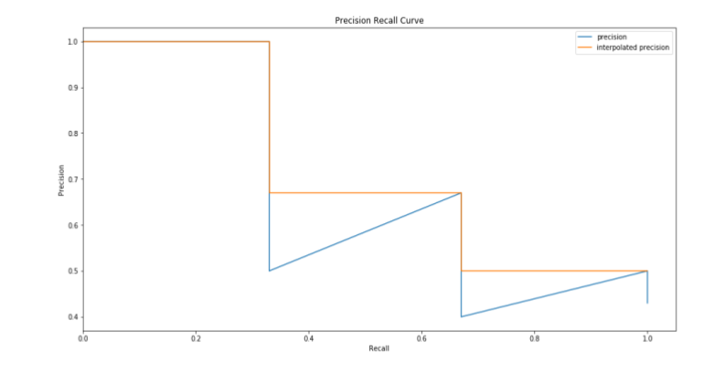

Interpolated AP, Pascal VOC2008
AP = 1/11 * (1 + 1 + 1 + 1 + 0.67 + 0.67 + 0.67 + 0.5 + 0.5 + 0.5 + 0.5) = 0.7282
Notes:
In Pascal VOC2008, an average for the 11-point interpolated AP is calculated.
However, this interpolated method is an approximation which suffers two issues. It is less precise. Second, it lost the capability in measuring the difference for methods with low AP. Therefore, a different AP calculation is adopted after 2008 for PASCAL VOC
Precision/Recall curves are for different classes, e.g. the class “dog” -> how well does the model classify and locate dogs

Slide 36
Interpolated AP, Pascal VOC2010-2012
Area under curve (AUC)
Samples the curve at all unique recall values (r₁, r₂, …), whenever the maximum precision value drops. With this change, we are measuring the exact area under the precision-recall curve after the zigzags are removed.
(0.33* 1) + (0.33 * 0.67) + (0.33 * 0.5) + = 0.7161
Notes:
This will turn out with the same value as our approximate example

Slide 37
Approximated vs. Interpolated AP
In our little example they are the same, but these next two graphs will highlight the fact that this isn’t always the case

Slide 38
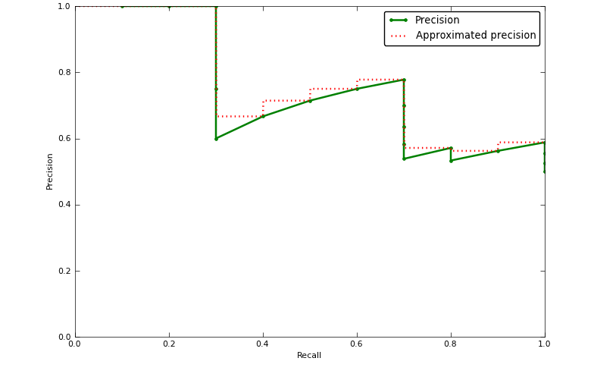
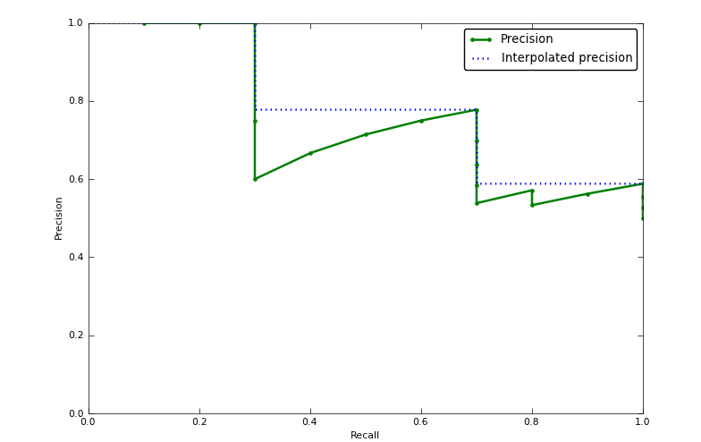
Approximated vs. Interpolated AP

Slide 39
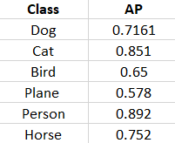
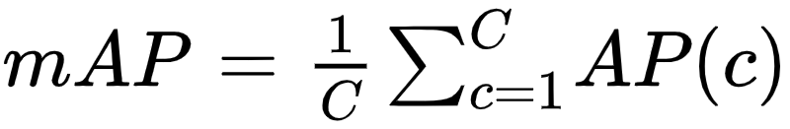
AP and mAP
AP is the average precision score for one class, e.g. “dog” while mAp (mean average precision) is simply the average over the average precisions for all the classes our model should be able to detect
1/6 * (0.7161 + 0.851 + 0.65 + 0.578 + 0.892 + 0.752) = 0.73985

Slide 40
Numerical Example 3:
Convolution and Max Pooling
Metrics for Object Detection
Value Iteration
Q-learning
ANN, forward pass

Slide 41
Markov Decision Process
Reinforcement learning
Markov decision process: a sequential decision problem for a fully observable, stochastic environment with a Markovian transition model and additive rewards
Consists of:
A set of states, with an initial state s0
A set of actions A(s) of actions in each state s
A transition model P(s’ | s, a)
Reward function R(s)
We are looking for a policy 𝜋 where 𝜋(s) denotes the action recommended by policy 𝜋 for state s
Notes:
To explain how the value iteration works we need to understand a markov decision process.
First of all this we are talking about reinforcement learning, where an agent in a given environment take actions based on some reward (or cost)
Specifically a markov decision process is a sequential decision problem for a fully observable, stochastic environment with a Markovian transition model and additive rewards.
A sequential decision problem means that the agents total utility depends on a sequence of decisions made by the agent
Fully observable: we can fully observe the environment in order to complete the task
Stochastic environment: the outcome of an action cannot be complete determined by a state and an action
Markovian transition model: the probability of reaching state s’ from s depends only on state s and not on any other states in the sequence
Additive reward: the utility for a given state sequence is the sum of the rewards for all the states in the sequence
So we are given a set of states, with an initial state s0, a set of actions A(s) of actions in each state s, a transition model P(s’ | s, a) as the probability of going into state s’ by performing action a in state s, and a reward function R(s)
What we basically want to find is a policy, 𝜋, where 𝜋(s) denotes the action recommended by policy 𝜋 for state s

Slide 42
Value iteration
The policy is determined by the utility U of the states
The utility of a state is the expected sum of discounted rewards from that state onwards
Bellman equation:
This equation is not linear, since “max” is not linear → We need to use an iterative approach
Bellman update:
Notes:
Gamma: Want rewards sooner than later

Slide 43
Example
Grid of 4x3 squares.
Two terminal states.
Reward of -0.04 for each states (living rewards), except the terminal states (+1, -1).
Discount factor of 0.6.
Possible actions are Up, Left, Down and Right.
80% of the time the action Up take the agent Up, 10% of the time it will take the agent Left and 10% of the time it will take the agent Right.
If the agent runs into a wall it will not move from the square.
Notes:
Negative reward -> Want to get to the +1 faster!

Slide 44
Example
 |  |  | +1
 |  |  | -1
Notes:
Have to make a policy so that the agent will get to the green square in the least amount of moves.

Slide 45
Example, iteration 0
0 | 0 | 0 | 0
0 |  | 0 | 0
0 | 0 | 0 | 0

Slide 46
Example, iteration 0
State (4, 3): U(4, 3) = 1 + 0.6 * max[ 0.8 * U(4, 3) + 0.1 * U(3, 3) + 0.1 * U(4, 3),
0.8 * U(3, 3) + 0.1 * U(4, 2) + 0.1 * U(4, 3),
0.8 * U(4, 2) + 0.1 * U(3, 3) + 0.1 * U(4, 3),
0.8 * U(4, 3) + 0.1 * U(4, 3) + 0.1 * U(4, 2)]
= 1 + 0.6 * max[ 0, 0, 0, 0] = 1
0 | 0 | 0 | 0
0 |  | 0 | 0
0 | 0 | 0 | 0
Notes:
Up, Left, Down, Right

Slide 47
Example, iteration 1
-0.04 | -0.04 | -0.04 | 1
-0.04 |  | -0.04 | -1
-0.04 | -0.04 | -0.04 | -0.04

Slide 48
Example, iteration 1
U(3, 3) = -0.04 + 0.6 * max[ 0.8 * U(3, 3) + 0.1 * U(2, 3) + 0.1 * U(4, 3),
0.8 * U(2, 3) + 0.1 * U(3, 2) + 0.1 * U(3, 3),
0.8 * U(3, 2) + 0.1 * U(2, 3) + 0.1 * U(4, 3),
0.8 * U(4, 3) + 0.1 * U(3, 2) + 0.1 * U(3, 3)]
= -0.04 + 0.6 * max[ 0.064, -0.04, 0.064, 0.792] = 0.435
-0.04 | -0.04 | -0.04 | 1
-0.04 |  | -0.04 | -1
-0.04 | -0.04 | -0.04 | -0.04
Notes:
Up, Left, Down, Right

Slide 49
Example, iteration 1
-0.0648 | -0.068 | 0.435 | 1
-0.0648 |  | -0.0648 | -1
-0.0648 | -0.0648 | -0.0648 | -0.0648
-0.065 | -0.065 | 0.435 | 1
-0.065 |  | -0.065 | -1
-0.065 | -0.065 | -0.065 | -0.065

Slide 50
Example, iteration 100
0.812 | 0.868 | 0.918 | 1
0.762 |  | 0.660 | -1
0.705 | 0.655 | 0.611 | 0.388

Slide 51
Numerical Example 4:
Convolution and Max Pooling
Metrics for Object Detection
Value Iteration
Q-learning
ANN, forward pass

Slide 52
Q-learning
Numerical example

Slide 53
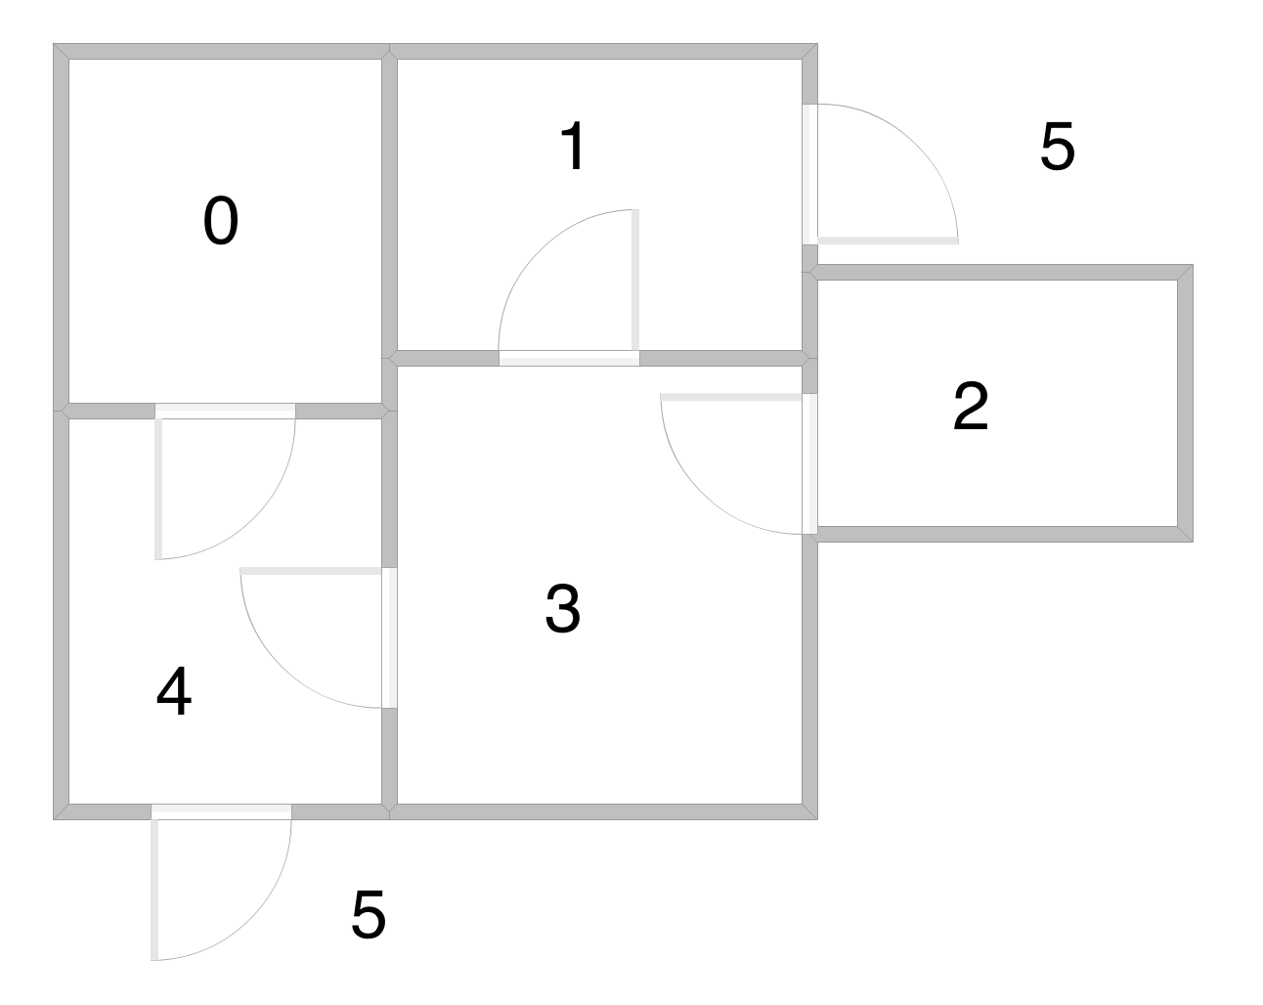
Q-learning, overview
Reinforcement learning
Model-free algorithm
E.g. the agent does not have prior knowledge about the environment
The goal is to learn the quality of each action a evaluated in a state s
It does this by exploiting and exploring the states in the environment (e.g. rooms in a house) and observe the reward

Slide 54
Algorithm
Initialize matrix Q to zero and matrix R to the rewards given for each state-action pair
For each episode:
Select a random initial state s0
Do while the goal state hasn’t been reached
Select an action a among all possible actions for state s0
Execute action and move to the next state
Calculate the reward and update matrix Q

Slide 55
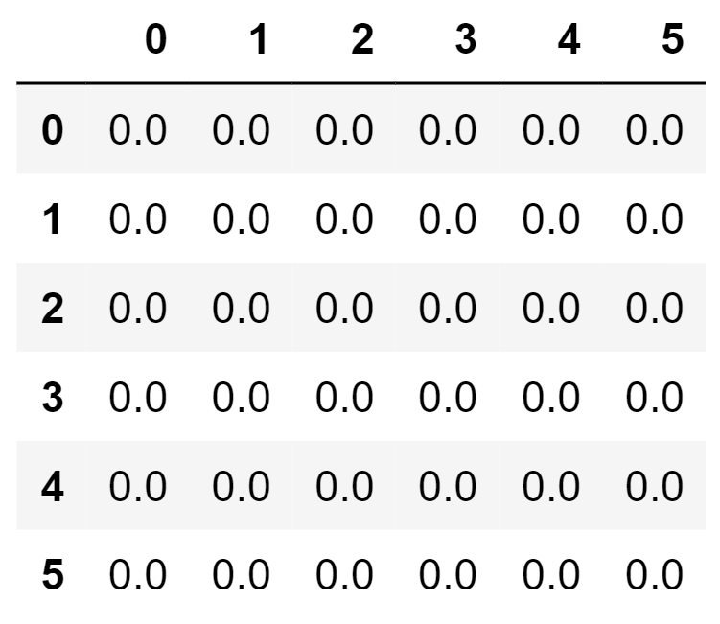
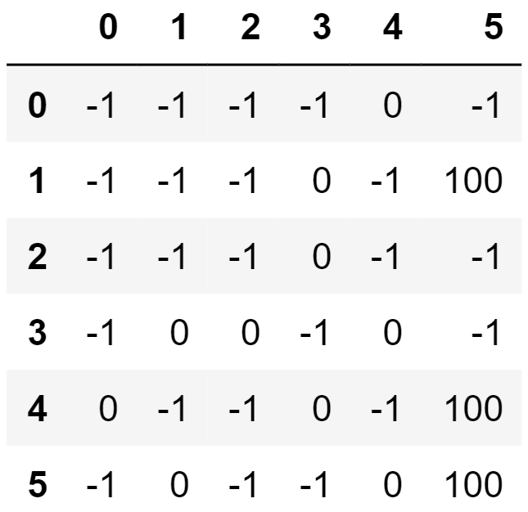
Initialize matrix Q and R
Q
R

Slide 56
For each episode
Do while the final state has not been reached
a ← The action with highest Q-value among possible actions from s (or choose random)
s’ ← state given by performing action a in state
s = s’
Notes:
Gamma is the discount factor: Future values are less valuable

Slide 57
Begin by choosing 4 as our initial state
Q
By random we choose action 5, since
all Q-values are 0

Slide 58
Find next Q-value for action 5 in state 4
𝛼 = 0.2
𝛾 = 0.8
_________________________________________________________________
s = 4
a = 5
Update matrix Q:
20

Slide 59
Terminal state 5 reached
Next episode: Choose a new starting state
State 3 chosen as new initial state
Action 4 is chosen randomly, since all q-values are 0
Q
20

Slide 60
Find next Q-value for action 4 in state 3
𝛼 = 0.2
𝛾 = 0.8
_________________________________________________________________
s = 3
a = 4
Update matrix Q:
16
16
20

Slide 61
Now we have reached state 4
We choose action 5, since this has the highest Q-value
Q
16
20

Slide 62
Find next Q-value for action 4 in state 3
𝛼 = 0.2
𝛾 = 0.8
_________________________________________________________________
s = 4
a = 5
Update matrix Q:
16
16
36

Slide 63
Exploring vs. exploiting
Exploring: select a random action to explore unvisited states
Exploiting: select the best action based on previous visitations
We use the parameter epsilon (ε) to balance exploration/exploitation

Slide 64
Numerical Example 5:
Convolution and Max Pooling
Metrics for Object Detection
Value Iteration
Q-learning
ANN, forward pass

Slide 65
Overview
Forward-passing refers to the process of propagating the input values through an artificial neural network
For each neuron in the network a sum of weighted inputs is calculated and passed forward to the next layer

Slide 66
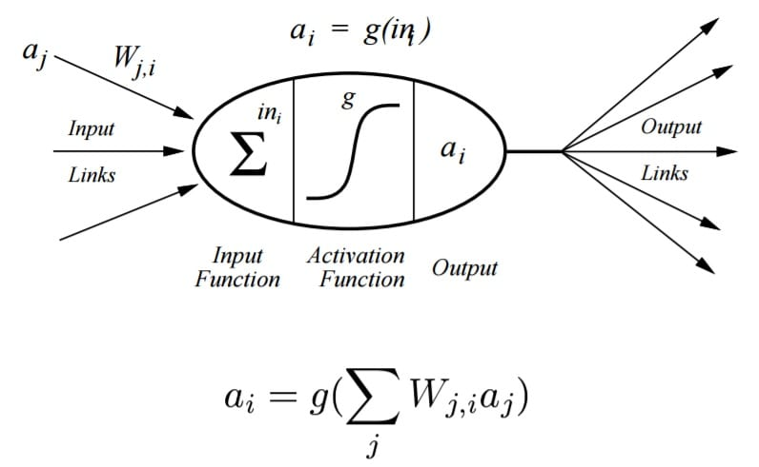
Perceptron

Slide 67
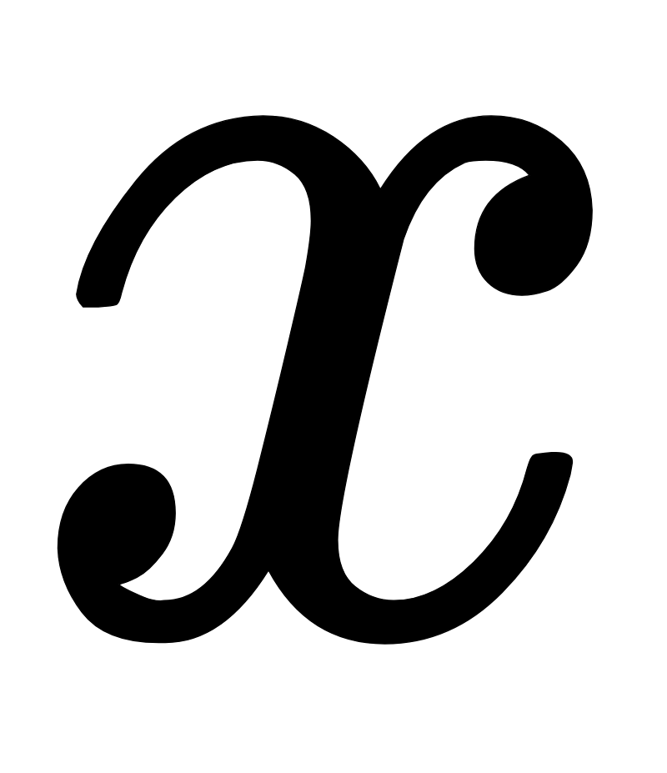
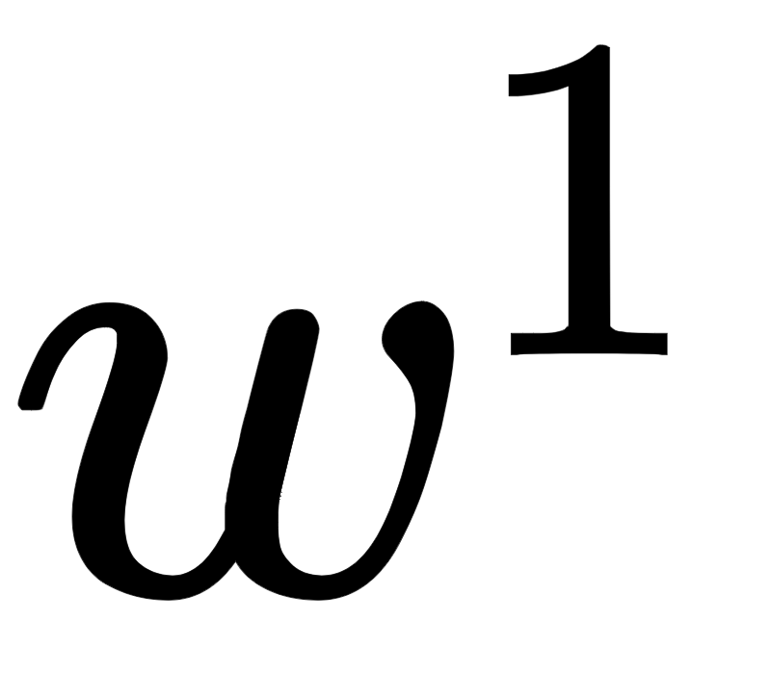
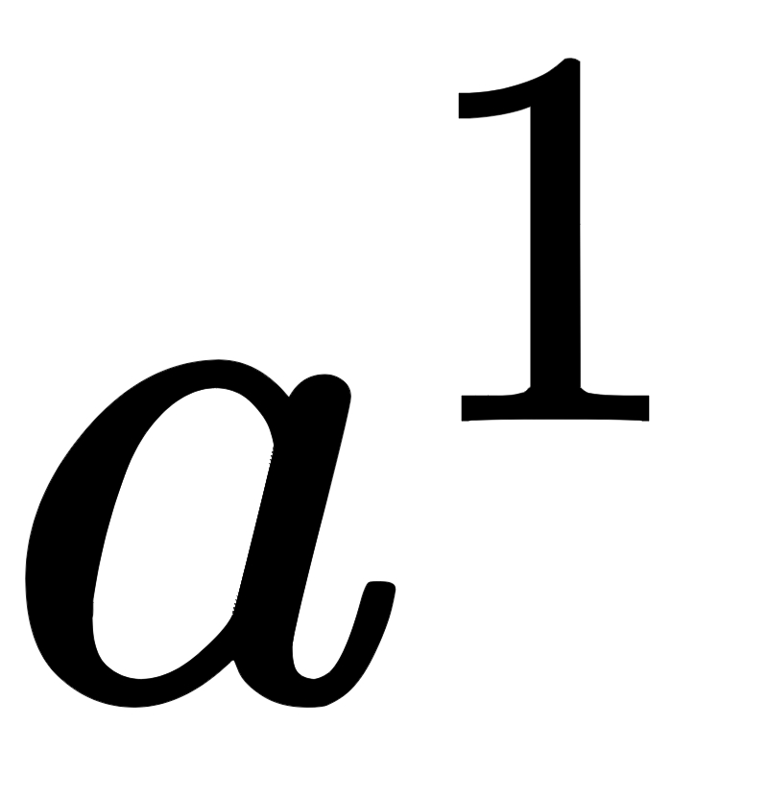
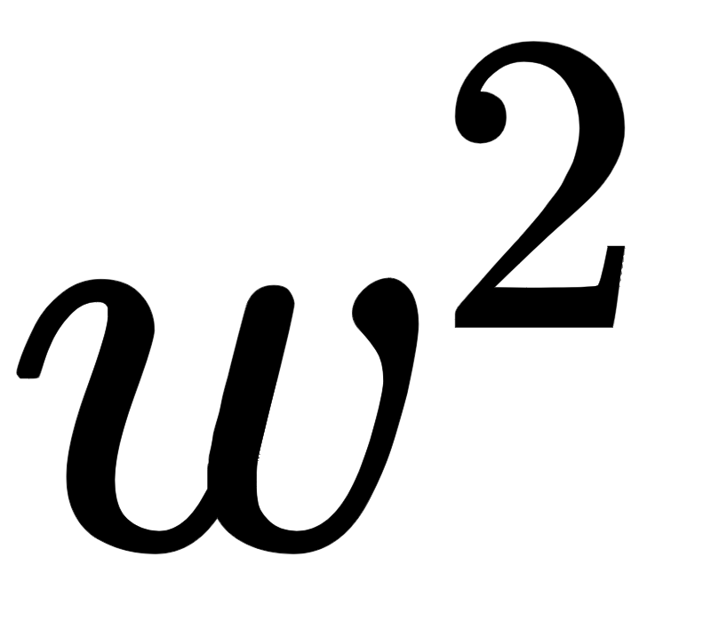
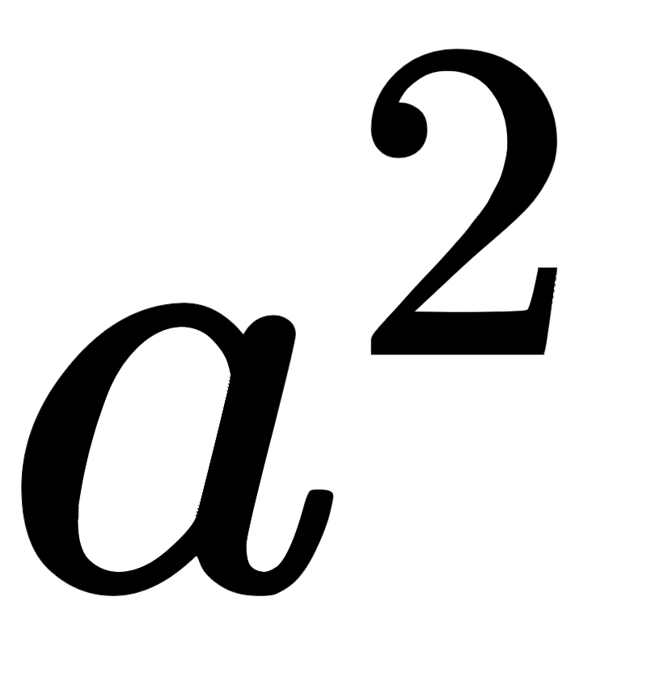
ANN

Slide 68
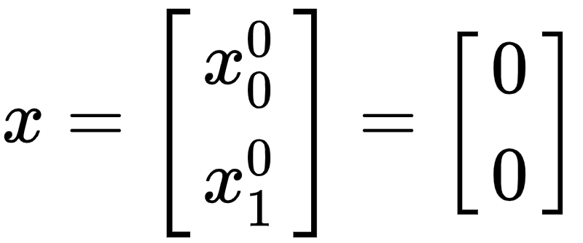
ANN - Input vector

Slide 69
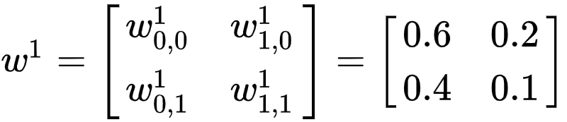
ANN - Weights 1

Slide 70
ANN - Hidden layer

Slide 71
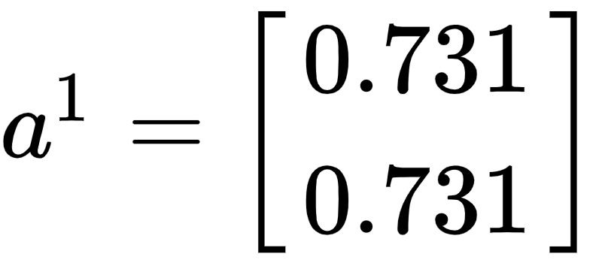
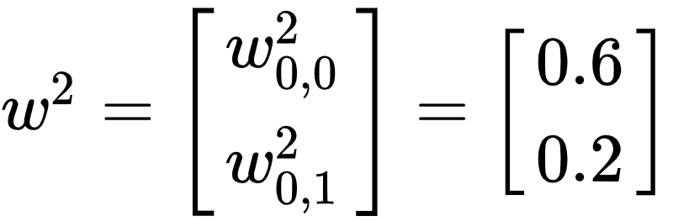
ANN - Weights 2

Slide 72
ANN - Output layer

