Slide 1
Code Reviews
March, 2018

Slide 2
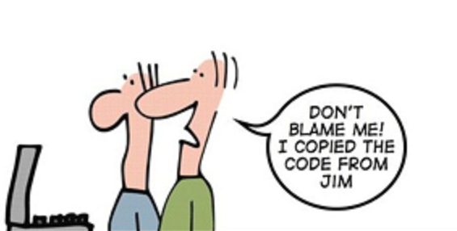
Goals
What is a code review?
Why do code reviews?
How to do code reviews
NOT talking about tooling

Slide 3


Slide 4
What is a Code Review?
Simple Definition
A code review is a process where two or more developers visually inspect a set of program code, typically, several times. The code can be a method, a class, or an entire program.

Slide 5
Why do Code Reviews?
Improve the quality of the team
Improve the quality of the communication
Improve the quality of the code
Find coding and potential security issues

Slide 6
Approach for Effective Code Reviews
Use your experience to guide you
Praise the good stuff
Find things to fix
Look for common problems

Slide 7
Code Review Steps
Look over User Story
Pull in developer if you need more explanation
Inspect each change for quality
Look for and comment on the good stuff
Identify issues, add suggestions
Look for good unit tests

Slide 8
Let’s Review Some Code!

