Slide 1
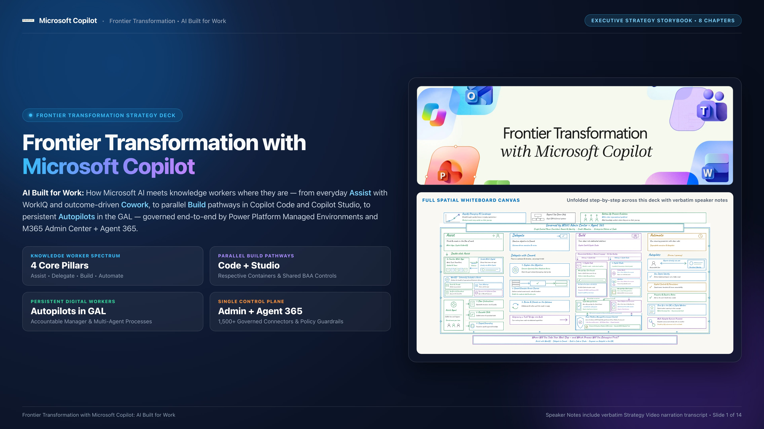
Notes:
SLIDE 1 — EXECUTIVE COVER & INTRODUCTION
Title: Frontier Transformation with Microsoft Copilot: AI Built for Work
Subtitle: Full-Canvas Strategy Storyline — From Everyday Assist to Governed Enterprise Scale
[Executive Framing Notes]
• Welcome to the Frontier Transformation Strategy Deck: AI Built for Work.
• This presentation unfolds the complete 8-chapter Microsoft AI Strategy spatial whiteboard storyline step by step, designed for audiences reviewing the narrative in slide format.
• Every chapter slide in this deck includes the exact verbatim narration transcript right here in the Speaker Notes, paired with the high-resolution whiteboard illustration and structured executive takeaways on the slide canvas.
Key Themes Covered Across This Deck:
1. A Rapidly Changing Landscape: Bottom-up process evolution within clear enterprise guardrails.
2. The Four-Pillar Knowledge Worker Spectrum: Assist, Delegate, Build, and Automate.
3. Assist & WorkIQ: Seamless presence across M365 Apps & M365 Copilot, grounded in Emails, Meetings, SharePoint/OneDrive, and Dynamics 365 — plus codifying team best practices with Assist Agents.
4. Delegate with Cowork: Outcome-driven execution where users explain and iterate on objectives rather than engineering prompts.
5. Democratized Building — Pathway 1 (Copilot Code): Natural-language coding agents for Managed Apps published to the Copilot Managed Runtime, with no-code to pro-code collaboration via Git & CLIs.
6. Parallel Build Pathway 2 (Copilot Studio) & Shared Governance: Custom Agents & Workflows running in Power Platform Environments, while Managed Apps (including Lovable and other coding agents) run in the Copilot Managed Runtime — both governed by Power Platform Managed Environment controls (1,500+ connectors, DLP, and BAA compliance readiness).
7. Autopilots in the GAL: Persistent digital identities reporting to accountable managers in the Global Address List.
8. Single Enterprise Control Plane: Surrounded and governed by M365 Admin Center + Agent 365.

Slide 2
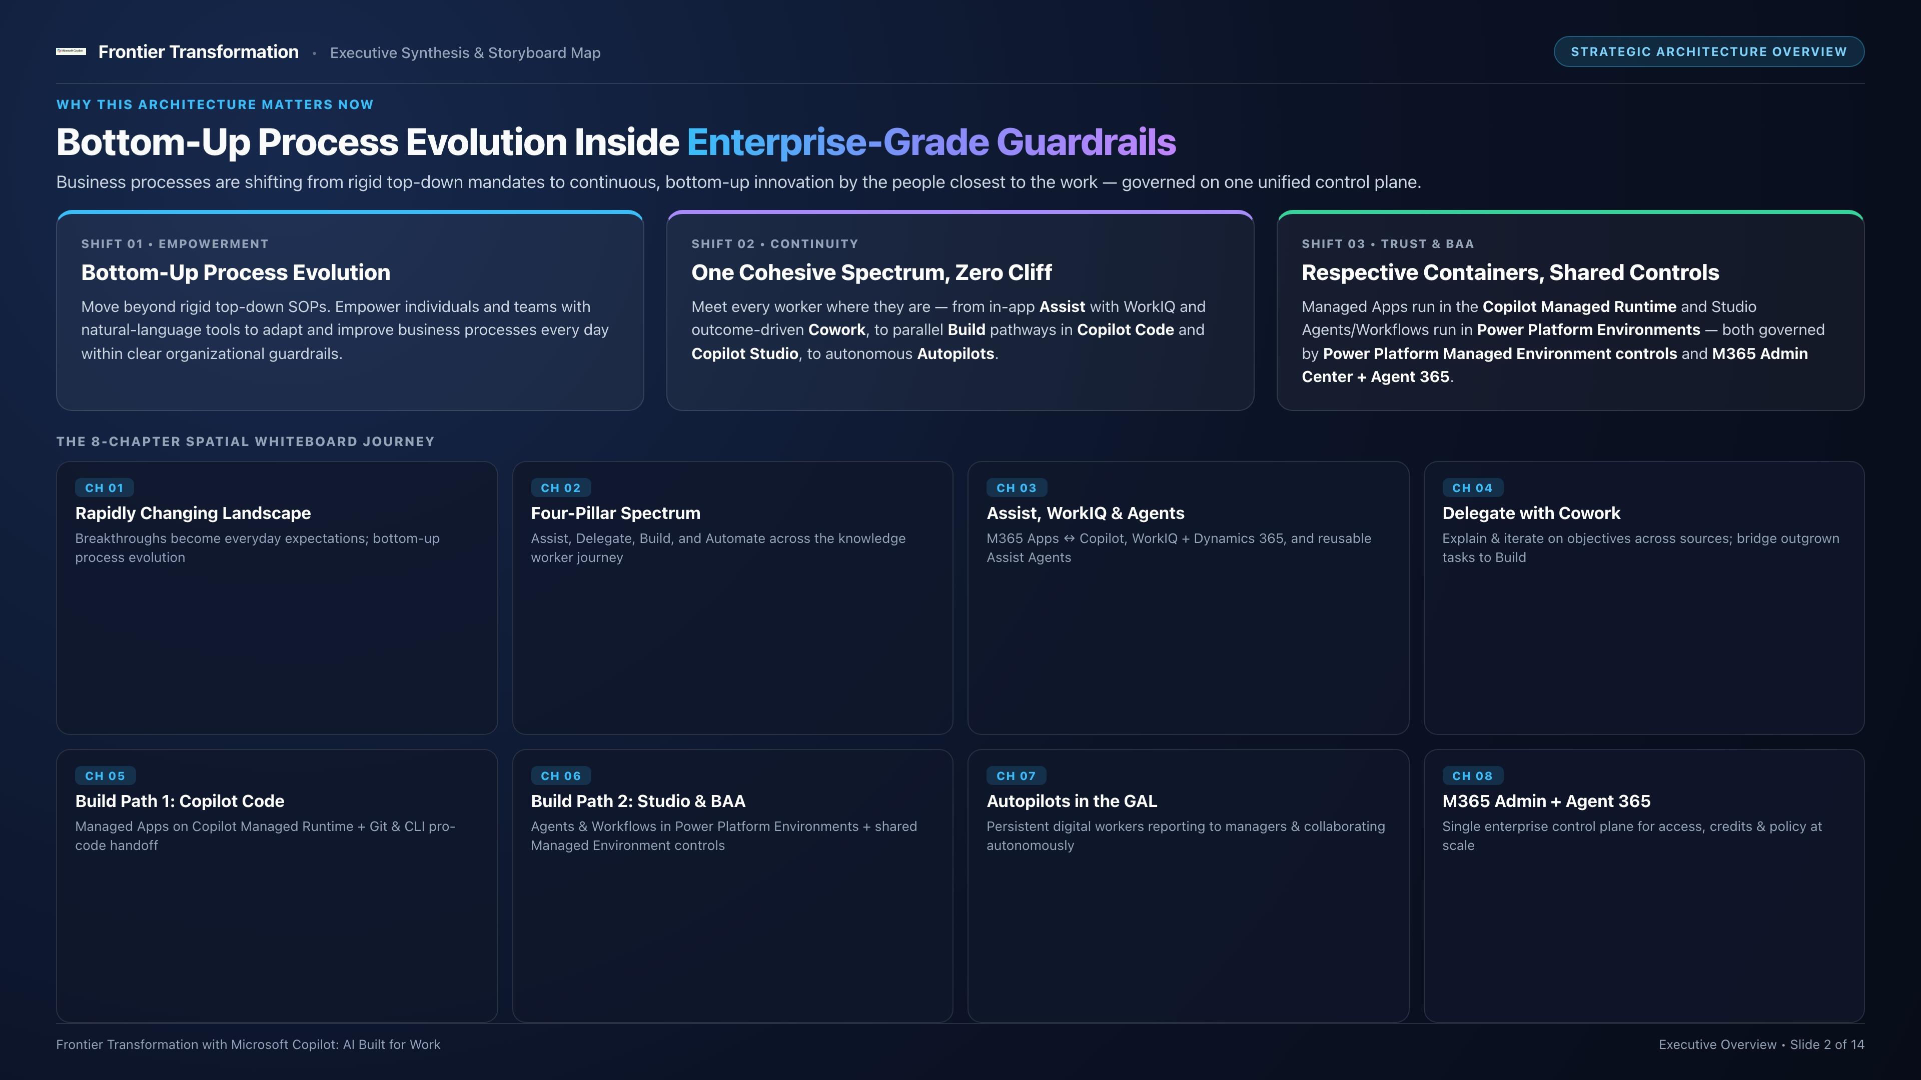
Notes:
SLIDE 2 — EXECUTIVE OVERVIEW & 8-CHAPTER STORYLINE MAP
Title: From Rigid Top-Down Procedures to Bottom-Up Empowerment Within Enterprise Guardrails
[Executive Summary]
• Before stepping into the 8 chapters of the spatial whiteboard, this slide frames the macro shift happening across every enterprise:
1. Work is no longer defined solely by rigid top-down standard operating procedures pushed through monolithic IT queues.
2. Empowered individuals and teams are evolving business processes every day from the bottom up — within clear organizational guidelines.
• Across the 8 chapters below, we trace how Microsoft Copilot provides a single coherent architecture for that journey:
- Ch 01: A Rapidly Changing Landscape (Bottom-up process evolution)
- Ch 02: The Four-Pillar Knowledge Worker Spectrum (Assist, Delegate, Build, Automate)
- Ch 03: Double-Click into Assist (Seamless M365 Apps ↔ Copilot, WorkIQ + Dynamics 365, Assist Agents)
- Ch 04: Delegate with Cowork (Objective-driven execution & iteration, bridging into Build)
- Ch 05: Build Pathway 1 — Copilot Code (Managed Apps in Copilot Managed Runtime + Git/CLI pro-code handoff)
- Ch 06: Build Pathway 2 — Copilot Studio & Shared Governance (Custom Agents & Workflows in Power Platform Environments; both containers governed by Power Platform Managed Environment controls & BAA readiness)
- Ch 07: Autopilots in the GAL (Persistent digital workers reporting to accountable managers)
- Ch 08: Single Enterprise Control Plane (Governed by M365 Admin Center + Agent 365)

Slide 3
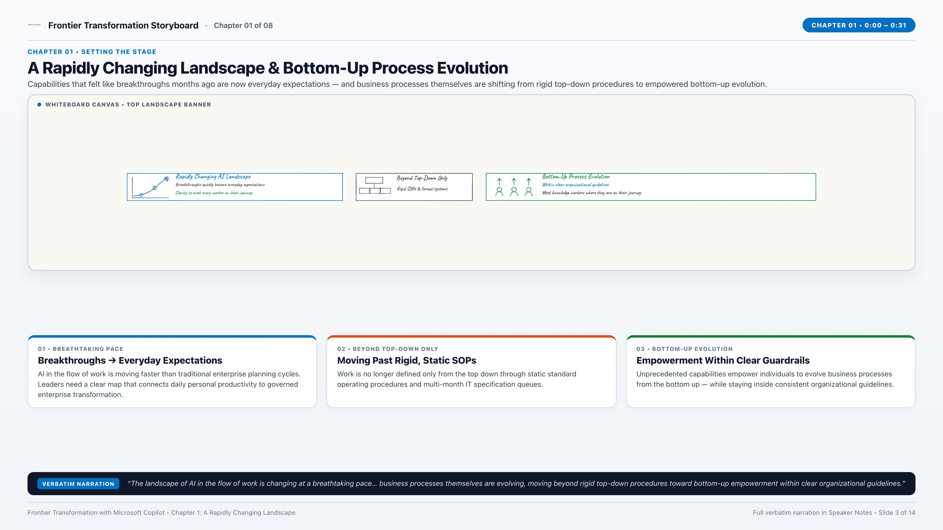
Notes:
CHAPTER 1 — A RAPIDLY CHANGING LANDSCAPE (Strategy Video 0:00 – 0:31)
[VERBATIM NARRATION TRANSCRIPT]
"The landscape of AI in the flow of work is changing at a breathtaking pace. Capabilities that felt like breakthroughs just months ago are now everyday expectations. At the same time, business processes themselves are evolving, moving beyond rigid top-down procedures toward bottom-up empowerment within clear organizational guidelines. This video brings clarity to that vast landscape, showing how Microsoft AI meets knowledge workers where they are on their journey."
[KEY WHITEBOARD CALLOUTS]
• Rapidly Changing AI Landscape: Breakthroughs quickly become everyday expectations; Microsoft AI brings clarity across a vast landscape.
• Beyond Top-Down Only: Moving past rigid, static SOPs and top-down-only mandates.
• Bottom-Up Process Evolution: Individual empowerment within clear guardrails; business processes evolve continuously from the ground up.

Slide 4
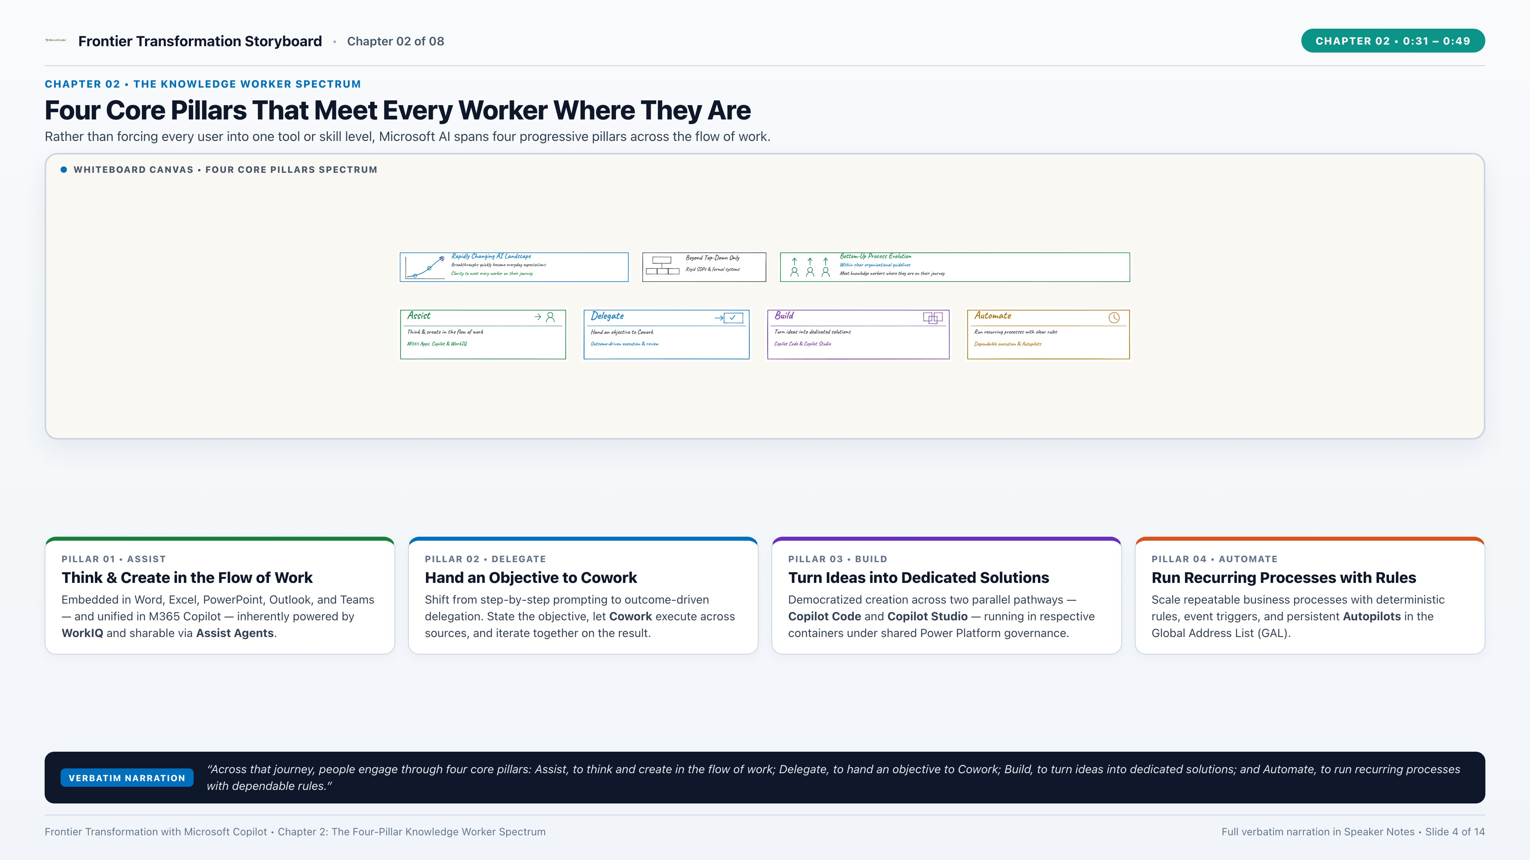
Notes:
CHAPTER 2 — THE FOUR-PILLAR KNOWLEDGE WORKER SPECTRUM (Strategy Video 0:31 – 0:49)
[VERBATIM NARRATION TRANSCRIPT]
"Across that journey, people engage through four core pillars: Assist, to think and create in the flow of work; Delegate, to hand an objective to Cowork; Build, to turn ideas into dedicated solutions; and Automate, to run recurring processes with dependable rules."
[KEY WHITEBOARD CALLOUTS]
• Pillar 1 — Assist: Think & create in the flow of work (M365 Apps, Copilot, WorkIQ & Assist Agents).
• Pillar 2 — Delegate: Hand an objective to Cowork (Outcome-driven execution & review).
• Pillar 3 — Build: Turn ideas into dedicated solutions (Parallel pathways: Copilot Code & Copilot Studio).
• Pillar 4 — Automate: Run recurring processes with rules (Predictable, repeatable execution at scale).

Slide 5
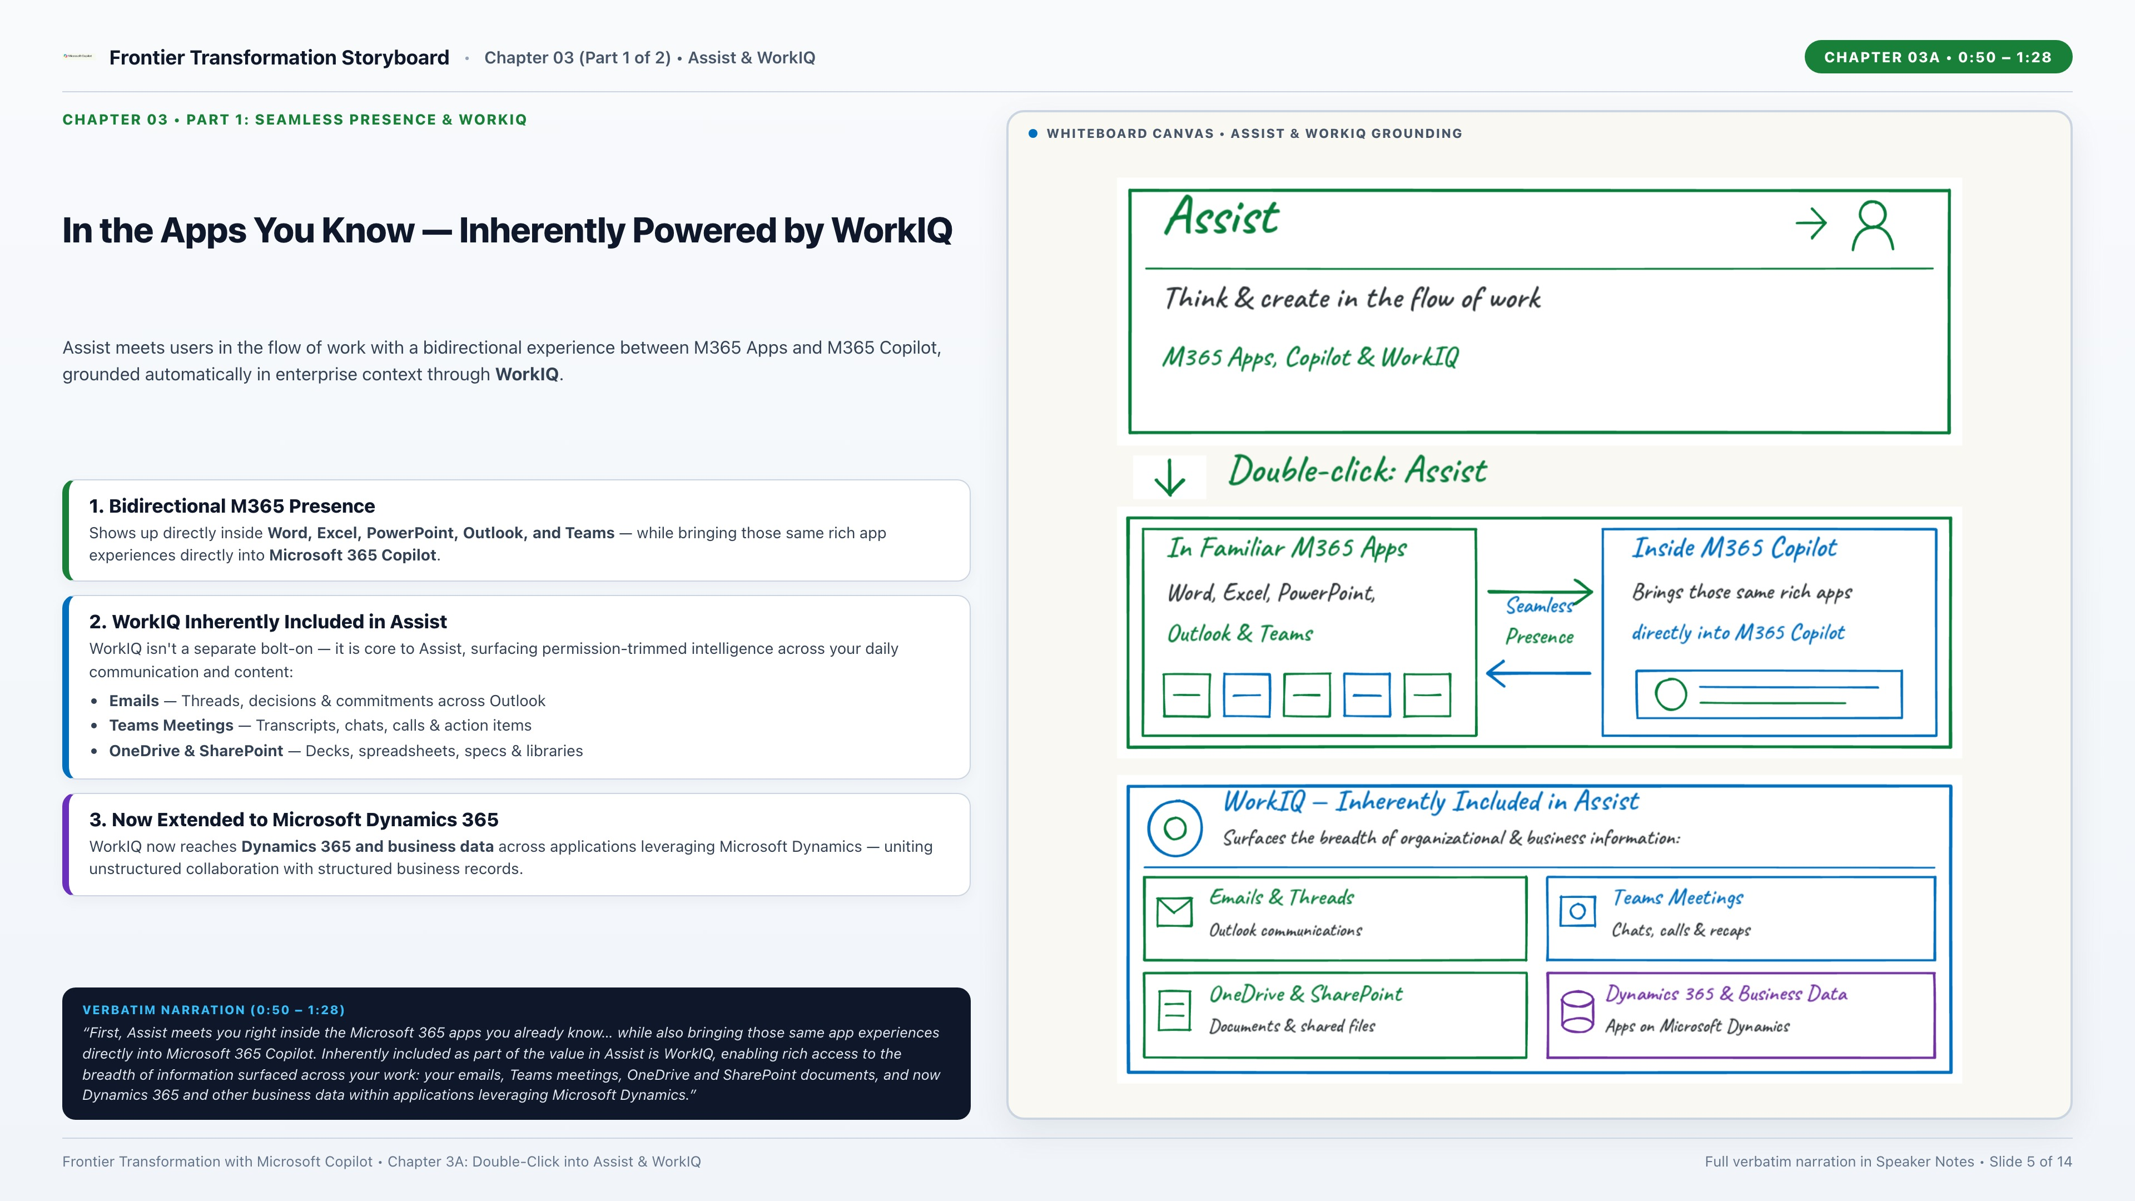
Notes:
CHAPTER 3 (PART 1) — DOUBLE-CLICK INTO ASSIST: M365 APPS & WORKIQ (Strategy Video 0:50 – 1:28)
[VERBATIM NARRATION TRANSCRIPT — PART 1 OF CHAPTER 3]
"Double-click into Assist. First, Assist meets you right inside the Microsoft 365 apps you already know, like Word, Excel, PowerPoint, Outlook, and Teams, while also bringing those same app experiences directly into Microsoft 365 Copilot. Inherently included as part of the value in Assist is WorkIQ, enabling rich access to the breadth of information surfaced across your work: your emails, Teams meetings, OneDrive and SharePoint documents, and now Dynamics 365 and other business data within applications leveraging Microsoft Dynamics."
(Full Chapter 3 Verbatim Transcript for Reference):
"Double-click into Assist. First, Assist meets you right inside the Microsoft 365 apps you already know, like Word, Excel, PowerPoint, Outlook, and Teams, while also bringing those same app experiences directly into Microsoft 365 Copilot. Inherently included as part of the value in Assist is WorkIQ, enabling rich access to the breadth of information surfaced across your work: your emails, Teams meetings, OneDrive and SharePoint documents, and now Dynamics 365 and other business data within applications leveraging Microsoft Dynamics. And when an everyday workflow becomes a best practice worth sharing across your team, you can build an Assist Agent that codifies it, combining clear instructions, reusable skills, and scoped grounding to the specific knowledge that agent is focused on."

Slide 6
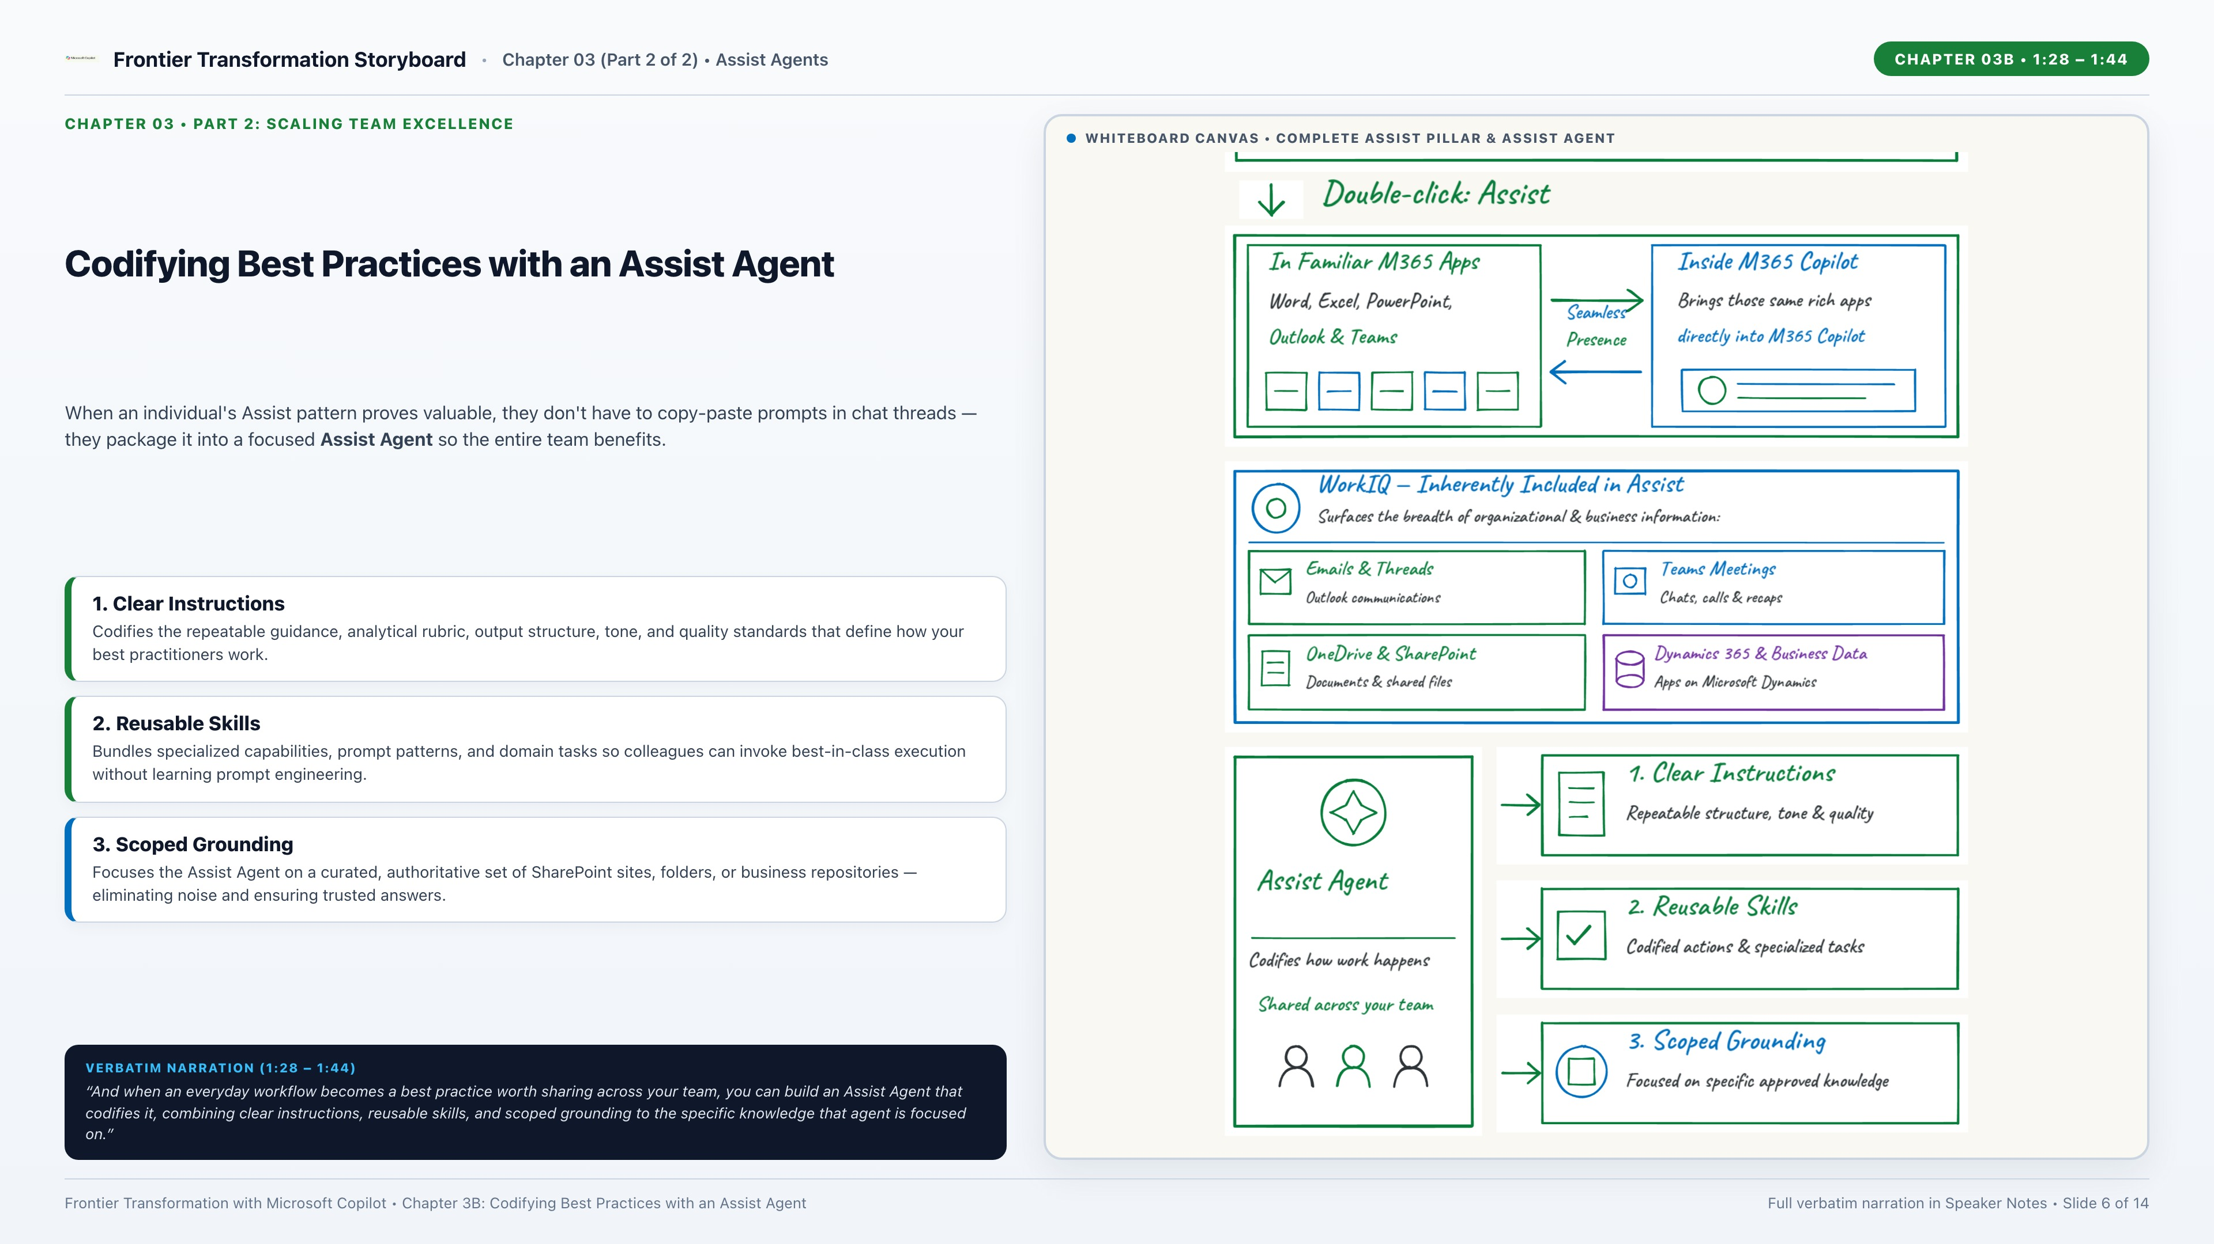
Notes:
CHAPTER 3 (PART 2) — CODIFYING BEST PRACTICES WITH AN ASSIST AGENT (Strategy Video 1:28 – 1:44)
[VERBATIM NARRATION TRANSCRIPT — PART 2 OF CHAPTER 3]
"And when an everyday workflow becomes a best practice worth sharing across your team, you can build an Assist Agent that codifies it, combining clear instructions, reusable skills, and scoped grounding to the specific knowledge that agent is focused on."
[KEY WHITEBOARD CALLOUTS]
• Assist Agent (Codify & Share Best Practices):
1. Clear Instructions — Repeatable guidance, structure, tone & quality standards.
2. Reusable Skills — Packaged prompts, actions & specialized tasks.
3. Scoped Grounding — Focused on a specific set of approved team knowledge.

Slide 7
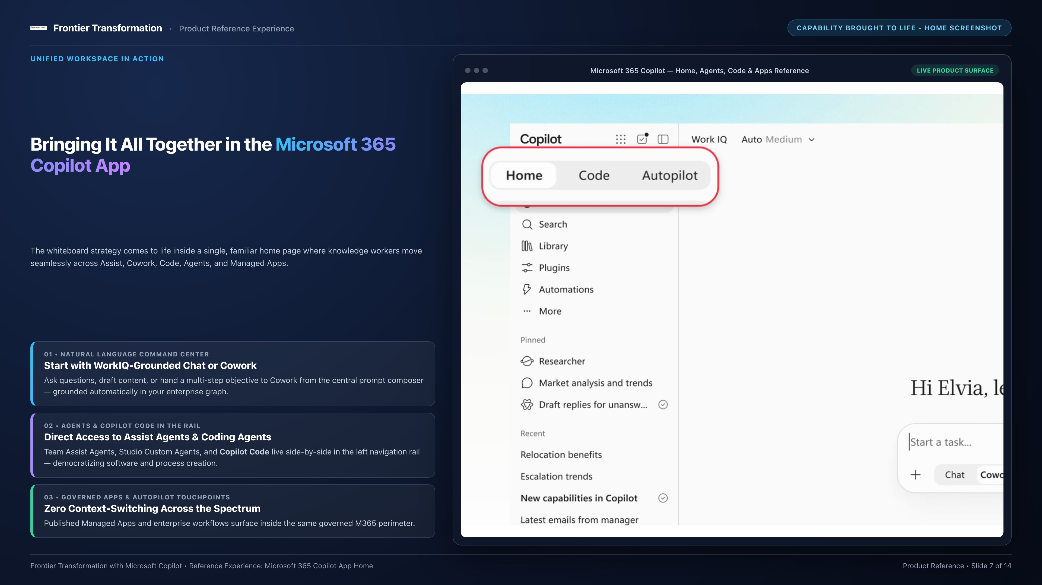
Notes:
SLIDE 7 — REFERENCE EXPERIENCE: MICROSOFT 365 COPILOT APP HOME
Title: Bringing It Together in the Copilot App — One Unified Entry Point for Work
[Executive Walkthrough Notes]
• This slide anchors the whiteboard strategy in the real product experience knowledge workers open every morning: the Microsoft 365 Copilot App Home.
• Notice how the four pillars show up naturally in the left navigation and central canvas without requiring users to switch tools or learn separate interfaces:
1. Chat & WorkIQ Grounding: Instant access to work context across emails, meetings, files, and Dynamics business data.
2. Agents (Assist Agents & Custom Agents): Pinned right in the rail, including specialized agents like Code and team-built Assist Agents.
3. Cowork & Objective Execution: Users describe what they want to achieve in natural language and iterate on deliverables.
4. Apps & Managed Runtime Surfaces: Published Managed Apps and enterprise tools appear right alongside daily chat and agents.

Slide 8
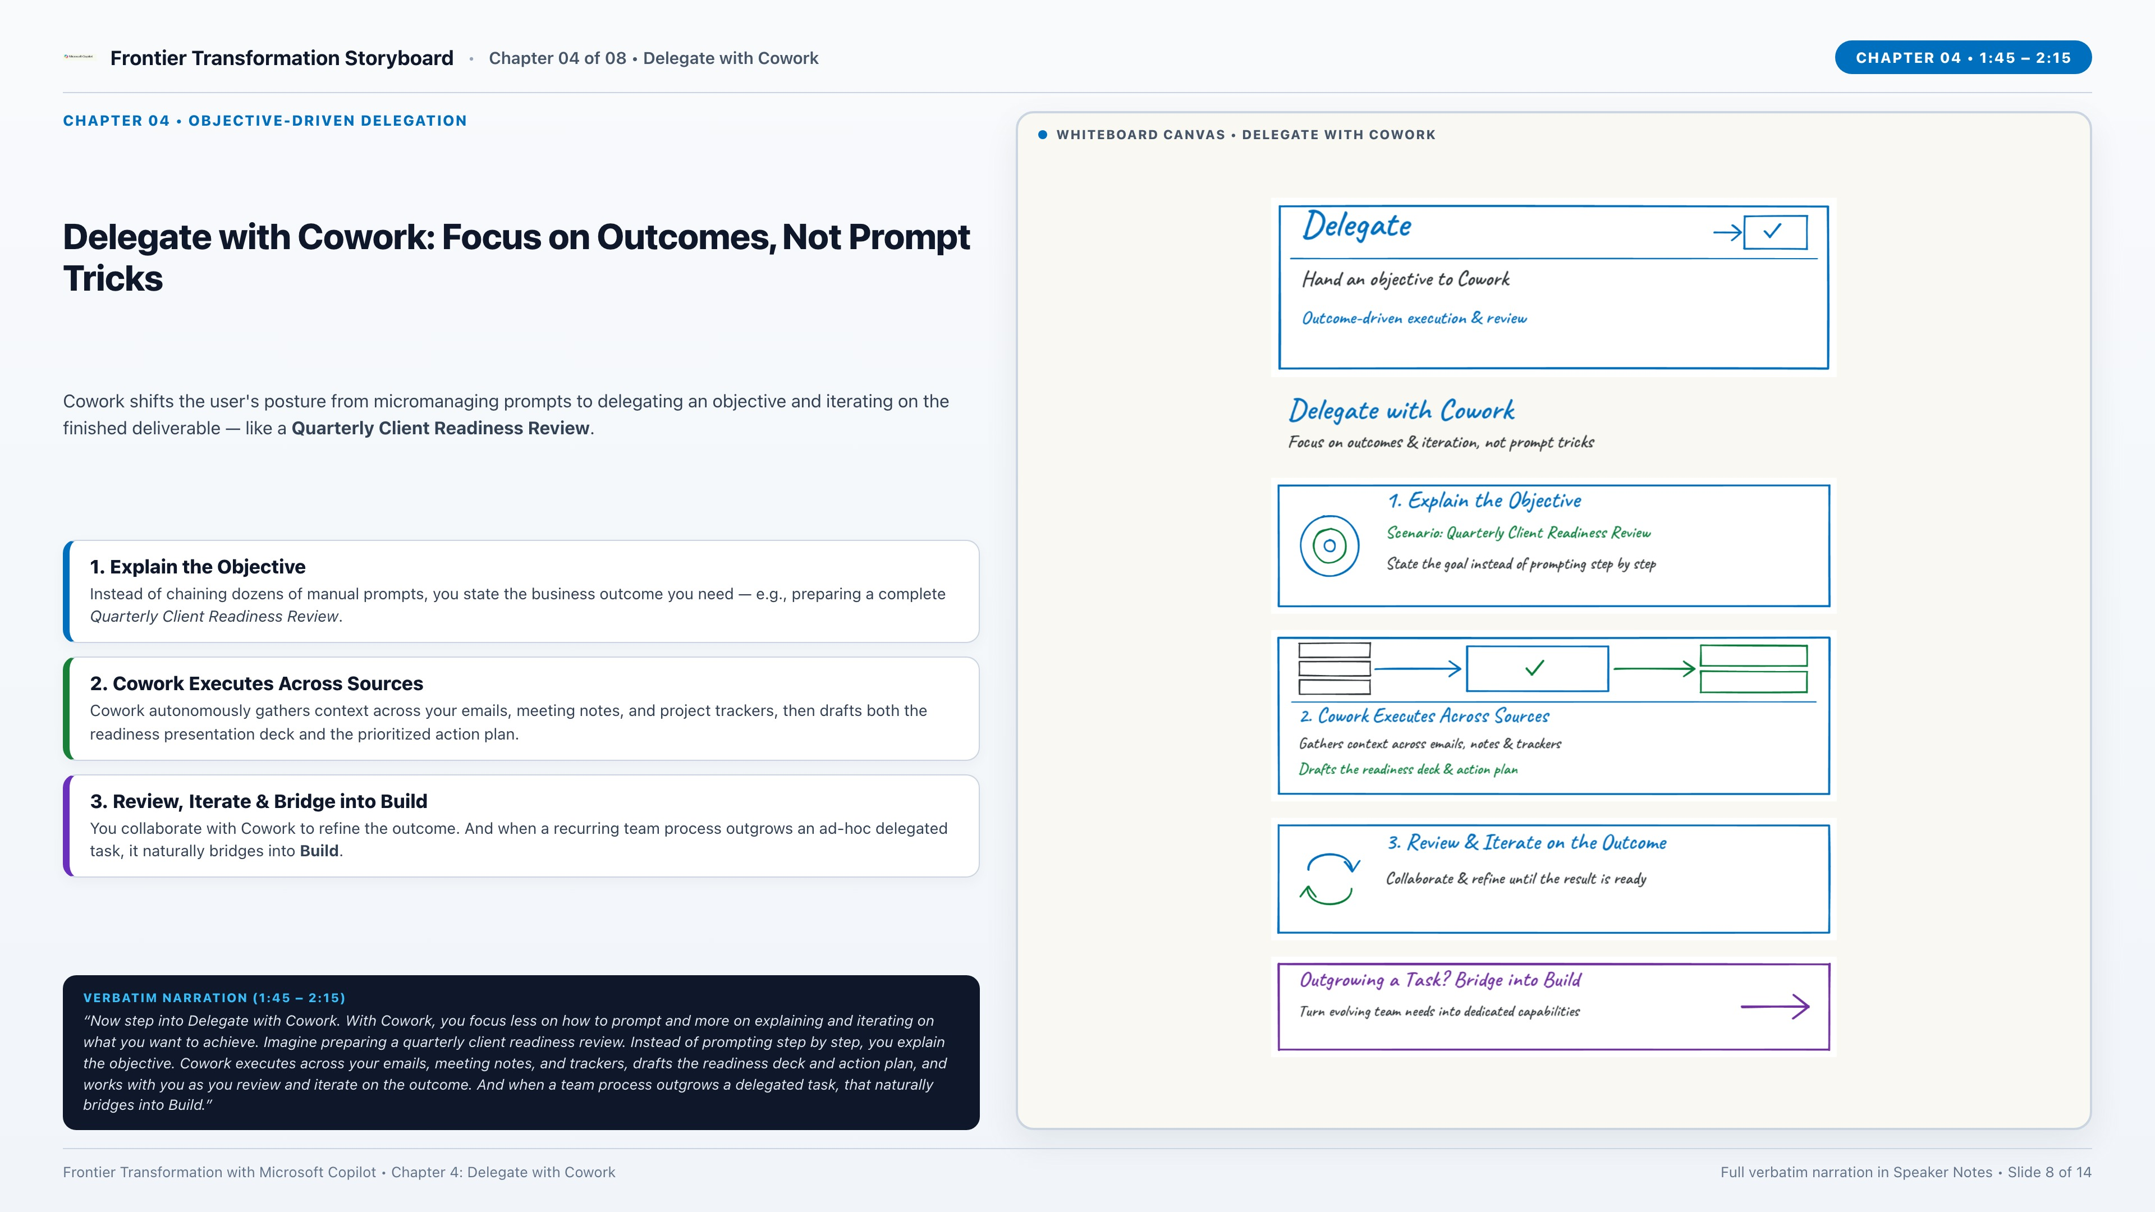
Notes:
CHAPTER 4 — DELEGATE WITH COWORK (Strategy Video 1:45 – 2:15)
[VERBATIM NARRATION TRANSCRIPT]
"Now step into Delegate with Cowork. With Cowork, you focus less on how to prompt and more on explaining and iterating on what you want to achieve. Imagine preparing a quarterly client readiness review. Instead of prompting step by step, you explain the objective. Cowork executes across your emails, meeting notes, and trackers, drafts the readiness deck and action plan, and works with you as you review and iterate on the outcome. And when a team process outgrows a delegated task, that naturally bridges into Build."
[KEY WHITEBOARD CALLOUTS]
• Delegate with Cowork: Focus on outcomes & iteration, not prompt tricks.
1. Explain the Objective — Scenario: Quarterly Client Readiness Review; state the goal instead of prompting step by step.
2. Cowork Executes Across Sources — Gathers context across emails, notes & trackers; drafts the readiness deck & action plan.
3. Review & Iterate on the Outcome — Collaborate & refine until the result is ready.
• Outgrowing a Task? Bridge into Build — Turn evolving team needs into dedicated capabilities.

Slide 9
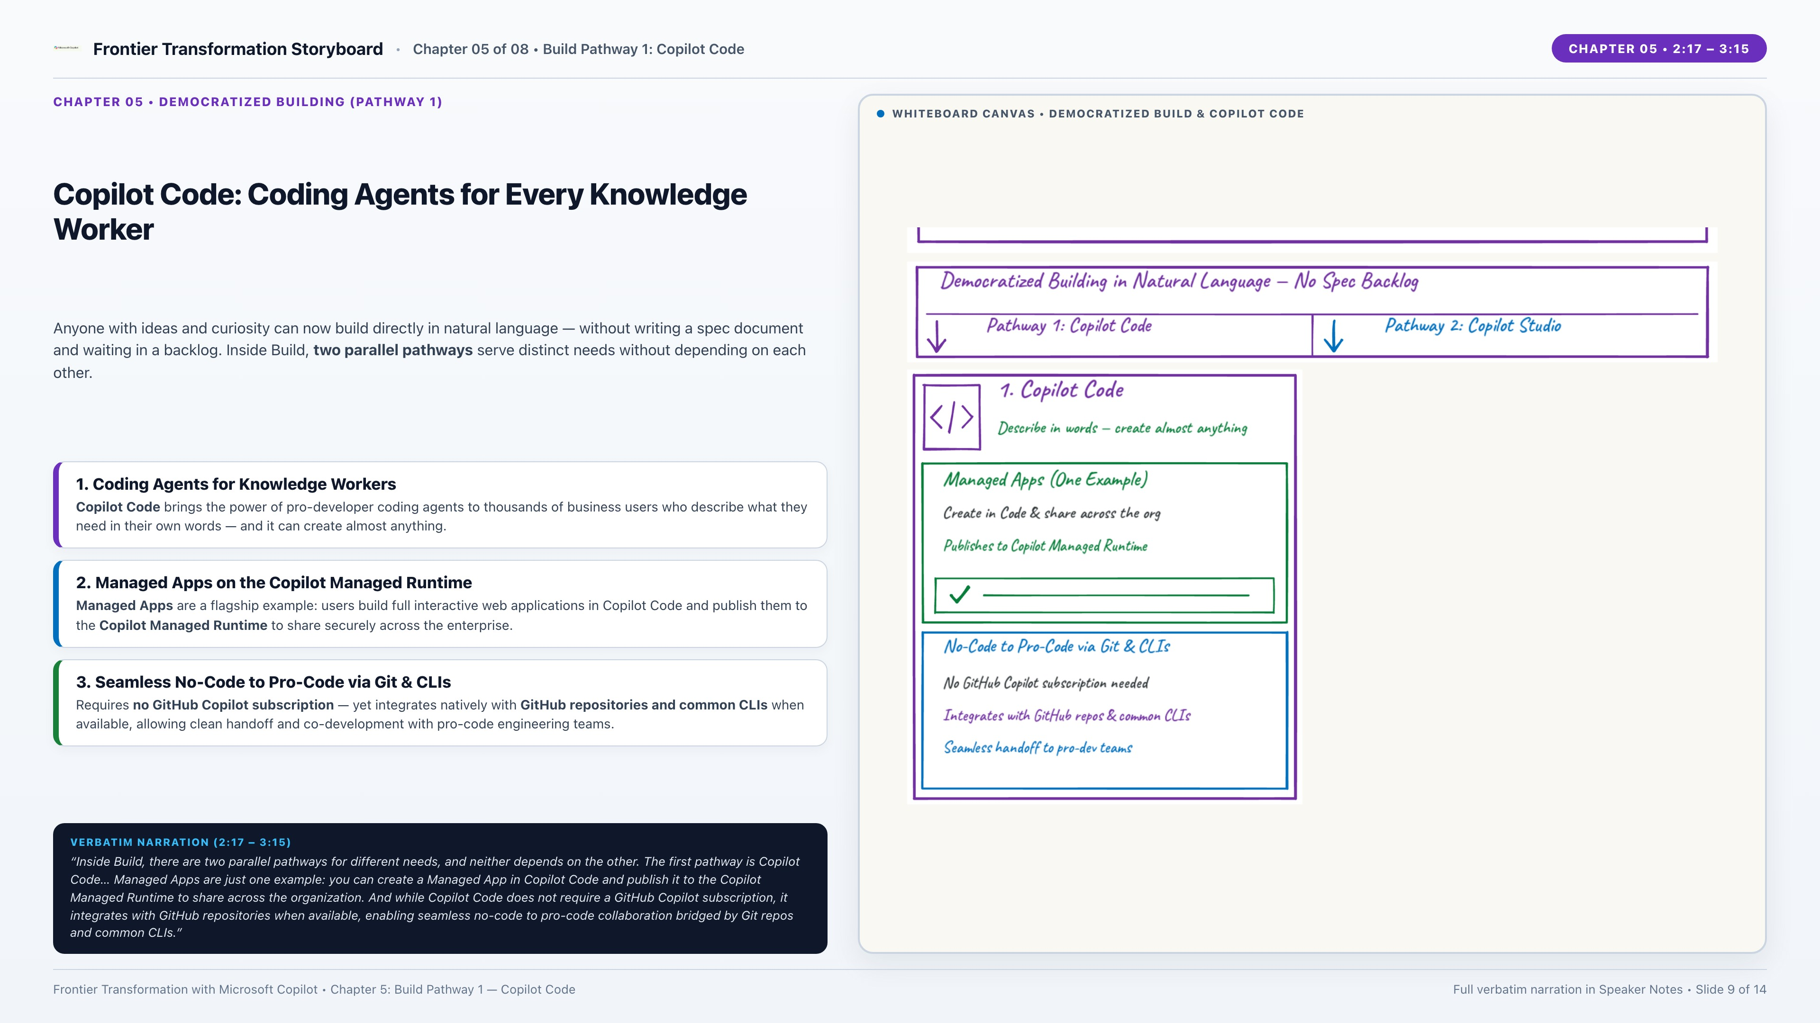
Notes:
CHAPTER 5 — DEMOCRATIZED BUILDING: PATHWAY 1 — COPILOT CODE (Strategy Video 2:17 – 3:15)
[VERBATIM NARRATION TRANSCRIPT]
"Double-click into Build. Building is now democratized for anyone with innovation, ideas, and curiosity, using natural language without writing a spec document and waiting for someone else to build it. Inside Build, there are two parallel pathways for different needs, and neither depends on the other. The first pathway is Copilot Code. Copilot Code brings the power of coding agents to thousands of knowledge workers who describe what they need through their words, just like pro developers do, and it can create almost anything. Managed Apps are just one example: you can create a Managed App in Copilot Code and publish it to the Copilot Managed Runtime to share across the organization. And while Copilot Code does not require a GitHub Copilot subscription, it integrates with GitHub repositories when available, enabling seamless no-code to pro-code collaboration bridged by Git repos and common CLIs."
[KEY WHITEBOARD CALLOUTS]
• Democratized Building: Natural language for anyone with ideas & curiosity — no spec handoff required; two parallel pathways inside Build.
• Pathway 1: Copilot Code:
- Coding agents for thousands of knowledge workers; describe what you need in words — can create almost anything.
- Managed Apps (One Example): Created in Copilot Code & published to the Copilot Managed Runtime to share across the org.
- No-Code to Pro-Code via Git & CLIs: No GitHub Copilot subscription required; integrates with GitHub repos & CLIs for pro-dev handoff.

Slide 10
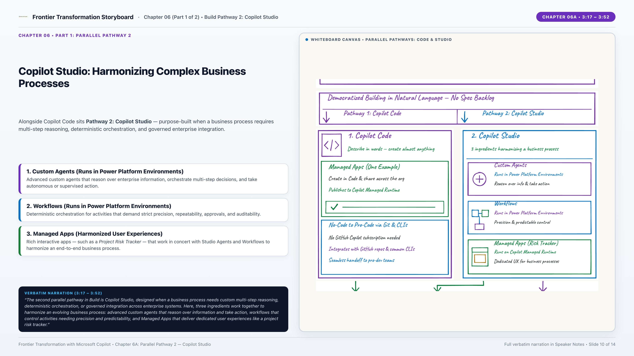
Notes:
CHAPTER 6 (PART 1) — PARALLEL BUILD PATHWAY 2: COPILOT STUDIO (Strategy Video 3:17 – 3:52)
[VERBATIM NARRATION TRANSCRIPT — PART 1 OF CHAPTER 6]
"The second parallel pathway in Build is Copilot Studio, designed when a business process needs custom multi-step reasoning, deterministic orchestration, or governed integration across enterprise systems. Here, three ingredients work together to harmonize an evolving business process: advanced custom agents that reason over information and take action, workflows that control activities needing precision and predictability, and Managed Apps that deliver dedicated user experiences like a project risk tracker."
(Full Chapter 6 Verbatim Transcript for Reference):
"The second parallel pathway in Build is Copilot Studio, designed when a business process needs custom multi-step reasoning, deterministic orchestration, or governed integration across enterprise systems. Here, three ingredients work together to harmonize an evolving business process: advanced custom agents that reason over information and take action, workflows that control activities needing precision and predictability, and Managed Apps that deliver dedicated user experiences like a project risk tracker. Notice how their execution containers and governance work together: Managed Apps from both Copilot Code and Copilot Studio, along with apps built in Lovable and other coding agents, converge to run in the Copilot Managed Runtime, while Copilot Studio agents and workflows run in Power Platform Environments. Critically, both containers are associated with and governed by Power Platform Managed Environment controls, with over 1,500 governed connectors, data policies, and lifecycle guardrails. That shared governance model is a major enterprise differentiator and a clear signal of compliance readiness, especially BAA."

Slide 11
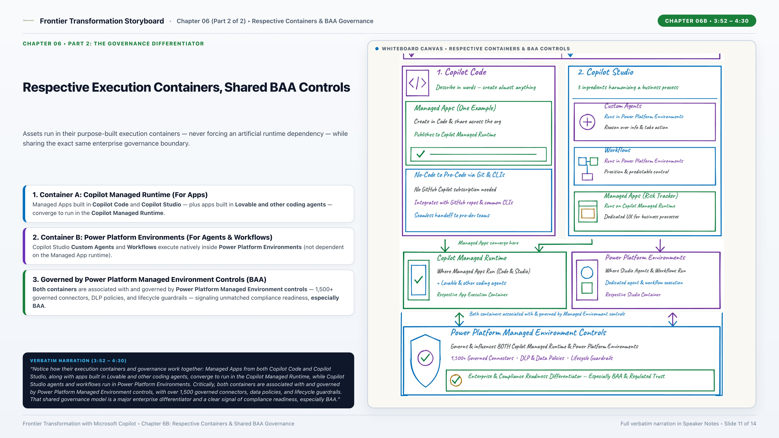
Notes:
CHAPTER 6 (PART 2) — RESPECTIVE EXECUTION CONTAINERS & SHARED GOVERNANCE / BAA (Strategy Video 3:52 – 4:30)
[VERBATIM NARRATION TRANSCRIPT — PART 2 OF CHAPTER 6]
"Notice how their execution containers and governance work together: Managed Apps from both Copilot Code and Copilot Studio, along with apps built in Lovable and other coding agents, converge to run in the Copilot Managed Runtime, while Copilot Studio agents and workflows run in Power Platform Environments. Critically, both containers are associated with and governed by Power Platform Managed Environment controls, with over 1,500 governed connectors, data policies, and lifecycle guardrails. That shared governance model is a major enterprise differentiator and a clear signal of compliance readiness, especially BAA."
[KEY WHITEBOARD CALLOUTS]
• Respective Execution Containers:
- Container 1: Copilot Managed Runtime — Runs Managed Apps from Copilot Code & Copilot Studio, plus apps built in Lovable & other coding agents.
- Container 2: Power Platform Environments — Runs Copilot Studio Custom Agents & Workflows with native orchestration & state.
• Shared Governance Foundation — Power Platform Managed Environment Controls:
- Associated with & governing BOTH runtime containers.
- 1,500+ Governed Connectors • DLP & Data Policies • ALM & Lifecycle Guardrails.
- Enterprise & Compliance Readiness Differentiator — Especially BAA & Regulated Trust.

Slide 12
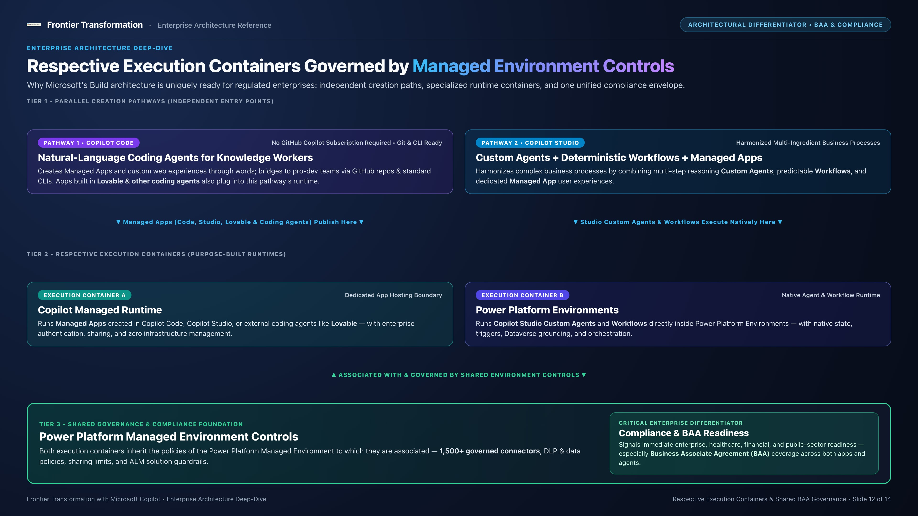
Notes:
SLIDE 12 — ENTERPRISE ARCHITECTURE DEEP-DIVE (FROM COMPANION HTML ARCHITECTURE SECTION)
Title: How Parallel Build Pathways, Respective Execution Containers, and Power Platform Managed Environment Controls Fit Together
[Executive Briefing Notes]
• This slide translates the whiteboard diagram into a clean architectural reference schematic for CIOs, CISOs, and Enterprise Architects:
1. Top Layer — Two Independent Build Pathways:
- Pathway 1: Copilot Code (Natural-language coding agents; Git & CLI pro-code handoff; no GitHub Copilot license required).
- Pathway 2: Copilot Studio (Custom Agents, deterministic Workflows, and Managed Apps).
- External Coding Agents: Apps built in Lovable & other coding agents can also onboard into the same runtime boundary.
2. Middle Layer — Respective Execution Containers:
- Copilot Managed Runtime: Hosts Managed Apps (from Code, Studio, and Lovable/external coding agents).
- Power Platform Environments: Hosts Copilot Studio Custom Agents and Workflows.
3. Shared Governance Foundation — Power Platform Managed Environment Controls:
- Governs BOTH execution containers via environment association: 1,500+ governed connectors, DLP & data policies, environment routing, and ALM guardrails.
- Critical Enterprise & Compliance Readiness Differentiator — Especially HIPAA Business Associate Agreement (BAA) and regulated industry trust.

Slide 13
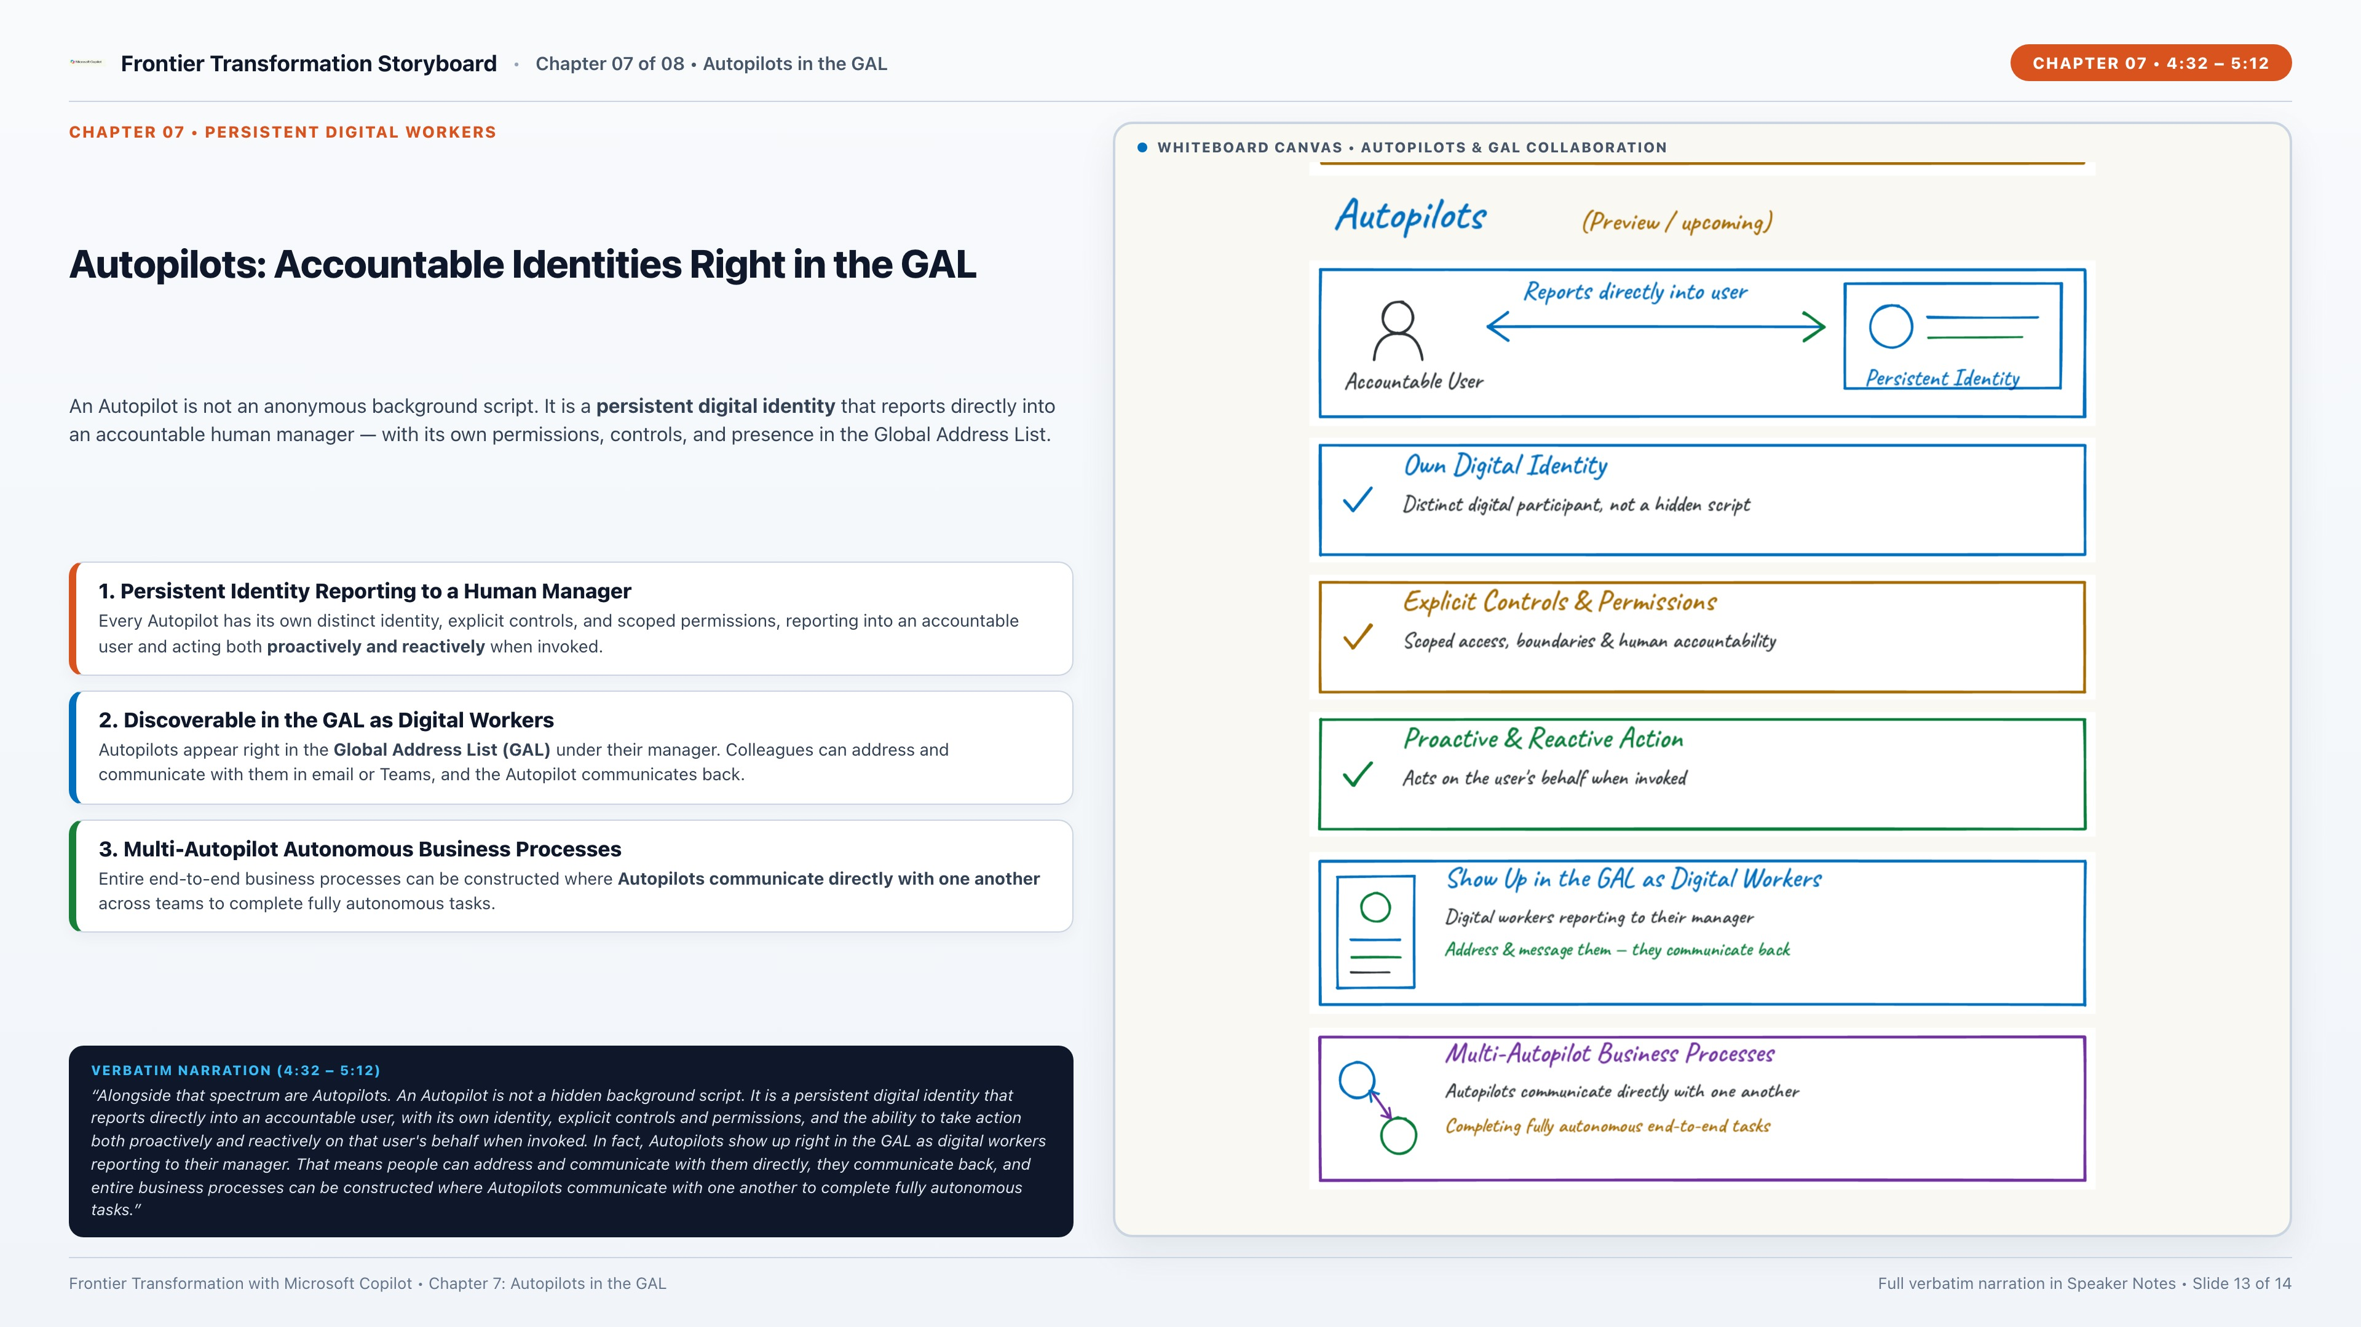
Notes:
CHAPTER 7 — AUTOPILOTS: PERSISTENT DIGITAL WORKERS IN THE GAL (Strategy Video 4:32 – 5:12)
[VERBATIM NARRATION TRANSCRIPT]
"Alongside that spectrum are Autopilots. An Autopilot is not a hidden background script. It is a persistent digital identity that reports directly into an accountable user, with its own identity, explicit controls and permissions, and the ability to take action both proactively and reactively on that user's behalf when invoked. In fact, Autopilots show up right in the GAL as digital workers reporting to their manager. That means people can address and communicate with them directly, they communicate back, and entire business processes can be constructed where Autopilots communicate with one another to complete fully autonomous tasks."
[KEY WHITEBOARD CALLOUTS]
• Autopilots (Persistent Digital Identities):
- Accountable User (Manager) ↔ Reports To ↔ Autopilot Identity (Persistent Digital Worker).
- Own Digital Identity: Distinct identity tied to an accountable human owner.
- Explicit Controls & Permissions: Scoped access, audit trail & policy guardrails.
- Proactive & Reactive Action: Acts on schedules, events, or direct invocation.
- Show Up in the GAL as Digital Workers: Discoverable in the Global Address List reporting to their manager; people message them & they reply back.
- Multi-Autopilot Business Processes: Autopilots communicate with one another to complete fully autonomous end-to-end tasks.

Slide 14
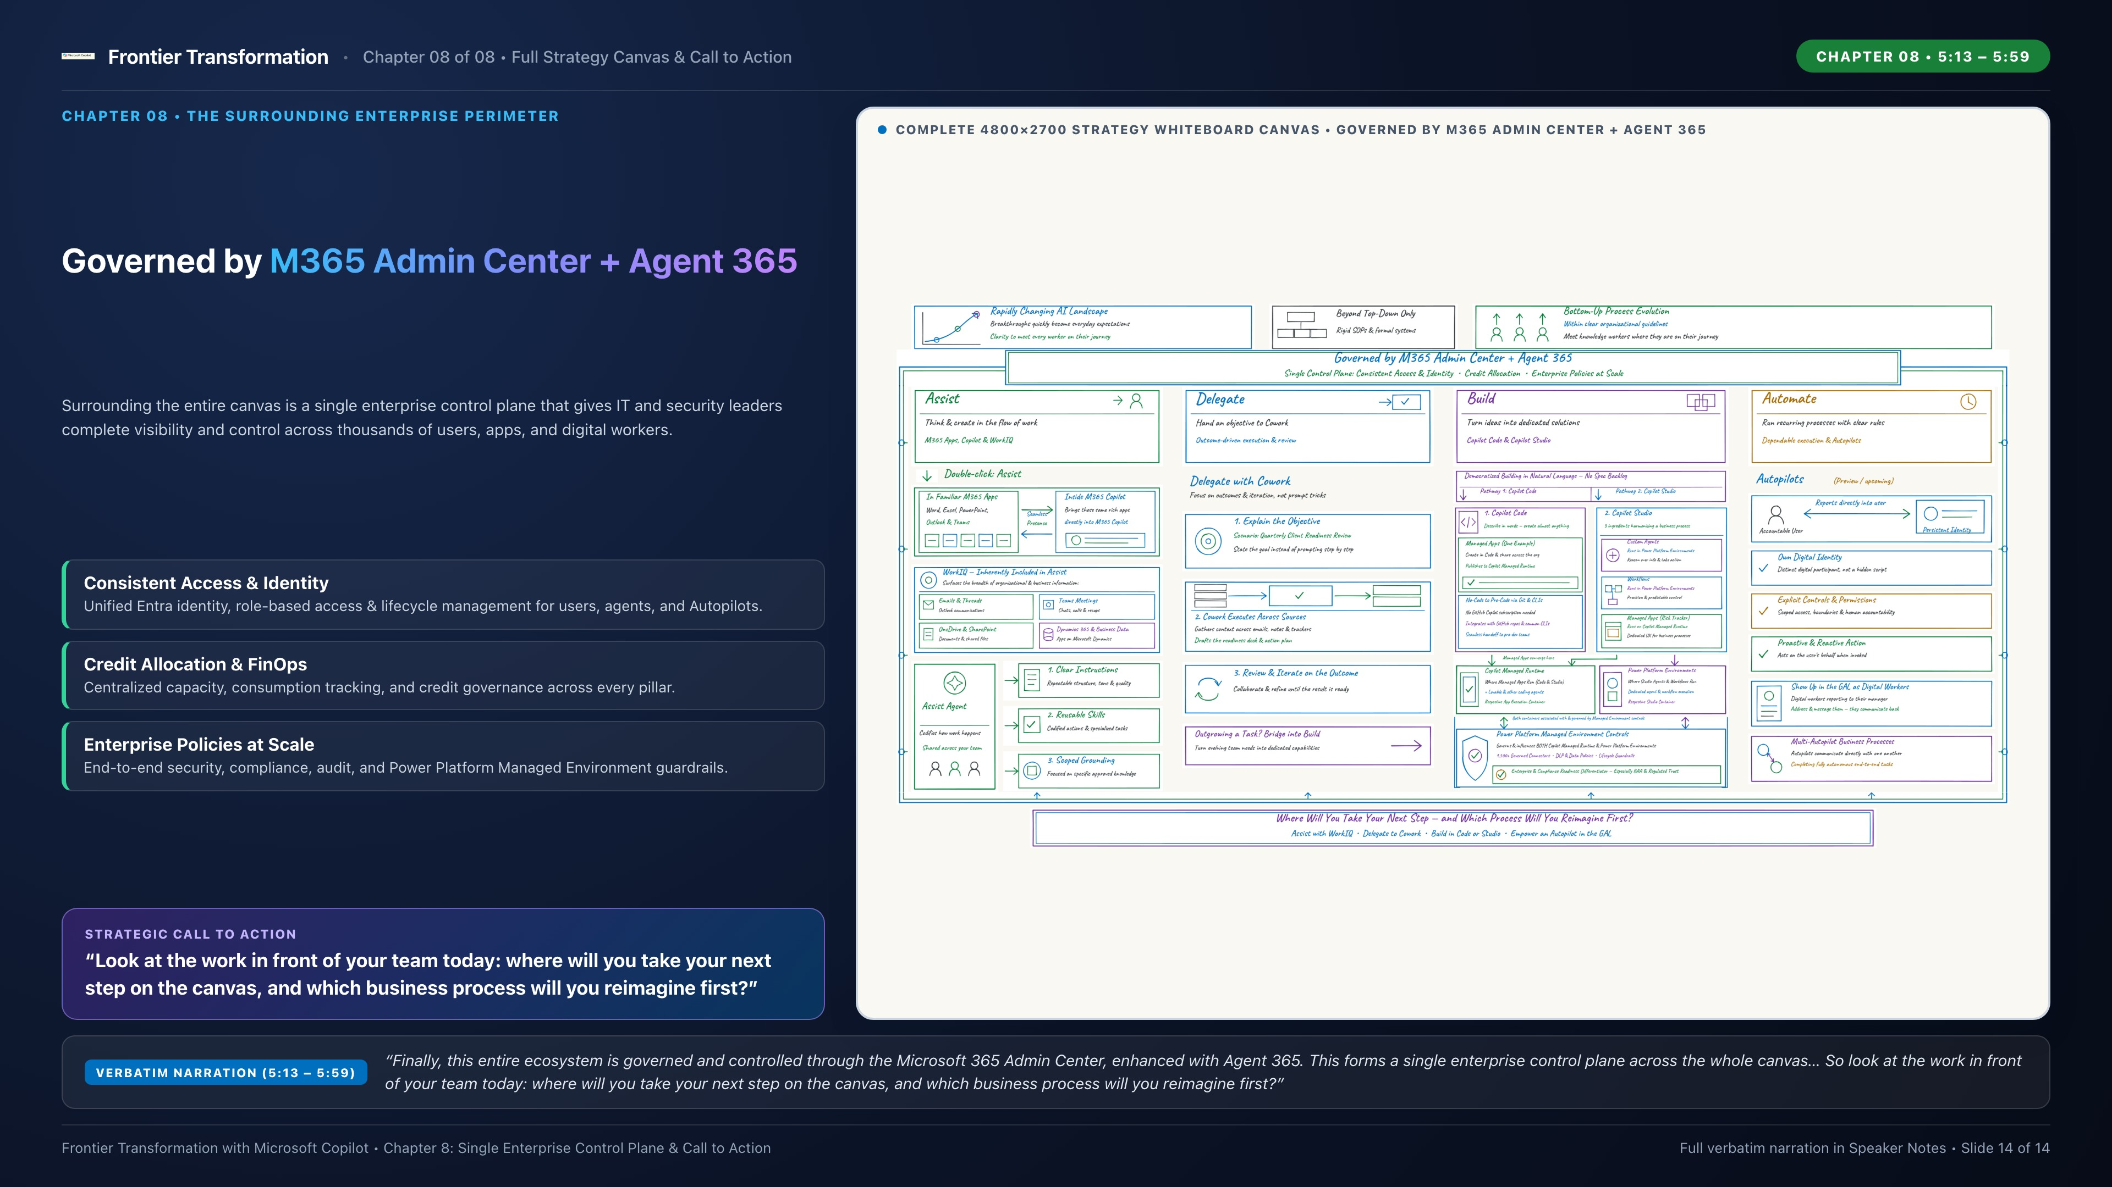
Notes:
CHAPTER 8 — SINGLE ENTERPRISE CONTROL PLANE & CALL TO ACTION (Strategy Video 5:13 – 5:59)
[VERBATIM NARRATION TRANSCRIPT]
"Finally, this entire ecosystem is governed and controlled through the Microsoft 365 Admin Center, enhanced with Agent 365. This forms a single enterprise control plane across the whole canvas, managing consistent access and identity, credit allocation, and administrative policies across thousands of users. From everyday Assist with WorkIQ, to delegating outcomes in Cowork, to building along parallel pathways in Copilot Code and Copilot Studio, to autonomous Autopilots in the GAL, the entire canvas is ready. So look at the work in front of your team today: where will you take your next step on the canvas, and which business process will you reimagine first?"
[CLOSING CALL TO ACTION FOR AUDIENCE DISCUSSION]
1. Where on this canvas will your teams take their next step?
2. Which recurring team workflow is ready to be codified as an Assist Agent or delegated to Cowork?
3. Which high-value business process will you reimagine first across Copilot Code, Copilot Studio, and Autopilots in the GAL?

