Slide 1


Neo4j Pokemon GO
Martin Heil

Slide 2
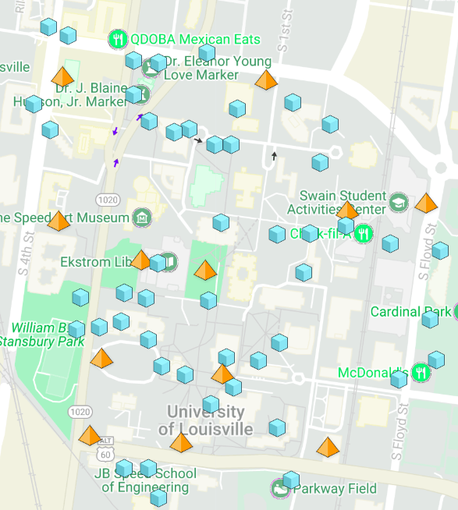

Gathering the Data
Huge thanks to www.pokemongomap.info for the locations of the PokeStops and Gyms in the University of Louisville Area

Slide 3
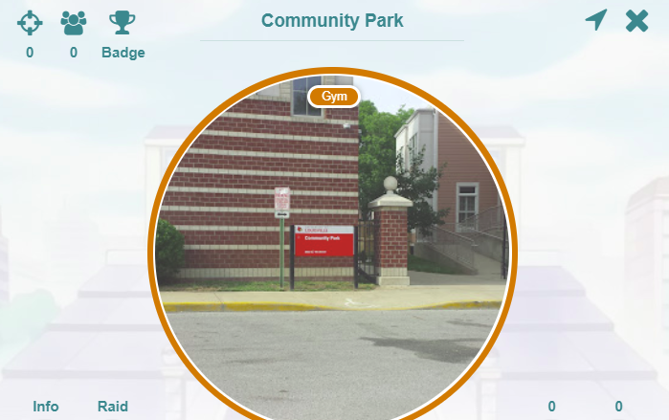


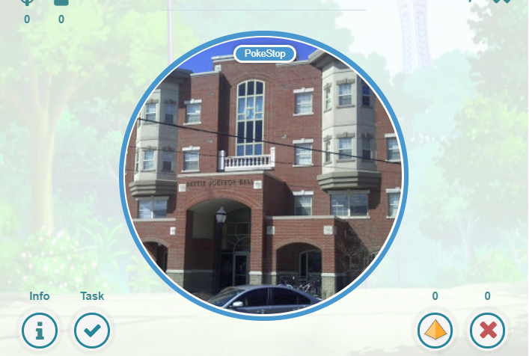

Nodes
Gyms – 12 Nodes
PokeStops – 45 Nodes

Slide 4

Spatial Data
Address:
Bettie Johnson Hall, South 4th Street, Louisville, Jefferson County, Kentucky, 40214, United States of America
APOC.spatial.geocode()
Location Object
(longitude,latitude,description)

Slide 5


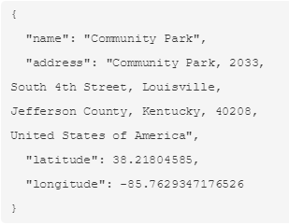
Example Creation Script
CALL
apoc.spatial.geocodeOnce('2033, South 4th Street, Louisville, Jefferson County, Kentucky, 40208, United States of America') YIELD location
CREATE
(:Gym {name:"Community Park", latitude:location.latitude, longitude:location.longitude, address:location.description})

Slide 6
Relationships

Slide 7

Relationships
Volleyball Court

Slide 8

Relationships

Slide 9

Relationships

Slide 10
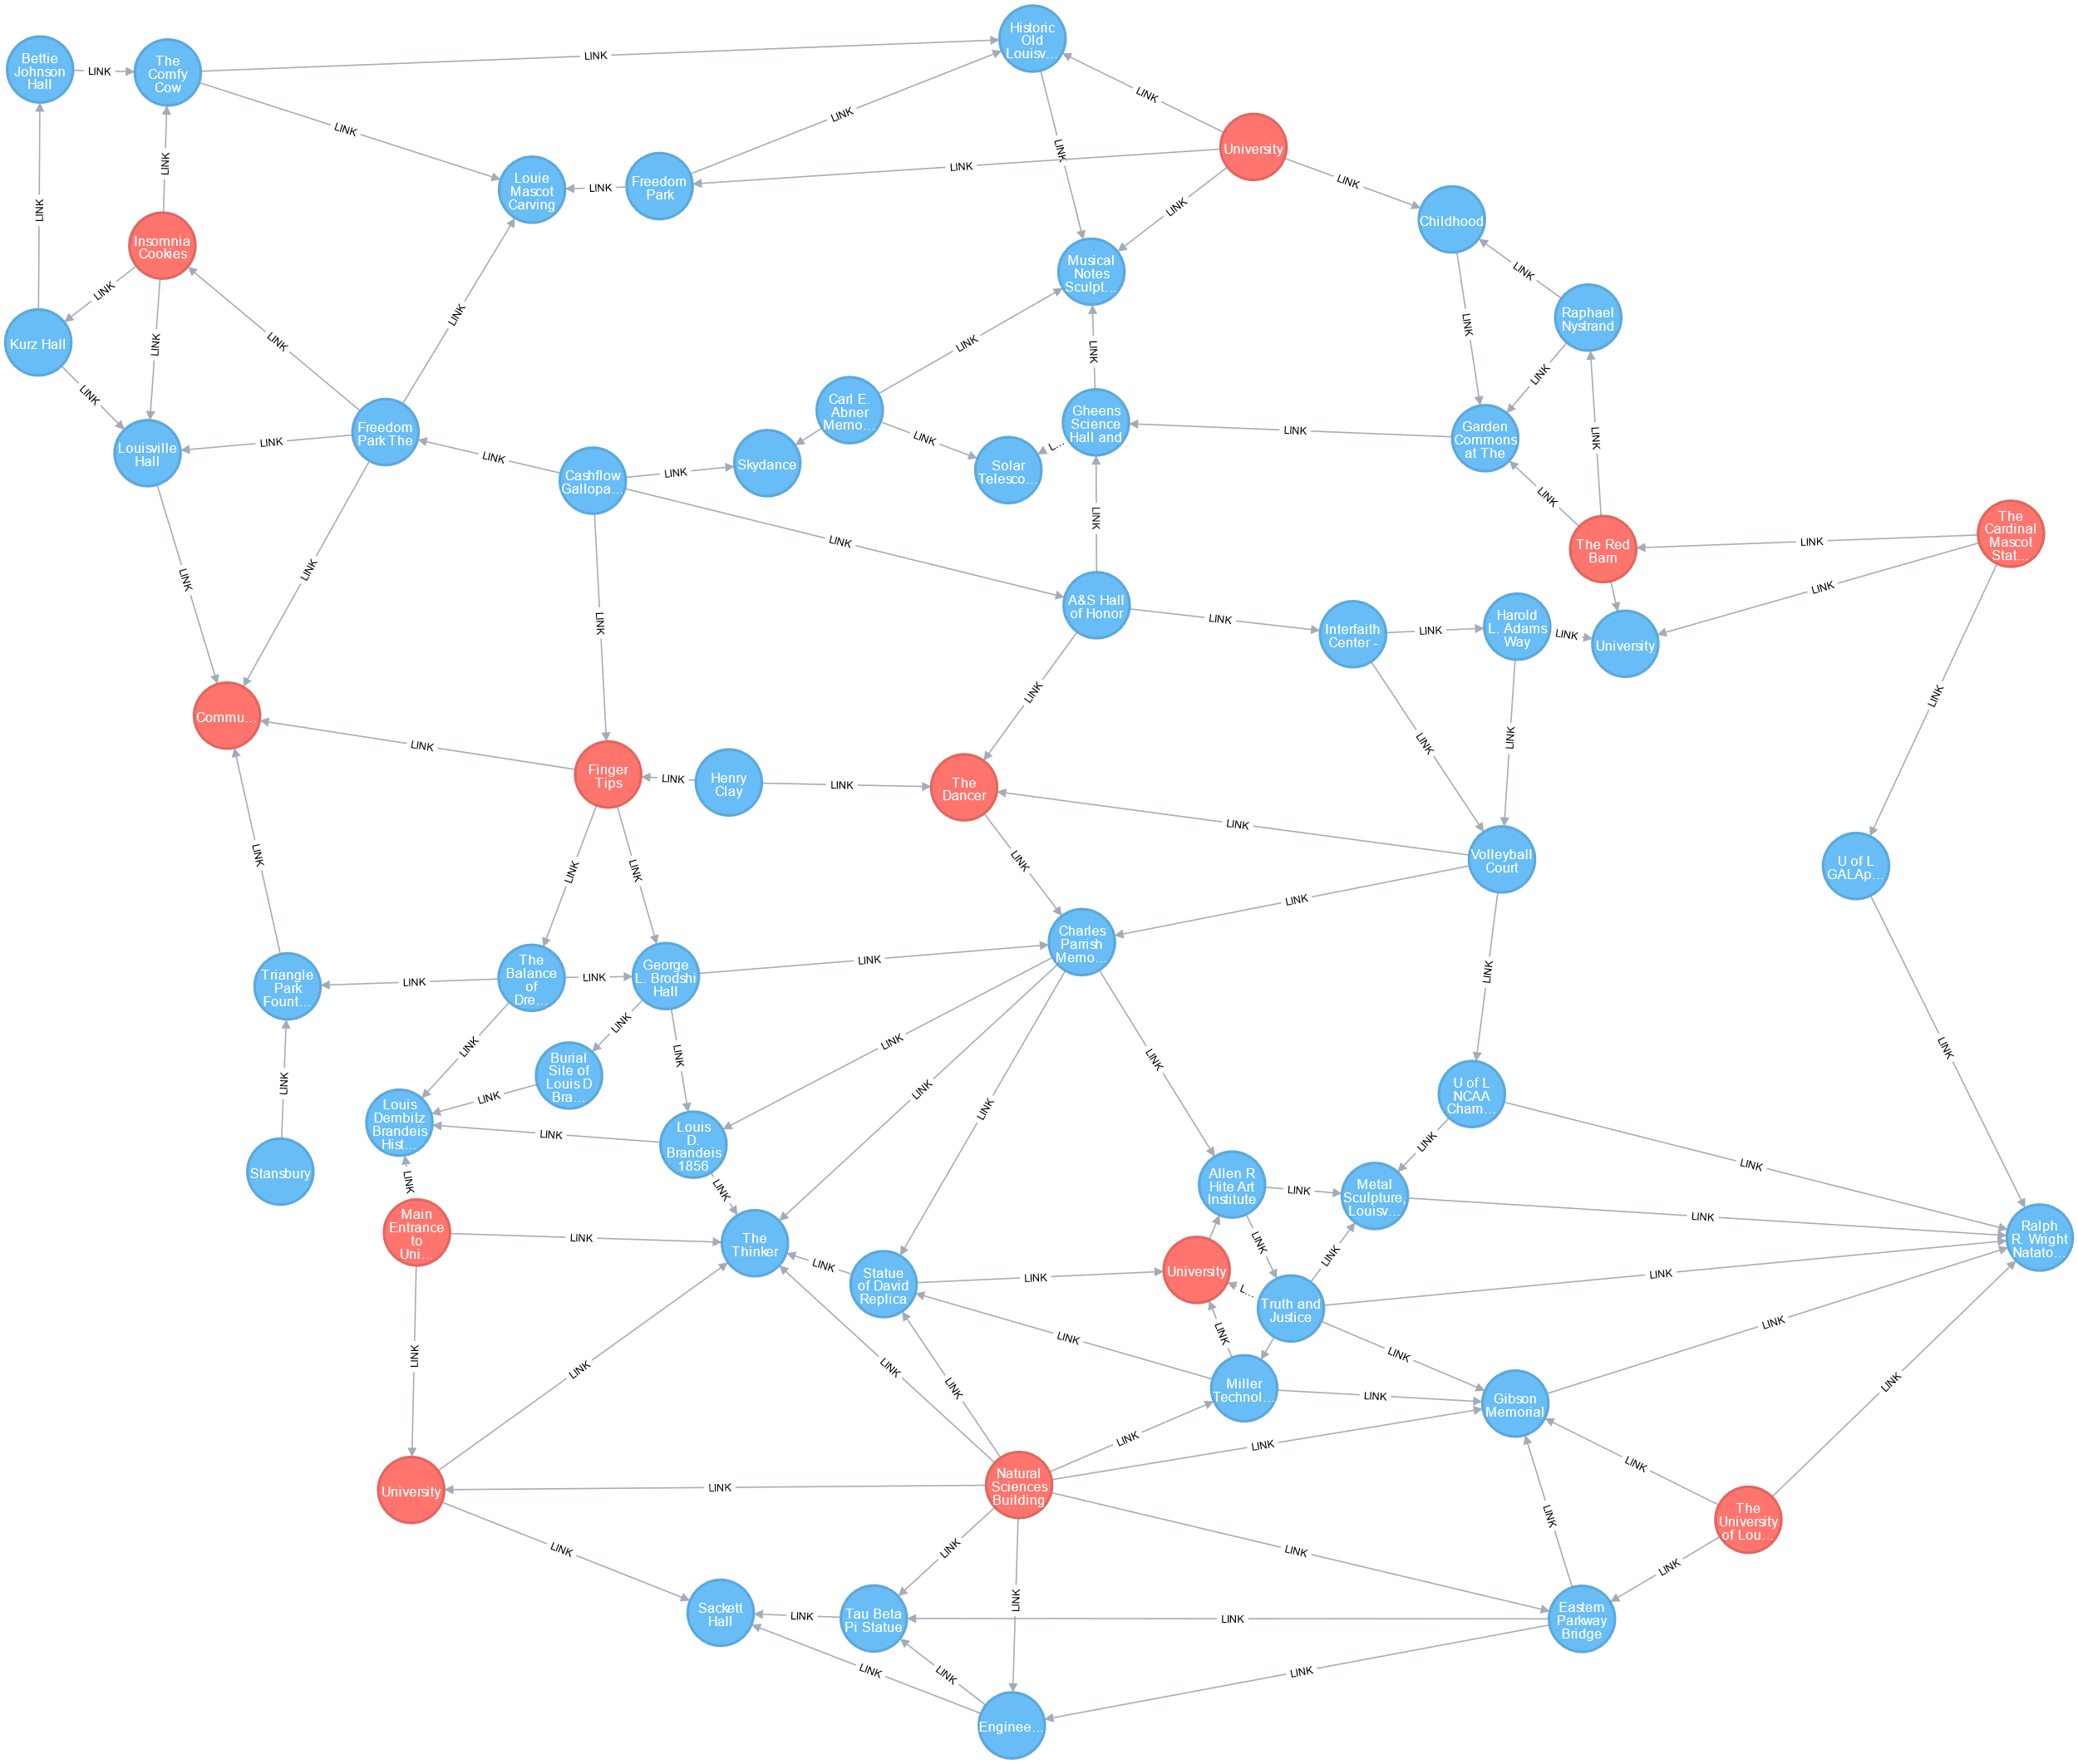

Final Network

Slide 11
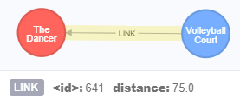

Distances between Nodes
MATCH (a:PokeStop)-[l:LINK]->(b:PokeStop)
WITH l, point({ longitude: a.longitude, latitude: b.latitude}) as aPoint, point({ longitude: b.longitude, latitude: b.latitude}) as bPoint, a.name as aName, b.name as bName
SET l.distance = round(distance(aPoint, bPoint))
(must set distances for all relationship types: PokeStop->PokeStop, PokeStop->Gym, Gym->Gym, Gym->PokeStop)

Slide 12

APOC’s Dijkstra & A* Search Algorithms
Dijkstra
MATCH (a:PokeStop),(b:PokeStop)
WHERE a.name=X and b.name=Y
CALL apoc.algo.dijkstra(a, b, 'LINK', 'distance') YIELD path AS path, weight AS weight
RETURN path, weight
A*
MATCH (a:PokeStop),(b:PokeStop)
WHERE a.name=X and b.name=Y
CALL apoc.algo.aStar(a, b, 'LINK', 'distance', 'latitude', 'longitude') YIELD path AS path, weight AS weight
RETURN path, weight

Slide 13

Dijkstra Search Algorithm
(https://en.wikipedia.org/wiki/Dijkstra%27s_algorithm)

Slide 14

A* Search Algorithm
A* is an informed search algorithm, or a best-first search, meaning that it solves problems by searching among all possible paths to the solution (goal) for the one that incurs the smallest cost (least distance travelled, shortest time, etc.), and among these paths it first considers the ones that appear to lead most quickly to the solution.
(https://en.wikipedia.org/wiki/A*_search_algorithm)

Slide 15

Insomnia Cookies -> University of Louisville Fountains
Dijkstra and A* both find the shortest path for nodes located a short distance away.
Both completed this search in ~ 10 ms.

Slide 16

Insomnia Cookies -> Charles Parish Memorial
Dijkstra finds the shortest path for nodes a medium distance away. (weight=357)
It completed this search in ~ 11 ms.
A* finds a longer path for nodes a medium distance away. (weight=390)
It completed this search in ~ 5 ms.

Slide 17

Insomnia Cookies -> Eastern Parkway Bridge
Dijkstra finds the shortest path for nodes a large distance away. (weight=685)
It completed this search in ~ 10 ms.
A* finds a longer path for nodes a large distance away. (weight=718)
It completed this search in ~ 5 ms.

Slide 18

University of Louisville Fountains -> University of Louisville South Entrance
Dijkstra and A* both find the shortest path for nodes located a large distance away when the first node is an obvious choice.
Dijkstra completed this search in ~ 9 ms.
A* completed this search in ~ 5 ms.

Slide 19

Conclusion
A* is about twice as fast on average compared to Dijkstra even on a small dataset. This speed would be very important if applied to a larger dataset. Although, it doesn’t always find the shortest path.
Latitude and Longitude are specific enough to determine shortest paths when points are nearby one another.
Getting latitude and longitude data from addresses can lead to issues when points are nearby.

Slide 20

Github Repo
https://github.com/martyheil/neo4jPokemonGO

