Slide 1
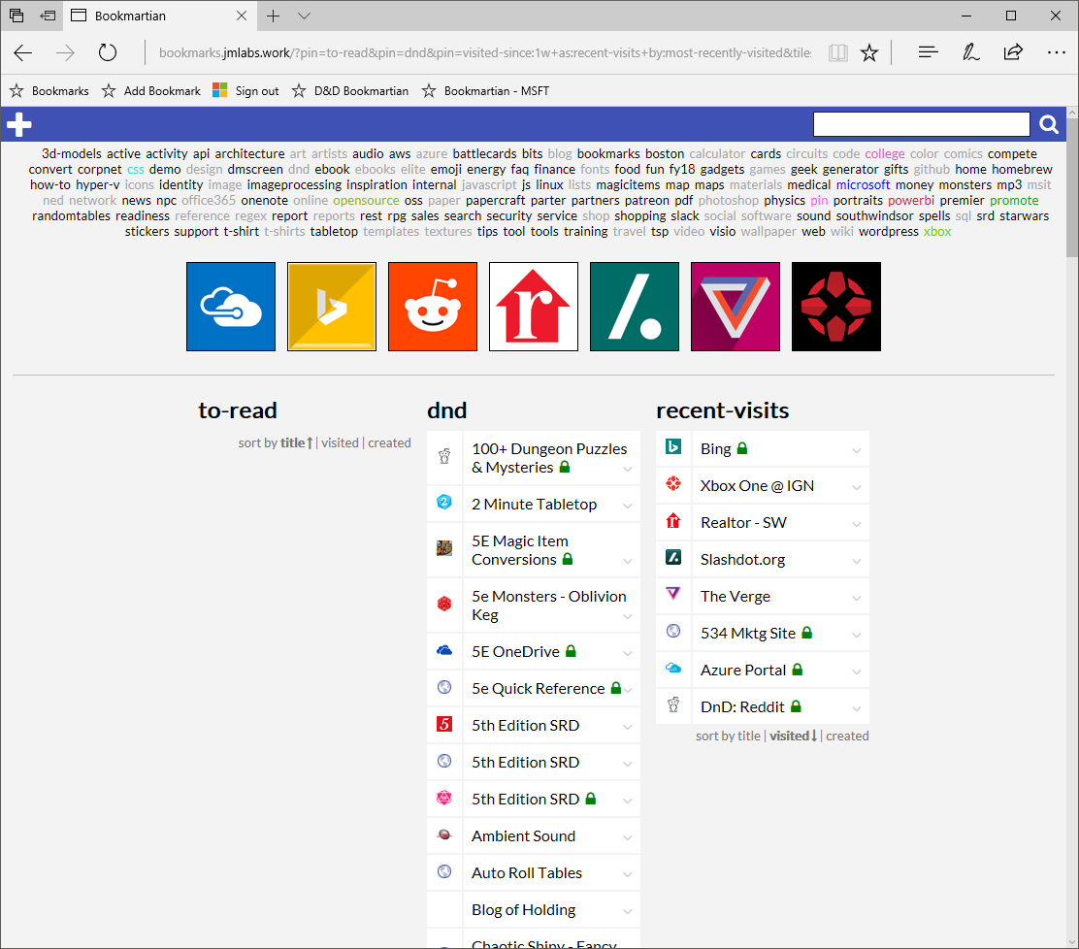

Slide 2



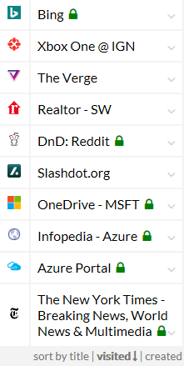
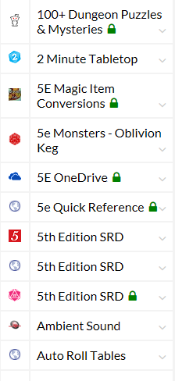
my links
3dmodels
active
activity
api
architecture
art
artists
audio
aws
azure
battlecards
bits
blog
bookmarks
boston
calculator
cards
circuits
code
college
color
comics
compete
convert
corpnet
css
demo
design
dmscreen
dnd
ebook
ebooks
elite
emoji
energy
faq
finance
fonts
my links
dnd
recent-visits
dnd …
recent-visits …
another-pin …

Slide 3
my links
Bookmartian
3dmodels
active
activity
api
architecture
art
artists
audio
aws
azure
battlecards
bits
blog
bookmarks
boston
calculator
cards
circuits
code
college
color
comics
compete
convert
corpnet
css
demo
design
dmscreen
dnd
ebook
ebooks
elite
emoji
energy
faq
finance
fonts
Title
my links
URL
dnd
recent-visits
another-pin
Tags
Notes
Image URL
dnd …
recent-visits …
another-pin …
save
cancel

Slide 4
my links
Bookmartian
3dmodels
active
activity
api
architecture
art
artists
audio
aws
azure
battlecards
bits
blog
bookmarks
boston
calculator
cards
circuits
code
college
color
comics
compete
convert
corpnet
css
demo
design
dmscreen
dnd
ebook
ebooks
elite
emoji
energy
faq
finance
fonts
Title
my links
URL
dnd
recent-visits
another-pin
Tags
Notes
Image URL
save
cancel
dnd …
recent-visits …
another-pin …

Slide 5
my links
3dmodels
active
activity
api
architecture
art
artists
audio
aws
azure
battlecards
bits
blog
bookmarks
boston
calculator
cards
circuits
code
college
color
comics
compete
convert
corpnet
css
demo
design
dmscreen
dnd
ebook
ebooks
elite
emoji
energy
faq
finance
fonts
my links
dnd
recent-visits
another-pin
Title
URL
Tags
Notes
Image URL
dnd …
recent-visits …
save
cancel
another-pin …

Slide 6
top promoted
3dmodels
active
activity
api
architecture
art
artists
audio
aws
azure
battlecards
bits
blog
bookmarks
boston
calculator
cards
circuits
code
college
color
comics
compete
convert
corpnet
css
demo
design
dmscreen
dnd
ebook
ebooks
elite
emoji
energy
faq
finance
fonts
news and info
dnd
recent-visits
another-pin

Slide 7


