Slide 1
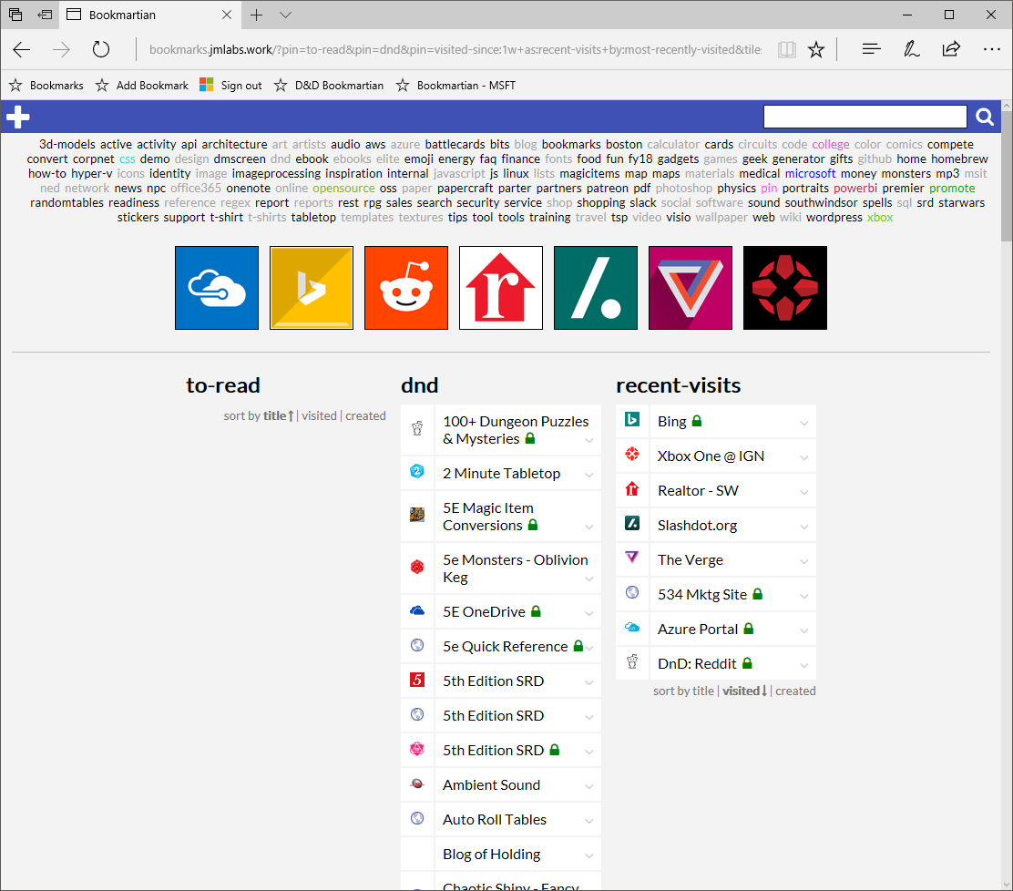

Slide 2



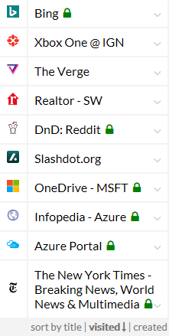
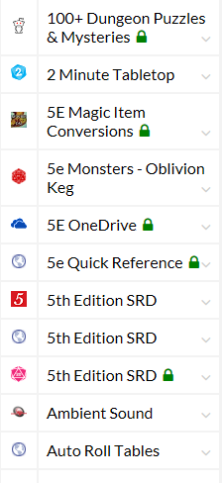
my links
3dmodels
active
activity
api
architecture
art
artists
audio
aws
azure
battlecards
bits
blog
bookmarks
boston
calculator
cards
circuits
code
college
color
comics
compete
convert
corpnet
css
demo
design
dmscreen
dnd
ebook
ebooks
elite
emoji
energy
faq
finance
fonts
my links
dnd
recent-visits
dnd …
recent-visits …
another-pin …

Slide 3
my links
Bookmartian
3dmodels
active
activity
api
architecture
art
artists
audio
aws
azure
battlecards
bits
blog
bookmarks
boston
calculator
cards
circuits
code
college
color
comics
compete
convert
corpnet
css
demo
design
dmscreen
dnd
ebook
ebooks
elite
emoji
energy
faq
finance
fonts
Title
my links
URL
dnd
recent-visits
another-pin
Tags
Notes
Image URL
dnd …
recent-visits …
another-pin …
save
cancel

Slide 4
my links
Bookmartian
3dmodels
active
activity
api
architecture
art
artists
audio
aws
azure
battlecards
bits
blog
bookmarks
boston
calculator
cards
circuits
code
college
color
comics
compete
convert
corpnet
css
demo
design
dmscreen
dnd
ebook
ebooks
elite
emoji
energy
faq
finance
fonts
Title
my links
URL
dnd
recent-visits
another-pin
Tags
Notes
Image URL
save
cancel
dnd …
recent-visits …
another-pin …

Slide 5
my links
3dmodels
active
activity
api
architecture
art
artists
audio
aws
azure
battlecards
bits
blog
bookmarks
boston
calculator
cards
circuits
code
college
color
comics
compete
convert
corpnet
css
demo
design
dmscreen
dnd
ebook
ebooks
elite
emoji
energy
faq
finance
fonts
my links
dnd
recent-visits
another-pin
Title
URL
Tags
Notes
Image URL
dnd …
recent-visits …
save
cancel
another-pin …

Slide 6
top promoted
3dmodels
active
activity
api
architecture
art
artists
audio
aws
azure
battlecards
bits
blog
bookmarks
boston
calculator
cards
circuits
code
college
color
comics
compete
convert
corpnet
css
demo
design
dmscreen
dnd
ebook
ebooks
elite
emoji
energy
faq
finance
fonts
news and info
dnd
recent-visits
another-pin

Slide 7


Slide 8





Querystring parameters drive the page display so that you can easily have a ‘home’ and ‘work’ view
http://bookmarkhomepage.jmutchek.com?promote=microsoft,d&d,materials
All tags as links to quickly filter/search
animation art artist azure blog brush cli color comic convert cool css d&d dashboard data décor diy dns ebook electronics filter font forum game git hometheater http icon image iot itpro javascript jewelry leather list logo malpen map materials microsoft o365 oss outdoor paper photo photoshop php physics powerbi print programming reference regex rest rpg scripting security service shop simulator software sql t-shirt textures tinker tools travel tutorial utility vector video wallpaper web wiki
Search for more complex tag queries and fulltext
Promoted links: either by frequency or a sort order / priority
microsoft
d&d
materials
Not sure of the sort order here… or if this is a complete list or just “top n”
Promoted tags: specified on query string?
 | Fiscal year reporting FY17 updated once per month
 | Roadmap decks
 | Human Resources
 | US Travel
 | Monthly Training
 | Taxidermic Owlbear
 | Giant in the Playground (5E)
 | One Use Magic Items (5E)
 | Kobold Fight Club
 | 5th Edition SRD
 | Jelinek Cork Group
 | K&J Magnetics
 | Sugru Fix that thing clay
 | TAP Plastics
 | Playing Surface Fabric
 | More good stuff
 | Shapeways 3D Printing
 | Hobby chemicals
 | Unusual paints
Dynamic tags: recent, frequent, etc.
recently added
freqently used
 | Taxidermic Owlbear
 | Sugru Fix that thing clay
 | Human Resources
 | US Travel
 | Monthly Training
 | Kobold Fight Club
 | Roadmap decks
 | US Travel
 | Monthly Training
 | Monthly Training

Slide 9


http://bookmarkhomepage.jmutchek.com?search=d&d
After a search
d&d
animation art artist azure blog brush cli color comic convert cool css d&d dashboard data décor diy dns ebook electronics filter font forum game git hometheater http icon image iot itpro javascript jewelry leather list logo malpen map materials microsoft o365 oss outdoor paper photo photoshop php physics powerbi print programming reference regex rest rpg scripting security service shop simulator software sql t-shirt textures tinker tools travel tutorial utility vector video wallpaper web wiki
d&d
favicons?
 | Taxidermic Owlbear
 | Giant in the Playground (5E)
 | One Use Magic Items (5E)
 | Kobold Fight Club
 | 5th Edition SRD
 | Sly Flourish
 | Wizard of the Coast
 | Neverwinter Nights
 | The Angry DM
Edit controls, etc. appear on hover?

Slide 10

http://theverge.com
Bookmarklet while browsing
BOOKMARKLET
Add a bookmark…
Name:
The Verge
Tags:
news tech gadgets
✓
URL:
http://theverge.com
Advanced
Advanced options might expose favicon, icon, disable fulltext, etc

Slide 11
