Slide 1
CSP2348/CSP5243 Data Structures
Lecture 02
Fundamentals of
Algorithm Analysis

Slide 2
Contents
Fundamental Principles of Algorithms
Time and Space Efficiency of Algorithms
Complexity of Algorithms
  Growth Rates & Big O-notation
Guide

Slide 3
Objectives
Describe the fundamental principles of algorithms;
Determine the time and space efficiency of various algorithms;
Use big O-notation to analyse the time and space efficiency of algorithms.

Slide 4
Principles (1)
Recall: An algorithm is a step-by-step procedure for solving a stated problem in a finite amount of time (or finite steps).
  It will be performed by a processor, which may be human, mechanical, or electronic.
  It must be expressed in steps that the processor is capable of performing.
  It must eventually terminate.

Slide 5
Principles (2)
An algorithm must be expressed in some language that the processor “understands”, but the underlying procedure is independent of the particular language chosen.
The stated problem must be solvable, i.e., capable of solution by a step-by-step procedure.
Notes:
Algorithm was also mentioned in lecture 01 , slides 3.

Slide 6
Efficiency of an algorithm
Given several algorithms to solve the same problem, which algorithm is “best”?
Given an algorithm, is it feasible to use it at all? In other words, is it efficient enough to be usable in practice?
How much time does the algorithm require?
How much space (memory) does the algorithm require?
In general, both time and space requirements depend on the algorithm’s input (typically the “size” of the input).

Slide 7
A dummy question:
An matrix A(n, n) stores the same value, say, x, in its all elements. - Which of the following algorithms would be the best (fastest) to sum all elements?
Algorithm 1
Algorithm 3
Algorithm 2
sum=0;
for (i=0; i<n; i++)
for (j=0; j<n; j++)
sum +=A(i,j);
s=0; sum =0;
for (i=0; i<n; i++) s += A(0,i);
for (i=0; i<n; i++) sum +=s;
Which one do you think the
best? And why?
sum = n * n* A(0,0);

Slide 8
Example: efficiency
Hypothetical profile of two sorting algorithms:
4
Key:
3
Algorithm A
Algorithm B
time (ms)
2
1
0
10
20
30
40
items to be sorted, n
Algorithm B’s time grows more slowly than A’s.

Slide 9
Efficiency: measuring time
Measure time in seconds?
  + is useful in practice
  – depends on language, compiler, and processor.
Count algorithm steps?
  + does not depend on compiler or processor
  – depends on granularity of steps.
Count characteristic operations? (e.g., arithmetic operations in mathematical algorithms, comparisons in searching algorithms, etc.)
  + depends only on the algorithm itself
  + measures the algorithm’s intrinsic efficiency.

Slide 10
Example: power algorithms (1)
Simple power algorithm:
To compute b^{n}:
1. Set p to 1.
2. For i = 1, …, n, repeat:
2.1. Multiply p by b.
3. Terminate with answer p.

Slide 11
Example: power algorithms (2)
Analysis (counting multiplications):
  Step 2.1 performs one
  multiplication.
  This is repeated n times
  in Step 2.
  Total number of
  multiplications = n
Simple power algorithm:
To compute b^{n}:
1. Set p to 1.
2. For i = 1, …, n, repeat:
2.1. Multiply p by b.
3. Terminate with answer p.

Slide 12
Example: power algorithms (3)
Implementation in Java:
int simplePower(int b, int n)
{ //return b^n, where n>=0
if (n<0) return 0;
int p = 1;
for (int i = 1; i <= n; i++)
p *= b;
return p;
}

Slide 13
Example: power algorithms (4)
Smart power algorithm
Idea: b¹⁰⁰⁰ = b⁵⁰⁰ ∗ b⁵⁰⁰. If we know b⁵⁰⁰, we can compute b¹⁰⁰⁰ with only 1 more multiplication!
To compute b^{n}:
1. Set p to 1, set q to b, and set m to n.
2. While m > 0, repeat:
2.1. If m is odd, multiply p by q.
2.2. Halve m (discarding any remainder).
2.3. Multiply q by itself.
3. Terminate with answer p.
Notes:
P18.

Slide 14
Example: power algorithms (4)
Run the algorithm, considering the case of n = 22:
p q m
1 b 22
b²
b⁴
b⁸
b¹⁶
b³²
To compute b^{n}:
1. Set p to 1, set q to b, and set m to n.
2. While m > 0, repeat:
2.1. If m is odd, multiply p by q.
2.2. Halve m (discarding any remainder).
2.3. Multiply q by itself.
3. Terminate with answer p
11
b²
b²
5
b⁴⁺²
b⁶
2
Principles: convert n to its binary format:
22₁₀ = 16+4+2
= 2⁴+2²+2¹
= 010110₂
1
b¹⁶⁺⁴⁺²
b²²
0
b¹⁶
b⁴
b²
Notes:
Another way (more algorithmic): convert 22 to binary -> 10110, and …

Slide 15
Example: power algorithms (5)
Analysis (counting multiplications):
  Steps 2.1–2.3 together perform at most 2 multiplications.
  They are repeated as often as we must halve the value of n (discarding any remainder) until it reaches 0, which is floor(log₂ n) + 1 times.
  Maximum number of
  multiplications =
  2 ×(floor(log₂ n) + 1)
  = 2 ×floor(log₂ n) + 2
To compute b^{n}:
1. Set p to 1, set q to b, and set m to n.
2. While m > 0, repeat:
2.1. If m is odd, multiply p by q.
2.2. Halve m (discarding any remainder).
2.3. Multiply q by itself.
3. Terminate with answer p

Slide 16
Example: power algorithms (6)
Implementation in Java:
int smartPower(int b,
int n)
{ //return b^n, where n>=0
if (n<0) return 0;
int p = 1, q = b, m = n;
while (m > 0)
{ if ((m%2) != 0) p *= q;
m /= 2;
q *= q;
}
return p;
}

Slide 17
Example: power algorithms (7)
Comparison:
50
simple power algorithm
40
30
No. of multiplications
20
smart power algorithm
10
0
0
10
20
30
40
50
n

Slide 18
Complexity
For many interesting algorithms, the exact number of operations is too difficult to analyse mathematically.
To simplify the analysis, we normally
  identify the fastest-growing term
  neglect slower-growing terms
  neglect the constant factor in the fastest-growing term.
The resulting formula is the algorithm’s time complexity. It focuses on the growth rate of the algorithm’s time requirement.
Similarly for space complexity.

Slide 19
Example : analysis of power algorithms (1)
Analysis of simple power algorithm (counting multiplications):
  Number of multiplications = n
  Time taken is approximately proportional to n.
  Time complexity is of order n. This is written O(n).

Slide 20
Example : analysis of power algorithms (2)
Analysis of smart power algorithm (counting multiplications):
  - Maximum number of multiplications =
  2 × floor(log₂ n) + 2
Neglect slow-growing term, +2.
  Simplified to 2×floor(log₂ n)
Normalize constant factor, 2.
  then to floor(log₂ n)
Neglect floor(), which subtracts a constant value <1.0 from log₂n
  then to log₂ n
  Time complexity is of order (log₂n), written O(log₂n).

Slide 21
Example : analysis of power algorithms (3)
50
Comparison:
n
40
simple power algorithm
30
20
2*floor(log₂n)+2
10
log n
smart power algorithm
0
0
10
20
30
40
50
n

Slide 22
Big O-notation (1)
We have seen that an O(log n) algorithm is inherently better than an O(n) algorithm for large values of n.
O(log n) signifies a slower growth rate than O(n).
Complexity O(Y) means “of order Y”,
  i.e., growing proportionally to Y.
  signifies the growth rate, neglecting slower-growing terms and constant factors.

Slide 23
Big O-notation (2)
Common time complexities:
O(1) constant time (feasible)
O(log n) logarithmic time (feasible)
O(n) linear time (feasible)
O(n log n) log linear time (feasible)
O(n²) quadratic time (sometimes feasible)
O(n³) cubic time (less often feasible)
O(2^{n}) exponential time (rarely feasible)

Slide 24
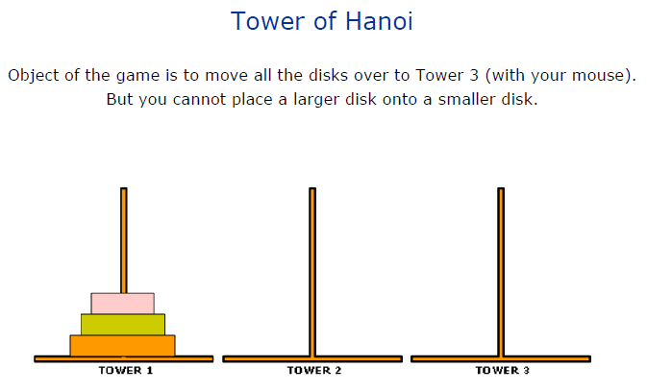
Big O-notation (3)
Q: Is there any algorithm whose intrinsic growing rate (or complexity) is of order O(2^{n})?
Yes, many of them. One of the examples is
“The tower of Hanoi”
game.
  Given n discs, it
  needs at least 2^{n} -1
  movements to move
  them from one tower
  to another tower.
  Why? You try it ☺
Notes:
Check and play it say from http://www.mathsisfun.com/games/towerofhanoi.html

Slide 25
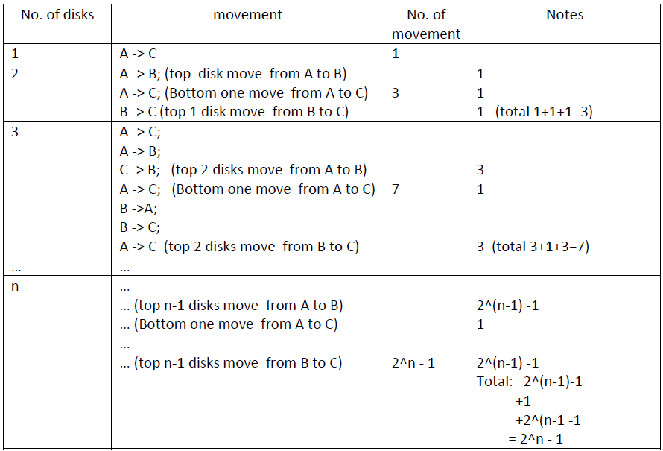
Big O-notation (4)
Move n disks from Pole A to Pole C (via Pole B)

Slide 26
Growth rates (1)
Comparison of growth rates:
 | n | 10 | 20 | 30 | 40
Complexity of | O(1) | 1 | 1 | 1 | 1
 | O(log n) | 3.3 | 4.3 | 4.9 | 5.3
 | O(n) | 10 | 20 | 30 | 40
 | O(n log n) | 33 | 86 | 147 | 213
 | O(n²) | 100 | 400 | 900 | 1,600
 | O(n³) | 1,000 | 8,000 | 27,000 | 64,000
 | O(2^{n}) | 1,024 | 1.0 million | 1.1 billion | 1.1 trillion
Notes:
For any positive integers a and n, we have log a(n) = log 2(n)/log 2(a),
or log 2(n) = log a(n)*log 2(a)
Let a=10, then log 2(n) = log 10(n)*log 2(10), or simply log 2 (n) = 3.32*log(n)

Slide 27
Growth rates (2)
f(n)
100
2^{n}
n²
n log n
Graphically:
80
60
n
40
20
log n
0
n
0
10
20
30
40
50
n

Slide 28
Big O-notation (3)
In terms of growth rate
Slowest Fastest
O(1) < O(log n) < O(n) < O(n log n) < O(n²) < O(n³) < … < O(2^{n})
O-notation operations
Rule1: O(g(n)± h(n)) =O(g(n)) ± O(h(n)) ⇒max{O(g(n)), O(h(n))}.
Rule2: O(g(n) x h(n)) = O(g(n)) x O(h(n))
Rule3: O(g(n) / h(n)) = O(g(n)) / O(h(n))

Slide 29
Big O-notation (4) – An example
Q: An algorithm consists of 3 steps performed in sequence.
  Step 1 takes a constant number of operations c to create a file;
  Step 2 takes b* n operations to read n values into the file;
  Step 3 takes a* n² operations to sort the n values in ascending order.
  What is the time complexity of this algorithm?
  Solution 1 (suppose a, b and c are constants, n variable):
  Total number of operations T_{n}= S1 + S2 + S3 =c +b×n + a× n².
  Thus, O(T_{n}) = O(c + b*n+ a* n²)
  = max {O(c), O(b * n), O(a * n²)} = O(a * n²).
  Normalizing, O(T_{n}) = O(n²).

Slide 30
O-notation (5) - An example (cont…)
Q: An algorithm consists of 3 steps performed in sequence.
  Step 1 takes a constant number of operations c to create a file;
  Step 2 takes b* n operations to read n values into the file;
  Step 3 takes a* n² operations to sort the n values in ascending order.
  What is the time complexity of this algorithm?
  Solution 2 (suppose a, b and c are constants, n variable):
  Step 1: O(S1) = O(c) = O(1)
  Step 2: O(S2) = O(b*n) = O(n)
  Step 3: O(S3) = O(a*n²) = O(n²)
  So, O(T_{n}) = O(S1) + O(S2) + O(S3) = max{O(S1), O(S2), O(S3)}
  = max{O(1), O(n), O(n²)} = O(n²).

Slide 31
Lecture 2 Study Guide
Reading:
  Chapter 2, Java Collections by D.A. Watt and D.F. Brown (2001)
  Appendix A, Java Collections by D.A. Watt and D.F. Brown (2001)
Tutorial 2
  Algorithm Analysis
Next lecture:
  Lecture: Arrays and Algorithm Analysis
  Chapter 3, Java Collections by D.A. Watt and D.F. Brown (2001)

