Slide 1
Lecture 3
Uncertainty management in rule-
based expert systems
Introduction, or what is uncertainty?
Basic probability theory
Bayesian reasoning
Bias of the Bayesian method
Certainty factors theory and evidential reasoning
Summary

Slide 2
Introduction, or what is uncertainty?
■ Information can be incomplete, inconsistent,
uncertain, or all three. In other words, information
is often unsuitable for solving a problem.
■ Uncertainty is defined as the lack of the exact
knowledge that would enable us to reach a perfectly
reliable conclusion. Classical logic permits only
exact reasoning. It assumes that perfect knowledge
always exists and the law of the excluded middle
can always be applied:
IF A is true IF A is false
THEN A is not false THEN A is not true

Slide 3
Sources of uncertain knowledge
Weak implications. Domain experts and knowledge engineers have the painful task of establishing concrete correlations between IF (condition) and THEN (action) parts of the rules. Therefore, expert systems need to have the ability to handle vague associations, for example by accepting the degree of correlations as numerical certainty factors.

Slide 4
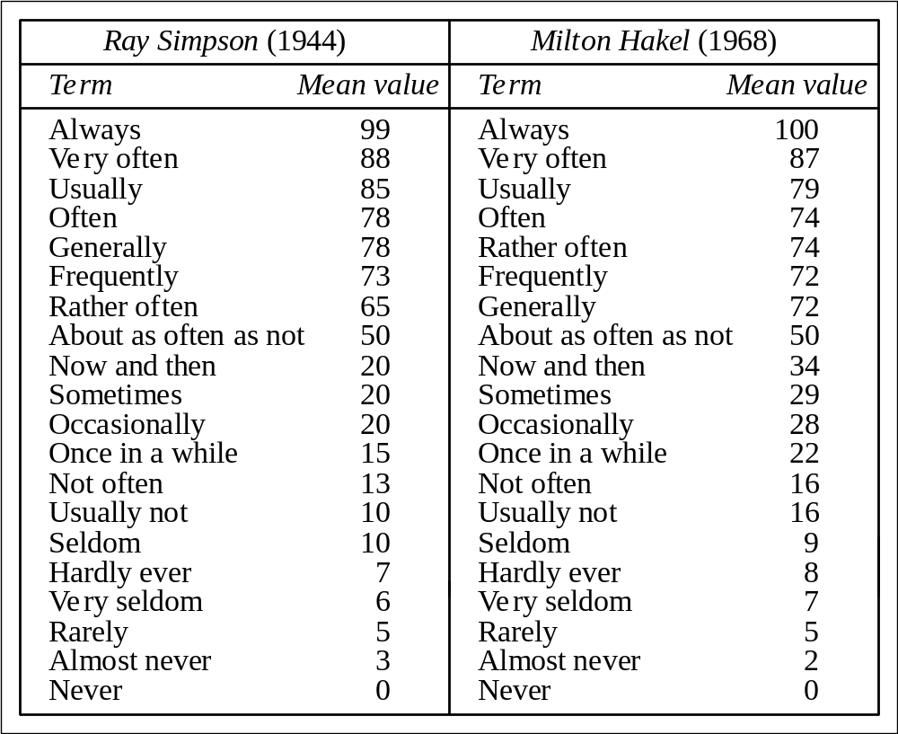
Quantification of ambiguous and imprecise terms on a time-frequency scale

Slide 5
Unknown data. When the data is incomplete or missing, the only solution is to accept the value “unknown” and proceed to an approximate reasoning with this value.
Combining the views of different experts. Large expert systems usually combine the knowledge and expertise of a number of experts. Unfortunately, experts often have contradictory opinions and produce conflicting rules. To resolve the conflict, the knowledge engineer has to attach a weight to each expert and then calculate the composite conclusion. But no systematic method exists to obtain these weights.

Slide 6
Basic probability theory
The concept of probability has a long history that goes back thousands of years when words like “probably”, “likely”, “maybe”, “perhaps” and “possibly” were introduced into spoken languages. However, the mathematical theory of probability was formulated only in the 17th century.
The probability of an event is the proportion of cases in which the event occurs. Probability can also be defined as a scientific measure of chance.

Slide 7
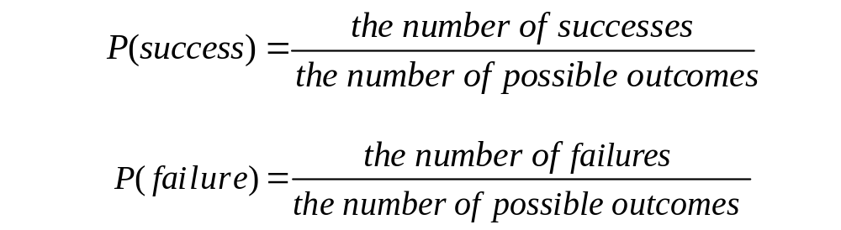
Probability can be expressed mathematically as a numerical index with a range between zero (an absolute impossibility) to unity (an absolute certainty).
Most events have a probability index strictly between 0 and 1, which means that each event has at least two possible outcomes: favourable outcome or success, and unfavourable outcome or failure.

Slide 8
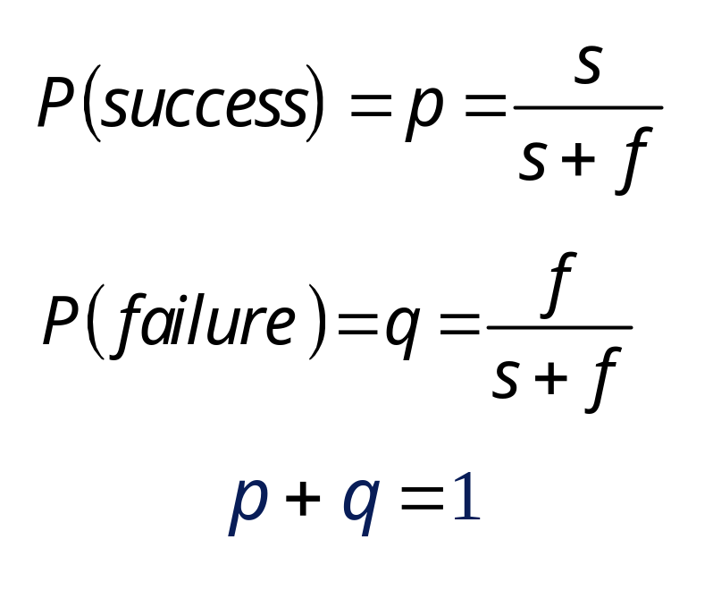
If s is the number of times success can occur, and f is the number of times failure can occur, then
and
If we throw a coin, the probability of getting a head will be equal to the probability of getting a tail. In a single throw, s = f =1, and therefore the probability of getting a head (or a tail) is 0.5.

Slide 9
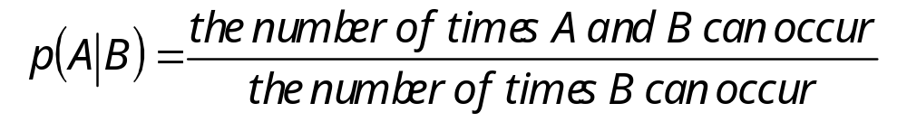
Conditional probability
Let A be an event in the world and B be another event. Suppose that events A and B are not mutually exclusive, but occur conditionally on the occurrence of the other. The probability that event A will occur if event B occurs is called the conditional probability. Conditional probability is denoted mathematically as p(A|B) in which the vertical bar represents GIVEN and the complete probability expression is interpreted as “Conditional probability of event A occurring given that event B has occurred”.

Slide 10
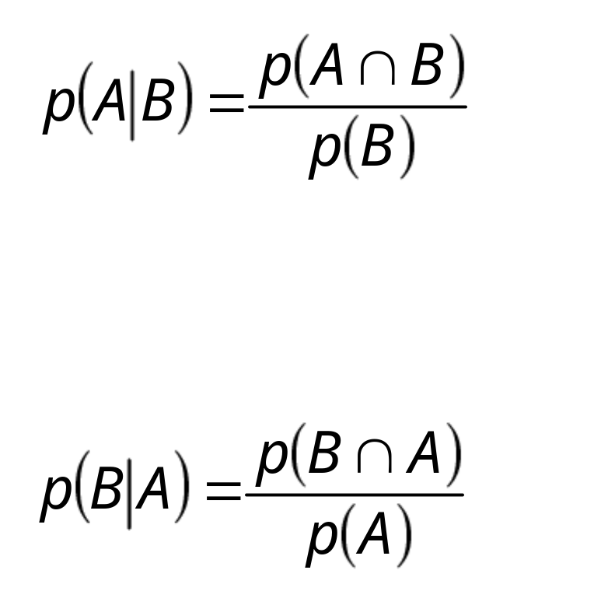
The number of times A and B can occur, or the probability that both A and B will occur, is called the joint probability of A and B. It is represented mathematically as p(A∩B). The number of ways B can occur is the probability of B, p(B), and thus
Similarly, the conditional probability of event B occurring given that event A has occurred equals

Slide 11
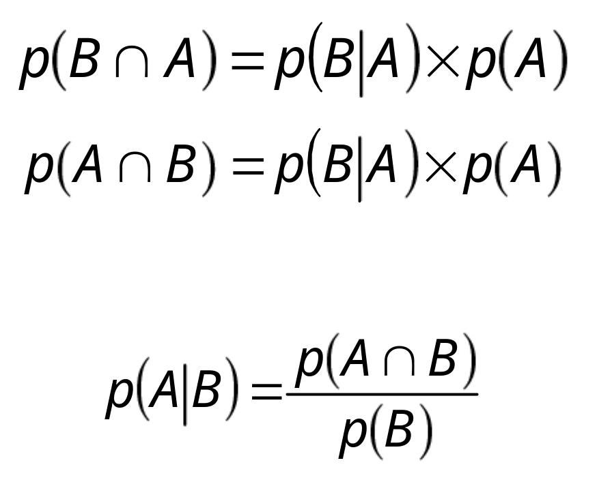
Hence,
or
Substituting the last equation into the equation
yields the Bayesian rule:

Slide 12
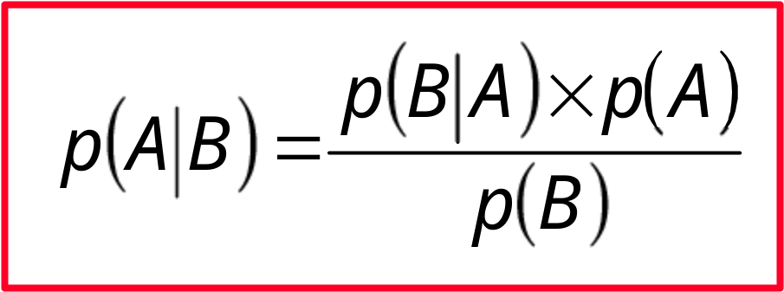
Bayesian rule
where: p(A|B) is the conditional probability that event A
occurs given that event B has occurred; p(B|A) is the conditional probability of event B
occurring given that event A has occurred; p(A) is the probability of event A occurring; p(B) is the probability of event B occurring.

Slide 13
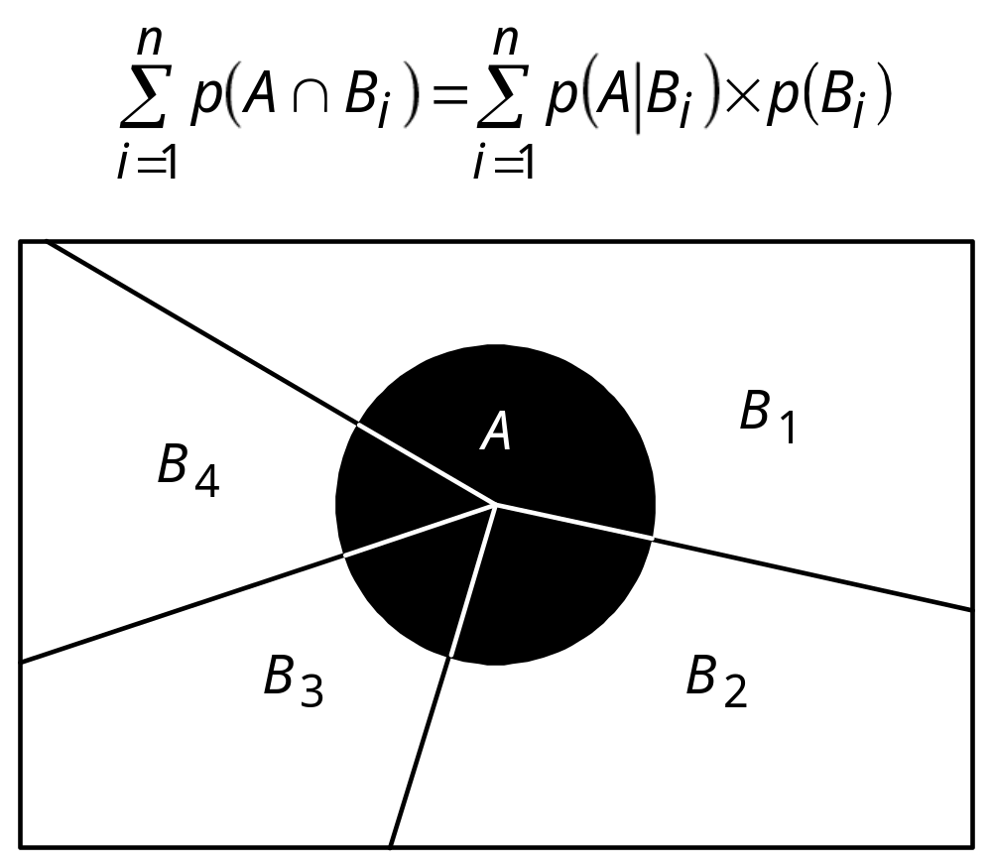
The joint probability

Slide 14
Bayesian reasoning
Suppose all rules in the knowledge base are represented in the following form:
This rule implies that if event E occurs, then the probability that event H will occur is p.
In expert systems, H usually represents a hypothesis and E denotes evidence to support this hypothesis.
IF E is true THEN H is true {with probability p}

Slide 15
Therefore, we can obtain a companion rule that states IF the symptom is “odd noises” THEN the starter is good {with probability 0.3}
Domain experts do not deal with conditional probabilities and often deny the very existence of the hidden implicit probability (0.3 in our example).
We would also use available statistical information and empirical studies to derive the following rules:
IF the starter is bad THEN the symptom is “odd noises” {probability 0.85}
IF the starter is bad THEN the symptom is not “odd noises” {probability 0.15}

Slide 16
Certainty factors theory and evidential reasoning
Certainty factors theory is a popular alternative to Bayesian reasoning.
A certainty factor (cf ), a number to measure the expert’s belief. The maximum value of the certainty factor is, say, +1.0 (definitely true) and the minimum −1.0 (definitely false). For example, if the expert states that some evidence is almost certainly true, a cf value of 0.8 would be assigned to this evidence.

Slide 17
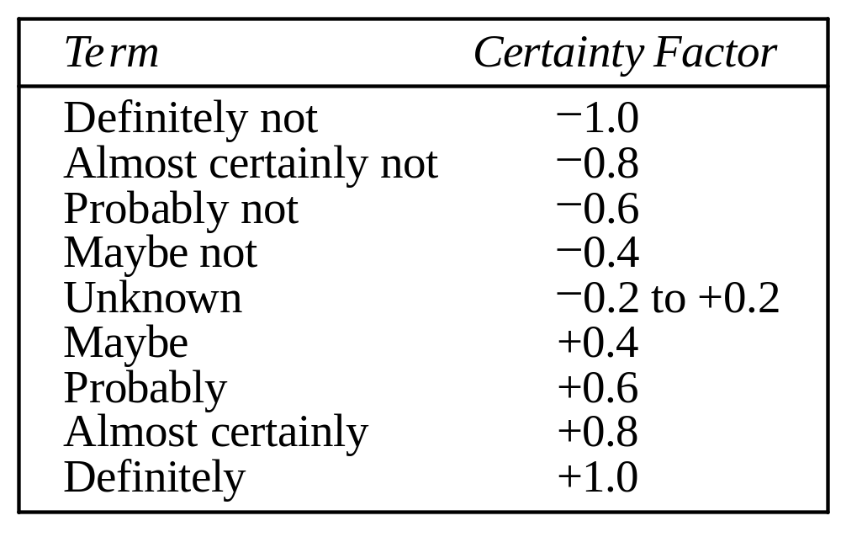
Uncertain terms and their interpretation in MYCIN

Slide 18
In expert systems with certainty factors, the knowledge base consists of a set of rules that have the following syntax:
IF <evidence> THEN <hypothesis> {cf }
where cf represents belief in hypothesis H given that evidence E has occurred.

Slide 19
Example: Consider a simple rule: IF A is X THEN B is Y An expert may not be absolutely certain that this rule holds. Also suppose it has been observed that in some cases, even when the IF part of the rule is satisfied and object A takes on value X, object B can acquire some different value Z.
IF A is X THEN B is Y {cf 0.7}; B is Z {cf 0.2}

Slide 20
Fuzzy expert systems: Fuzzy logic
Introduction, or what is fuzzy thinking?
Fuzzy sets
Linguistic variables and hedges
Operations of fuzzy sets
Fuzzy rules
Summary

Slide 21
Introduction, or what is fuzzy thinking?
Experts rely on common sense when they solve
problems.
How can we represent expert knowledge that
uses vague and ambiguous terms in a computer?
Fuzzy logic is not logic that is fuzzy, but logic that
is used to describe fuzziness. Fuzzy logic is the
theory of fuzzy sets, sets that calibrate vagueness.
Fuzzy logic is based on the idea that all things
admit of degrees. Temperature, height, speed,
distance, beauty – all come on a sliding scale. The
motor is running really hot. Tom is a very tall guy.

Slide 22
Boolean logic uses sharp distinctions. It forces us to draw lines between members of a class and non- members. For instance, we may say, Tom is tall because his height is 181 cm. If we drew a line at 180 cm, we would find that David, who is 179 cm, is small. Is David really a small man or we have just drawn an arbitrary line in the sand?
Fuzzy logic reflects how people think. It attempts to model our sense of words, our decision making and our common sense. As a result, it is leading to new, more human, intelligent systems.

Slide 23
Fuzzy, or multi-valued logic was introduced in the 1930s by Jan Lukasiewicz , a Polish philosopher. While classical logic operates with only two values 1 (true) and 0 (false), Lukasiewicz introduced logic that extended the range of truth values to all real numbers in the interval between 0 and 1. He used a number in this interval to represent the possibility that a given statement was true or false. For example, the possibility that a man 181 cm tall is really tall might be set to a value of 0.86. It is likely that the man is tall. This work led to an inexact reasoning technique often called possibility theory.

Slide 24
In 1965 Lotfi Zadeh, published his famous paper “Fuzzy sets”. Zadeh extended the work on possibility theory into a formal system of mathematical logic, and introduced a new concept for applying natural language terms. This new logic for representing and manipulating fuzzy terms was called fuzzy logic, and Zadeh became the Master of fuzzy logic.

Slide 25
Why fuzzy?
As Zadeh said, the term is concrete, immediate and descriptive; we all know what it means. However, many people in the West were repelled by the word fuzzy , because it is usually used in a negative sense.
Why logic?
Fuzziness rests on fuzzy set theory, and fuzzy logic is just a small part of that theory.

Slide 26
Fuzzy logic is a set of mathematical principles
for knowledge representation based on degrees
of membership.
Unlike two-valued Boolean logic, fuzzy logic is
multi-valued. It deals with degrees of
membership and degrees of truth. Fuzzy logic
uses the continuum of logical values between 0
(completely false) and 1 (completely true). Instead
of just black and white, it employs the spectrum of
colours, accepting that things can be partly true and
partly false at the same time.

Slide 27
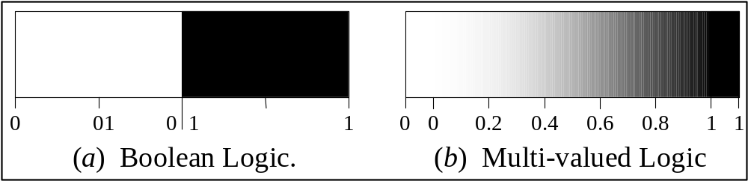
Range of logical values in Boolean and fuzzy logic
.

Slide 28
Fuzzy sets
The concept of a set is fundamental to mathematics.
However, our own language is also the supreme expression of sets. For example, car indicates the set of cars. When we say a car , we mean one out of the set of cars.

Slide 29
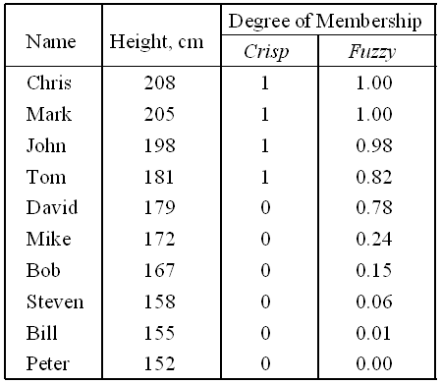
The classical example in fuzzy sets is tall men. The elements of the fuzzy set “tall men” are all men, but their degrees of membership depend on their height.

Slide 30
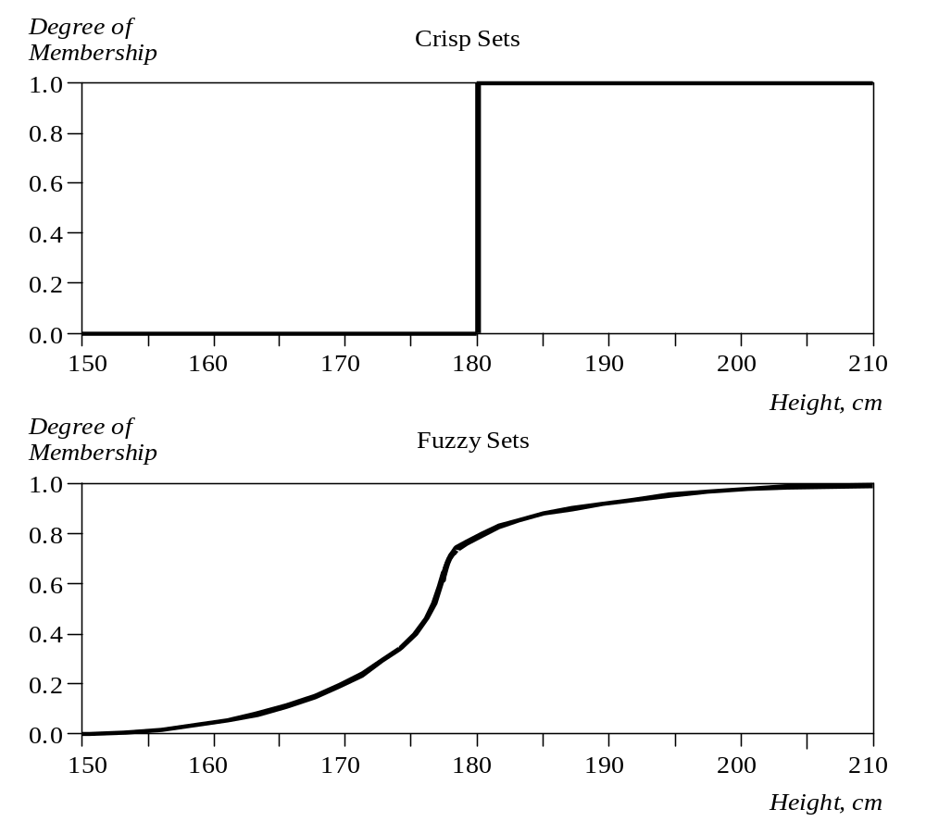
Crisp and fuzzy sets of “tall men”

Slide 31
The x-axis represents the universe of discourse – the range of all possible values applicable to a chosen variable. In our case, the variable is the man height. According to this representation, the universe of men’s heights consists of all tall men.
The y-axis represents the membership value of the fuzzy set. In our case, the fuzzy set of “tall men” maps height values into corresponding membership values.

Slide 32
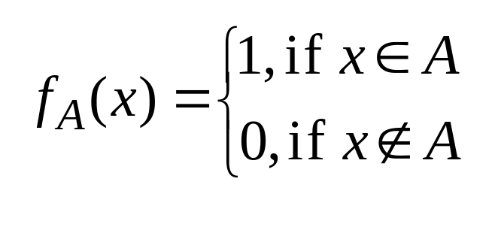
A fuzzy set is a set with fuzzy boundaries.
Let X be the universe of discourse and its elements be denoted as x. In the classical set theory, crisp set A of X is defined as function f_{A}(x) called the characteristic function of A
f_{A}(x): X  {0, 1}, where
This set maps universe X to a set of two elements.
For any element x of universe X, characteristic
function f_{A}(x) is equal to 1 if x is an element of set
A, and is equal to 0 if x is not an element of A.

Slide 33
In the fuzzy theory, fuzzy set A of universe X is defined by function _{A}(x) called the membership function of set A
μ_{A}(x): X → [0, 1], where μ_{A}(x) = 1 if x is totally in A;
μ_{A} (x) = 0 if x is not in A;
0 < μ_{A} (x) < 1 if x is partly in A.
This set allows a continuum of possible choices.
For any element x of universe X, membership
function μ_{A}(x) equals the degree to which x is an
element of set A. This degree, a value between 0
and 1, represents the degree of membership, also
called membership value, of element x in set A.

Slide 34
How to represent a fuzzy set in a computer?
First, we determine the membership functions. In our “tall men” example, we can obtain fuzzy sets of tall, short and average men.
The universe of discourse – the men’s heights – consists of three sets: short, average and tall men. As you will see, a man who is 184 cm tall is a member of the average men set with a degree of membership of 0.1, and at the same time, he is also a member of the tall men set with a degree of 0.4.

Slide 35
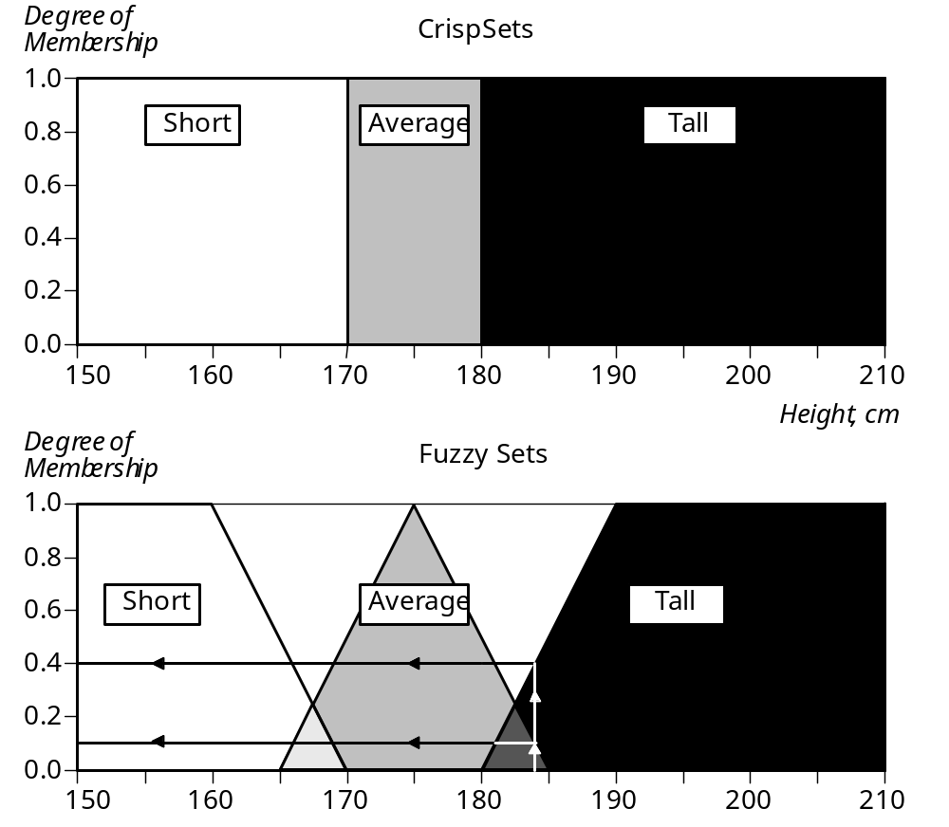
Crisp and fuzzy sets of short, average and tall men

Slide 36
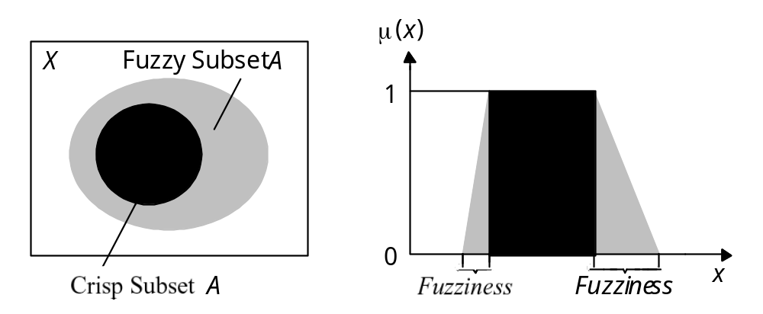
Representation of crisp and fuzzy subsets
Typical functions that can be used to represent a fuzzy
set are sigmoid, gaussian and pi. However, these
functions increase the time of computation. Therefore,
in practice, most applications use linear fit functions.

Slide 37
Linguistic variables and hedges
At the root of fuzzy set theory lies the idea of linguistic variables.
A linguistic variable is a fuzzy variable. For example, the statement “John is tall” implies that the linguistic variable John takes the linguistic value tall.

Slide 38
In fuzzy expert systems, linguistic variables are used
in fuzzy rules. For example:
IF wind is strong
THEN sailing is good
IF project_duration is long
THEN completion_risk is high
IF speed is slow
THEN stopping_distance is short

Slide 39
The range of possible values of a linguistic variable represents the universe of discourse of that variable. For example, the universe of discourse of the linguistic variable speed might have the range between 0 and 220 km/h and may include such fuzzy subsets as very slow, slow, medium, fast, and very fast.
A linguistic variable carries with it the concept of fuzzy set qualifiers, called hedges.
Hedges are terms that modify the shape of fuzzy sets. They include adverbs such as very, somewhat, quite, more or less and slightly.

Slide 40
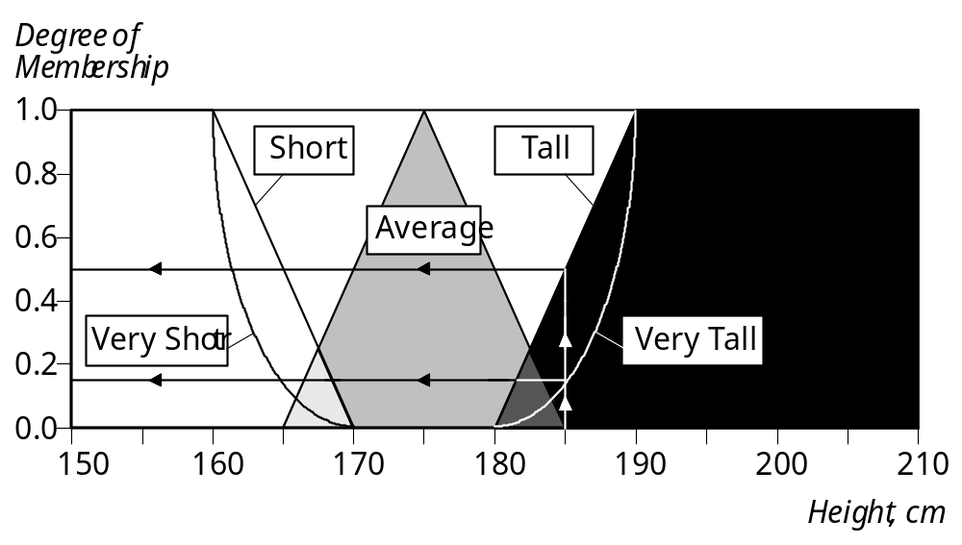
Fuzzy sets with the hedge very

Slide 41
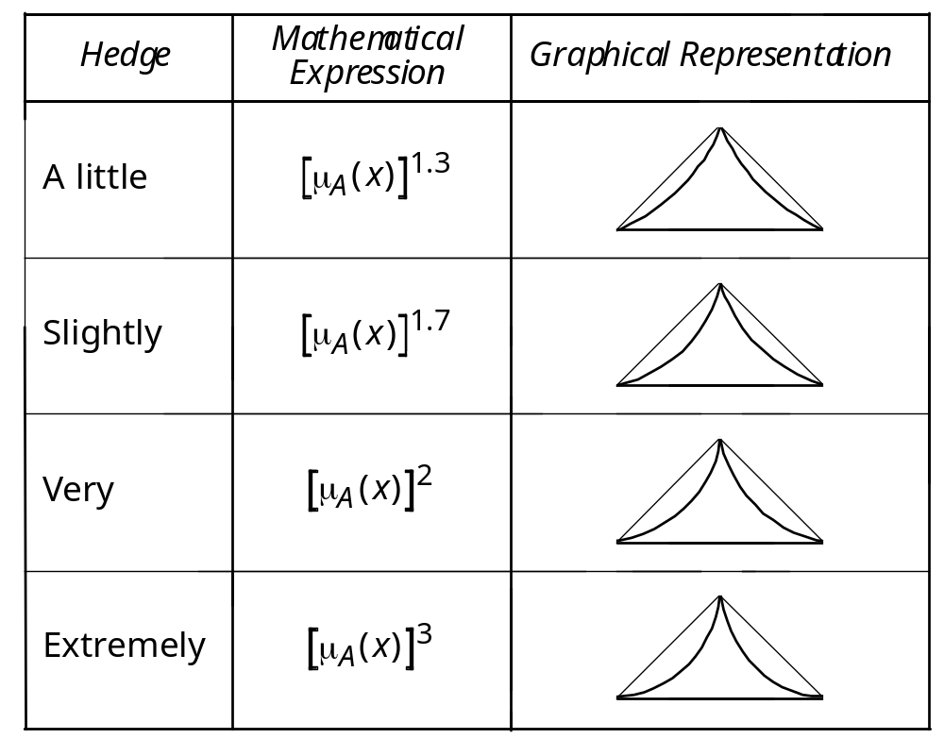
Representation of hedges in fuzzy logic

Slide 42
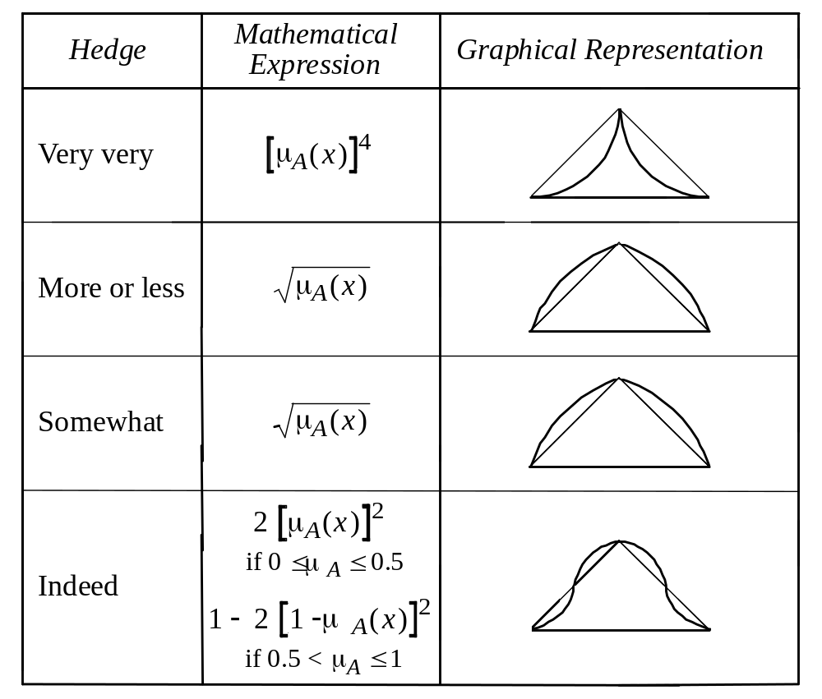
Representation of hedges in fuzzy logic (continued)

Slide 43
Operations of fuzzy sets
The classical set theory developed in the late 19th
century by Georg Cantor describes how crisp sets can
interact. These interactions are called operations.

Slide 44
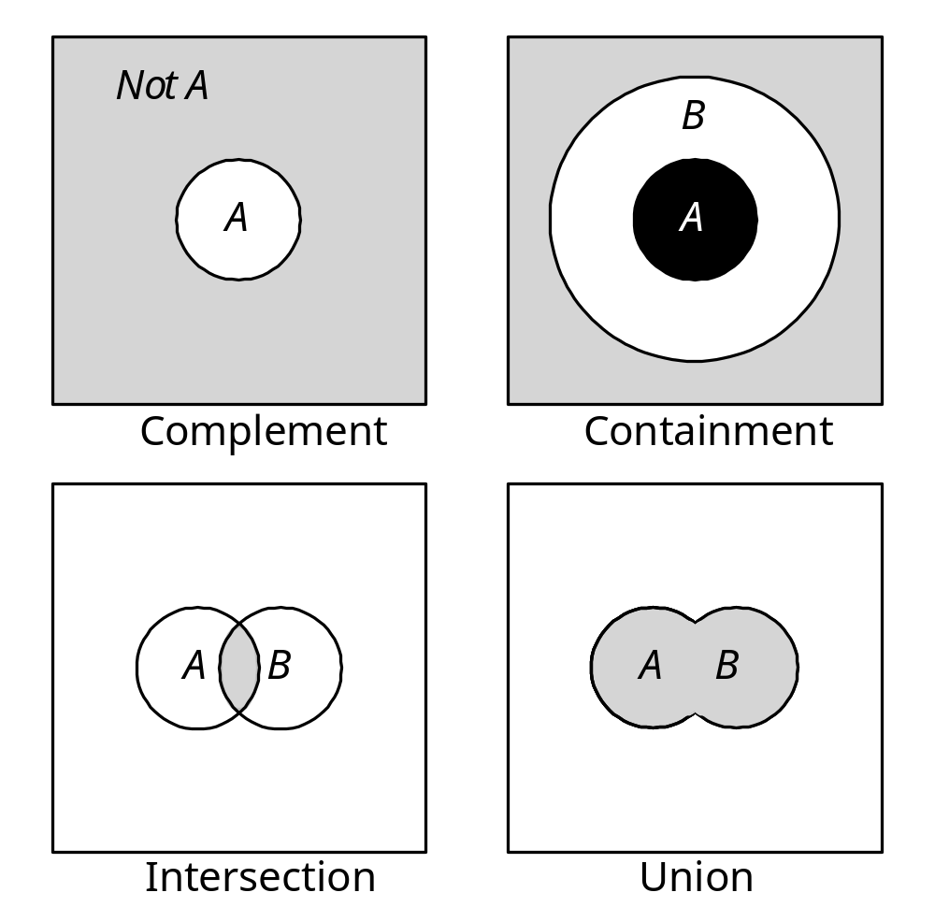
Cantor’s sets

Slide 45
Complement
Crisp Sets: Who does not belong to the set?
Fuzzy Sets: How much do elements not belong to
the set?
The complement of a set is an opposite of this set.
For example, if we have the set of tall men, its
complement is the set of NOT tall men. When we
remove the tall men set from the universe of
discourse, we obtain the complement. If A is the
fuzzy set, its complement ¬A can be found as
follows:
μ¬_{A}(x) = 1 − μ_{A}(x)

Slide 46
Containment
Crisp Sets: Which sets belong to which other sets?
Fuzzy Sets: Which sets belong to other sets?
Similar to a Chinese box, a set can contain other
sets. The smaller set is called the subset. For
example, the set of tall men contains all tall men;
very tall men is a subset of tall men. However, the
tall men set is just a subset of the set of men. In
crisp sets, all elements of a subset entirely belong to
a larger set. In fuzzy sets, however, each element
can belong less to the subset than to the larger set.
Elements of the fuzzy subset have smaller
memberships in it than in the larger set.

Slide 47
Intersection
Crisp Sets: Which element belongs to both sets?
Fuzzy Sets: How much of the element is in both sets?
In classical set theory, an intersection between two sets contains the elements shared by these sets. For example, the intersection of the set of tall men and the set of fat men is the area where these sets overlap. In fuzzy sets, an element may partly belong to both sets with different memberships. A fuzzy intersection is the lower membership in both sets of each element. The fuzzy intersection of two fuzzy sets A and B on universe of discourse X:
μ_{A}∩_{B}(x) = min [μ_{A} (x), μ_{B} (x)] = μ_{A} (x) ∩ μ_{B}(x),
where x∈X

Slide 48
Union
Crisp Sets: Which element belongs to either set?
Fuzzy Sets: How much of the element is in either set?
The union of two crisp sets consists of every element
that falls into either set. For example, the union of
tall men and fat men contains all men who are tall
OR fat. In fuzzy sets, the union is the reverse of the
intersection. That is, the union is the largest
membership value of the element in either set. The
fuzzy operation for forming the union of two fuzzy
sets A and B on universe X can be given as:
μ_{A}∪_{B}(x) = max [μ_{A} (x), μ_{B}(x)] = μ_{A} (x) ∪ μ_{B}(x),
where x∈X

Slide 49
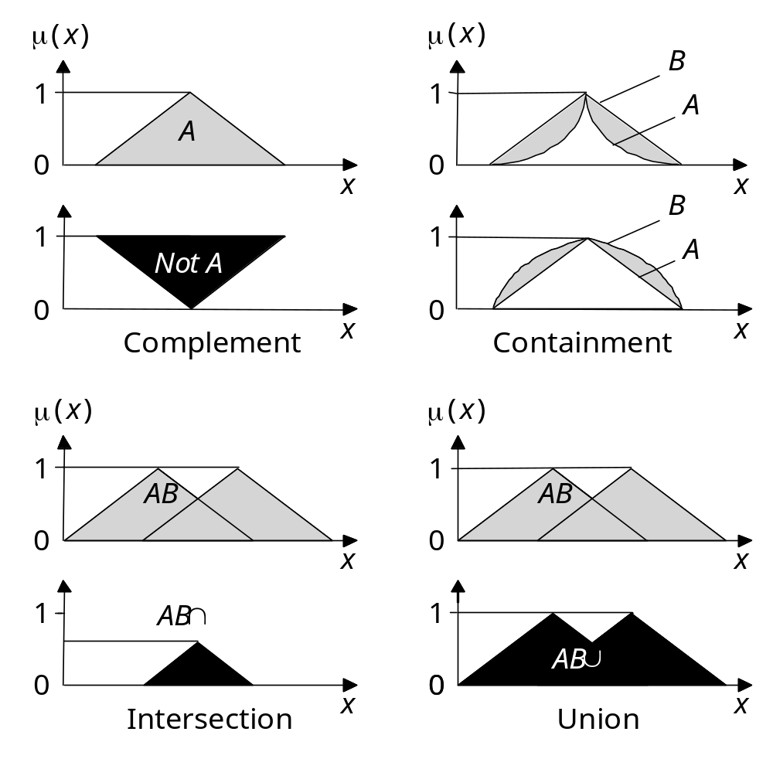
Operations of fuzzy sets

Slide 50
Fuzzy rules
In 1973, Lotfi Zadeh published his second most
influential paper. This paper outlined a new
approach to analysis of complex systems, in which
Zadeh suggested capturing human knowledge in
fuzzy rules.

Slide 51
What is a fuzzy rule?
A fuzzy rule can be defined as a conditional
statement in the form:
IF x is A
THEN y is B
where x and y are linguistic variables; and A and B
are linguistic values determined by fuzzy sets on the
universe of discourses X and Y, respectively.

Slide 52
What is the difference between classical and
fuzzy rules?
A classical IF-THEN rule uses binary logic, for example,
Rule: 1 Rule: 2
IF speed is > 100 IF speed is < 40
THEN stopping_distance is long THEN stopping_distance is short
The variable speed can have any numerical value
between 0 and 220 km/h, but the linguistic variable
stopping_distance can take either value long or short.
In other words, classical rules are expressed in the
black-and-white language of Boolean logic.

Slide 53
We can also represent the stopping distance rules in a
fuzzy form:
Rule: 1 Rule: 2
IF speed is fast IF speed is slow
THEN stopping_distance is long THEN stopping_distance is short
In fuzzy rules, the linguistic variable speed also has
the range (the universe of discourse) between 0 and
220 km/h, but this range includes fuzzy sets, such as
slow, medium and fast. The universe of discourse of
the linguistic variable stopping_distance can be
between 0 and 300 m and may include such fuzzy
sets as short, medium and long.

Slide 54
Fuzzy rules relate fuzzy sets.
In a fuzzy system, all rules fire to some extent, or in other words they fire partially. If the antecedent is true to some degree of membership, then the consequent is also true to that same degree.

Slide 55
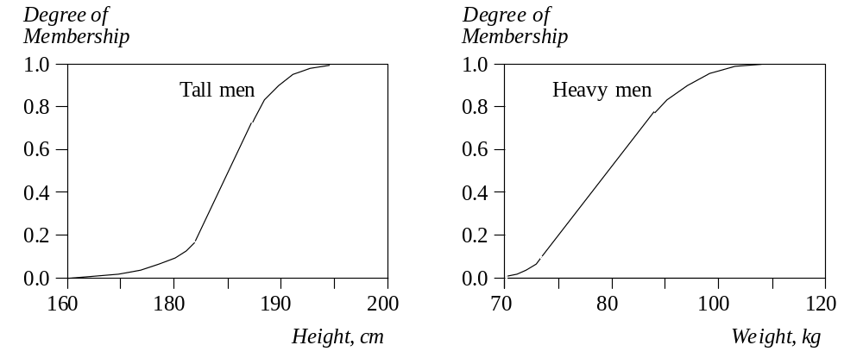
Fuzzy sets of tall and heavy men
These fuzzy sets provide the basis for a weight estimation
model. The model is based on a relationship between a
man’s height and his weight:
IF height is tall
THEN weight is heavy

Slide 56
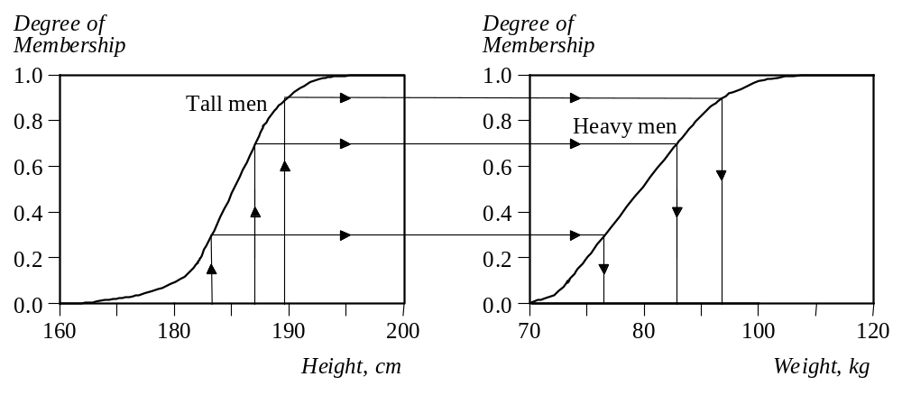
The value of the output or a truth membership grade of
the rule consequent can be estimated directly from a
corresponding truth membership grade in the
antecedent. This form of fuzzy inference uses a
method called monotonic selection.

Slide 57
A fuzzy rule can have multiple antecedents, for
example:
IF project_duration is long
AND project_staffing is large
AND project_funding is inadequate
THEN risk is high
IF service is excellent
OR food is delicious
THEN tip is generous

Slide 58
The consequent of a fuzzy rule can also include multiple parts, for instance:
IF temperature is hot
THEN hot_water is reduced;
cold_water is increased

