Slide 1
Understanding Operating Systems
Sixth Edition
Chapter 9
Network Organization Concepts

Slide 2
Learning Objectives
After completing this chapter, you should be able to describe:
Several different network topologies—including the star, ring, bus, tree, and hybrid—and how they connect numerous hosts to the network
Several types of networks: LAN, MAN, WAN, and wireless LAN
The difference between circuit switching and packet switching, and examples of everyday use that favor each
Conflict resolution procedures that allow a network to share common transmission hardware and software effectively
The two transport protocol models (OSI and TCP/IP) and how the layers of each one compare

Slide 3
Basic Terminology
Network
  Collection of loosely coupled processors
  Interconnected by communication links
    Using cables, wireless technology, both
  Common goal
    Provide convenient resource sharing
    Control access
  General network configurations
    Network operating system (NOS)
    Distributed operating system (D/OS)

Slide 4
Basic Terminology (cont'd.)
Network operating system (NOS)
  Networking capability
    Added to single-user operating system
  Users aware of specific computers and resources in network
  Access resources
    Log on to remote host
    Data transfer from remote host

Slide 5
Basic Terminology (cont'd.)
Distributed operating system (D/OS)
  Users not aware of specific computers and resources in network
    Access remote resources as if local
  Good control: distributed computing systems
    Allows unified resource access
  Total view across multiple computer systems
    No local dependencies for controlling and managing resources
  Cooperative management

Slide 6
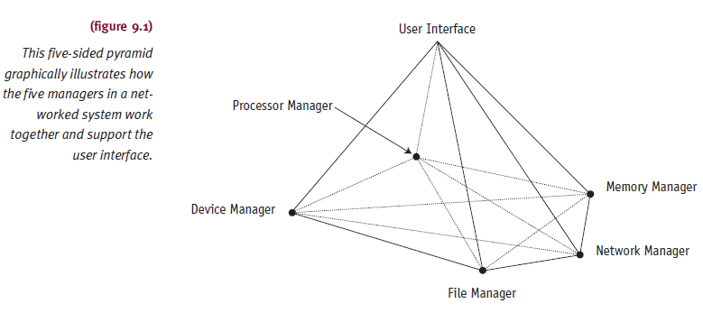
Basic Terminology (cont'd.)
Distributed operating system (D/OS) (cont'd.)
  Comprised of four managers with a wider scope

Slide 7
Basic Terminology (cont'd.)
Distributed operating system (D/OS) (cont'd.)
  Advantages over traditional systems
    Easy and reliable resource sharing
    Faster computation
    Adequate load balancing
    Good reliability
    Dependable communications among network users

Slide 8
Basic Terminology (cont'd.)
Remote
  Other processors and resources
Local
  Processor’s own resources
Site
  Specific location in network
    One or more computers
Host
  Specific computer system at site
    Services and resources used from remote locations

Slide 9
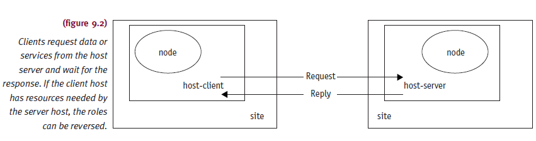
Basic Terminology (cont'd.)
Node
  Name assigned to computer system
    Provides identification

Slide 10
Network Topologies
Physically or logically connected sites
Star, ring, bus, tree, hybrid
Topology tradeoffs
  Need for fast communication among all sites
  Tolerance of failure at a site or communication link
  Cost of long communication lines
  Difficulty connecting one site to large number of other sites

Slide 11
Network Topologies (cont'd.)
Four basic criteria
  Basic cost
    Expense required to link various sites in system
  Communications cost
    Time required to send message from one site to another
  Reliability
    Assurance of site communication if link or site fails
  User environment
    Critical parameters for successful business investment

Slide 12
Star Topology
Transmitted data from sender to receiver
  Passes through central controller
Hub or centralized topology
Advantages
  Permits easy routing
  Easy access control to network
Disadvantages
  Requires extremely reliable central site
  Requires ability to handle all network traffic
    No matter how heavy

Slide 13
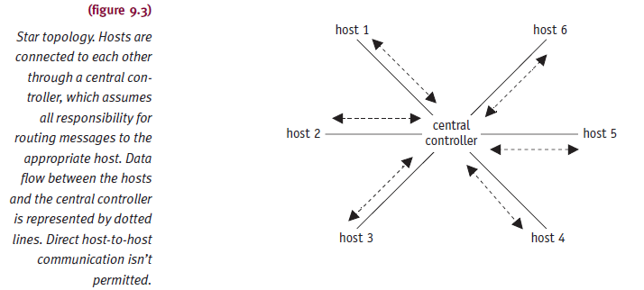
Star Topology (cont'd.)

Slide 14
Ring Topology
Sites connected in closed loop
May connect to other networks
  Using bridge (same protocols)
  Using gateway (different protocols)
Data transmitted in packets
  Source and destination address fields
Packet passed from node to node
  One direction only
Every node must be functional
  Bypass failed node needed for proper operation

Slide 15
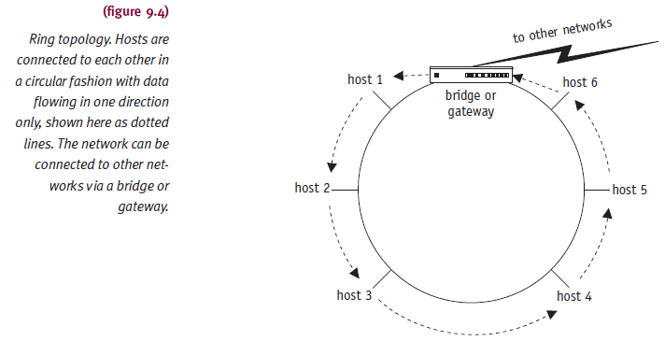
Ring Topology (cont'd.)

Slide 16
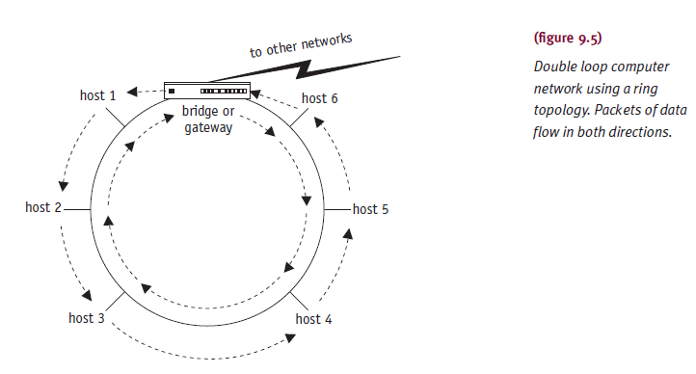
Ring Topology (cont'd.)

Slide 17
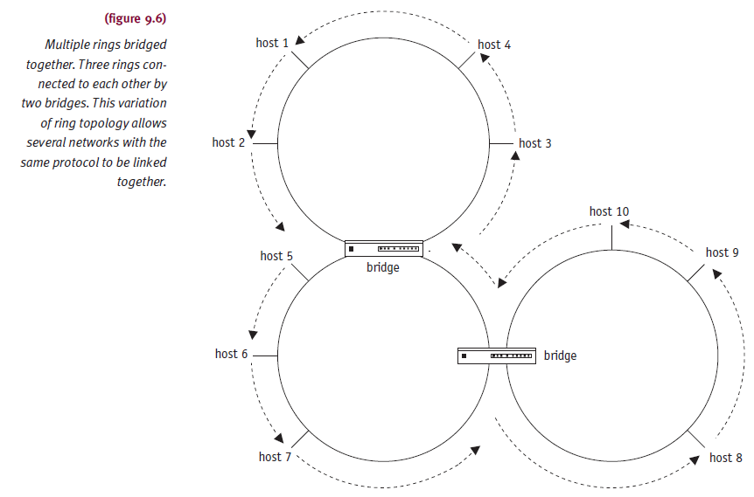
Ring Topology (cont'd.)

Slide 18
Bus Topology
Sites connect to single communication line
Messages circulate in both directions
One site sends messages at a time successfully
Need control mechanism
  Prevent collision
Data passes directly from one device to another
  Data may be routed to end point controller at end of the line

Slide 19
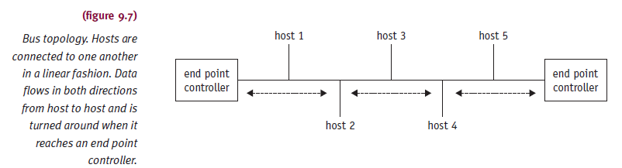
Bus Topology (cont'd.)
Understanding Operating Systems, Sixth Edition

Slide 20
Tree Topology
Collection of buses connected by branching cable
  No closed loops
Designers create networks using bridges
Message from any site
  Received by all other sites until reaching end point
Reaches end point controller without acceptance
  Host absorbs message
Advantage
  Message traffic still flows even if single node fails

Slide 21
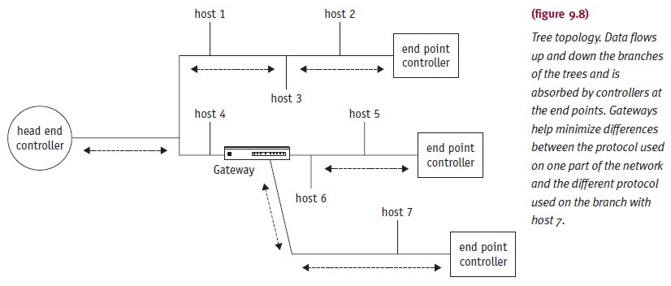
Tree Topology (cont'd.)

Slide 22
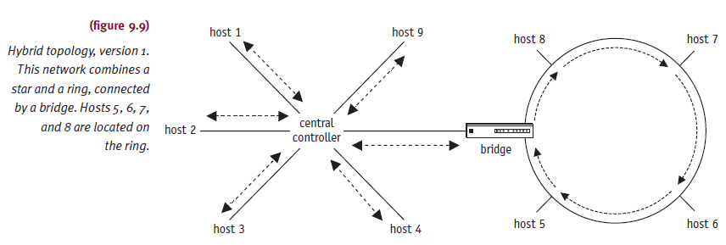
Hybrid Topology
Strong points of each topology in combination
  Effectively meet system communications requirements

Slide 23
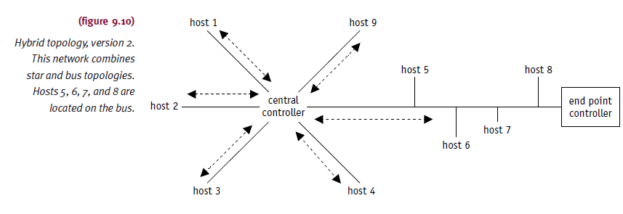
Hybrid Topology (cont'd.)

Slide 24
Network Types
Grouping
  According to physical distances covered
Characteristics blurring
Network types
  Local area networks (LAN)
  Metropolitan area networks (MAN)
  Wide area networks (WAN)

Slide 25
Local Area Network
Single office building, campus, similarly enclosed environment
  Single organization owns/operates
Communicate through common communication line
Communications not limited to local area only
  Component of larger communication network
  Easy access to outside
    Through bridge or gateway

Slide 26
Local Area Network (cont'd.)
Bridge
  Connects two or more geographically distant LANs
  Same protocols
    Bridge connecting two LANs using Ethernet
Gateway
  Connects two or more LANs or systems
  Different protocols
    Translates one network protocol into another
    Resolves hardware and software incompatibilities
    SNA gateway connecting microcomputer network to mainframe host

Slide 27
Local Area Network (cont'd.)
Data rates: 100 Mbps to more than 40 Gbps
Close physical proximity
  Very high-speed transmission
Star, ring, bus, tree, and hybrid
  Normally used
Transmission medium: varies
Factors determining transmission medium
  Cost, data rate, reliability, number of devices supported, distance between units

Slide 28
Metropolitan Area Network
Configuration spanning area larger than LAN
  Several blocks of buildings to entire city
    Not exceeding 100 km circumference
Owned and operated by a single organization
  Used by many individuals and organizations
  May be owned and operated as public utilities
    Means for internetworking several LANs
High-speed network often configured as a logical ring

Slide 29
Wide Area Network
Interconnects communication facilities in different parts of a country or world
  Operated as part of public utility
Uses common carriers’ communications lines
  Telephone companies
Uses broad range of communication media
  Satellite, microwaves
WANs generally slower than LANs
  Examples: ARPAnet (first WAN), Internet (most widely recognized WAN)

Slide 30
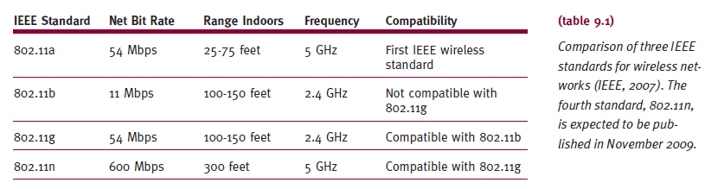
Wireless Local Area Network
LAN using wireless technology to connect computers or workstations
  Located within range of network
Security vulnerabilities
  Open architecture; difficulty keeping intruders out

Slide 31
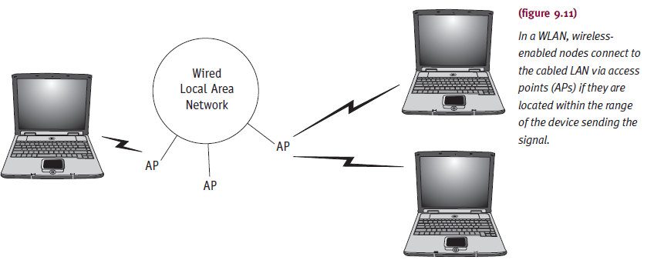
Wireless Local Area Network (cont'd.)
WiMAX standard 802.16
  High bandwidth, long distances

Slide 32
Software Design Issues
How do sites use addresses to locate other sites?
How are messages routed and how are they sent?
How do processes communicate with each other?
How are conflicting demands for resources resolved?

Slide 33
Addressing Conventions
Addressing protocols
  Fulfill need to uniquely identify users
  Closely related to site network topology and geographic location
Distinction between local and global name
  Local name within its own system
  Global name outside its own system
    Must follow standard name conventions (length, formats)

Slide 34
Addressing Conventions (cont'd.)
Example: Internet address
  someone@icarus.lis.pitt.edu
  Uses Domain Name Service (DNS) protocol
    General-purpose data query service
    Hierarchical
Domain names read left to right
  Logical user to host machine
  Host machine to net machine
  Net machine to cluster
  Cluster to network
Periods separate components

Slide 35
Routing Strategies
Router
  Internetworking device (primarily software driven)
  Directs traffic
    Between two different types of LANs
    Between two network segments (different protocol addresses)
  Network layer operation
  Role changes (network designs changes)
Connects sites
  To other sites and Internet

Slide 36
Routing Strategies (cont'd.)
Router functions
  Securing information
    Generated in predefined areas
  Choosing fastest route
    From one point to another
  Providing redundant network connections
Routing protocol considerations
  Addressing, address resolution, message format, error reporting
Address resolution
  Maps hardware address

Slide 37
Routing Strategies (cont'd.)
Message formats
  Allow performance of protocol functions
    Finding new network nodes
    Determine whether they work (testing)
    Reporting error conditions
    Exchanging routing information
    Establishing connections (transmit data)
Most widely used Internet routing protocols
  Routing information protocol (RIP)
  Open shortest path first (OSPF)

Slide 38
Routing Strategies (cont'd.)
Routing information protocol (RIP)
  Path selection based on node and hop number
    Between source and destination
  Path with smallest number of hops chosen (always)
  Advantage
    Easy to implement
  Disadvantages
    No consideration: bandwidth, data priority, network type
    Update and reissue routing table: changes or not
    Tables propagate (router to router)

Slide 39
Routing Strategies (cont'd.)
Open shortest path first (OSPF)
  Network state determined first
  Transmission path selected
  Update messages sent when changes in routing environment occur
    Reduces number of messages in internetwork
    Reduces message size: not sending entire table
  Disadvantages
    Increased memory usage
    Bandwidth savings offset by higher CPU usage
    Shortest path calculation

Slide 40
Connection Models
Communication network concern
  Moving data from one point to another
  Minimizing transmission costs
  Providing full connectivity
Circuit switching
  Dedicated communication path
    Established between two hosts before transmission begins
  Example: telephone system
  Disadvantage
    Delay before signal transfer begins

Slide 41
Connection Models (cont'd.)
Packet switching
Store-and-forward technique
  Before sending message
    Divide into multiple equal-sized units (packets)
  At destination
    Packets reassembled into original long format
    Header contains pertinent packet information
Advantages
  More flexible, reliable
  Greater line efficiency
  Users allocate message priority

Slide 42
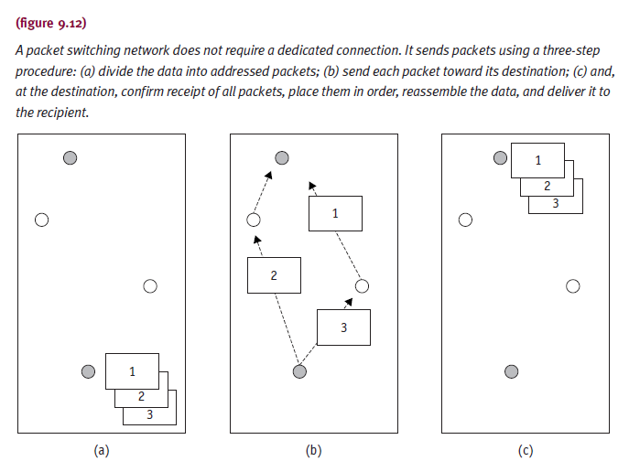
Connection Models (cont'd.)

Slide 43
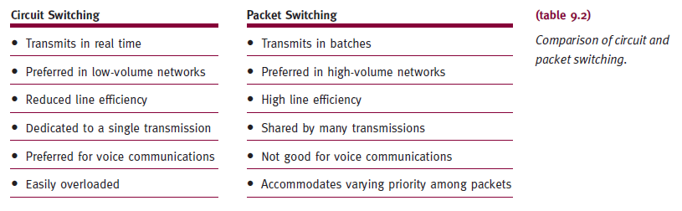
Connection Models (cont'd.)

Slide 44
Connection Models (cont'd.)
Datagrams
  Packet destination and sequence number added to information
    Uniquely identifying message to owning packet
  Each packet handled independently
  Route selected as each packet accepted
  At destination
    All packets of same message reassembled
  Advantages
    Diminishes congestion and provides reliability

Slide 45
Connection Models (cont'd.)
Datagrams (cont'd.)
  Message not delivered until all packets accounted for
  Receiving node requests retransmission
    Lost or damaged packets
  Advantages
    Diminishes congestion
    Sends incoming packets through less heavily used paths
    More reliability
    Alternate paths set up upon node failure

Slide 46
Connection Models (cont'd.)
Virtual circuit
  Complete path sender to receiver
    Established before transmission starts
  All message packets use same route
  Several virtual circuits to any other node
  Advantages
    Routing decision made once
    Speeds up transmission
  Disadvantages
    All virtual circuits fail upon one failure
    Difficult to resolve congestion (in heavy traffic)

Slide 47
Conflict Resolution
Device sharing requires access control methods
  Facilitates equal and fair network access
Access control techniques
  Round robin
  Reservation
  Contention
Medium access control protocols
  Carrier sense multiple access (CSMA)
  Token passing
  Distributed-queue, dual bus

Slide 48
Conflict Resolution (cont'd.)
Round robin
  Node given certain time to complete transmission
  Efficient
    If many nodes transmitting over long time periods
  Substantial overhead
    If few nodes transmit over long time periods
Reservation
  Good if lengthy and continuous traffic
  Access time on medium divided into slots
  Node reserves future time slots

Slide 49
Conflict Resolution (cont'd.)
Reservation (cont'd.)
  Good configuration
    Several terminals connected to host through single I/O port
Contention
  No attempt to determine transmission turn
  Nodes compete for medium access
  Advantages and disadvantages
    Easy implementation; works well under light to moderate traffic; better for short and intermittent traffic
    Performance breaks down under heavy loads

Slide 50
Conflict Resolution (cont'd.)
Carrier sense multiple access (CSMA)
  Contention-based protocol
  Easy implementation (Ethernet)
  Carrier sense
    Node listens to/tests communication medium before transmitting messages
    Prevents collision with node currently transmitting
  Multiple access
    Several nodes connected to same communication line as peers
    Same level and equal privileges

Slide 51
Conflict Resolution (cont'd.)
CSMA Disadvantages
  Collision
    Two or more nodes transmit at same instant
  Probability of collision increases
    As nodes get further apart
  Large or complex networks
    Less appealing access protocol

Slide 52
Conflict Resolution (cont'd.)
CSMA/CD
  Modification of CSMA
  Includes collision detection (Ethernet)
  Reduces wasted transmission capacity
  Prevents multiple nodes from colliding
    Collisions not completely eliminated (reduced)
  Implemented in Apple’s cabling system: LocalTalk
  Collision occurrence involves small packet
    Not actual data (in case of Apple CSMA/CA)
No guarantee data will reach destination
  Ensures error free data delivery

Slide 53
Conflict Resolution (cont'd.)
Token Passing
  Special electronic message (token)
    Generated and passed node to node
  Only node with token allowed to transmit
    Then passes token
  Fast access
  Collisions nonexistent
  Typical topologies
    Bus
    Ring
Understanding Operating Systems, Sixth Edition

Slide 54
Conflict Resolution (cont'd.)
Token-bus
  Token passed to node in turn
    Data attached; sent to destination
  Receiving node
    Copies data; adds acknowledgment; returns packet to sending node
  Sending node passes token to next node in sequence
  Initial node order determination
    Cooperative decentralized algorithm
    Then determined by priority based on node activity

Slide 55
Conflict Resolution (cont'd.)
Token-bus (cont'd.)
  Higher overhead at each node (than CSMA/CD)
  Nodes have long waits before receiving token
Token-ring
  Token moves between nodes in turn
    One direction only
  To send message
    Node must wait for free token
  Receiving node copies packet message
    Sets copied bit indicating successful receipt

Slide 56
Conflict Resolution (cont'd.)
Distributed-queue, dual bus (DQDB)
Dual-bus configuration
  Each bus transports data one direction only
  Steady stream of fixed-size slots
Slots generated at end of each bus
  Marked as free and sent downstream
    Marked busy and written to
    Written by nodes ready to transmit
  Nodes read and copy data from slots
  Continue travel toward end of bus: dissipate

Slide 57
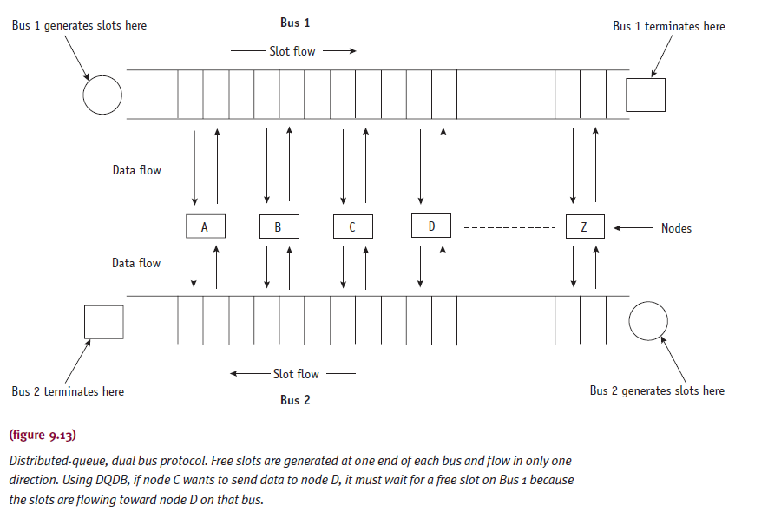
Conflict Resolution (cont'd.)

Slide 58
Conflict Resolution (cont'd.)
DQDB advantages
  Negligible delays under light loads
  Predictable queuing under heavy loads
  Suitable for MANs managing large file transfers
  Satisfy interactive users’ needs

Slide 59
Transport Protocol Standards
Network usage grew quickly (1980s)
Need to integrate dissimilar network devices
  Different vendors
Creation of single universally adopted architecture
  OSI reference model
  TCP/IP

Slide 60
OSI Reference Model
Basis for connecting open systems
  Distributed applications processing
“Open”
  Connect any two systems conforming to reference model and related standards
    Vendor independent
Similar functions collected together
  Seven logical clusters (layers)

Slide 61

The OSI Reference Model

Slide 62
OSI Reference Model (cont'd.)
Layer 1: The Physical Layer
  Describes mechanical, electrical, functional specifications
  Transmits bits over communication line
    Examples: 100Base-T, RS449, CCITT V.35
Layer 2: The Data Link Layer
  Establishes and controls physical communications path before data sent
  Transmission error checking
  Problem resolution (on other side) E.g. HDLC and SDLC
Layer 3: The Network Layer
  Addressing and routing services moving data through network to destination
Layer 4: The Transport Layer
  Maintains reliable data transmission between end users
    Example: Transmission Control Protocol (TCP)

Slide 63
OSI Reference Model (cont'd.)
Layer 5: The Session Layer
  Provides user-oriented connection service
  Transfers data over communication lines
    Example: TCP/IP
Layer 6: The Presentation Layer
  Data manipulation functions common to many applications
    Formatting, compression, encryption
Layer 7: The Application Layer
  Application programs, terminals, computers
    Access network
  Provides user interface
  Formats user data before passing to lower layers

Slide 64
TCP/IP Model
Transmission Control Protocol/Internet Protocol (TCP/IP)
  Oldest transport protocol standard
  Internet communications basis
  File-transfer protocol: send large files error free
  TCP/IP
    Emphasizes internetworking
    Provides connectionless services
  Organizes communication system
  Three components: processes, hosts, networks
  Four layers

Slide 65
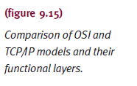
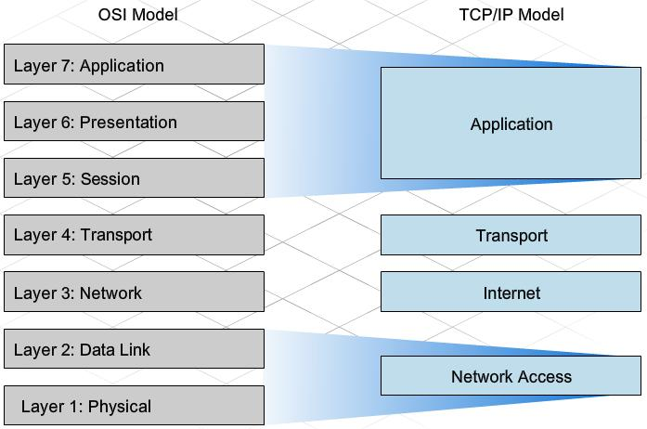
TCP/IP Model v/s The OSI Reference Model

Slide 66
TCP/IP Model Explained

Slide 67
TCP/IP Model (cont'd.)
Network Access Layer
  Protocols provide access to communication network
  Flow control, error control between hosts, security, and priority implementation performed
Internet Layer
  Equivalent to OSI model network layer performing routing functions
  Implemented within gateways and hosts
  Example: Internet Protocol (IP)

Slide 68
TCP/IP Model (cont'd.)
Host-Host Layer
  Transfer data between two processes
    Different host computers
  Error checking, flow control, manipulate connection control signals
  Example: Transmission Control Protocol (TCP)
Process/Application Layer
  Protocols for computer-to-computer resource sharing and terminal-to-computer remote access
  Examples: FTP, SMTP, Telnet

Slide 69
Summary
Network operating systems: coordinate functions
  Memory Manager, Processor Manager, Device Manager, File Manager
  Must meet owner reliability requirements
    Detect node failures; change routing instructions to bypass; retransmit lost messages successfully
Basic network organization concepts
  Terminology
  Network topologies and types
  Software design issues
  Transport protocol standards

