Slide 1
Communicating in an IT Environment
Lecture 7 – Effective Presentations
(M.Brogan & B.Combes)

Slide 2
Class Activity
A tale of two presentations
The following presentations are different
  The first presentation involves ten basic errors in presentation
    See if you can identify them
  Organize your observations and write them down under the headings of:-
    Story telling
    Slides
    Delivery
  The second presentation may or may not be more effective. Decide for yourself, making further notes under the heading above.

Slide 3
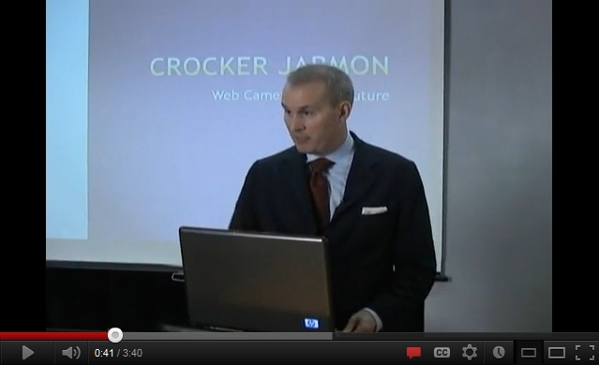

A tale of two presentations
Crocker Jarmon

Slide 4
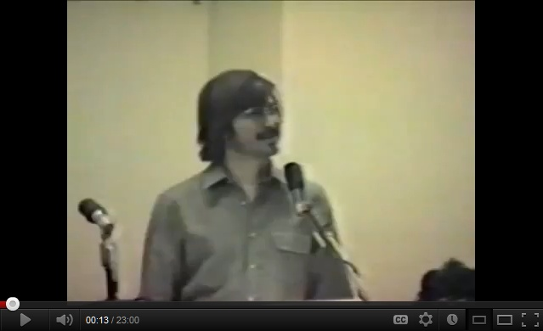
A tale of two presentations
Steve Jobs 1980

Slide 5

Schwertley, s. (2011). How to be a Presentation God. Hoboken: John Wiley & Sons, 2011., p.7.
Notes:
Thinking of presenting your work as an end of process obligation rather than opportunity, is flawed thinking. You should aim to create a lasting impression of a job well done, or a thesis proven.
Life is short, you may be

Slide 6
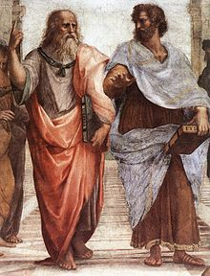
Argumentation
Recall that argumentation is a form of communication that aims to persuade with effective reasoning based on
    Logic
    Rhetoric
    Dialectic
Like academic writing, presentation is another way of going about argumentation.
Presentation
Logic
Rhetoric
Argumentation
Dialectic
Notes:
However, the skill set required for effective presentation is different from academic writing. Ideas like referencing, logic, the thesis statement, evidence and argumentation remain relevant, but presentation introduces new skills in public speaking, acting, the psychology of persuasion and effective use of presentation aids, to name a few.

Slide 7

Presentation Components
Presentations are made up of:
  Stories
    a logical flow of ideas and facts that makes a coherent narrative that is persuasive.
  Slides
    Two viewpoints – ‘Death by PowerPoint’ (Garber, 2001) AND ‘PowerPoint as an aid to effective presentation’
    Three purposes 1) Add structure 2) Prompt and 3) Enhancing the monologue
  Delivery
    Act of performance
    Where connections are made at a human level and the role of technology is to frame and amplify the message and to promote recall
Kapterev, A. (2011). Presentation Secrets, Hoboken : John Wiley & Sons, 2011. [E-book]
http://library.ecu.edu.au/record=b2213323~S1
Notes:
According to Alexie Kapterev (2011, p. 5), story telling is and always has been the essence of good business presentations. Story telling is about putting a thesis and supporting evidence in sequence and making connections. This is not story telling as you would experience it in a fiction novel, rather a logical flow of ideas and facts that makes a coherent narrative that is persuasive. Persuasion can come from the sheer power of your logic or emotion.
Visual aids to presentation based on computer generated video slides have been around since 1979 when Hewlett Packard introduced a program called BRUNO (Kapterev (2011, p. 7). The idea was taken up by Microsoft and became a runaway success with PowerPoint. Though several iterations of Office PowerPoint and Adobe equivalents, slide presentations became the norm for presenting many forms of communication, including the results of academic investigation. In 2001, Angela Garber, a journalist, challenged the conventional wisdom about the effectiveness of slide presentations, declaring the phenomenon of ‘Death by PowerPoint’. War has raged ever since about the efficacy and effectiveness of slide presentations. These competing ideas will be discussed later under the mantle of good and bad PowerPoint. What we can be certain of it that poorly executed PowerPoint is a presentation killer!
Delivery is ever

Slide 8

Rules for effective presentation
Schwerlty (2011) describes the following protocols (or rules) for effective presentations
  Clarify your objectives
  Brainstorm and develop a theme
  Outline your content
  Introduction
  Thesis
  Supporting Evidence
  Conclusion
  Rehearse

Slide 9
Story telling:
Effective content
“Because so much of the content we’re presenting these days is so vast, so complicated, or in such gray areas, presenters often get lost in their own labyrinthine heads.”
Your content must be effective and sufficient telling the audience everything it needs to know:
  -Every chair in the room is filled with a person who will absorb your content and make a decision in response: to either to go along with you or not.
http://library.ecu.edu.au/record=b2193904~S1
Notes:
“Because so much of the content we’re presenting these days is so vast, so complicated, or in such gray areas, presenters often get lost in their own labyrinthine heads.”

Slide 10
1) Story telling
Narrative & Empathy
Human beings are susceptible to and prefer story telling
  Knowledge or information presented as a story is more likely to create a lasting impression than the same information presented as a ‘solution’ to a ‘problem’
Clever presenters display empathy with their audience and adjust their presentation accordingly
  Understand and react to your audience
  Adjust your presentation
    Expert knowledge
    Fatigue
    Demography
http://library.ecu.edu.au/record=b2193904~S1
Notes:
“Because so much of the content we’re presenting these days is so vast, so complicated, or in such gray areas, presenters often get lost in their own labyrinthine heads.

Slide 11

2) Slides
PowerPoint performs THREE basic functions in presentation:
  Providing structure
  Prompting the presenter
  Enhancing the monologue
    Graphical explanations (e.g. charts)
    Visual stimulus
    New information
    Focus
Theobald, T. (2011). Develop Your Presentation Skills : Build Your Confidence; Be Charismatic; Give a Polished Performance. London. Kogan Page.

Slide 12


Slide 13
Creating great PPTs
Why I love Wilfred:
  Role reversal
  Social commentary
  Man in a skin
Wilfred is a half-hour, live-action comedy about "Ryan," a young man struggling unsuccessfully to make his way in the world until he forms a unique friendship with "Wilfred," his neighbor’s canine pet. Everyone else sees Wilfred as just a dog, but Ryan sees a crude and somewhat surly, yet irrepressibly brave and honest, Australian bloke in a cheap dog suit. While leading him through a series of comedic and existential adventures, Wilfred the dog shows Ryan the man how to overcome his fears and joyfully embrace the unpredictability and insanity of the world around hi
There is something
not quite right about
this slide. What’s
the problem?

Slide 14

Using text: Fonts
Tahoma
Fonts
  Use Tahoma or similar font (e.g., Arial, Verdana, Microsoft Sans Serif).
    Tahoma has a ratio of stroke width to height and letter width to height that makes it highly legible.
    Don’t overwhelm your audience with bells and whistles.
Arial
Durso,F., Pop,V, Burnett,J. and Stearman, E. (2011). Evidence-Based Human Factors Guidelines for PowerPoint Presentations. In Ergonomics in Design: The Quarterly of Human Factors Applications 19(4), pp.4-8

Slide 15
Using text: Fonts
Fonts
  Use sentence case for your bullets.
  Avoid overly compressed or extended texts.
  Minimize the use of font embellishments.
Durso,F., Pop,V, Burnett,J. and Stearman, E. (2011). Evidence-Based Human Factors Guidelines for PowerPoint Presentations. In Ergonomics in Design: The Quarterly of Human Factors Applications 19(4), pp.4-8

Slide 16
Chilean Exports
Fresh fruit leads Chile's export mix - Chile emerges as major supplier of fresh fruit to world market due to ample natural resources, consumer demand for fresh fruit during winter season in U.S. and Europe, and incentives in agricultural policies of Chilean government, encouraging trend toward diversification of exports and development of nontraditional crops - U.S. Dept. of Agriculture, Economic Research Service Report
Chile is among the developing economies taking advantage of these trends, pursuing a free market economy. This has allowed for diversification through the expansion of fruit production for export, especially to the U.S. and Western Europe. Chile has successfully diversified its agricultural sector to the extent that it is now a major fruit exporting nation. Many countries view Chile's diversification of agriculture as a model to be followed.
Meanwhile, the U.S. remains the largest single market for Chile's fruit exports. However, increasing demand from the EC and Central and East European countries combined may eventually surpass exports to the U.S., spurring further growth in Chile's exports.
If you’ve read this far, your eyes probably hurt and you’ve been reading this tedious long-winded text instead of listening to me. I’m insulted- can’t you see I’m doing a presentation up here? Look at me! Congratulations, however, on having such good eyesight.
There is something
not quite right about
this slide. What’s
the problem?
Notes:
Too Much Text, and Font too small
Don’t put large blocks of text in your presentation.
Emphasize the main points.
The “Six-by-Six” Rule.
Use pictures- PowerPoint is multimedia!
Use a large font…at least 30-point or more.

Slide 17


Color Guidelines
Use high-contrast text-to-background combinations.
  Contrast has a large impact on legibility.
Use dark text on a light background.
Consider split complementary colours.
Durso,F., Pop,V, Burnett,J. and Stearman, E. (2011). Evidence-Based Human Factors Guidelines for PowerPoint Presentations. In Ergonomics in Design: The Quarterly of Human Factors Applications 19(4), pp.4-8
Complements
Split Complements
Notes:
-Use high-contrast text-to-background combinations. Contrast has a large impact on legibility. The highest contrast will be achieved by using black and white, but there are a number of other text-to background combinations that can produce an acceptable contrast (see the split complementary colours section below). However, this simple principle helps one avoid the especially poor combinations noted by Greco, Stucchi, Zavagno, and Marino (2008): light orange on white, red on blue, or red on black.
-You can meet the high-contrast criterion with dark text on a light background, or the opposite: light text on a dark background. Dark text on a light background is easier to read in well-lit rooms. Also, maintaining good contrast ratios is less difficult with dark on light when ambient light is present (Greco et al. 2008).
-Consider split complementary colours. If you want to include some colour in your presentation, you can achieve high contrast by using complementary colours (colours directly opposite each other on the colour wheel). However, true complementary colours often create a tension and may appear jarring. Using a split-complementary colour scheme (e.g., Fraser & Banks, 2004) commonly used in the arts begins with choosing two complementary colours, but instead of using the direct contrast, you would use one of the two colours adjacent to the contrast.
-Complementary Colours
Complementary colours are exact opposites that enhance one another. When you blend the two together, you get neutral black. When used together, they both appear brighter and more exciting. To find complementary colours, just draw a line through the circle from a hue on one side to the hue on the exact opposite side of the circle. (Refer to the diagram below.)
-Split Complements
If you would like a palette of three colours, first find the true complement of your chosen colour; then move one, two or three more spaces away on either side. A split complementary colour scheme is usually more pleasing than a true complementary scheme. (Refer to the diagram below.)

Slide 18
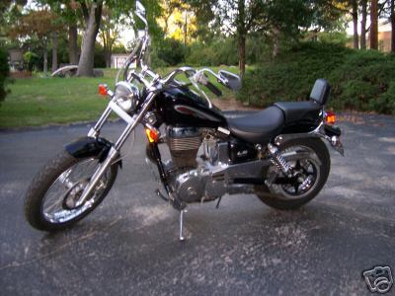
Beginner Motorcycles
My personal favorite: the Suzuki Savage
Light weight (~380lbs)
Adequate power (650cc engine)
Low seat height fits most riders

Slide 19
Layout Guidelines
Be consistent
  Keep aspects of your presentation, such as font and colours.
Line spacing should be half a character height.
Respect the slide margins.
Follow graphic design principles for:
  Size
  Balance
  Contrast
  Rhythm
Durso,F., Pop,V, Burnett,J. and Stearman, E. (2011). Evidence-Based Human Factors Guidelines for PowerPoint Presentations. In Ergonomics in Design: The Quarterly of Human Factors Applications 19(4), pp.4-8

Slide 20
Comprehension Guidelines
Use bullets (not multiline paragraphs).
Bullets should be affirmative and in active voice.
Use no more than 4 ± 1 bullets on a slide.
Avoid distracting elements.
  Animation effects when over-used add noise and detract from comprehension
Durso,F., Pop,V, Burnett,J. and Stearman, E. (2011). Evidence-Based Human Factors Guidelines for PowerPoint Presentations. In Ergonomics in Design: The Quarterly of Human Factors Applications 19(4), pp.4-8
Notes:
A considerable amount of work exists on how humans comprehend. Even novice writers realize that a paragraph should be a coherent expression of a single idea and that one idea should be related to the next. Much of what is needed to make a PowerPoint presentation comprehensible maps neatly onto this notion, such as having a single main idea per slide with bullets related to that idea.

Slide 21
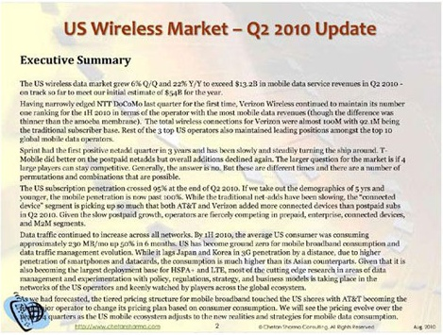

Slide 22

Charts, graphs and tables
Avoid the 3-D graph option
Do not use more than five or six colors or shapes.
Preview the color of graphs.
  Color shift should be expected with another laptop/projector
Less is more as long as it is enough.
  Too much information in a chart can make it unreadable
Position the legend to minimize information access costs
Notes:
Avoid the 3-D graph option. The 3-D graphs appear to give two estimates for the y-axis and can make it difficult to discern values. They can also give the false illusion of volume (Sanders & McCormick, 1993 [p. 118]).
Do not use more than five or six colors or shapes. When using colors to label categories in graphs or charts, do not use more than five or six colors. People will have difficulty making the necessary distinctions (Wickens et al., 2004 [p. 187]). This recommendation also applies to the shapes used to designate data points. Adding redundancy (e.g., texture, patterns) to the graphs will enable viewers to discriminate among more objects and will also aid those with color deficiencies. (See
Figure 2.)
Preview the color graphs. Although it is advisable to preview all aspects of your presentation, this guideline is especially true for colors. Projectors will not faithfully render the colors you choose.

Slide 23
3. Delivery
Organization
Murphy’s Laws
Anything that can go wrong, will go wrong.
There is always one more bug.
In case of doubt, make it sound convincing.
If you try to please everybody, nobody will like it.
Reconnaissance should be mandatory.
  Often you can avoid the agony of failed delivery by testing the setup on the day

Slide 24
Delivery
Organization
Murphy’s Laws
  Test your presentation before you show it.
  Always have a backup of your presentation on hand.
  Be prepared to do the presentation without the PowerPoint…professionals ALWAYS print handouts for the audience.
  Know your material.
  If using the Internet, make sure you have wireless or dongle backup for the connection
  Make sure you have a backup copy of your presentation if required

Slide 25
Delivery
Rehearse!
A presentation must work as a piece of theatre
Rehearse your presentation!
Speak slowly and clearly.
Face the audience, not the screen
  Make Eye Contact
  Use gesture, pause and movement
Don’t read the PPT (the audience can read too)
Think of the PPT slide as a mnemonic – a reminder

Slide 26
Delivery
Timing
Have your timing right. A half hour presentation = approx 10 to 15 slides (1 per 2 minutes with 5 to 10 mins Qs)
  A presentation of 50 slides is undeliverable
  If content is too dense, each time the slide changes, the audience will pause too read and ignore the oration
    Content should be graspable within 10 seconds.
    Aim to keep the narrative in sync with the slides
Keep it simple. PPT is a tool. If your audience requires detail then provide handouts.

Slide 27
Delivery
Public speaking
Mental preparation
dress appropriately
check your notes
leave time to get organised
adopt a confident and calm manner
always arrive at the venue early. Why?

Slide 28
Delivery
Public speaking
Creating a presence
Stand in an appropriate place in front of your audience.
Face them directly.
If you are confident, stand directly in front of them with your hands free to use hand gestures.
If you are a little unsure, stand behind a podium or desk on which you can rest your hands and your notes.

Slide 29
Delivery
Public speaking
Creating a presence
Maintain eye contact with the audience.
Move your eyes around the room and try to cover the whole audience.
Keep a lively, focused and intelligent expression and smile when appropriate.
Hint - look towards the back of the audience and don't actually look directly at anyone. You will still appear to be making eye contact.

Slide 30
Delivery
Public speaking
Being heard
Speak slowly, clearly and loudly
Use a modulated tone of voice, not a monotone.
Emphasise important points.
Pause after a key point or before one.
Project your voice from your lungs and breathe normally. (Sometimes when we are nervous, we hold our breath.)

Slide 31
Delivery
Public speaking
Maintaining interest
Use exclamations and rhetorical devices such as:
  a personal address,
  an anecdote,
  one word sentences
  questions
Break up your presentation with images, multimedia – make sure they are relevant.

Slide 32

Delivery
Public speaking
Maintaining interest
  Be passionate
  Pitch your talk to your audience
  Stick to your time limit
  Let your personality come through
  Try to connect with your audience
  Sound as though you mean it

