Slide 1

CSG1105 / CSG4130 Applied Communications
Chapter 1
What Is a Computer Network?
Chapter 2
Network Topology
Chapter 3
Networking Hardware

Slide 2
Objectives
Sketch and discuss the different types of network topologies and their advantages and disadvantages
Sketch and explain examples of digital data encoding
Discuss the OSI reference model
Explain the basic operation of Ethernet and token-ring networks
Describe the features of a network operating system
Explain the purpose of the IEEE 802 standards
CSG1105 / CSG4130 Applied Communications

Slide 3
Objectives (cont’d.)
Describe the difference between physical topology and logical topology
Sketch the physical topologies of bus, star, ring, fully connected, and hybrid networks
Explain what is meant by network hierarchy
Describe how a subnet is used to manage addresses on a network
Explain what a network access point is
Discuss the differences between a public network and a private network
CSG1105 / CSG4130 Applied Communications

Slide 4
Objectives (cont’d.)
List and describe the basic networking hardware components, including cabling, network interface cards, repeaters, transceivers, hubs, switches, routers, and firewalls
Explain the differences and similarities between 10base2 Ethernet, 10base5 Ethernet, 10baseFL Ethernet and 10baseT Ethernet
CSG1105 / CSG4130 Applied Communications

Slide 5
Objectives (cont’d.)
Compare the advantages of fiber optic cable over copper wire
Understand the relationship between network devices and the OSI network model
Describe the basic operation of Ethernet hubs and switches
CSG1105 / CSG4130 Applied Communications

Slide 6
Computer Network Topology
How individual computers (devices, nodes) connect
Common topologies
  Fully connected (mesh)
  Star
  Bus
  Hub
Consider:
  Costs
  Advantages
  Disadvantages
CSG1105 / CSG4130 Applied Communications

Slide 7
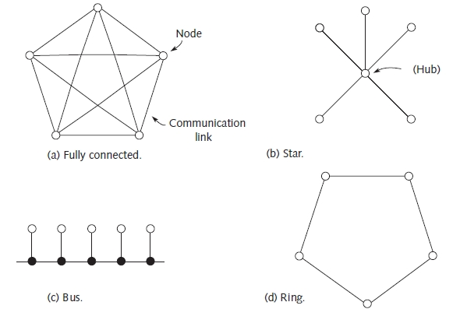
Computer Network Topology (cont’d.)
Figure 1-1 Topologies for a five-node network
CSG1105 / CSG4130 Applied Communications

Slide 8
Wired Networks Versus Wireless Networks
Disadvantage of wired networks
  Unsafe, expensive pulling wire, fiber through building
Wireless network
  Base station
    Broadcasts data into air
    High frequency RF signal
    Line-of-sight infrared laser
  Remote (mobile) stations
    Stay within base station range
    Allowed to move about
CSG1105 / CSG4130 Applied Communications

Slide 9
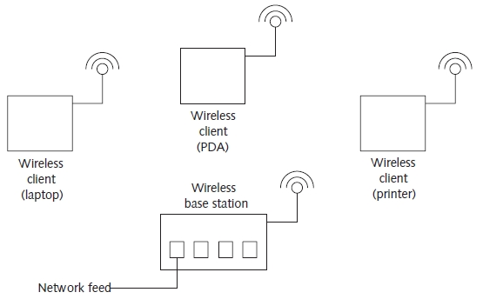
Wired Networks Versus Wireless Networks (cont’d.)
Figure 1-2 Example of a wireless network
CSG1105 / CSG4130 Applied Communications

Slide 10
Representing Digital Data
Computer information exchanged in digital form
  Digital representations vary
Analog medium transmitting digital data
  Carrier modulated signal represents data
    Amplitude modulation
    Frequency-shift keying
Digital medium transmitting digital data
  Digital waveform represents data
    Frequency-shift keying
    Nonreturn to zero (NRZ) technique
    Manchester encoding
CSG1105 / CSG4130 Applied Communications

Slide 11
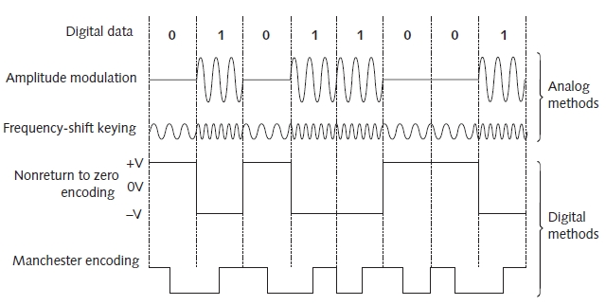
Representing Digital Data (cont’d.)
Figure 1-3 Methods of representing digital data
CSG1105 / CSG4130 Applied Communications

Slide 12
Working with Digital Data
Applications use network transmitted digital data
  Commonly exchange large data amounts
Secure connections
  Encrypt data in transit
Data compression
  Reduces storage requirements, downloading time
Compression and encryption
  Handled by software
  Supported by communication rules, protocols
  Represent data logically
CSG1105 / CSG4130 Applied Communications

Slide 13
Communication Protocols
Establish coherent communication between two network nodes
  Requires advance agreement
    Information format
    How to exchange information
Open Systems Interconnection (OSI) reference model standard
  Governs protocol use in computer networks
  Defines seven layers
    Required to establish reliable communication
CSG1105 / CSG4130 Applied Communications

Slide 14
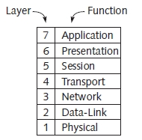
Communication Protocols (cont’d.)
Figure 1-4 OSI reference model
Interconnection (OSI) reference model (cont’d.)
  First and second layers
    Define type of physical signals
Different protocols used between layers
  Handle error recovery, information routing
CSG1105 / CSG4130 Applied Communications

Slide 15
Communication Protocols (cont’d.)
Remembering OSI layer names
  All Packets Should Take Network Data Paths
Physical Layer (layer 1)
  Responsible for transmitting, receiving bits
Data-Link Layer (layer 2)
  Frames data, error detection
  Maintains flow control over physical connection
  Works with MAC (Media Access Control) addresses
  Two sublayers
    LLC (Logical Link Control)
    MAC (Media Access Control)
CSG1105 / CSG4130 Applied Communications

Slide 16
Communication Protocols (cont’d.)
Network Layer (layer 3)
  Routes protocol-specific packets to proper destination
Transport Layer (layer 4)
  Assumes error-free physical data
  Provides correct communication between applications
    From logical perspective
Session Layer (layer 5)
  Handles communication
    Processes running on two different nodes
CSG1105 / CSG4130 Applied Communications

Slide 17
Communication Protocols (cont’d.)
Presentation Layer (layer 6)
  Text compression, conversion, encryption
Application Layer (layer 7)
  Where actual user program executes
  Makes use of lower layers
  Application Programming Interface (API)
    Interfaces directly with operating system to perform all network related activities
CSG1105 / CSG4130 Applied Communications

Slide 18
Ethernet LANs
Brief history
  1973-1975: developed by Xerox Palo Alto Research Corporation (PARC )
  1980: Ethernet promoted as networking standard
Baseband system
  Single digital signal transmitted
Transmission speeds
  10 Mbps (10base2, 10base5, or 10baseFL)
    Use different media types (coaxial cable, fiber)
    Encode data in the same way (Manchester)
  100 Mbps, 1000 Mbps, 10,000 Mbps (more current)
CSG1105 / CSG4130 Applied Communications

Slide 19
Ethernet LANs (cont’d.)
10base2 Ethernet device transceiver
  Provides electronic connection
    Between device, coaxial cable
  Converts digital data to signals usable over cable
Segments
  Groups devices
    Tap for each device
  Important to correctly terminate both ends of cable in each segment
  Segments connected with repeaters
CSG1105 / CSG4130 Applied Communications

Slide 20
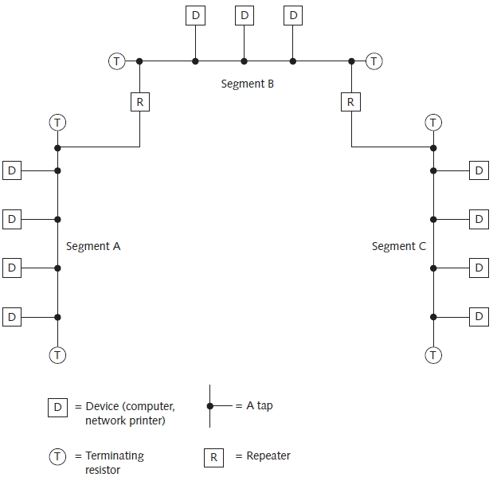
Ethernet LANs (cont’d.)
Figure 1-5 Eleven-node Ethernet LAN
CSG1105 / CSG4130 Applied Communications

Slide 21
Ethernet LANs (cont’d.)
Ethernet device has own unique binary address
Broadcasting
  Every device on Ethernet LAN receives data when one device transmits data
    Each device waits to see its own address on the network cable before acting on data
Collision
  Two or more devices transmit data at same time
  Carrier Sense Multiple Access with Collision Detection (CSMA/CD)
    Transmitting devices stop, wait random time period
CSG1105 / CSG4130 Applied Communications

Slide 22
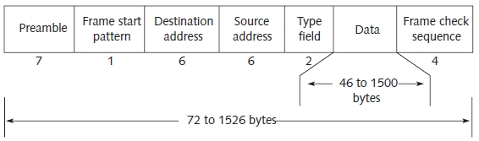
Ethernet LANs (cont’d.)
Figure 1-6 Ethernet frame format
Frame
  Format Ethernet transmits data
CSG1105 / CSG4130 Applied Communications

Slide 23
Token-Ring LANs
Not as popular as Ethernet systems
Advantage
  Eliminates high Ethernet system collision rate
Basic operation
  Token circulates between ring nodes
  Two options when node receives token
    Passes token on
    Hold token and transmits its own data frame
  Data frame examined at each node for ownership
Disadvantage
  One node’s frame can circulate at any one time
CSG1105 / CSG4130 Applied Communications

Slide 24
Network Operating Systems
Software
  Controls communication protocols
  Provides all networking functions
Examples
  Windows (95 and up), UNIX, Linux, Mac OS, NetWare
Services provided
  DHCP, e-mail, authentication, Web server, FTP server, telnet server
  Windows provides great control over network operation
CSG1105 / CSG4130 Applied Communications

Slide 25
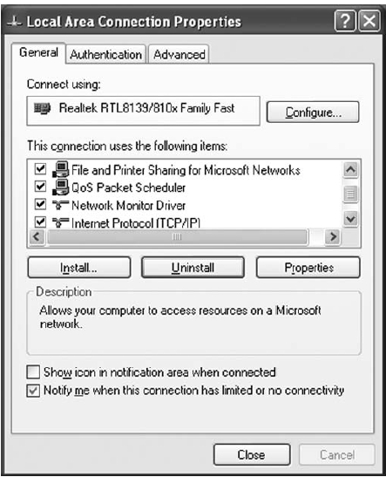
Network Operating Systems (cont’d.)
Figure 1-7 Local Area Connection Properties in Windows XP
CSG1105 / CSG4130 Applied Communications

Slide 26
IEEE 802 Standards
Institute of Electrical and Electronics Engineers, Inc.
  Web site: http://www.ieee.org
  Committees dedicated to defining computer networking standards
  Companies entering networking marketplace
    Must manufacture networking hardware complying with published standards
CSG1105 / CSG4130 Applied Communications

Slide 27
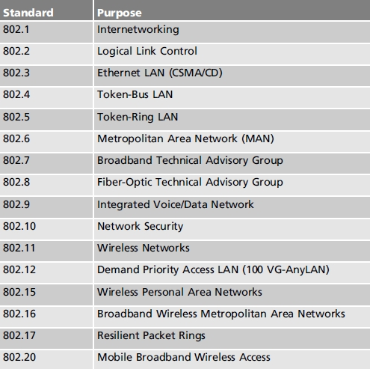
IEEE 802 Standards
Table 1-1 IEEE 802 Standard
CSG1105 / CSG4130 Applied Communications

Slide 28
Troubleshooting Techniques
Troubleshooting can take many forms
  Hardware, software, or both
  Application failure
Trial and error required
Requires organized, systematic approach
CSG1105 / CSG4130 Applied Communications

Slide 29
Troubleshooting Techniques (cont’d.)
Eight steps
  Establish symptoms
  Identify affected area
  Establish what has changed
  Select most probable cause
  Implement a solution
  Test the result
  Recognize solution’s potential effects
  Document the solution
Develop set of procedures for each step
CSG1105 / CSG4130 Applied Communications

Slide 30
BREAK!
Up next …
Network Topology

Slide 31
Physical Topology Versus Logical Topology
Topology
  Structure of connections between network computers
Cloud
  Graphic symbol describing network
    Does not specify nature of connections
Physical topology
  Intermediate network nodes, machines, and connection between intermediate nodes
Logical topology
  Data packet network path
CSG1105 / CSG4130 Applied Communications

Slide 32
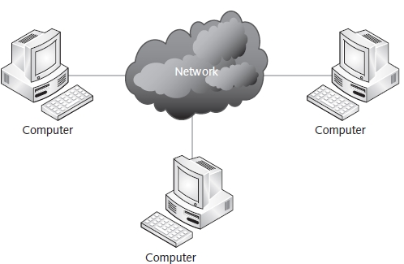
Physical Topology Versus Logical Topology (cont’d.)
Figure 2-1 Network cloud connecting three machines
CSG1105 / CSG4130 Applied Communications

Slide 33
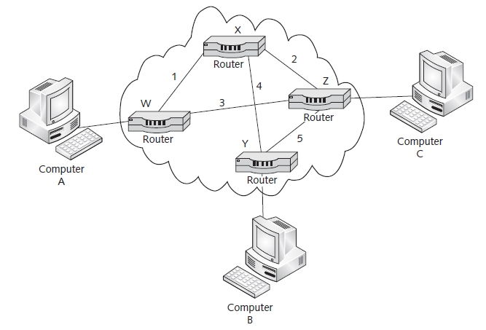
Physical Topology Versus Logical Topology (cont’d.)
Figure 2-2 Physical network topology
Network software protocols
  Properly reassemble packets into correct sequence
  Eliminate duplicated information
CSG1105 / CSG4130 Applied Communications

Slide 34
Physical Topology Versus Logical Topology (cont’d.)
Virtual circuit between machines
  Used for large amounts of data
  Prearranged network path all packets travel
    Used for particular session between machines
Virtual private network (VPN)
  Uses public network connections to establish private communication
    Encrypts data
CSG1105 / CSG4130 Applied Communications

Slide 35
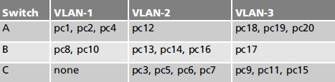
Physical Topology Versus Logical Topology (cont’d.)
Table 2-1 Grouping of 20 PCs into 3 virtual LANs
Special switches allow virtual LANs (VLANs)
Example for Table 2-1:
  Twenty computers connected to three VLAN-capable switches
  Grouped into two or more VLANs
CSG1105 / CSG4130 Applied Communications

Slide 36
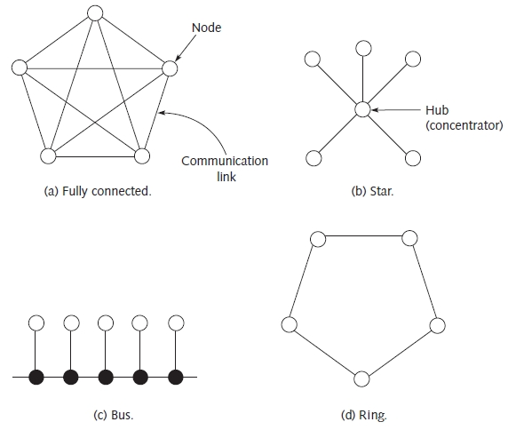
Fully Connected Networks
See Figure 2-3(a)
  Most expensive to build
Figure 2-3 Network topologies
CSG1105 / CSG4130 Applied Communications

Slide 37
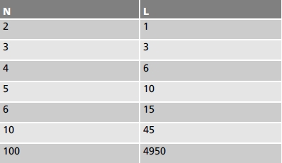

Fully Connected Networks (cont’d.)
Number of links (L) required in fully connected network of N nodes:
Number of connections at each node
  Equals total number of nodes minus one
Table 2-2 Number of links in a fully connected network
CSG1105 / CSG4130 Applied Communications

Slide 38
Star Networks
See Figure 2-3(b)
All nodes connect to central communications hub (concentrator)
Small networks
  Require single hub
    Four, eight, 16, 32, or more connections available
Large networks
  Require multiple hubs
    Increases hardware, cabling costs
CSG1105 / CSG4130 Applied Communications

Slide 39
Star Networks (cont’d.)
Advantage
  Can isolate failing nodes
Hub characteristic
  Broadcasts data received on one port to all other ports
    Each network node has opportunity to see each packet
Switch
  Learns where to send data
    Eliminates data broadcast traffic
  Provides star topology
CSG1105 / CSG4130 Applied Communications

Slide 40
Bus Networks
See Figure 2-3(c)
All nodes on common bus (cable) compete for possession
  Broadcast data when an idle bus is detected
Collision
  Two or more nodes transmit data at the same time
  Handled by Carrier Sense Multiple Access with Collision Detection (CSMA/CD)
    Nodes stop, wait before retransmitting
CSG1105 / CSG4130 Applied Communications

Slide 41
Bus Networks (cont’d.)
Bus wiring not difficult
  Daisy-chained via T-connectors into one long segment
  Issues causing cause intermittent, excessive collisions
    Bad crimps on BNC connectors
    Poor connections in T-connectors
    Improperly terminated cable segment
  Time domain reflectometer (TDR) used in troubleshooting
Bus network is easy to set up and cost-efficient
CSG1105 / CSG4130 Applied Communications

Slide 42
Ring Networks
See Figure 2-3(d)
Each node connected to exactly two other nodes
  Data circulates in ring
  Number of links
    Same as number of nodes (similar to Star)
    No central hub (difference from Star)
Link failure worst-case scenario
  Message travels completely around ring (takes time)
Central multistation access units (MAUs)
  Physical star connection outside
  Physical ring connection inside
CSG1105 / CSG4130 Applied Communications

Slide 43
Hybrid Networks
Combines two or more network topologies components
Requires careful planning
  Various rules dictate how individual components are connected and used
Logical viewpoint and overall organization must be planned
CSG1105 / CSG4130 Applied Communications

Slide 44
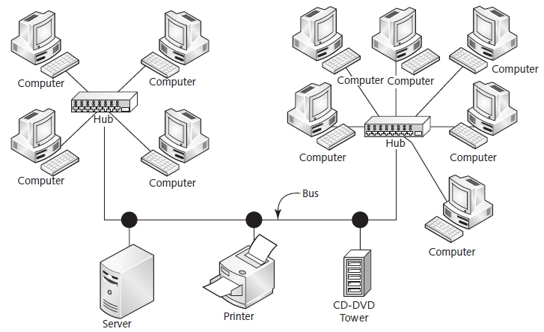
Hybrid Networks (cont’d.)
Figure 2-4 Hybrid network
CSG1105 / CSG4130 Applied Communications

Slide 45
Network Hierarchy
Hierarchy
  Layered organization
Switches act like hubs
  Differ by forwarding data selectively
Switches enforce hierarchy
  Learn where data packets should be forwarded
    Based on destination addresses
CSG1105 / CSG4130 Applied Communications

Slide 46
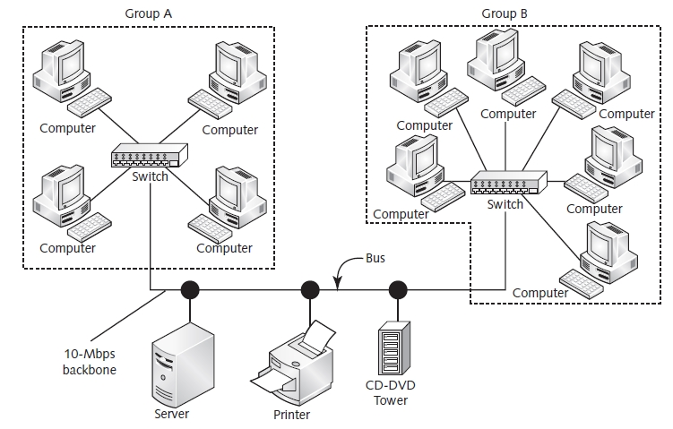
Network Hierarchy (cont’d.)
Figure 2-5 Hybrid network with hierarchy
CSG1105 / CSG4130 Applied Communications

Slide 47
Subnets
IP address
  Unique for each network node
  32-bit number
    Locates, identifies Internet nodes
Subnetting: logical activity
  Accomplished using special subnet mask
    Logically ANDed with IP address to determine network address
Subnet mask separates IP address
  Network portion and host portion
Nodes on different logical subnets require router
CSG1105 / CSG4130 Applied Communications

Slide 48
Network Access Points
Provide access to national, global network traffic
Companies can install independent communication networks
  Connect to one or more NAPs
  Act as NAPs themselves
Companies connected to a NAP
  Enter into peering agreements with each other
    Allows traffic exchange
  If traffic Internet-based
    Connection called a point-of-presence (POP)
CSG1105 / CSG4130 Applied Communications

Slide 49
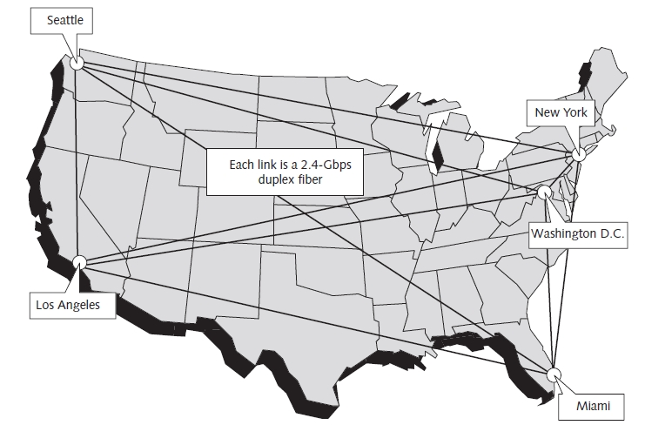
Network Access Points (cont’d.)
Figure 2-6 RWA Software national backbone
CSG1105 / CSG4130 Applied Communications

Slide 50
Public Networks Versus Private Networks
Two most pervasive public networks
  Public Switched Telephone Network (PSTN)
  Broadband cable
Public access requires limitations
  User bandwidth, legal matters, user location
Private networks
  Bandwidth limitations dependent on monetary network infrastructure investment
  Higher maintenance costs per user
CSG1105 / CSG4130 Applied Communications

Slide 51
Public Networks Versus Private Networks (cont’d.)
Ways to keep network private
  Keep all components inside locked building
    No Internet connection
  Allow Internet access through managed firewall
  Encrypt all information needing to remain private
CSG1105 / CSG4130 Applied Communications

Slide 52
Troubleshooting Techniques
Intentional harm to network
  Know what is required to partition network
    Prevents communication
    Disrupts normal network operation
    Negatively affects security, reliability
Network troubleshooting requirements
  Knowledge of topology
    Both physical and logical
  Understanding of how network is partitioned
    Testing and repairing can proceed smoothly
CSG1105 / CSG4130 Applied Communications

Slide 53
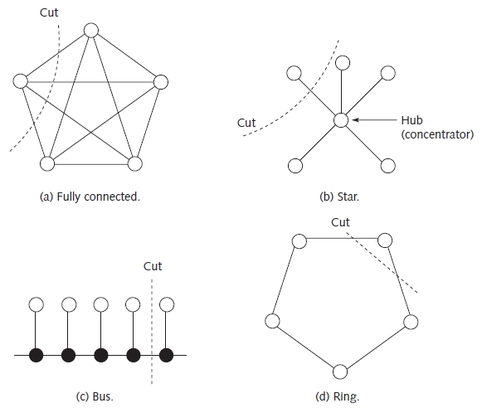
Troubleshooting Techniques (cont’d.)
Figure 2-7 Partitioning a network
CSG1105 / CSG4130 Applied Communications

Slide 54
Computer Networking From LANs to WANs: Hardware, Software, and Security
BREAK!
But don’t go too far …
We’ll be right back with
Networking Hardware
Right after these important messages!

Slide 55
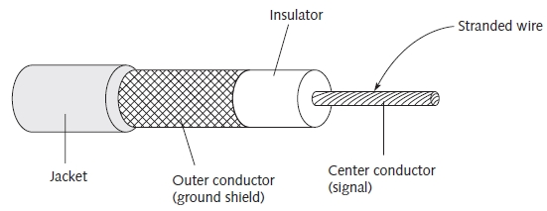
Ethernet Cabling
Three main varieties
  RG-58 coaxial cable (thinwire): 10base2 operation
  RG-11 coaxial cable (thickwire): 10base5 operation
  Unshielded twisted pair (UTP)
    10baseT, 100baseT, 1000baseT operation
Specialized cables: Fiber optic cable (10baseFL)
Figure 3-1 Coaxial cable construction
CSG1105 / CSG4130 Applied Communications

Slide 56
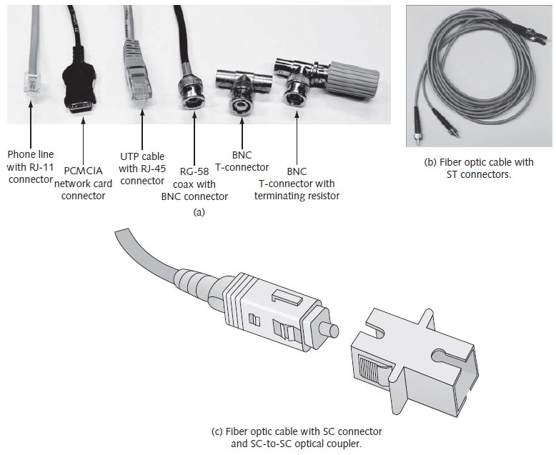
Figure 3-2 Ethernet cabling
CSG1105 / CSG4130 Applied Communications

Slide 57
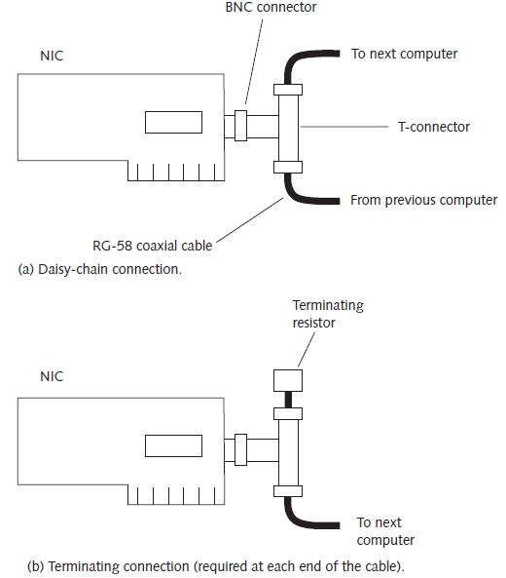
Figure 3-3 10base2 Ethernet wiring
Connect machines using daisy-chain approach
CSG1105 / CSG4130 Applied Communications

Slide 58
Ethernet Cabling (cont’d.)
RG-11 coaxial cable
  Backbone cable
UTP cable
  Used with hubs, switches, and other 10/100baseT equipment
  Twisted pair wires
    Reduces noise and crosstalk
    Allows higher-speed data rates
CSG1105 / CSG4130 Applied Communications

Slide 59
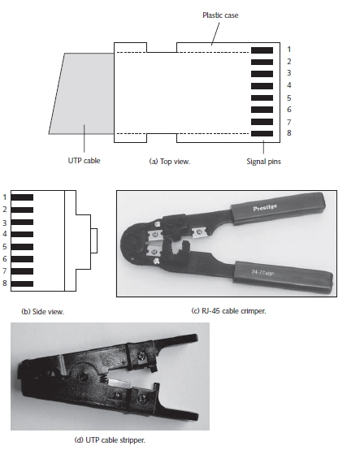
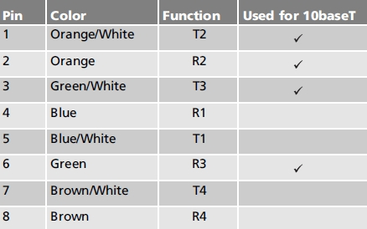
Table 3-1 RJ-45 pin assignments
(568B standard)
Figure 3-4 RJ-45 (10baseT) connector
CSG1105 / CSG4130 Applied Communications

Slide 60
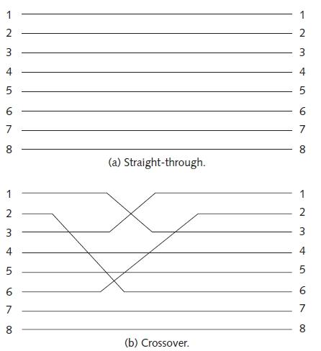
Ethernet Cabling (cont’d.)
Figure 3-5 RJ-45 cabling
UTP wiring
  Straight-through or crossover cables
CSG1105 / CSG4130 Applied Communications

Slide 61
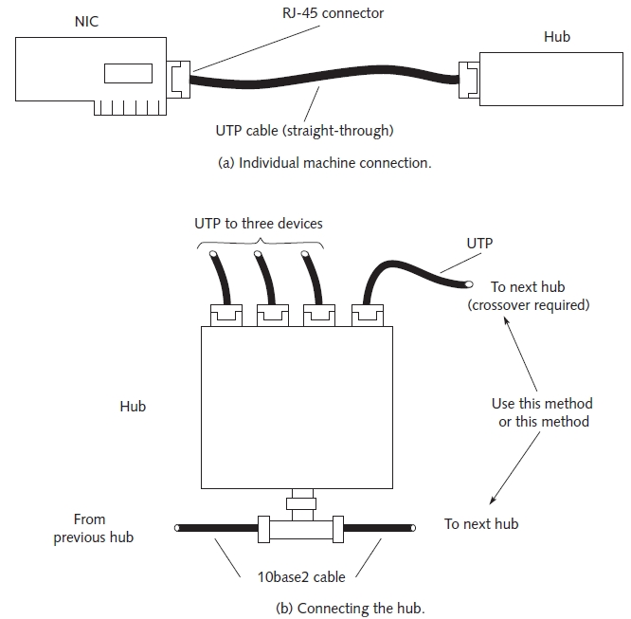
Figure 3-6 10baseT Ethernet wiring
CSG1105 / CSG4130 Applied Communications

Slide 62
Ethernet Cabling (cont’d.)
Fiber optic cable
  Light pulses carry information
Construction
  Plastic or glass with different physical properties
    Light beam reflects off boundary between core and cladding
Single mode or multi-mode allowed
Advantage
  Eliminates problems found in copper wires
Disadvantage
  Fragile
CSG1105 / CSG4130 Applied Communications

Slide 63
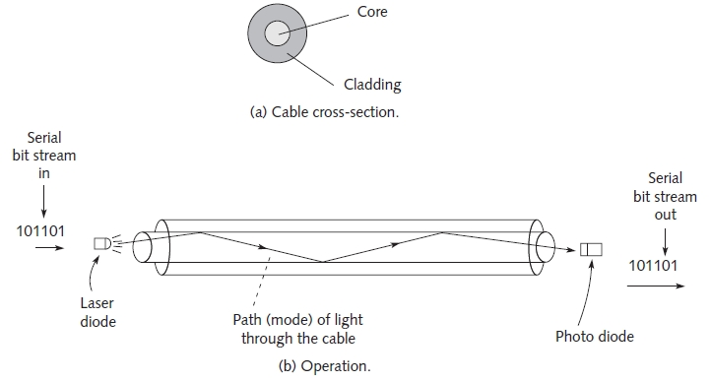
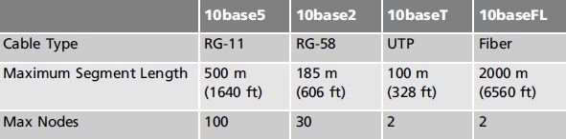
Figure 3-7 Fiber optic cable
Table 3-2 Comparing cabling systems
CSG1105 / CSG4130 Applied Communications

Slide 64
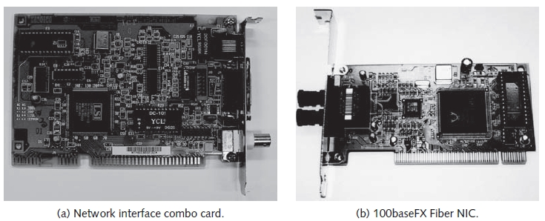
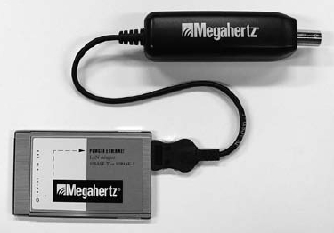
The NIC
Interface between networked device and physical network connection
  Connects to coaxial, UTP cable, fiber segment
  Operates in OSI model Physical layer
Figure 3-8 Two types of NICs
Figure 3-9 PCMCIA Ethernet
card with cable
CSG1105 / CSG4130 Applied Communications

Slide 65
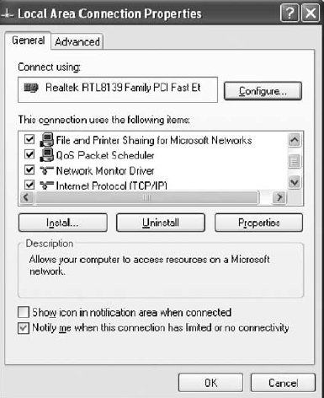
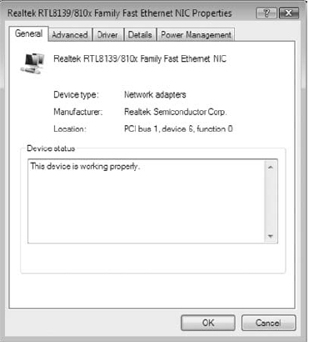
The NIC (cont’d.)
Windows XP and Vista
  Identify installed NIC in Local Area Network properties
Figure 3-10(b) Windows XP
Realtek RTL8139 NIC entry
Figure 3-10(c) Windows Vista
Realtek RTL8139/810x NIC entry
CSG1105 / CSG4130 Applied Communications

Slide 66
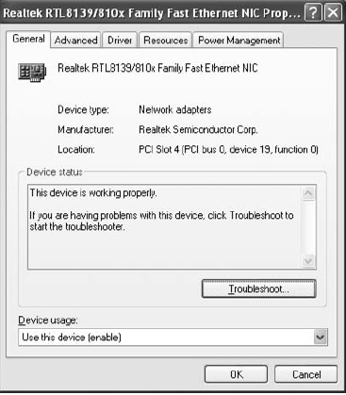
The NIC (cont’d.)
To examine NIC properties (Windows XP, Vista)
  Click Configure button
Figure 3-11(b) Windows XP
NIC Properties window
Figure 3-11(c) Windows Vista
NIC Properties window
CSG1105 / CSG4130 Applied Communications

Slide 67
The NIC (cont’d.)
NDIS/ODI interface decouples protocols from NIC
  Protocols use NDIS/ODI drivers to perform network operations
  Drivers responsible for specific hardware
Unique 48-bit MAC address
  First six digits: manufacturer, vendor
  Last 6 digits: NIC serial number
NIC utilizes two addresses
  MAC address: assigned by manufacturer, unique
  IP address: assigned by operating system, may change
CSG1105 / CSG4130 Applied Communications

Slide 68
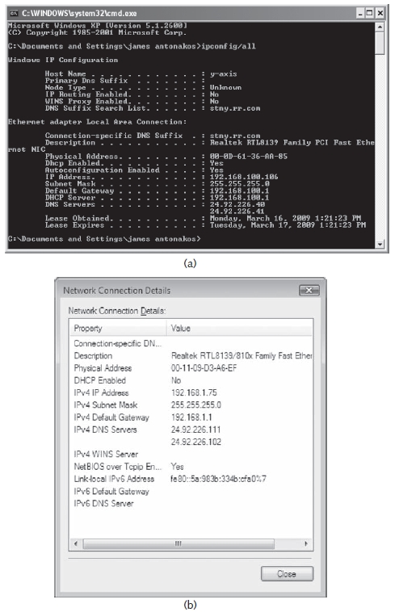
Figure 3-13 Viewing the NIC’s MAC (Adapter) address
using (a) IPCONFIG and (b) Windows Vista
CSG1105 / CSG4130 Applied Communications

Slide 69
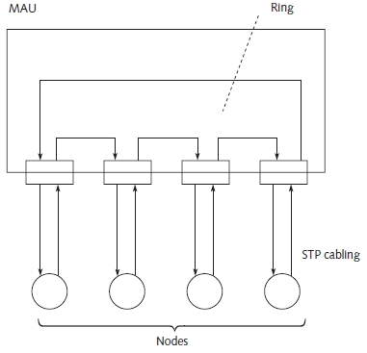
Token-Ring
Mid-1980s: 4-Mbps (16-Mbps available)
Multistation access unit (MAU)
  Establishes ring connection
Connections made using STP cables
Figure 3-14 Token-ring network
CSG1105 / CSG4130 Applied Communications

Slide 70
Repeaters
Connects two network segments
  Broadcasts packets between the segments
  Amplifies signal, extends usable length
Common Ethernet rule
  Four repeaters can join up to five segments maximum
  Physical limitation
    Designed to keep collision detection (CSMA/CD) working properly
Operates at OSI model layer 1 (Physical layer)
CSG1105 / CSG4130 Applied Communications

Slide 71
Transceivers
Convert transmissions from one media type to another
  Common to use more than one media type in an installation
    Many different transceivers available
Operates at OSI model layer 1
Important when upgrading a network
CSG1105 / CSG4130 Applied Communications

Slide 72
Hubs
Expands one Ethernet connection into many
Similar to repeater
  Difference: hub broadcasts data received by any port to all other ports on hub
Contain small amount of intelligence
  Examines received packets, checks for integrity
Operates at Physical layer
Limit to number of hubs connected in series
CSG1105 / CSG4130 Applied Communications

Slide 73
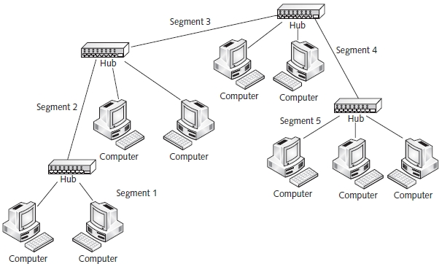
Hubs (cont’d.)
Figure 3-17 Connecting five 10baseT segments with hubs
CSG1105 / CSG4130 Applied Communications

Slide 74
Bridges/Switches
Bridge
  Partition large network into smaller groups
  Learns which packets cross segments
Switch
  Enhancements over bridge
    Multiple ports for directing packets
    Store-and-forward
    Auto-sensing
    Simple network management protocol (SNMP) support
Operate at OSI model layer 2 (Data-Link)
CSG1105 / CSG4130 Applied Communications

Slide 75
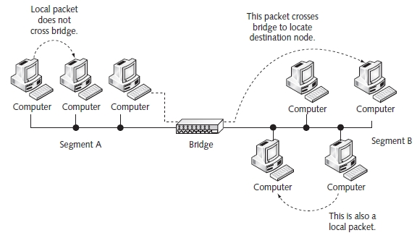
Bridges/Switches (cont’d.)
Figure 3-18 Operation of a bridge
CSG1105 / CSG4130 Applied Communications

Slide 76
Routers and Firewalls
Router
  Basic Internet building block
  Connects two or more networks together
  Examines each packet
  Connects networks using:
    Different technologies, addressing methods, media types, frame formats, and speeds
  Special-purpose device
    Interconnects networks
  Maintains routing tables
    Stores information about network physical connections
CSG1105 / CSG4130 Applied Communications

Slide 77
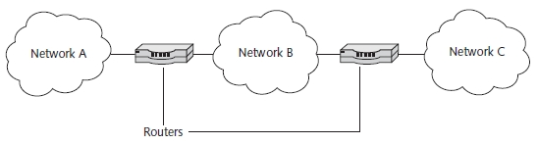

Figure 3-21 Two routers connecting three networks
Table 3-3 Network components and their associated OSI model layer of operation
CSG1105 / CSG4130 Applied Communications

Slide 78
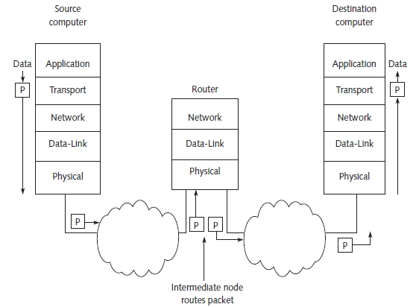
Figure 3-22 Packet routing
CSG1105 / CSG4130 Applied Communications

Slide 79
Routers and Firewalls (cont’d.)
Firewall
  Hardware device, software program
    Inspects network traffic
    Allows or denies traffic according to rule set
  Purpose
    Protects a network and computer from outside access
CSG1105 / CSG4130 Applied Communications

Slide 80
Cable Modems
High-speed network device
  Connected to local cable television provider
Data transmission
  Uses pair of channels (transmit, receive) on cable system
Internet service provider (ISP) service
  At head-end of network: cable supplier office
  Uses traditional telecommunications devices
Subscribers to cable modem service
  Use a splitter to create two cable wires
CSG1105 / CSG4130 Applied Communications

Slide 81
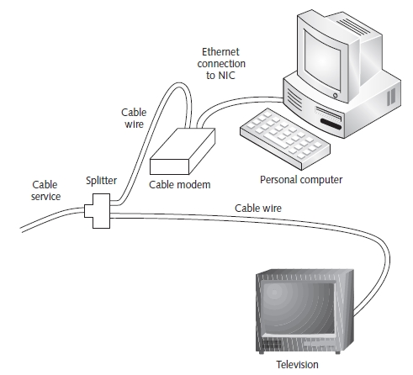
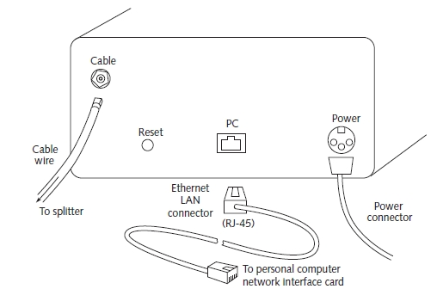
Cable Modems (cont’d.)
Figure 3-24 Cable service connections
Figure 3-25 Cable modem connections
CSG1105 / CSG4130 Applied Communications

Slide 82
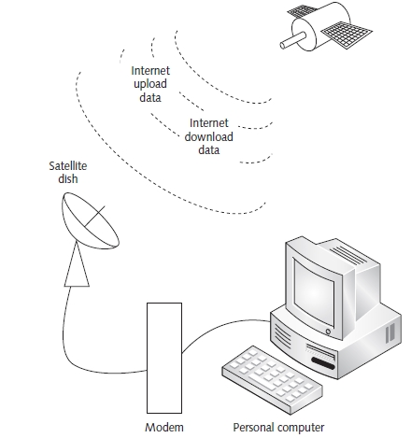
Satellite Network System
Figure 3-27 Satellite Internet
HughesNet Internet satellite networking system
  Internet data download speed: 500Kbps to 800Kbps
  Upload speed: 128Kbps
CSG1105 / CSG4130 Applied Communications

Slide 83
Exotic Hardware and Software
Replace multiple 16-port switches
  Use single industrial switch
    64 ports or more with port management
Networks distributed over large geographic area
  Use line-of-sight infrared lasers
  Use fiber repeaters
Wireless Ethernet hardware
Security purposes
  Use network-ready cameras
Advanced network management software
CSG1105 / CSG4130 Applied Communications

Slide 84
Troubleshooting Techniques
Expensive to buy finished cables
Test equipment available for custom-made cables
  Cable tester
    Used in preparing and testing custom-made cables
  Fluke LANMeter, other sophisticated test equipment
    Capture and diagnose network packets, gather statistics, perform standard network operations, transmit packets for troubleshooting purposes
Approach troubleshooting with a fresh mind
CSG1105 / CSG4130 Applied Communications

Slide 85
Summary
Topology defines how network nodes connect
  Several topology types (mesh, star, bus, ring)
Digital data traverses computer network
  Encoded for transmission over network cable
Communication protocols
  Enable communication between two networked devices
  Example: OSI reference model
    Defines seven layers
CSG1105 / CSG4130 Applied Communications

Slide 86
Summary (cont’d.)
LAN technology
  Ethernet: popular
    Baseband communication system
    Operating speeds: 10, 100, 1000, and 10,000 Mbps
Network operating systems
  Controls communication protocols
  Provides all networking functions
IEEE 802 standards
  Define networking and communication standards
Troubleshooting techniques
  Requires organized, systematic approach
CSG1105 / CSG4130 Applied Communications

Slide 87
Summary (cont’d.)
Network cloud
  Describes network without specifying nature of connections
Computer network connection views
  Physical
  Logical
    VPN tunnel
VLANs may exist on same physical network
Network topologies
  Fully connected, star, bus, ring, and hybrid
CSG1105 / CSG4130 Applied Communications

Slide 88
Summary (cont’d.)
Switch provides dedicated bandwidth
Hub provides shared bandwidth
Router required for nodes on different logical subnets to talk to each other
Network Access Points (NAPs)
  Provide access to national, global network traffic
  POP
    Internet-based NAP connections
Public networks: PSTN, broadband cable
Private network: owned and managed by private organization
CSG1105 / CSG4130 Applied Communications

Slide 89
Summary (cont’d.)
Ethernet networks use different types of cables
  RG-58, RG-11, UTP, Fiber
NICs interface between node, physical connection
Token-ring networks use MAU to connect computers
Devices connect network segments
  Repeater, transceiver, hub, bridge, switch, router
Firewall protect network
Cable modems connect computer to ISP
Many exotic devices available
Network hardwire trouble shooting tools available
CSG1105 / CSG4130 Applied Communications

