Slide 1

CSG1105 / CSG4130 Applied Communications
Chapter 4
Ethernet Technology

Slide 2
Objectives
Describe the format of an Ethernet frame and the interframe gap
Explain the basic operation of collision detection
Compare the features of the different 10-Mbps Ethernet, Fast Ethernet, Gigabit Ethernet, and 10 Gigabit Ethernet technologies
Discuss the principles of wireless Ethernet
CSG1105 / CSG4130 Applied Communications

Slide 3
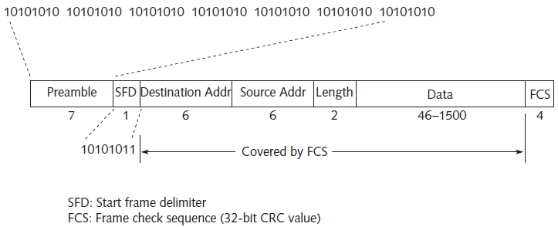
The Ethernet Frame Format
Figure 4-1 IEEE 802.3 Ethernet frame
Comparison to Ethernet II
  Identical preamble, no SFD, 2-byte Type filed in place of Length field, Data field longer than 1500 bytes
Bits transmitted LSB to MSB (most significant byte)
Minimum, maximum sizes: 72 bytes, 1526 bytes
CSG1105 / CSG4130 Applied Communications

Slide 4
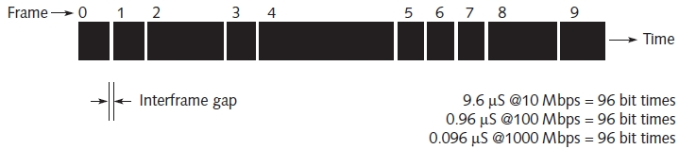
Interframe Gap
Figure 4-2 Interframe gap separates each Ethernet frame
Idle time appended to end of every frame
  Network media can stabilize
  Network components can process frame
10-Mbps Ethernet: 9.6 microseconds interframe gap
  Corresponds to 96 bit times
CSG1105 / CSG4130 Applied Communications

Slide 5
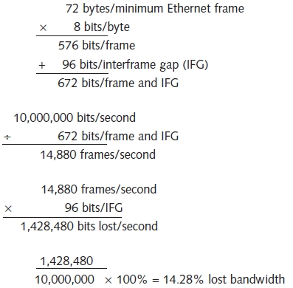
Interframe Gap (cont’d.)
Minimum-length Ethernet frame
  Followed by 96 bit times of silence
  14,880 frames/second frame rate
Figure 4-3 Calculating the effect of frame size on lost bandwidth
CSG1105 / CSG4130 Applied Communications

Slide 6
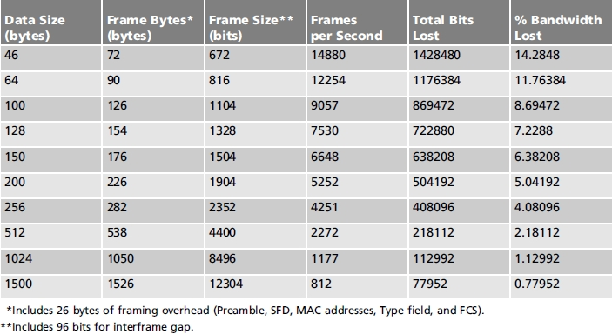
Interframe Gap (cont’d.)
When frame size is larger:
  More available bandwidth utilized
  96-byte interframe gap becomes less significant
Table 4-2 Effect of frame size on bandwidth utilization
CSG1105 / CSG4130 Applied Communications

Slide 7
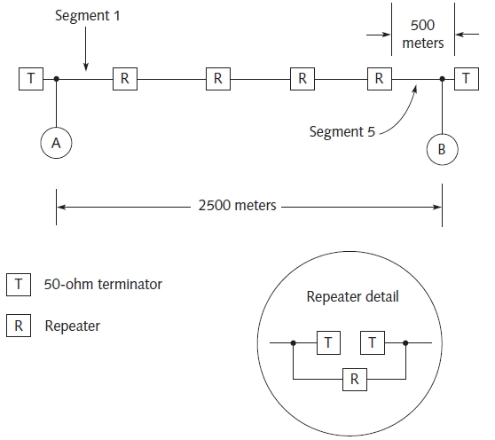
CSMA/CD
Figure 4-4 10base5 Ethernet network
Allows bandwidth sharing
Collision domain
  Portion of LAN (or entire LAN)
    Two or more transmitting stations interfere with each other
CSG1105 / CSG4130 Applied Communications

Slide 8
CSMA/CD (cont’d.)
No Collision During Frame
  Station waits an idle period
    Equal to (or longer than) the interframe gap
  Station begins transmitting frame one bit at a time
  Electronic signal represents each bit traveled
    Limited speed within thickwire coax
    10.8 microseconds worst case to travel 2500 meters from station A to B
    Time based on cable speed coefficient
  Signal absorbed at coaxial segment endpoint
    By terminating resistor
CSG1105 / CSG4130 Applied Communications

Slide 9
CSMA/CD (cont’d.)
A Collision Occurs During the Frame
  Ethernet transceivers detect signal, energy distortions
  Stations output a jam sequence
    Begin random waiting period before retransmitting
  Station must still be transmitting to detect collisions
  Round-trip time
    Important to collision detection
CSG1105 / CSG4130 Applied Communications

Slide 10
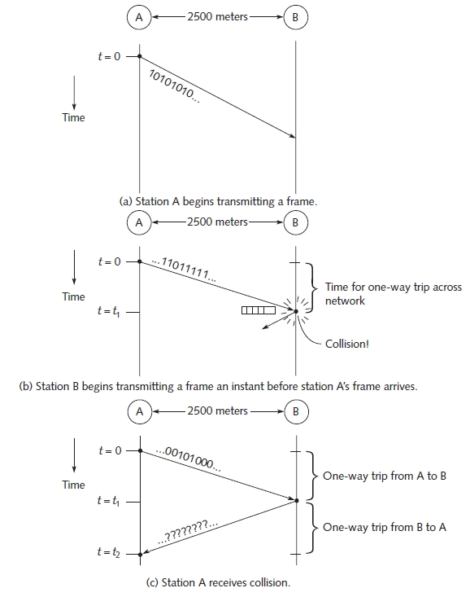
Figure 4-5 Collision example
CSG1105 / CSG4130 Applied Communications

Slide 11
CSMA/CD (cont’d.)
Detecting errors
  Transceiver listens to itself as it transmits
  If signals do not match:
    Most likely due to collision, network malfunction
Jam sequence
  Generated by stations detecting collision
  32-bit pattern
    Propagates collision throughout the network
Random waiting period
  Multiple of Ethernet slot time
    Time required to transmit 512 bits
CSG1105 / CSG4130 Applied Communications

Slide 12
Ethernet Controllers
Network interface card digital operations
  Transmit and receive Ethernet frames
    Performed by single dedicated ASIC (Application Specific Integrated Circuit) Ethernet controller
ASIC
  Handle chores
  Contains bus interface logic
    Connect directly to PCI, other standard PC bus architectures
Example: Realtek RTL8130
CSG1105 / CSG4130 Applied Communications

Slide 13
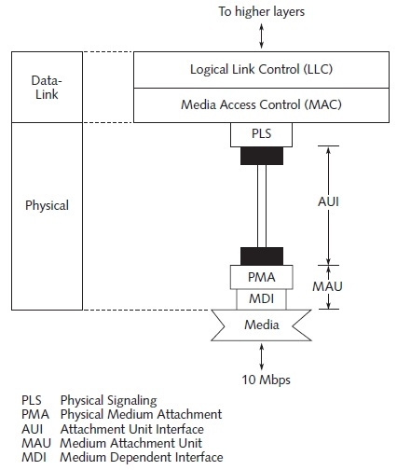
10-Mbps Ethernet
Figure 4-7 10-Mbps architecture
First three widely used Ethernet technologies
  10base5, 10base2, 10baseT
CSG1105 / CSG4130 Applied Communications

Slide 14

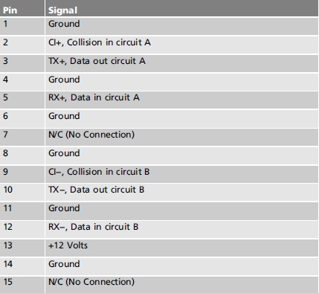
Table 4-3 AUI connector signal descriptions
Figure 4-8 Pin numbering
on the AUI connector
Media (coax, UTP)
  MDI (medium dependent interface)
  PMA (physical medium attachment)
  MDI, PMA make up a MAU (medium attachment unit)
  AUI (attachment unit interface)
CSG1105 / CSG4130 Applied Communications

Slide 15
10-Mbps Ethernet (cont’d.)
10base5: thickwire coax
10base2: thinwire coax
10baseT: category 3, 4, 5 UTP
10baseF: fiber
  Original FOIRL (fiber optic inter-repeater link) specification
  New specifications
    10baseFL: fiber link specification
    10baseFB: fiber backbone specification
    10baseFP: fiber passive specification
CSG1105 / CSG4130 Applied Communications

Slide 16
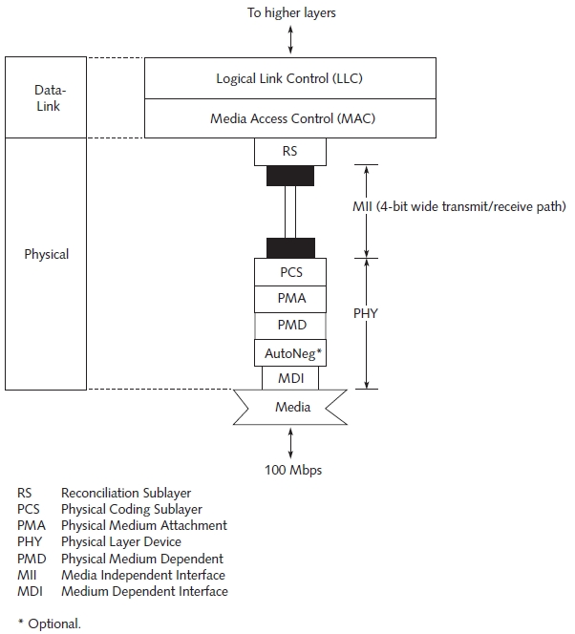
100-Mbps Ethernet (Fast Ethernet)
Figure 4-12 100baseT architecture
Disadvantage
  Smaller network diameter than 10-Mbps Ethernet
    Necessary to maintain CSMA/CD parameters
CSG1105 / CSG4130 Applied Communications

Slide 17
100-Mbps Ethernet (cont’d.)
New sublayers added for 100-Mbps transmission
100baseT4: three pairs Category 3 (or higher) UTP
  8B6T coding replaces 8-bit data values
    Six ternary codes with values of −, +, 0
100baseTX: pairs of Category 5 UTP
  4B5B coding with sixteen 4-bit data patterns
100baseFX: single mode fiber limit of 10,000 meters
  4B5B encoding
100baseT2: two pairs Category 3 (or higher) UTP
  PAM5x5 encoding
CSG1105 / CSG4130 Applied Communications

Slide 18
100-Mbps Ethernet (cont’d.)
Fast link pulses
  Autonegotiation between each end of 100baseT link
  Series of short pulses exchanged between ports
    33 pulses in series (17 clock pulses, 16 data pulses)
Two repeater types
  Class I: translates between many 100baseT technologies
  Class II: faster, supports a single technology
100VG-AnyLAN
  Handles both Ethernet and token-ring frames
  Uses domain-based priority access
CSG1105 / CSG4130 Applied Communications

Slide 19
1000-Mbps Ethernet (Gigabit Ethernet)
For bandwidth demand exceeding 100-Mbps
  Natural extension to earlier Ethernet versions
  More logical than non-compatible technology
    ATM (asynchronous transfer mode)
    FDDI (fiber distributed data interface)
Disadvantages
  Decrease in the network diameter
  Solutions to maintain reasonable network diameter
    Carrier extension
    Frame bursting
CSG1105 / CSG4130 Applied Communications

Slide 20
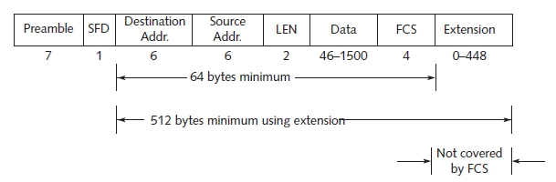
1000-Mbps Ethernet (cont’d.)
Figure 4-19 Ethernet frame with carrier extension
Carrier extension
  Used to maintain a minimum 512-byte Ethernet frame
Frame bursting
  Sending multiple frames in a burst of transmission
Single repeater type
CSG1105 / CSG4130 Applied Communications

Slide 21
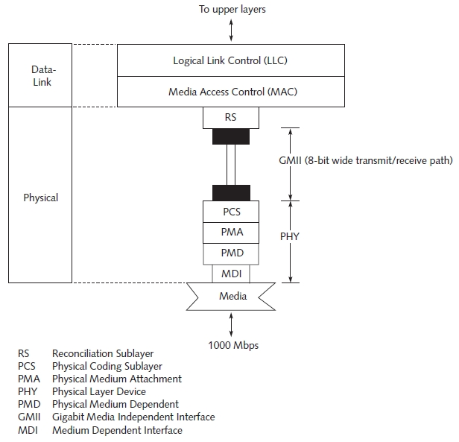
Figure 4-20 Gigabit Ethernet architecture
Differences from 10-Mbps and 100-Mbps Ethernet
  New 8- bit-wide transmit and receive path
  Full-duplex operation available in every Gigabit technology
CSG1105 / CSG4130 Applied Communications

Slide 22
1000-Mbps Ethernet (cont’d.)
1000baseT
  IEEE standard 802.3ab
1000baseCX
  Short haul copper
1000baseSX
  Short wavelength laser
    Wavelength: 770–860 nanometers
1000baseLX
  Long wavelength laser
    Wavelength: 1270–1355 nanometers
CSG1105 / CSG4130 Applied Communications

Slide 23
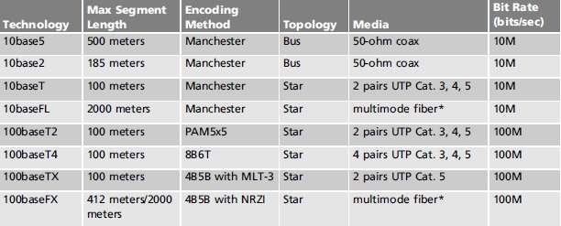
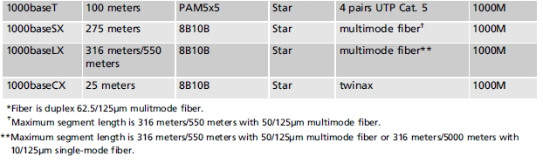
Table 4-7 Comparison of Ethernet technologies
CSG1105 / CSG4130 Applied Communications

Slide 24
10 Gigabit Ethernet
Increases network speed
  Between servers
  On the high-speed switched backbone
    Corporate LAN, or across a MAN, WAN
10GbE
  Solution for streaming audio and video, fast backups
  Standard specifies several types of fiber and copper cabling requirements
Standard specifies several types of fiber and copper cabling requirements
CSG1105 / CSG4130 Applied Communications

Slide 25
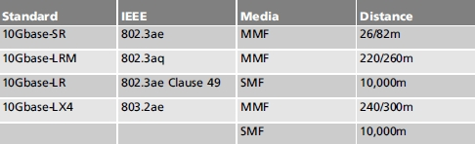
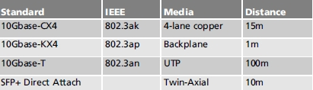
10 Gigabit Ethernet (cont’d.)
Table 4-8 10GbE Fiber standards
Table 4-9 10GbE Copper standards
CSG1105 / CSG4130 Applied Communications

Slide 26
10 Gigabit Ethernet (cont’d.)
Attractive solution for clusters of computers
  Crank out trillions of calculations each second
  Competes with InfiniBand high-speed serial communication technology
  InfiniBand
    Data rates of 2.5 Gbps, 5 Gbps, Gbps over a point-to-point link, switched fabric network, not 10GbE compatible
PHY WAN specification further extends 10GbE
  Describes 10GbE transport over a SONET/SDH fiber network
CSG1105 / CSG4130 Applied Communications

Slide 27
Wireless Ethernet
Ethernet over radio frequency (RF) or Infrared (IR)
  Covered by IEEE 802.11 standard
Wireless Ethernet network components
  One or more fixed stations (base stations)
    Service multiple mobile stations
Implementation details:
  Same frame formats for Ethernet and Token-ring
  CSMA/CA utilized
  1-Mbps, 2-Mbps, 11-Mbps, 54Mbps supported
  Faster speeds becoming available
CSG1105 / CSG4130 Applied Communications

Slide 28
Wireless Ethernet (cont’d.)
Carrier Sense Multiple Access with Collision Avoidance (CSMA/CA)
  Differs from CSMA/CD
    Wireless transceiver cannot listen for other transmissions while transmitting
    Stations attempt to avoid collisions by using random backoff delays
    Handshaking sequence used between communicating stations
CSG1105 / CSG4130 Applied Communications

Slide 29
Wireless Ethernet (cont’d.)
RF-based
  Signals propagate through objects (walls)
  ISM band used for transmission
  Uses spread spectrum technologies frequency hopping and direct sequence
IR-based
  Diffused IR bounces signals off walls, ceilings, floors
    Data rate limited by the multipath effect
  Point-to-point IR
    Uses line-of-sight IR lasers, faster data rate than diffused IR, works over larger distances (up to 1 mile)
CSG1105 / CSG4130 Applied Communications

Slide 30
Troubleshooting Techniques
Common problems encountered in actual network
  MTU (maximum transmission unit)
    Maximum frame size allowed on the network
    Affects bandwidth
  Jabber
    Frame longer than 1526 bytes
  Runt
    Any transmitted frame with length less than the minimum frame size
    Includes short frame with valid FCS
CSG1105 / CSG4130 Applied Communications

Slide 31
Troubleshooting Techniques (cont’d.)
Common problems encountered in actual network (cont’d.)
  Alignment error
    Last bit received is not last bit of the frame final byte
    Frame bits not a multiple of eight
    Causes FCS to be invalid, frame discarded
    Caused by intermittent connections, collisions
  Cabling errors
    Coax, UTP
    Lost termination
    Excess Utilization
CSG1105 / CSG4130 Applied Communications

Slide 32
Summary
Ethernet described by 802.3 standard
Two Ethernet frame types: version 1 and version 2
Interframe idle time helps regulate transmissions
Collision domain
  Only one computer, station transmits data at a time
  CSMA/CD: allows bandwidth sharing
Various Ethernet varieties exist
  Ethernet media type has its own characteristics
Troubleshooting requires Ethernet characteristic knowledge
CSG1105 / CSG4130 Applied Communications

