Slide 1
CSI1241
The data dictionary

Slide 2
The Data Dictionary
The data dictionary is where all definitions of data will be recorded. It is a section in the requirements specification
Systems analysts define all the data being used in the system so that others (such as programmers) can later on read these definitions and can then develop the system accordingly

Slide 3
Types of definition
There are two types of definition to be stored:
- elementary
- composite
elementary
This is data which for our purposes need not be split down any further e.g. a customer no., a part code.
composite
Composite definitions are composed of elementary definitions eg a document which contains many elementary data items

Slide 4
Elementary data sub-section
Each elementary data item appears only once in this sub-section even although the data item appears in many pages and documents throughout the system
The data items are sorted into alphabetical order so that they can easily be found by others.
So we need to create a list of all the data items to be used in the system and start to populate this sub-section.

Slide 5
Elementary definitions
Each data item contains:
  name e.g. account-no
  type e.g. character
  size e.g. 8
  format
  constraint

Slide 6
Type
Type can be character which means any character i.e. any alphabetic, numeric or other keyboard character
Type can be date which means that a date is declared e.g. 12/12/2010
Type can be alphabetic which means any stream of alphabetic characters
Type can be alphanumeric which means any stream of alphabetic and numeric characters

Slide 7
Type
Type can be numeric which means that only digits and possibly a decimal point are permitted. Calculations can only be performed on numeric fields. So if your student number is 10002345 then it is not numeric because calculations are not performed on it. If decimal points are used then size is the total number of characters used i.e. including the decimal point and the digits after the decimal point

Slide 8
Type
For a website, type can be link which means that the icon is a link to another part of the website or another website
For a website, type can be button which means that some executable program is initiated on pressing the button

Slide 9
Format
Format provides a statement of the structure of the elementary data item. Sometimes it is not used depending on the type.
Examples:
  dd/mm/yyyy to show the structure of a data type.
  $ to indicate dollar format – 12345.50
  ZZZ9 indicates leading spaces for a 4 digit number e.g. __76
  Pulldown indicates that a pull-down menu is being used
  Radio indicates that radio buttons are employed

Slide 10
Constraint
A constraint is any restriction placed on the range of values that may be assumed by a data item.
A constraint may be:
  a member of a set ie one of a list of possible values eg Amex or Visa or Mastercard
  limited to a range of numeric values eg 100 - 500
  a limitation in the characters that may be used within a data item e.g. a car registration number must always begin with the characters ‘1’, ‘6’, ‘7’, ‘8’ or ‘9’.

Slide 11
Legend
This is positioned at the end of the elementary data dictionary sub-section. Here a reader is informed of the coding system used by the writer
Mostly the legend defines the codes used in the type column such as N or D, but sometimes codes are used in the format or constraint column too e.g. $ for dollar format ($ZZZ9.99), Z for leading spaces

Slide 12
Quiz
What’s the elementary data dictionary definition for:
  employee-no e.g. 12345
  employee-name

Slide 13
Answer
Name Type Size Format Constraint
employee-name X 35
employee-no X 5 99999
Legend
X = any character
9 = any digit
Alphabetical sequence

Slide 14
Answer notes
Since there will be no actual calculation performed on employee-no, X (any character) is chosen and the format limits it to any digit. Marks will be lost in assignments and exams if you do not follow this rule.
Since people’s names may contain spaces, hyphens or apostrophes, use X. Marks will be lost in assignments and exams if you do not follow this rule.

Slide 15
Quiz
Create elementary dictionary items for each data item on the bank statement
(Note that there will be a problem in defining trans-no since the size varies depending on whether it is a deposit or a withdrawal. We will deal with this later in the lecture. For the moment define two elementary items – deposit-no and withdrawal-no.)

Slide 16
Bank Statement
account-no account-name date
10067307 Smith 30/03/2010
trans-no trans-type amount balance status
D101756 D 50 101.50
D101759 D 25 126.50
700557/W W 150 -23.50 *

Slide 17
Answer
Name Type Size Format Constraint
account-name X 15
account-no X 8 9(8)
amount N 8 $
balance N 8 -$
deposit-no* X 7 ‘D’ + 999999
statement-date D 10 dd/mm/yyyy last day of month
status X 1 must be * for –ve balance
trans-type A 1 either ‘D’ or ‘W’
withdrawal-no* X 8 999999 + ‘/W’
Legend X: any keyboard character
D: date format
A: alphabetic
N: numeric
9: any digit
$: leading spaces but ends in .99
-: leading negative sign possible

Slide 18
Composite definitions
In organisations, data usually occurs in groups e.g. web pages, documents, files etc.
This is composite because it is constructed out of elementary items.
Note that we are only interested in capturing the ‘dynamic’ data into the data dictionary i.e. things that change. Note that in most web-based systems designed today, headings, titles, pictures etc. are defined in the composite data dictionary since they can be changed on the web page layout via middleware.

Slide 19
Composite data dictionary sub-section
The requirements specification contains a composite data dictionary sub-section. Within this sub-section there are a number of further sub-sections – one for each type of composite i.e. one for web pages, one for documents and so on.
Within these, the definitions are defined alphabetically for easy access.

Slide 20
Composite definitions
The same notation is used to describe any type of composite data. There are four concepts involved (sometimes known as constructs)
  Sequence
  Repetition
  Selection (and Case)
  Optionality

Slide 21
Sequence
The top line of the bank statement shows three data items occurring serially:
statement = account-no + account-name + statement-date
Write the composite definition for your student card or driver’s licence

Slide 22
Repetition
The bottom part of the bank statement shows a series of lines which are repeated:
statement = account-no +account-name + statement-date
+ {trans-no + trans-type +amount + balance + status}

Slide 23
Repetition
The curly brackets indicate that a series of lines exists.
The above is not equivalent to:
{trans-no} + {trans-type} + ...
which would be shown as:
D10756 + D10159 + 700557/W + D + D + W + ...

Slide 24
Repetition
Upper and lower limits, if known, are shown as follows:
2{item} lower limit only known
{item}5 upper limit only known
2{item}5 both upper and lower limits known

Slide 25
Selection
The ‘trans-no’ field actually contains two different forms of transaction:
one to describe a deposit
one to describe a withdrawal
This is selection i.e. either one type or the other must appear (but not both)

Slide 26
Selection
This is shown as:
statement = account-no + account-name + statement-date + {[withdrawal-no | deposit-no]
+ trans-type + amount + balance + status}

Slide 27
Case
The concept of selection can be extended to describe a more general situation - CASE
Case is where two or more alternatives exist and one has to be chosen eg
main-course = [meat | fish | vegetarian]

Slide 28
Optionality
When the account goes into the ‘red’, an asterisk is shown in the status column. This is known as optionality, because it may or may not appear.
statement = account-no +account-name + statement-date + {[withdrawal-no | deposit-no]
+ trans-type + amount + balance
+ (status)}

Slide 29
Optionality
Note that optionality is different from selection. With selection something must appear; with optionality it may or may not appear.

Slide 30
Nesting
It is possible to ‘nest’ composite definitions. Nesting means to embed one definition within another
statement = account-no + account-name + statement-date + {line}
line = [withdrawal-no | deposit-no] + trans-type
+ amount + balance + (status)

Slide 31
Nesting
As well as being easier to read and understand, ‘line’ can be reused in other definitions thus simplifying the definition there as well
Going back to the earlier problem with deposit-no and withdrawal-no, we can now define trans-no as a nested composite data item i.e.
trans-no = [deposit-no | withdrawal-no]
and define deposit-no and withdrawal-no as elementary items

Slide 32
Standard naming
If we adopt standard ways of naming data items then a lot of confusion can be avoided. In this unit:
  Always use lower case names (can then cut and paste)
  Always hyphenate (rather than a combination of different approaches)
  Always qualify a name (e.g. if we just say ‘date’– is it today’s date? report-date? This is why we used statement-date in the data dictionary as it is much clearer)

Slide 33
Standard naming
A standard approach to naming composite items also makes sense. It means all developers have a shorthand to describe common structures
For example, on a web page typically there are many blocks or divisions. We will use the word ‘para’ (short for paragraph)
  e.g. web-page = header-para + detail-para
Similarly in reports we can use the suffix ‘-line’

Slide 34
Buttons, pulldowns and rollovers
With online systems and the internet, significant use is made of:
  Buttons to execute functions (e.g. submit, clear)
  Pulldown menus to provide the use with a range of choices to select
  Rollover menus (similar to pulldowns but sometimes with several levels of choices)
Use the type or format columns to deal with these

Slide 35
Questions
Create composite and elementary data dictionary definitions for the following web page.

Slide 36
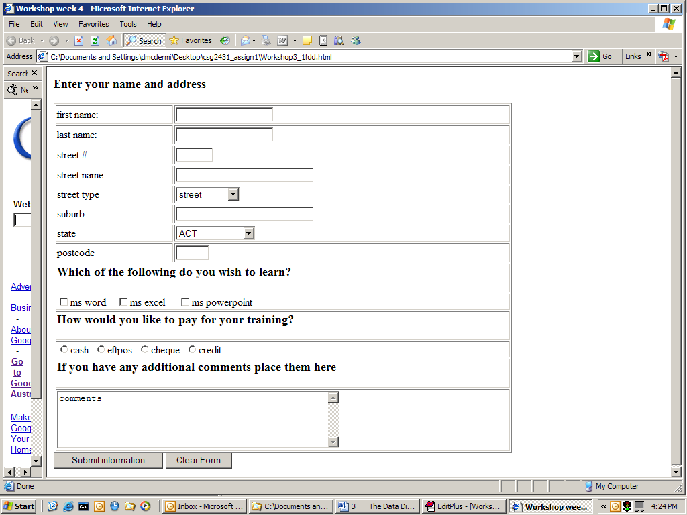
Web page

Slide 37
Composite answer
details-para = first-name + last-name + street-no +
street-name + street-type + suburb + state
+ post-code
learning-para = 1{learning-choice}3
States = [WA, SA, VIC, NSW, QLD, TAS, NT, ACT]
web-page = details-para +learning-para + payment-para
+ comments-para + submit-button + clear-button

Slide 38
Elementary answer
Name Type Size Format Constraint
clear-button B 10 name = “Clear Form”
comments-para X 256
first-name X 20
last-name X 20
learning-choice X 1 CB one of Word, Excel or Powerpoint
payment-para X 1 R one of cash, eftpos, cheque or
credit
post-code X 4 9999
street-name X 30
street-no X 4 ZZZ9
street-type X 10 P one of a set: \std\street-types.doc
state X 3 P States
submit-button B 18 name = “Submit information”
suburb X 30

Slide 39
Elementary answer
Legend:
  X any character
  B button
  P pulldown menu
  Z leading spaces
  R radio button
  CB check box

Slide 40
Review
Define the following:
  elementary data item
  composite data item
  constraint
  sequence
  repetition
  selection
  case
  optionality
  nesting

Slide 41
Review
List four formats
What different situations can constraint relate to?
What is the difference between selection and optionality?
Why does size define the total characters taken up on a web page?

