Slide 1
CSP2348/CSP5243 Data Structures
Lecture 01
Introduction to
Data Structures & Algorithms

Slide 2
Covers
Introduction to algorithm
  Examples of algorithms
  Describe relationship between algorithms and programs
Data structures
  Commonly used data structures
Brief introduction to abstract data types (ADTs)
  Data types
  Abstract data types
  Distinguish between data types and ADTs

Slide 3
Objectives
  Introduce the concept of algorithms
  Describe relationship between algorithms and programs
  Introduce the concept of data types and data structures
  Be aware of the ideas of abstract data types (ADTs)
  Distinguish between data types and ADTs by their features

Slide 4
What is an algorithm?
An algorithm is a step-by-step procedure for solving a stated problem in a finite amount of time.
For example, consider the problem of multiplying two numbers. There are many possible algorithms for solving this problem:
  multiplication using a table
    suitable only for small numbers
  multiplication manually using a pen and paper
  multiplication using logarithms
  multiplication using a slide rule
  binary fixed-point or floating-point multiplication (in a computer, or a calculator).

Slide 5
Example 1: finding a midpoint (1)
Midpoint algorithm:
To find the midpoint of a given straight-line segment AB:
1. Draw intersecting circles of equal radius, centered at A
and B respectively.
2. Let C and D be the points where the circles intersect.
3. Draw a straight line between C and D.
4. Let E be the point where line CD intersects with line AB.
5. Terminate with answer E.
Could be performed by a human equipped with drawing instruments.
A
B

Slide 6
Example 1: finding a midpoint (2)
Animation:
1. Draw intersecting circles
of equal radius, centered
at A and B respectively.
2. Let C and D be the points where the circles intersect.
3. Draw a straight line between C and D.
4. Let E be the point where CD intersects AB.
5. Terminate with answer
E.
1. Draw intersecting circles
of equal radius, centered
at A and B respectively.
2. Let C and D be the points where the circles intersect.
3. Draw a straight line between C and D.
4. Let E be the point where CD intersects AB.
5. Terminate with answer
E.
1. Draw intersecting circles
of equal radius, centered
at A and B respectively.
2. Let C and D be the points where the circles intersect.
3. Draw a straight line between C and D.
4. Let E be the point where CD intersects AB.
5. Terminate with answer
E.
1. Draw intersecting circles
of equal radius, centered
at A and B respectively.
2. Let C and D be the points where the circles intersect.
3. Draw a straight line between C and D.
4. Let E be the point where CD intersects AB.
5. Terminate with answer
E.
1. Draw intersecting circles
of equal radius, centered
at A and B respectively.
2. Let C and D be the points where the circles intersect.
3. Draw a straight line between C and D.
4. Let E be the point where CD intersects AB.
5. Terminate with answer
E.
1. Draw intersecting circles
of equal radius, centered
at A and B respectively.
2. Let C and D be the points where the circles intersect.
3. Draw a straight line between C and D.
4. Let E be the point where CD intersects AB.
5. Terminate with answer
E.
1. Draw intersecting circles
of equal radius, centered
at A and B respectively.
2. Let C and D be the points where the circles intersect.
3. Draw a straight line between C and D.
4. Let E be the point where CD intersects AB.
5. Terminate with answer
E.
1. Draw intersecting circles
of equal radius, centered
at A and B respectively.
2. Let C and D be the points where the circles intersect.
3. Draw a straight line between C and D.
4. Let E be the point where CD intersects AB.
5. Terminate with answer
E.
1. Draw intersecting circles
of equal radius, centered
at A and B respectively.
2. Let C and D be the points where the circles intersect.
3. Draw a straight line between C and D.
4. Let E be the point where CD intersects AB.
5. Terminate with answer
E.
1. Draw intersecting circles
of equal radius, centered
at A and B respectively.
2. Let C and D be the points where the circles intersect.
3. Draw a straight line between C and D.
4. Let E be the point where CD intersects AB.
5. Terminate with answer
E.
A
A
A
A
A
A
A
A
A
A
D
D
D
D
E
E
C
C
C
C
B
B
B
B
B
B
B
B
B
B

Slide 7
Example 2: GCDs (1)
The greatest common divisor (GCD) of two positive integers is the largest integer that exactly divides both. E.g., the GCD of 77 and 21 is 7.
Euclid’s GCD algorithm:
To compute the GCD of positive integers m and n:
  1. Set p to m, and set q to n.
  2. Until q exactly divides p, repeat:
  2.1. Set r to (p mod q), p to q, and set q to r.
  3. Terminate with answer q.
Could be performed by a human, perhaps equipped with an abacus or calculator.

Slide 8
Example 2: GCDs (2)
Animation:
To compute the GCD of positive integers m and n:
1. Set p to m, and set q to n.
2. Until q exactly divides p, repeat:
2.1. Set r to (p mod q), p to q, and q to r.
3. Terminate with answer q.
To compute the GCD of positive integers m and n:
1. Set p to m, and set q to n.
2. Until q exactly divides p, repeat:
2.1. Set r to (p mod q), p to q, and q to r.
3. Terminate with answer q.
To compute the GCD of positive integers m and n:
1. Set p to m, and set q to n.
2. Until q exactly divides p, repeat:
2.1. Set r to (p mod q), p to q, and q to r.
3. Terminate with answer q.
To compute the GCD of positive integers m and n:
1. Set p to m, and set q to n.
2. Until q exactly divides p, repeat:
2.1. Set r to (p mod q), p to q, and q to r.
3. Terminate with answer q.
To compute the GCD of positive integers m and n:
1. Set p to m, and set q to n.
2. Until q exactly divides p, repeat:
2.1. Set r to (p mod q), p to q, and q to r.
3. Terminate with answer q.
To compute the GCD of positive integers m and n:
1. Set p to m, and set q to n.
2. Until q exactly divides p, repeat:
2.1. Set r to (p mod q), p to q, and q to r.
3. Terminate with answer q.
To compute the GCD of positive integers m and n:
1. Set p to m, and set q to n.
2. Until q exactly divides p, repeat:
2.1. Set r to (p mod q), p to q, and q to r.
3. Terminate with answer q.
To compute the GCD of positive integers m and n:
1. Set p to m, and set q to n.
2. Until q exactly divides p, repeat:
2.1. Set r to (p mod q), p to q, and q to r.
3. Terminate with answer q.
r =77%21=14 (since 77/21 =3, with remainder 14)
r = 21%14=7 (since 21/14 =1, with remainder 7)
r = 14%7=0 (since 14/7 =2, with remainder 0)
m
77
n
21
m
n
m
77
n
21
m
m
m
n
n
77
n
21
77
77
77
21
21
m
77
n
21
m
77
n
21
21
p
77
q
21
p
21
q
14
p
p
p
q
q
p
q
77
q
21
14
21
14
14
7
p
14
q
7
7
Notes:
77%21=14 (since 77/21 =3, with remainder 14)
(i.e., 21 divides 77: we got a quotient 3, and remainder 14)
21%14=7 (since 21/14 =1, with remainder 7)
14%7=0 (since 14/7 =2, with remainder 0)

Slide 9
Example 2: GCDs (3)
Algorithm Implemented in Java:
int gcd (int m, int n)
{ //find greatest common divisor of m>0,n>0
if (m<1||n<1) return 0;
int p = m, q = n;
while ((p % q) != 0)
{ int r = p % q;
p = q;
q = r;
}
return q;
}

Slide 10
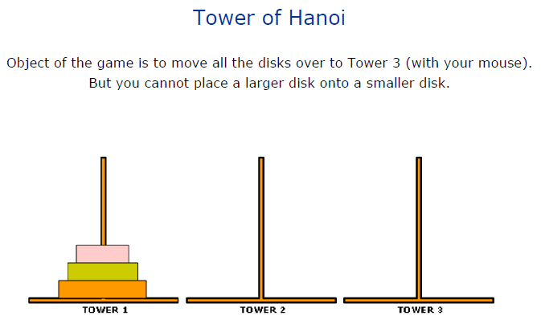
Example 3: The Tower of Hanoi
From Google search “The tower of Hanoi“ –Math is fun http://www.google.com.au/search?hl=en-AU&source=hp&q=the+tower+of+hanoi&gbv=2&oq=the+tower+of+honoi&gs_l=heirloom-hp.1.0.0i13l10.2184.8424.0.12449.18.16.0.1.1.0.406.2060.2-4j2j1.7.0....0...1ac.1.34.heirloom-hp..10.8.2060.CeA00tdMop4

Slide 11
Algorithms vs. programs (1)
An algorithm: a procedure that
  can be performed by humans or machines
  can be expressed in any suitable language
  may be as abstract as we like.
A program: an algorithm that
  must be performed by machines
  must be expressed in a programming language
  must be detailed and specific.

Slide 12
Algorithms vs. programs (2)
If we wish to use an algorithm on a computer, we must first code it in a programming language.
There may be many ways of coding the algorithm, and there is a wide choice of programming languages. But all the resulting programs are implementations of the same underlying algorithm.
Here we express our implementations in Java.
(Alternatives would be C, Pascal, Ada, etc.)

Slide 13
Data structures
A data structure is a systematic way of
  Organizing a collection of data elements in memory,
  Define a set of operations to add, remove and access elements in the collection.
    The design and implementation of these operations is achieved via the design/implementation of algorithms.
Example:
  Say we require an application to read from the input stream a user typed string and then display to the output stream the string in reverse order.
  String “Java”
0
1
2
3
Array:
‘J’
‘a’
‘v’
‘a’
0
1
2
3
‘a’
‘v’
‘a’
‘J’

Slide 14
Data structures (2)
As the choice of data structure affects the performance of a given program, a data structure is normally selected based on a given application’s data and data processing requirements.
There are different types of DS
  static data structure: one whose capacity is fixed at creation-time, such as an array.
  dynamic data structure: one whose capacity is variable, so it can expand or contract during life time.
  e.g.: linked list, binary tree.
Commonly used DS include:
  arrays, lists, maps, sets, stacks, queues, heaps, trees and graphs.

Slide 15
Data structures (3)
Array
  Stores data collection using an index.
    Allows access anywhere via index
    Has a fixed length specified at array declaration time.
ArrayList
  Ability to grow dynamically to meet the runtime needs of a program
Linked list
  insertions and deletion of data element by position (at anywhere)
    by breaking and creating new links between data elements
0
1
2
3
Array:
‘J’
‘a’
‘v’
‘a’
Linked list:
‘J’
‘a’
‘v’
‘a’ •

Slide 16
Data structures (4)
Map
  stores data as a key-value pair.
    key can be compared to an index say in arrays.
    Example: In the “Java” example we can associate Key “first” with value ‘J’
    »map.put(“first”, ‘J’);
    »letter = map.get(“first");
Set
  stores data collection with no duplicates
Stack
  Allows insertions and removals only at top of stack (LIFO)
Queue
  Allows insertions at the back and removals from the front (FIFO)

Slide 17
Data structures (5)
Trees
  E.g., data structures to represent the set of words {bat, cat, mat, rat, sat}:
0
1
2
3
4
5
6
7
(Sorted) array:
bat
cat
mat
rat
sat
•
•
•
Binary search tree:
cat
• bat •
rat
• mat •
• sat •

Slide 18
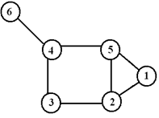
Data structures (6)
Graph
  A collection of vertices (or nodes) and the connections between them (or arcs)
    Example
      V:={1,2,3,4,5,6}
      E:={{1,2},{1,5},{2,3},{2,5},{3,4},{4,5},{4,6}}

Slide 19
Data types (1)
We classify all data into data types, such as:
  Booleans
  integers
  objects of various classes.
Each data type is characterized by:
  a set of values
  a data representation
  (which is common to all these values)
  a set of operations
  (which can be applied uniformly to all these values).

Slide 20
Data types (2)
Java built-in data types
Type
Values
Data representation
Operations
boolean
false, true
1 byte
|| && !
char
Unicode characters
2 bytes
(as for int)
int
negative, zero, positive whole numbers
32-bit twos-complement
+ - * / %
< > == etc.
float
negative, zero, positive floating-point numbers
IEEE 32-bit floating-point
String
sequences of characters
array of characters
+ length charAt etc.

Slide 21
Abstract data types (1)
When we write application code, we don’t care how strings are represented: we just declare variables of type String, and manipulate them using String operations.
Similarly, we don’t care how sets are represented: we just declare variables of type Set, and manipulate them using Set operations.
An abstract data type (ADT) is a data type whose representation is hidden from, and of no concern to, the application code.
Examples: String, Set.
ADTs provide an excellent way to design large programs.

Slide 22
Abstract data types (2)
ADTs in the Java class library
Class java.lang.String is similar to String.
Class java.lang.StringBuffer is similar to MutableString.
Interface java.util.List supports lists.
Interface java.util.Set supports sets.
Interface java.util.Map supports maps (tables).
Packages java.awt, java.io, java.util, etc., support many other ADTs.

Slide 23
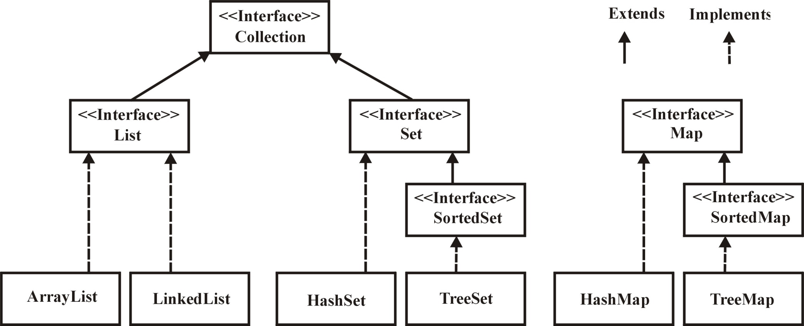
Abstract data types (3)
Java Collection Framework (simplified)

Slide 24
Conclusions
So far
  Introduction to algorithm with examples
    Describe relationship between algorithms and programs
  Data structures
    Commonly used data structures
      –arrays, lists, maps, sets, stacks, queues, heaps, trees and graphs.
  Considerations to take into account when selecting a data structure:
    problem and data analysis including
      What are the required data processing requirements, etc.?
      Time and space requirements, constraints and complexity, etc.?
    Select appropriate ADT
  Brief introduction to data types and abstract data types (ADTs)

Slide 25
Lecture 01 Study Guide
Reading:
  Chapter 1: Java Collections by D.A. Watt and D.F. Brown (2001)
  Appendix C: Java Collections by D.A. Watt and D.F. Brown (2001)
Next lecture: Algorithm Analysis
  Chapter 2: Java Collections by D.A. Watt and D.F. Brown (2001)
  Appendix A: Java Collections by D.A. Watt and D.F. Brown (2001)

