Slide 1
CSI1241/CSI4201
Business Rules Diagrams
And
Event Specification Tables

Slide 2
Contents
Introduction
Business rules diagram
Event specification table

Slide 3
Assumptions
You have read through the other slides in this module, viz:
  Business rules and business rules diagrams
  Event specification tables
You have also had a look at the sample BRDs provided to get an idea of the style of the diagrams

Slide 4
Introduction
We know that a Business Rule Diagram is
  A process model
  State-based
What we many not have noticed (yet) is that the BRD follows a strict “meta-rule”-that each pair of states must be separated by at least one event

Slide 5
Creating a BRD
A use case diagram would exist by this point together with an elaborated use case for each use case
The use case elaboration is the basis for the BRD
The appropriate OLH is also used during the process (if useful)
We will look at refining the BRD of pay invoice

Slide 6
(Part-) pay invoice explanation
The elaborated use case indicates there are three possible scenarios (conditions):
  Payment amount equals balance in which case the invoice is fully paid
  Payment amount is greater than balance in which case the customer has almost certainly entered the wrong amount (here there would be no state change)
  Payment amount is less than balance in which case a part payment is assumed

Slide 7
Draft payment BRD
payment
invoice
exists
Part
paid
Amt =
Pymt?
Amt >
Pymt?
Amt <
Pymt?
Accept final
payment
Reject payment
Accept
Part
payment
Paid
message
paid
Reject
payment
Part
paid
Part paid
message

Slide 8
Is the BRD correct?
Several issues appear in the diagram
  Multiple start states
    Choice of start state?
  No final state for the Reject Payment event
  Many conditions (too many?)
  Two payment events that do the same thing
  …

Slide 9
Final payment BRD
S1
Un-
paid
T1 Payment
C1
Amt >
Pymt?
C2
Amt <
Pymt?
E1
Reject payment
E2 Accept a
payment
Selection
Selection
M1 Reject
payment
S1
Un-
paid
S2
Paid
S3
Part-
paid
M2 Paid
message
M3 Part paid
message

Slide 10
Is any BRD correct?
Drawing the diagram is easy, but how do we know that it represents the real-world problem well enough (i.e. is a good model)?
BRDs can be ambiguous due to the use of “Selection” within the Harel Blob
How to resolve this problem so that the diagrams make sense?

Slide 11
Event Specification Table (EST) to the rescue
An EST is a tabular model that serves several purposes in the BRD method
It acts to clarify ambiguities in a BRD by:
  Providing another model that is different from text (a use case) or a graphic (a BRD)
  Links the BRD to the functional requirements (and/or assumptions)
  Describes the lawful state space of a BRD

Slide 12
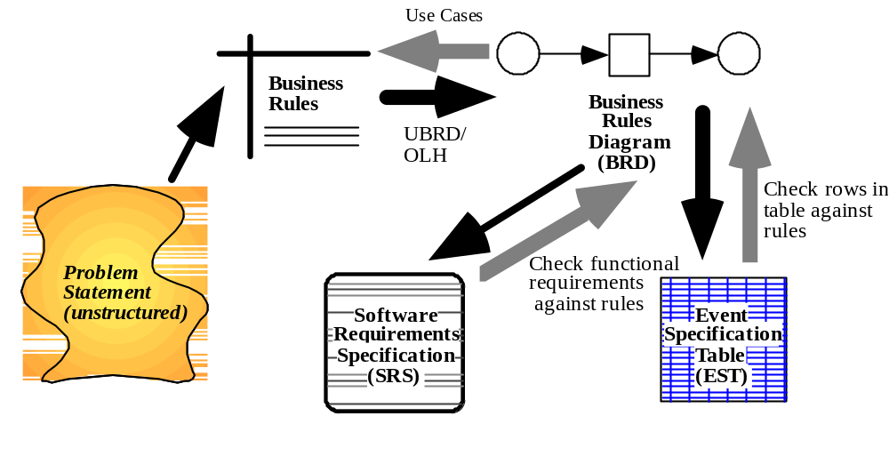
The Process of the BRD method

Slide 13
The EST of the payment BRD
Event | Trigger | Message | Condition | Pre-state | Post-state | FR/A
E1 | T1 | M1 | !C1 & C2 | S1 | S1 | 3.1.1
E2 | T1 | M2 | !C1 & !C2 | S1 | S2 | 3.1.2
E2 | T1 | M3 | C1 & !C2 | S1 | S3 | 4.0.1

Slide 14
The Solution
The EST provides a link back to the functional requirements (and/or assumptions) and ensures that each state transition is represented
It guarantees that the BRD makes sense because the requirements are represented

