Slide 1
CSG2341
Intelligent Systems
Prediction and Performance

Slide 2
Another neural network application - prediction
See Negnevitsky pp 326-330
Real estate appraisal

Slide 3
Real estate appraisal problem
Inputs:
  House location
  House condition
  Number of bedrooms
  Number of bathrooms
  Living area
  Land size
  Garage
  Heating
Output:
  Selling price

Slide 4
Putting data in
Data can be
  Categorical
    E.g. Heating System – wood, oil, electric
    1 of N encoding
    3 neurons
    Wood = [1 0 0], Oil = [0 1 0], Electric = [0 0 1]
  Discrete
    E.g. Location Rating – 0, 1, 2 , .. 9
    One neuron, 0.0, 0.1, 0.2, …, 0.9
  Continuous
    E.g. Living area
    Range 50 – 250 sq.m.
    One neuron, e.g. 121 sq.m. -> (121-50)/(250-50) = 0.355

Slide 5
Getting data out
Data can be
  Categorical
    E.g. Heating System – wood, oil, electric
    1 of N encoding
    3 neurons
    E.g. [0.6, 0.4, 0.1] choose max -> wood
  Discrete
    E.g. Location Rating – 0, 1, 2 , .. 9
    One neuron
    E.g. 0.23 round -> 0.2 = rating 2
  Continuous
    E.g. Selling price
    Range $50K –$225K
    One neuron, e.g. 0.3 -> 50 + 0.3*(225 – 50) = $102,500

Slide 6
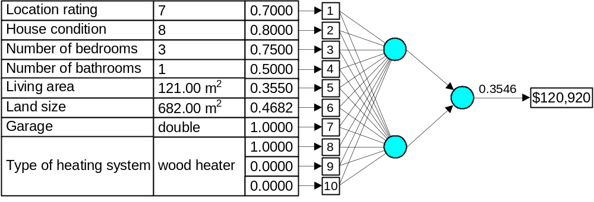
Possible network design

Slide 7
How much training data needed/how many hidden neurons to use
Widrow’s rule (of thumb)
  Number of weights = error*number of patterns
  E.g. Number of weights =
    Nhidden*(ninput+1) + noutput*(nhidden+1)
    2*(10+1) + 1*(2+1) = 25
  If error = 0.1, need at least 250 training examples
  (Just a rule of thumb)

Slide 8
Credit approval problem
1. Title: Credit Approval
2. Sources:
(confidential)
Submitted by quinlan@cs.su.oz.au
3. Past Usage:
See Quinlan,
* "Simplifying decision trees", Int J Man-Machine Studies 27,
Dec 1987, pp. 221-234.
* "C4.5: Programs for Machine Learning", Morgan Kaufmann, Oct 1992
4. Relevant Information:
This file concerns credit card applications. All attribute names
and values have been changed to meaningless symbols to protect
confidentiality of the data.
This dataset is interesting because there is a good mix of
attributes -- continuous, nominal with small numbers of
values, and nominal with larger numbers of values. There
are also a few missing values.
5. Number of Instances: 690
6. Number of Attributes: 15 + class attribute
7. Attribute Information:
A1: b, a.
A2: continuous.
A3: continuous.
A4: u, y, l, t.
A5: g, p, gg.
A6: c, d, cc, i, j, k, m, r, q, w, x, e, aa, ff.
A7: v, h, bb, j, n, z, dd, ff, o.
A8: continuous.
A9: t, f.
A10: t, f.
A11: continuous.
A12: t, f.
A13: g, p, s.
A14: continuous.
A15: continuous.
A16: +,- (class attribute)
8. Missing Attribute Values:
37 cases (5%) have one or more missing values. The missing
values from particular attributes are:
A1: 12
A2: 12
A4: 6
A5: 6
A6: 9
A7: 9
A14: 13
9. Class Distribution
+: 307 (44.5%)
-: 383 (55.5%)

Slide 9
Credit approval data
b,30.83,0,u,g,w,v,1.25,t,t,01,f,g,00202,0,+
a,58.67,4.46,u,g,q,h,3.04,t,t,06,f,g,00043,560,+
a,24.50,0.5,u,g,q,h,1.5,t,f,0,f,g,00280,824,+
b,27.83,1.54,u,g,w,v,3.75,t,t,05,t,g,00100,3,+
b,20.17,5.625,u,g,w,v,1.71,t,f,0,f,s,00120,0,+
b,32.08,4,u,g,m,v,2.5,t,f,0,t,g,00360,0,+
b,33.17,1.04,u,g,r,h,6.5,t,f,0,t,g,00164,31285,+
a,22.92,11.585,u,g,cc,v,0.04,t,f,0,f,g,00080,1349,+
b,54.42,0.5,y,p,k,h,3.96,t,f,0,f,g,00180,314,+
b,42.50,4.915,y,p,w,v,3.165,t,f,0,t,g,00052,1442,+
b,22.08,0.83,u,g,c,h,2.165,f,f,0,t,g,00128,0,+
b,29.92,1.835,u,g,c,h,4.335,t,f,0,f,g,00260,200,+
…………
Let’s design a network to predict whether or not to grant approval

Slide 10
Credit approval
Let’s try it! – see MLPExample.java
How can we tell how accurate the trained network is?

Slide 11
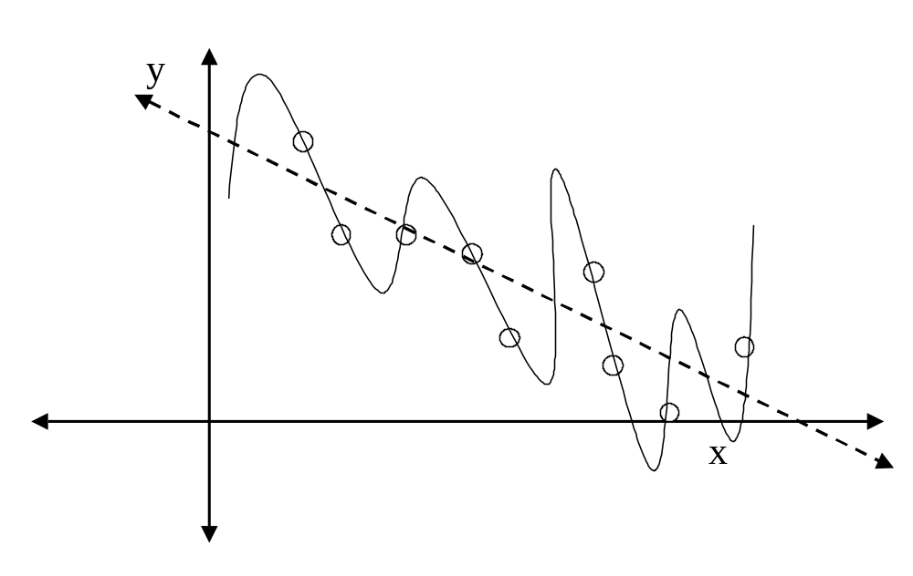
Overfitting

Slide 12
Estimating performance
Using the training set is wrong!
Using a separate test set is better, but
Cross-validation is better still

Slide 13
N-fold cross-validation for classifiers
Divide the training set into n equal parts.
For each part, train the classifier using the other (n-1) parts, and find the classification rate on the chosen part (the “holdout”).
Average the classification rates for each part.

Slide 14
Stratified cross-validation
If the n parts are selected so that the proportion of each class in each part is maintained, this is called “stratified” cross-validation.
Usually, 10-fold stratified cross validation gives a good estimate.

Slide 15
N-fold cross-validation for predictors
Divide the training set into n equal parts.
For each part, train the predictor using the other (n-1) parts, and find the error rate on the chosen part (the “holdout”).
Average the error rates for each part.
For extra accuracy, run the training several times on each part (since back-propagation is not deterministic)

