Slide 1
Lecture 6 Artificial neural networks: Supervised learning
The Hopfield network
Bidirectional associative memories (BAM)
Summary
Assignment A
Assignment B

Slide 2
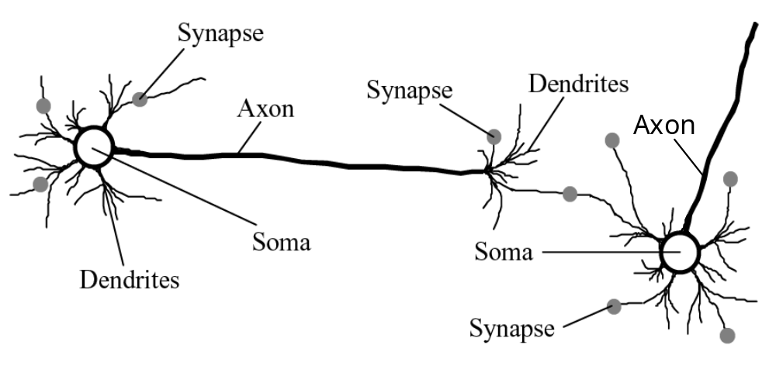
Biological neural network

Slide 3
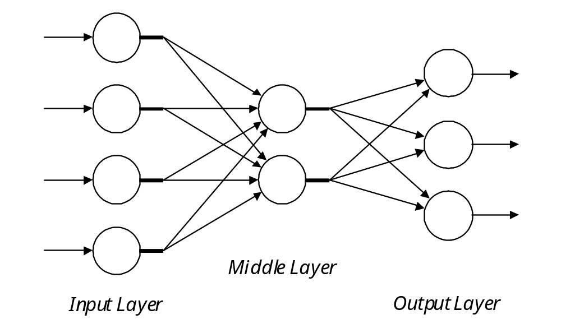
Architecture of a typical artificial neural network
I n p u t S i g n a l s
O u t p u t S i g n a l s

Slide 4
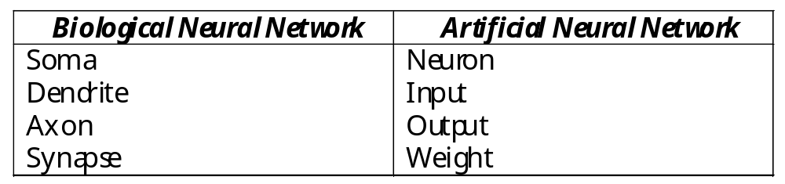
Analogy between biological and artificial neural networks

Slide 5
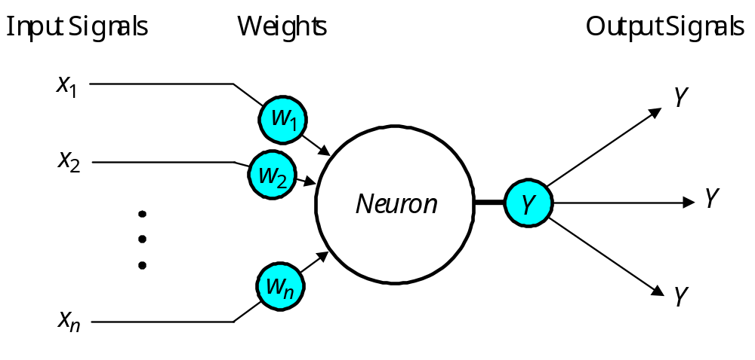
The neuron as a simple computing element
Diagram of a neuron

Slide 6
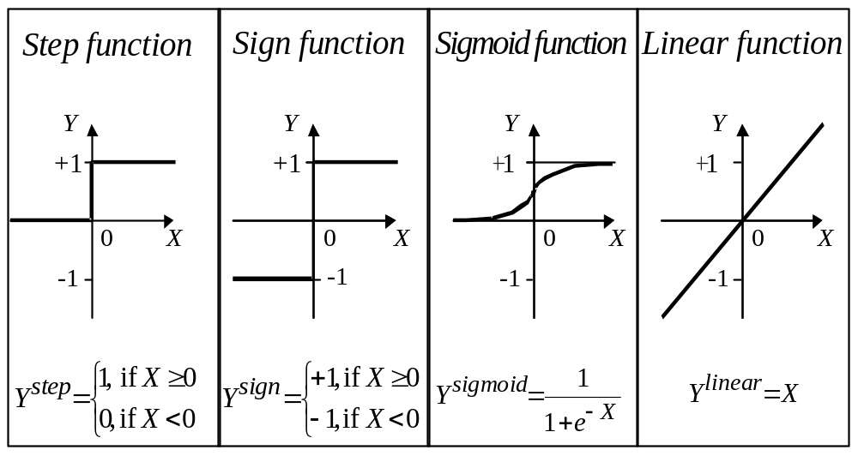
Activation functions of a neuron

Slide 7
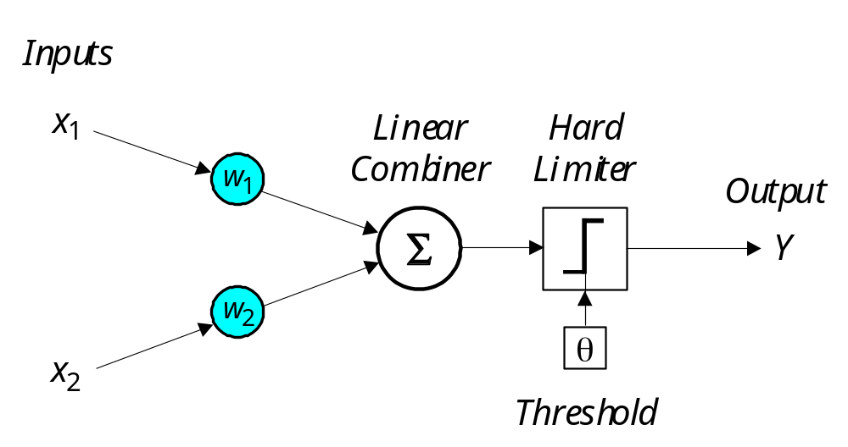
Single-layer two-input perceptron

Slide 8
Multilayer neural networks
A multilayer perceptron is a feedforward neural network with one or more hidden layers.
The network consists of an input layer of source neurons, at least one middle or hidden layer of computational neurons, and an output layer of computational neurons.
The input signals are propagated in a forward direction on a layer-by-layer basis.

Slide 9
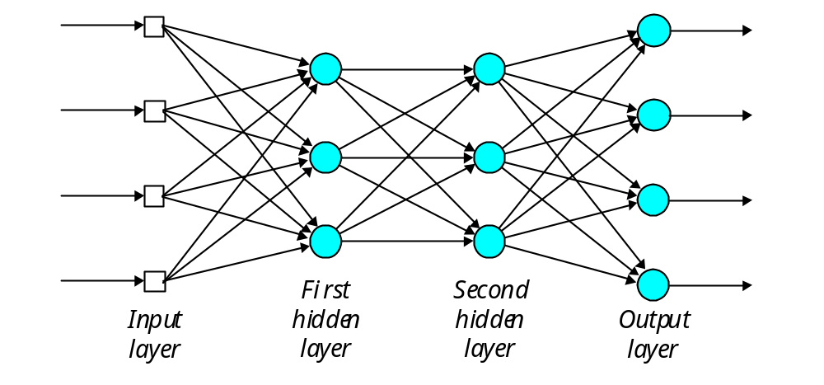
Multilayer perceptron with two hidden layers
I n p u t S i g n a l s
O u t p u t S i g n a l s

Slide 10
Back-propagation neural network
Learning in a multilayer network proceeds the same way as for a perceptron.
A training set of input patterns is presented to the network.
The network computes its output pattern, and if there is an error − or in other words a difference between actual and desired output patterns − the weights are adjusted to reduce this error.

Slide 11
In a back-propagation neural network, the learning algorithm has two phases.
First, a training input pattern is presented to the network input layer. The network propagates the input pattern from layer to layer until the output pattern is generated by the output layer.
If this pattern is different from the desired output, an error is calculated and then propagated backwards through the network from the output layer to the input layer. The weights are modified as the error is propagated.

Slide 12
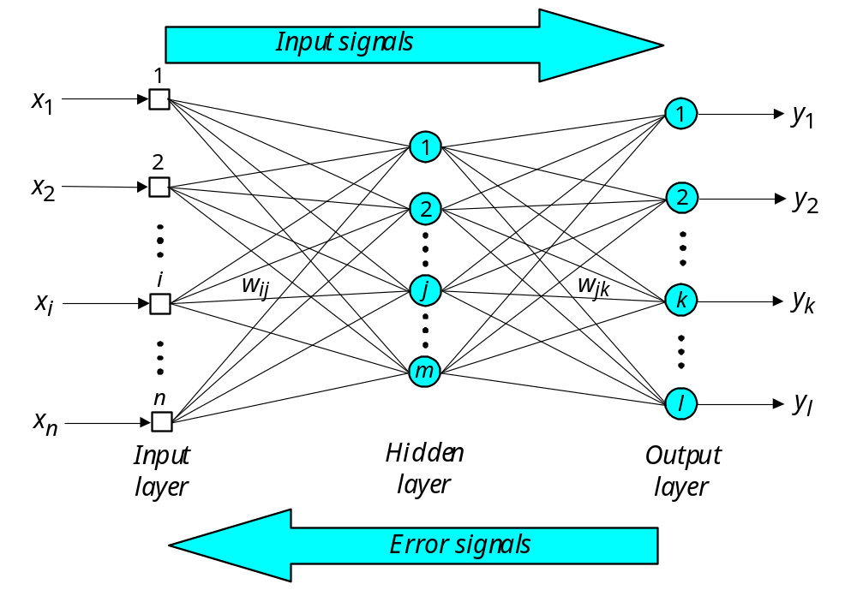
Three-layer back-propagation neural network

Slide 13
The Hopfield Network
Neural networks were designed on analogy with the brain. The brain’s memory, however, works by association. For example, we can recognise a familiar face even in an unfamiliar environment within 100-200 ms. We can also recall a complete sensory experience, including sounds and scenes, when we hear only a few bars of music. The brain routinely associates one thing with another.

Slide 14
Multilayer neural networks trained with the back-propagation algorithm are used for pattern recognition problems. However, to emulate the human memory’s associative characteristics we need a different type of network: a recurrent neural network.
A recurrent neural network has feedback loops from its outputs to its inputs. The presence of such loops has a profound impact on the learning capability of the network.

Slide 15
The stability of recurrent networks intrigued several researchers in the 1960s and 1970s. However, none was able to predict which network would be stable, and some researchers were pessimistic about finding a solution at all. The problem was solved only in 1982, when John Hopfield formulated the physical principle of storing information in a dynamically stable network.

Slide 16
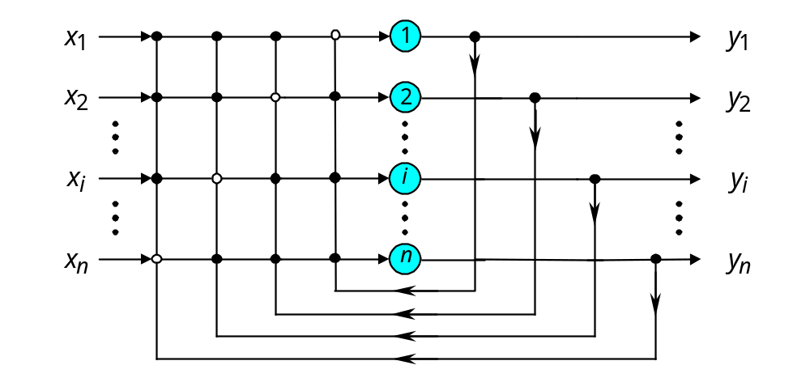
Single-layer n-neuron Hopfield network
I n p u t S i g n a l s
O u t p u t S i g n a l s

Slide 17
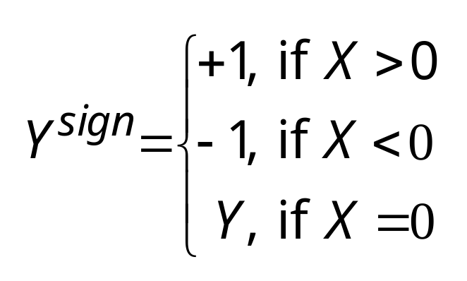
The Hopfield network uses McCulloch and Pitts neurons with the sign activation function as its computing element:

Slide 18
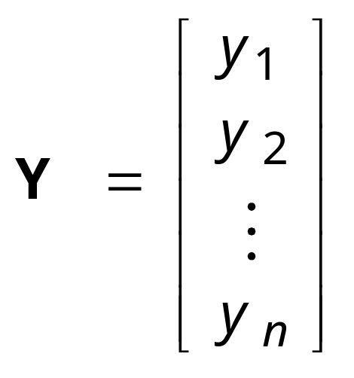
The current state of the Hopfield network is determined by the current outputs of all neurons, y₁, y₂, . . ., y_{n}.
Thus, for a single-layer n-neuron network, the state can be defined by the state vector as:

Slide 19
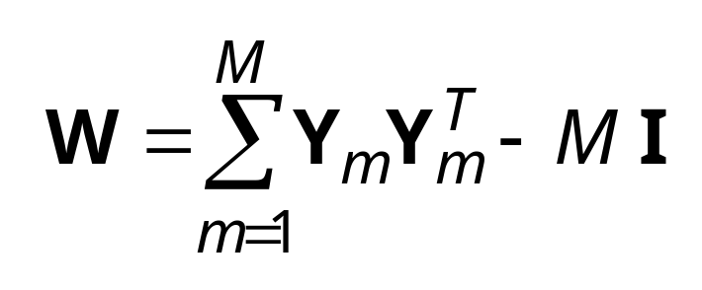
In the Hopfield network, synaptic weights between neurons are usually represented in matrix form as follows:
where M is the number of states to be memorised by the network, Y_{m} is the n-dimensional binary vector, I is n × n identity matrix, and superscript T denotes matrix transposition.

Slide 20
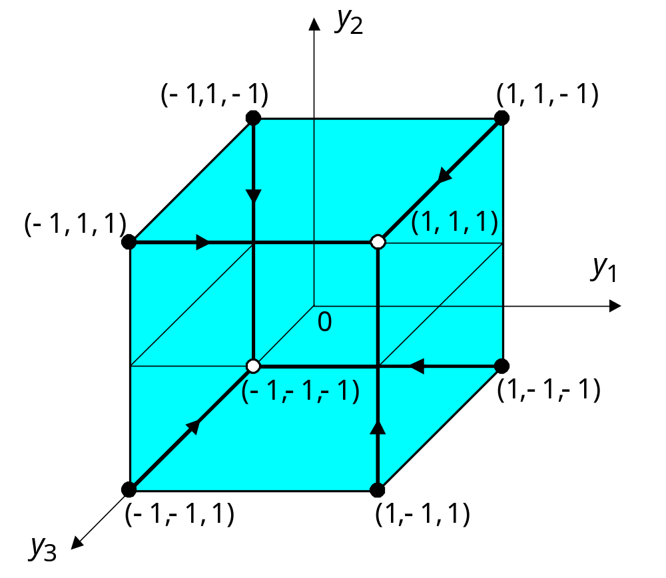
Possible states for the three-neuron Hopfield network

Slide 21
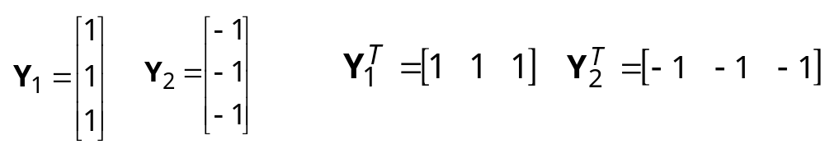
The stable state-vertex is determined by the weight matrix W, the current input vector X, and the threshold matrix θ. If the input vector is partially incorrect or incomplete, the initial state will converge into the stable state-vertex after a few iterations.
Suppose, for instance, that our network is required to memorise two opposite states, (1, 1, 1) and (−1, −1, −1). Thus,
or
where Y₁ and Y₂ are the three-dimensional vectors.

Slide 22
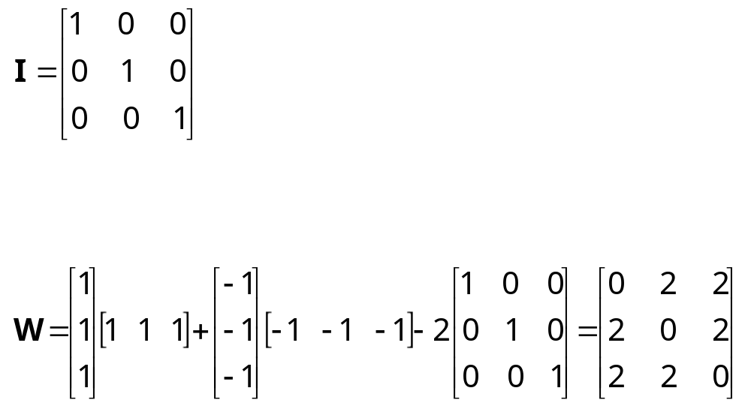
The 3 × 3 identity matrix I is
Thus, we can now determine the weight matrix as follows:
Next, the network is tested by the sequence of input vectors, X₁ and X₂, which are equal to the output (or target) vectors Y₁ and Y₂, respectively.

Slide 23
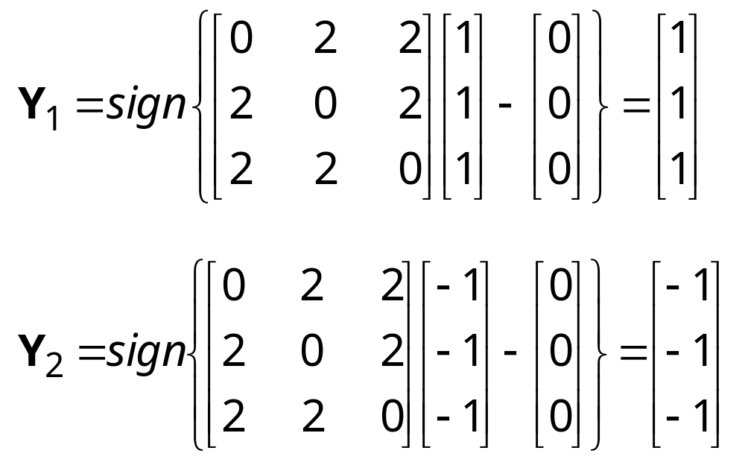
First, we activate the Hopfield network by applying the input vector X. Then, we calculate the actual output vector Y, and finally, we compare the result with the initial input vector X.

Slide 24
The remaining six states are all unstable. However, stable states (also called fundamental memories) are capable of attracting states that are close to them.
The fundamental memory (1, 1, 1) attracts unstable states (−1, 1, 1), (1, −1, 1) and (1, 1, −1). Each of these unstable states represents a single error, compared to the fundamental memory (1, 1, 1).
The fundamental memory (−1, −1, −1) attracts unstable states (−1, −1, 1), (−1, 1, −1) and (1, −1, −1).
Thus, the Hopfield network can act as an error correction network.

Slide 25
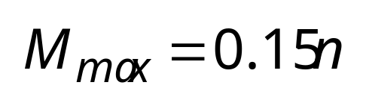
Storage capacity of the Hopfield network
Storage capacity is or the largest number of fundamental memories that can be stored and retrieved correctly.
The maximum number of fundamental memories M_{max} that can be stored in the n-neuron recurrent network is limited by

Slide 26
Bidirectional associative memory (BAM)
The Hopfield network represents an autoassociative type of memory − it can retrieve a corrupted or incomplete memory but cannot associate this memory with another different memory.
Human memory is essentially associative. One thing may remind us of another, and that of another, and so on. We use a chain of mental associations to recover a lost memory. If we forget where we left an umbrella, we try to recall where we last had it, what we were doing, and who we were talking to. We attempt to establish a chain of associations, and thereby to restore a lost memory.

Slide 27
To associate one memory with another, we need a recurrent neural network capable of accepting an input pattern on one set of neurons and producing a related, but different, output pattern on another set of neurons.
Bidirectional associative memory (BAM), first proposed by Bart Kosko, is a heteroassociative network. It associates patterns from one set, set A, to patterns from another set, set B, and vice versa. Like a Hopfield network, the BAM can generalise and also produce correct outputs despite corrupted or incomplete inputs.

Slide 28
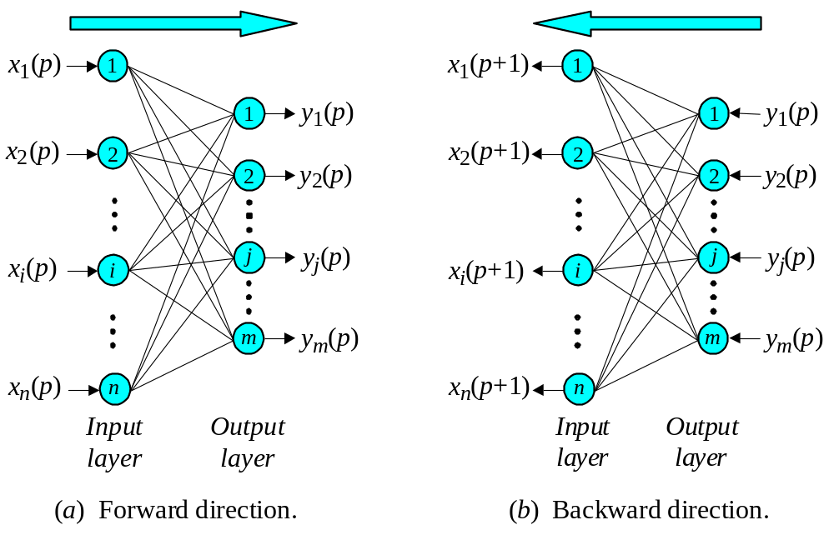
BAM operation

Slide 29
The basic idea behind the BAM is to store pattern pairs so that when n-dimensional vector X from set A is presented as input, the BAM recalls m-dimensional vector Y from set B, but when Y is presented as input, the BAM recalls X.

Slide 30
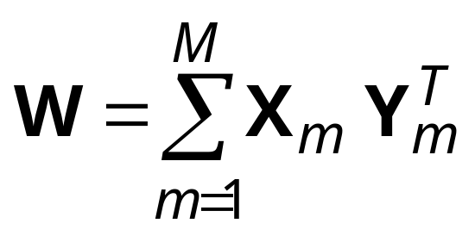
To develop the BAM, we need to create a correlation matrix for each pattern pair we want to store. The correlation matrix is the matrix product of the input vector X, and the transpose of the output vector Y^{T}. The BAM weight matrix is the sum of all correlation matrices, that is,
where M is the number of pattern pairs to be stored in the BAM.

Slide 31
Stability and storage capacity of the BAM
The BAM is unconditionally stable. This means that any set of associations can be learned without risk of instability.
The maximum number of associations to be stored in the BAM should not exceed the number of neurons in the smaller layer.
The more serious problem with the BAM is incorrect convergence. The BAM may not always produce the closest association. In fact, a stable association may be only slightly related to the initial input vector.

