Slide 1

Building Serverless APIs with Azure Functions and API Management
Development and Extensibility
@mrcoups
Notes:
Please do not change the format of this slide.

Slide 2
Notes:
Please do not amend.
Please ensure you make a reference to our sponsors as part of your introduction – without them, we wouldn’t be here today.

Slide 3
Notes:
Please do not amend.
Please ensure you make a reference to our sponsors as part of your introduction – without them, we wouldn’t be here today.

Slide 4
Why use serverless?
Inherently scalable
Roll with the punches! Flexible scalability means the ability to deal with peaks in usage efficiently.
Quick deployments
No infrastructure and a focus on code means you can deploy quickly and make updates quicker.
Decreased latency
With point of presence on a global scale, code is often closer to the user so decreased latency.
No server management
It’s in the name but without servers to manage, you don’t need to worry about management, just your code.
Pay for what you use
Only use compute time when your code needs it, it’s a great way to cut costs and remove human input which is costly.
Sustainability
Consuming only what you need is a greener way of operating then using virtual machines.

Slide 5
Benefits of Azure Functions
Less complex
Still supports a microservice architecture, without the complexity of containers.
Scalable and automated
Highly scalable solution with the ability to build and manage via pipelines.
Microservice architecture
Breaks down large monolithic architecture into loosely-coupled functions.

Slide 6
Advantages of OpenAPI
Collaborate on API design
Formalised plain-text documents that can reside in a repository, just like code.
Publishing your API
Publishing your OpenAPI definition along with your API also allows client developers to use their preferred tools in combination with your API.
Documentation
Developers can see a list of available API operations and quickly send a request in their browser to test how the API responds before writing any code of their own.
Notes:
LucyBot, Redoc, Gelato

Slide 7
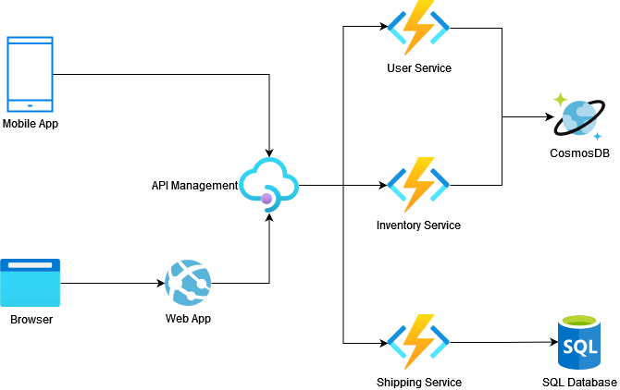
Example Architecture

Slide 8
Demo
Let’s build an API!

Slide 9
Notes:
Please do not amend this slide.
Please ensure you close with this slide – do not delete!
As you close, please remind people:
Charity Quiz (Charity is Breast Cancer) kicks off at 7pm in the ballroom. Registration required (link via South Coast Summit Website).
Sponsored Drinks at 5.30 in the Atrium / Expo Hall and Ballroom Foyer.

