Slide 1
Delphi Process — Technical Anatomy
Heuristics, aggregation math, and information flow: MiroFish public service vs Delphi3080 vs DelphiCursor · Marty Schoffstall, co-author · github.com/martyschoff/veracity2

Slide 2
1 · The MiroFish public service — mechanics
Claim ingest → temporal knowledge graph: episodes → entity extraction (LLM) → relation edges → per-round re-summarization (Graphiti's add_episodes pipeline)
Agent society: role-specialized agents (domain taxonomy × persona) each read graph context, produce structured Findings
Rounds = evidence propagation: each agent's report is re-ingested; later agents condition on earlier findings (gossip/consensus dynamics)
ReportAgent: aggregates all findings → single verdict label + rationale; no numeric vote aggregation in the standard
Implicit heuristics: graph-recall via hybrid BM25+vector search; hop-count ≈ rounds; no eligibility gating — every claim judged in full

Slide 3
2 · Delphi3080 — pipeline internals
Fixture: {claim_id, claim, date, category, transcript_excerpt, test_eligible_at} → entity-extract prompt (strict own-voice; quoted material excluded by prompt contract)
Embeddings: nomic-embed-text, batch create; empty-batch heuristic → proxy synthesizes 768-dim dummy vector (client would otherwise raise No-embedding-data)
PanelRunner: 2 rounds, specialists seeded per category; round-2 agents see round-1 findings (evidence propagation like MiroFish, halved depth)
ReportAgent: verdict ∈ {correct, incorrect, unclear} + confidence ∈ [0,1]; rationale is free-text grounded in findings, not a vote count
Error posture: any stage failure → claim marked error + queue continues; single-instance worker lock serializes writers

Slide 4
3 · Verdict mapping & confidence heuristics
Delphi3080: label from ReportAgent; 'refuted/implausible' → incorrect; graph evidence shortfall → unclear; confidence is the ReportAgent's self-assessed posterior, uncalibrated
Swarm (Monte Carlo layer): 40 one-shot personas, i.i.d. reads of claim+transcript; vote ∈ {on-track, unclear, off-track}; majority share → score; split = |p(on-track) − p(off-track)|
Eligibility gate (heuristic we added): no adjudication unless test_eligible_at passed or \b(20[2-9]\d)\b regex hits — personas otherwise label future claims failed (horizon bias)
Prompt debiasing: 'unclear' requires ABSENCE of evidence, not model caution; 'no' requires positive failure evidence — both to fight the small-model default-to-deny
Panel: weighted tier vote — score = Σᵢ wᵢ·voteᵢ (w ∈ {1.5, 1.25, 1.0}); verdict thresholds set on weighted score; tied → escalate

Slide 5
4 · DelphiCursor — decision-theoretic framing
Single-judge posterior: one frontier model call = an ideal observer with retrieval, replacing the ensemble; bias risk shifts from plurality to anchoring
Anti-anchoring heuristic: fixture REDACTS owner mark and any owner-adjacent signals; prior adjudicator outputs included only as contestedness evidence
Vote contract: {vote: correct|incorrect|unclear, confidence 0-100, reasoning, sources_checked, dissent_from_prior}; strict schema validation, malformed → 1 corrective retry
Temporal semantics heuristic: 'on track' ≠ correct; future-dated claims judged on trajectory evidence, not headlines (recency-bias guard)
Calibration post-checks (worker-side): confidence >90 vs 3+ dissenting prior adjudicators → flag; unclear vs 90%-decisive swarm → flag

Slide 6
5 · Escalation & aggregation topology
Escalation trigger (DelphiCursor eligibility): any ≥2 of — swarm split ≤30%; panel |score| ≤1.5 (deadlock band); Delphi3080 unclear or confidence <0.60; recency-sensitive (post-2024 refs); panel_weight ≥1.25
Hard exclusions: verdict_source=authoritative (external override); not-due (eligibility gate); owner-final
Precedence lattice: authoritative > owner > DelphiCursor > Delphi3080 > panel > swarm — disagreement LOGGED (delphicursor_disagreements.jsonl) for inter-system calibration, never auto-overriding above it
Divergence metric: rate of DelphiCursor-vs-swarm/panel disagreement tracked as a system-health signal (adjudicator calibration drift)

Slide 7
Differences vs the MiroFish public service
Dimension | MiroFish public service | Delphi3080 (ours) | DelphiCursor (ours)
Judge | Multiple role agents, generic | Simulated specialists, 32B local | Single Opus-class, may browse
Knowledge graph | Core deliverable | Reused (Graphiti/Neo4j) | None - fixture-only
Latency / claim | Minutes-hours, unbounded | ~15-30 min | ~1-5 min (timeout 300s)
Cost | High | $0 marginal | Paid Cursor (flat-fee)
Scale target | Deep research per claim | All graded predictions daily | Contested cases only (Mode A)
Failure stance | Run must complete | Error-marked, queue survives | Validated + retry <=2, capped
Notes:
The stack: Fact-Check > Marty (FINAL) > DelphiCursor > Delphi3080 > Panel > Swarm.

Slide 8
6 · Known technical gaps
Zero-entity extraction runs → empty graph → degraded rounds (root cause: strict own-voice prompt vs LLM extraction ability); needs extraction-robustness scoring
ReportAgent confidence is uncalibrated (no Brier/log-score tracking yet); swarm gives us the labeled distribution to calibrate against
Round depth (2) chosen for latency, not validated for evidence saturation — MiroFish's deeper rounds may matter on multi-entity claims
Single-judge DelphiCursor is non-deterministic; determinism is procedural (schema, timeout, isolation), not statistical — k-sample voting is the documented fallback

Slide 9
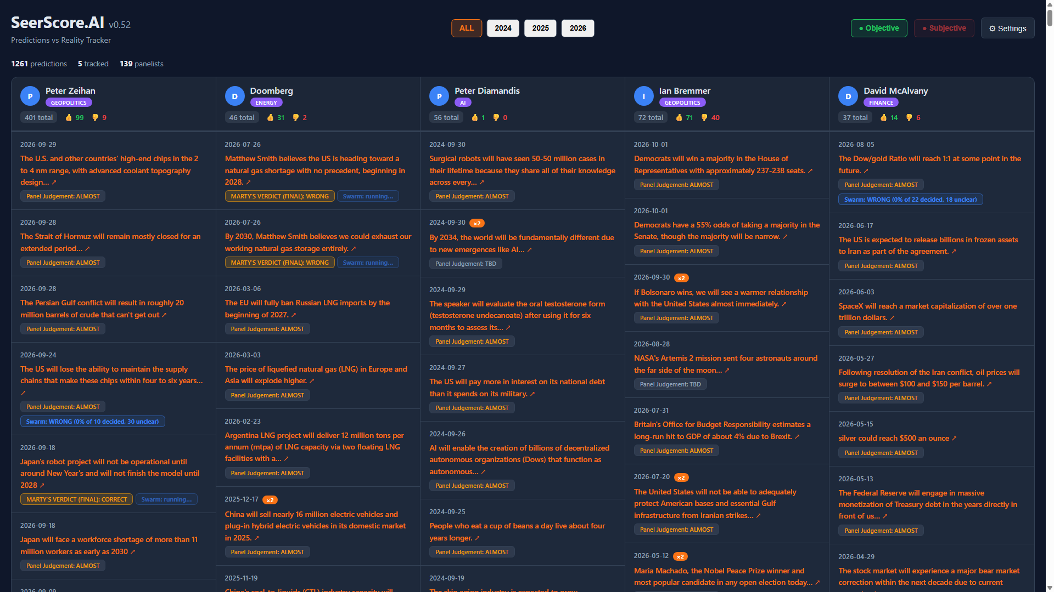
7 · The product this adjudication feeds
Live grid (seerscore.pages.dev) — verdict boxes, Marty final, Delphi3080 badge + hover rationale
Notes:
Live grid (seerscore.pages.dev): five tracked columns; verdict boxes (Panel Judgement / MARTY'S VERDICT FINAL); Delphi3080 badges with hover rationale tooltips.

