Slide 1
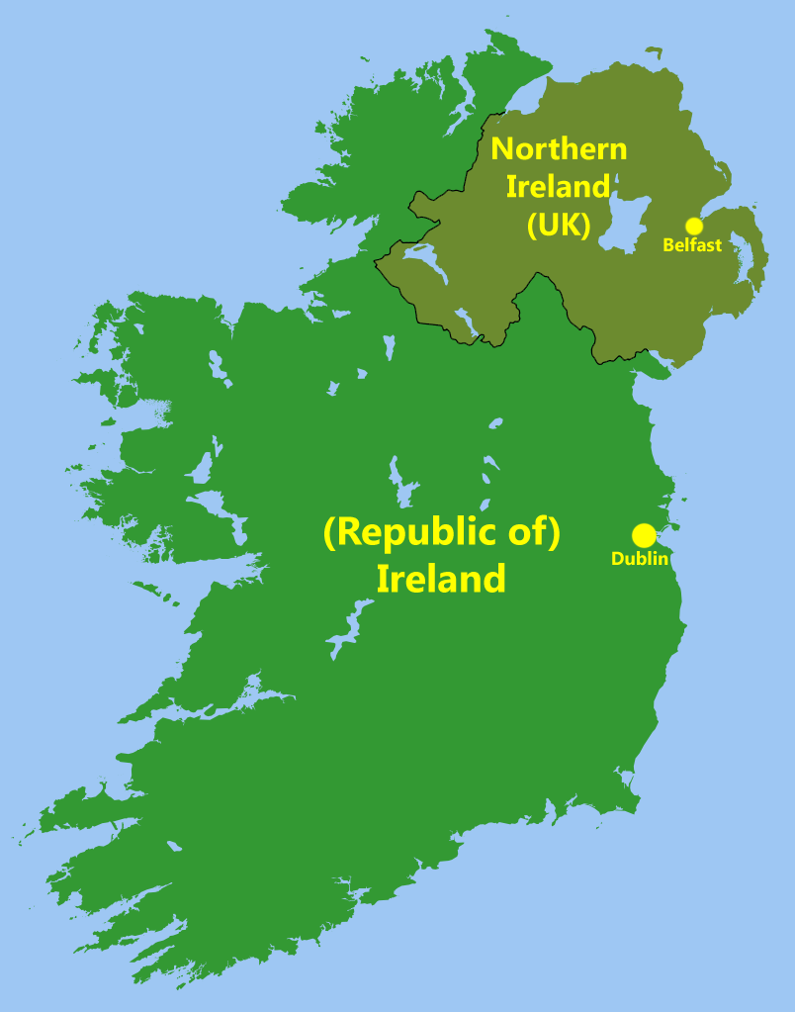
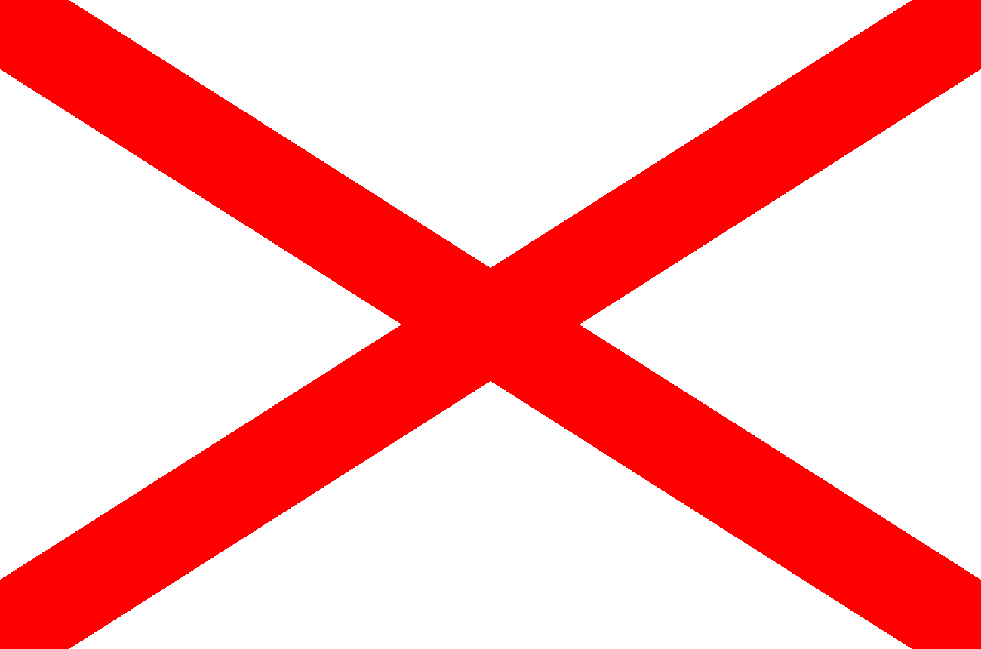
G) Ireland
Geographical term VS political entity?
16th and early 17th centuries: conquest
Dependency + colonization
1801: Union with Great Britain
19th century: unionists vs nationalists
1916: Easter Rising
1921: Division between
Irish Free State (today called the Republic of Ireland)
Northern Ireland

Slide 2
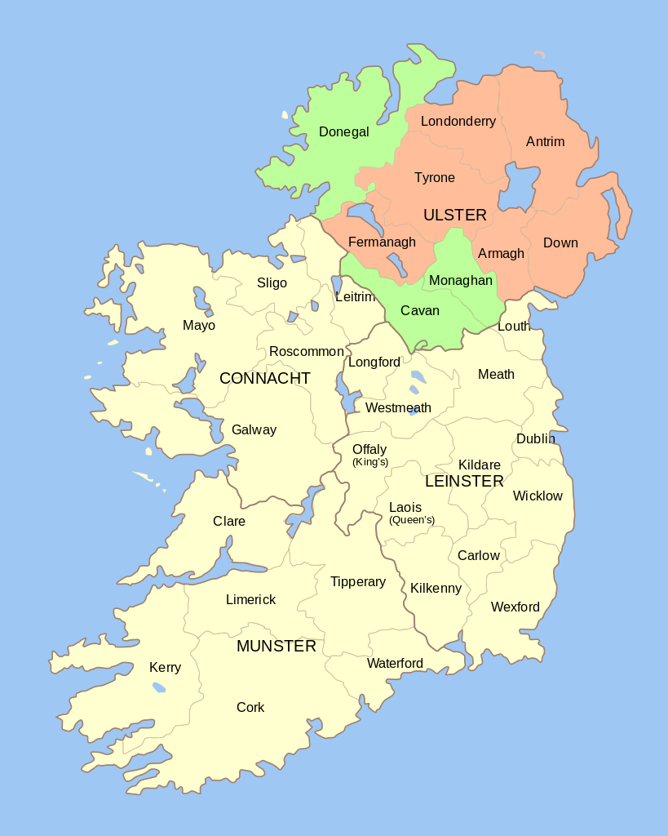
H) Northern Ireland
North eastern part of Ireland.
Nickname: Ulster.
1461: Ulster passed to the English crown.
1921: partitioned into the six counties of Northern Ireland and the Ulster province of the Republic of Ireland.

Slide 3
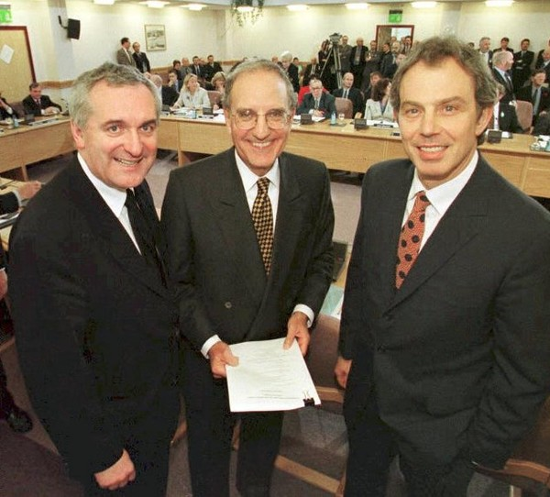
H) Northern Ireland
Very complex <- ethno-nationalist conflict for several decades
Unionists vs Nationalists (now : Democratic Unionist Party aka DUP vs. Sinn Féin)
Protestants vs Catholics
Paramilitary fights Black and Tans vs. IRA =
= Civil War & Troubles
Very long peace process with help from the EU and the US in the 80s and 90s
Good Friday Agreement (/Belfast Agreement) on April 10th 1998.
Now described as a country, a region or a province.

Slide 4
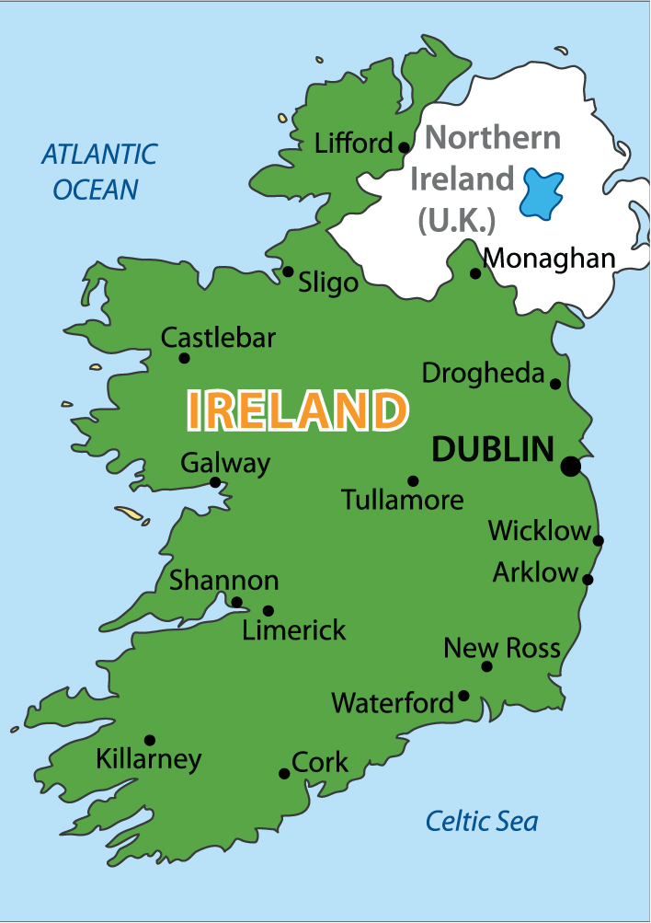
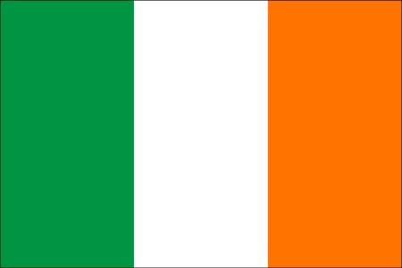
I) The Republic of Ireland
Most of Ireland.
- 1916 : Easter Rising
- 1919 Declaration of Independence (unilateral) => Irish Republic: revolutionary state (1919-1922)
- December 1922 the entire island => self-governing Dominion (= a semi-independent state) : the Irish Free State (Saorstát Éireann, 1922-1937) .
- Still part of the Commonwealth.
- Irish Civil War (1922-1923)
- 1937 : New Constitution and new name : Éire
- 1949 : full independence as a Republic, out of the Commonwealth
- 1973 : joined the EEC (former EU).
Organisation: President (representation only) + Taoiseach & Tánaiste

Slide 5
 | Population (2015)
England | 54.8 m
Wales | 3.1 m
Scotland | 5.3 m
GREAT-BRITAIN | 63.2 m
Northern Ireland | 1.9 m
UK | 65.1 m
IRELAND | 4.9 m
British Isles | 70 m
FRANCE | 66.5 m

Slide 6
2. SOME CONSTITUTIONAL REMARKS

Slide 7
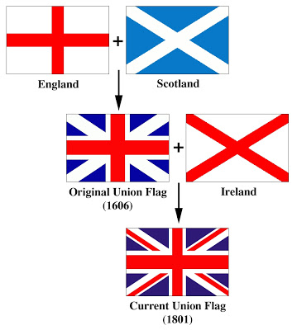
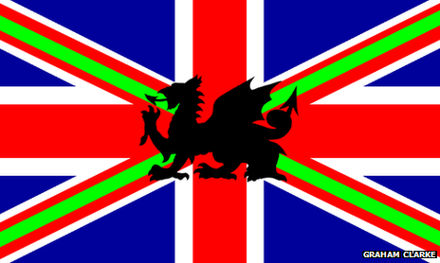
National flag of the UK:
England = St George's cross
Scotland = St Andrew's Cross
Ireland (!) = St Patrick's Cross
Union Flag, sometimes called the Union Jack, = unity of the three countries.
Welsh national flag = ?
Complex links

Slide 8
