Slide 1







Product Presentation
a product
by
designed in collaboration with

Slide 2

“Get your food the cooler way”

Slide 3
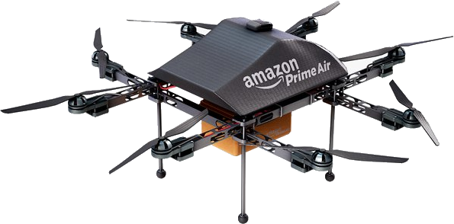
Product1
Refrigerator
Elevator platform
+ Connecting funnel
Mounted on extendable actuators
+ Security hatches
Smartphone app
Different models
+ Website
→ Order food and supplies
Frigid’Air — Insider
Frigid’Air — Outsider
Drone delivery
Developed by Amazon® and Zipline®
Small drone (current)
10 miles — 16 km
5lbs — 2.25 kg
Large drone (project)
25 miles — 40 km
15lbs — 7.75 kg

Slide 4
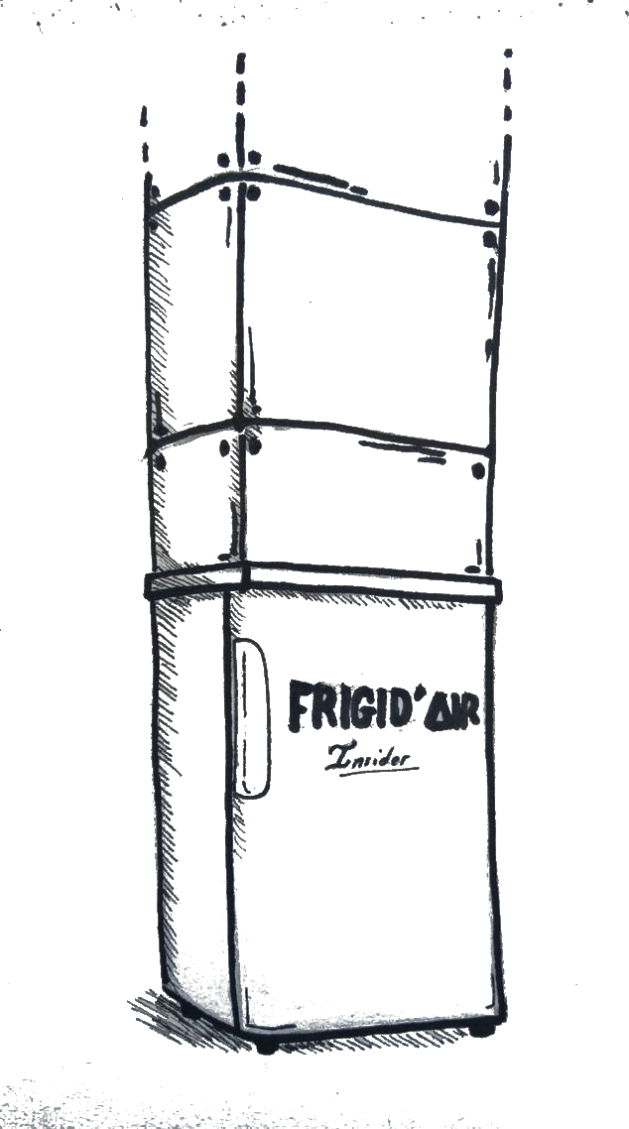
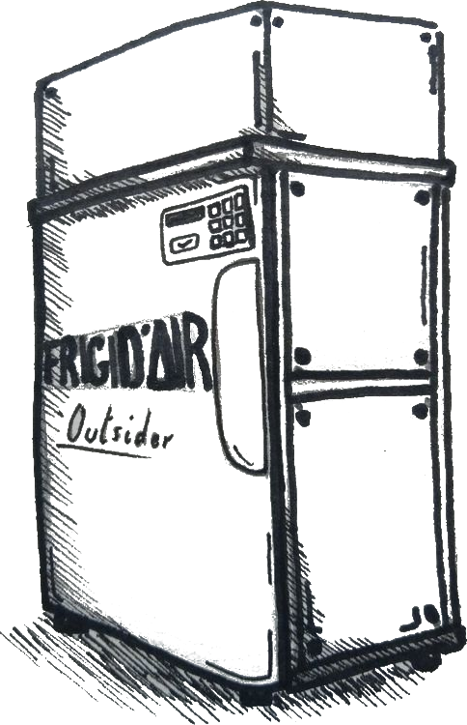

product2
Frigid’Air – Insider
Frigid’Air – Outsider
Installed inside
Requires :
funnel installation
Piercing through the roof
Installed outside (no funnel required)
Additional PIN code lock
Requires :
Complete clearance (5ft. Radius)
(1.5 meters)
Products’ concept arts
Funnel
Pin code lock
Hardened external shell

