Slide 1
Magnetic Twist to LDC

Slide 2
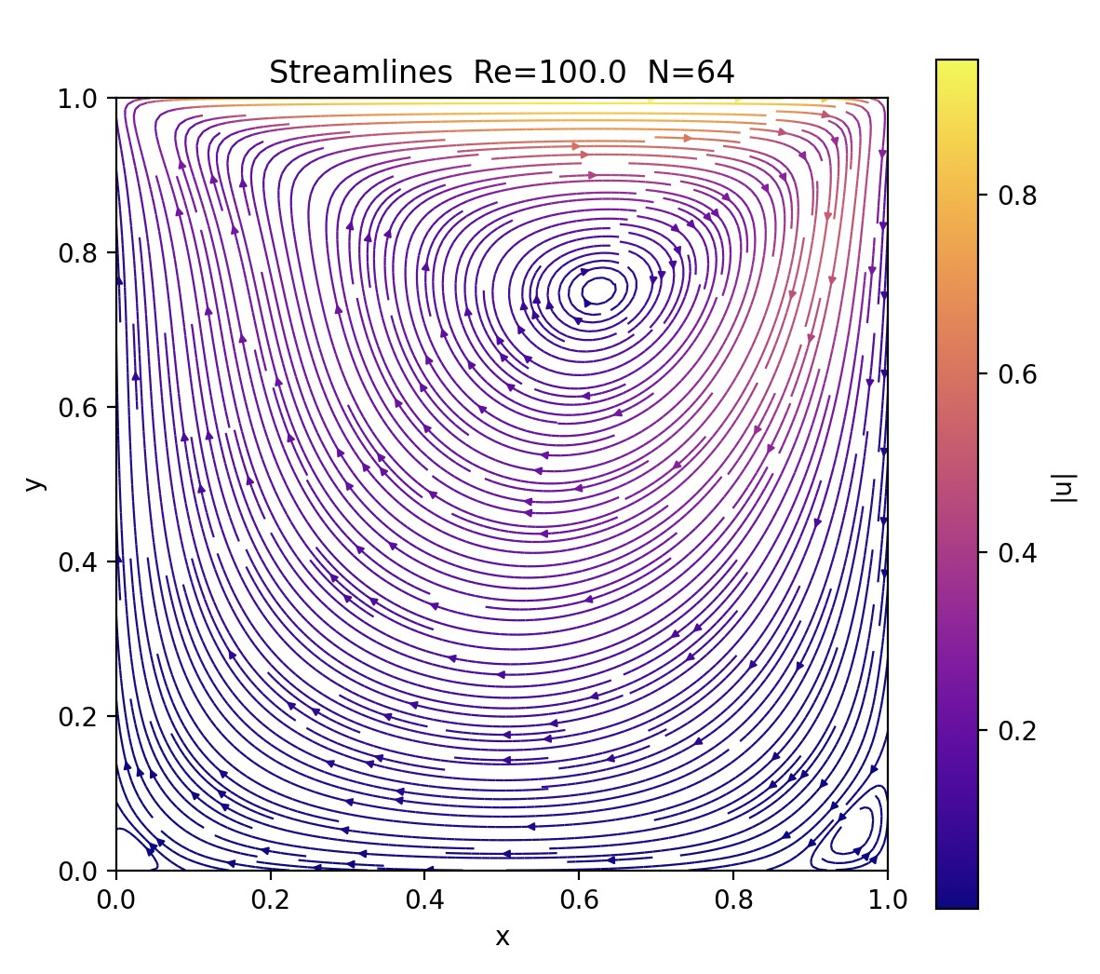
Dt = 0.005, N_int = 0.0

Slide 3
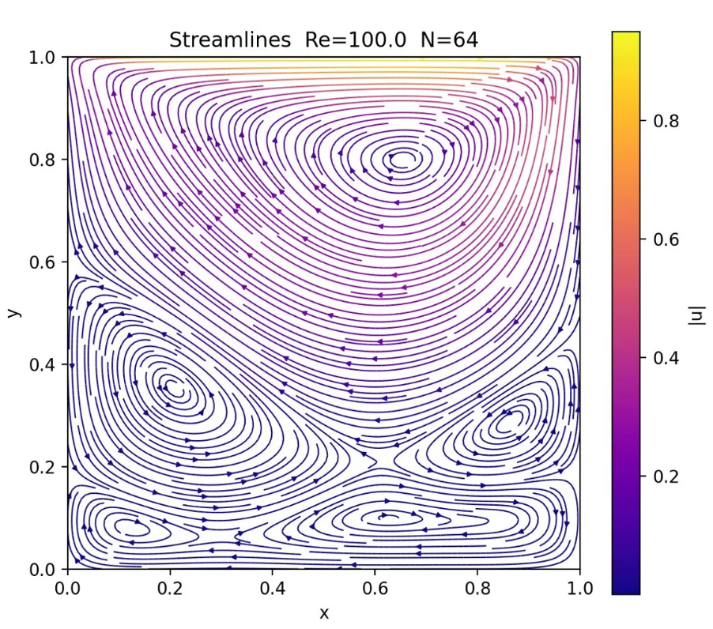
Dt = 0.005 N_int = 0.1

Slide 4
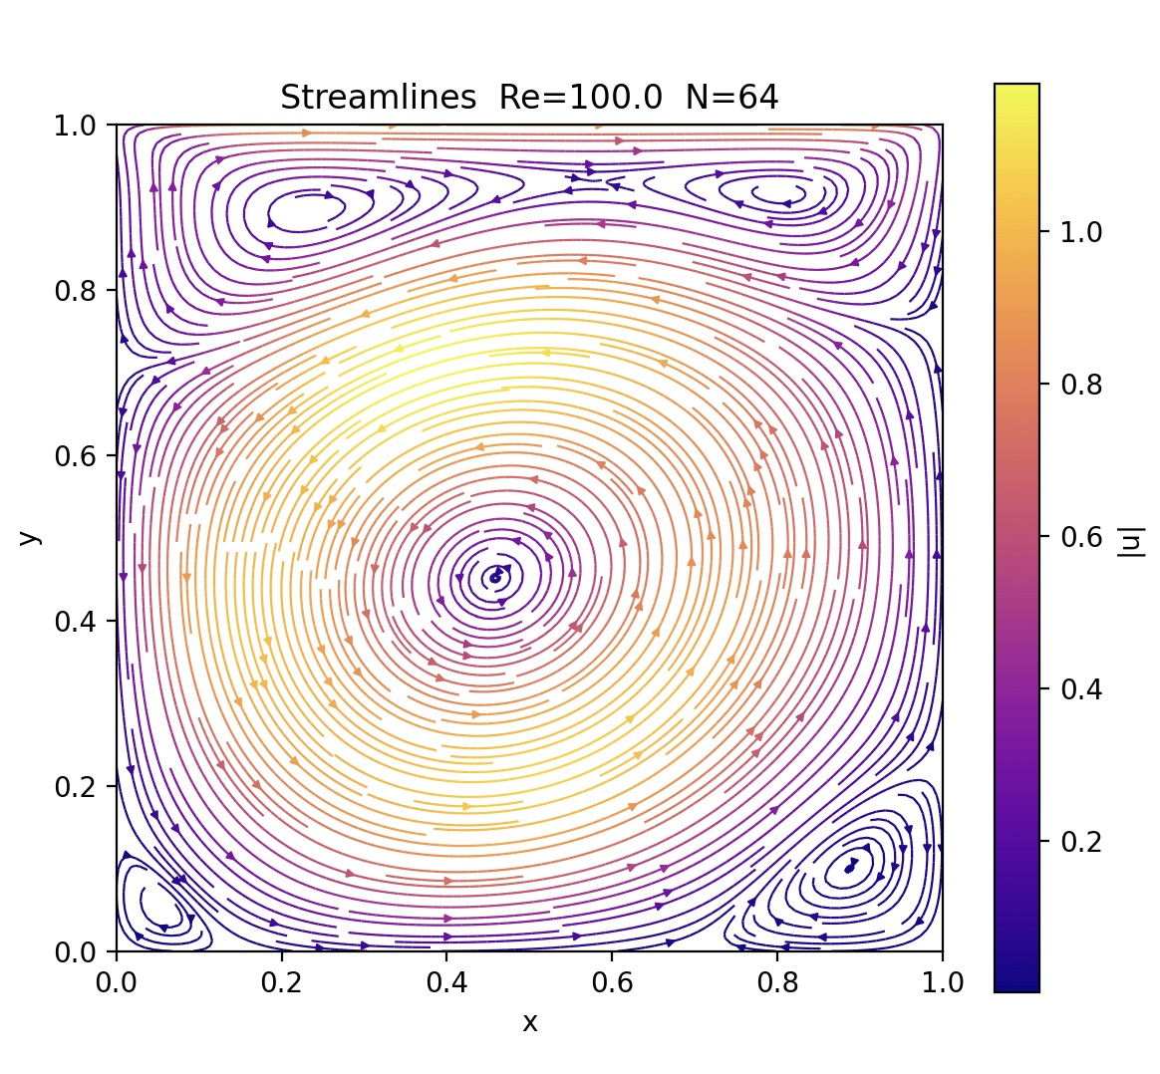
Dt = 0.005 N_int = 1.0

