Slide 1
IT 418/518: Foundations of Data Science
Class 10
Dr. Rajeev Bukralia

Slide 2
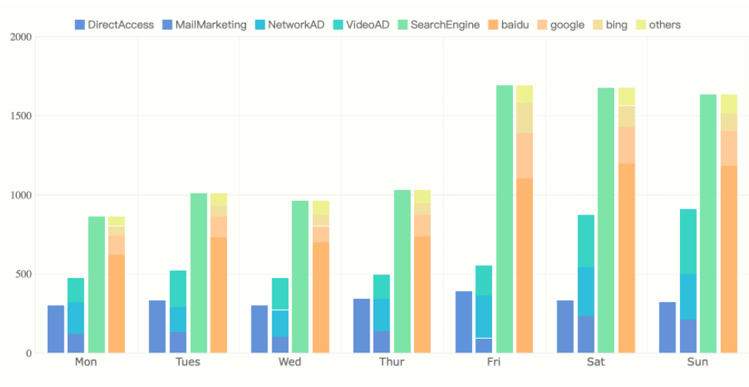
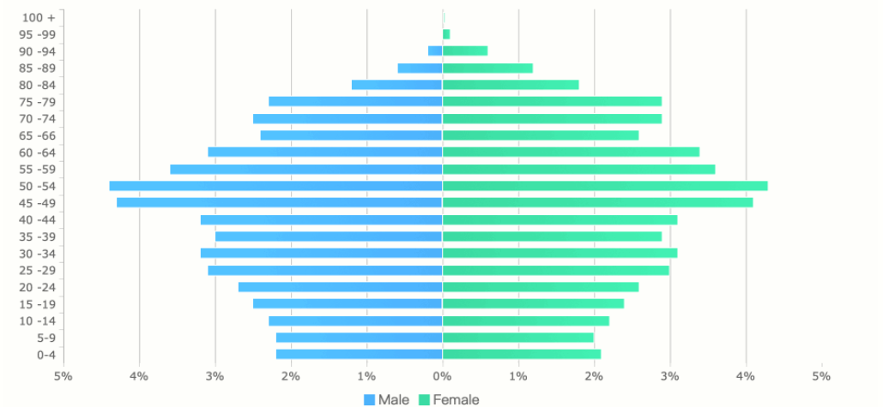
Column (Bar) Chart
Vertical columns to show numerical comparisons between categories
Great for showing differences as the human eye is sensitive to height differences
Only suitable for small and medium-sized data sets
The positions of its two axes can be changed to get more space on the Y-axis

Slide 3
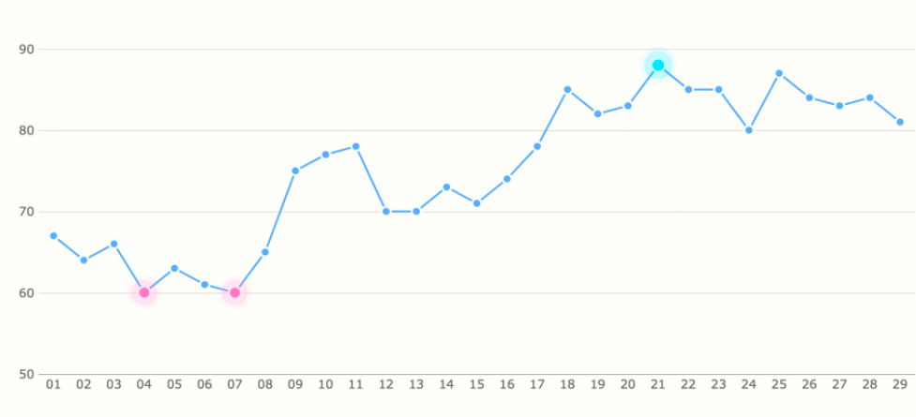
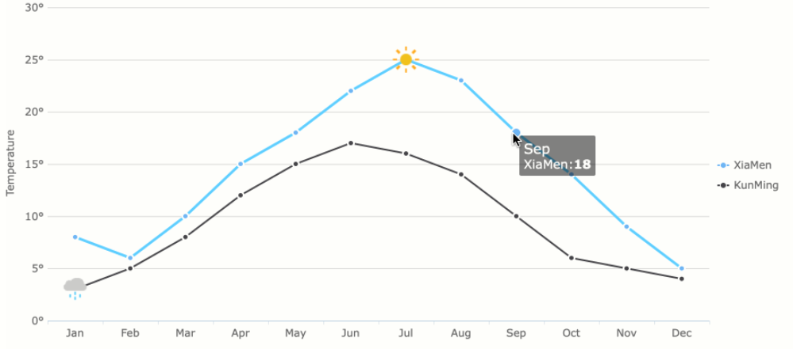
Line Chart
Shows the change of data over a continuous time interval or time span
You can use it to show trends of data volume over time and to compare of series two or more trends

Slide 4
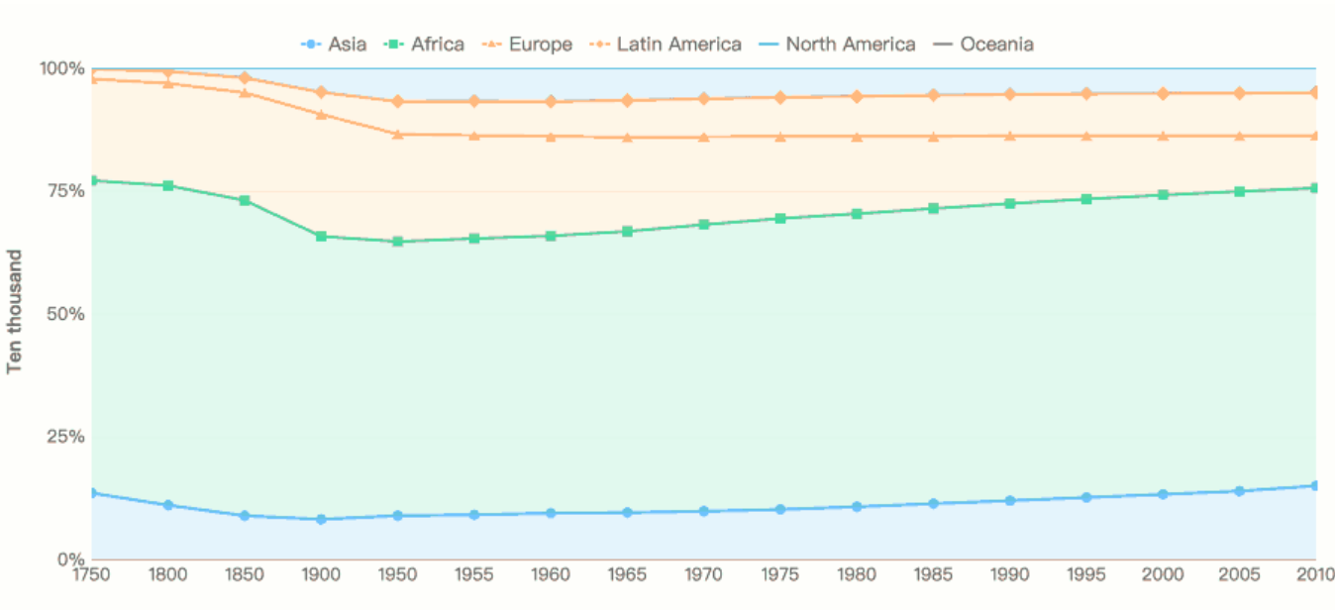
Area Chart
Derivative of line chart
Fills the area between the polyline and the axis in the line chart with color. The color filling can highlight the trend information better
Excellent for time trends

Slide 5
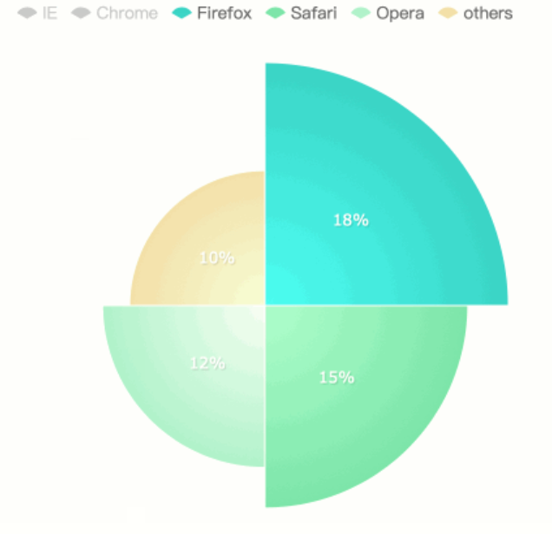
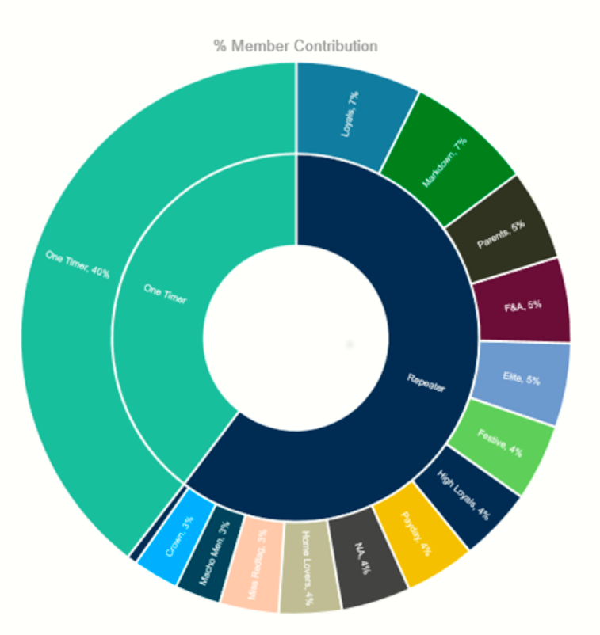
Pie Chart
Represents the proportion of different classifications and can be used to compare various classifications by the arc
Great for showing the proportion of different categorical data
Multi-layer pie chart can reflect the hierarchical relationships

Slide 6
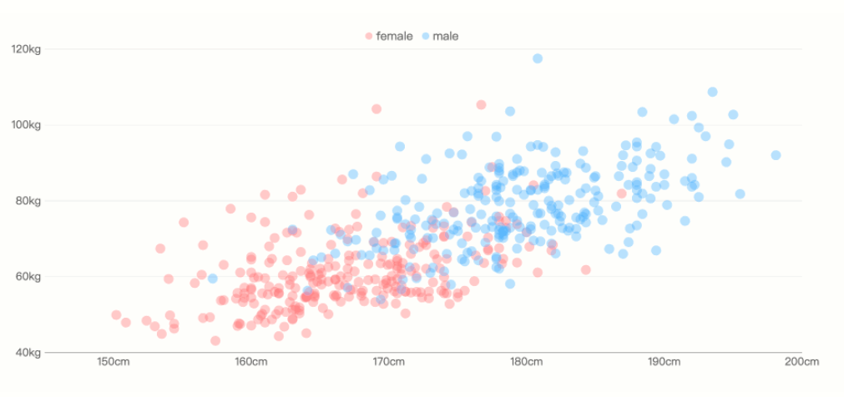
Scatter Plot
Shows correlation between two variables
You may need a lot of data, otherwise the correlation may not be obvious
Helps detect outliers

Slide 7
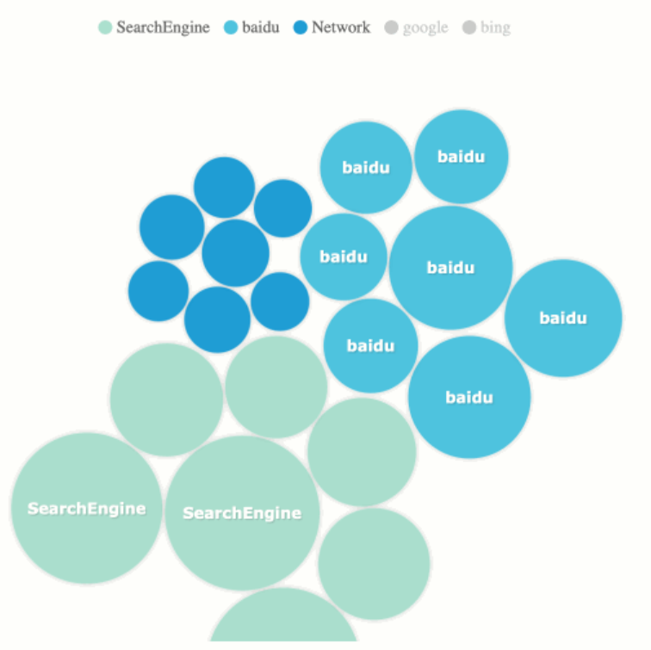
Bubble Chart
Multivariate version of scatter plot
In addition to two variables represented by the X and Y axes, the area of each bubble represents the third variable
Too many bubbles will make the chart difficult to read

Slide 8
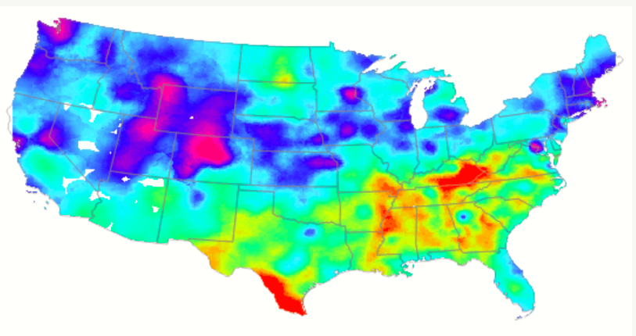
Heat Maps
Used for indicating the weight of each point in the geographic area.
The map serves as the background layer, you can also use other images (image mashups)
Color in a heatmap usually refers to density
Good for geographical distribution of data

Slide 9
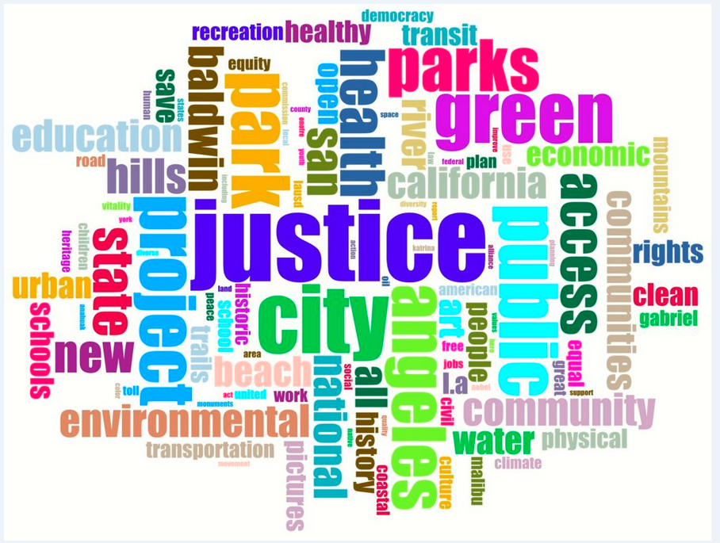
Word Cloud Chart
A visual representation of text data
Shows themes in large amount of text
Good for showing term frequency

Slide 10
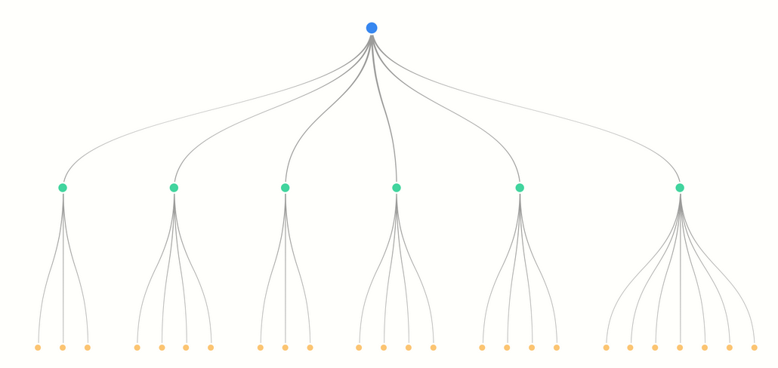
Frame Diagram
Shows the hierarchical relationship
Good for hierarchy display or process display

Slide 11
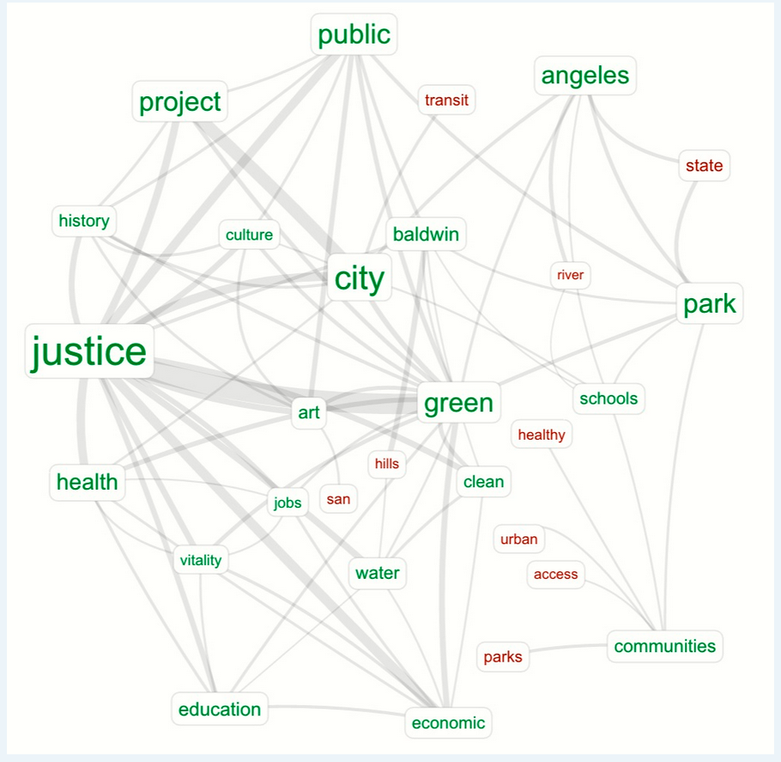
Network Diagram
Shows interconnections between a set of entities
Each entity is represented by a node (or vertices) Connections between nodes are represented through links (or edges)

Slide 12
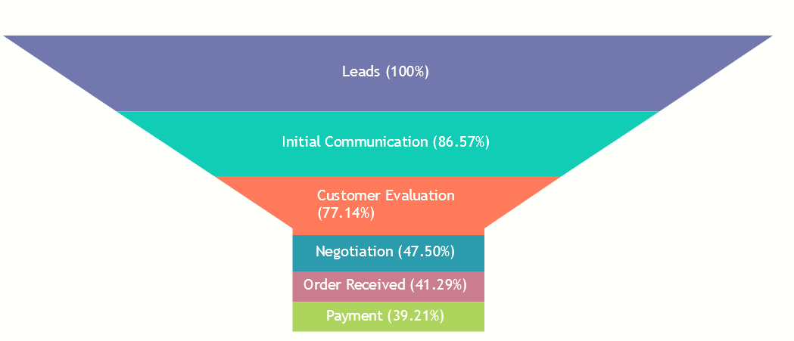
Funnel Chart
Sales Process
Shows values across multiple stages in a process
Typically, the values decrease gradually, allowing the bars to resemble a funnel.

