Slide 1
IT 418/518: Foundations of Data Science
Class 12
Dr. Rajeev Bukralia

Slide 2
Regression
Regression analysis is one of the most frequently employed statistical methods.
Regression line is the line that best represents the linear correlation between two quantitative variables in a scatterplot.
The best fitting line is the line for which the sum of the squared residuals (vertical distances of the cases in your scatterplot to the line) is the smallest.
It is very useful because it can help us make predictions about our dependent variable. We can make these predictions by means of the regression equation of which important ingredients are the regression coefficient and the regression slope.

Slide 3
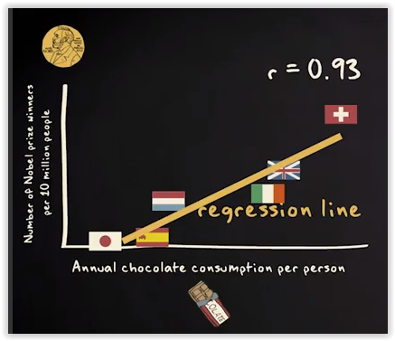
Does eating chocolate make you a Nobel prize winner?

Slide 4
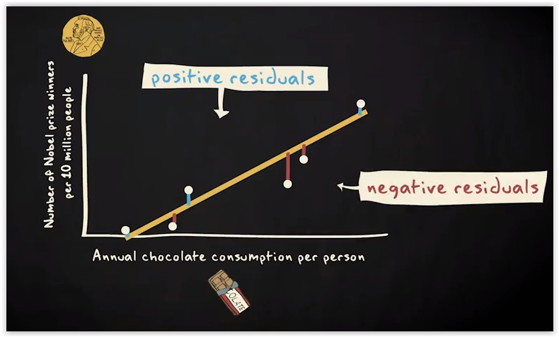
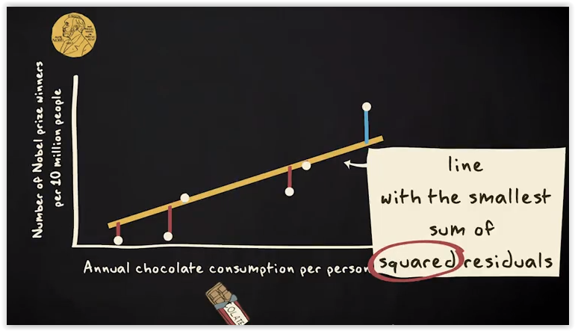
How to find a regression line?
The regression line is the straight line that describes the linear relationship between the two variables best.
First, measure the vertical distance between the data points and a line (Residuals). Then, measure these residuals for every possible line through the scatterplot.
Eventually, you choose the line for which the sum of the squared residuals is the smallest.
The best fitting line is called a regression line and the name of the method of analysis is called ordinary least squares regression, which refers to the way we have found the line.

Slide 5
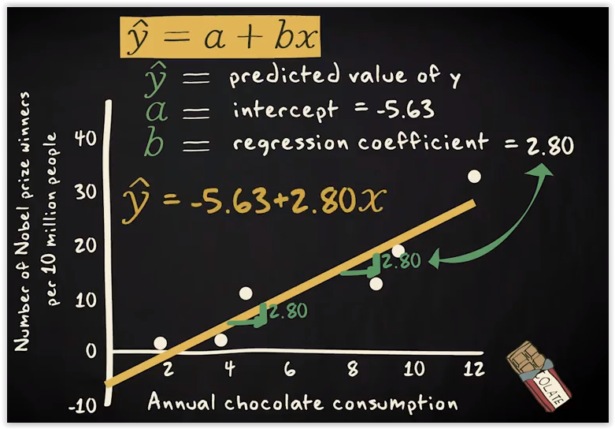
Regression Equation

Slide 6
How good is the regression line?
The reason to look at how well a regression line fits is that researchers want to know how accurately a regression analysis predicts the dependent variable in a study.
The extent to which a regression line fits the data is expressed by means of the so called r squared.
r squared is the amount of variance in your dependent variable, y, that is explained by your independent variable, x.
For example, if r-squared is 0.69, this means that the prediction error is 69% smaller when you use the regression line than when you employ the mean.

Slide 7
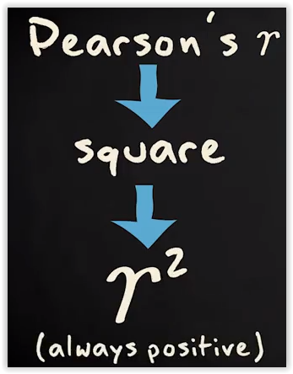
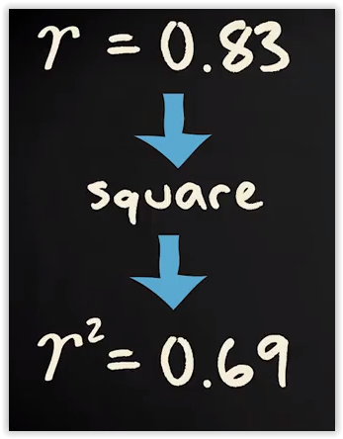
r squared (Coefficient of Determination)
r-squared is closely related to the Pearson's r. It is nothing more than Pearson's r-squared.
Once you have computed your Pearson's r, you only need to square this number to obtain r-squared.
r-squared is always a positive number.
When we have a perfect linear relationship between two variables, both Pearson's r and r-squared are equal to 1 (1 squared is, after all, 1).
If there is no linear relationship at all, both values equal 0.

Slide 8
Person’s r Vs. r squared
Pearson's r tells you whether the linear relationship between two variables is positive or negative, and it shows you how strong this relationship is.
r-squared tells you nothing about the direction of a relationship between two variables because it is always a positive number. But, it tells you two things about the relationship between two variables:
How much better a regression line predicts your dependent variable than the mean of that dependent variable?
How much of the variance in your dependent variable is explained by your independent variable?

Slide 9
Caveats with Regression Analysis
Correlation is not the same as causation.
We can never be certain that one of the variables is the cause of the other variable.
There might be confounding variables that can skew judgment.
Confounding variables can lead to Simpson’s Paradox
If independent variables are highly correlated, it will lead to multicollinearity. Try removing confounding variables.
Influential outliers can have strong effects on the results of an analysis.

Slide 10
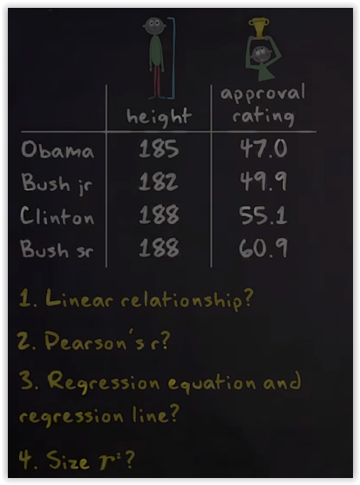
Exercise

Slide 11
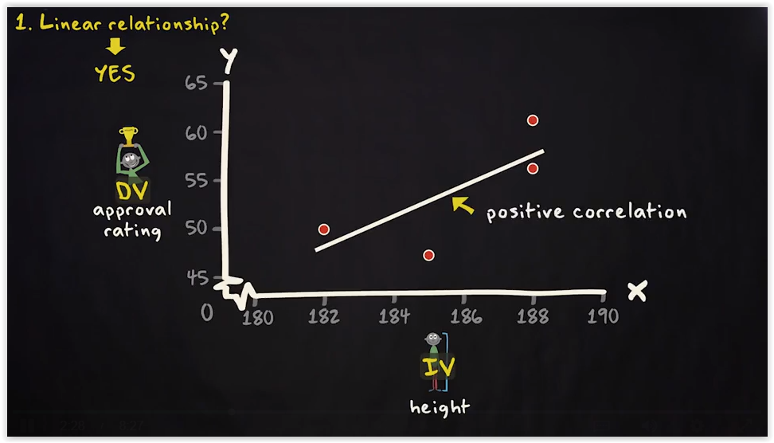
Answer part 1

Slide 12
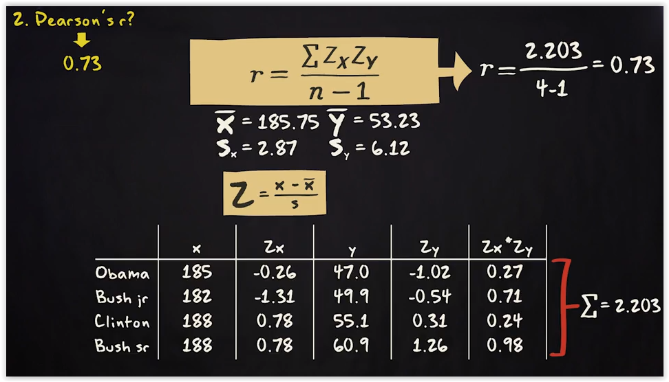
Answer part 2

Slide 13
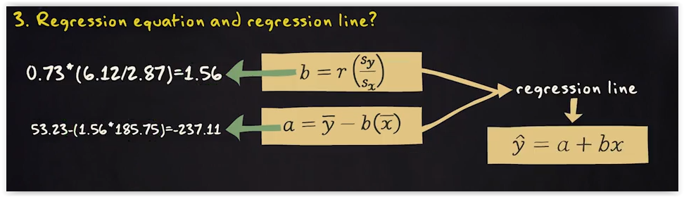
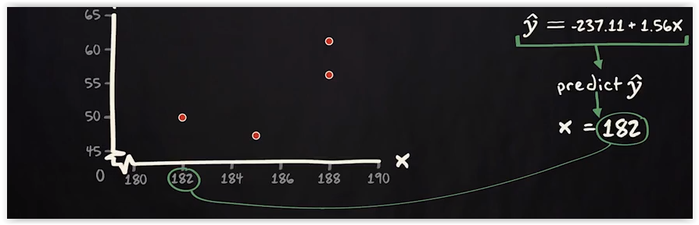
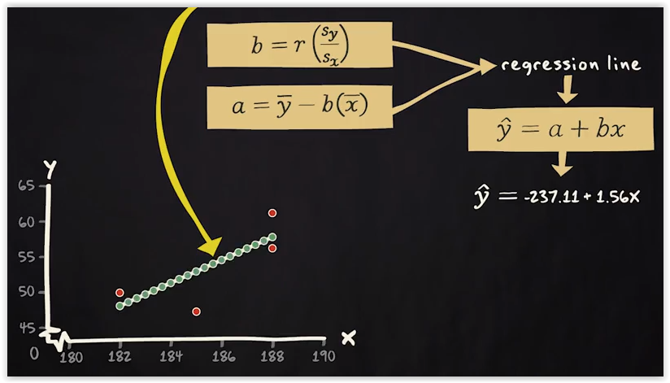
Answer part 3

Slide 14
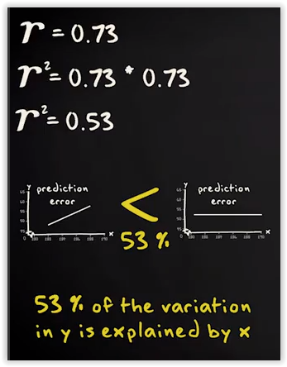
Answer part 4
Conclusion: This dataset indicates that the tall leaders are more successful than short leaders in terms of approval ratings……but this sample has only four observations…..and each observation does not differ too much when it comes to height….so this is a far reaching inference.

Slide 15
Evaluating Linear Regression Models
“Goodness of fit” measures
r Squared (r² or the Coefficient of Determination): It tells you how many points fall on the regression line. For example, R Square of 0.8 means 80% of the values fit the model
Adjusted r Squared: The adjusted R-square adjusts for the number of terms in a model
F-statistic (F-Test): It tests the overall hypothesis that regression model is no improvement over just modeling y with its mean. The null hypothesis can be rejected is F-statistic<0.05
Residuals: Errors in prediction

Slide 16
Question
In a regression analysis, the coefficient of determination is 0.7. It means:
The model explains 70% of the variation of y-values around the mean are explained by the x-values.
The model explains 70% of the variation of y-values around the mean are not explained by the x-values.
The model explains 30% of the variation of y-values around the mean are explained by the x-values.
The model explains 0.7 of the variation of y-values around the mean are not explained by the x-values.

