Slide 1
IT 418/518: Foundations of Data Science
Class 13
Dr. Rajeev Bukralia

Slide 2
Announcements
Midterm canceled
Quiz 4 canceled
No changes to the final exam, group project, and quiz 5 currently
Grade table will be revised to reflect cancellation of midterm and quiz 4
Assignment 2 posted (due on April 15, 11 pm Central time)
Assignment 1 grades will be posted by next week
Zoom meetings are optional; no attendance
Check your MNSU email and D2L daily
Check the updated deadline document in D2L

Slide 3

Binary Classification
Classification:
Supervised, unlike clustering: unsupervised
Binary Classification: predict one of two outcomes

Slide 4
Common Classification Algorithms (Classifiers)
Neural Networks
Support Vector Machines (SVM)
Logistic Regression
Decision Trees
Naïve Bayes
k-Nearest Neighbors

Slide 5
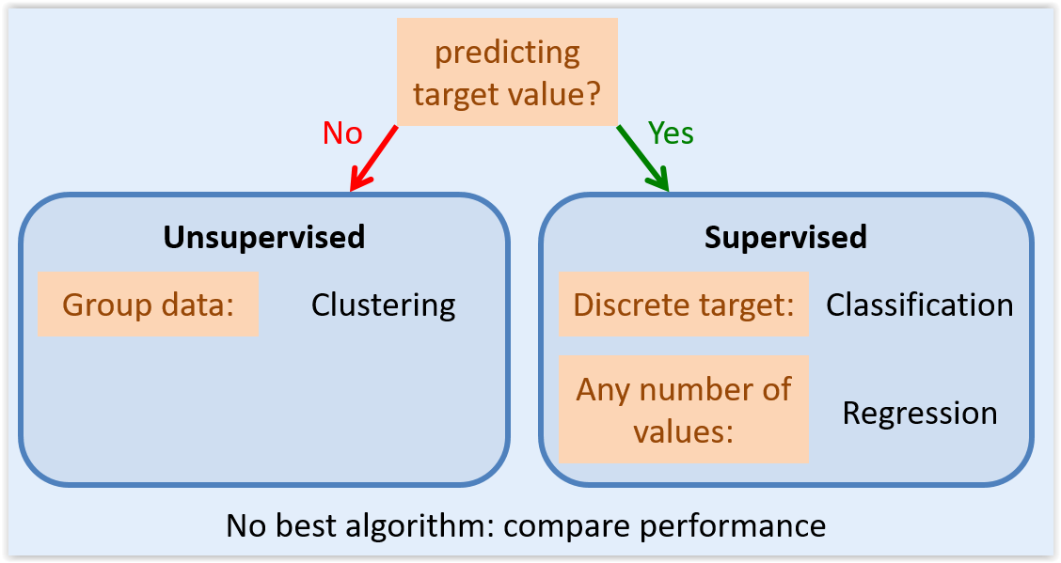

Slide 6
Logistic Regression
Logistic regression is a simple machine learning method that you can use to predict an observation's category based on the relationship between the target feature and independent categorical predictive features in the data set.
Logistic regression differs from linear regression in that, with logistic regression, you're predicting categories for ordinal variables, in linear progression you're predicting values for numeric continuous variables.
Most common binary classification technique.

Slide 7
Applications
A/B testing
Customer churn prediction
Employee attrition modeling
Hazardous event prediction
Dropout prediction
Disease prediction

Slide 8
Assumptions for Logistic Regression
Data is free of missing values
The predicted variable is binary, in other words it only accepts two values, or it could be ordinal, a categorical variable with ordered values (multi-class)
All predictors are independent of each other
There are at least 50 observations per predictor variable to ensure reliable results.

Slide 9
Logistic Regression
Appropriate for categorical response variable with two possible outcomes (i.e. binary outcomes)
Part of family of models called the Generalized Linear Model (GLM)
Can be extended for use with multi-level categorical variable: multinomial logistic regression
Logistic transformation of the odds, referred to as logit, serves as the dependent variable:

Slide 10
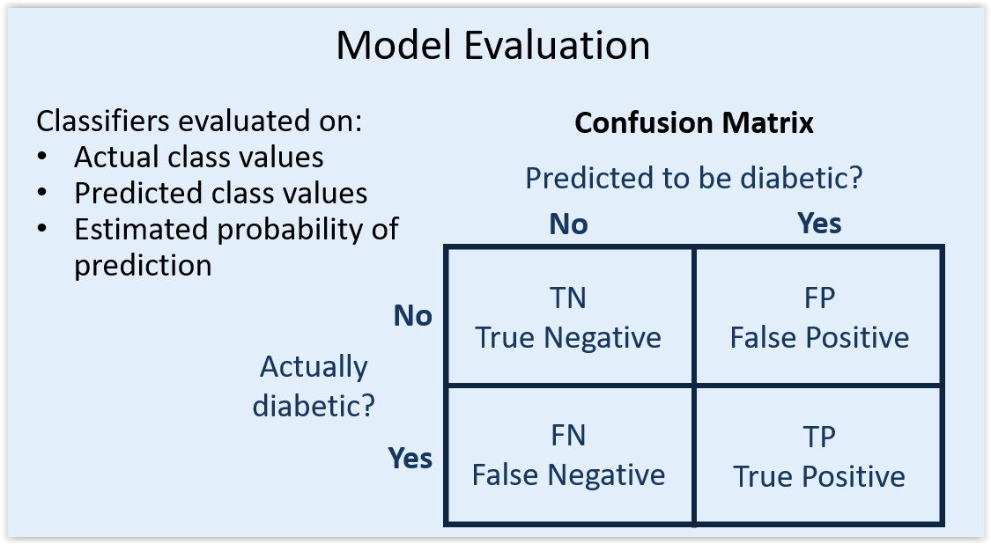

Slide 11
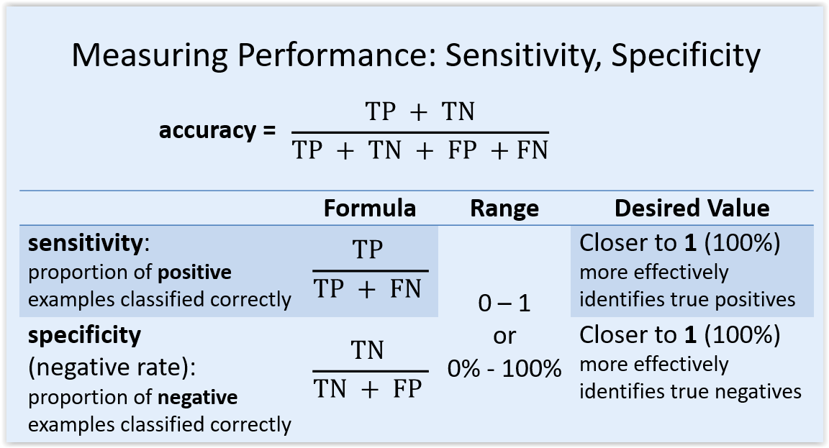

Slide 12
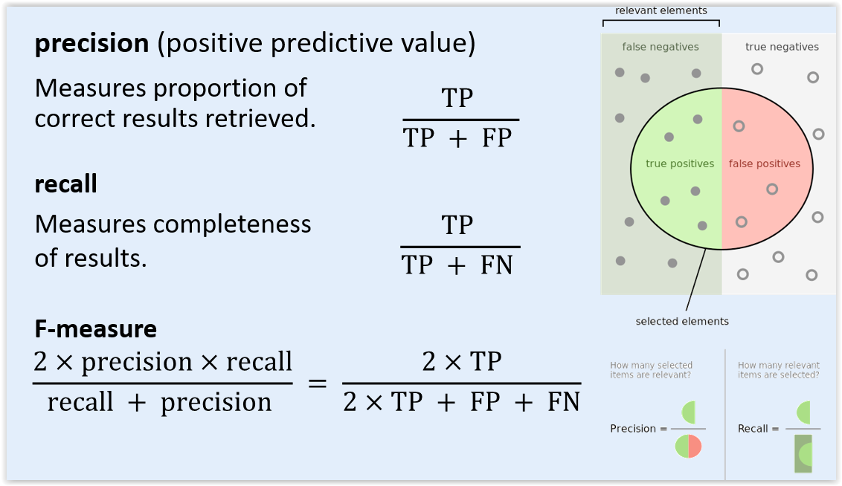

Slide 13
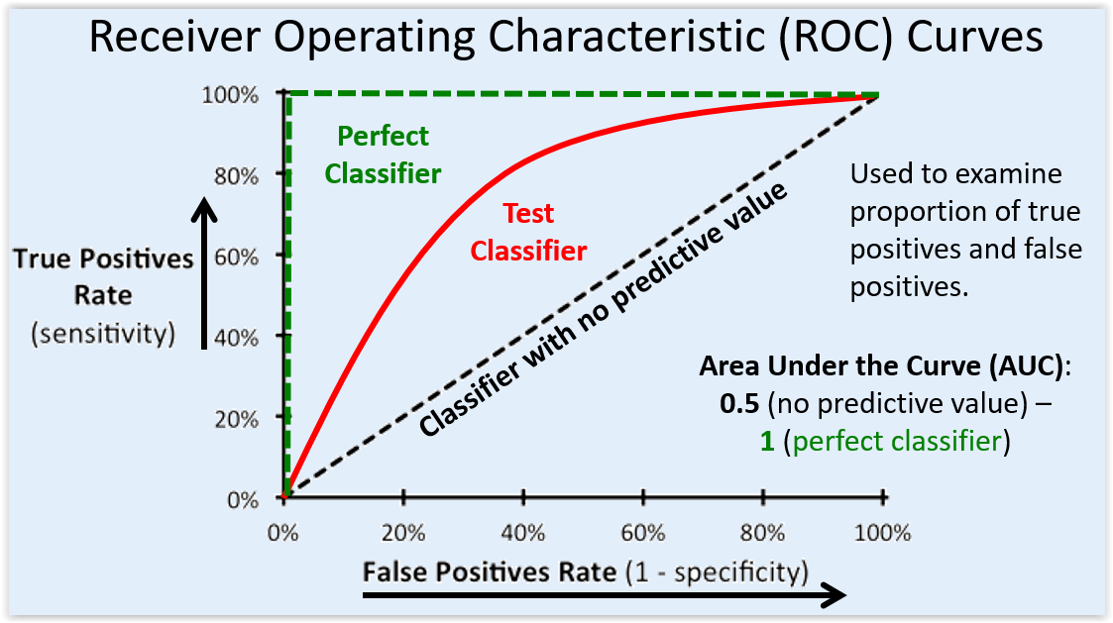

Slide 14
Choosing a classification algorithm
Sensitivity/recall – how good a test is at detecting the positives. A test can cheat and maximize this by always returning “positive”.
Specificity – how good a test is at avoiding false alarms. A test can cheat and maximize this by always returning “negative”.
Precision – how many of the positively classified were relevant. A test can cheat and maximize this by only returning positive on one result it’s most confident in.

Slide 15
Choosing a classification algorithm
No single classifier works best across all possible scenarios.
In practice, it is always recommended that you compare the performance of at least a handful of different learning algorithms to select the best model for the particular problem; these may differ in the number of features or samples, the amount of noise in a dataset, and whether the classes are linearly separable or not.

Slide 16
# Logistic Regression
from sklearn import datasets
from sklearn import metrics
from sklearn.linear_model import LogisticRegression
# load the iris datasets
dataset = datasets.load_iris()
# fit a logistic regression model to the data
model = LogisticRegression()
model.fit(dataset.data, dataset.target)
print(model)
# make predictions
expected = dataset.target
predicted = model.predict(dataset.data)
# summarize the fit of the model
print(metrics.classification_report(expected, predicted))
print(metrics.confusion_matrix(expected, predicted))

