Slide 1
IT 418/518: Foundations of Data Science
Class 15
Dr. Rajeev Bukralia

Slide 2
Classifiers
In addition to logistic regression, there are many classifiers:
Naive Bayes classifier
K-nearest neighbor (or knn)
Random forests
Support vector machines (SVMs)
Decision trees
Gradient boosting (XGBoost)
Neural networks

Slide 3
Decision Tree
Decision tree classifiers are excellent if you need interpretability.
The DT model breaks down data by making decisions based on a series of questions.
Based on the features in our training set, the decision tree model learns a series of questions to infer the class labels of the samples.
The algorithm starts at the tree root and split the data on the feature that results in the largest information gain (IG).
A deep tree will have many nodes, which can lead to overfitting. Thus, we typically want to prune the tree by setting a limit for the maximal depth of the tree.
SciKit Learn has a DT classifier:
from sklearn.tree import DecisionTreeClassifier

Slide 4
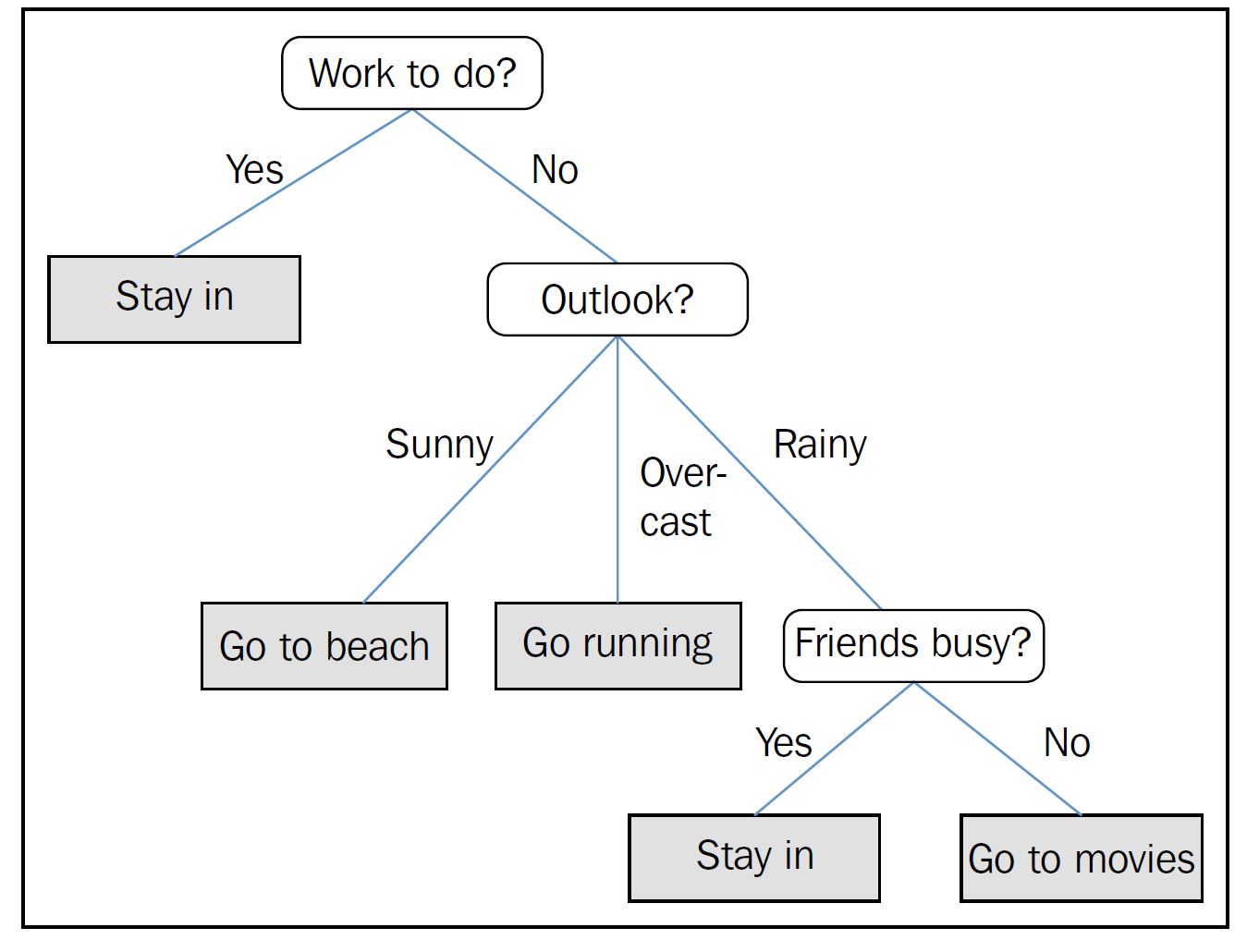
Decision Trees

Slide 5
Random Forest
Random forests are an example of an ensemble method, which relies combining a set of weak learners to create a strong learner.
Random forests are an example of an ensemble learner built on decision trees.
Decision trees are prone to overfitting. The main causes of prediction errors are noise, bias and variance in data.
The idea is multiple overfitting estimators can be combined to reduce the effect of this overfitting. This is known as bagging, which makes use of an ensemble (a grab bag, perhaps) of parallel estimators, each of which overfits the data, and averages the results to find a better classification. An ensemble of randomized decision trees is known as a random forest.

Slide 6
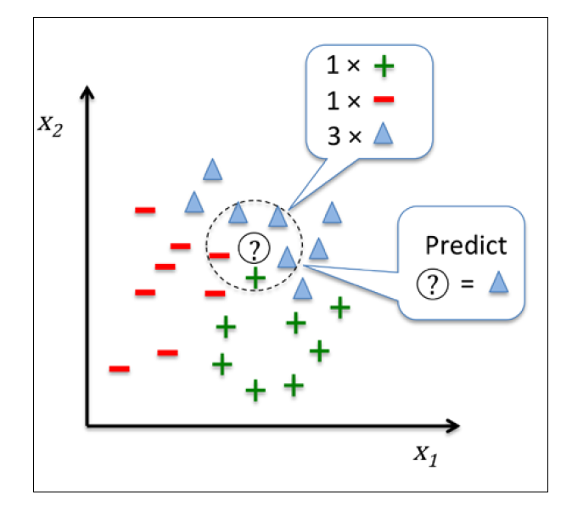
K-nearest Neighbors (KNN)
KNN is a typical example of a lazy (simple) learner. It doesn't learn a discriminative function from the training data but memorizes the training dataset instead.
KNN can be summarized by the following steps:
Choose the number of k and a distance metric.
Find the k nearest neighbors of the sample that we want to classify.
Assign the class label by majority vote.

Slide 7
Naïve Bayes
Naive Bayes models are a group of extremely fast and simple classification algorithms that are often suitable for very high-dimensional datasets. They are useful as a quick-and-dirty baseline for a classification problem.
Based on Bayes’ theorem, it is probabilistic classifier. In Gaussian naive Bayes classifier, the “naïve” assumption is that data from each label is drawn from a simple Gaussian (normal) distribution.
They provide straightforward probabilistic prediction and are often very easily interpretable. They have very few (if any) tunable parameters. They are good for very high-dimensional data, when model complexity is less important.

