Slide 1
IT 418/518: Foundations of Data Science
Class 17
Dr. Rajeev Bukralia

Slide 2
Reminders
Quiz 5 is scheduled on April 21 (12 am to 11:59 pm Central time)
Group Project due on April 23, 11 pm
Group Project Presentation on April 28
Extra Credit Activities due on May 3, 11 pm
Final Exam: Monday, May 4, 2:45-4:45 pm
If you are out of the US, contact Dr. Bukralia to reschedule time

Slide 3
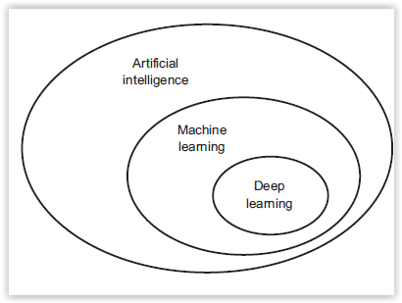
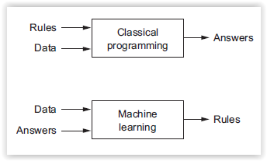
Artificial intelligence, machine learning, and deep learning
Artificial Intelligence (AI): an effort to automate intellectual tasks normally performed by humans.
Machine Learning (ML): could a computer automatically learn these rules by looking at data?
Deep Learning: a subfield of machine learning - a new take on learning representations (neural networks) from data that puts an emphasis on learning successive layers (deep) of increasingly meaningful representations.

Slide 4
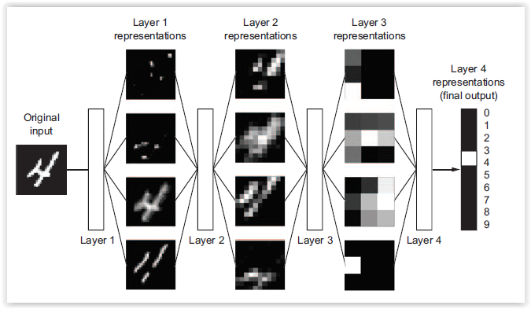
Deep Learning
Deep representations learned by a digit-classification model using the MINST database.
Notes:
Deep Neural Networks. Deep learning is excellent at feature engineering. With deep learning, you learn all features in one pass rather than having to engineer them yourself.
The first layer will try to detect edges and subsequent layers will combine them into simple shapes. The final layer matches in all input images into weighted sum.

Slide 5
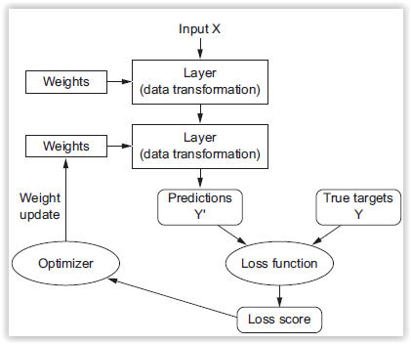
Deep Learning
Map inputs (such as images) to targets (such as the label “cancer”) by observing many examples of input and targets.
In deep neural networks this input-to-target mapping is done by a sequence of simple data transformations (deep layers). These data transformations are learned by exposure to examples.
What a layer does to its input data is stored in the layer’s weights.
Loss function: how far the output is from what you expected.
Adjust the value of the weights a little, in a direction that will lower the loss score.
Deep Learning Steps
Notes:
The loss score is used as a feedback signal to adjust the weights.

Slide 6
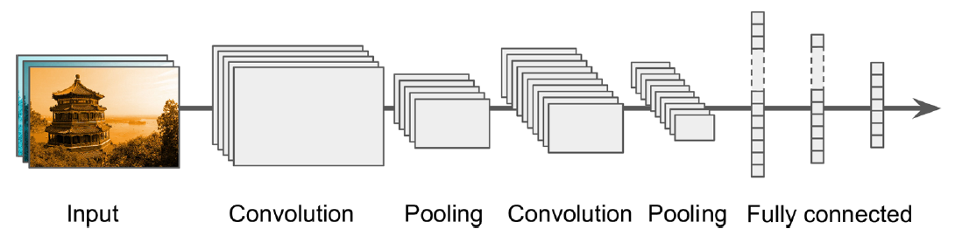
Deep Learning Models
Convolutional Neural Networks (CNN): excellent at visual tasks such as image search, self-driving cars, and automatic video classification
Recurrent Neural Networks (RNN): used for analyzing time series data such as stock prices. Widely used in natural language processing (NLP) systems such as automatic translation, speech-to-text, or sentiment analysis
CNN Architecture. Source
Notes:
convolutional networks (for computer vision), recurrent networks (for sequence processing)
Typical CNN architectures stack a few convolutional layers (each one generally followed
by a ReLU layer), then a pooling layer, then another few convolutional layers
(+ReLU), then another pooling layer, and so on. The image gets smaller and smaller
as it progresses through the network, but it also typically gets deeper and deeper

Slide 7
Deep Learning Breakthroughs
Improved Image classification
Improved Speech recognition
Improved Handwriting transcription
Improved machine translation
Improved text-to-speech conversion
Digital assistants such as Google Now, Apple Siri, and Amazon Alexa
Improved search results on the web
Go playing

Slide 8
Why DL is growing now?
Hardware
CUDA (NVIDIA’s programming interface for GPUs)
Google’s TPUs (Tensor Processing Units)
Data
Big data
Open source data repositories for training (ImageNet has over 1.4 million images)
Democratization of technology
Cloud computing
Edge computing
Kaggle and other competitions
Algorithms
Better activation functions for neural layers
Better optimization schemes such as RMSProp and Adam
New libraries: Keras, TensorFlow, PyTorch, SageMaker, etc.
Industry investments

Slide 9
Tensors
Tensors are multi dimensional NUMPY arrays
ML systems use tensors as their basic data structure
A tensor is a container of data (almost always numerical data), so it is a container of numbers
Scalar (0D tensor): A tensor that contains only one number
Vector (1D tensor): An array of numbers
Matrices (2D tensors): An array of matrix. A matrix has two axes (rows and columns) or rectangular grid of numbers.

Slide 10
Image Data
Images typically have 3 dimensions: height, width and color depth. Color images are 3D tensors.
Grayscale images (MNIST dataset) have single color channel
Tensor shape for a batch of 128 grayscale images of size 256X256 pixels: (128, 256, 256, 1)
Tensor shape for a batch of 128 color images of size 256X256 pixels: (128, 256, 256, 3)
Video data is 4D or 5D tensor

Slide 11
Key Terms
Weight: Parameters of a layer. What a layer does to its input data is stored in the layer’s weights, which are a bunch of numbers
Learning Rate: A key hyperparameter which is set in order to train a neural network for gradient descent.
Activation Function: Essential for learning non-linear complex functional mappings between the inputs and response variable. They introduce non-linear properties to neural nets. Examples: Sigmoid or Logistic, ReLu (Rectified Linear Units), Tanh (Hyperbolic Tangent), and Softmax

Slide 12
TensorFlow
Open source, deep learning library developed by Google
Version 2.0 recently released
Data flow graph-based ML and DL library
Leverages GPU (cuDNN) and TPUs
Can be scaled over cluster
Large number of APIs
TensorFlow.js: JavaScript library for training and deploying models in the browser and on Node.js
TensorFlow Lite: lightweight library for deploying models on mobile and embedded devices.
TensorFlow Extended: an end-to-end platform for preparing data, training, validating, and deploying models in large production environments.
TensorBoard: visualization tool (https://www.tensorflow.org/tensorboard)

Slide 13
Deep Learning Libraries
TensorFlow (Google)
PyTorch (Facebook)
MXNet (Apache)
Fast.ai
Theano
CNTK (Microsoft)

Slide 14
Resources
https://www.tensorflow.org/
https://pytorch.org/
https://www.tensorflow.org/js
https://www.tensorflow.org/lite
https://github.com/aymericdamien/TensorFlow-Examples
https://www.tensorflow.org/tensorboard

Slide 15

Image Recognition
Classify handwritten digits in the MNIST dataset
Classify grayscale images of handwritten digits (28 × 28 pixels) into their 10 categories (0 through 9)
A set of 60,000 training images, plus 10,000 test images from NIST
Classifier: Convolutional Neural Network (CNN) using Keras with TensorFlow backend
The neural net model had a baseline error of 1.83%, while the CNN model had a baseline error of 0.72%

