Slide 1
IT 418/518: Foundations of Data Science
Class 2
Dr. Rajeev Bukralia

Slide 2
Agenda
In-class group exercise
Additional data Science terminology

Slide 3
Activity
Watch Video: Big data is better data
Complete the in-class exercise

Slide 4
NoSQL
Not No SQL but more of a Not Only SQL
Class of non-relational data storage systems
NoSQL databases do not require a fixed table schema nor do they use the concept of joins
Do not intend to replace RDBMS; technology to add to data management toolbox
Growing rapidly
Designed to be distributed (cloud-scale) and are well suited for unstructured and semi-structured data
Examples: Cassandra, Neo4J, MongoDB, CouchDB, BigTable, and Dynamo

Slide 5
Data Center
A facility that houses computer systems and associated components (UPS, SAN, etc. )
Data in business settings are stored in database servers: enterprise-class computer systems running specialized database software systems

Slide 6
Data Warehouse (DW)
Consolidation of data from a variety of sources designed to support strategic and tactical decision making
ETL (Extract, Transform, Load) is an important architectural component
Database of historical data used for analysis and reporting; important for Business Intelligence (BI) and analytics initiatives
Design different from transactional databases. For example, reducing data redundancy (through normalization) is not a concern with DWs

Slide 7
Data Mart
A subset of a data warehouse
Focuses on a specific business function such as sales, finance, or payroll
Often controlled by a single department in an organization

Slide 8
Data Lake
Storage repository that holds a vast amount of raw data in native format
A distributed file store containing both relational and non-relational data without transformation or schema definition
Often associated with Hadoop-based data storage (HDFS or Hadoop Distributed File System)
Often used in the context of big data

Slide 9
Cloud Computing
The practice of transitioning computer services such as computation and data storage to multiple redundant offsite locations available on the Internet
Can be public, private, or hybrid
Various service models (or stacks)

Slide 10
Cloud Computing Service Models
Service Model | Description | Examples
SaaS (Software as a Service) | Delivering software applications through the Internet | Google Apps, Office 365, Sales Force
PaaS (Platform as a Service) | A platform for creation of software and delivered over the web | Amazon Web Services (AWS) Beanstalk, Heroku, Google App Engine
IaaS (Infrastructure as a Service) | Self-service model for accessing, monitoring, and managing remote data center infrastructure | Microsoft Azure, AWS EC2
DaaS (Data as a Service) | Provides data on demand. Reduces data redundancy and expenditures by storing data in a single location and allowing multiple users to access. Initially used to create Web mashups. | Oracle DaaS

Slide 11
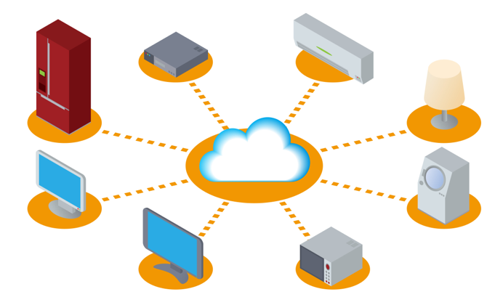
Internet of Things (IoT)
Machine-to-machine communication (M2M) fostered by cloud computing and smart devices
Notes:
Audio: 00:00:00-00:01:57

Slide 12

Example: IoT
Image source: www.npr.org

Slide 13
Master Data: Addressing Poor Data Quality
Core business objects shared by applications across an enterprise (Product, Customer, Supplier, etc.)
Provide single source of truth about data, consistent data definitions across organization
Management of master data essential for data governance as it improves data quality in the organization

Slide 14
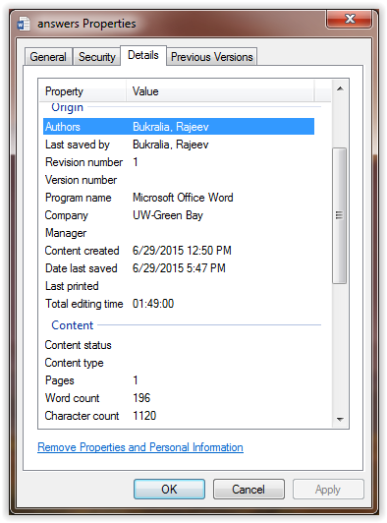
Metadata
Describe other data; data about data
Can make finding and working with particular instances of data easier.
Examples of basic document metadata: author, date created, date modified, file type, file size, keywords

Slide 15
Additional Terms
Latency: Any delay in a response or delivery of data from one point to another
Scalability: The ability of a computer application or hardware to continue to function well as it is changed in size or volume in order to meet increased user demand
Dashboard: A graphical reporting of static or real-time data on a desktop or mobile device. The data represented are typically high-level to give managers a quick report on status or performance
Anonymization: The act of removing all data that links a person to a particular piece of information. Also known as de-identification

Slide 16
Recap: Common Terms
Difference between data, information, knowledge, wisdom?
Difference between structured, unstructured, semi-structured data?
What is a database and how is it different from a file?
What are relational databases and how are they different from NoSQL databases?
What is metadata and master data?
What is the difference between a data center, data warehouse, data mart, and data lake?
What is big data and how is Hadoop an example of its architecture?
What is an algorithm?
What is data wrangling?
What are the four classifications of data analytics?
What is cloud computing and what are its service models?
What is the Internet of Things and how does it intersect with big data?

Slide 17
Take Home Activity
Visit Glassdoor.com or indeed.com. Review the job description of a few data scientist positions.
  Class discussion: What did you learn about data science positions? What skills and competencies are required for data scientists?
Review the Harvard Business Review article: The Data Scientist: the Sexiest Job of the 21st Century
  Class discussion: What are your key takeaways?

Slide 18
Next Class
Ethical, legal, and sociological implication of data science

