Slide 1
IT 418/518: Foundations of Data Science
Class 4
Dr. Rajeev Bukralia

Slide 2
Examples of Algorithmic Bias
Review the Algorithmic bias cases posted in D2L

Slide 3
Key Ethical AI Principles
Privacy
  Informed consent (opt-in), privacy by design, right to erasure and ratification
Accountability
  New regulations, impact assessment, remedy for automated decisions, algorithmic audit
  Long-term effects
Transparency and Explainability
  Open source data and algorithms
  Fairness and non-discrimination
Human Control of Technology
  Human review
Safety and Effectiveness
  Security and safety
  Accuracy and fairness tradeoff

Slide 4
Causes of bias
Historical human biases
  Historical human biases are shaped by pervasive and often deeply embedded prejudices against certain groups, which can lead to their reproduction and amplification in computer models.
Incomplete or unrepresentative training data
  Insufficient training data is another cause of algorithmic bias. If the data used to train the algorithm are more representative of some groups of people than others, the predictions from the model may also be systematically worse for unrepresented or under-representative groups.

Slide 5
Solutions
Need for new regulations governing big data and AI (accountability).
Operators of algorithms should regularly audit for bias
Consumers need better algorithmic literacy
Increase human involvement in the design and monitoring of algorithms
Operators of algorithms must rely upon cross-functional work teams and expertise

Slide 6
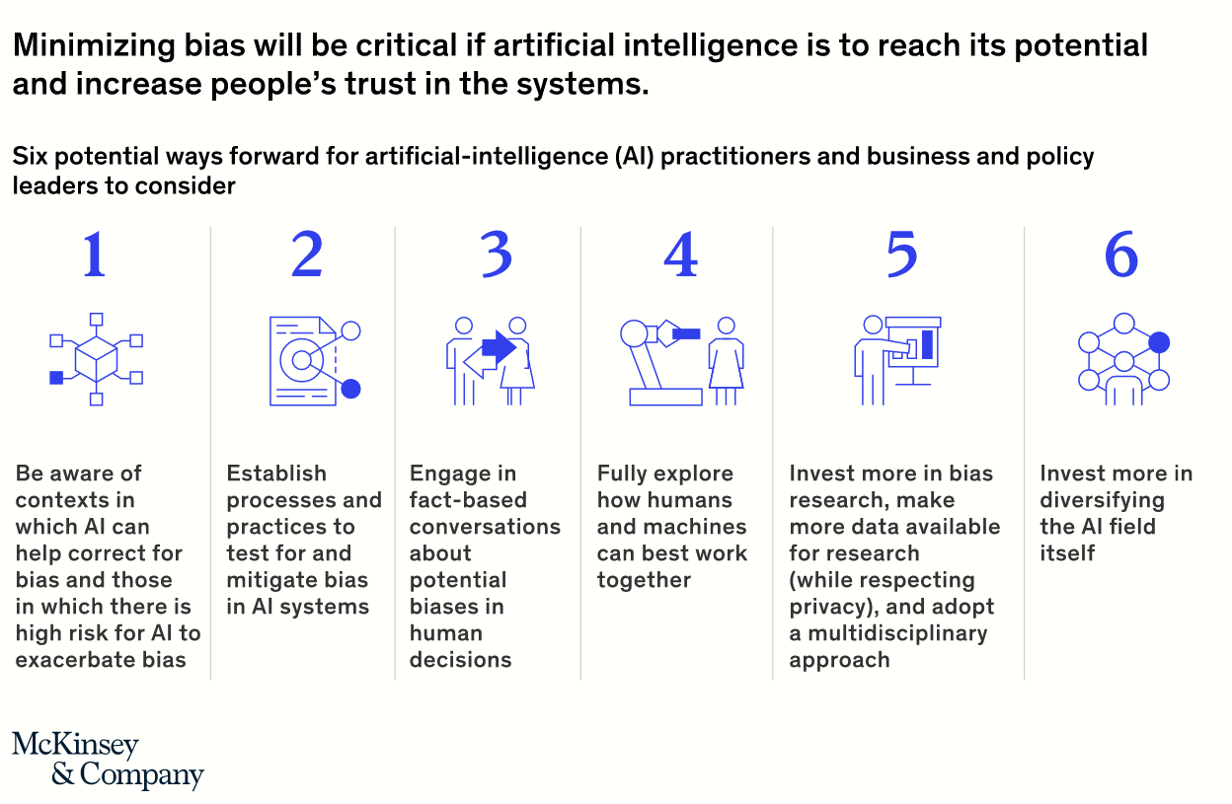

Slide 7
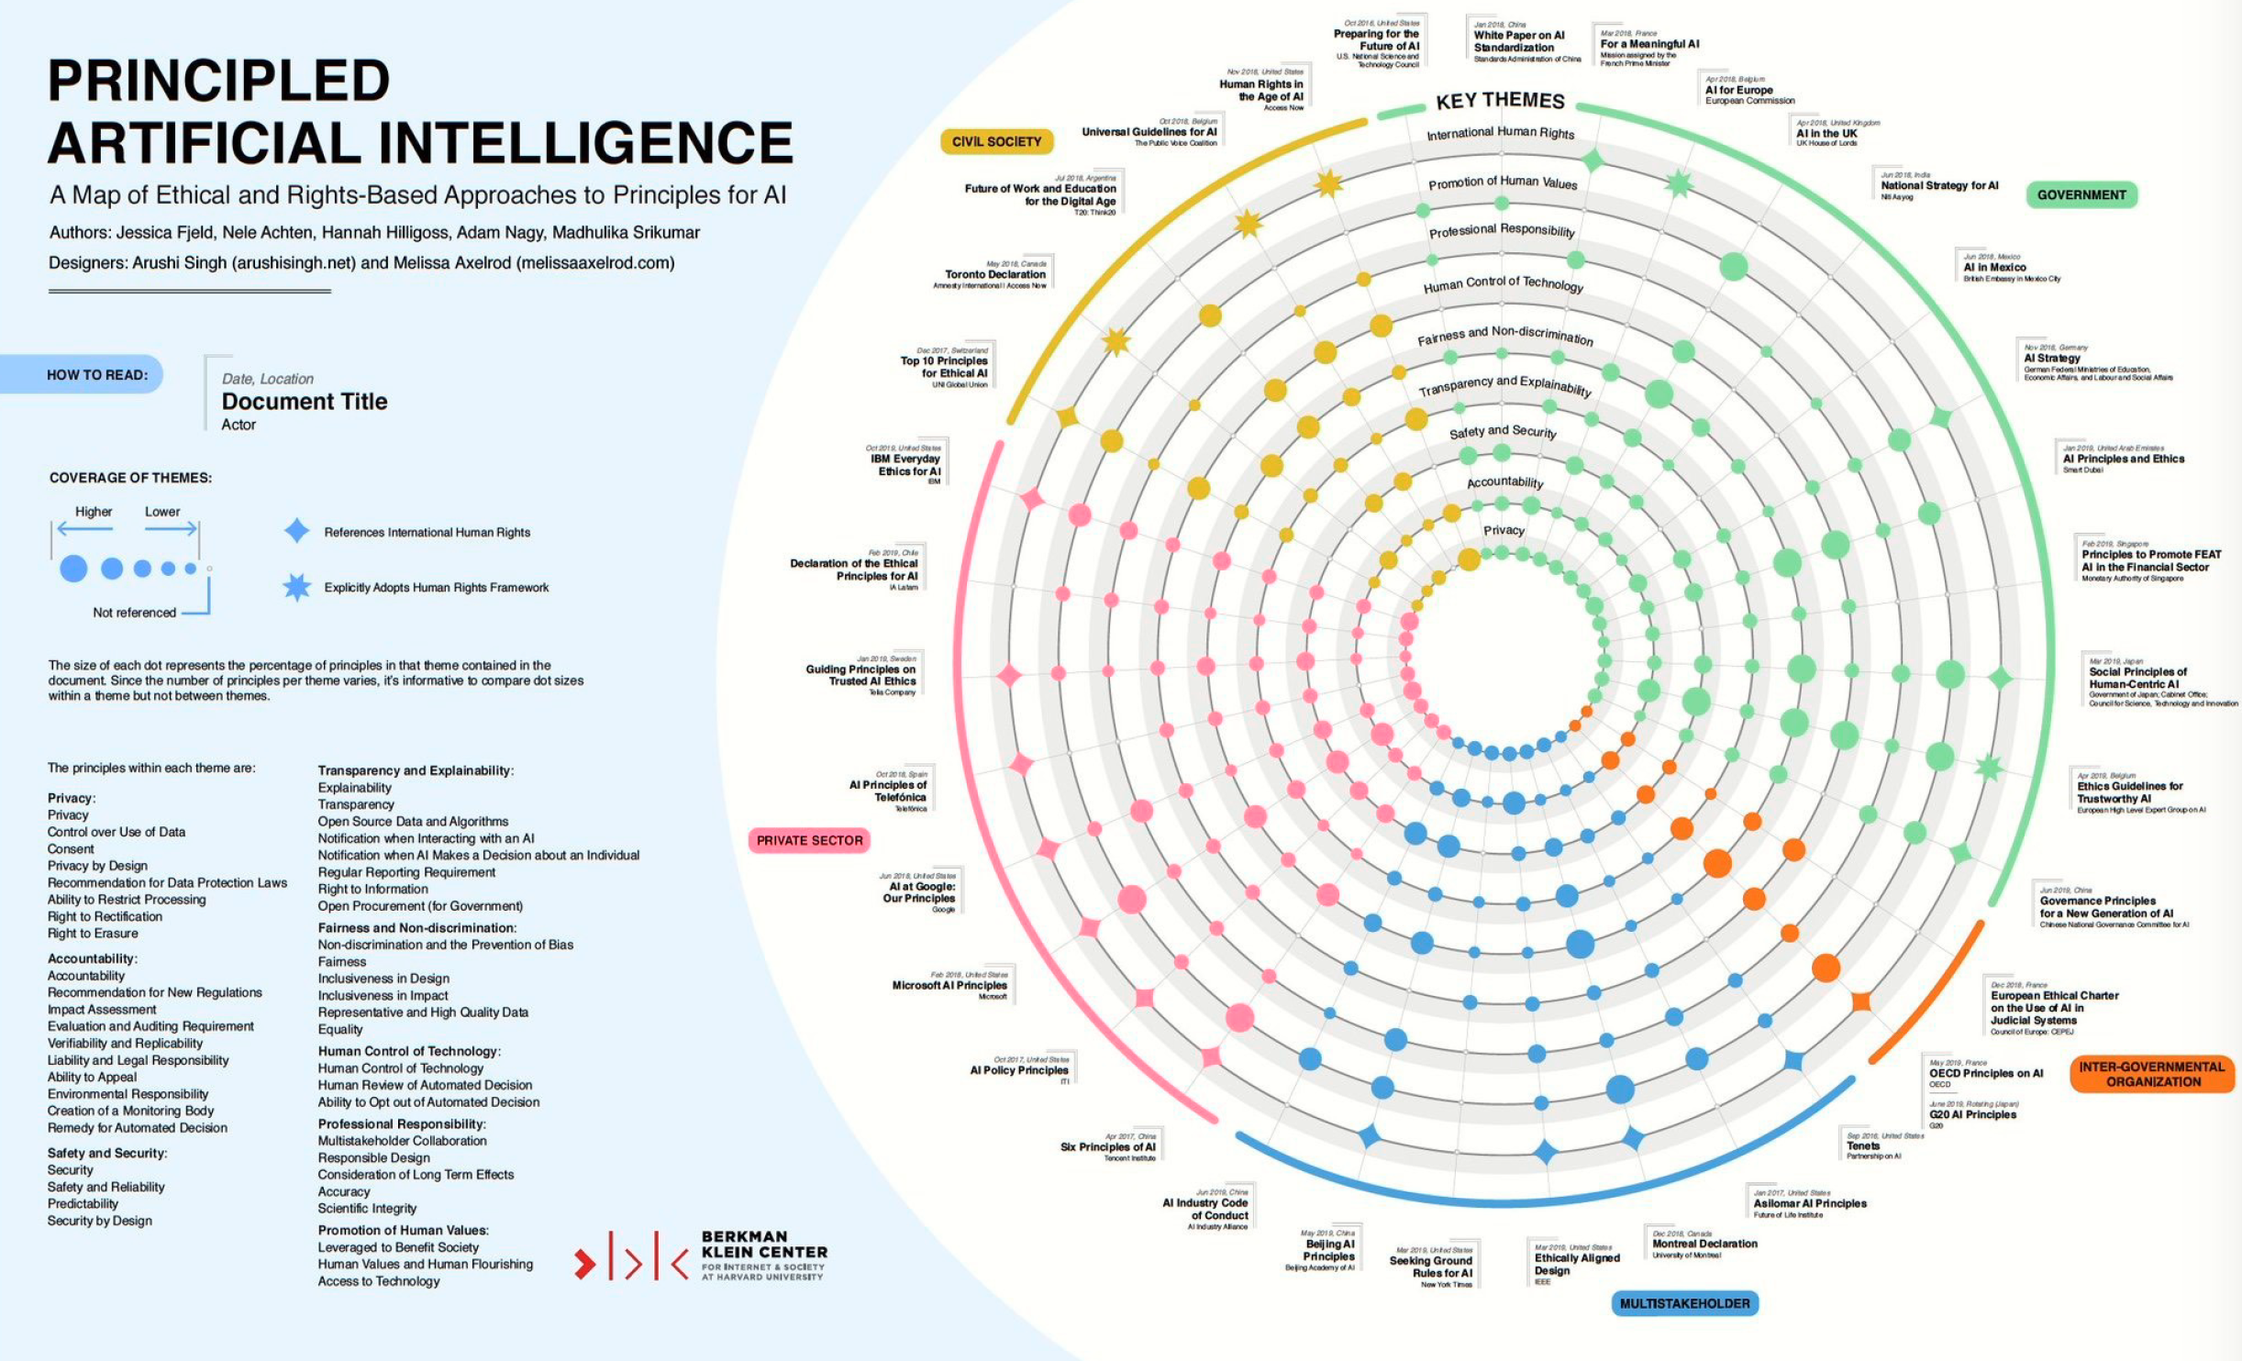

Slide 8
Next Class
Framework for ethical, responsible, and interpretable AI and data science
Emerging Technical Solutions
  XAI
  K-Anonymity
  Differential Privacy

