Slide 1
IT 418/518: Foundations of Data Science
Class 5
Dr. Rajeev Bukralia

Slide 2
Learning Objectives
Class discussions
  Data scientist job description
Analytics
  Define analytics
  Discuss the types of analytics and their role in decision making
  Describe the uses of analytic thinking
  Discuss the steps of analytics

Slide 3
Discussion
Visit Glassdoor.com or indeed.com. Review the job description of a few data scientist positions.
  Class discussion: What did you learn about data science positions? What skills and competencies are required for data scientists?

Slide 4

Analytics
Socrates said, “The unexamined life isn’t worth living.” We’d argue that the unexamined decision isn’t worth making.
~ Davenport et al., Analytics at Work

Slide 5
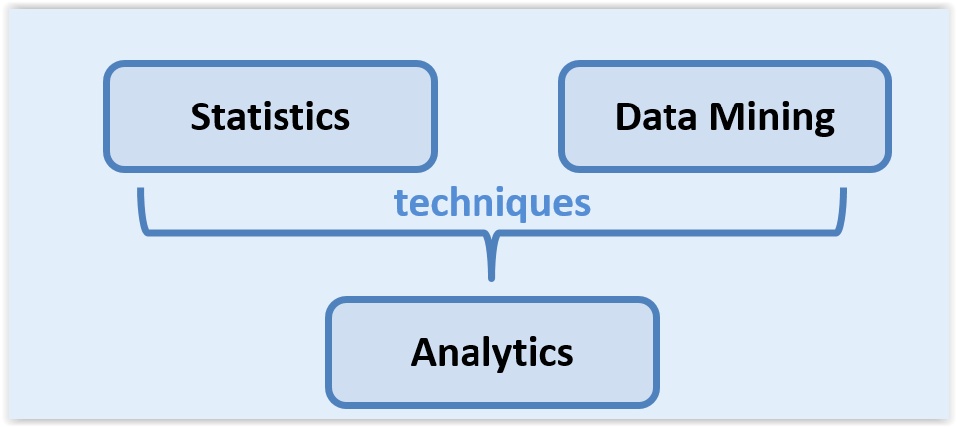
What is Analytics?
Extensive use of data to drive decisions and add value.

Slide 6
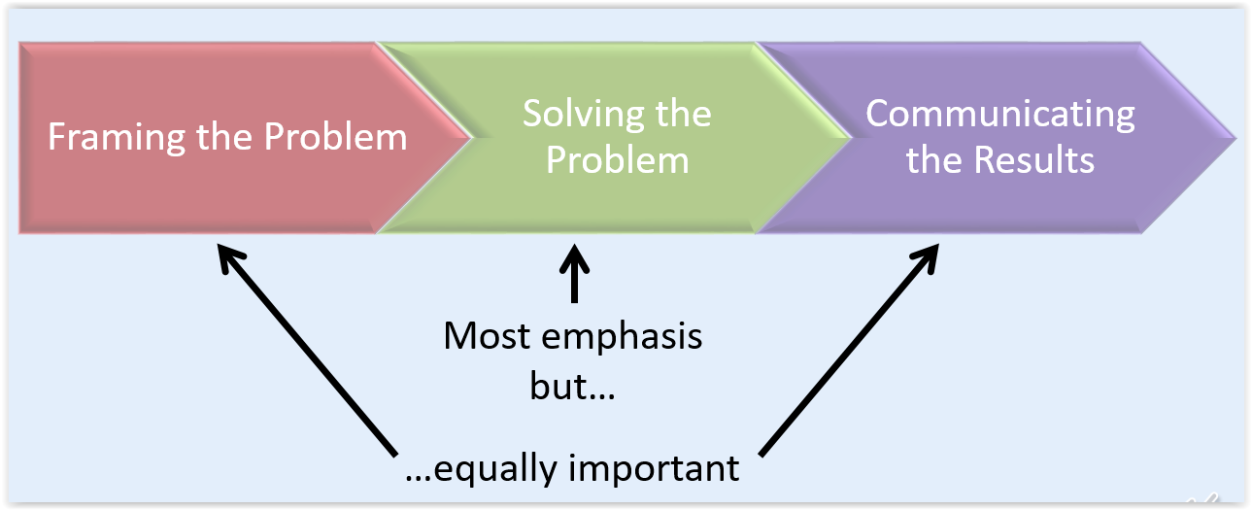
Analytic Stages

Slide 7


Types of Analytics
Descriptive analytics (reporting): What is happening or has happened?
Predictive analytics: What will or might happen in the future?
Prescriptive analytics (recommender systems): What to recommend based on predictions?
Optimization: Find optimal solutions while satisfying constraints.

Slide 8
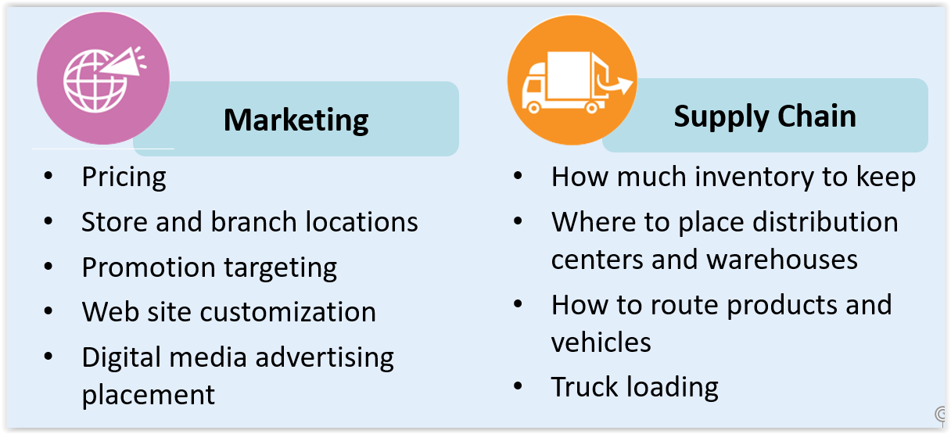
Uses of Analytics

Slide 9
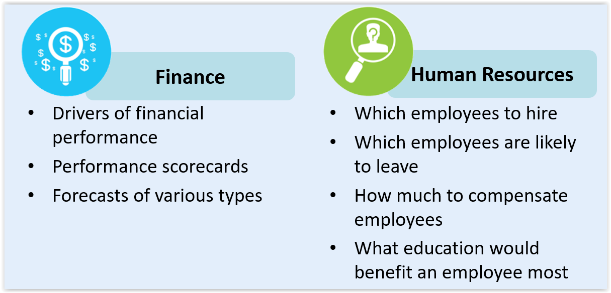
Uses of Analytics

Slide 10
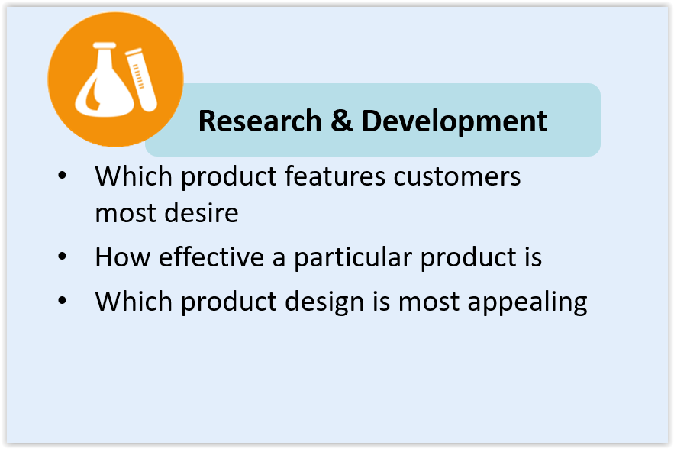
Uses of Analytics

Slide 11

When Not to Use Analytics?
Need to act fast (such as emergencies)
Data-averse organizational culture
Absence of reliable data

Slide 12
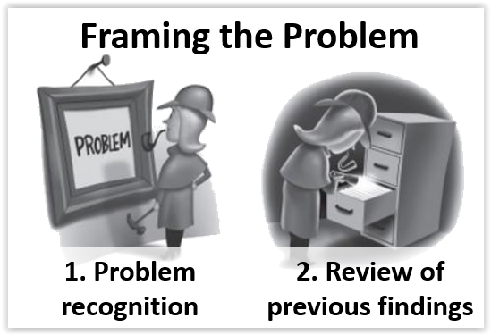
Source: Keeping Up with the Quants

Slide 13
Framing the Problem
Problem recognition
  Identify stakeholders (RACI Framework)
  Scope of the problem
  Getting specifics
Review previous findings
Reframe problem if needed

Slide 14
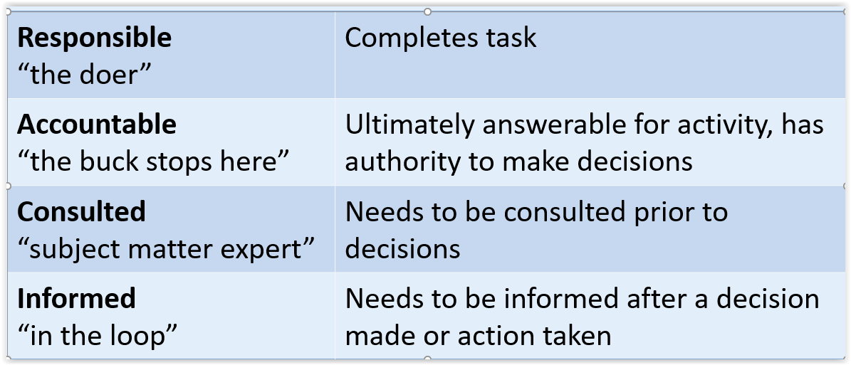
RACI Framework
Responsible, Accountable, Consulted, Informed matrix is used to establish project accountabilities and to identify stakeholders.

Slide 15
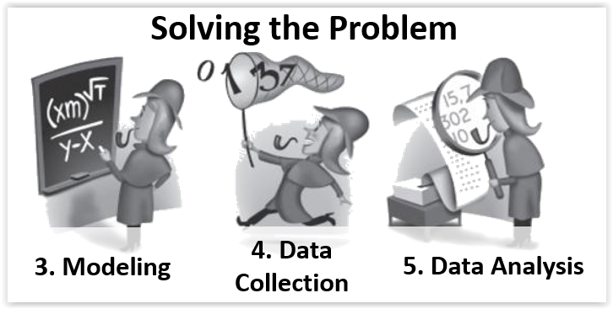
Source: Keeping Up with the Quants

Slide 16
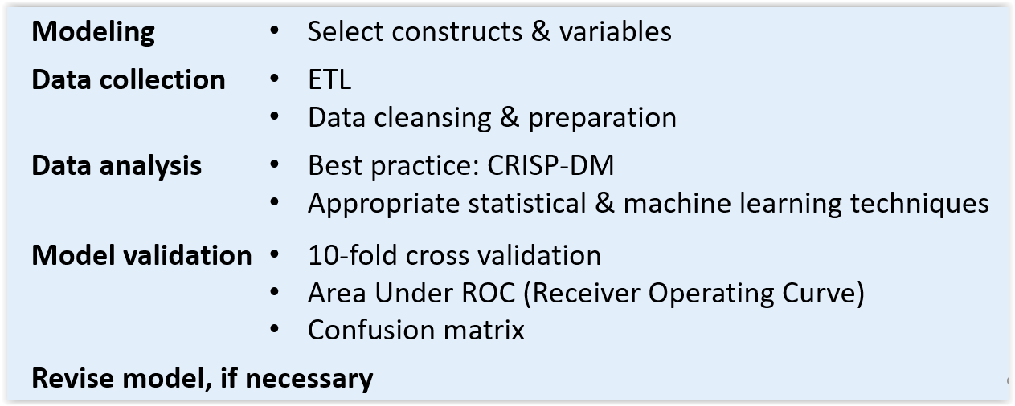
Solving the Problem

Slide 17
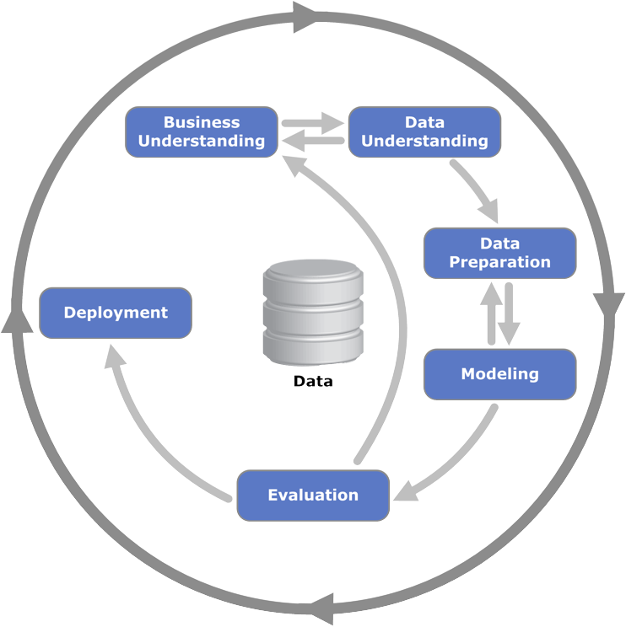
CRISP-DM
Cross-Industry Standard Process for Data Mining (CRIS-DM)
Provides an overview of data mining lifecycle and typical project phases
Flexible, customizable
Incorporated in many data mining tools, such as IBM Modeler

Slide 18
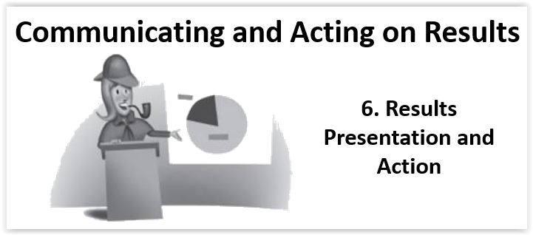
Source: Keeping Up with the Quants

Slide 19
Communicating the Results
Storytelling with data
Visual analytics
Engaging with stakeholders
Acting on results

