Slide 1
IT 418/518: Foundations of Data Science
Class 6
Dr. Rajeev Bukralia

Slide 2
Measurement
Measurement is the process of systematically assigning numbers to objects and their properties, to facilitate the use of mathematics in studying and describing objects and their relationships.
Some types of measurement are fairly concrete: for instance, measuring a person’s weight in pounds or kilograms, or their height in feet and inches or in meters.
There are Tests to measure abstractions like intelligence and scholastic aptitude.

Slide 3
Levels of Measurement
Four types or levels of measurement
Nominal data
Ordinal data
Interval data
Ratio data

Slide 4
Nominal Data
The numbers function as a name or label and do not have numeric meaning.
For example, you might create a variable for gender, which takes the value 1 if the person is male and 0 if the person is female. The 0 and 1 have no numeric meaning but function simply as labels in the same way that you might record the values as “M” or “F.”
Why choose numeric rather than text values to code nominal data?
Numeric data are easier to process than text data
It can help avoid data entry errors (you can type “M” as “m”)
You can have more than two categories of nominal data.
When data can take on only two values, as in the male/female example, it is called binary data.

Slide 5
Ordinal Data
Data has some meaningful order, so that higher values represent more of some characteristic than lower values.
For example, the third-degree burns the most serious than first-degree burns. The stage 4 cancer is more serious than the stage 1 cancer.
There is no metric analogous to a ruler or scale to quantify how great the distance between categories is.
it is appropriate to calculate the median (central value) of ordinal data, but not the mean (which assumes interval data).
Many ordinal scales involve ranks.
The numbers used for measurement with ordinal data carry more meaning than those used in nominal data.
Likert Scale is another example of ordinal data.

Slide 6
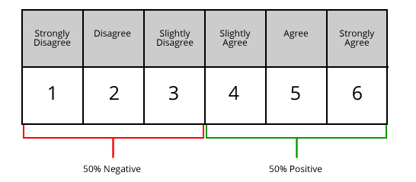
Likert Scale
Source: https://www.fieldboom.com/blog/likert-scale/

Slide 7
Interval Data
Interval data has a meaningful order and equal intervals between measurements.
Example: Fahrenheit temperature scale. The difference between 10 degrees and 25 degrees (a difference of 15 degrees) represents the same amount of temperature change as the difference between 60 and 75 degrees.

Slide 8
Ratio Data
Ratio data has all the qualities of interval data (natural order, equal intervals) plus a natural zero point.
Many physical measurements (height, weight, and age) are ratio data.
How about income or bank balance?
They are ratio data as you can certainly earn 0 dollars in a year, or have 0 dollars in your bank account.

Slide 9
Continuous Vs. Discrete Data
Continuous data can take any value, or any value within a range.
Most data measured by interval and ratio scales, other than that based on counting, is continuous: for example: weight, height, distance, and income are all continuous.
Discrete data can only take on particular values, and has clear boundaries. Any variable based on counting is discrete, whether you are counting the number of books purchased in a year or the number of prenatal care visits made during a pregnancy or number of children.
Parents cannot have 1.27 children
Nominal data is also discrete, as are binary and rank-ordered data.

Slide 10
Proxy Measurement
Sometimes measurement are not quick and easy to administer in the field.
For example, individuals suspected of drunkenness can be evaluated by proxy measures (field observations such as breath smelling of alcohol, slurred speech, and flushed skin) instead of more accurate testing of their blood alcohol content.
Choosing good proxy measurements is a matter of judgment informed by knowledge of the subject area, usual practices in the field, and common sense.
Is one proxy better than another? How do we know?
You can use correlations or chi-squares between the measures to evaluate.

Slide 11
Reliability and Validity
Two standards we use to evaluate measurements are reliability and validity.
Reliability refers to how consistent or repeatable measurements are.
Validity means how well a test (or rating scale) measures what is it supposed to measure.
Measurement Bias
Selection Bias: it can enter during the selection and retention of the objects of study, or in the way information is collected about the objects.
Information Bias: it may enter the study through the methods used to collect and record data.

Slide 12
String and Numeric Data
Strings: character or alphanumeric variables, can include letters, numbers, blanks, and symbols.
Numeric: variables are stored as numeric values and may be used in mathematical and statistical procedures (such as addition, subtraction, etc.)

Slide 13
Unit of Analysis
A major entity of the research study
The following situations have different unit of analysis:
Academic achievement of individual schoolchildren
Achievement levels among different schools
Academic achievement in different cities

Slide 14
Missing Data
Most datasets have missing data (very common situation)
Missing data poses two problems:
it reduces the number of cases available for analysis, thereby reducing statistical power.
It may also introduce bias into the data.

Slide 15
Dealing with Missing Data
Investigate the following questions:
Why data is missing?
What is the distribution of missing data?
Create visualizations such as a “missingness” map (For example, R has a package called Amelia and Python has the missingno package)
Summary statistics [example: head() or df.head()]
Decide on the best analysis strategy to yield the least biased estimates

Slide 16
Dealing with Missing Data
Deletion Methods
Listwise deletion, pairwise deletion
How much are you deleting? Will reduce statistical power
Imputation Methods
Mean substitution
Influenced by outliers
Median substitution
Better than mean
Dummy variable adjustment
Create an indicator for missing value (1=value is missing for observation; 0=value is observed for observation). Can be biased.
Regression
Replaces missing values with predicted score from a regression equation. Weakens variance

Slide 17
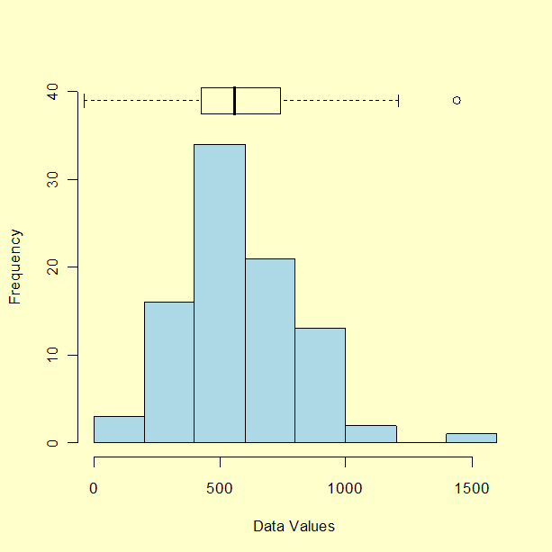
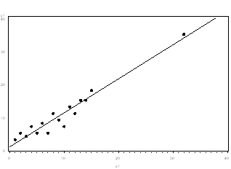
Dealing with Outliers
An outlier is a data point that is too distant from other similar points.
It may indicate variability in the measurement or experimental errors.
In some cases, outliers can be natural and explainable.
You can detect outliers using visualizations such as scatterplot and boxplots.
If the outlier is due to incorrectly entered or measured data, you should drop it.
If the outlier significantly changes the assumptions and results of analysis, you should run the analysis with and without it.

Slide 18
Next Class
Agenda
Basic Statistics
Missing Data

