Slide 1
IT 418/518: Foundations of Data Science
Class 7
Dr. Rajeev Bukralia

Slide 2
Variables
An object, event, idea, feeling, time period, or any other type of category you are trying to measure
Independent (predictors) and dependent (response variables)
Known as features or attributes in machine learning

Slide 3
Qualitative and Quantitative Variables
Quantitative | Watch for units and scale of measurement Time series: quantitative variable measured at regular intervals over time
Qualitative (Categorical) | Have categories. May have an intrinsic order (ordinal) or not (nominal) or interval (have interval between categories)
Don’t assume variables are quantitative or categorical without thinking about data they represent.
You can summarize data using Frequency Tables and graphs.

Slide 4
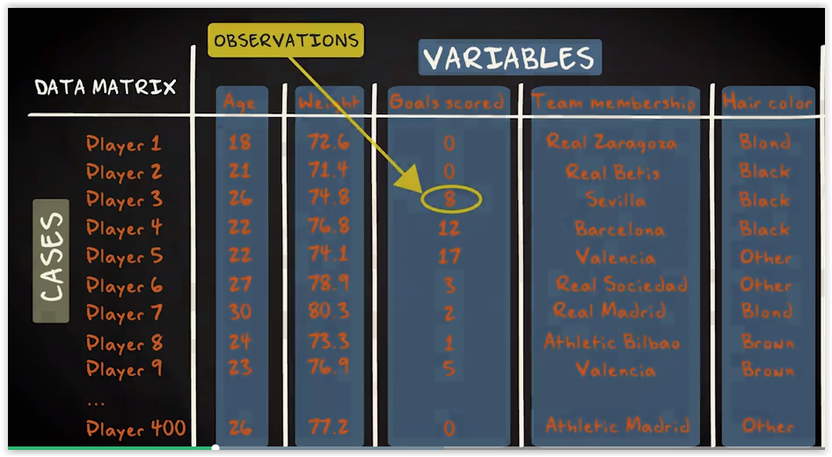

Slide 5
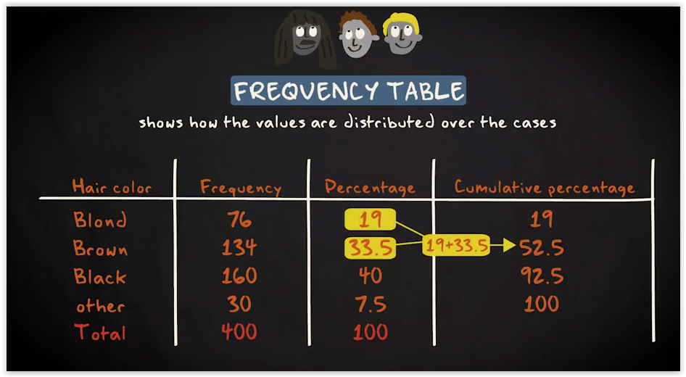

Slide 6
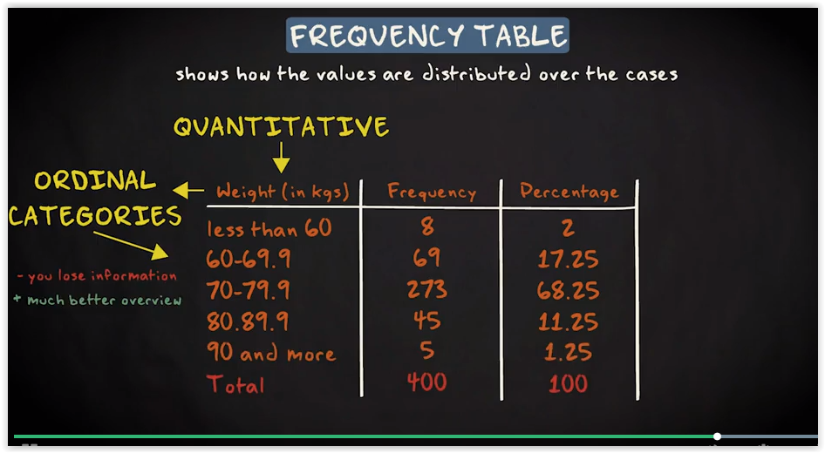

Slide 7
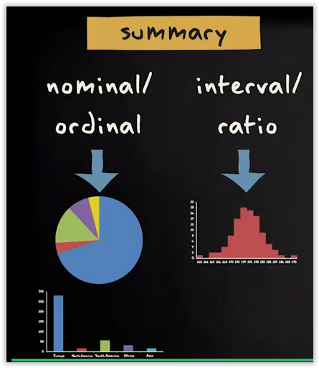
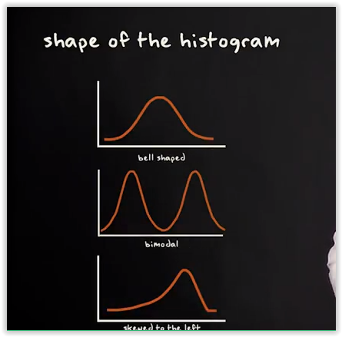
Summarize data using plots

Slide 8
Measures of central tendency and dispersion
Measures of central tendency:
Mean (sum of all values divided by number of observations)
Median (middle value of your observations when arranged from the smallest to largest)
Mode (value that occurs most frequently; use it when your variable is categorical)

Slide 9
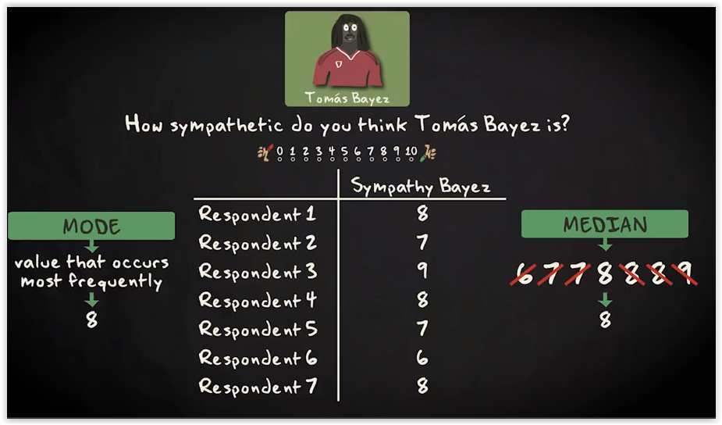

Slide 10
Question 1
What is the median of this data set?
1 2 3 4 5 6 7 8

Slide 11
Answer
4.5
The data set has 8 values, which is an even number; the median is therefore the average of the middle two values, in this case 4 and 5.

Slide 12
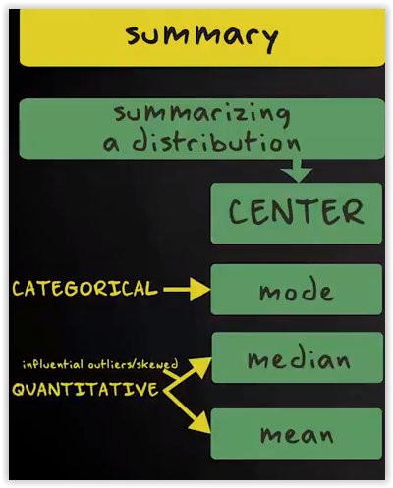

Slide 13
Measures of dispersion
Range (difference between highest and lowest value)
It only takes account of extreme values
Interquartile range it basically divides your distribution in four equal parts.)
Better measure of dispersion
Variance
Standard Deviation

Slide 14
Boxplot
A graph that nicely presents the variability of a distribution is the box plot.
The box plot shows you at a glance Q1, Q2 and Q3. The minimum value that's not an outlier, the maximum value that's not an outlier and the outliers.
The length of the box represents the IQR (=Q3 – Q1)
The horizontal line inside the box is the median or in other words, Q2.
If the median (horizontal line or Q2) is roughly centered then the data is roughly symmetric (if not, it is skewed).
Use the 1.5 IQR rule to determine outliers

Slide 15
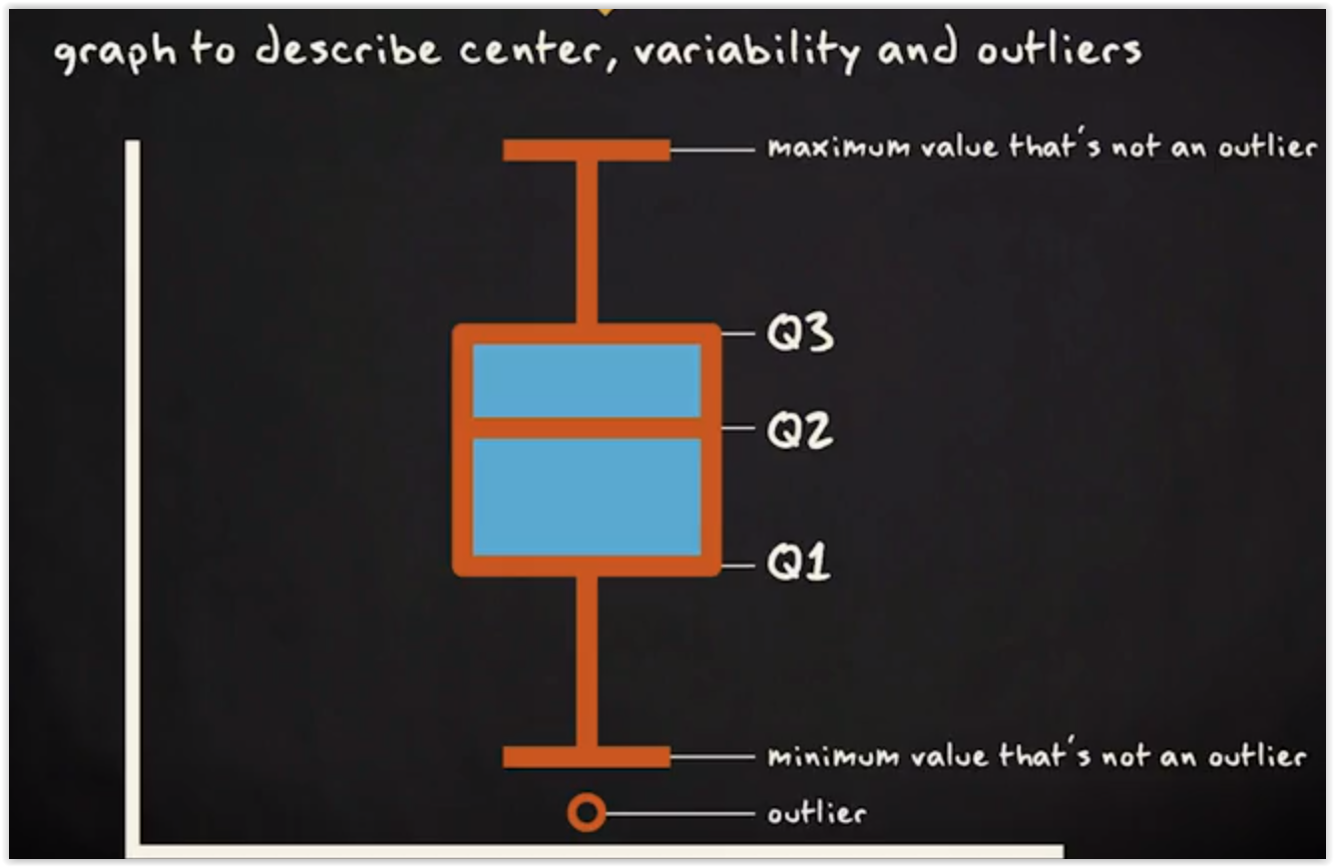
Boxplot

Slide 16
Question 2
The quartiles of a dataset are 13 and 24.5 and the IQR 11.5. Calculate the outlier data points.

Slide 17
Answer
1.5 * IQR
IQR = 11.5
= 17.25
A point would have to be larger than 24.5+17.25 = 41.75 to be an outlier
Or smaller than -4.25 (13-17.25) to be an outlier.

Slide 18
Variance
The most common measures of dispersion for continuous data are the variance and standard deviation. Both describe how much the individual values in a dataset vary from the mean or average value.
The variance and standard deviation are calculated slightly differently depending on whether a population or a sample is being studied, but basically the variance is the average of the squared deviations from the mean.
The larger the variance, the larger the variability.
That means the larger the variance, the more the values are spread out around the mean.

Slide 19
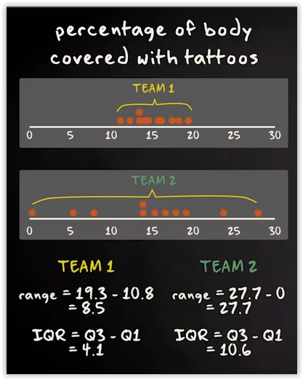
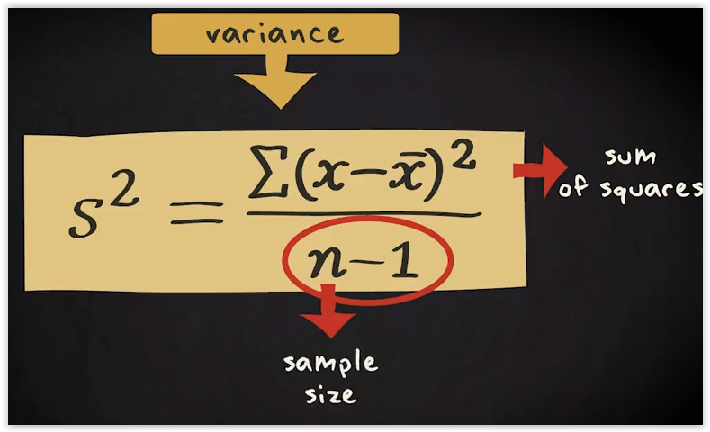
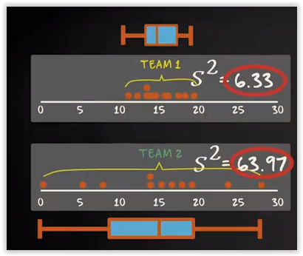
Variance

Slide 20
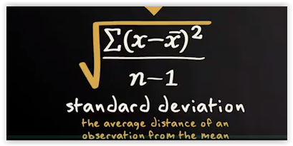
Standard Deviation
The standard deviation can be seen as the average distance of an observation from the mean.
The larger the standard deviation, the larger the variability of the data.
We just take the square root of the variance. We call what we get, the standard deviation.

Slide 21
Question 3
Calculate the variance of the following sample data set
(1, 2, 3, 4, 5)

Slide 22

Answer

Slide 23
Exercise 1
Calculate the variance and standard deviation of the following sample data set using pandas
(1, 2, 3, 4, 5)

Slide 24
Question 4
For the following data points: 2, 51, 53,54, 43, 51, 62, 49, 50, 63, 60
Calculate median (Q2), lower quartile (Q1), upper quartile (Q3), and IQR
Find the outliers
Create a boxplot

Slide 25
Answer
Median = 51
Q1 = 49
Q3 = 60
IQR: 11
Largest value (not outlier) = 63
Add 1.5 x (IQR) to the third quartile
Lowest value (not outlier) = 43
Subtract 1.5 x (IQR) from the first quartile
Outlier value = 2

Slide 26
Exercise 2
Calculate the variance and standard deviation and a boxplot of the following sample data set using pandas:
(2, 51, 53,54, 43, 51, 62, 49, 50, 63, 60)

Slide 27
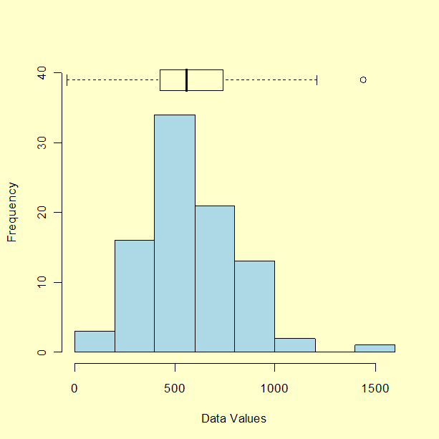
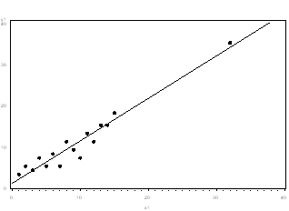
Dealing with Outliers
An outlier is a data point that is too distant from other similar points.
It may indicate variability in the measurement or experimental errors.
In some cases, outliers can be natural and explainable.
You can detect outliers using visualizations such as scatterplot and boxplots.
If the outlier is due to incorrectly entered or measured data, you should drop it.
If the outlier significantly changes the assumptions and results of analysis, you should run the analysis with and without it.

Slide 28
Preparing Data for Analysis
Examine data before modeling
summary() in R
Use summary (descriptive) statistics and visual analytics to spot problems:
Missing values
Invalid values
Outliers
Data range or measurement unit issues
Have footnote in findings explaining if you treated data for missing values, outliers, etc.

Slide 29
Missing Values
Many modeling algorithms drop missing values, which can lead to erroneous conclusions.
Why is data missing? Find reason for and distribution of missing data.
The variable is.employed is missing for about a third of the data.
is.employed
Mode :logical
FALSE :73
TRUE :599
NA’s :328
The variable income has negative values, which are potentially invalid.
Income
Min. : -8700
1st Qu.: 14600
Median : 35000
Mean : 53505
3rd Qu.: 67000
Max. :615000

Slide 30
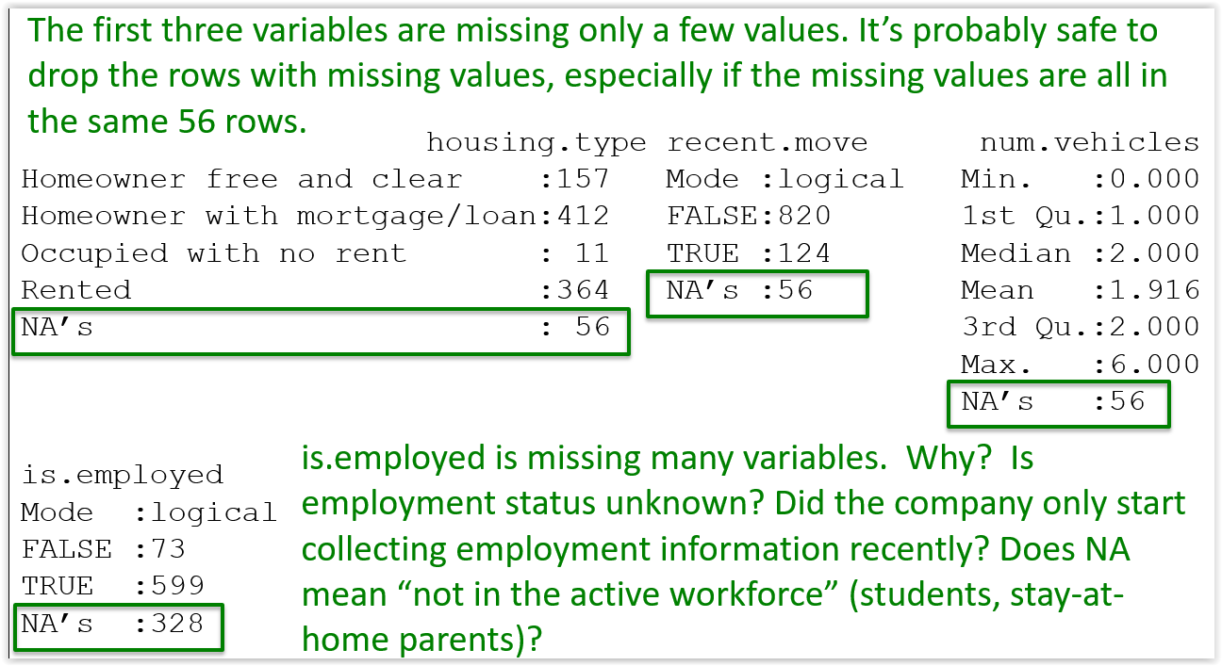

Slide 31
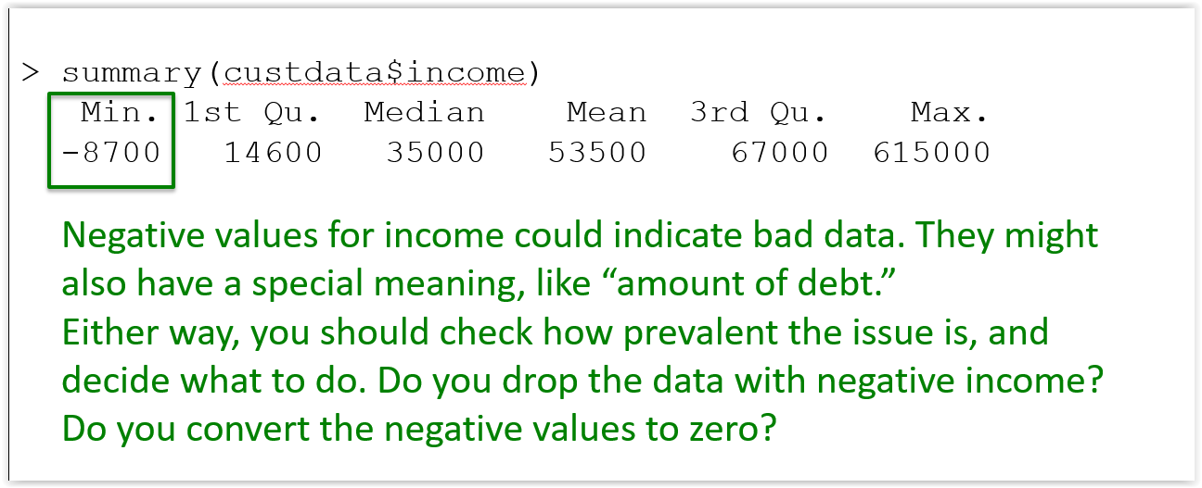

Slide 32
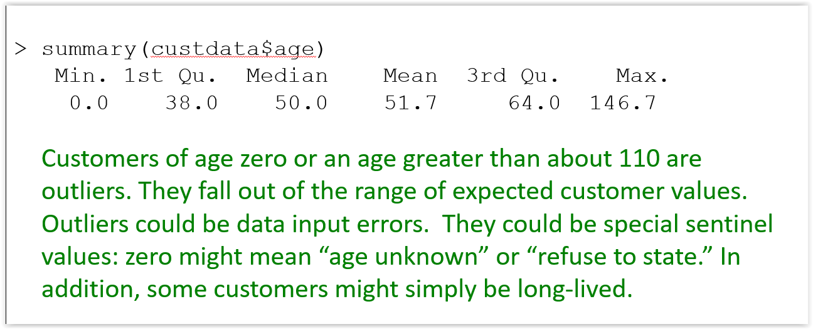

Slide 33
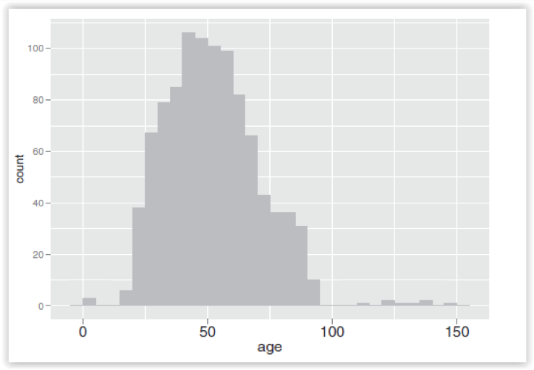
Invalid Values
Outliers

Slide 34
Treating Invalid Values and Outliers
Before estimating a model, plot the data and identify values that appear out of range.
If outlier is due to entry or measurement errors, drop it.
You can consider deletion of rows of missing data if it is relatively small compared to data size.
Use appropriate imputation (median, regression, etc.) to replace invalid values and outliers.
If outliers are valid, run the analysis both with and without outliers. Do the outliers affect results and assumptions?

Slide 35
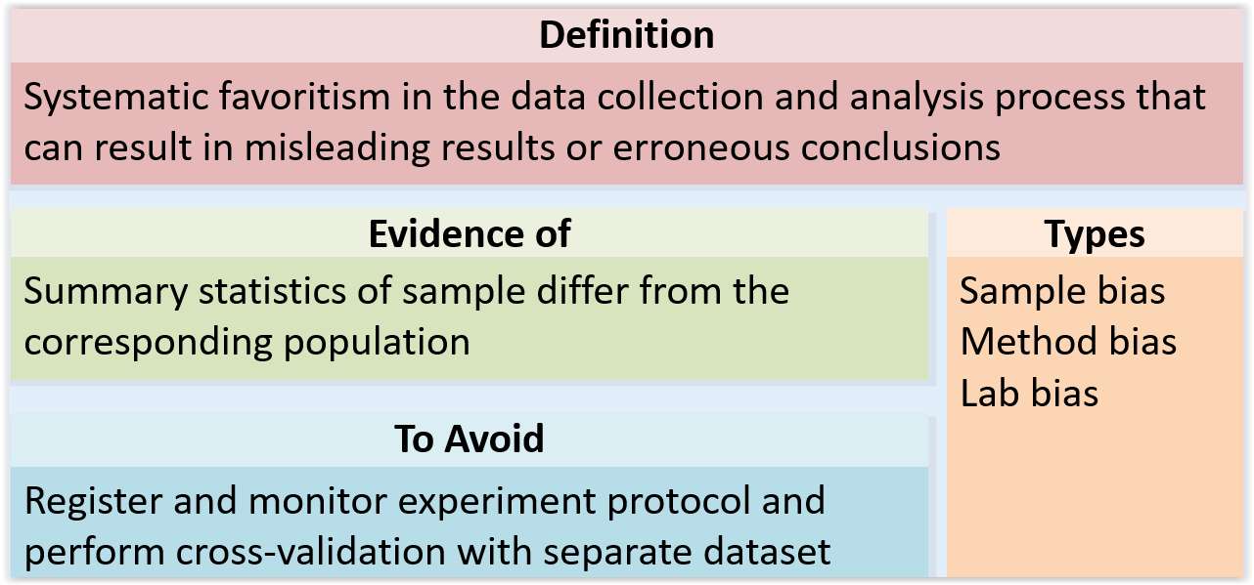
Bias

Slide 36
Sampling
An unbiased sample can provide information about population.
Do
Randomize with sampling methods such as stratified, cluster, and multi-stage
Identify sources of bias
Don’t
Introduce sampling bias
Use long, unclear surveys
Introduce response bias
Use push polls

