Slide 1

Symplectic integrator for the Dirac equation in the phase-space
Denys Bondar
New Orleans, USA

Slide 2
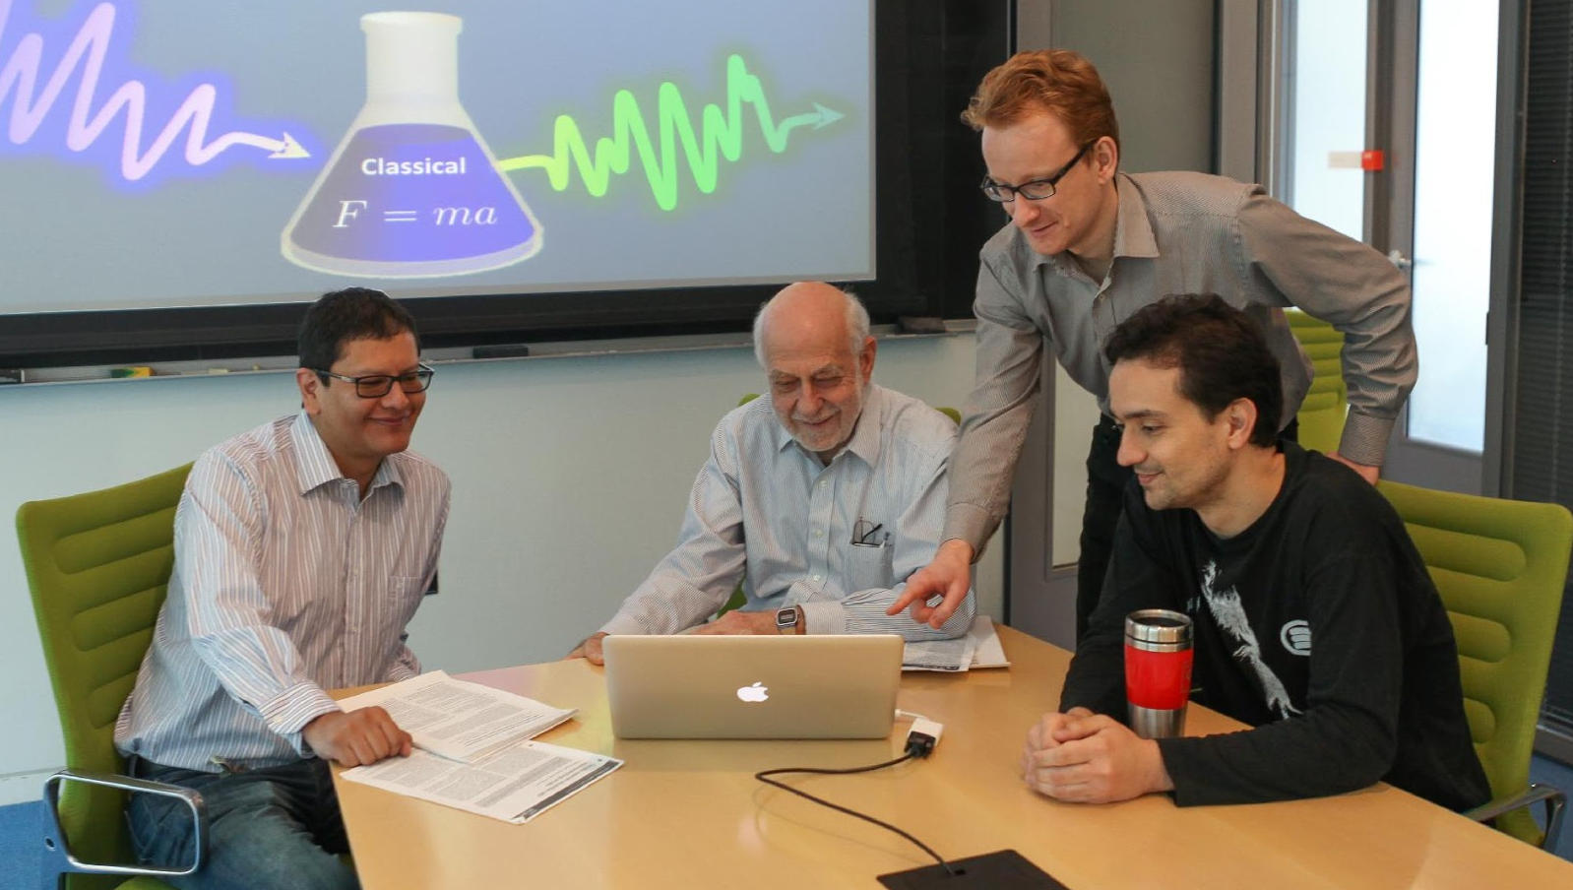
Thanks to collaborator
Renan Cabrera
Herschel Rabitz
Andre Campos

Slide 3
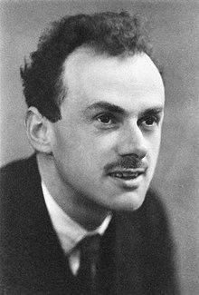

Modern applications of the Dirac equation
High-energy physics of spin ½ particles
High-intensity lasers
Solid state
Optics, cold atoms, trap ions, circuit QED
Chemistry of heavy elements

Slide 4
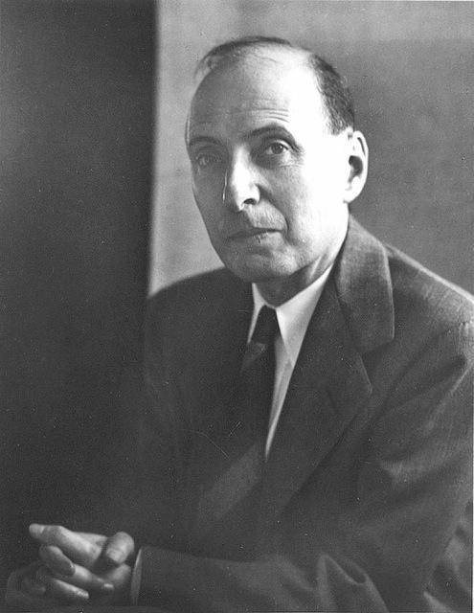
The Wigner (phase-space) representation for the Dirac equation
Applications
Quantum plasma
Relativistic statistical mechanics
Original formulation of the Wigner function for the Dirac equation
R. Hakim and J. Heyvaerts, Phys. Rev. A 18, 1250 (1978).
R. Hakim and H. Sivak, Ann. Phys. (NY) 139, 230 (1982).
H. Elze, M. Gyulassy, and D. Vasak, Phys. Lett. B 177, 402 (1986).
D. Vasak, M. Gyulassy, and H. Elze, Ann. Phys. (NY) 173, 462 (1987).
R. Hakim, Introduction to Relativistic Statistical Mechanics (World Scientific, Singapore, 2011).
E. Wigner, Phys. Rev. 40, 749 (1932).

Slide 5
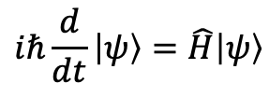
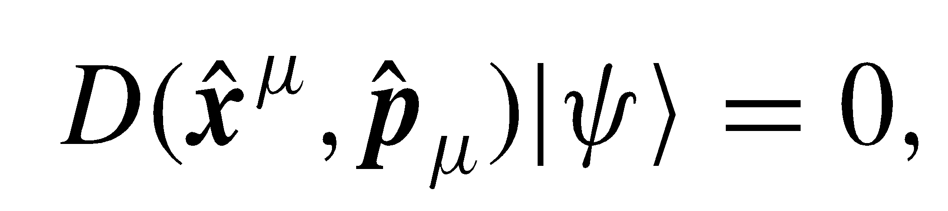
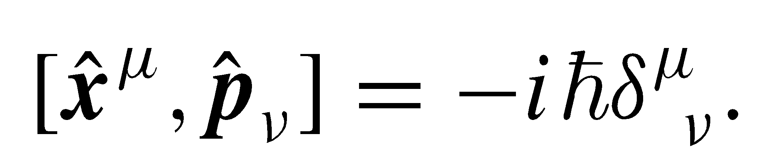
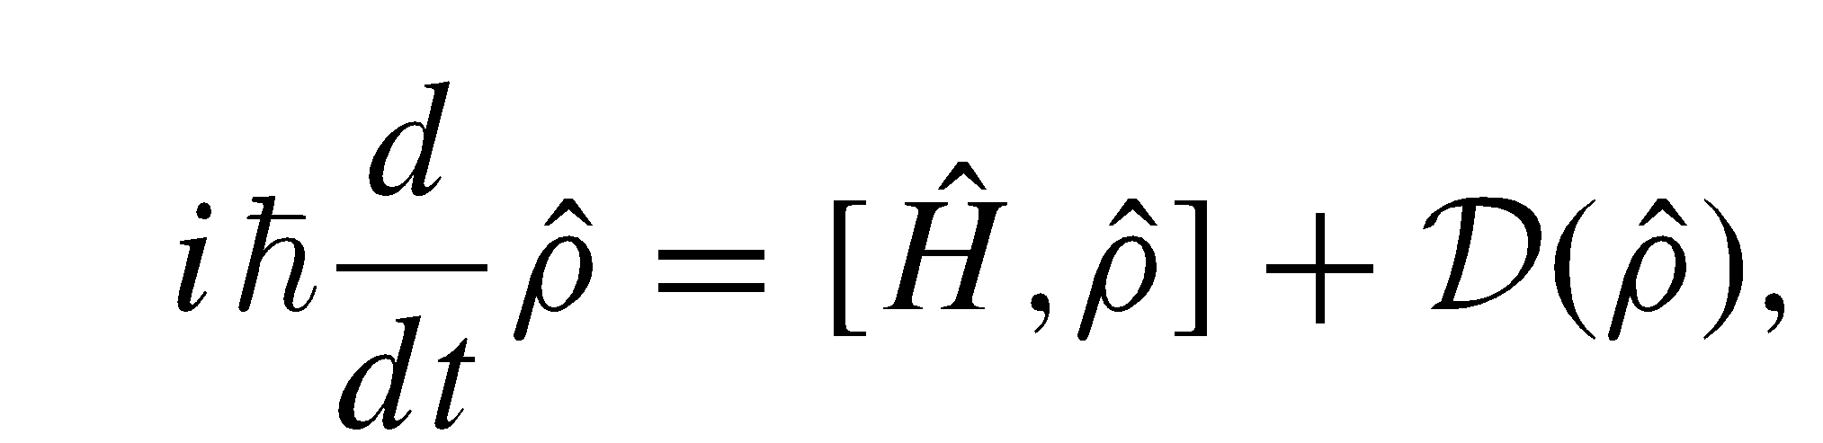
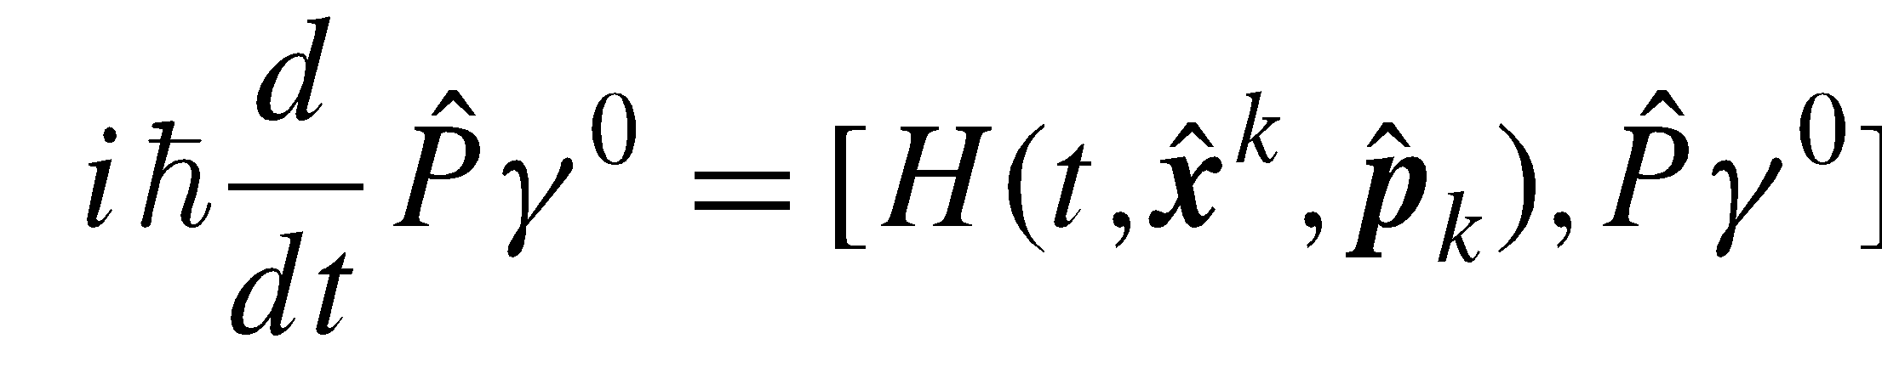
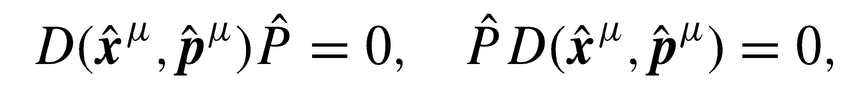
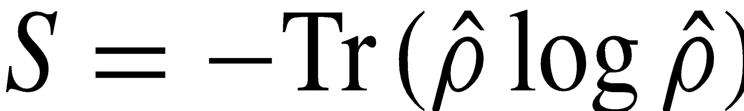
Quantum statistical mechanics
Reminder: Non-relativistic
Covariant but not manifestly covariant (3+1 splitting)
Manifestly covariant
Schrodinger equation
Dirac equation
Dirac Hamiltonian
von Neumann and kinetic master equations
von Neumann equation
von Neumann equation
No master equation
No master equation

Slide 6
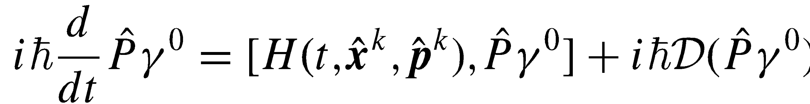
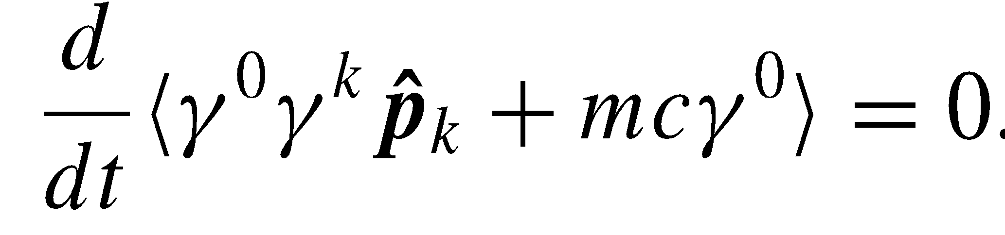
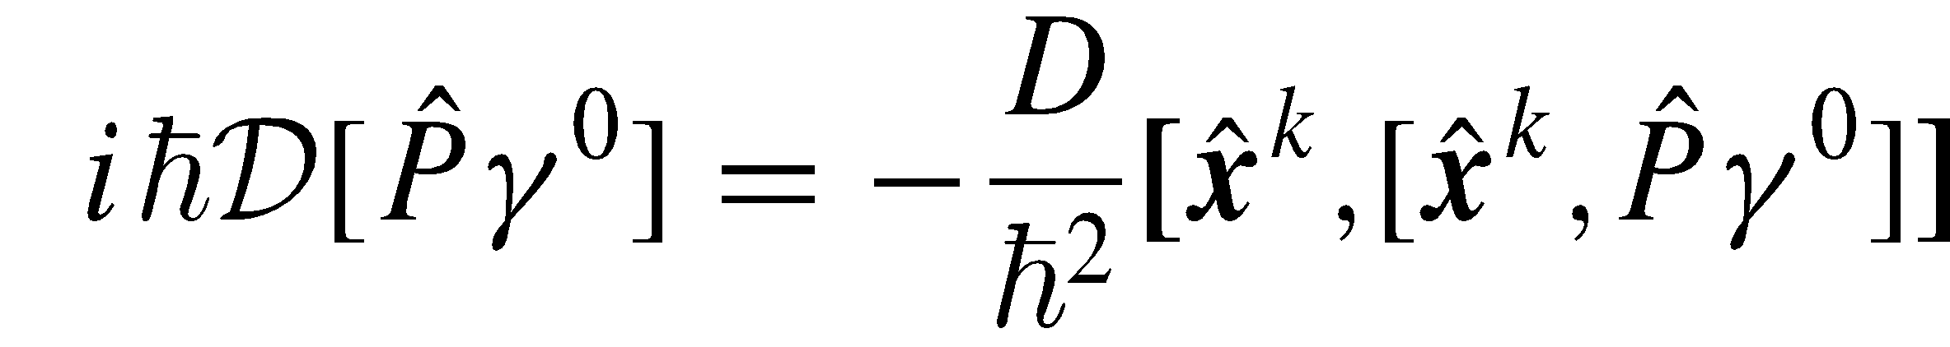
Quantum statistical mechanics
Noncovariant master equation
Covariant but not manifestly covariant (3+1 splitting)
Lindblad-like master equation
Dirac Hamiltonian
von Neumann equation
Example:
decoherence dissipator
The Landau–Pomeranchuk–Migdal effect: Role of multiple scattering in bremsstrahlung and pair production
A. B. Migdal, Dokl. Akad. Nauk SSSR 105, 77 (1955).
A. B. Migdal, Phys. Rev. 103, 1811 (1956).
No master equation
Notes:
https://en.wikipedia.org/wiki/Landau%E2%80%93Pomeranchuk%E2%80%93Migdal_effect

Slide 7
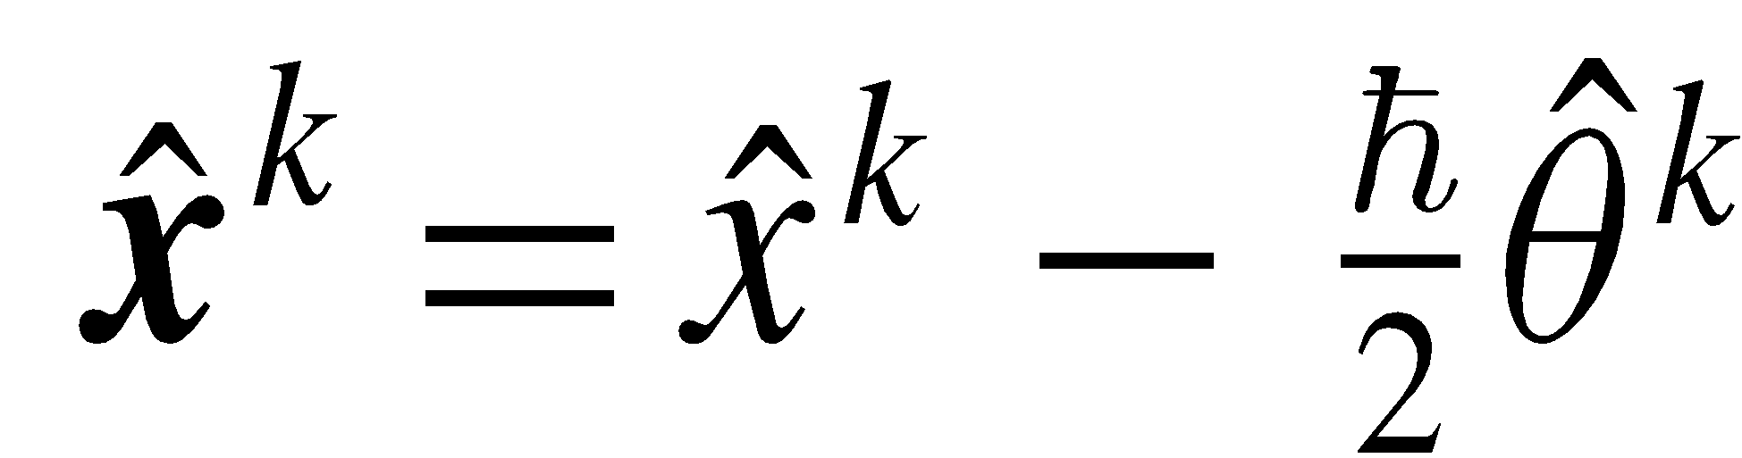
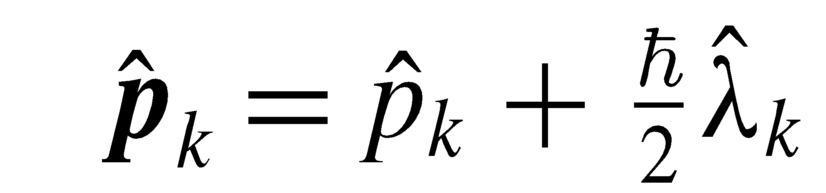
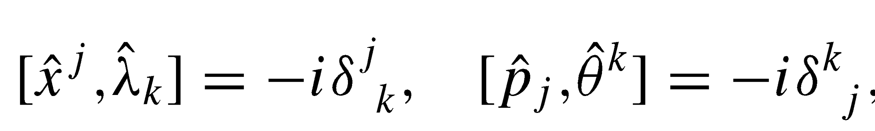
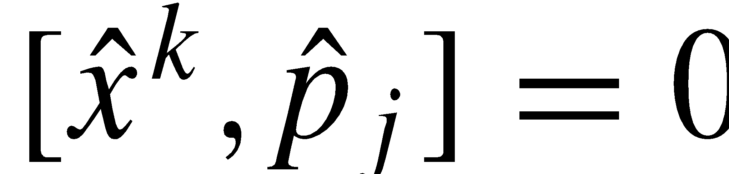
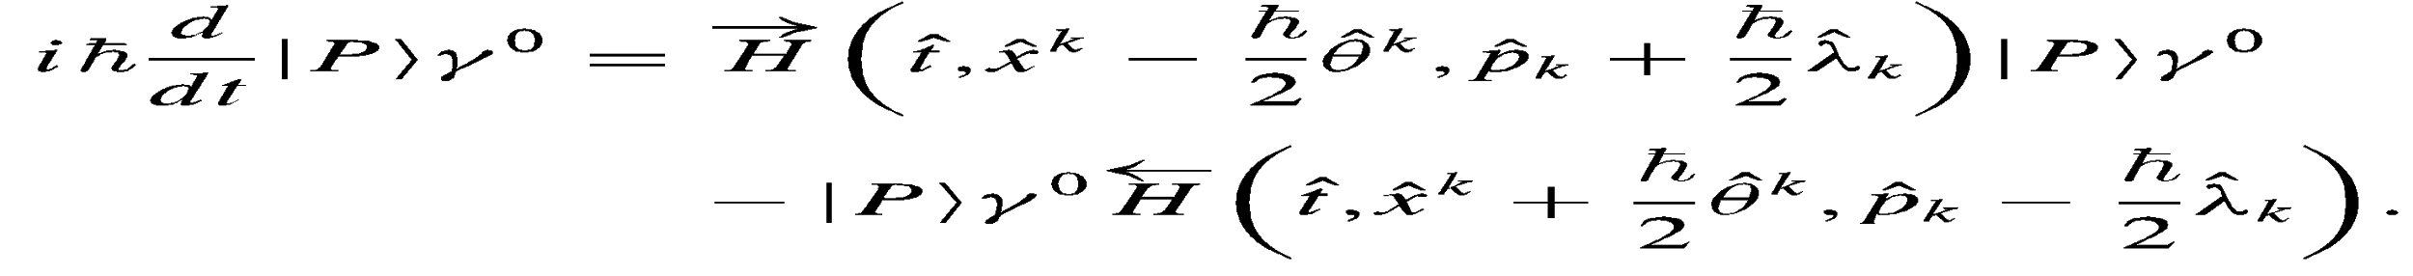
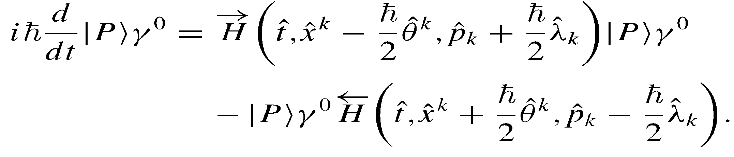

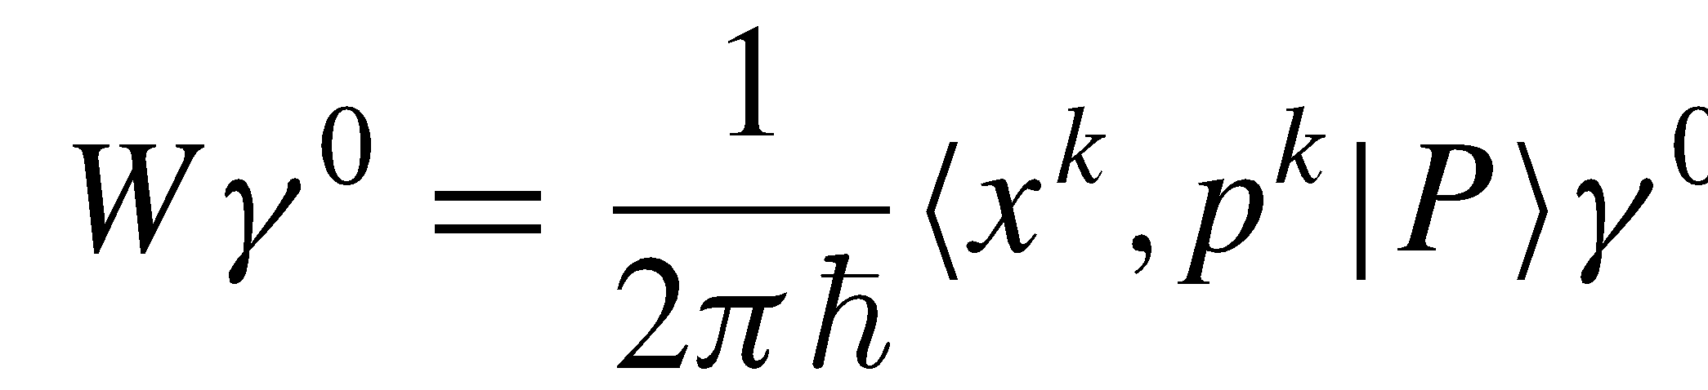
The Wigner-Dirac Function
[Following our non-relativistic approach Phys. Rev. A 92, 042122 (2015)]
The Bopp rotation: Going to the phase space
quantum phase space variables
classical phase-space variables
The Wigner-Dirac function:

Slide 8
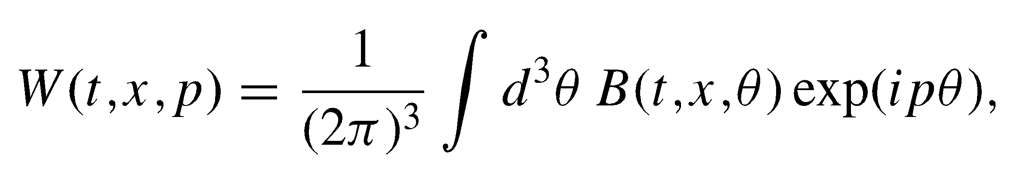
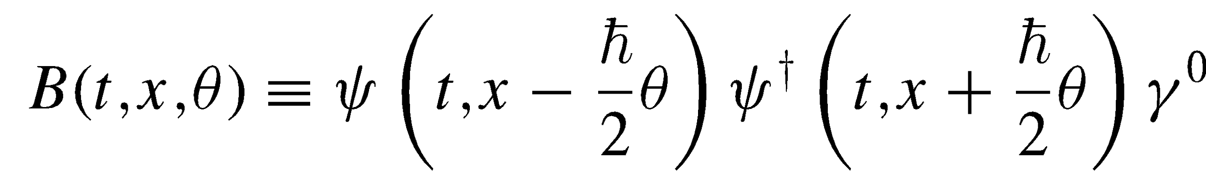
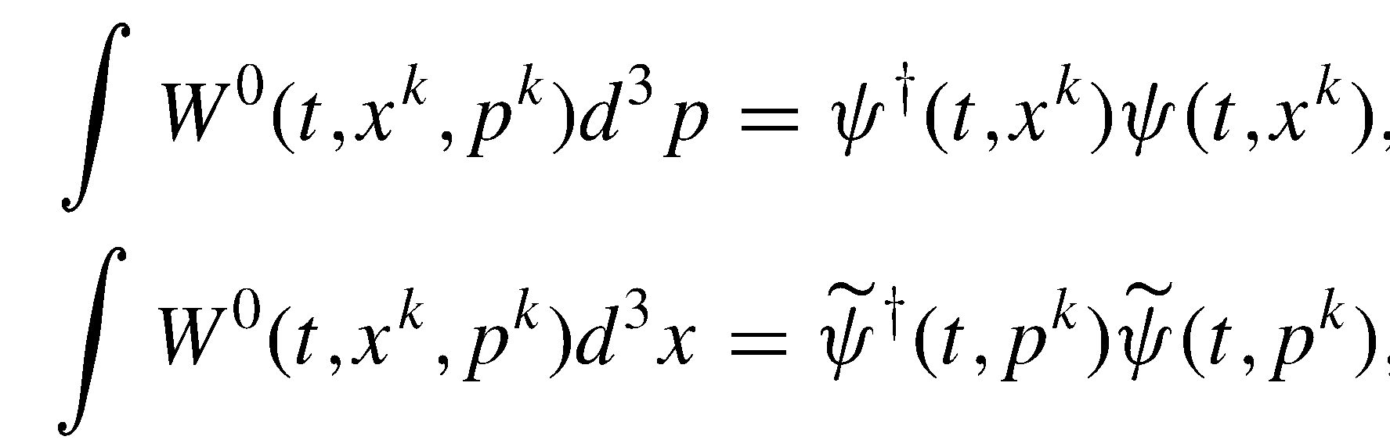
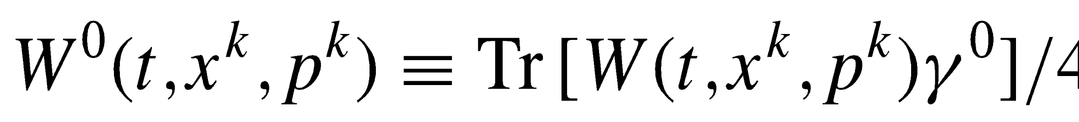
The Wigner-Dirac Function
4x4 Wigner matrix
Marginals
Wigner function

Slide 9
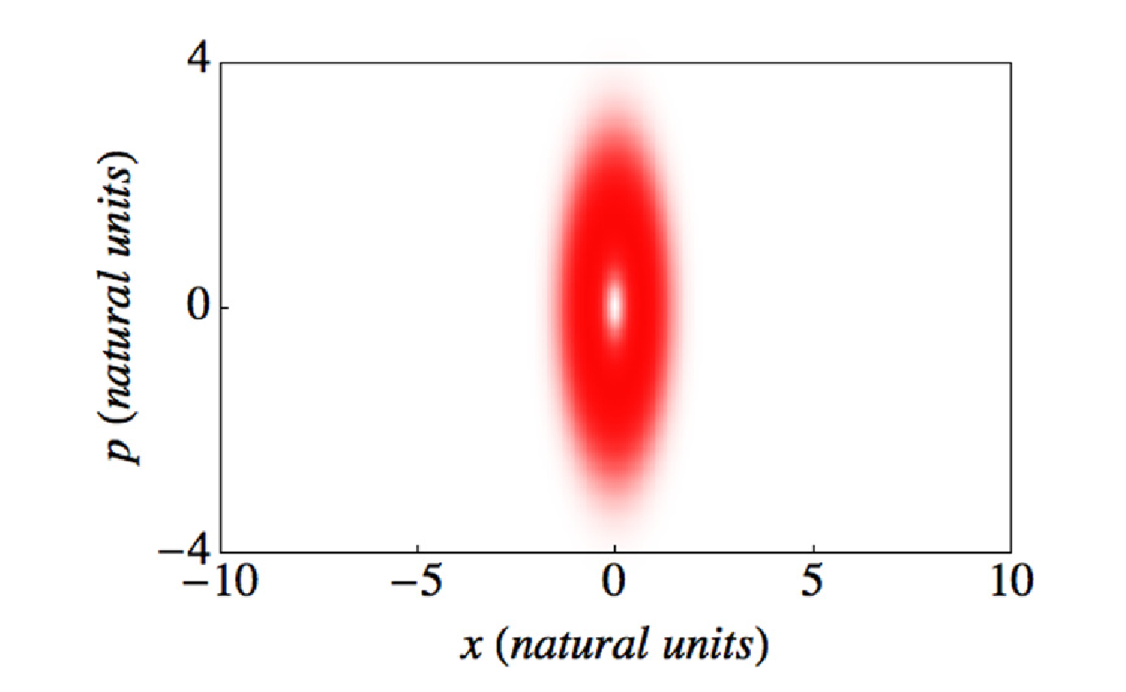
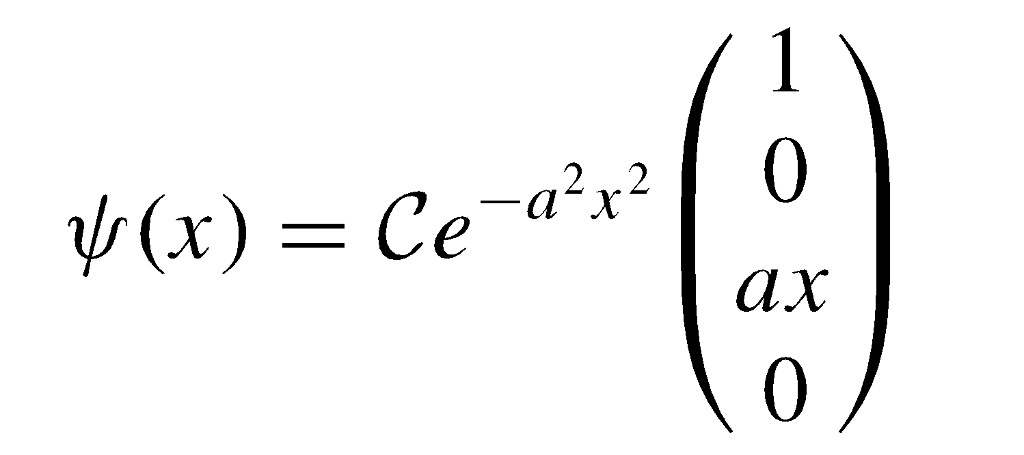
Nonrelativity vs Relativity
Hudson’s theorem is violated for the Dirac equation
[Phys. Rev. A 90, 034102 (2014)]
Counterexample:
Hudson’s theorem: The Wigner function for a pure state is positive if and only if the underlying wave function is a Gaussian
[R. Hudson, Rep. Math. Phys. 6, 249 (1974).]
The first-excited state of the Dirac equation for an electron in a constant and homogenous magnetic field.

Slide 10
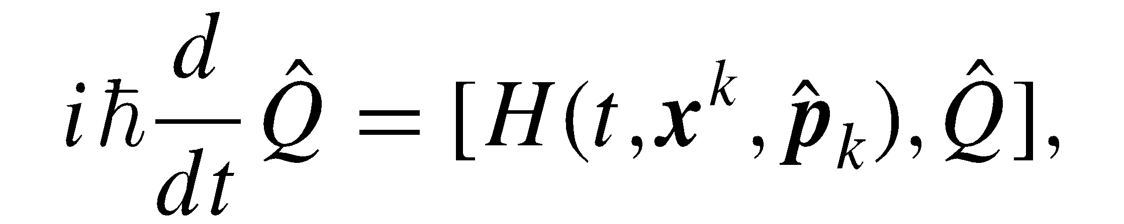
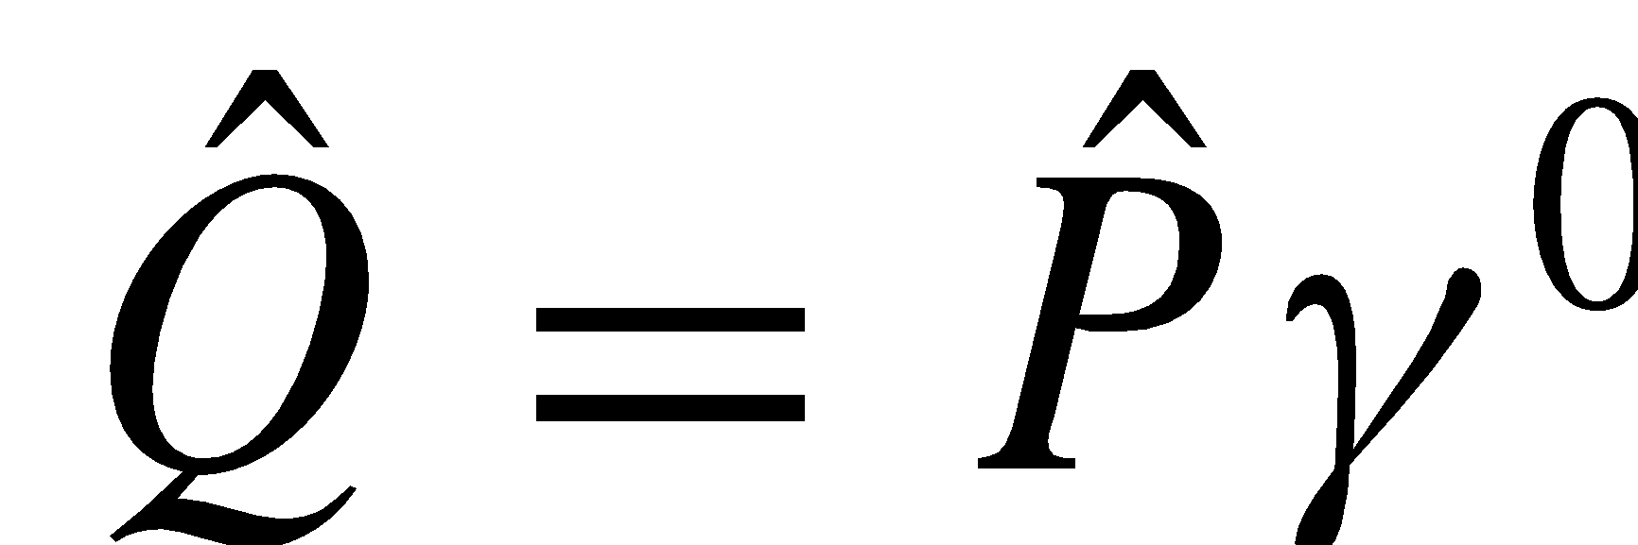
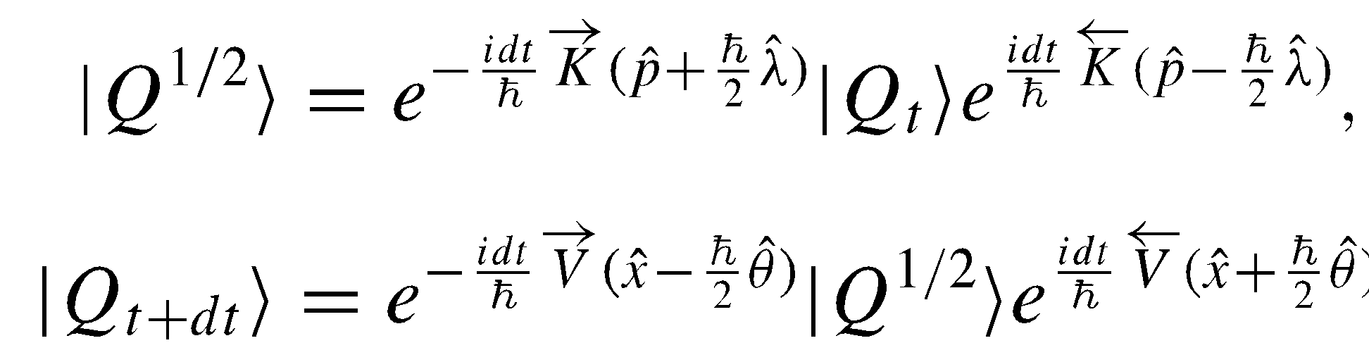
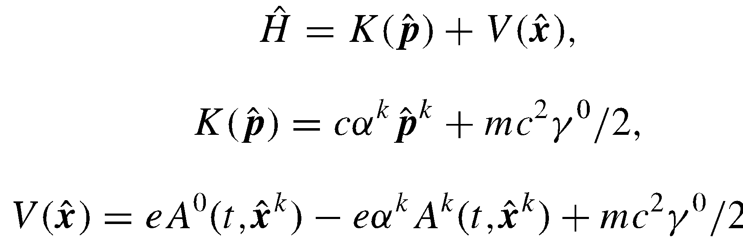
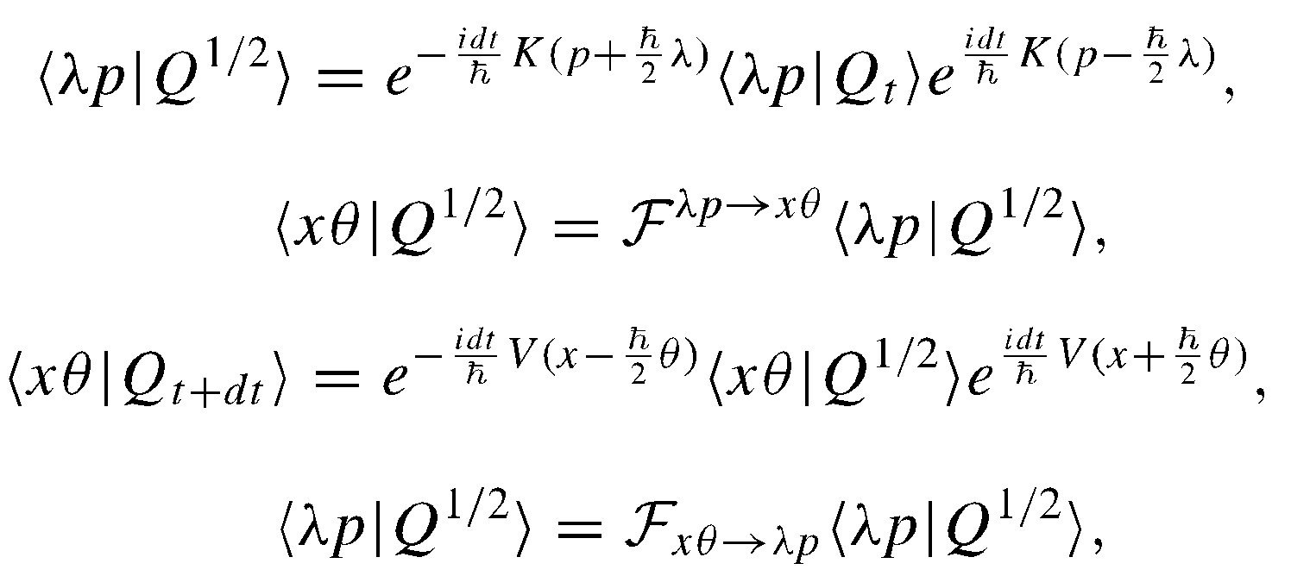
Symplectic method for the Wigner-Dirac
Bopp-rotated expressions
Final algorithm:
FFT
First-order split-operator propagator
[Following our non-relativistic approach Phys. Rev. A 92, 042122 (2015)]

Slide 11
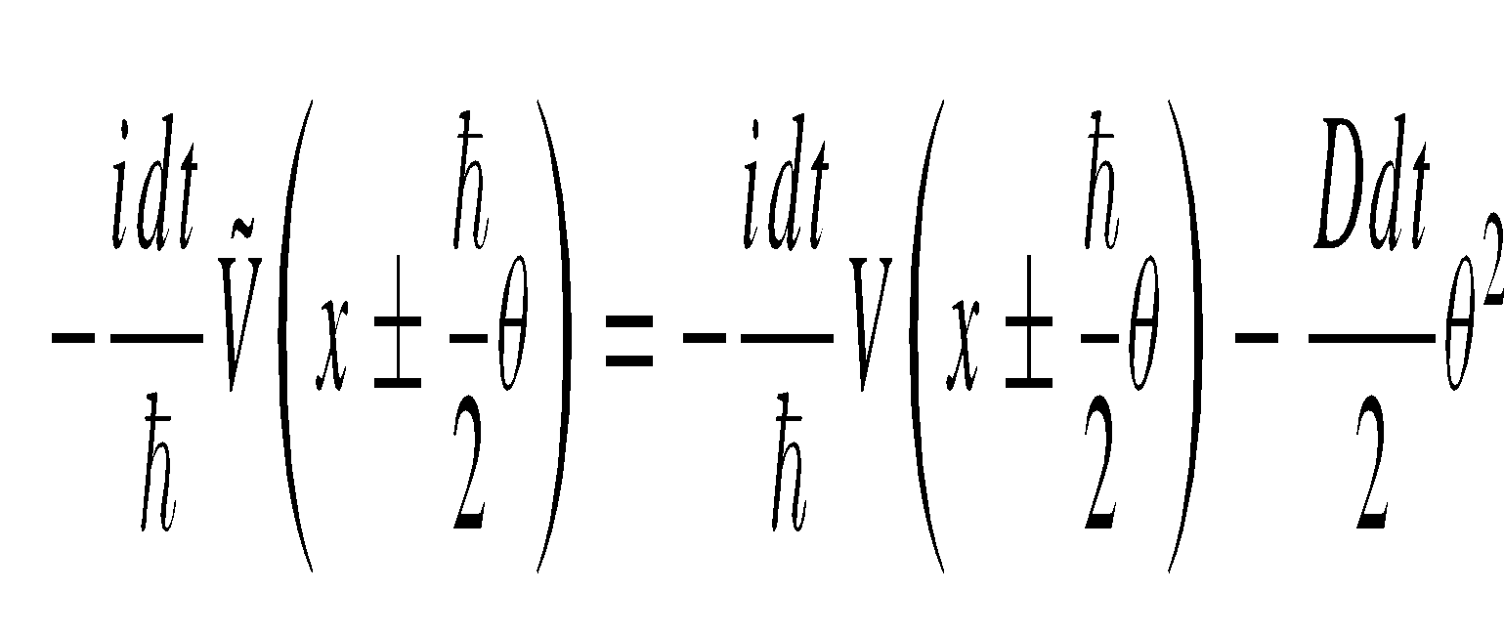
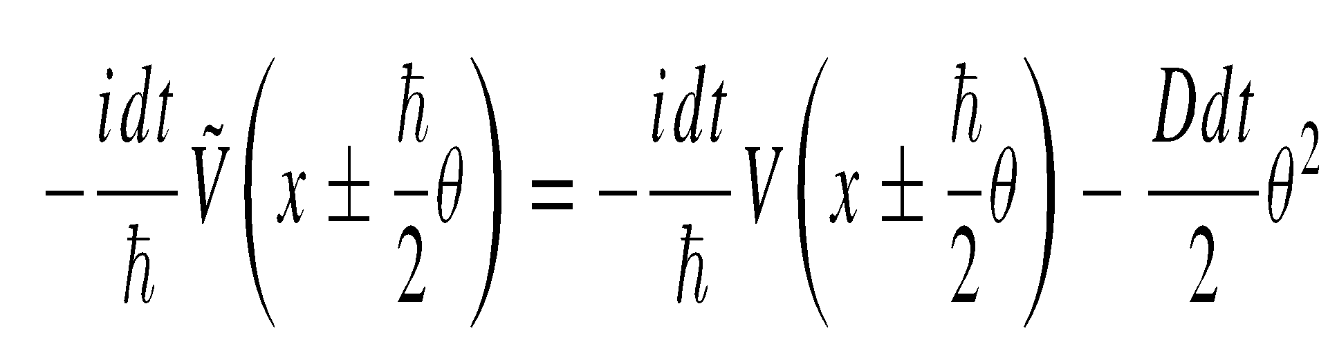
Including Decoherence
To include
Final algorithm:
replace
with

Slide 12
Illustrations

Slide 13
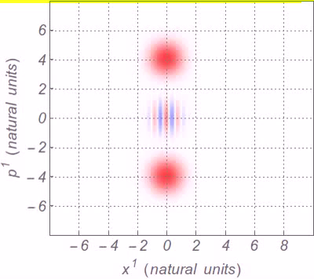
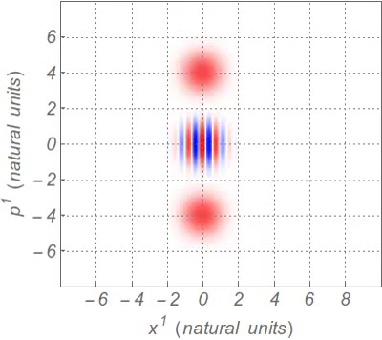
Robustness of Majorana spinors
Cat state undergoing decoherence
Majorana spinor undergoing decoherence

Slide 14
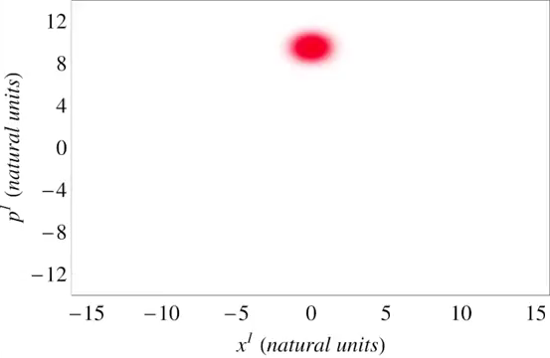
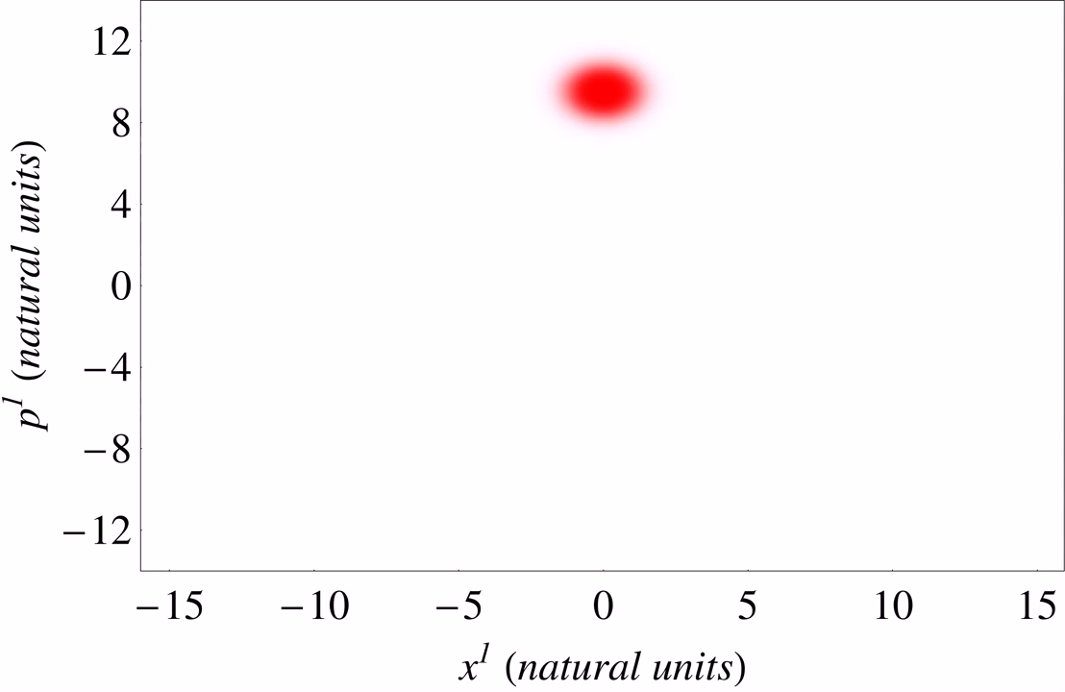
Klein paradox without decoherence
Klein paradox with
decoherence

Slide 15
Conclusions
The developed numerical propagator conserves energy and positivity of the density matrix
Provides intuitive representation of relativist dynamics in the phase space
Currently working on master equation to capture QED effects
Further info:
Phys. Rev. A. 94, 052111 (2016).
Eur. Phys. J. Special Topics 227, 2195 (2019).

