Slide 1

Design and Frontend Engineering of a Web-Based Point of Sale (POS) Management System
Industrial Training Defense, Summer 2026
Department of Computer Science and Engineering
Green University of Bangladesh

Slide 2
Presented By
Supervised By
Anisur Rahaman Maruf (ID 222902078)
Student
Department of Computer Science and Engineering
Green University of Bangladesh
Ms. Mayeesha Farjana
Lecturer
Department of Computer Science and Engineering
Green University of Bangladesh
Board Member
Most. Rokeya Khatun
Lecturer
Department of Computer Science and Engineering
Green University of Bangladesh
Ms. Sagufta Sabah Nakshi
Lecturer
Department of Computer Science and Engineering
Green University of Bangladesh
Page-02
Industrial Training Defense, Summer 2026

Slide 3
Content
1. Problem Domain & UI/UX Solution
7. POS System Interfaces
2. Training Motivation & Objectives
8. Specific Details on Training
3. Academia vs. Industry Gap
9. Acquired Skills During Industrial Training
4. Industrial Training Details Plan
10. Academic PO & UN SDG Mapping
5. Organization Overview & Internship Role
11. Conclusion
6. System Architecture & Template Design
12. Reference
Page-03
Industrial Training Defense, Summer 2026

Slide 4
Introduction
Problem Domain
Retail Counter Bottlenecks (The Problem):
  Cluttered user interfaces & complex navigation
  Slow manual checkouts & long customer queues
  Frequent cashier input and calculation errors
  Lack of screen responsiveness on counter devices
Page-04
Industrial Training Defense, Summer 2026

Slide 5
Training Motivation & Objectives
Training Motivation:
  Bridging academic CSE coursework with industry-grade web development
  Transitioning from static assignments to dynamic, live software systems
  Mastering frontend UI/UX engineering within commercial workflows
Core Technical Objectives:
  Responsive UI Design: Engineering multi-device templates using Bootstrap 5
  Client-Side Interactivity: Implementing zero-reload cart scripts using Vanilla JS
  Print-Ready Invoices: Designing custom @media print CSS stylesheets
  Team Collaboration: Version control and template synchronization via Git/GitHub
Page-05
Industrial Training Defense, Summer 2026

Slide 6
Academia vs. Industry Gap
Academic Environment (Classroom Learning):
  Theoretical algorithms & isolated programming assignments
  Static web pages without real-time database binding
Industry Environment (O’dell Tech Ltd.):
  Production-ready web application with dynamic ORM context binding
  Multi-developer collaboration via Git/GitHub & cross-browser QA
Page-06
Industrial Training Defense, Summer 2026

Slide 7
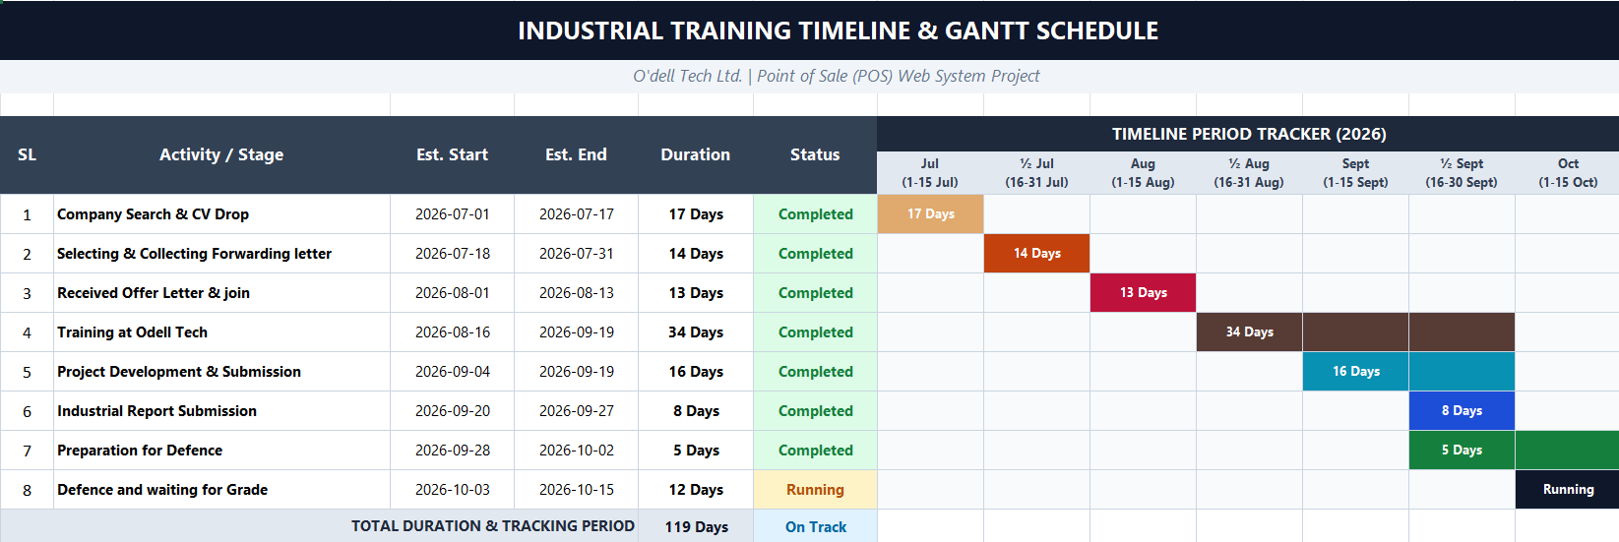
Industrial Training Details Plan
Page-07
Industrial Training Defense, Summer 2026

Slide 8
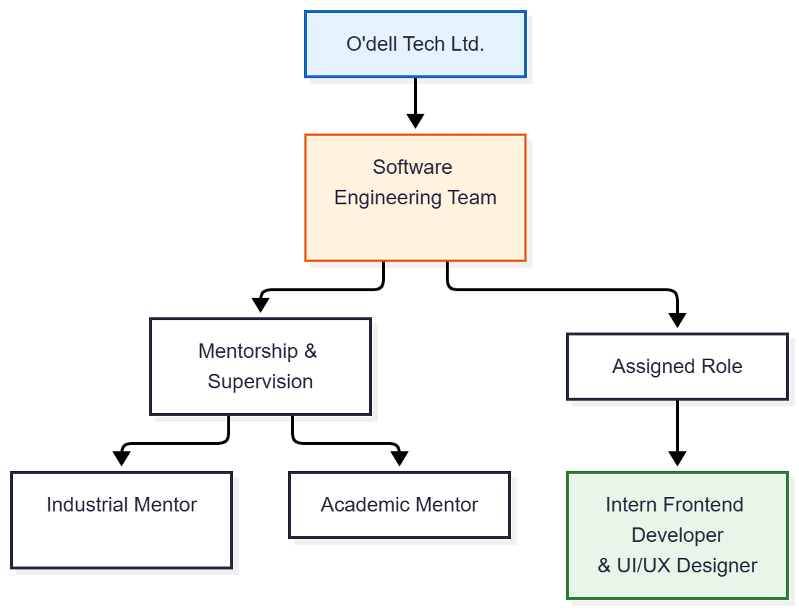
Organization Overview & Internship Role
Host Organization Profile:
O’dell Tech Ltd., a sister concern of O’dell Group located in Mirpur DOHS, Dhaka, specializes in enterprise software solutions and RMG sector digitalization.
Assigned Role & Supervision:
As an Intern Frontend Developer & UI/UX Designer in the software development team, my focus was engineering responsive, user-centric web interfaces under academic and industrial mentorship.
Page-08
Industrial Training Defense, Summer 2026

Slide 9
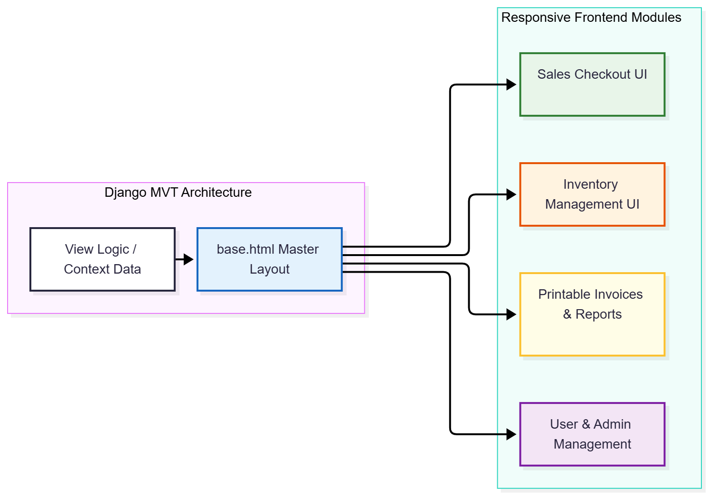
System Architecture & Template Design
Django MVT Architecture:
  Decoupled presentation layer separating HTML templates from backend logic & database ORM
Modular Template Inheritance:
  Central base.html providing unified navigation, sidebars, and styling across all modules
  Specialized templates inheriting base styles for Sales, Inventory, and User Management
Page-09
Industrial Training Defense, Summer 2026

Slide 10

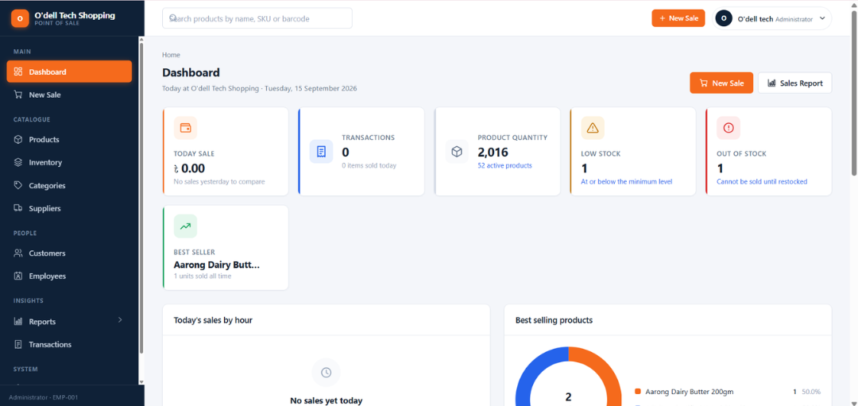
POS System Interfaces
Log in Interface
Dashboard
Page-10
Industrial Training Defense, Summer 2026

Slide 11
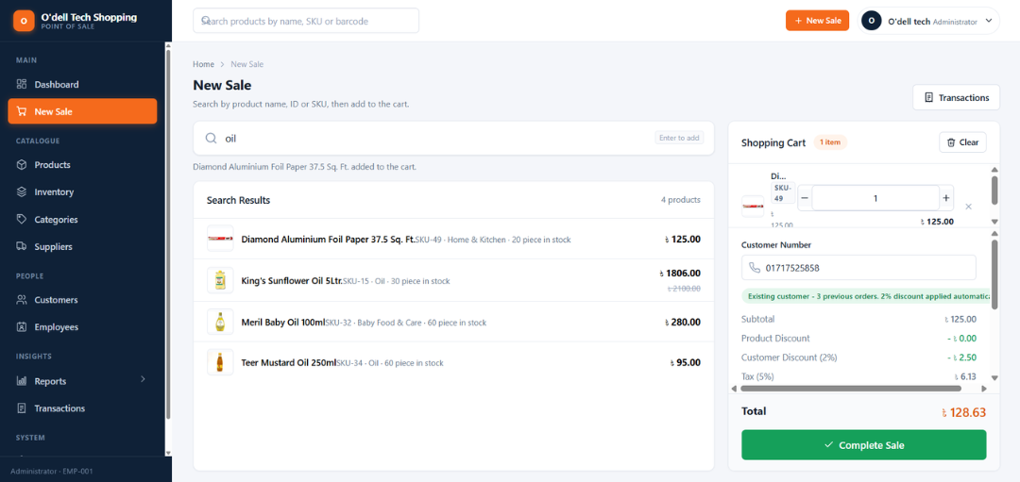
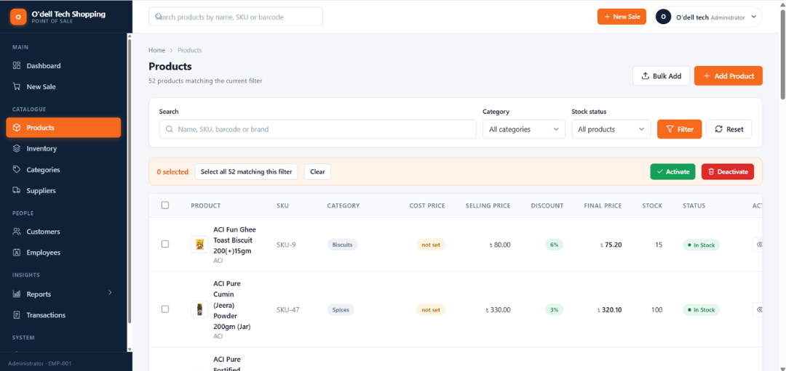
POS System Interfaces
Cart
Product
Page-11
Industrial Training Defense, Summer 2026

Slide 12
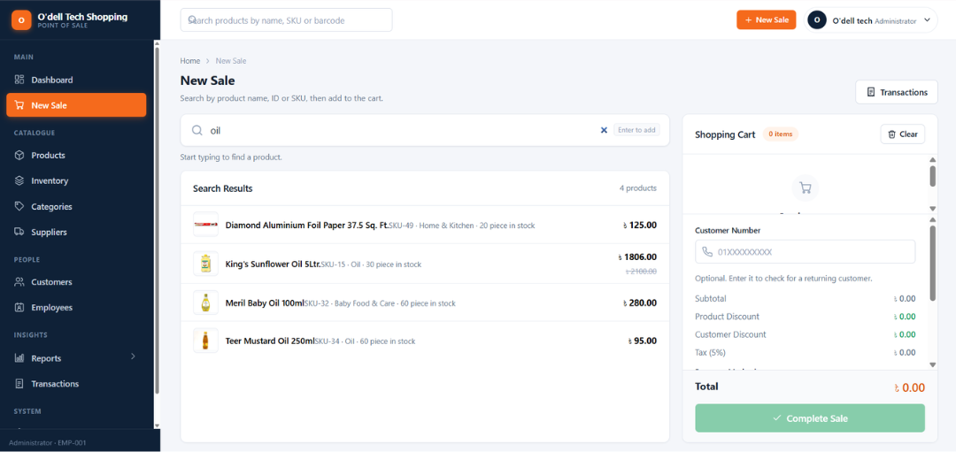
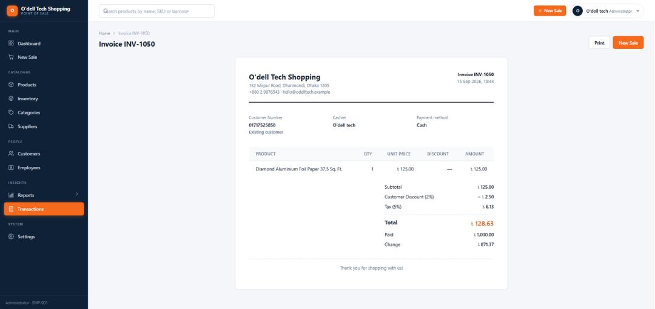
POS System Interfaces
New Sale
Invoice
Page-12
Industrial Training Defense, Summer 2026

Slide 13
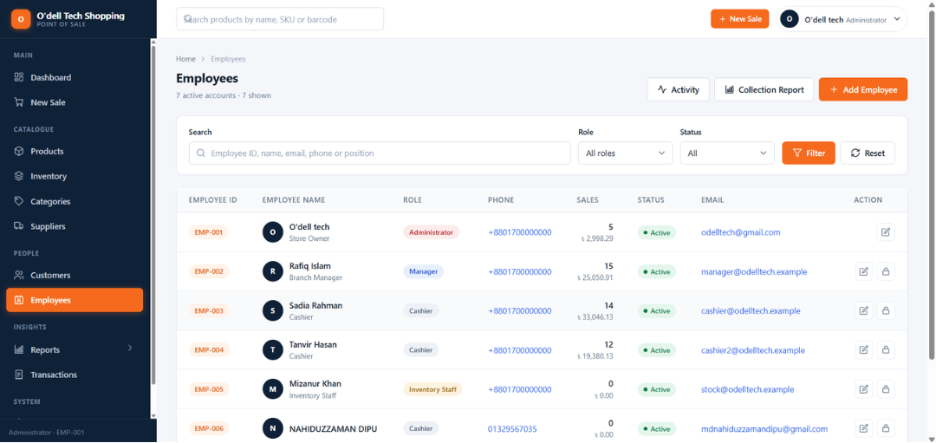
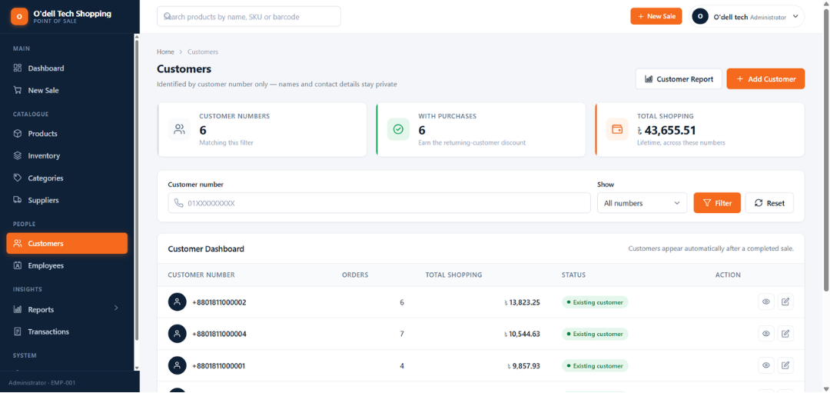
POS System Interfaces
Employee List
Customer List
Page-13
Industrial Training Defense, Summer 2026

Slide 14
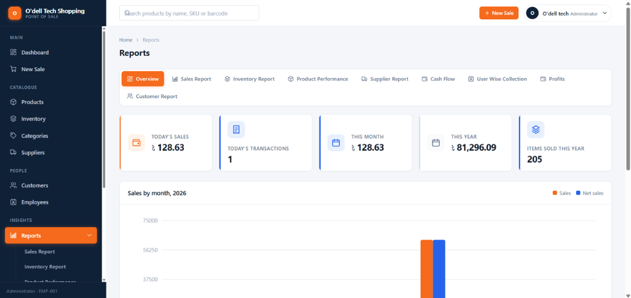
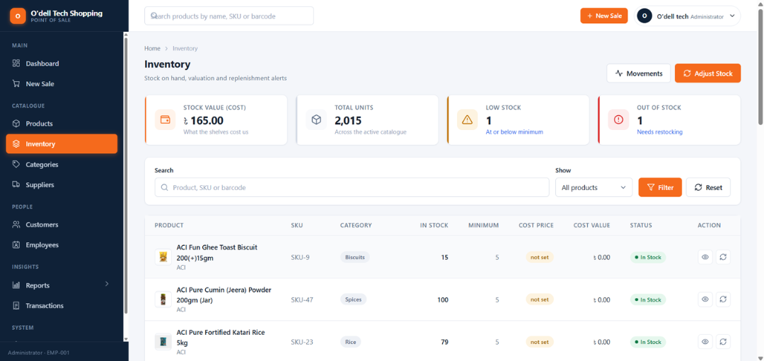
POS System Interfaces
Report
Inventory
Page-14
Industrial Training Defense, Summer 2026

Slide 15
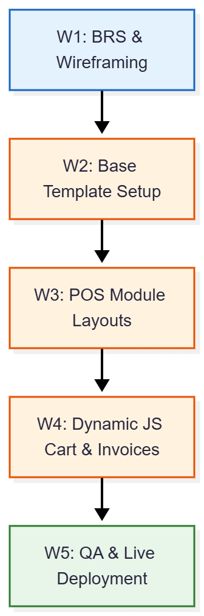
Specific Details on Training
Week 1 (16–20 Aug)
Orientation, BRS analysis & Django architecture
Week 2 (23–27 Aug)
Django practice & task-management app
Week 3 (30 Aug–2 Sep)
POS interface planning & module layouts
Week 4 (8–13 Sep)
Customer/Inventory modules, dynamic cart & testing
Week 5 (14–19 Sep)
QA, retesting & live deployment on pos.odelltech.com
Page-15
Industrial Training Defense, Summer 2026

Slide 16
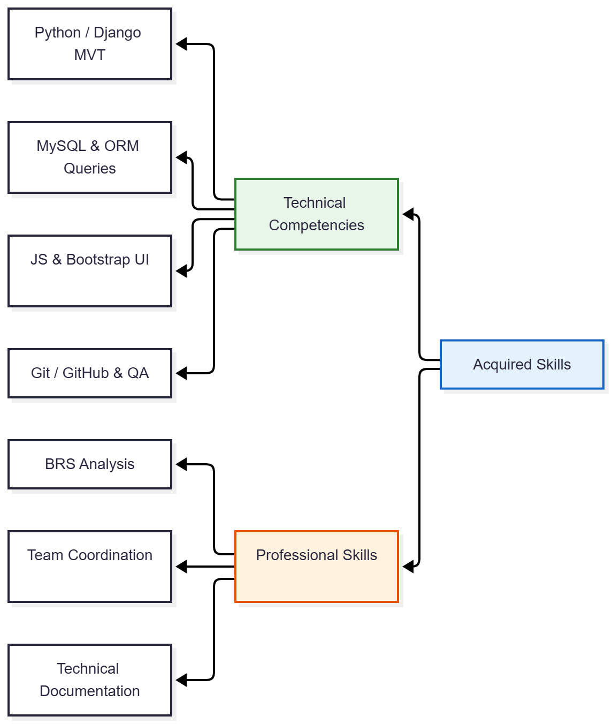
Acquired Skills During Industrial Training
Technical Core Competencies:
  Python & Django: Views, models, ORM queries, forms, authentication, & service logic
  MySQL Database: Migrations, relational design, transactional updates, & stock validation
  Frontend Engineering: HTML, CSS, JavaScript, and Django responsive templates
  DevOps & QA: Git/GitHub version control, debugging, & cross-browser testing
Professional & Workplace Skills:
  BRS requirement analysis, technical documentation, teamwork, & presentation skills
Page-16
Industrial Training Defense, Summer 2026

Slide 17
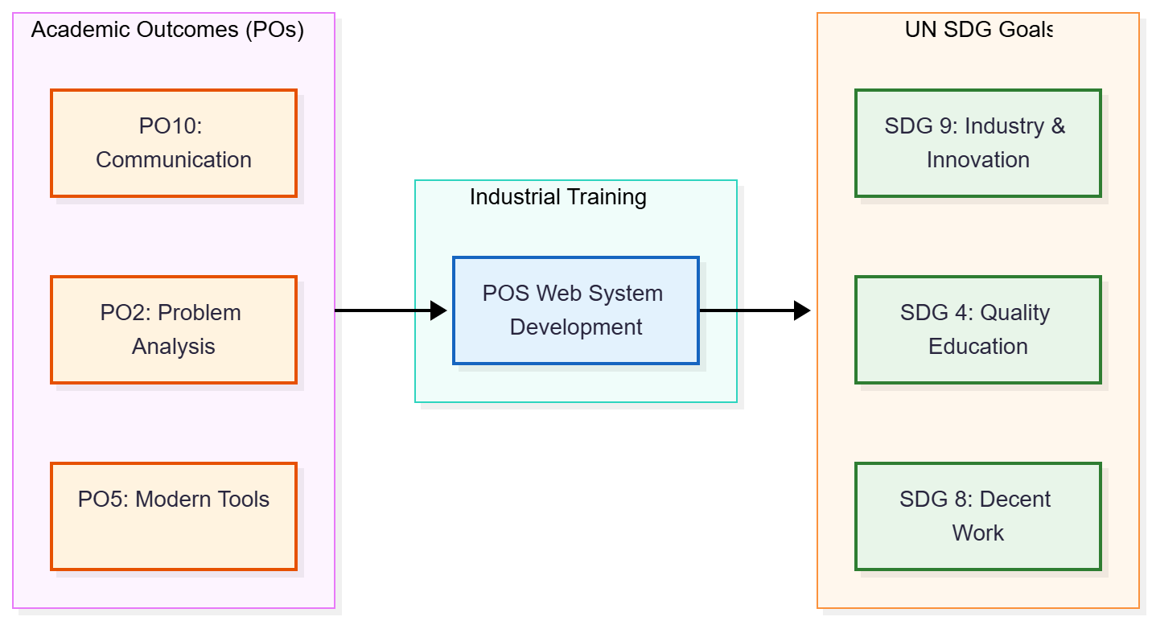
Academic PO & UN SDG Mapping
Academic Program Outcomes (Green University POs):
  PO2 (Problem Analysis) & PO5 (Modern Tool Usage): Analyzing retail business rules & applying Django, MySQL, Git/GitHub
  PO8 (Ethics), PO10 (Communication) & PO12 (Life-Long Learning): Accurate documentation, team collaboration, & continuous self-learning
UN Sustainable Development Goals (SDGs):
  SDG 4 (Quality Education): Transforming theoretical classroom knowledge into practical industry learning
  SDG 8 (Decent Work) & SDG 9 (Industry & Innovation): Developing workplace readiness & digitalizing retail business operations
Page-17
Industrial Training Defense, Summer 2026

Slide 18
Conclusion
My five-week industrial training at O’dell Tech Ltd. successfully bridged academic software engineering theory with practical industry standards. By engineering and deploying a functional, responsive Web POS system, I gained hands-on experience in Django MVT architecture, client-side JavaScript interactivity, custom invoice print styling, and production web deployment.
Page-18
Industrial Training Defense, Summer 2026

Slide 19
Reference
[1] O’dell Tech Ltd., “O’dell Tech,” company information and services.
[2] Python Software Foundation, “Python Documentation.”
[3] Django Software Foundation, “Django Documentation.”
[4] Oracle, “MySQL 8.4 Reference Manual.”
[5] Git, “Git Documentation.”
[6] OWASP Foundation, “OWASP Web Security Testing Guide.”
[7] United Nations, “Sustainable Development Goals.”
[8] Green University of Bangladesh, Department of CSE, Industrial Training / CSE curriculum materials.
Page-19
Industrial Training Defense, Summer 2026

Slide 20
Thank You
Page-20
Industrial Training Defense, Summer 2026

