Slide 1

Tourism management system
Presented to: Asif khan Shakir
Senior Lecturer
Dept. of SWE
Presented By:
Maruf Islam Bhuiyan (173-35-2268)
Sakibul Alam Ador (173-35-2272)
Eshita Akter (173-35-2214)

Slide 2
Abstract
Tourism Management is management of all activities related to tourism business. This site introduces you to various types of tourism places, geographical nature, destination awareness, development, and management market segmentation, tourism products and services and trends in tourism. Tourism was mainly been traditional in its early form. With the evolution of cultures, economies, and knowledge, tourism took a different form called sustainable tourism with the aspect of well-planned tour, well-studied destination, and conservation of destination.

Slide 3
Functional Requirements
Functional Requirements for Customer :
Sign in
Sign up
View Packages
Booking/Cancel
View Booking
Enquiry
Update Profile

Slide 4
Functional Requirements
Functional Requirements for Admin :
Login
View Booking
Delete / Update Places
Confirmation
Manage Users

Slide 5
Non-Functional Requirements
Color
Reliability
Maintainability
Efficiency
Security

Slide 6
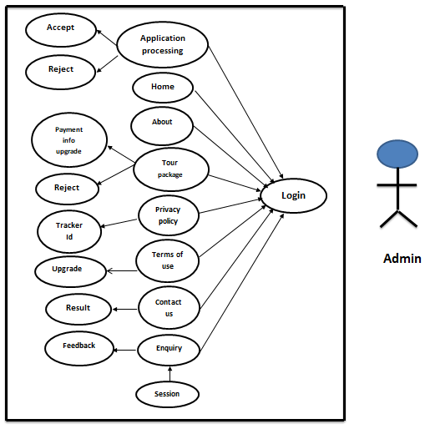
Use Case Diagram for Admin

Slide 7
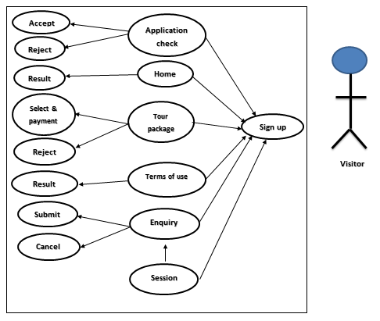
Use Case Diagram for Visitors

Slide 8
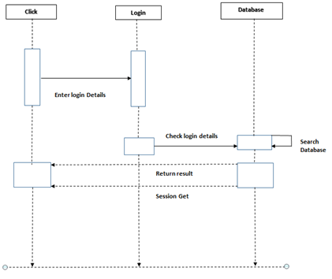
Sequence Diagram
Fig. Sequence Diagram For Login

Slide 9
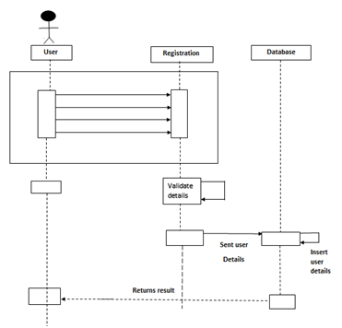
Sequence Diagram
Fig. Sequence Diagram For Signup

Slide 10
Future Enhancement
Digital Payment System
Discount or Voucher System
Guest profile
Purchase Products

Slide 11
Thank
You !

