Slide 1
CSE221 Presentation
Presented by,
Samanta Karmaker
ID: 20101436
Section: 5
Maruf Morshed
ID: 20101299
Section: 5
Department of Computer Science and Engineering,
Brac University.
Presented to,
Shaily Roy
Lecturer,
Department of Computer Science and Engineering,
Brac University.

Slide 2
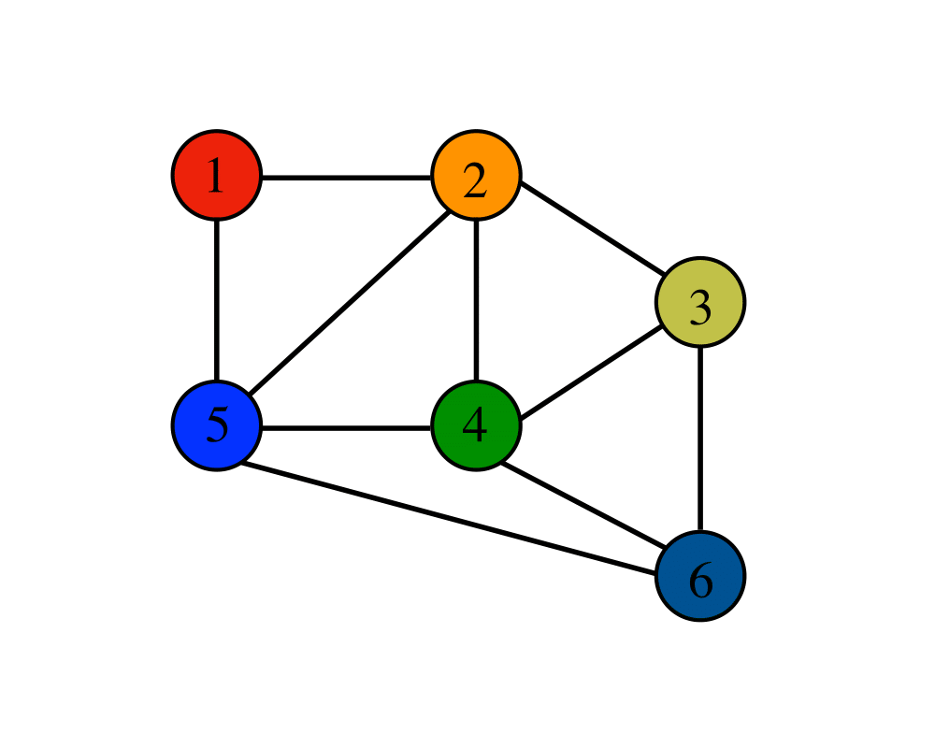
Detecting cycle in a graph using DFS

Slide 3
Problem Description
Cycle Detection.
Have to Use Depth First Search (DFS)

Slide 4
A Quick recap

Slide 5
A Quick recap
What is a cycle?
A
B
C
Here,
B-> E-> F->B
is a cycle
D
E
F

Slide 6
A Quick recap
How DFS works?

Slide 7
Algorithm Idea
Colours
White -> unvisited nodes
Gray -> visited but not completely processed yet
Black -> visited and completely processed

Slide 8
Algorithm Idea
Modify DFS such that it looks for both white and gray nodes.
If it gets a white node, move on.
If it gets a gray node, stop and return true.
If after the end of the traversal, no cycle is found return false.

Slide 9
Algorithm Idea
REMEMBER:
GRAY -> GRAY EDGE = CYCLE

Slide 11
Simulation
A
B
C
D
E
F

Slide 12
Simulation
1/
A
B
C
D
E
F

Slide 13
Simulation
1/
2/
A
B
C
D
E
F

Slide 14
Simulation
1/
2/
3/
A
B
C
D
E
F

Slide 15
Simulation
1/
2/
3/4
A
B
C
D
E
F

Slide 16
Simulation
1/
2/
3/4
A
B
C
D
E
F
5/

Slide 17
Simulation
1/
2/
3/4
A
B
C
D
E
F
5/
6/

Slide 18
Simulation
1/
2/
3/4
A
B
C
D
E
F
5/
6/

Slide 19
Simulation
1/
2/
3/4
A
B
C
D
E
F
5/
6/

Slide 20
Simulation
1/
2/
3/4
A
B
C
D
E
F
5/
6/
B->E->F->B

Slide 21
CSE221 Presentation
Presented by,
Samanta Karmaker
ID: 20101436
Section: 5
Maruf Morshed
ID: 20101299
Section: 5
Department of Computer Science and Engineering,
Brac University.
Presented to,
Shaily Roy
Lecturer,
Department of Computer Science and Engineering,
Brac University.

Slide 22
Pseudocode
Create an map Color [Size = no. of vertices] //Global variable
DFS_Detect_Cycle(G):
For each vertex a ∈ G
Do color[a] = white
For each vertex a ∈ G
Do if color[a] == white:
Then flag = DFS_Detect_Cycle_Util(G,a)
If flag == true
Break
Return flag

Slide 23
Pseudocode
DFS_Detect_Cycle_Util(G,u):
Create an empty stack S
S.push(u)
Do color[u]<- Grey
While S is not empty
Do u<-S.pop()
If no v adjacent to u ∈ G Do
Color[u]<-- Black
S.pop(u)
for all v adjacent to u ∈ G where v is not the parent
if color[v]=White
Do S.push(v)
Do color[v]<- Grey
Else if color[v]= Grey
Return True
End Iteration
Return False
End

Slide 24
Time complexity
Create an map Color [Size = no. of vertices] //Global variable
DFS_Detect_Cycle(G):
For each vertex a ∈ G
Do color[a] = white
For each vertex a ∈ G
Do if color[a] == white:
Then flag = DFS_Detect_Cycle_Util(G,a)
If flag == true
Break
Return flag
O(V)
O(V)

Slide 25
Time Complexity
DFS_Detect_Cycle_Util(G,u):
Create an empty stack S
S.push(u)
Do color[u]<- Grey
While S is not empty
Do u<-S.pop()
If no v adjacent to u ∈ G Do
Color[v]<-- Black
S.pop(u)
for all v adjacent to u ∈ G where v is not the parent
if color[v]=White
Do S.push(v)
Do color[u]<- Grey
Else if color[v]= Grey
Return True
End Iteration
Return False
End
∴ Total time complexity = O(|V| + |E|)
O(V)
O(E)

Slide 26
Uses and variations
Used to find out Deadlock in OS (Wait for graph)
Used in pseudorandom number generator.
Used to find out DAGs. DAGs are important in Topological Sort.
Detection of infinite loops in certain Computer Programs.
Periodic configuration in cellular automata.
Use in other Algorithm
Floyd’s Tortoise and Hare Algorithm.
Brent’s Algorithm.
Gosper’s Algorithm.

Slide 27
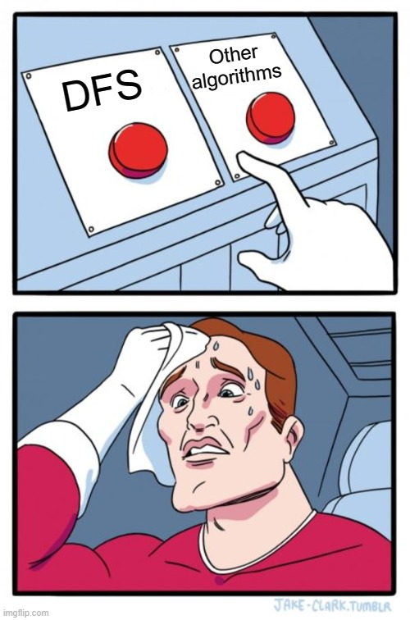

Slide 28
Variations
BFS can be used but doesn’t gives appropriate results every time.
DFS is way more simpler than most other algorithms.

Slide 29


