Slide 1
Continual Learning for Natural Language Generations with Transformer Calibration
Presentation By,
Maruf Morshed
20101299
Section: 01

Slide 2
Table of contents
Introduction
Related Work
01
02
Method
Empirical Experiments
03
04
Continual Learning, Continual Language Generation,
Preliminary, Transformer Calibration, Learning Calibration Parameters , Optimization.
Application: Paraphrase Generation, Experimental Results (Accuracy Measurement, Forgetting Measurement) etc.

Slide 3
Table of contents
Conclusion
05

Slide 4
01
Introduction

Slide 5
02
Related Work

Slide 6
Continual Learning.
Continual Language Generation.

Slide 7
03
Method

Slide 8
Preliminary
Transformer Calibration
Learning Calibration Parameters
Optimization

Slide 9
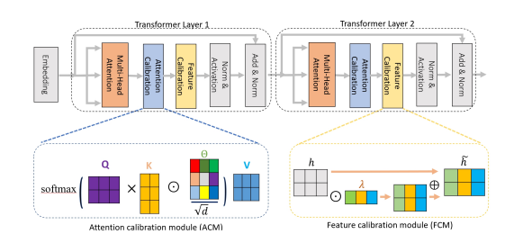
Transformer Calibration

Slide 10

Learning Calibration Parameters

Slide 11


Optimization

Slide 12
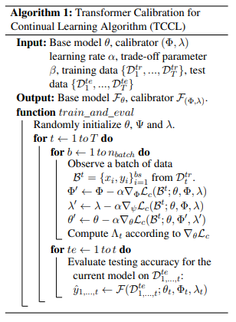

Slide 13
04
Empirical Experiments
You can enter a subtitle here if you need it

Slide 14
Application: Paraphrase Generation
Dataset
Experimental Setting (Finetune, Full, EWC)
Experimental Results
Accuracy Measurement
Forgetting Measurement.

Slide 15
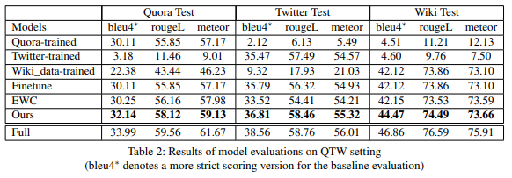
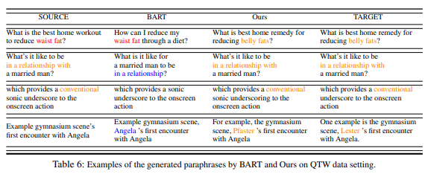

Slide 16
Application: Dialog Response Generation
Dataset
Experimental Setting (Finetune, Full, ARPER, ER)
Comparison Results
Dynamic Results in Continual Learning

Slide 17
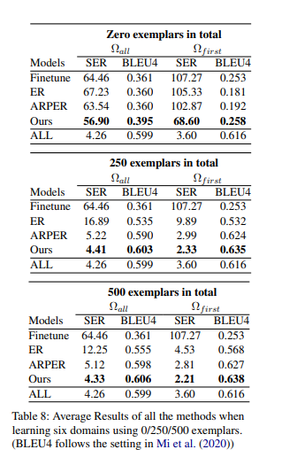
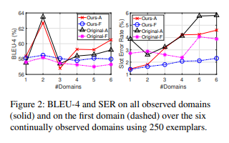

Slide 18
05
Conclusion
You can enter a subtitle here if you need it

Slide 19
Thanks!

