Slide 1


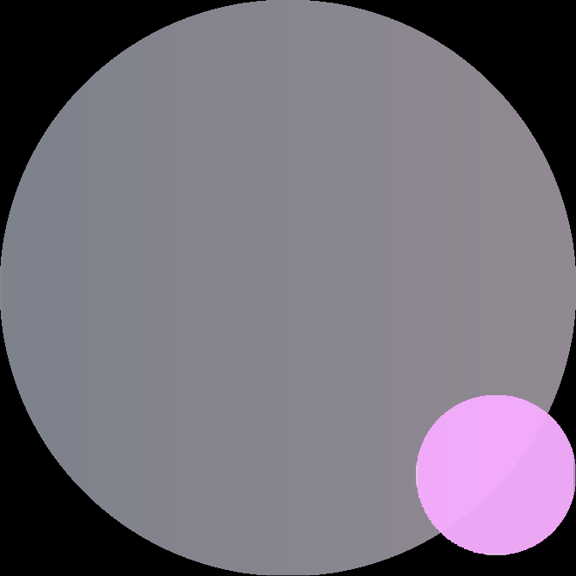
Online Medication and Prescription Tracker
MEDICARE
A smart platform connecting Doctors, Patients, Staff & Admins for seamless prescription
management and real-time medication adherence tracking
Page 01

Slide 2




PROBLEM STATEMENT
Patients forget to take medicines on time — leading to poor health outcomes
No live communication channel between doctor, patient and caretaker
Doctors have no real-time visibility into whether patients follow prescriptions
Hospital staff waste time manually tracking patient medication schedules
Paper prescriptions are easily lost, misread or forgotten entirely
No centralized system to monitor and report adherence across all patients
Page 02

Slide 3





OBJECTIVE & OVERVIEW
MediCare is a role-based digital health platform built to solve medication non-adherence through smart automation and AI.
Enable doctors to issue digital prescriptions with precise per-slot timing
Give hospital staff a live dashboard to monitor all patients per shift
Allow patients to track and mark daily medicine intake in real time
Give admins full control over user management and approvals
✦
Auto-classify medicine status: On Time, Late or Missed — by clock
Integrate an AI chatbot using patient's real prescription data from DB
Page 03

Slide 4





KEY FEATURES
DOCTOR
PATIENT
STAFF
ADMIN
• Digital prescriptions
• Today's medicine schedule
• Monitor all patients live
• Approve/reject doctors
• Per-slot meal & time settings
• Mark taken (auto On Time/Late)
• Mark medicines per shift
• System-wide stats & charts
• Accept patient requests
• AI chatbot queries
• Live shift-based dashboard
•Activate/deactivate users
• Prescription history
• Track adherence %
Page 04

Slide 5
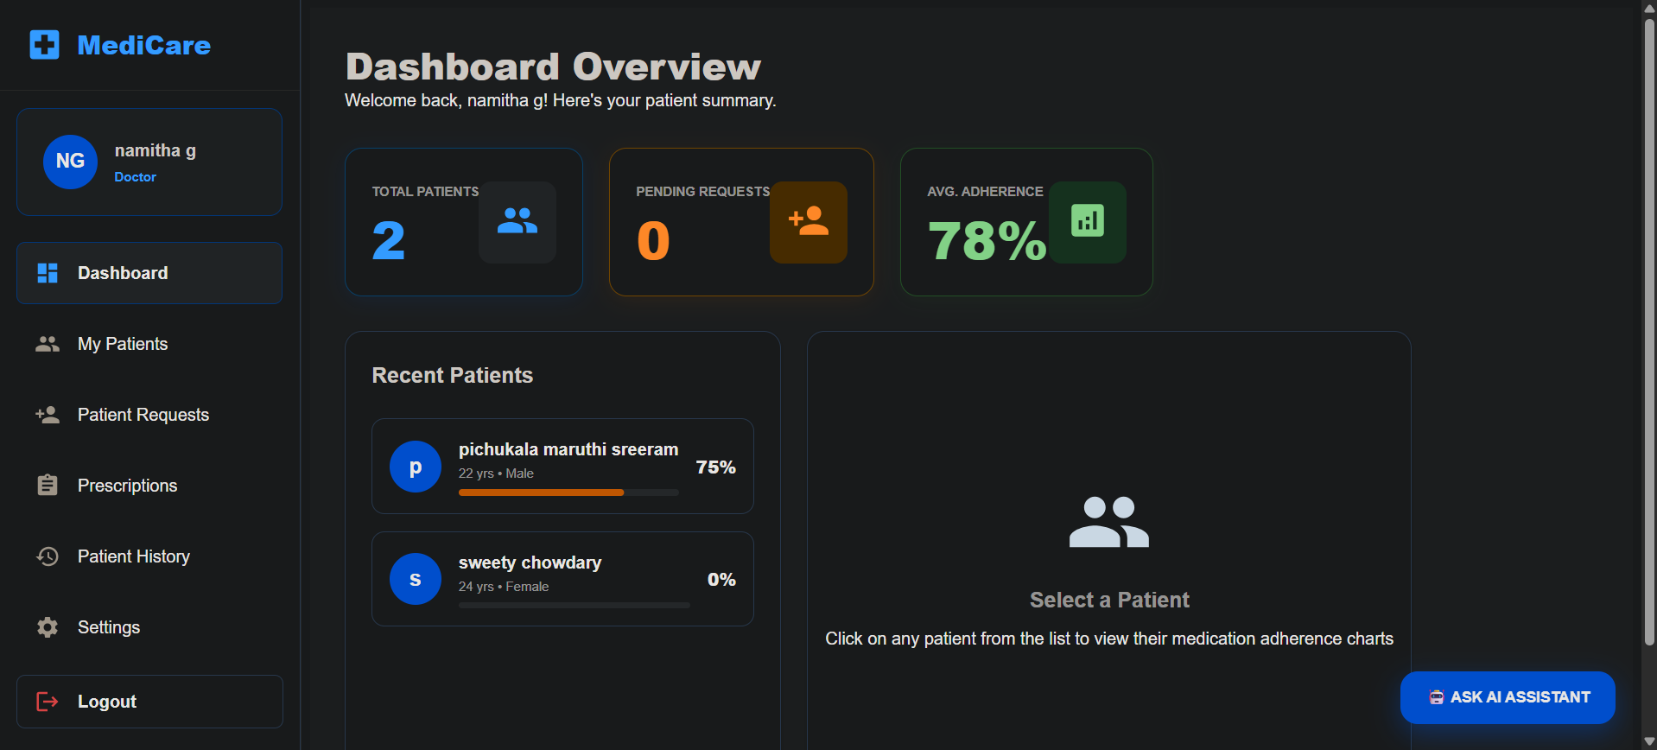


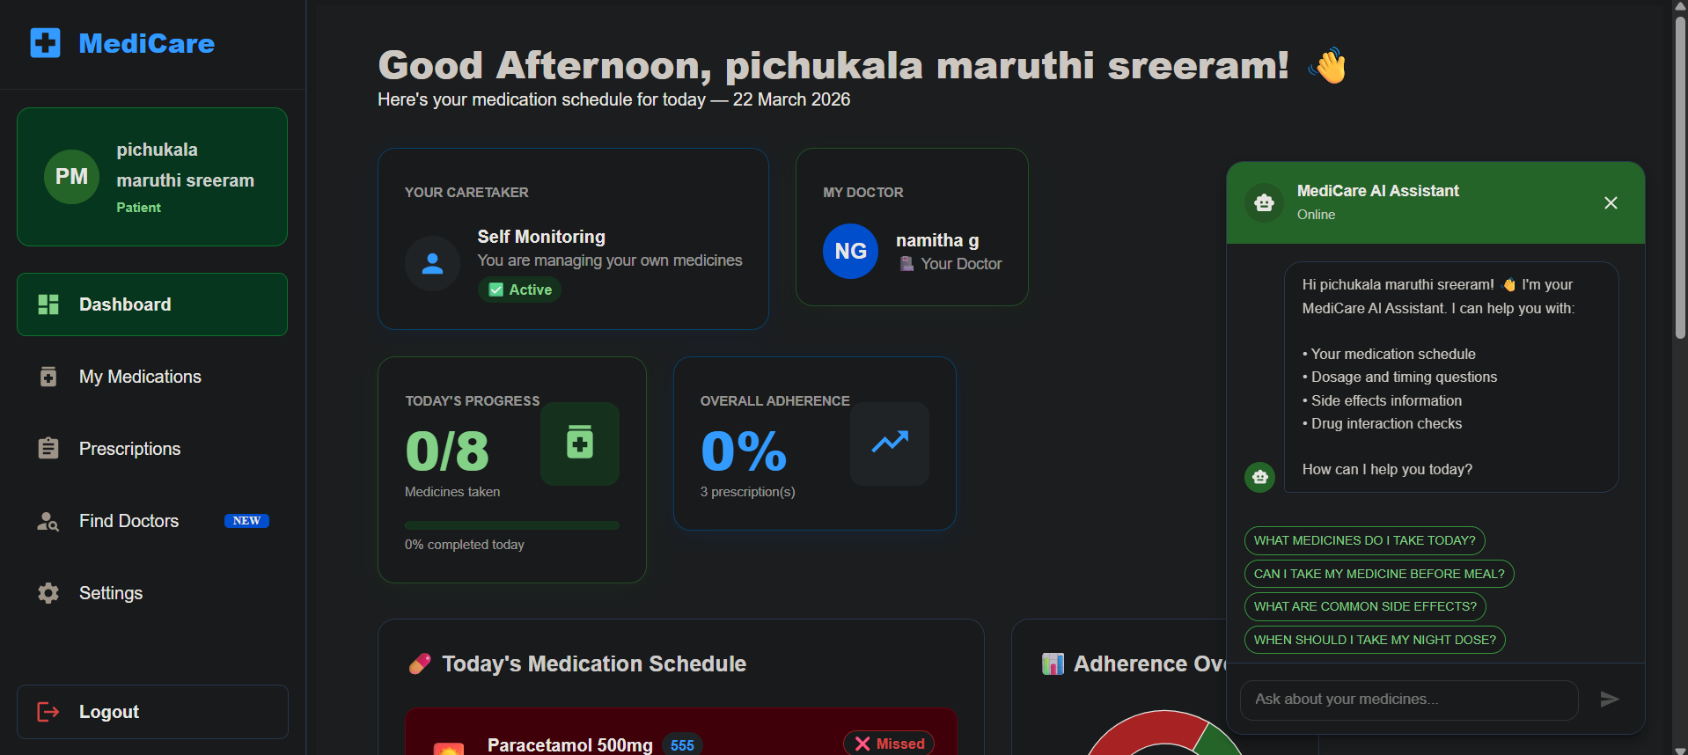
DOCTOR DASHBOARD
Issue prescriptions, accept patients, track and monitor medication adherence.
PATIENT DASHBOARD
View daily schedule, mark medicines, chat with AI assistant.
Page 05

Slide 6
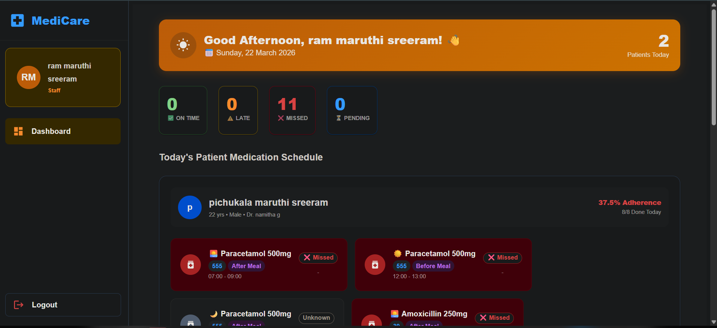

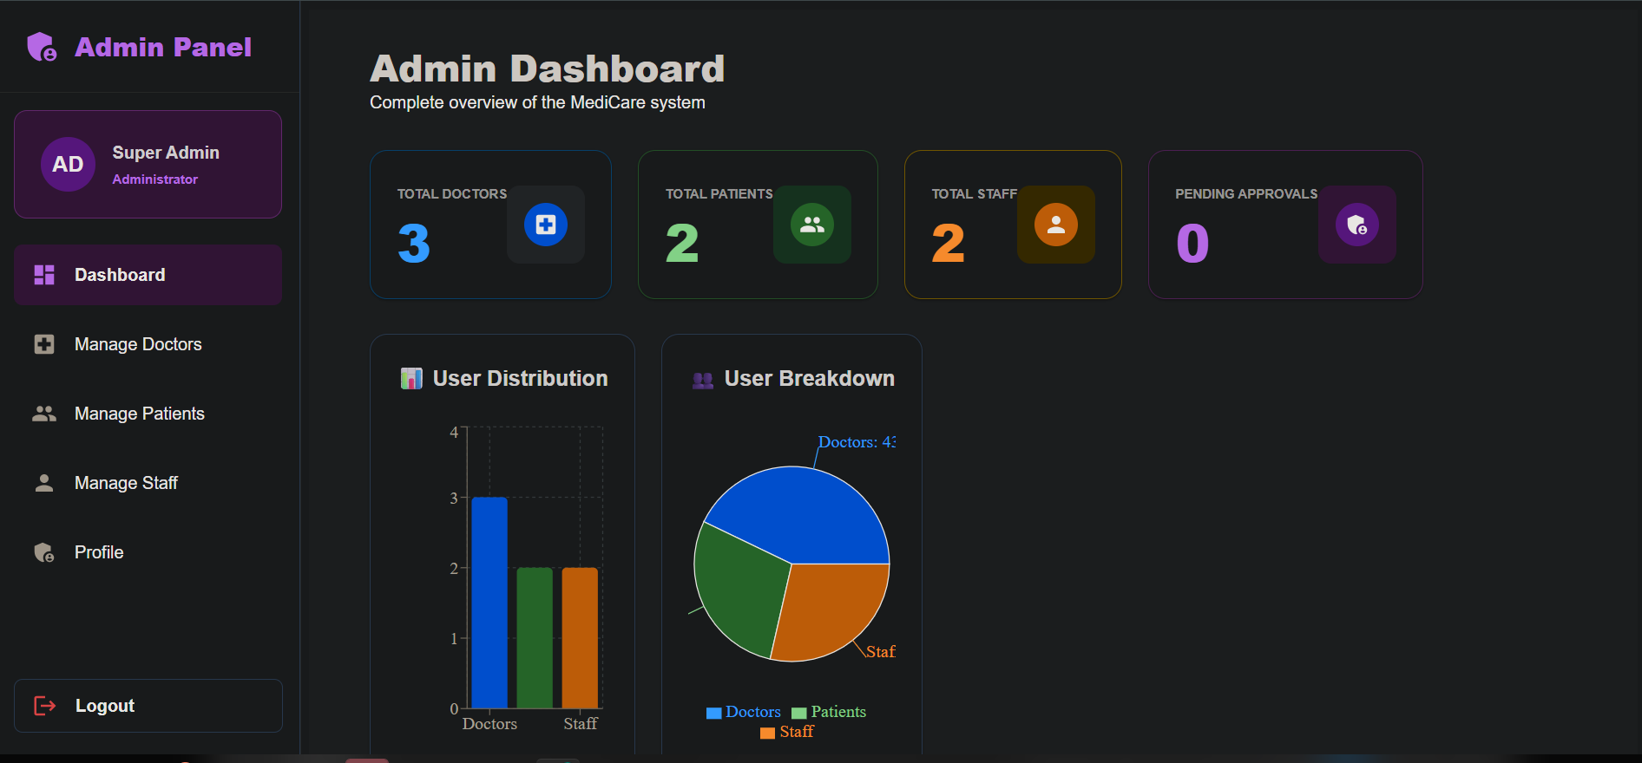

STAFF DASHBOARD
Monitor all patients live, mark medicines every shift.
ADMIN DASHBOARD
Approve doctors, manage all users, deactivate accounts, view stats.
Page 06

Slide 7



SYSTEM ARCHITECTURE
React Frontend
Spring Boot Backend
Python AI Service
Material UI · Recharts
Java 17 · JPA · JWT
SQL Query
FastAPI · Groq LLM
REST API
PORT 3000
PORT 8321
PORT 8000
JWT Auth
MySQL Database
Groq LLM
BCrypt · Role guard
Llama 3.1 8B Instant
PORT 3306 · Auto-created by Hibernate
MYSQL TABLES — AUTO-CREATED BY HIBERNATE
admin
doctors
patients
staff
prescriptions
chat_history
medication_tracking
medicines
Page 07

Slide 8





SMART TIME-BASED TRACKING
Status is auto-calculated by comparing the current clock time
against the doctor-set slot window. No manual configuration needed.
UPCOMING
PENDING
ON TIME
LATE
MISSED
Slot has not opened yet
Mark Taken button hidden
Slot is active right now
Mark Taken button shown
Medicine marked within
the slot window
Marked after the slot
window already closed
Window passed and
not marked — auto-set
All statuses are driven entirely by the backend — the frontend just displays them.
Page 08

Slide 9




AI MEDICATION ASSISTANT
CAPABILITIES
→ Medication schedule & timing queries
01
Patient asks a question
Via the floating chat button on the Patient Dashboard
→ Dosage information and instructions
AI reads real prescriptions
→ Side effects awareness
02
Fetches actual medicine data directly from MySQL for that patient
→ Drug interaction checks
03
Groq LLM generates answer
→ Refill reminder guidance
Llama 3.1 8B Instant — fast, accurate, context-aware response
→ Never diagnoses — always ends with:
"Please consult your doctor"
04
Chat saved to database
Full conversation history stored in chat_history table
Groq API · Llama 3.1 8B Instant · Python FastAPI
Page 09

Slide 10
TECHNOLOGY STACK
FRONTEND
BACKEND
DATABASE
TESTING
Spring Boot 3
Jest
PyTest
Postman
Swagger UI
Selinium
React 18
MySQL 8
Java 17
Hibernate ORM
Material UI v5
Spring Data JPA
Recharts
Auto DDL
Axios
Spring Security
11 Tables
React Router
JWT Auth
Shared DB
AI SERVICE — Python · FastAPI · Groq API · Llama 3.1 8B Instant · mysql-connector-python · python-dotenv
Page 10

Slide 11
CONCLUSION
Real-world impact
4 roles, 1 platform
Directly addresses medication non-adherence — one of healthcare's biggest problems
Admin, Doctor, Patient and Staff all connected in one seamless system
✦
Time-aware intelligence
AI-powered assistant
Backend auto-classifies every dose — accurate adherence reporting with zero manual work
Personalized medication chatbot using real prescription data — not generic advice
NEXT PHASE → Email reminders · Mobile application · Teleconsultation module

Slide 12
MY TEAM
BACKEND
FRONTEND
P Maruthi Sreeram
G Namitha
MENTOR : Vinay Prashant
AI CHATBOT
TESTING
B Pramodhini
S Sathwik
Page 12

Slide 13


Thank
You.
MediCare — Online Medication and Prescription Tracker
Page 13

