Slide 1

A Cryptographic technique for Sensor Networks
Implemented by
D.Maruthi
K.Akhil
IT Department Y.Krishna
V.Prashanth
Under the guidence of
Dr.Padmalaya Nayak

Slide 2
Introduction
Wireless sensor networks have applications in many areas, such as military, homeland security, health care, environment, agriculture, manufacturing, and so on. In the past several years, sensor networks have been a very active research area. Most previous research efforts consider homogeneous sensor networks, where all sensor nodes have the same capabilities. However, a homogeneous ad hoc network suffers from poor fundamental limits and performance. Research has demonstrated its performance bottleneck both theoretically, and through simulation experiments and tested measurements . Several recent work studied Heterogeneous Sensor Networks (HSNs), where sensor nodes have different capabilities in terms of Communication, computation, energy supply, storage space, reliability and other aspects.

Slide 3
ABSTRACT
In an olden research on sensor network security mainly considers homogeneous sensor networks, where all sensor nodes have the same capabilities.
Research has shown that homogeneous ad hoc networks have poor performance and scalability
The many-to-one traffic pattern dominates in sensor networks, and hence a sensor may only communicate with a small portion of its neighbors.
Most existing key management schemes try to establish shared keys for all pairs of neighbor sensors, no matter whether these nodes communicate with each other or not, and this causes large overhead.

Slide 4
We propose a novel routing-driven key management scheme, which only establishes shared keys for neighbor sensors that communicate with each other.
The performance evaluation and security analysis show that can provide better security with significant reductions on communication overhead, storage space and energy consumption than other key management schemes.

Slide 5
Existing System:
Previous research on sensor network security mainly considers homogeneous sensor networks, where all sensor nodes have the same capabilities.
An Existing key management schemes require a large storage space for key pre-distribution and are not suitable for small sensor nodes
Most existing key management schemes try to establish shared keys for all pairs of neighbor sensors, no matter whether these nodes communicate with each other or not, and this causes large overhead.
Sensor key management schemes are designed to set up shared keys for all pairs of neighbor sensors, without considering the actual communication pattern.

Slide 6
Disadvantage of an existing system:
Homogeneous ad hoc networks have poor performance and scalability.
It needs a large storage space.

Slide 7
Proposed System:
We adopt a heterogeneous sensornetwork (hsn) model for better performance and security.
A public key algorithm – RSA is used to further improve the key management scheme.
Several approaches for encryption and decryption using RSA have been proposed.
We propose a novel routing-driven key management scheme, which only establishes shared keys for neighbor sensors that communicate with each other.

Slide 8
Data Flow Diagram
Node Details
Node
Cluster Head
Key Details
Key Generation Using RSA
Communication Node1
Communication Node2
Sink

Slide 9
Modules
User Interface Design
Sender Module
Cryptography

Slide 10
Module Description
User Interface Design:-
In this module we design the windows for the project. These windows are used to access the server. We use the Swing package available in Java to design the User Interface. Swing is a widget toolkit for Java. It is part of Sun Microsystems' Java Foundation Classes (JFC) — an API for providing a graphical user interface (GUI) for Java programs.

Slide 11
Sensor Network Formation
Cluster Header
In sensor networks, clustering, a method of grouping sensor nodes, has numerous advantages. It can support
    network scalability,
    reduce the size of the routing table stored at the individual node and
    prolong the battery life of the individual sensors and the network lifetime, etc.
    To minimize additional overheads in energy limited sensor networks, we propose CH selection algorithm which selects CH by utilizing only its information.

Slide 12
Node Registration
  Number of cluster nodes under a cluster header is registered.
  Cluster nodes also called as low end sensors (L sensors)
  Each one has given a unique ID which is alphanumeric, later used for its authentication purpose.
Login
Both cluster header (H sensor) and sensor node (L sensor)
are authenticated by giving their username and ID.

Slide 13
Technique Used
RSA Algorithm
RSA stands for Ron Rivest, Adi Shamir and Leonard Adleman
RSA is an algorithm for public-key cryptography that is based on the presumed difficulty of factoring large integers, the factoring problem
A user of RSA creates and then publishes the product of two large prime numbers, along with an auxiliary value, as their public key. The prime factors must be kept secret. Anyone can use the public key to encrypt a message, but with currently published methods, if the public key is large enough, only someone with knowledge of the prime factors can feasibly decode the message

Slide 14
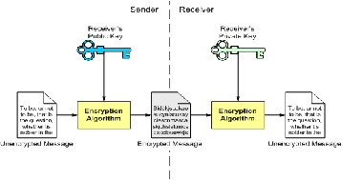
RSA involves a public key and a private key. The public key can be known to everyone and is used for encrypting messages. Messages encrypted with the public key can only be decrypted using the private key

Slide 15

Screen Shots:

Slide 16


Slide 17
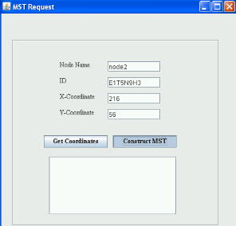

Slide 18
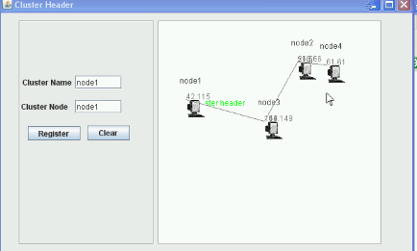

Slide 19


Slide 20


Slide 21
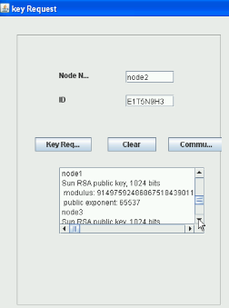

Slide 22
Applications
Parallel Computer Interconnection network
Military Based Application
Internal enterprise data center

Slide 23
Conclusion
In this project, we presented an efficient key management scheme for heterogeneous sensor networks. The proposed key management scheme utilizes the fact that a sensor only communicates with a small portion of its neighbors and thus greatly reduces the communication and computation overheads of key setup. A public key algorithm – RSA is used to further improve the key management scheme. The scheme only pre-loads a few keys on each L-sensor and thus significantly reduces sensor storage requirement.

Slide 24
REFERENCES:
P. Gupta and P. R. Kumar, “The capacity of wireless networks,” IEEE Trans. Inform. Theory, vol. IT-46, no. 2, pp. 388-404, Mar. 2000.
E. J. Duarte- Melo and M. Liu, “Data-gathering wireless sensor networks: organization and capacity,” Computer Networks (COMNET) Special Issue on Wireless Sensor Networks, vol. 43, no. 4, pp. 519-537, Nov. 2003.
K. Xu, X. Hong, and M. Gerla, “An ad hoc network with mobile backbones,” in Proc. IEEE ICC 2002, New York, NY, Apr. 2002.
L. Girod, T. Stathopoulos, N. Ramanathan, et al., “A system for simulation, emulation, and deployment of heterogeneous sensor networks," in Proc. ACM SenSys 2004.

