Slide 1
CRISP-DM FRAMEWORK
While performing the data analysis we face multiple problems like understanding the problem statement, collecting the correct data, selecting the relevant data, which technique I should follow etc.
CRISO-DM framework helps the data analysts in following a set of procedures to solve any analytical problem irrespective of the industry. Advantage of CRISP-DM is it is not tightly associated with any industry, technology, application and applicable to any line of industry.
History
CRISP-DM (CRoss Industry Standard Process for Data Mining) was conceived in late 1996 by the automotive company Dailmler- Chrystler, the statistical software provider SPSS, and the data warehouse provider NCR (Chapman et al., 2000)
CRISP-DM is a comprehensive data mining methodology and process model that provides anyone—from novices to data mining experts—with a complete blueprint for conducting a data mining project.
Based on current research CRISP-DM is the most widely used form of data-mining model because of its various advantages which solved the existing problems in the data mining industries.

Slide 2
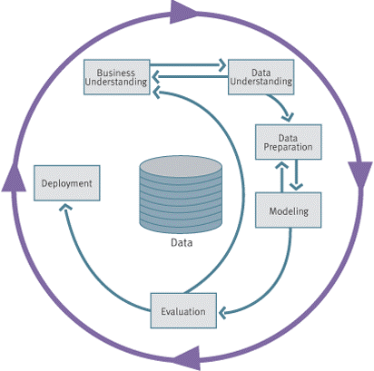
CRISP-DM FRAMEWORK
CRISP-DM breaks the process of data mining into six major phases.
Business understanding
Data understanding
Data Preparation
Data Modelling
Model Evaluation
Model Deployment
Above steps in CRISP-DM framework are not necessarily
sequential and one can always go back to the previous step
if required. It is a continuous process where we can improve
the model in the next iteration based on the feedback or
learnings from the previous iteration.

Slide 3
CRISP-DM FRAMEWORK
Business Understanding
Understanding project objectives and requirements
Data mining problem definition
Data Understanding
Initial data collection and familiarization
Identify data quality issues
Initial, obvious results
Data Preparation
Record and attribute selection
Data cleansing
Modeling
Run the data mining tools
Evaluation
Determine if results meet business objectives
Identify business issues that should have been addressed earlier
Deployment
Put the resulting models into practice
Set up for repeated/continuous mining of the data

Slide 4
Linear Regression
Linear regression attempts to model the relationship between two variables by fitting a linear equation to observed data.
One variable is considered to be an explanatory variable, and the other is considered to be a dependent variable.
For example, a modeler might want to relate the weights of individuals to their heights using a linear regression model.
Before attempting to fit a linear model to observed data, a modeler should first determine whether or not there is a relationship between the variables of interest.
This does not necessarily imply that one variable causes the other (for example, higher SAT scores do not cause higher college grades), but that there is some significant association between the two variables.

Slide 5
Linear Regression
A scatterplot can be a helpful tool in determining the strength of the relationship between two variables. If there appears to be no association between the proposed explanatory and dependent variables (i.e., the scatterplot does not indicate any increasing or decreasing trends), then fitting a linear regression model to the data probably will not provide a useful model.
If we consider single independent variable to calculate the dependent variable we call it Simple Linear Regression
If we consider more than one independent variable to calculate the dependent variable we call it Multiple Linear Regression
A simple linear regression model attempts to explain the relationship between a dependent and an independent variable using a straight line.
The independent variable is also known as the predictor variable. And the dependent variables are also known as the output variables

Slide 6
Linear Regression
In credit risk analytics, let’s assume that you need to predict the average amount defaulted by any customer based on different factors such as the credit score of the person, the frequency of using the credit card, the average amount spent during each shopping session, etc.
Can you tell what would be the dependent variable for this regression
problem?
Can you tell what would be the independent variable for this regression
problem?
What kind of regression problem is this?

Slide 7
Linear Regression
In credit risk analytics, let’s assume that you need to predict the average amount defaulted by any customer based on different factors such as the credit score of the person, the frequency of using the credit card, the average amount spent during each shopping session, etc.
Can you tell what would be the dependent variable for this regression
problem? - Average amount defaulted by customer
Can you tell what would be the independent variable for this regression
problem? - credit score of the person, the frequency of using the credit
card, the average amount spent during each shopping session
What kind of regression problem is this? – Multiple regression

Slide 8
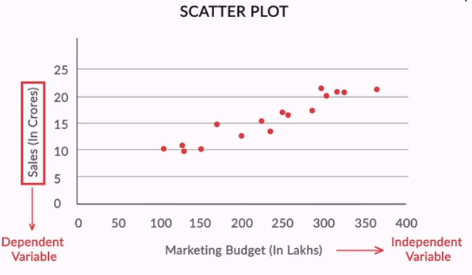
Linear Regression - Regression Line

Slide 9
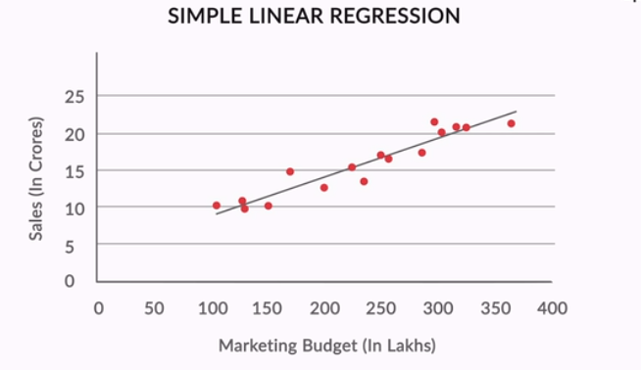
Linear Regression - Regression Line

Slide 10
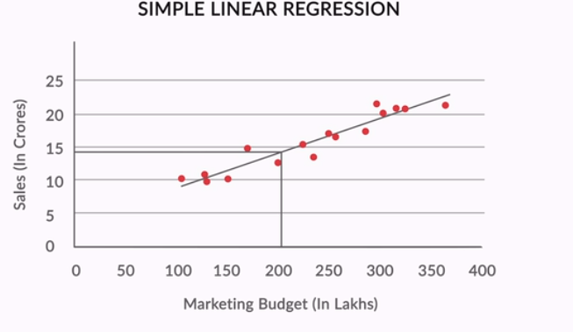
Linear Regression - Regression Line

Slide 11
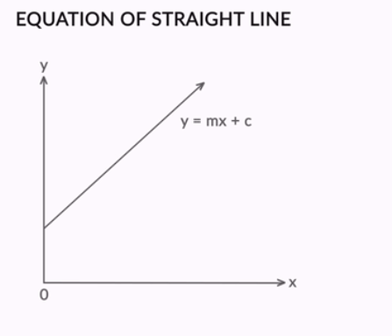
Linear Regression - Regression Line

Slide 12
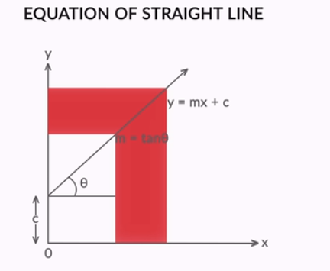
Linear Regression - Regression Line

Slide 13
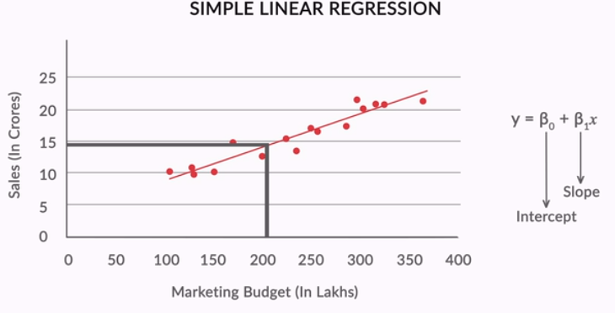
Linear Regression - Regression Line

Slide 14
Linear Regression - Regression Line

Slide 15
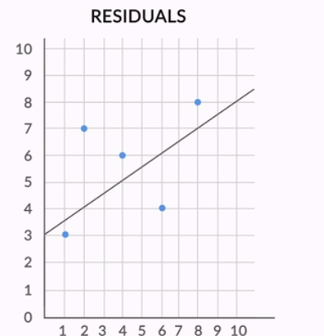
Linear Regression - Best Fit Line
In regression, there is a notion of a best-fit line — the line which fits the given scatter-plot in the best way. Let’s look at how you can define the notion of a best-fit line.

Slide 16
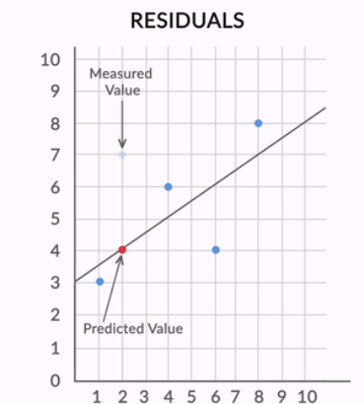
Linear Regression - Best Fit Line
In regression, there is a notion of a best-fit line — the line which fits the given scatter-plot in the best way. Let’s look at how you can define the notion of a best-fit line.

Slide 17
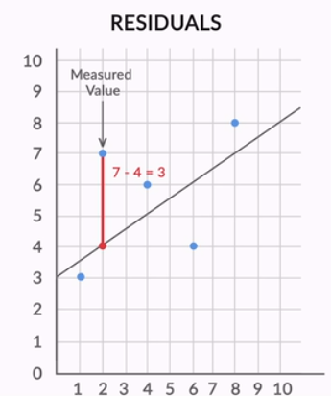
Linear Regression - Best Fit Line
In regression, there is a notion of a best-fit line — the line which fits the given scatter-plot in the best way. Let’s look at how you can define the notion of a best-fit line.

Slide 18
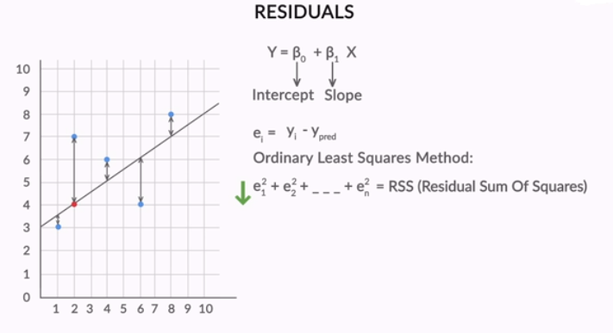
Linear Regression - Best Fit Line

Slide 19
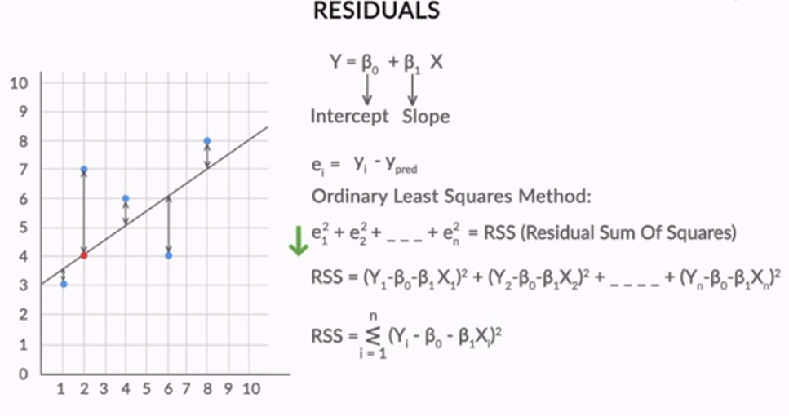
Linear Regression - Best Fit Line

Slide 20
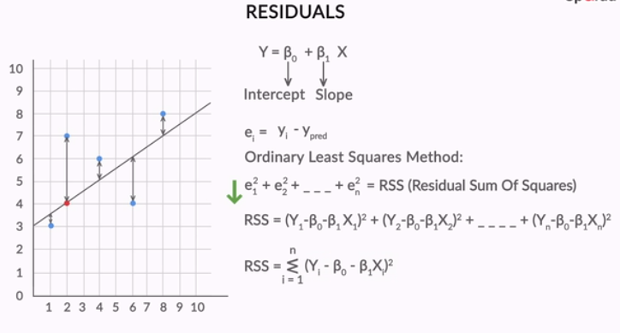
Linear Regression - Best Fit Line

Slide 21
Linear Regression - Best Fit Line
Since now you know that the best-fit line is obtained by minimising a quantity called Residual Sum of Squares (RSS), this is the best time to be introduced to what is known as the cost function.

Slide 22
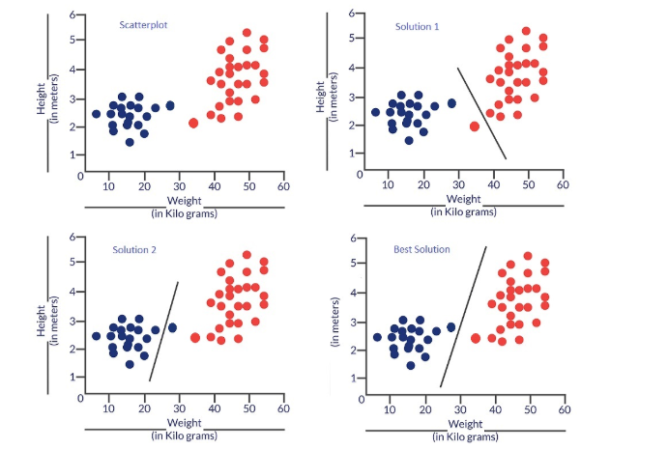
Linear Regression - Cost Function
Consider a situation - you are trying to solve a classification problem, i.e. classify data into categories. Suppose the data is pertaining to the weight and height of two different categories of fishes denoted by red and blue points in the scatter plot below

Slide 23
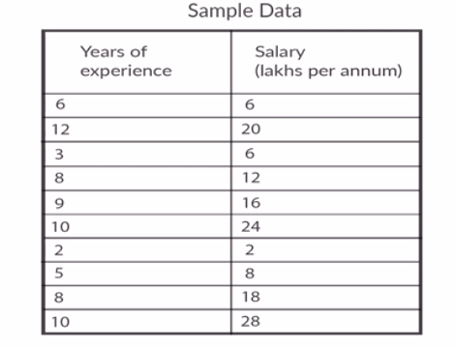
Linear Regression - Best Fit Line

Slide 24
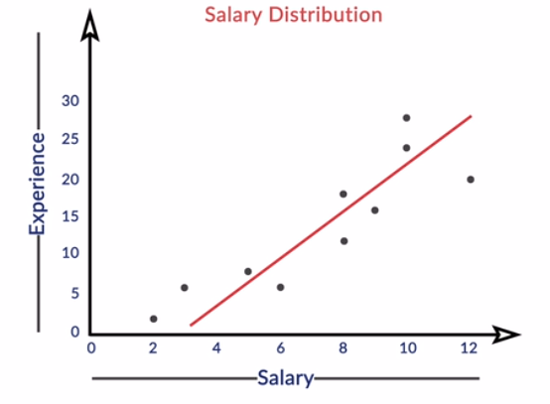
Linear Regression - Best Fit Line

Slide 25
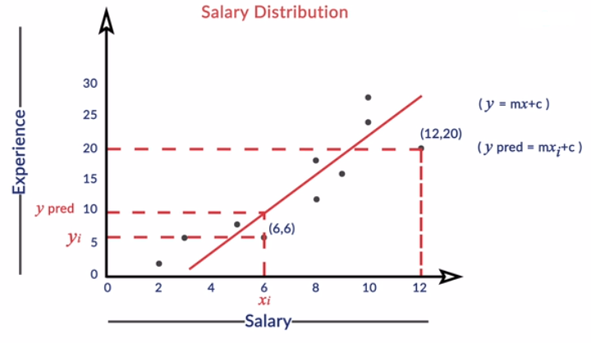
Linear Regression - Best Fit Line

Slide 26
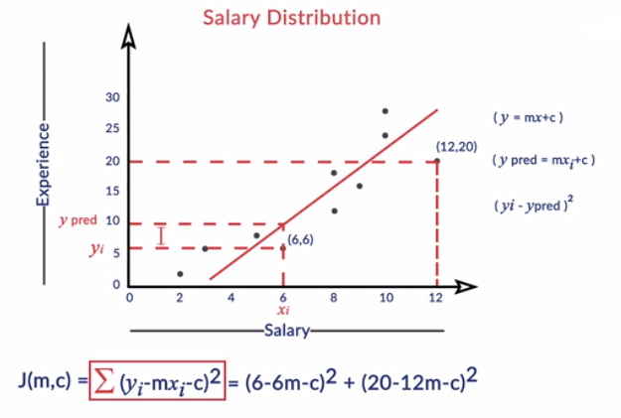
Linear Regression - Best Fit Line

Slide 27
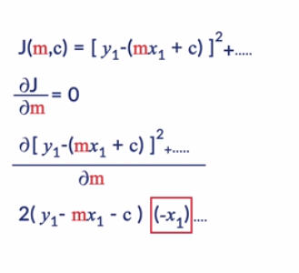
Linear Regression - Best Fit Line

Slide 28
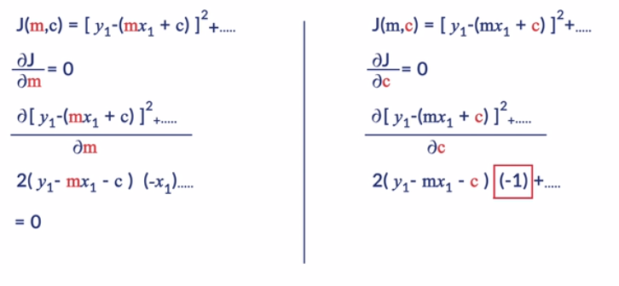
Linear Regression - Best Fit Line

Slide 29
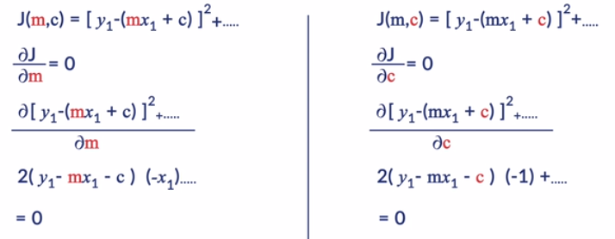
Linear Regression - Best Fit Line

Slide 30
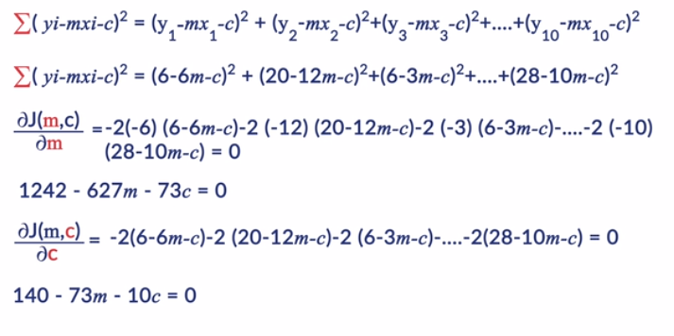
Linear Regression - Best Fit Line

Slide 31
Linear Regression - Best Fit Line
y = 0.0528x + 3.3525

Slide 32
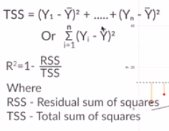
Linear Regression - Best Fit Line

Slide 33
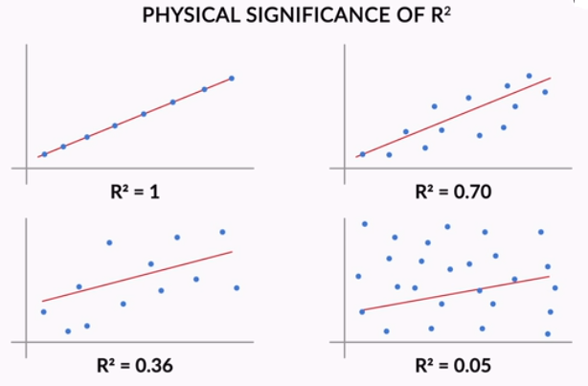
Linear Regression - Best Fit Line

Slide 34
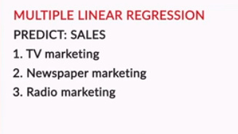
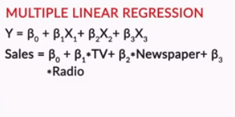
Multiple Variable Linear Regression
While performing the data analysis we face multiple problems like understanding the problem statement, collecting the correct data, selecting the relevant data, which technique I should follow etc.

Slide 35
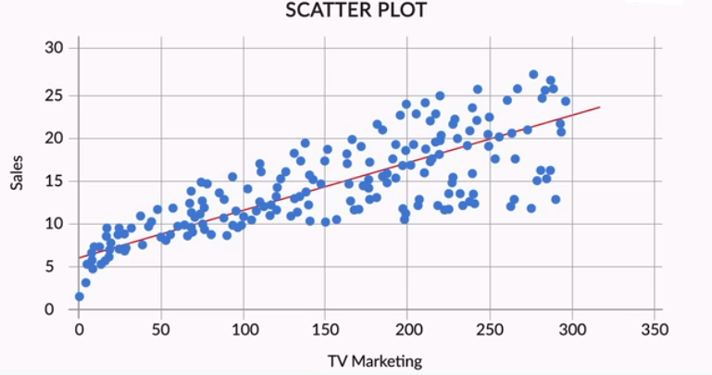
Multiple Variable Linear Regression
CRISP-DM breaks the process of data mining into six major phases.

Slide 36
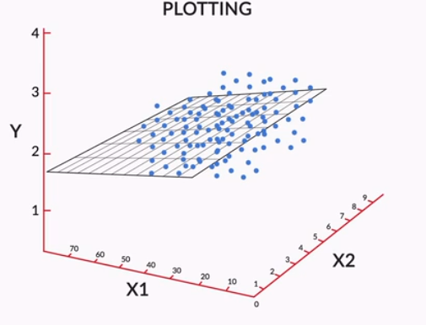
Multiple Variable Linear Regression
CRISP-DM breaks the process of data mining into six major phases.

Slide 37
Multiple Variable Linear Regression
Till now you have understood that the variable 'Newspaper' is probably not required in the model. Is it good to drop "Newspaper" from our model? How do you take that decision?

Slide 38
Multiple Variable Linear Regression
You saw that the variable 'Newspaper' is slightly correlated with 'Sales', though it is not a very significant variable in the overall model (its coefficient, compared to TV and Radio, is also quite small).
Now, how do you decide whether the variable 'Newspaper' should stay in the model? More importantly, can you say that 'Newspaper' significantly affects 'Sales’?
Find out the coefficient of ‘NewsPaper’ individually against ‘Sales’ and along with all other coefficients combined. See the difference.

Slide 39
Multiple Variable Linear Regression
Let's now understand about the model evaluation metric adjusted r-squared and why that is a more trustworthy metric than r-squared
adjusted r-squared penalizes the model if there are unnecessary features thus giving little low value compared

Slide 40
Multiple Variable Linear Regression
What is ‘P-Value’?
P-Value signifies how much null hypothesis is true? If it is high null hypothesis is also high and vice versa.
In this example null hypothesis is that there will not be any change in the output if we keep a variable or feature.
If that is the case why should we keep that in the model? We can remove that feature.
We can identify such features looking at P-Value. If it is high remove those

Slide 41
Multiple Variable Linear Regression
Problem Statement:
Consider a real estate company has a data set of the prices in the region of Delhi. It wishes to use the data to optimise the sale prices of the properties, based on important factors such as area, bedrooms, parking, etc.
Essentially the company wants:
To identify the variables affecting house prices, e.g. area, number of rooms, bathrooms, etc.
To create a linear model that quantitatively relates house prices with variables such as the number of rooms, area, number of bathrooms, etc.
To know the accuracy of the model, i.e. how well these variables predict house prices.

Slide 42
Multiple Variable Linear Regression
VIF - Variance Inflation Factor
VIF can be a good metrics to look at to tackle multicollinearity between variables. The VIF value can range from 1 to any higher value which indicates that if the particular variable is taken into the model how much it is contributing to the multicollinearity.

Slide 43
Multiple Variable Linear Regression
Variance Inflation Factor - A Useful Measure of Multicollinearity
Multicollinearity refers to a situation where multiple predictor variables are correlated with each other. Since multiple variables are involved, you cannot use the rather simplified 'correlation coefficient' to measure collinearity (it only measures the correlation between two variables).
Thus, you need a metric such as VIF(Variance Inflation Factor) to measure the correlation of one variable with multiple variables.
For example, consider a set of predictor variables x1,x2,x3....xnx1,x2,x3....xn. The VIF value of x1x1 is calculated by building a multiple linear regression model with x1x1 as the target variable and all the others (x2,x3....xnx2,x3....xn) as the predictors. The VIF of x1x1 is then computed using the r-squared value of this model R1R1, i.e.:

Slide 44
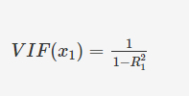
Multiple Variable Linear Regression
If the value of R1R1is high, such as 0.90 (which implies that x1x1 can be predicted using the other predictors), the VIF value will be high as well, and vice-versa. Since x1x1 can be predicted using all other predictor variables, it is advisable to remove it from the model to avoid making the model unnecessarily complex.
Note: In a later module, Model Selection, you will study the notion of model complexity and related concepts in detail.
Thus, VIF is a simple and useful metric used to measure collinearity or correlation between multiple variables.

Slide 45
Multiple Variable Linear Regression
To summarise, you learned the following important concepts:
Model building using p-Value and VIF
Why scaling of variables is important
Evaluation of model using r-squared and adjusted r-squared
In this case study, you only had a few variables, and one could eliminate variables by manually looking at the p-value, VIF values etc.

Slide 46
Multiple Variable Linear Regression
Though in most real-life problems, you may have a much larger set of variables, say more than 100. In that case, selecting variables manually might take forever and will be a quite mundane process.
Thus, we need an automatic way to eliminate the unnecessary variables from the model. Let's see in the next lecture how we can automate variable selection using a technique called RFE (Recursive Feature Elimination).

Slide 47
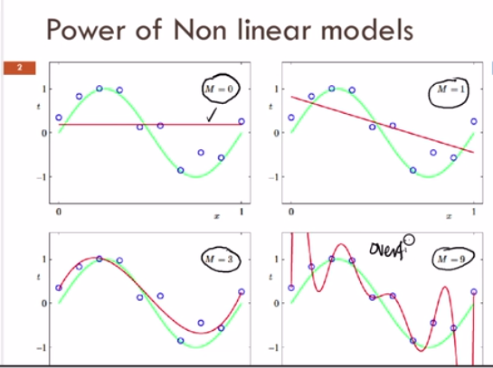
Multiple Variable Linear Regression

Slide 48
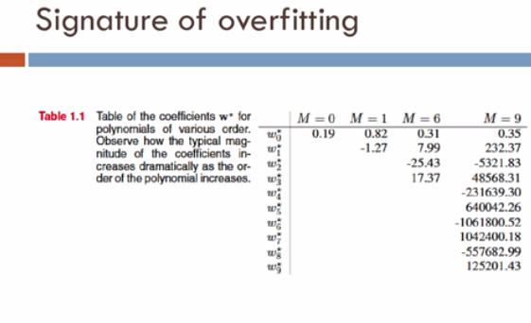
Multiple Variable Linear Regression

Slide 49
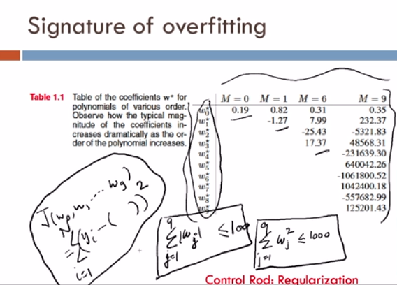
Multiple Variable Linear Regression
Here sum of modulus weights/ coefficients is L1 regularization (LASSO) and sum of squares of weights/coefficients is L2 regularization (RIDGE)

Slide 50
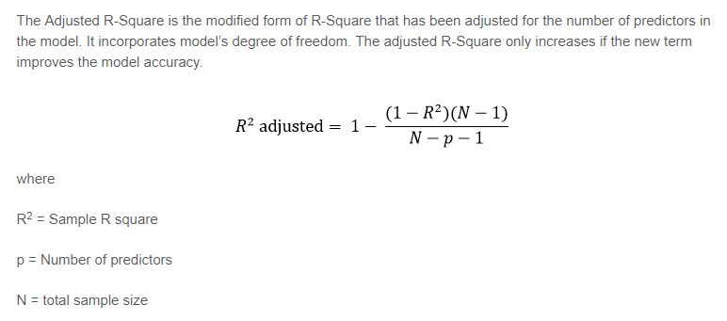
Multiple Variable Linear Regression

