Slide 1
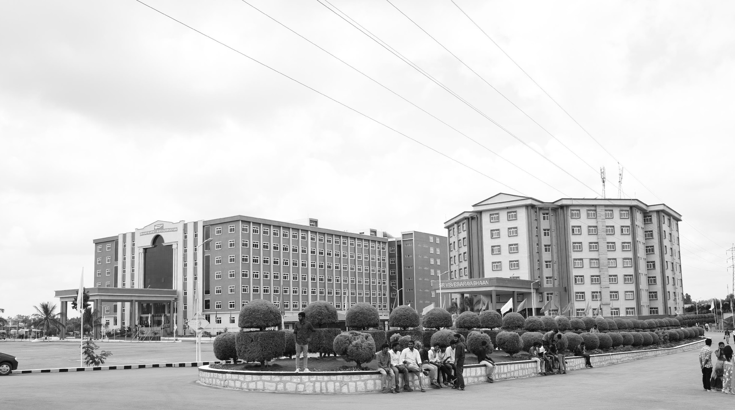

Design and performance analysis of III-V heterostructure for DNA detection
AY 2021-25
GITAM UNIVERSITY
Major Project
A University should be a place of light, of liberty, and of learning.
Department of Electrical Electronics and Communication Engineering
Project Team:
D Bhanuprakash
Bharath S N
Maruthi M
Project Mentor:
Mr. Girish Shankar Mishra
www.gitamedu.com

Slide 2


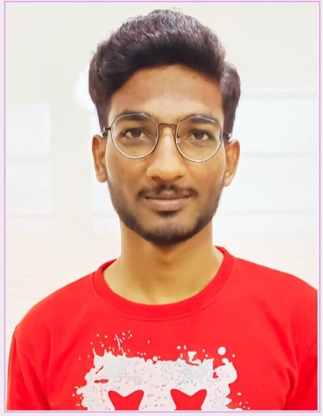

Project Group – Details
Photo
Track
Roll No
Name
EECE(Regular)
BU21EECE0100491
D Bhanuprakash
EECE(Regular)
BU21EECE0100525
Bharath S N
EECE(Regular)
BU21EECE0100554
Maruthi M

Slide 3
Objective and Goals
Objective
Design Objective: To design and develop a III-V semiconductor heterostructure device for detecting DNA molecules. The design should focus on leveraging the unique properties of III-V materials (such as GaAs, InP) to create a highly sensitive and efficient DNA sensor.
Performance Objective: To analyze and evaluate the performance of the designed heterostructure in terms of sensitivity, selectivity, stability, and response time in detecting DNA sequences. The aim is to improve upon existing detection methods by demonstrating enhanced device performance under various operational conditions.
Sensitivity Measurement: Quantify how well the device detects various concentrations of DNA and identify the limits of detection.
Selectivity Analysis: Ensure that the device can distinguish between different DNA sequences or types, minimizing false positives or cross-reactivity with non-target molecules.
Goals

Slide 4
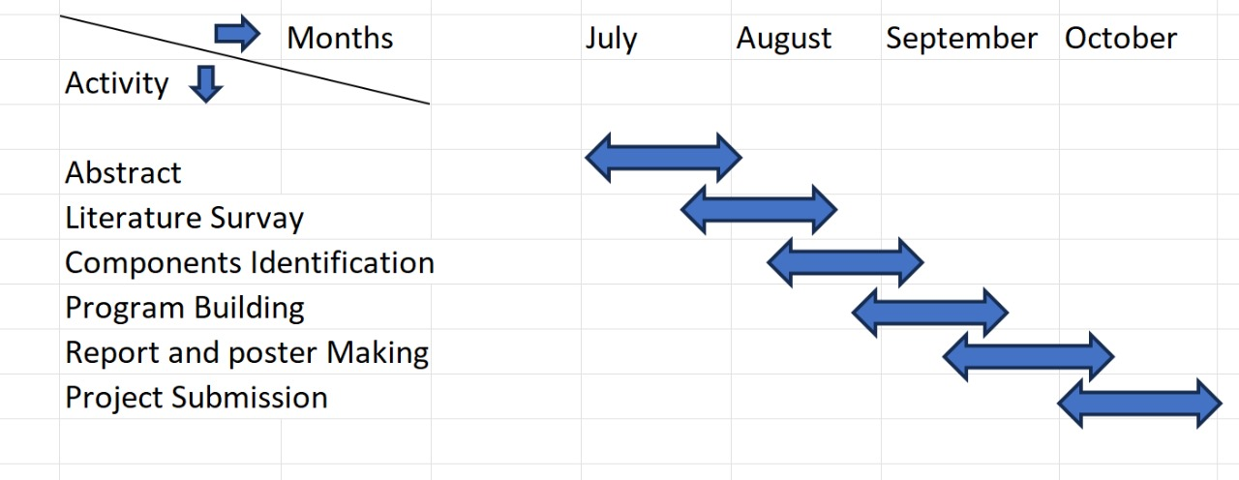
Project Plan

Slide 5
Literature Survey
SI.no | Title of the paper | Year | Author | Key Findings | Research Gap
1. 2. | Impact of InGaN notch on sensitivity in dielectric modulated dual channel GaN MOSHEMT for label-free biosensing. Efficient III-Nitride MIS-HEMT devices with high-k gate dielectric for high-power switching boost converter circuits | 2023 2017 | Girish Shankar Mishra, N. Mohankumar, Sankalp Kumar Singh A. Mohanbabu, N. Mohankumar a, D. Godwin Raj b , Partha Sarkar c , Samar K. Saha d | Approach: Investigates the impact of an InGaN notch on sensitivity in a dual-channel GaN MOSHEMT for label-free biosensing, enhancing carrier confinement via device simulations. .Results: Improved sensitivity (up to 74%), increased drain current (3.35 A/mm), threshold voltage shift, and enhanced transconductance (28 mS/mm) due to the InGaN notch. Approach: It involved designing and simulating a dielectric modulated dual-channel GaN MOSHEMT integrated with an InGaN notch. This structural modification aimed to enhance the sensitivity and performance of the device for label-free biosensing applications. Results: The results showed that the GaN MOSHEMT with high-κ HfAlOx dielectric achieved a threshold voltage of +5.3V, a drain current of 0.64 A/mm, and an OFF-state breakdown voltage of 1200V | The paper focuses on enhancing the sensitivity of Dielectric Modulated (DM) Dual Channel GaN MOSHEMTs for label-free biosensing applications by incorporating an InGaN notch layer. The study uses Sentaurus TCAD simulations to analyze the impact of the InGaN notch on parameters like drain current, threshold voltage, transconductance, and sensitivity. T he research gap identified in this study is the challenge of achieving normally-OFF or enhancement-mode GaN-based MIS-HEMTs with high threshold voltage, low leakage current, and improved breakdown voltage

Slide 6
SI.no | Title of the paper | Year | Author | Key Findings | Research Gap
3. 4. | Influence of the Source–Gate Distance on the AlGaN/GaN HEMT Performance Highly sensitive extended gate-AlGaN/GaN high electron mobility transistor for bioassay applications | 2007 2021 | Stefano Russo Aldo Di Carlo, Xiangzhen DingBin MiaoZhiqi GuBaojun WuYimin HuHong WangJian ZhangDongmin Wu | Approach: The approach used in the paper involves Monte Carlo simulations to study the effects of source–gate (S–G) distance scaling on the performance of AlGaN/GaN High Electron Mobility Transistors (HEMTs). Results: Downscaling the source–gate distance in GaN-based HEMTs increases output current and transconductance due to enhanced electron velocity. Smaller S–G distances also affect breakdown behavior, causing harder breakdown, while passivation does not alter the scaling benefits observed in the study. Approach:The approach involved designing an extended gate structure for an AlGaN/GaN HEMT. The gate was separated from the transistor channel, providing a larger sensing area. Result:The study developed an extended gate-AlGaN/GaN high electron mobility transistor (EG-AlGaN/GaN HEMT) that demonstrated high sensitivity for bioassay applications.The device also showed improved current response due to its larger sensing area. | The research gap identified in this study is the challenge of achieving normally-OFF or enhancement-mode GaN-based MIS-HEMTs with high threshold voltage, low leakage current, and improved breakdown voltage. Previous research has focused on achieving these characteristics, but few studies have successfully combined them with high electrostatic control and reduced subthreshold slope. The lack of high-quality, thermodynamically stable insulators on III-Nitride semiconductors with low interface state density also remains a critical challenge in the design of high-power switching devices. Research Gap: The gap identified was that previous work on AlGaN/GaN HEMTs had not explored the potential of extended gate structures for bioassay applications. While other forms of biosensors have utilized the extended gate field effect transistor (EG FET) design, this had not been demonstrated in AlGaN/GaN HEMTs. The paper aimed to address this gap by investigating whether the EG-AlGaN/GaN HEMT could achieve comparable or superior electrical performance to other biosensor designs.

Slide 7
SI.no | Title of the paper | Year | Author | Key Findings | Research Gap
5. 6. | A Dielectrically Modulated GaN/AlN/AlGaN MOSHEMT with a Nanogap Embedded Cavity for Biosensing Applications Open gate AlGaN/GaN HEMT biosensor: Sensitivity analysis and optimization | 2021. 2021 | Aasif Mohammad Bhat, Arathy Varghese, Nawaz Shafi & C. Periasamy Praveen Pal , Yogesh Pratap , Mridula Gupta , Sneha Kabra | Approach:The approach of the research focuses on the development and analysis of a GaN/AlN/AlGaN MOS-HEMT (Metal-Oxide-Semiconductor High-Electron-Mobility Transistor) with a nanogap embedded cavity, specifically designed for biosensing applications. Results:. The results from the simulations demonstrate that the proposed MOS-HEMT structure is highly sensitive to the presence of different biomolecules. Specifically, shifts in threshold voltage (ΔVth) up to 1.1 V and changes in drain current (ΔIDS) up to 153.7 mA/mm were observed for neutral biomolecules. Approach:A physics-based analytical model was developed for the open gate AlGaN/GaN HEMT biosensor. It evaluates electrical parameters such as drain current and threshold voltage sensitivity, along with capacitance, channel conductance, and transconductance. Result:. The biosensor demonstrated a significant sensitivity, particularly for biomolecules like uricase, glucose, cytochrome-c, and biotin. The maximum drain current sensitivity for uricase reached 3.95 × 10^8, and the threshold voltage sensitivity was 820 mV. | The research addresses a gap in the existing biosensing technologies by focusing on the development of a GaN/AlN/AlGaN-based MOS-HEMT device capable of detecting both neutral and charged biomolecules with high sensitivity. While previous studies have explored silicon-based FET biosensors, their chemical instability in aqueous solutions and low sensitivity have limited their applicability. The biosensor exhibits potential for use in biomedical applications such as detecting diseases related to glucose and uric acid levels. It also highlights the role of biomolecules like cytochrome-c in regulating cellular activities, particularly in diseases like cancer and neurodegenerative disorders.

Slide 8
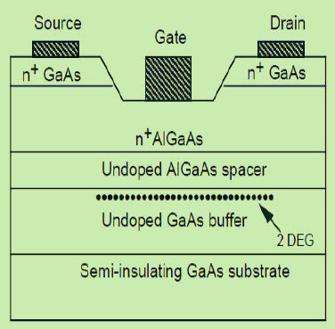
Introduction
High Electron Mobility Transistor(HEMT)
HEMT (High Electron Mobility Transistor) is a type of field-effect transistor (FET) known for its high-speed and high-frequency performance. It is primarily used in applications that require high power and fast switching, such as microwave and RF (radio frequency) systems, satellite communications, radar, and high-speed digital circuits.
HEMT Structure

Slide 9
Key Features of HEMT
High Electron Mobility: HEMT uses a heterostructure (typically made of materials like GaAs, AlGaAs, or GaN) that creates a region where electrons can move at very high speeds, resulting in high electron mobility. This feature is critical for achieving high-frequency operation
Heterojunction Design: HEMTs use a junction between two different semiconductor materials (heterojunction) with differing band gaps, typically wide-bandgap materials. This creates a two-dimensional electron gas (2DEG) where the electrons can flow freely without scattering from impurities.
High-Frequency Performance: Due to the high electron mobility, HEMTs can operate at much higher frequencies than traditional MOSFETs or JFETs, making them suitable for GHz-range applications.

Slide 10
Advantages of HEMT
1.High-Frequency Operation
Faster Switching Speeds
2. Low Noise
Excellent Low-Noise Characteristics
3. High Efficiency
Power Efficiency at High Frequencies
4.High Power Density
High Power Output
1.High Fabrication Cost
Expensive Materials
2.Thermal Management
Heat Dissipation
3.Lower Threshold Voltage
Difficult Control of Threshold Voltage
Disadvantages of HEMT

Slide 11
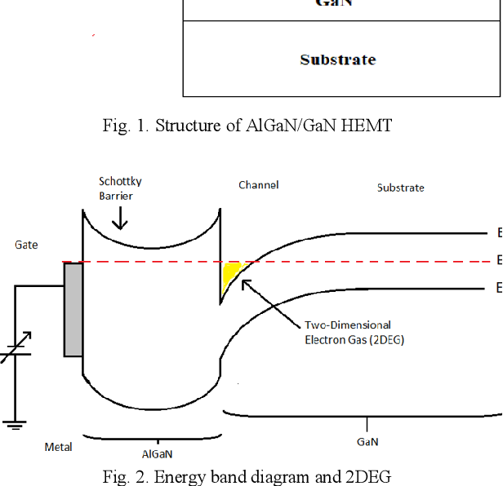
Two-Dimension Electron Gas(2DEG)
The Two-Dimensional Electron Gas (2DEG) is a quantum phenomenon that occurs at the interface between two different semiconductor materials, typically in heterostructures like those used in HEMTs (High Electron Mobility Transistors). In this structure, the electrons are confined to move in only two dimensions, drastically altering their behavior compared to electrons in a conventional three-dimensional space.
Two Dimension Electron Gas

Slide 12
Analysis - SWOT
Strengths
Weaknesses
W1. Complex Fabrication
W2. Surface Chemistry Challenges
W3. Material Cost
W4. Environmental Sensitivity
S1. High Sensitivity
S2. Biocompatibility
S3. Optoelectronic Properties
S4.Customization of Bandgap
Threats
Opportunities
T1. High Production Costs
T2. Market Acceptance
O1.Advanced Biomedical Diagnostics
02.Point-of-Care Devices
O3. Data-Driven Healthcare
04. Market Demand for Innovative Biosensors
12

Slide 13
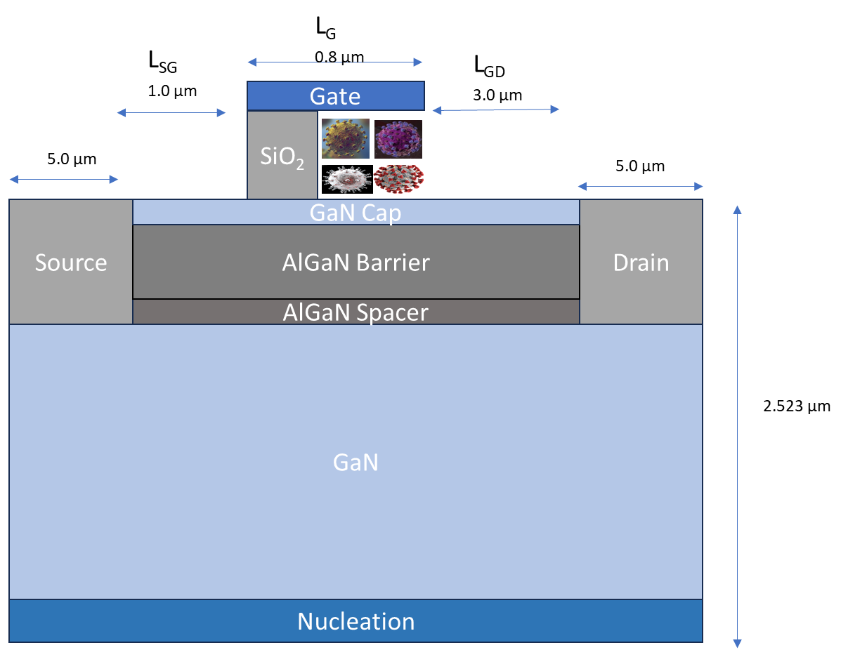
Nominal Structure
Nominal Structure of MOSHEMT

Slide 14
Materials and Layers:
GaNa (Gallium Nitride) Layer:
Gallium Nitride (GaN) is a key material in High Electron Mobility Transistors (HEMTs) due to its remarkable electrical and physical properties. HEMTs are essential in high-frequency, high-power, and high-temperature applications, and the GaN layer is critical to their performance.
AlGaN Spacer:
The AlGaN (Aluminum Gallium Nitride) spacer layer plays a critical role in the performance of High Electron Mobility Transistors (HEMTs), particularly in enhancing the electron mobility and controlling the properties of the two-dimensional electron gas (2DEG) formed in the device.
AlGaN (Aluminum Gallium Nitride) Barrier Layer:
The AlGaN (Aluminum Gallium Nitride) barrier layer is a fundamental component in High Electron Mobility Transistors (HEMTs), particularly in GaN-based devices. This layer plays a critical role in the formation and functionality of the two-dimensional electron gas (2DEG), which is essential for the high-speed and high-power operation of HEMTs.

Slide 15
GaN Cap Layer:
The GaN cap layer in High Electron Mobility Transistors (HEMTs) serves as a crucial element in improving device performance, especially in enhancing the stability, reliability, and overall control of the HEMT structure. This layer is typically placed on top of the AlGaN barrier layer and plays a key role in fine-tuning the electrical characteristics of the device.
Nucleation Layer:
The thin red layer marked "Nucleation" at the bottom of the structure suggests a growth layer used to improve the quality of the GaN layer. This layer helps in stress management and the reduction of defects during the epitaxial growth of GaN on substrates like silicon or sapphire .

Slide 16
This type of structure is commonly used in High Electron Mobility Transistors (HEMTs) or Field Effect Transistors (FETs), where the primary function is to utilize the high electron mobility in a 2D electron gas (2DEG) formed at the interface of GaN and AlGaN layers. The AlGaN layer induces a strong polarization charge due to differences in spontaneous and piezoelectric polarization between GaN and AlGaN, which enhances carrier confinement and mobility.
Doping and Polarization:
The GaN cap and AlGaN layers are doped with donors (Nd) and acceptors (Np), which help control the electron concentration in the 2DEG.
The presence of spacers, such as the AlGaN spacer, minimizes scattering and improves carrier transport by distancing the 2DEG from the impurities.

Slide 17
1) Capacitance Calculation : The formula for the overall capacitance is:
C _{Ox Bio}= C_{Sio2} + C _{Bio}
Where :
C_{Sio2} ​and 𝐶_{Bio} are the capacitances due to the Sio2 and the biomolecules, respectively.
𝑘_{Sio2} And K _{Bio} ​ ​ are the permittivities of Sio2 and the biomolecules.
𝑑 _{Sio2} And 𝑑_{Bio}​ are the thicknesses of the oxide and the cavity, respectively.
Since it is stated that the thickness of the oxide and cavity layers is considered equal, we can write:
C _{ox Bio}=𝑘_{Sio2}/d_{SIO2}+𝑘_{Bio}/d _{Bio}
2) Total Equivalent Capacitance:
The total capacitance C_{MOSHEMT} can be calculated as
1/C_{MOSHEMT} =1/ C_{MOSHEMT} +1/C_{ox Bio}
​This formula indicates that the total capacitance of the MOSHEMT is influenced by both the HEMT capacitance and the oxide capacitance. In the diagram, this would relate to the layers under the Gate (SiO₂, GaN Cap, AlGaN Barrier, and Spacer).

Slide 18
3) Nano-Quantum Well and 2DEG Charges:
The concentration of 2DEG (two-dimensional electron gas) at the AlGaN/GaN interface can be given by
n_{s}=𝐷𝑉_{th}ln⁡(exp⁡(𝐸_{𝐹}−𝐸_{th}/V_{th})+1)
Where :
n_{s}​ represents the carrier concentration in the quantum well.
D is the density of states.
𝑉 _{th}= 𝑘𝑇/q is the thermal voltage, with k being the Boltzmann constant, q the electronic charge, and T the temperature.
In the diagram, the AlGaN Barrier and the GaN layers form this heterojunction, where the 2DEG is located.

Slide 19
4) Drain Current Expression:
𝐼_{𝑑}=𝑞𝑊𝑛_{𝑠}(𝑉_{𝑔𝑠}−𝑉_{th})𝜇
Where:
𝐼_{𝑑} is the drain current.
W is the channel width.
𝜇 is the electron mobility.
𝑉_{𝑔𝑠}is the gate-source voltage.
𝑉 _{th}​ is the threshold voltage.
The drain current flows from the Source to the Drain regions in the diagram, affected by the channel width and mobility of the carriers.
5) Drift Velocity:
For low electric fields, the drift velocity of electrons can be approximated by:
𝑉(𝐹_{𝑥})=𝜇𝐹_{𝑥}/1+𝐹_{𝑥}/𝐹₀
Where F₀​ is the field where velocity saturates, and 𝜇 is mobility. This formula describes how carriers move under an applied electric field across the channel.

Slide 20
Adapting the Equations:
To match the HEMT structure shown in the diagram :
Capacitance Calculations: Consider the role of the GaN Cap, AlGaN Barrier, and SiO₂ under the gate. These layers contribute to the total capacitance.
2DEG Formation: The AlGaN/GaN interface is critical for forming the 2DEG, which impacts carrier mobility and drain current.
Source, Drain, and Gate Relationships: Adjust parameters like 𝑊W (channel width) based on the specific dimensions shown (e.g., 𝐿𝐺=0.8𝜇𝑚).
By applying these formulas, you can derive the behavior of the HEMT device based on the dimensions and materials indicated in the diagram.

Slide 21
Conclusion
This study presents a comprehensive design and performance analysis of III-V heterostructures for DNA detection, demonstrating their potential to outperform traditional silicon-based biosensors. III-V materials, such as GaAs and InP, offer high electron mobility, tunable bandgaps, and excellent surface reactivity, making them ideal candidates for biosensing applications.
The heterostructure-based sensor design enhances sensitivity, response time, and selectivity in DNA detection by leveraging the unique electronic properties of these materials.
Theoretical simulations suggest that these heterostructures can provide low detection limits and fast response times, making them suitable for applications in medical diagnostics, environmental monitoring, and real-time sensing.

Slide 22
Future Work
Future research should focus on experimental validation by fabricating and testing the proposed III-V heterostructure-based DNA sensors to confirm the theoretical predictions.
Additionally, optimizing the material properties, such as doping and layer thickness, could further enhance performance. Integrating these sensors with microfluidic systems could allow for real-time, small-volume sample analysis in lab-on-a-chip platforms.
Moreover, efforts should be made to ensure biocompatibility and effective surface functionalization for selective DNA binding. Exploring scalable, cost-effective manufacturing methods will also be essential for transitioning these sensors from research to practical, commercial applications.

Slide 23

THANK YOU

