Slide 1
Hibernate Essentials

Slide 2
About Me
Maruthi R Janardhan
  Been doing java since jdk 1.2
  Been with IBM, ANZ, HCL-HP, my own startup Leviossa..
  Total 16 years programming C, C++, Java, Ruby, Perl, Python, PHP, etc

Slide 3
ORM
Object Relational Mapping
  Does all the plumbing work
  Acts as a layer of abstraction over JDBC and keeps the code queries database independent (ideally)
  Allows for a lot of easy programming fragments
  Special patterns allow loading only whats needed

Slide 4
Comparison
Statement statement = getCon().createStatement();
ResultSet rs = statement.executeQuery("select * from users");
List<User> users = new ArrayList<User>();
while(rs.next()){
User u = new User();
u.setId(rs.getInt("id"));
u.setAge(rs.getInt("age"));
u.setEmailId(rs.getString(“email_id"));
u.setJoinDate(rs.getDate(“join_date"));
u.setName(rs.getString(“name")); u.setPassword(rs.getString(“password”));
u.setState(rs.getString("state"));
users.add(u);
}
return users;
session.createQuery("select u from User u").list();

Slide 5
Standard SQL
Derby
CREATE TABLE users
(
id INTEGER NOT NULL GENERATED
ALWAYS AS IDENTITY (START WITH 1, INCREMENT BY 1),
name varchar(100),
email_id varchar(100) ,
password varchar(100) ,
join_date timestamp ,
age int ,
state varchar(2) ,
CONSTRAINT primary_key_users PRIMARY KEY (id)
)
MySql
CREATE TABLE `users` (
`id` int(10) unsigned NOT NULL AUTO_INCREMENT,
`email` varchar(255) COLLATE utf8_unicode_ci NOT NULL,
`name` varchar(255) COLLATE utf8_unicode_ci NOT NULL,
`password` varchar(255) COLLATE utf8_unicode_ci NOT NULL,
`created_at` timestamp NOT NULL DEFAULT '0000-00-00 00:00:00',
`updated_at` timestamp NOT NULL DEFAULT '0000-00-00 00:00:00',
`remember_token` varchar(100) COLLATE utf8_unicode_ci DEFAULT NULL,
PRIMARY KEY (`id`),
UNIQUE KEY `users_email_unique` (`email`)
) ENGINE=InnoDB AUTO_INCREMENT=4 DEFAULT CHARSET=utf8 COLLATE=utf8_unicode_ci;

Slide 6
Hibernate Dialects
<property name=“hibernate.dialect">org.hibernate.dialect.DerbyDialect</property>
OR
<property name="hibernate.dialect">org.hibernate.dialect.MySqlDialect</property>

Slide 7
Loading Relationships
List<Users> userList = session.createQuery("select u from User u").list();
for (Users u : userList) {
Set<Orders> orders = u.getOrders();
}

Slide 8
Configuring Session Factory
<hibernate-configuration>
<session-factory>
<property name="hibernate.connection.driver_class">org.apache.derby.jdbc.ClientDriver</property>
<property name="hibernate.connection.password">app</property>
<property name="hibernate.connection.url">jdbc:derby://localhost:1527//Users/maruthir/Documents/Training/workspace/CRUD/WebContent/WEB-INF/mydb</property>
<property name="hibernate.connection.username">APP</property>
<property name="hibernate.dialect">org.hibernate.dialect.DerbyDialect</property>
<property name="hibernate.show_sql">true</property>
<mapping resource="com/mydomain/model/Users.hbm.xml"/>
</session-factory>
</hibernate-configuration>

Slide 9
Mapping Objects
<hibernate-mapping>
<class name="com.mydomain.model.User" table="USERS" schema="APP">
<id name="id" type="int">
<column name="ID" />
<generator class="native" />
</id>
<property name="name">
<column name="NAME"/>
</property>
<property name="emailId">
<column name="EMAIL_ID"/>
</property>
</hibernate-mapping>

Slide 10
Loading SessionFactory And Querying
Configuration configuration = new Configuration().configure("hibernate.cfg.xml");
ServiceRegistry serviceRegistry
= new StandardServiceRegistryBuilder()
.applySettings(configuration.getProperties()).build();
SessionFactory sessionFactory = configuration.buildSessionFactory(serviceRegistry);
Session session = sessionFactory.openSession();
List<User> userList = session.createQuery("select u from User u”).list();
System.out.println(userList);
session.close();

Slide 11
Annotation Based Config
Instead of mapping hbm.xml, the configuration can be done with annotations too
Mapping resource change in hibernate.cfg.xml:
<mapping class="com.mydomain.model.Users"/>
Mapping on entity
@Entity
@Table(name="USERS")
public class Users implements java.io.Serializable {
@Id
@GeneratedValue(strategy=GenerationType.AUTO)
private Integer id;
@Column(name = "EMAIL_ID", nullable = true, length=100)
private String emailId;
@OneToMany
private Set<Orders> orders;

Slide 12
Saving Data
Create a new User object, set all fields except the ID
call session.save()
Wrap it in a transaction
Transaction tx= session.beginTransaction();
tx.commit();

Slide 13
Updating Data
Create an User object
Set all fields including the ID field
call session.update() wrapped in a transaction

Slide 14
An Experiment
Open a session and start a transaction
Load all users and print them
Now create an user object and set all fields including id for updating
call session.update
Commit transaction

Slide 15
Session Cache
Session acts like a first level cache
Session.evict removes an object from session cache
Session.clear removes all objects from session
Create a new object, save it with Session.save, then modify the object and commit the transaction

Slide 16
More About Session
Create a new object, save it with Session.save, then modify the object, evict the object using session.evict() and commit the transaction
Create a new object, save it with Session.save, then modify the object, flush using session.flush(), evict the object using session.evict() and commit the transaction

Slide 17
Problems With Session Cache
Session cache can cause memory issues in long running operations with heavy data.
Flush and clear the session often in long running operations

Slide 18
Session Behaviour
Open two sessions, start two transactions, read an user object using session.load(User.class,id) in both sessions
Modify age field in both objects
Commit both transactions
Re-run the same program

Slide 19
Session Cache
Session keeps a copy of every loaded object in its original form and knows when an object is modified by means of comparing with existing objects at the time of commit.
If the object has not changed, there is no update done

Slide 20
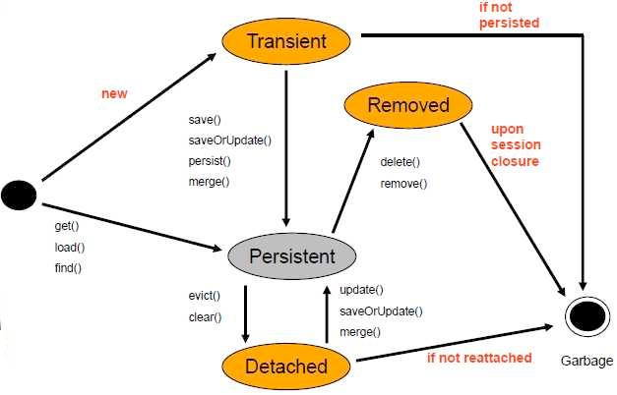
Bean Life Cycle

Slide 21
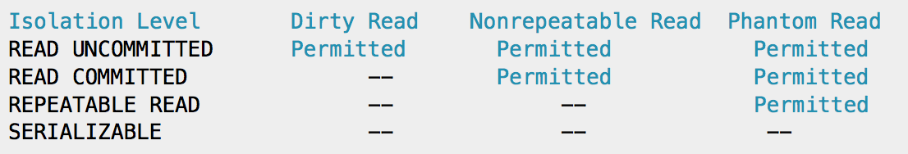
Transaction Isolation
<property name="hibernate.connection.isolation">2</property>
1: READ UNCOMMITTED
2: READ COMMITTED
4: REPEATABLE READ
8: SERIALIZABLE

Slide 22
Isolation Behaviour 1
Open two sessions, start two transactions, read an user object using session.load(User.class,id) in both sessions
Modify age field in both objects
Commit both transactions
Repeat the program with isolation setting 8,4,2
<property name="hibernate.connection.isolation">8</property>

Slide 23
Isolation Behaviour 2
Open two sessions, start two transactions, select all users using
List<Users> userList = session.createQuery("select u from User u”).list();
Create a new user object and call session.save in any one session
Commit both transactions
Repeat the program with isolation setting 8,4,2
<property name="hibernate.connection.isolation">8</property>

Slide 24
Optimistic Locking
Use a lower isolation level but prevent objects from being overwritten in other transactions
Map the PRODUCTS table to Product entity
Map the version column after id column in hbm like this: <version column="version" name="version" type="int" insert="true" />
Repeat the isolation behaviour 1 program with isolation setting removed

Slide 25
Mapping Relationships
One to Many
Many to Many
Many to One
One to One

Slide 26
One to Many
Map the order table’s fields to an Order entity with a hbm.xml
Define a “Set<Order> orders” property in User entity
In User.hbm.xml mention this relationship
<set name="orders">
<key column="user_id"/>
<one-to-many class="com.mydomain.model.Orders" />
</set>
List<Users> userList = session.createQuery("select u from User u").list();
for (Users u : userList) {
Set<Orders> orders = u.getOrders();
}

Slide 27
Many to One
Define a property “private User user” in Order class
Define the Many to One relationship
<many-to-one name="user" column="user_id"
class="com.mydomain.model.Users" not-null="true"/>

Slide 28
Many to Many
Map the “Products” table to Product entity in hbm.xml
In Order entity create a “Set<Product> products” property
Map the many to many relationship in orders.hbm.xml using the intermediate table
<set name="products" table="PRODUCT_ORDER_LNK">
<key column="order_id" />
<many-to-many column="product_id" class="com.mydomain.model.Products" />
</set>
Map the reverse relationship from Product to order aswell

Slide 29
One to One
Map the Billing_info table to BillingInfo entity in hbm.xml
In Order create a “BillingInfo billingInfo” property
Then provide the mapping in order.hbm.xml
<one-to-one name="billingInfo" class="com.mydomain.model.BillingInfo"
cascade="all" foreign-key="order_id"></one-to-one>

Slide 30
Transform the WebApp to Hibernate
A WebApp implemented with JDBC is shared (HibernateWebApp). Transform that to use hibernate.
Create a class HibernateUtil that loads the SessionFactory from configuration.
Bring in User<—>Order relationship and in User::getOrderCount, return orders.size();
Change getAllUsers method to use hibernate

Slide 31
Basic HibernateUtil
public class HibernateUtil {
private static SessionFactory sesFac = null;
static{
Configuration configuration = new Configuration().configure("hibernate.cfg.xml");
ServiceRegistry serviceRegistry
= new StandardServiceRegistryBuilder()
.applySettings(configuration.getProperties()).build();
sesFac = configuration.buildSessionFactory(serviceRegistry);
}
public static Session getSession(){
return sesFac.openSession();
}
}

Slide 32
Lazy Initialisation
Works on one to many, many to many and many to one relationships
Javassist (Java programming assistant) is a Java library providing a means to manipulate the Java bytecode of an application.
  Support for structural reflection, i.e. the ability to change the implementation of a class at run time.

Slide 33
Open Session-in-view
Design Pattern for solving lazy loading issues in Web apps
A filter opens a session and sets it in a thread-local
DAO uses the session from thread-local

Slide 34
Filter For This Pattern
public void doFilter(ServletRequest req, ServletResponse res, FilterChain chain) throws IOException, ServletException {
Transaction tx=null;
HttpServletRequest request = (HttpServletRequest) req;
try {
//Begin and Commit Transaction
Session ses = HibernateUtil.currentSession();
tx = ses.beginTransaction();
chain.doFilter(req, res);
tx.commit();
} catch (Exception e) {
tx.rollback();
throw new ServletException(e);
} finally {
HibernateUtil.closeSession();
}
}
<filter>
<filter-name>HibernateSessionFilter</filter-name>
<filter-class>com.mydomain.HibernateSessionFilter</filter-class>
</filter>
<filter-mapping>
<filter-name>HibernateSessionFilter</filter-name>
<url-pattern>/*</url-pattern>
</filter-mapping>

Slide 35
Hibernate Interceptors
Interceptors in hibernate are fired for various events in the session and session factory
There can be an interceptor for the entire session factory or one for each session.
Create a class that extends EmptyInterceptor and override onSave() method. Update the join date of a user whenever an user is saved
Also prevent users from saving string data with leading/trailing spaces
Override the onFlushDirty method to update the modified date each time an user is updated

