Slide 1
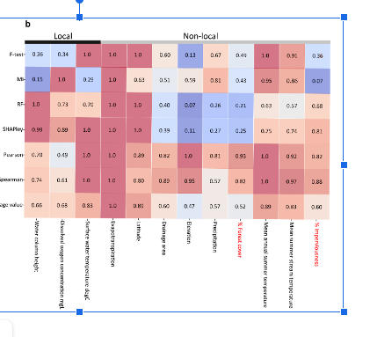
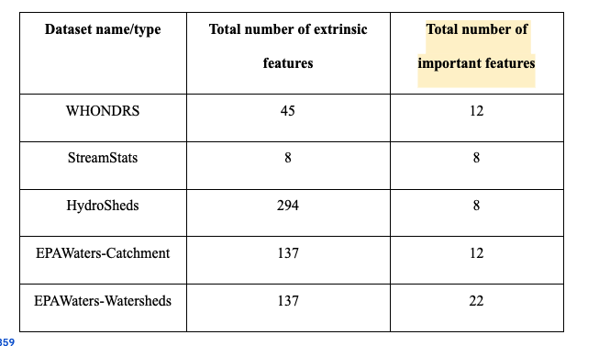
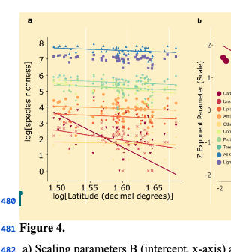
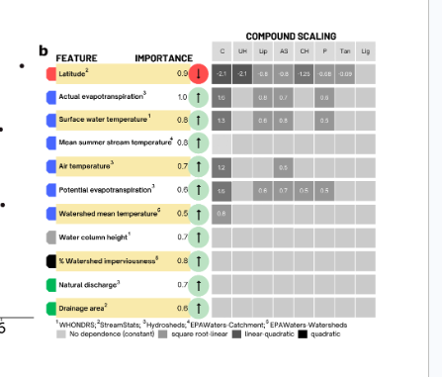
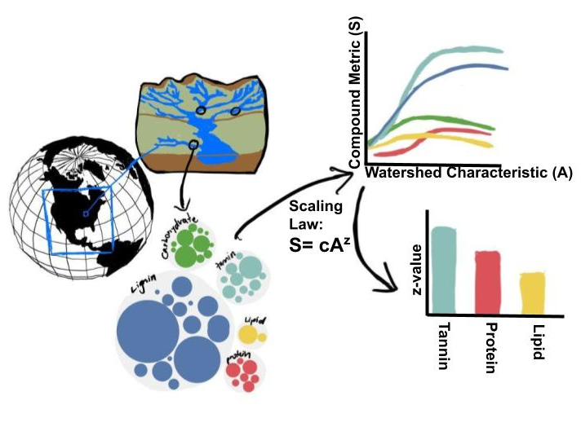



4. Feature set importances across datasets
3. Reduced set of features
Feature filtering
Thresholds on correlations coefficients
Spearman (0.275)
Pearson (0.3)
2. Total number of features for different datasets
6. Scaling laws for dominant features
1. Different dataset curation
5 Features greater than 0.5 and selecting important ones across all the datasets

Slide 4
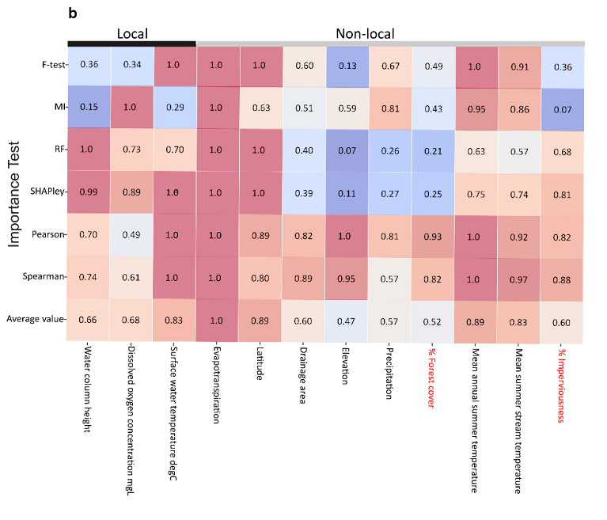

Slide 5
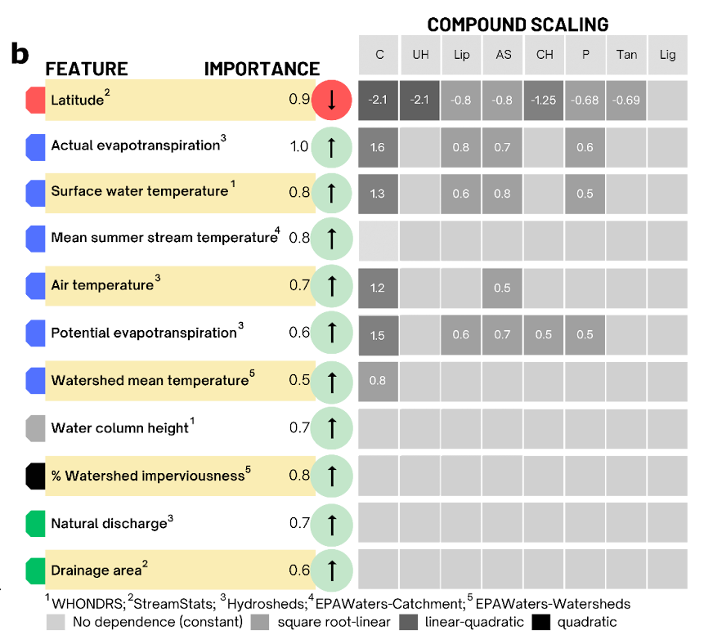

Slide 6
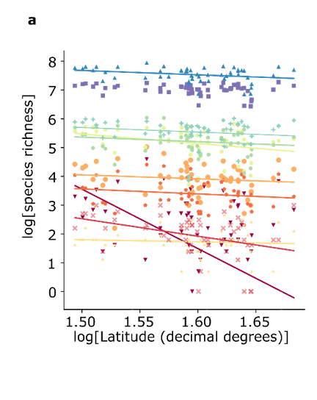

Slide 7



4. Feature set importances across datasets
3. Reduced set of features
Feature filtering
Thresholds on correlations coefficients
Spearman (0.275)
Pearson (0.3)
2. Total number of features for different datasets
Dataset name | Reduced feature | Avg feature importance value
4. Features greater than 0.5 and selecting important ones across all the datasets
1. Different dataset curation

