Slide 1
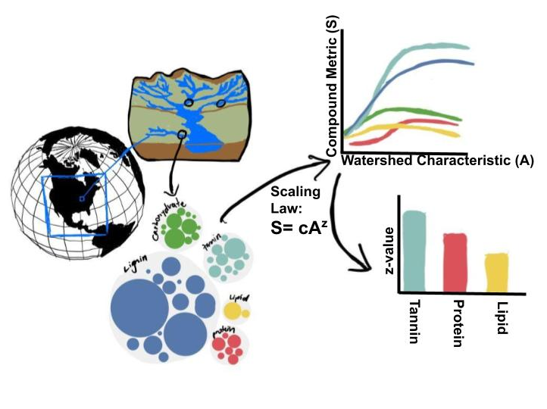
Supplementary material – Plots and description
Feature importances
Correlation plots for all compounds
Averaged feature importances
Scaling laws
S = cA^{z}
Z-value of bar plot
C-value of bar plot
Additional PCA figures and loadings (if needed)
Notes:
Significance of explanatory variables → Effect of random seed on the loading matrix importance.

Slide 2
Feature importances
Plots for significant features
WHONDRS
StreamStats
HydroSheds
EPAWaters-Catchment
EPAWaters-Watersheds
Methods include

Slide 3
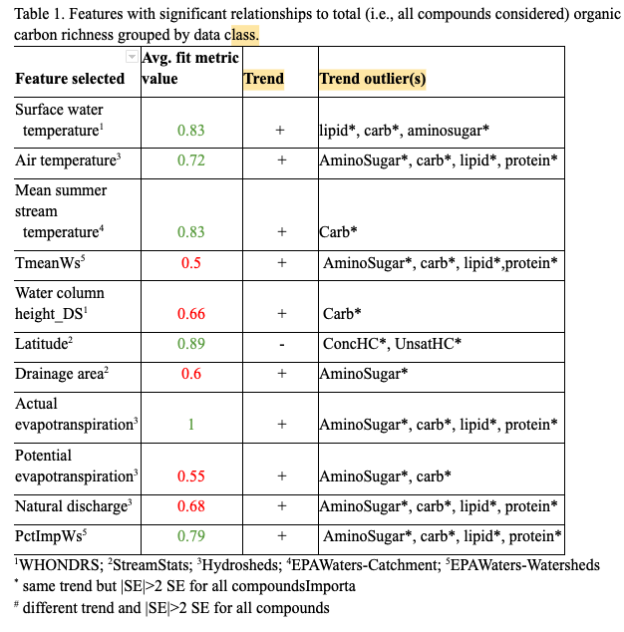
Important features
Some high-to-low important features
Actual ET (Hydrosheds)
Latitude (StreamStats)
Surface water temperature (WHONDRS)
Mean summer stream temperature (EPAW-catchment)
PctImpWs (EPAW-Watersheds)
Air temperature (HydroSheds)

Slide 4
Relevant WHONDRS figures → Local extrinsic variables
Relevant features
Surface water temperature
Water column height_DS

Slide 5
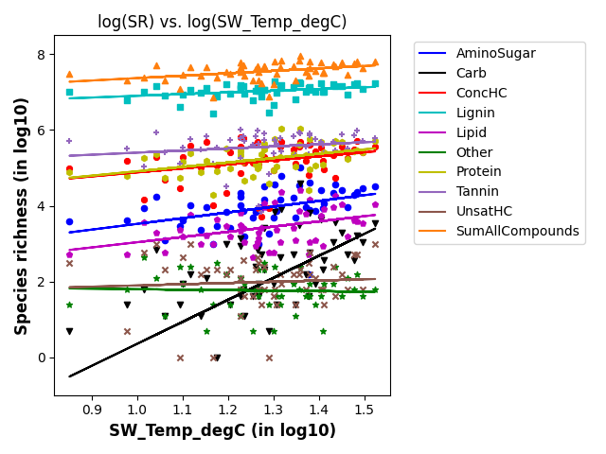
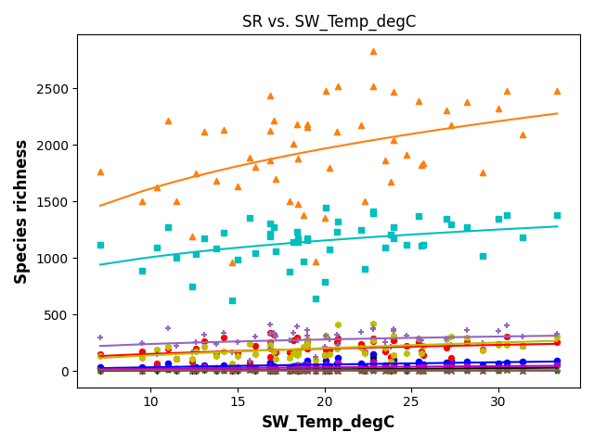
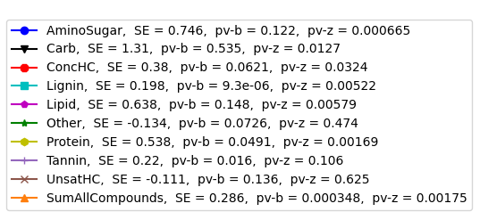
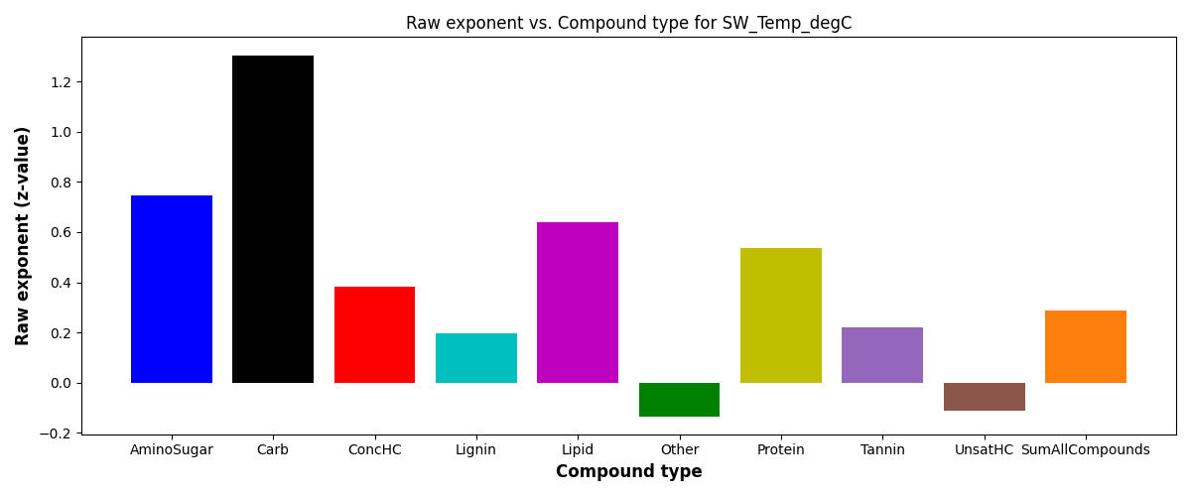
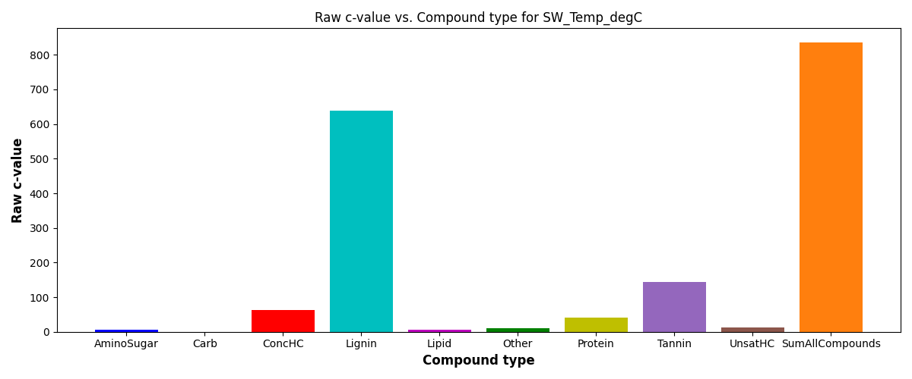
SR vs Surface water temperature
S = c*(ftr)^{z}
SE = scaling exponent or z-value

Slide 6
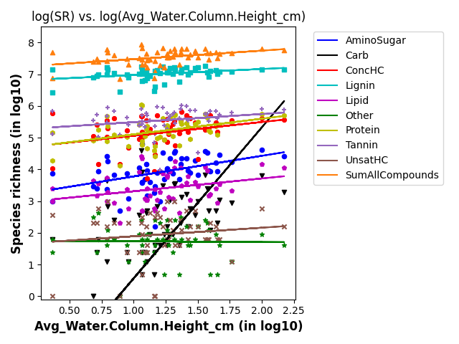
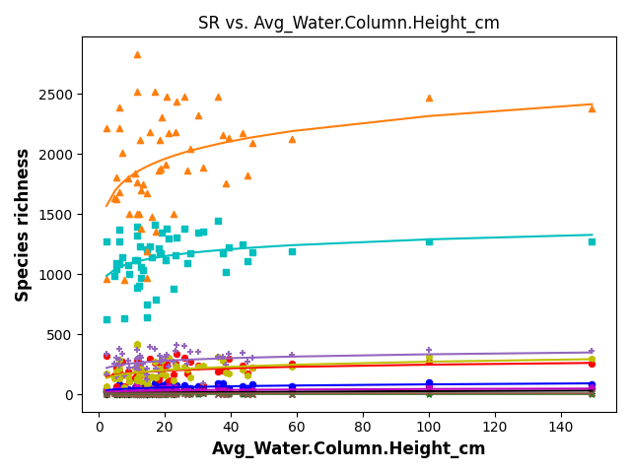
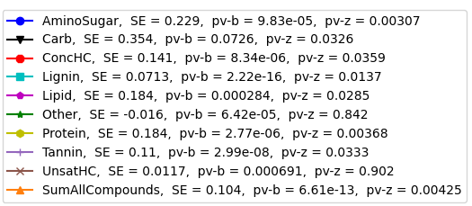
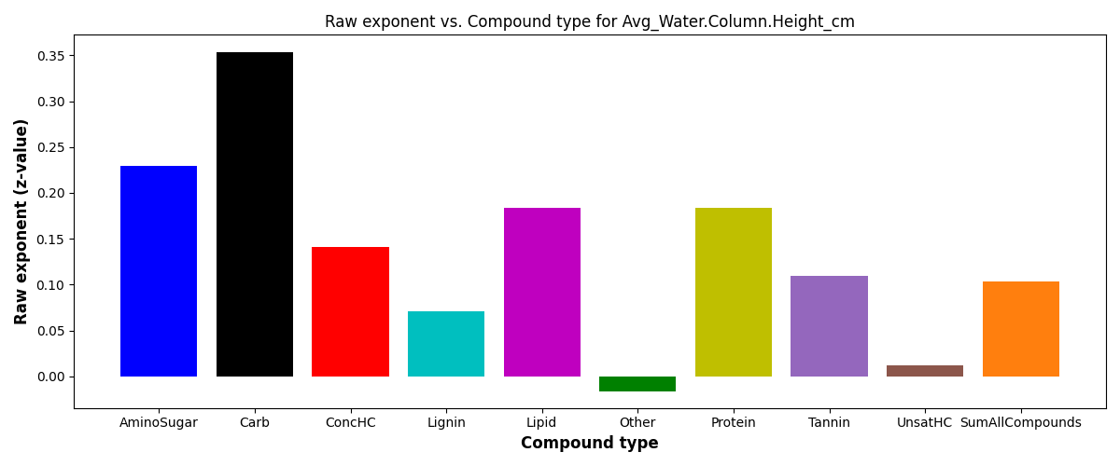
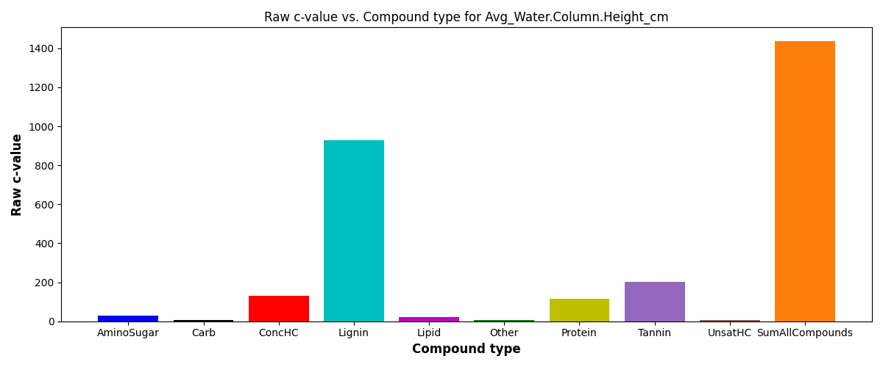
SR vs Water column height_DS
S = c*(ftr)^{z}
SE = scaling exponent or z-value

Slide 7
Relevant StreamStats figures → Local extrinsic variables
Relevant features
Latitude
Drainage area

Slide 8
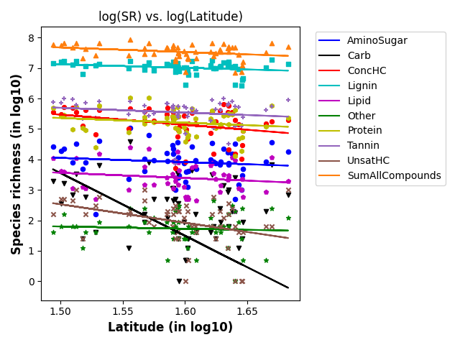
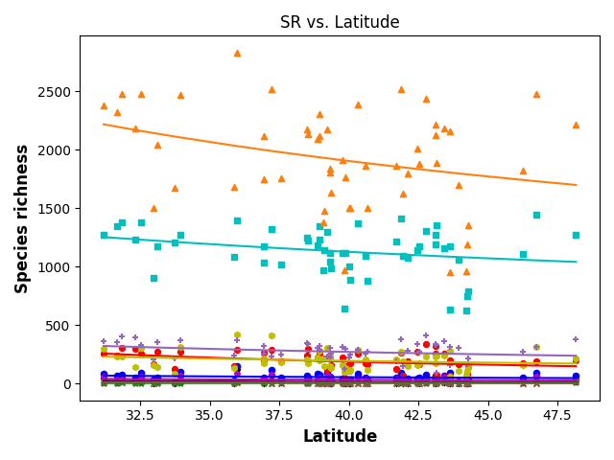
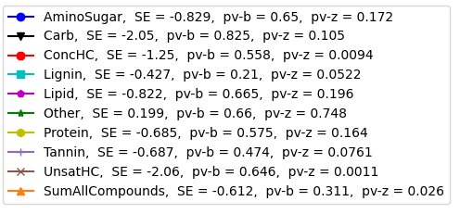
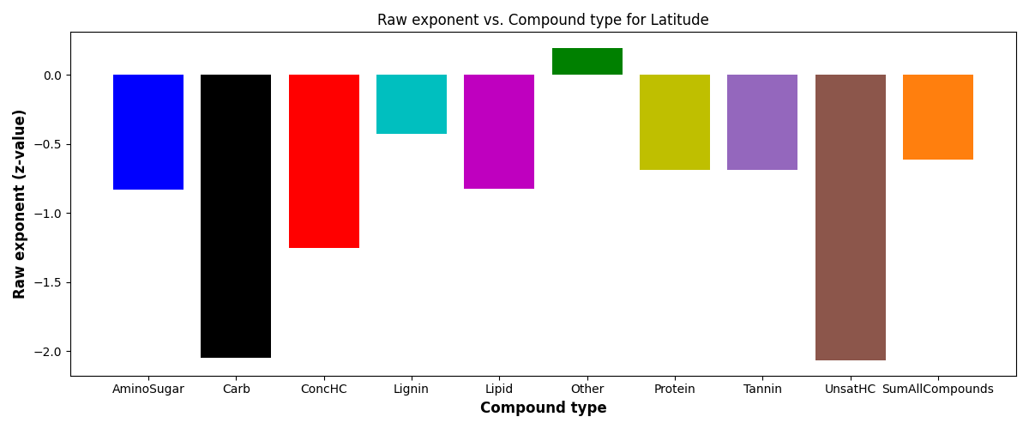
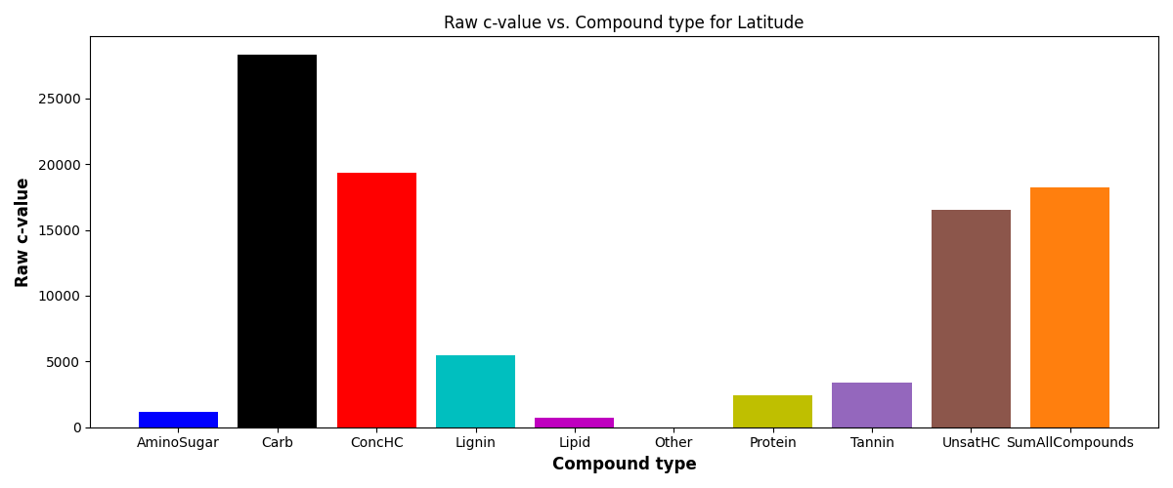
SR vs Latitude
S = c*(ftr)^{z}
SE = scaling exponent or z-value

Slide 9
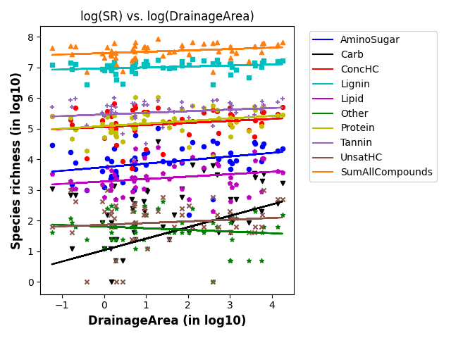
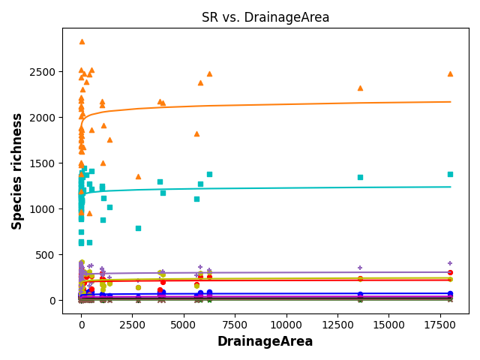
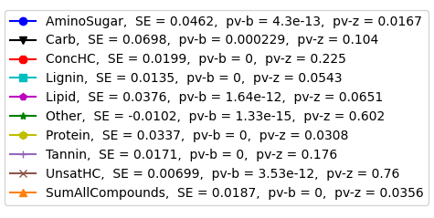
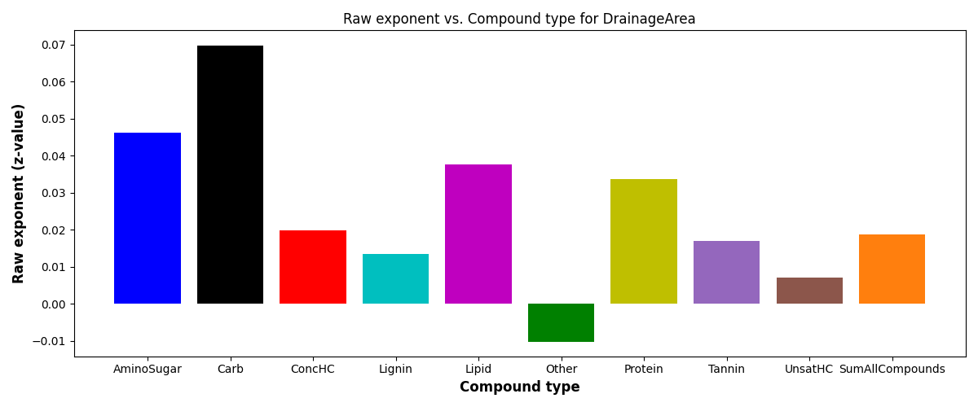
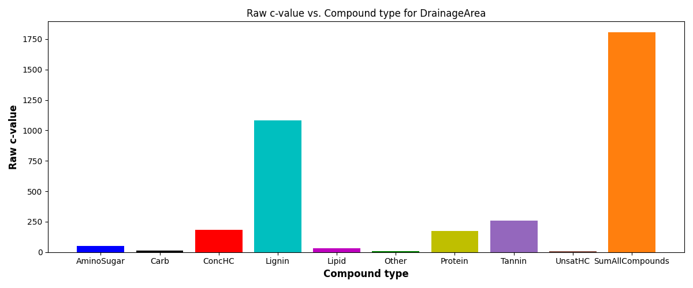
SR vs Drainage area
S = c*(ftr)^{z}
SE = scaling exponent or z-value

Slide 10
Relevant HydroSheds figures → Non-local extrinsic variables
Relevant features
Air temperature
Actual ET
Potential ET
Natural discharge

Slide 11
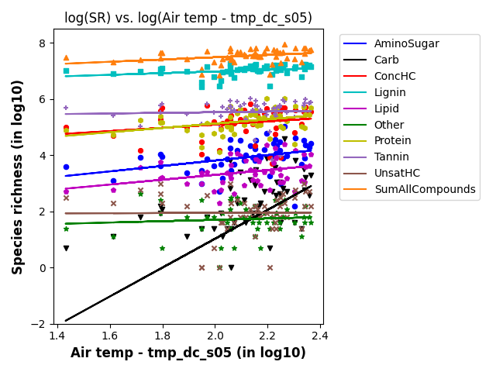
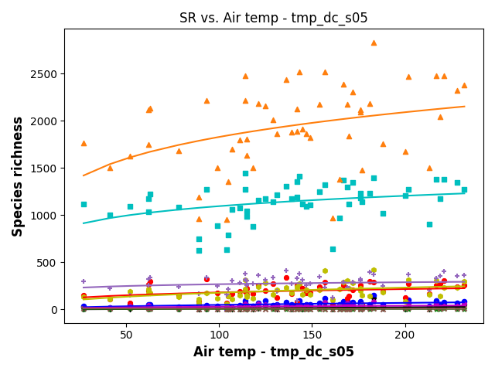
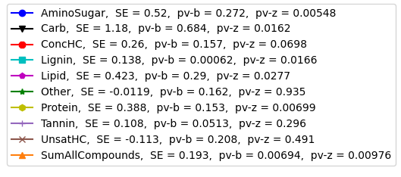
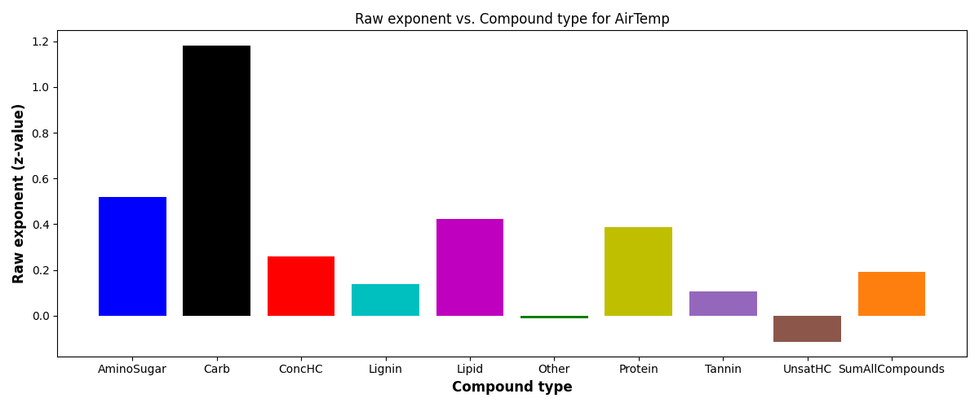
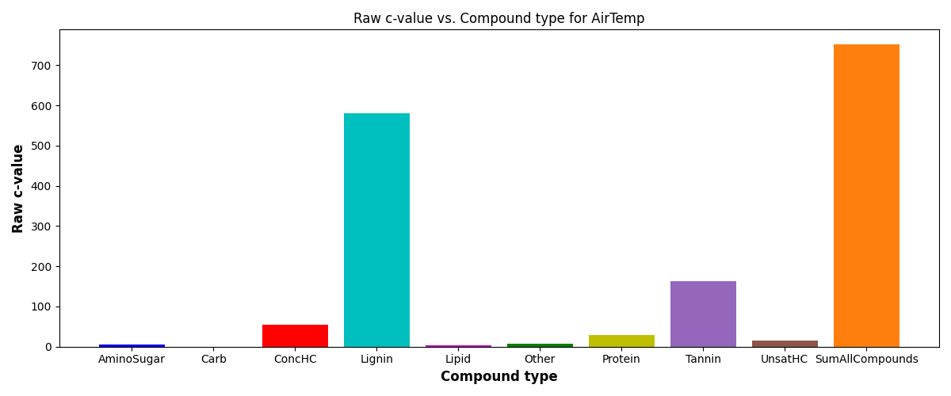
SR vs Air temperature
S = c*(ftr)^{z}
SE = scaling exponent or z-value

Slide 12
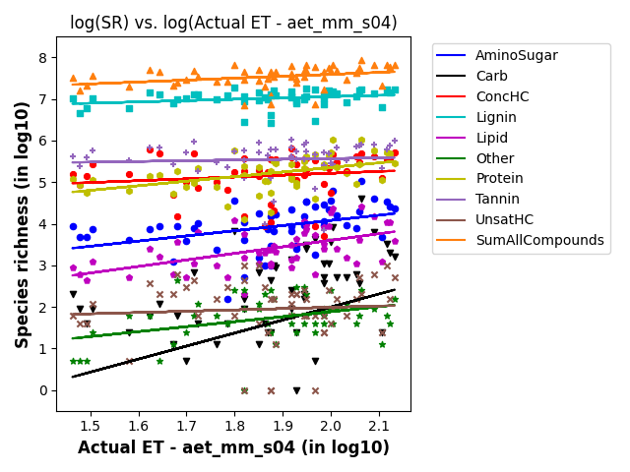
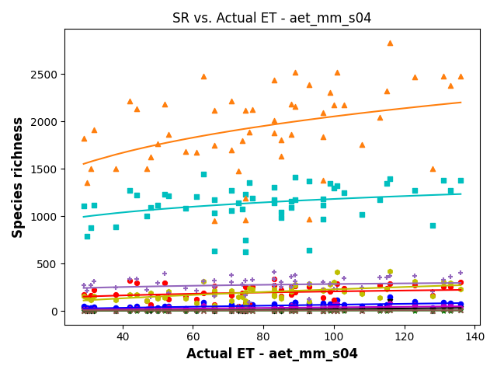
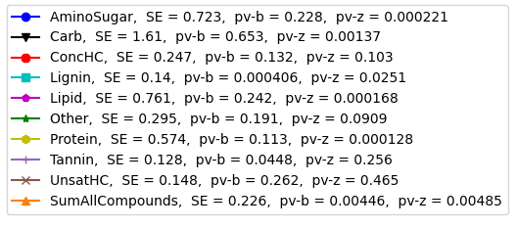
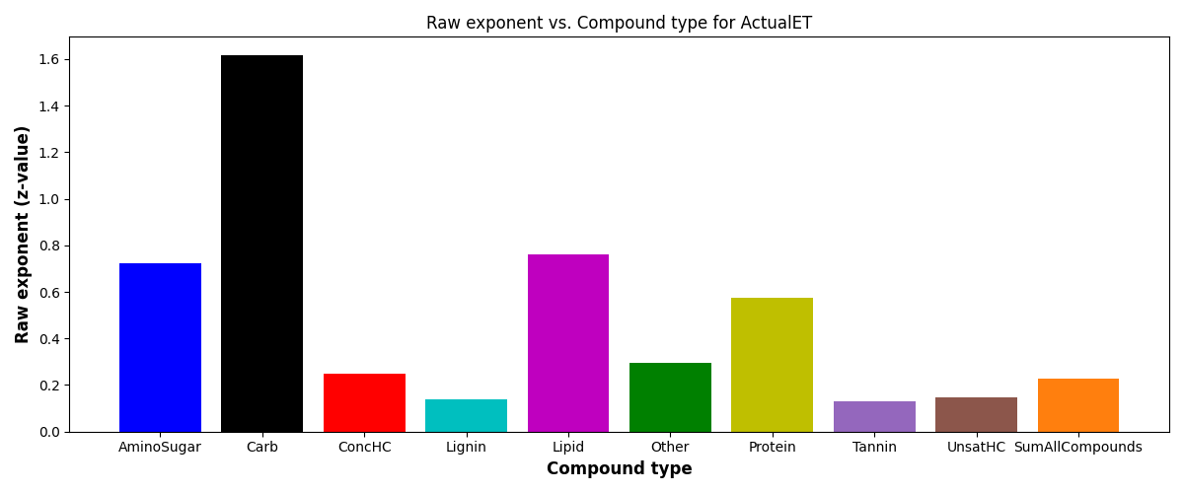
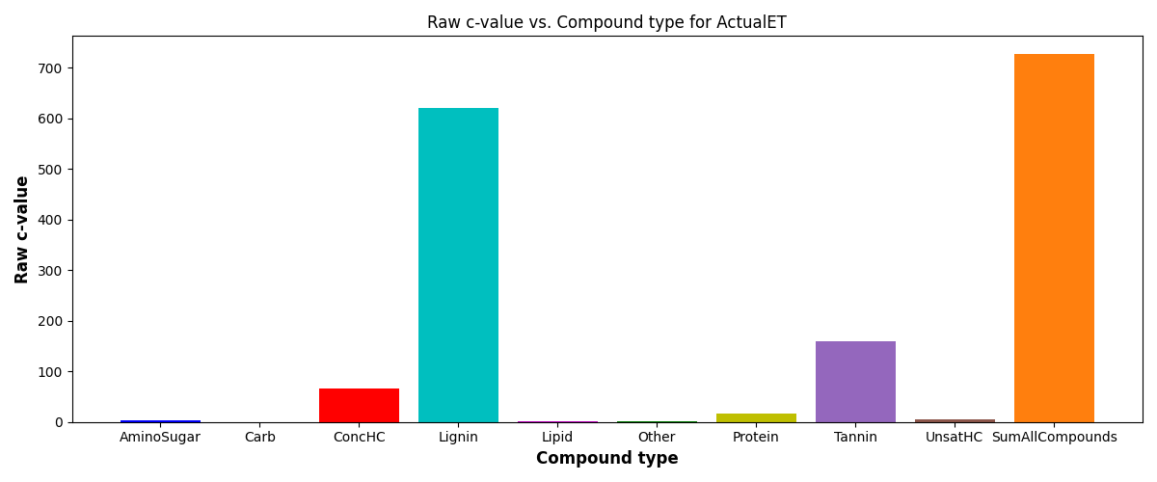
SR vs Actual ET
S = c*(ftr)^{z}
SE = scaling exponent or z-value

Slide 13
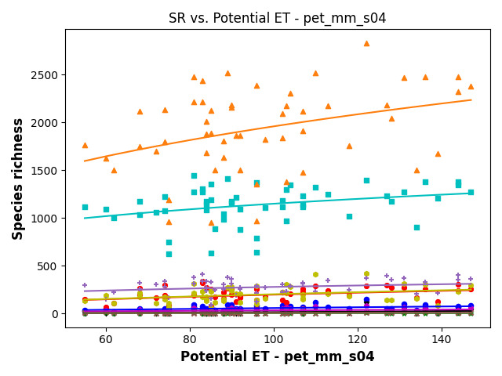
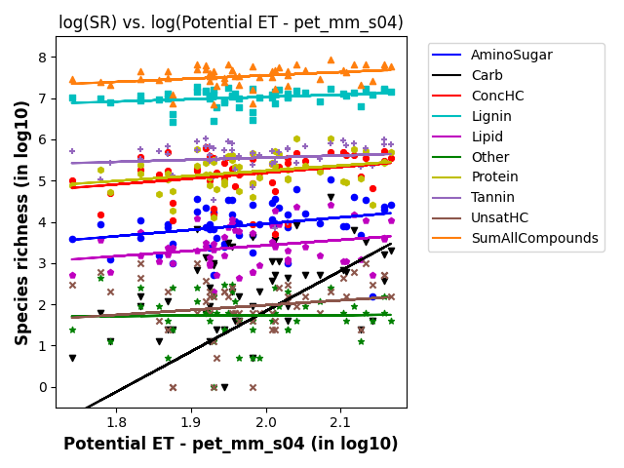
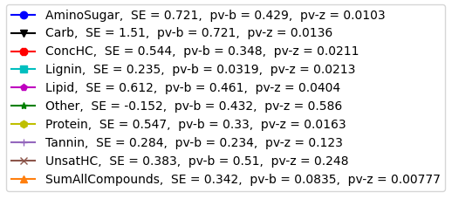
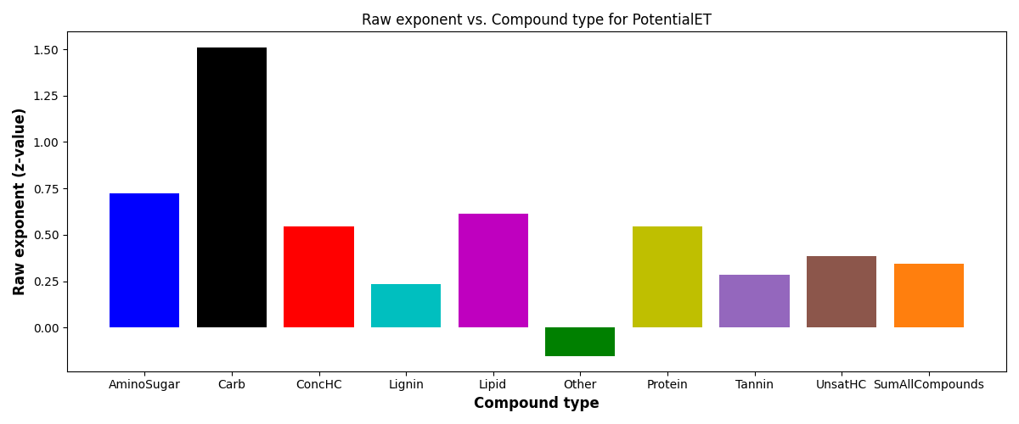
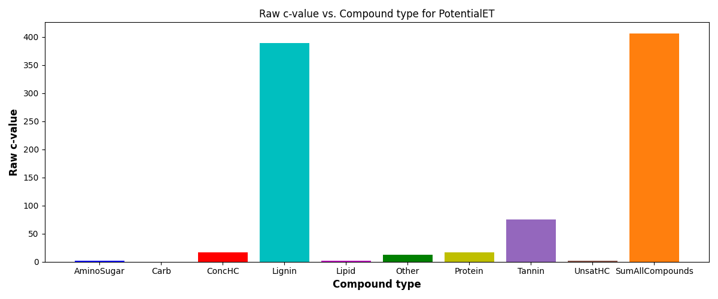
SR vs Potential ET
S = c*(ftr)^{z}
SE = scaling exponent or z-value

Slide 14
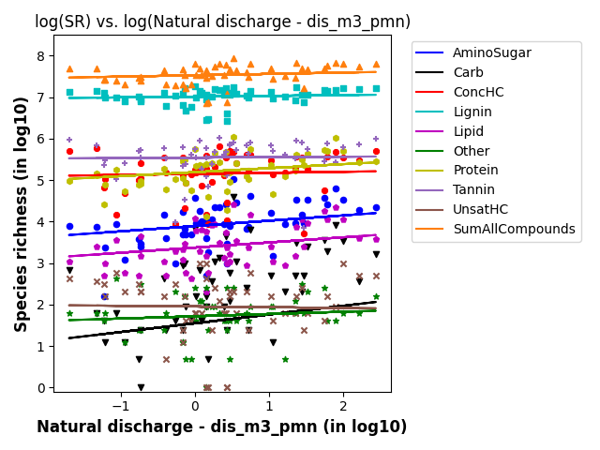
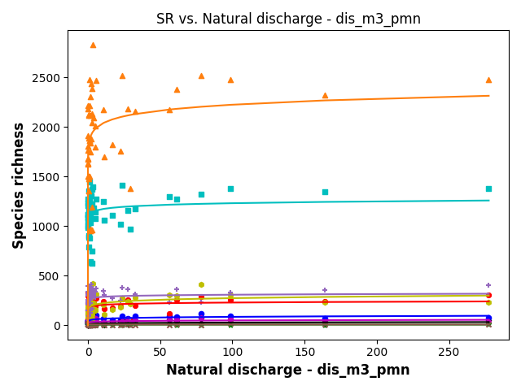
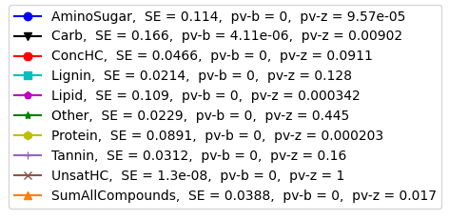
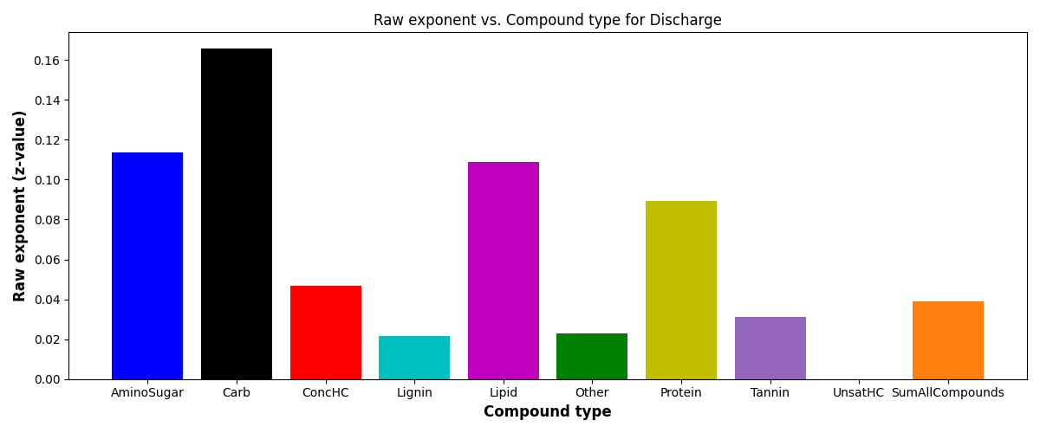

SR vs Natural discharge
S = c*(ftr)^{z}
SE = scaling exponent or z-value

Slide 15
Relevant EPAW-Catchment figures → Non-local extrinsic variables
Relevant features
Mean summer stream temperature

Slide 16
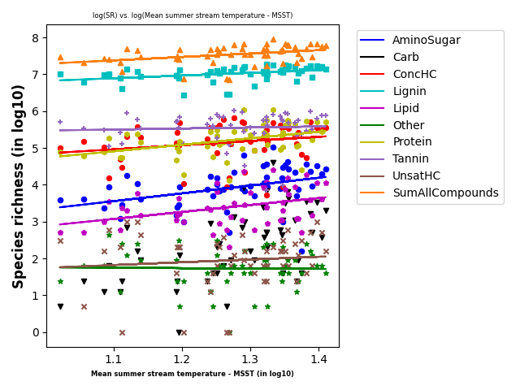
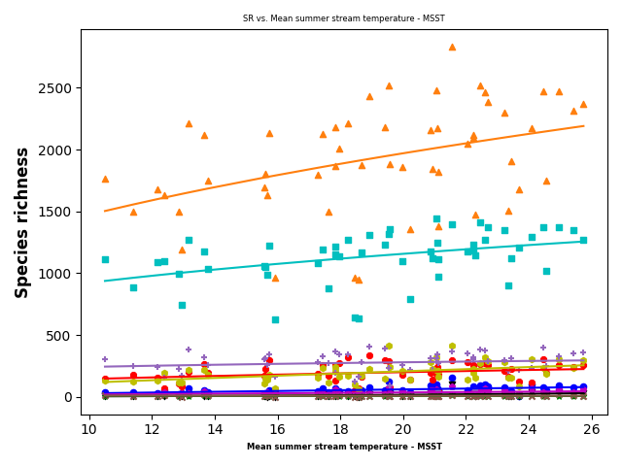
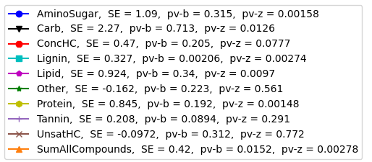
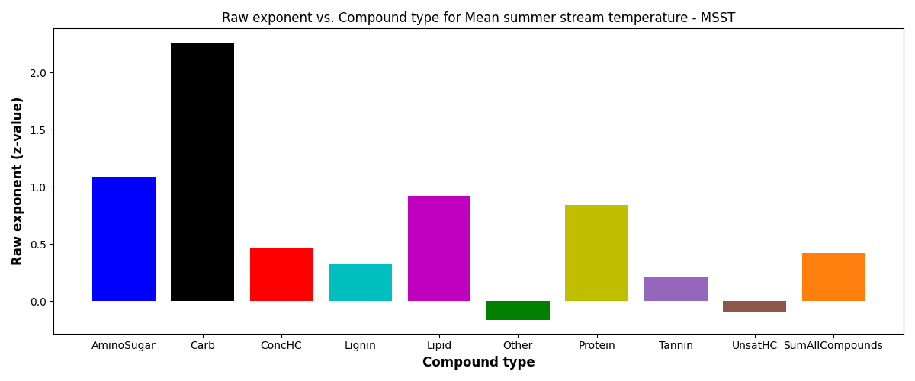
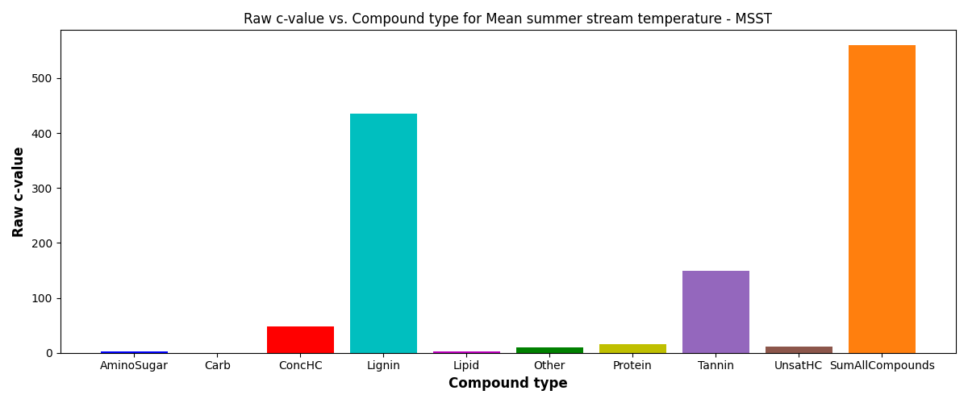
SR vs Mean summer stream temperature
S = c*(ftr)^{z}
SE = scaling exponent or z-value

Slide 17
Relevant EPAW-Watershed figures → Non-local extrinsic variables
Relevant features
TmeanWs
PctImpWs

Slide 18
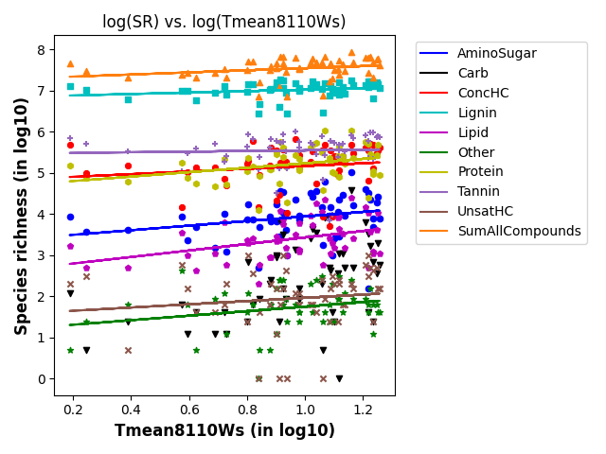
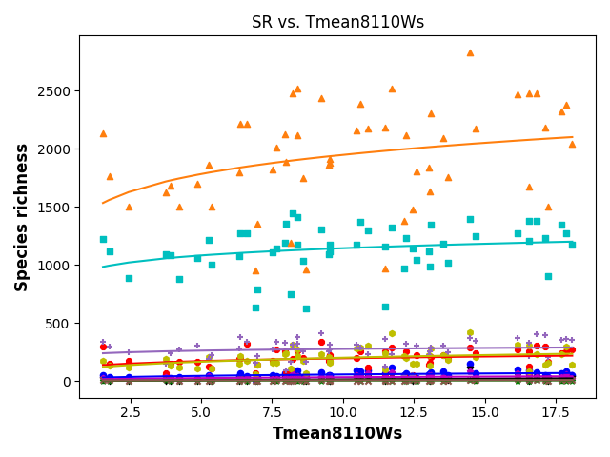
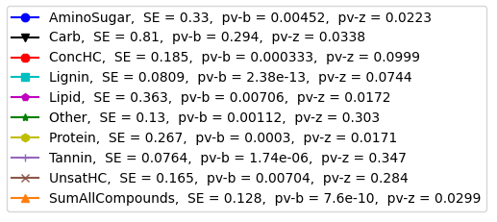
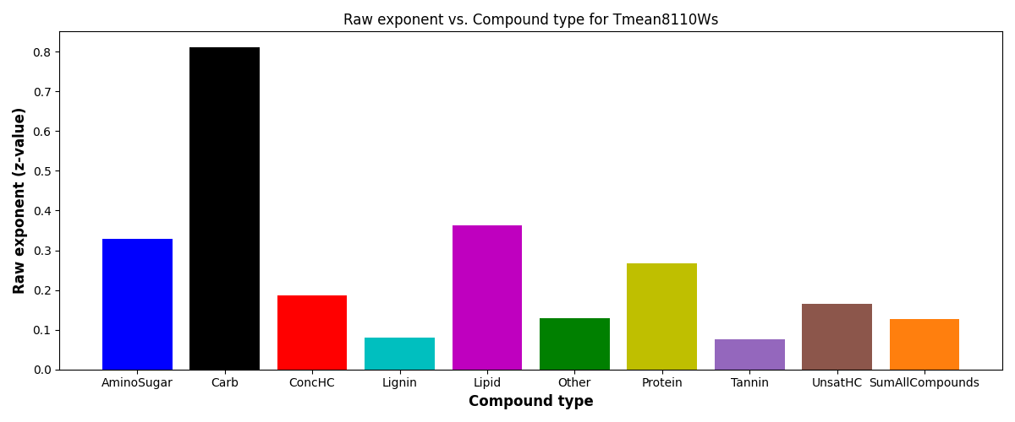

SR vs TmeanWs
S = c*(ftr)^{z}
SE = scaling exponent or z-value

Slide 19





SR vs PctImpWs
S = c*(ftr)^{z}
SE = scaling exponent or z-value

Slide 20

PCA analysis and biplots (variation across data samples w.r.t to 11 features)

