Slide 1
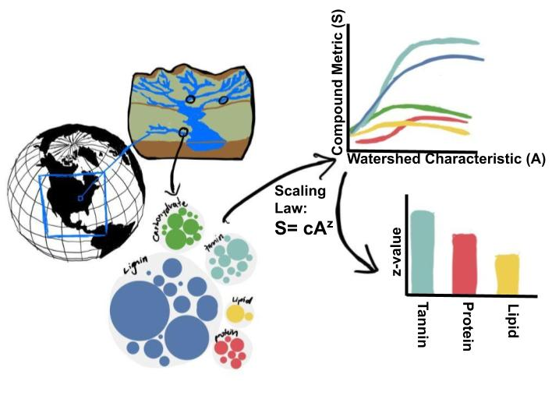
Lignin - #7E72B4
Carbohydrate - #9E0142
Tannin - #66C2A5
Lipid - #F46D43
Protein - #ABDDA4

Slide 2
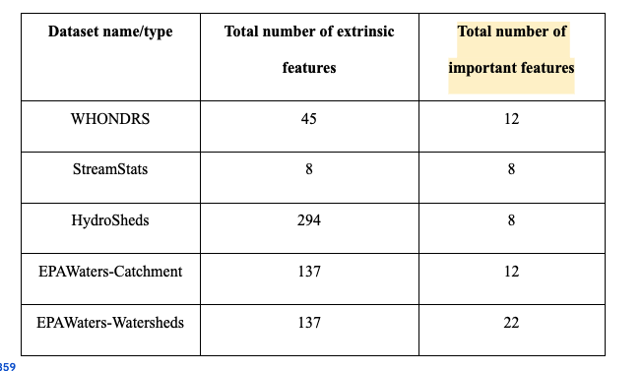
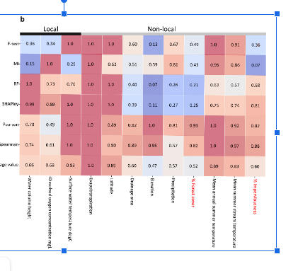
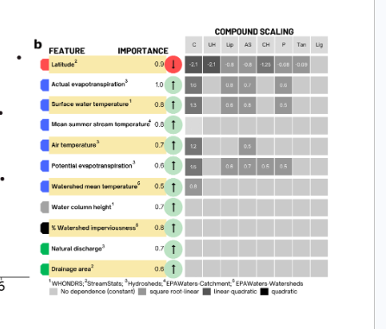
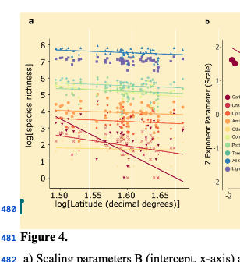
Total features (n=627) and all compound types (n=9)
Spearman and Pearson Correlation (Sup XX)
Reduced set of features
Local versus Non-local (Figure 3)
Most Important Features
Feature Clustering (Figure 4a)
Feature importance greater than 0.5 (Supp XX)
Fitting Scaling Relationships
Across Compounds Figure 4b,5b, Across Features Figure 5a
Notes:
The tables should be rotated so that the text is horizontal. Little graphics for features and compounds

