Slide 1
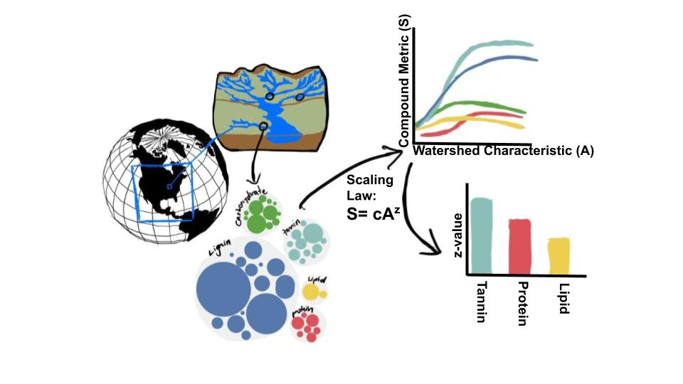
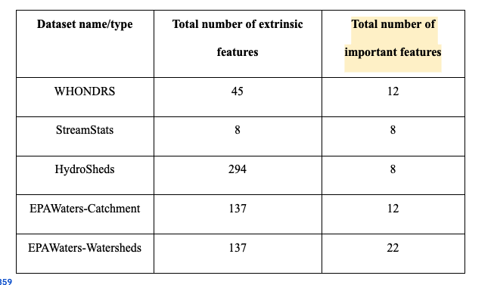
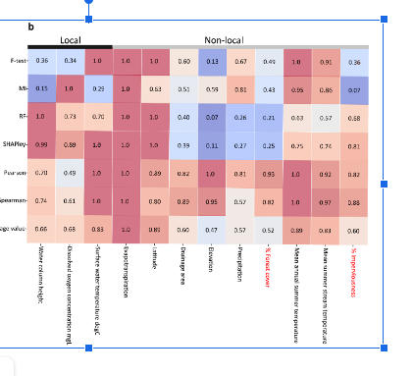
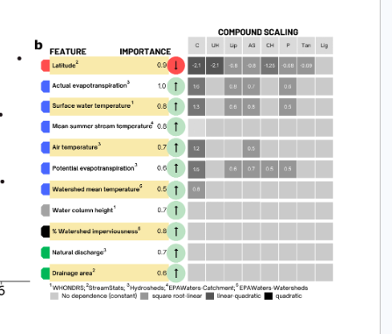
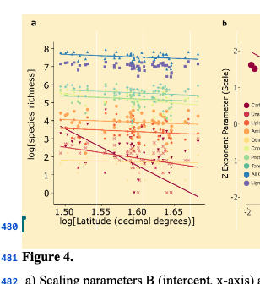
1. Dataset curation
2. Total features ( n= 627) and all compound types (n = 9)
Spearman and Pearson Correlation (see Supp. material)
3. Reduced set of features : Local versus Non-local
4. Most important Features: Feature Clustering
Feature importance greater than 0.5 (see Supp material)
5. Fitting Scaling Relationships
Across Compounds and across Features
Notes:
The tables should be rotated so that the text is horizontal. Little graphics for features and compounds

Slide 2
Lignin - #7E72B4
Carbohydrate - #9E0142
Tannin - #66C2A5
Lipid - #F46D43
Protein - #ABDDA4

Slide 3
Backup slide figures

Slide 5
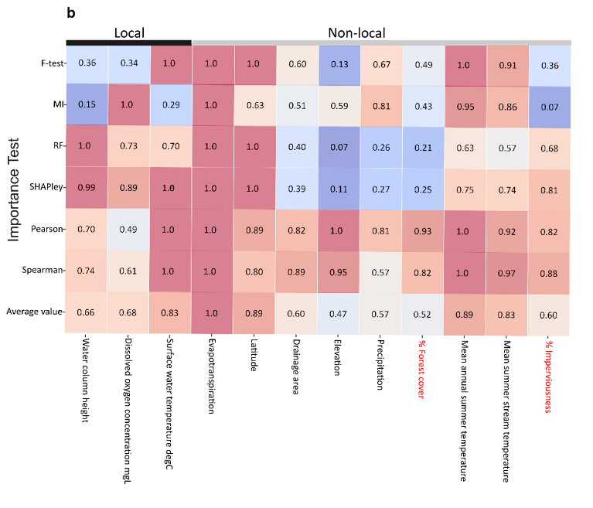

Slide 6
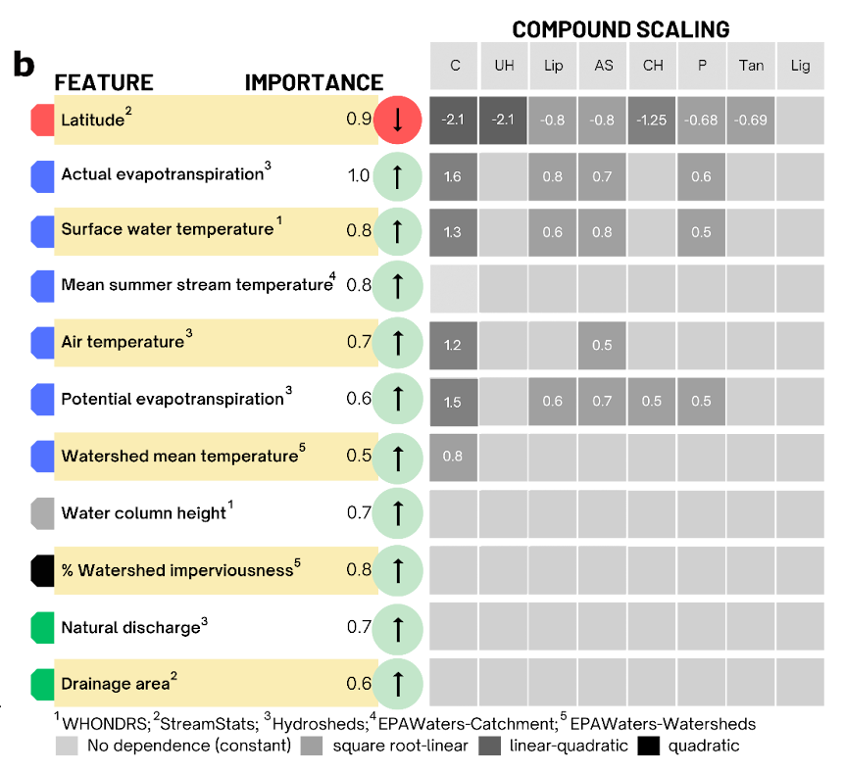

Slide 7
