Slide 1
Discussion items – Dec-20th
PCA analysis
Variation across data features
Variation across data samples
Scaling laws with p-values for
Inundation Extent (from hydrosheds)
Min Basin Elevation (from streamstats)
Mean Imperviousness (from epa waters-catchment)
Open water land cover (from epa waters-catchment)
Developed Catchment Area (LU) (from epa waters-catchment)
PctImpWs (from epa waters-watersheds)
PctFrstLossWs (from epa waters-watersheds)
PctNonAgIntrodManagVegWs (from epa waters-watersheds)
TmeanWs (from epa waters-watersheds)
NPDESDensWs (from epa waters-watersheds)
SuperfundDensWs (from epa waters-watersheds)

Slide 2
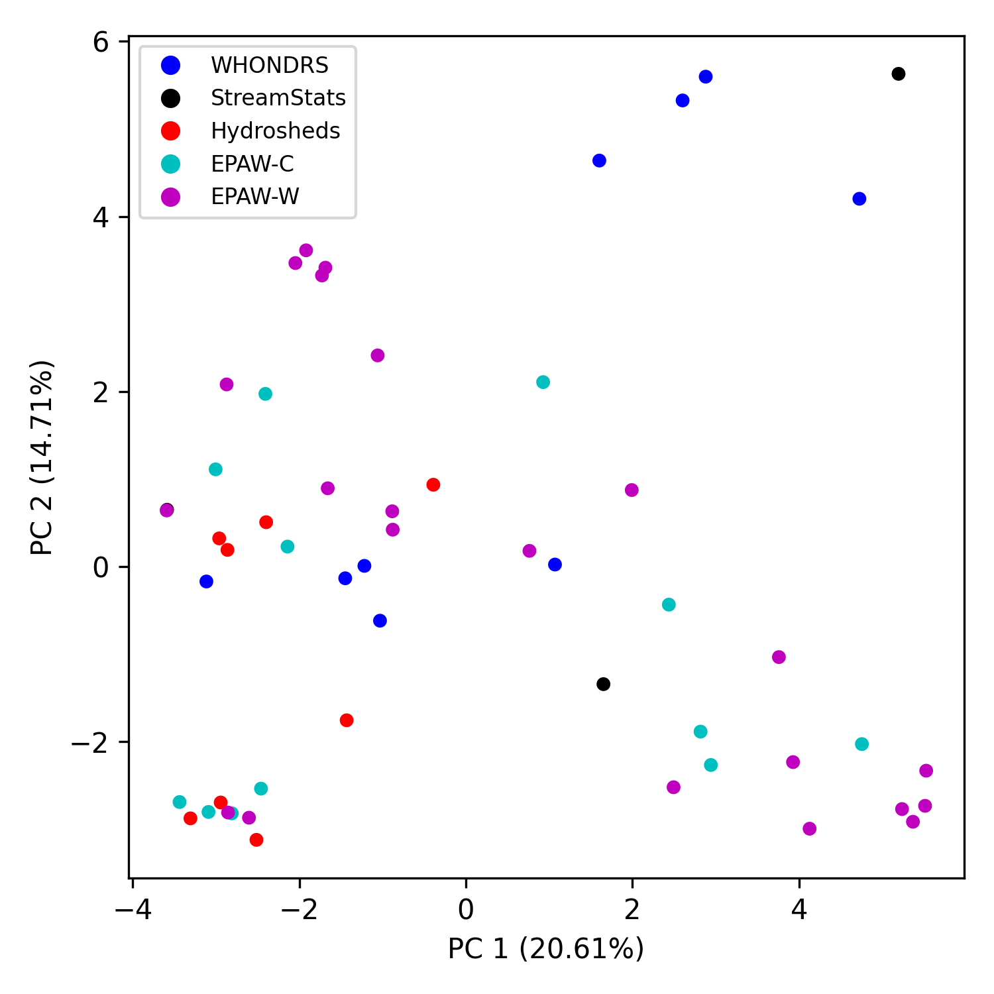
PCA analysis (variation across data features)

Slide 3
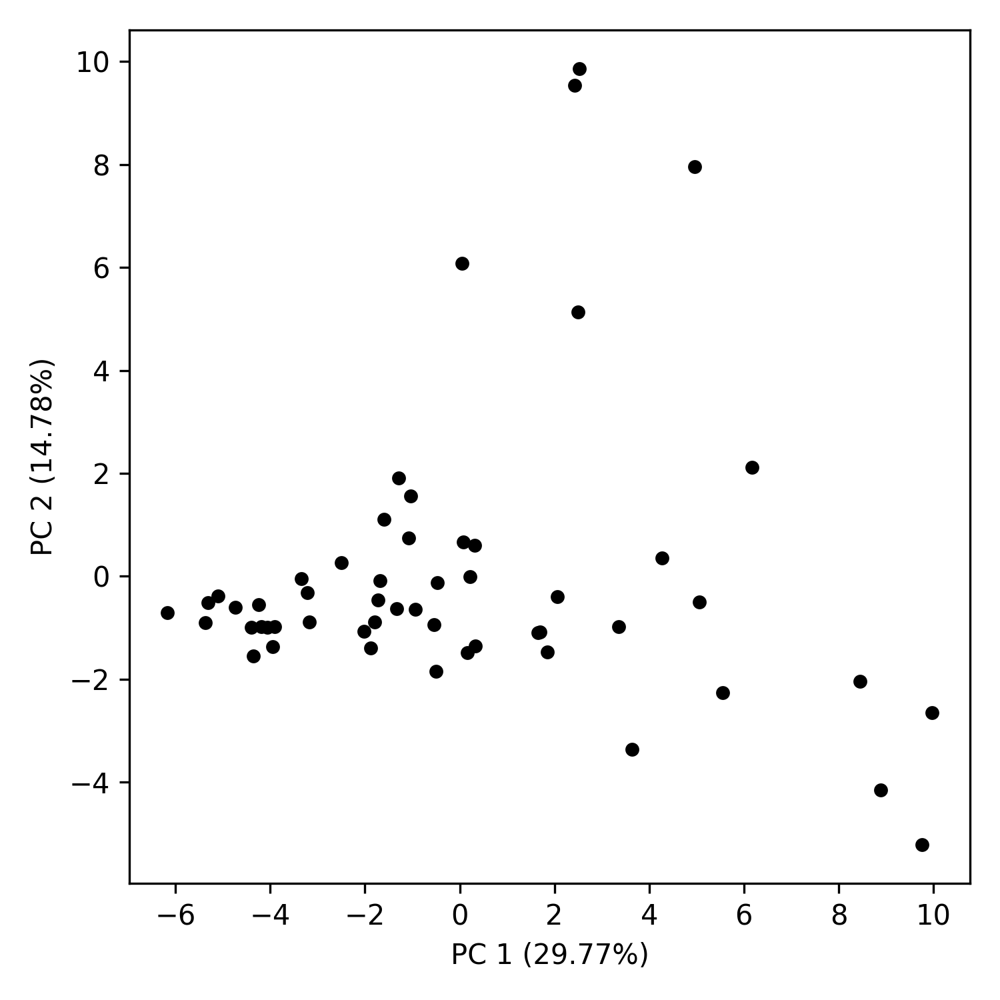
PCA analysis (variation across data samples)

Slide 4
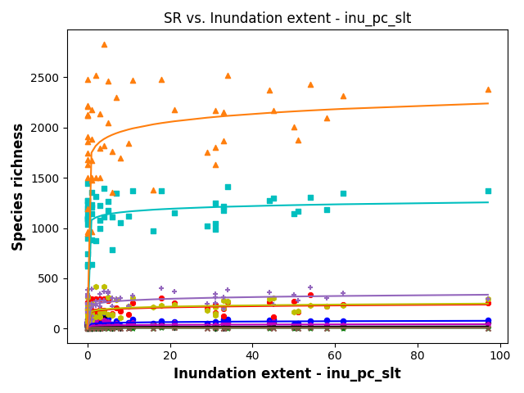
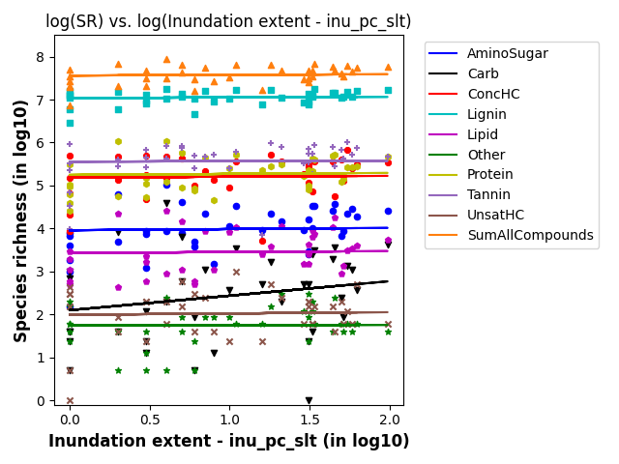
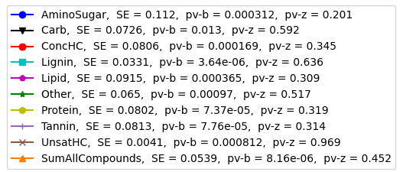
SR vs Indundation Extent

Slide 5
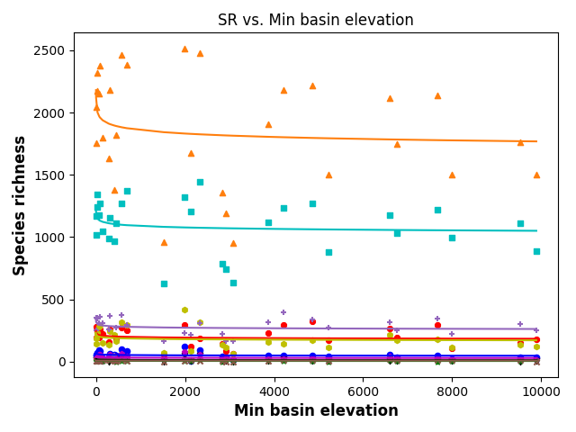
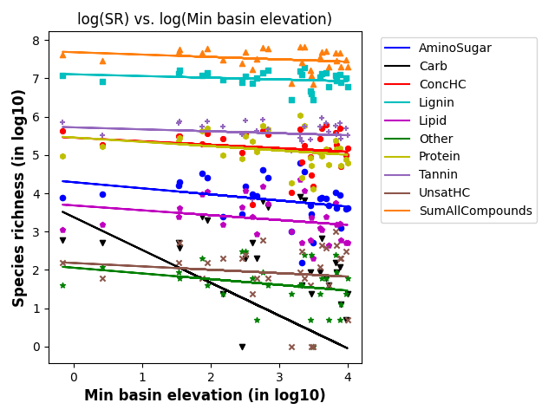
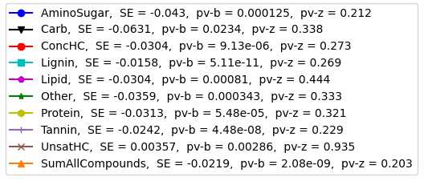
SR vs Min basin elevation

