Slide 1
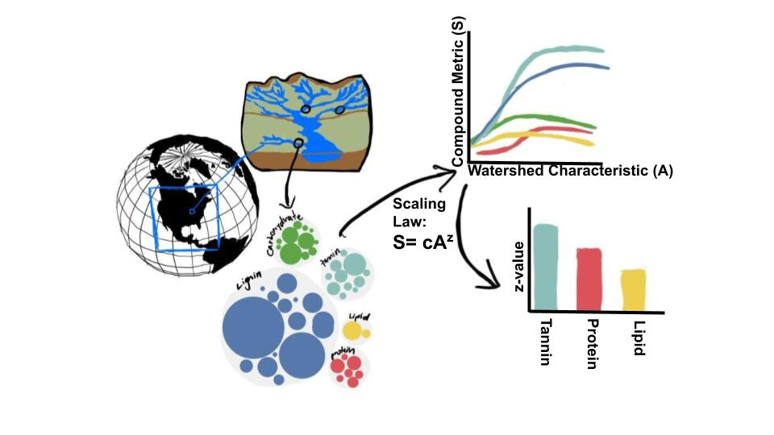
Discussion items – March-2nd
S = cA^{z} (done)
Z-value of bar plot
C-value of bar plot
What can we put in supplementary figures? (working on this)
Notes:
Significance of explanatory variables → Effect of random seed on the loading matrix importance.

Slide 2
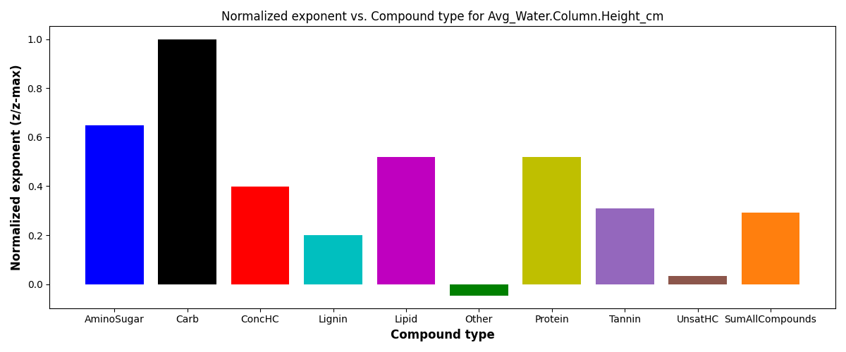
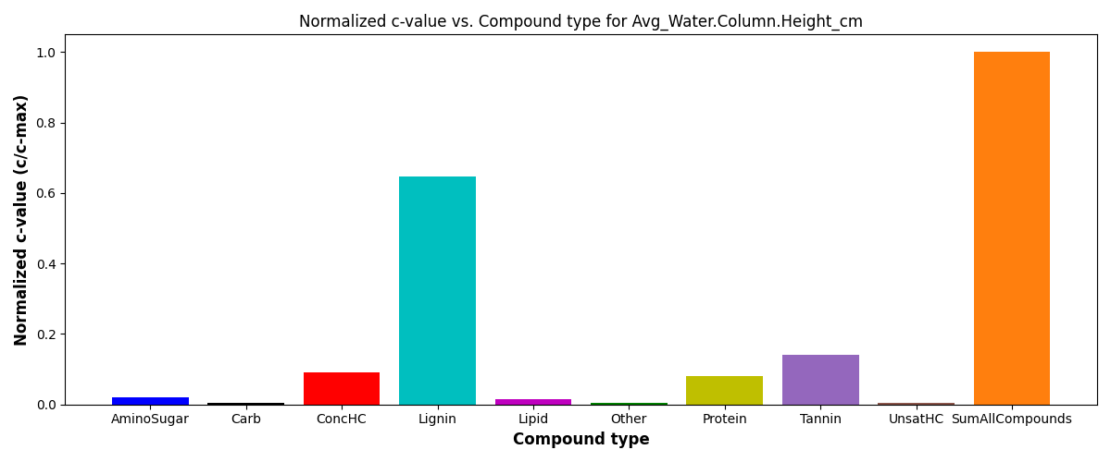
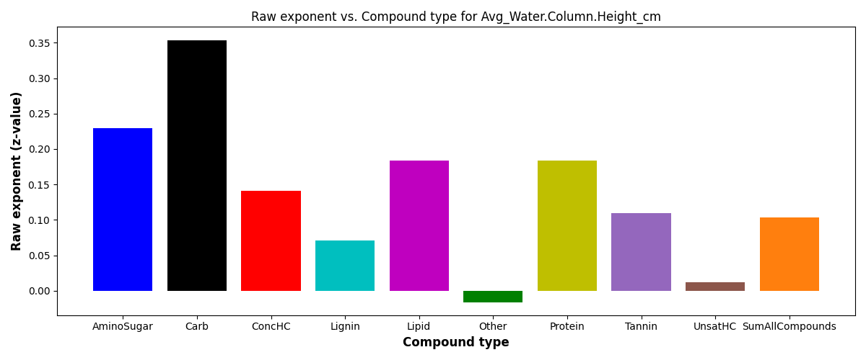
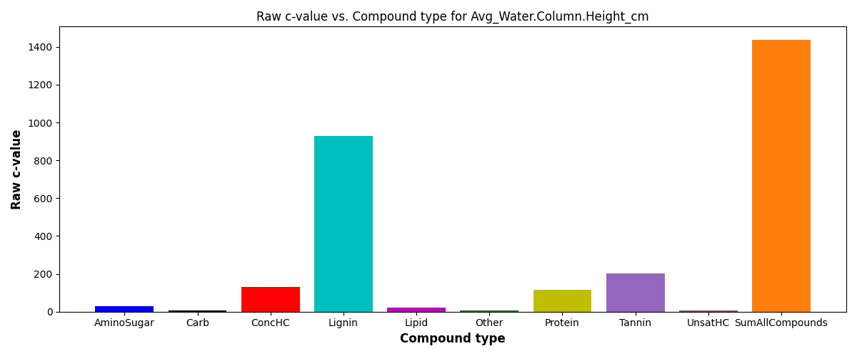
WHONDRS bar plot
S = c*(ftr)^{z}
SE = scaling exponent or z-value

Slide 3
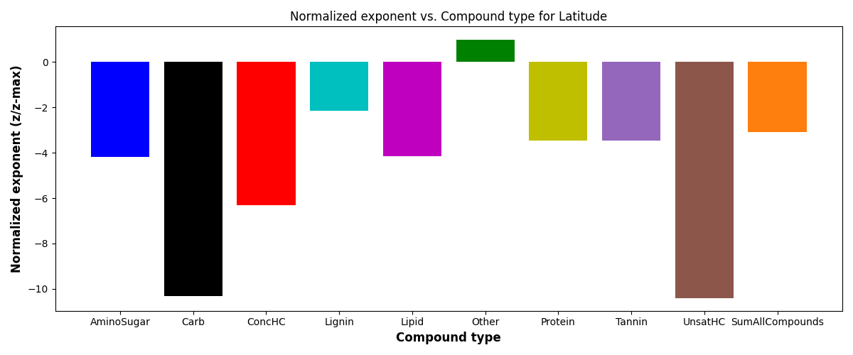
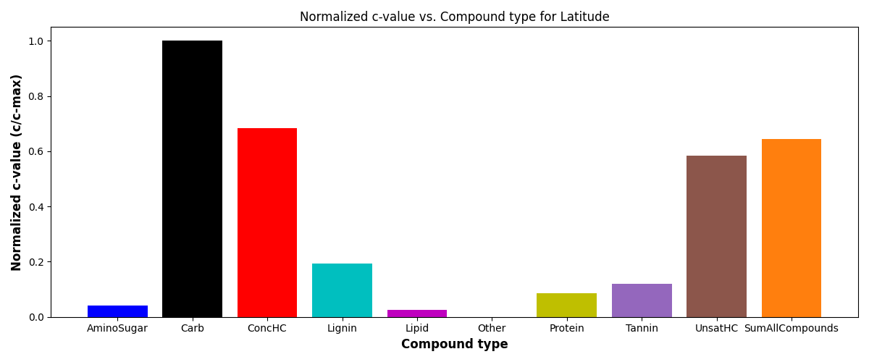
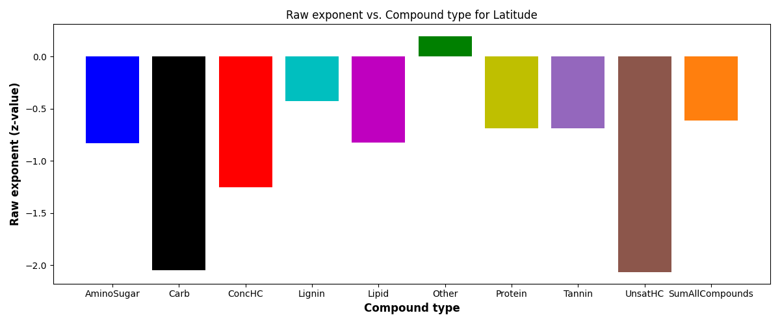
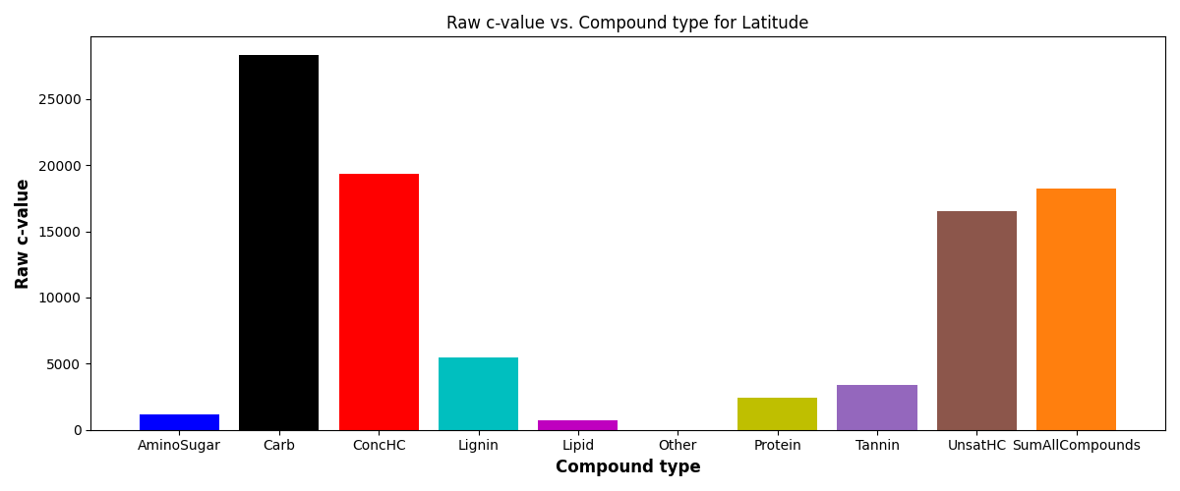
StreamStats bar plot
S = c*(ftr)^{z}
SE = scaling exponent or z-value

Slide 4
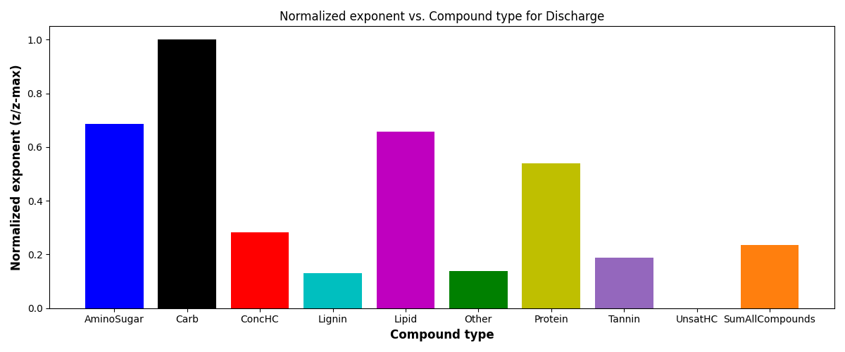
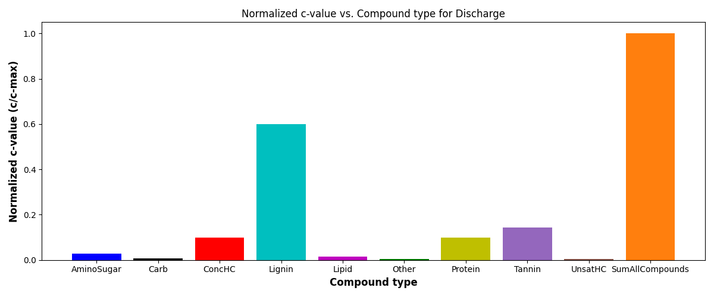
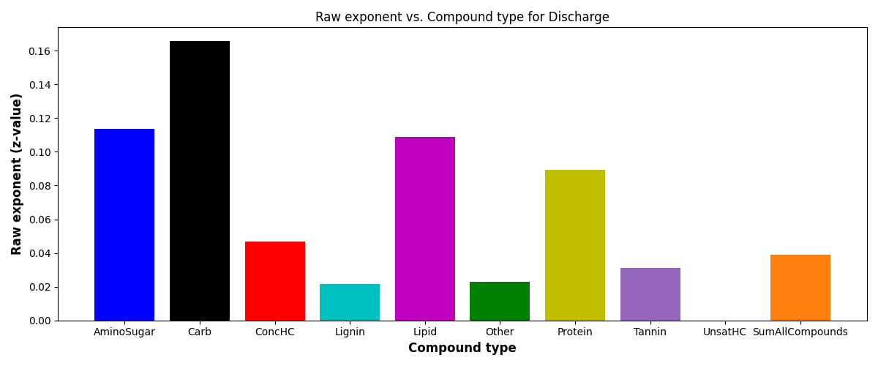
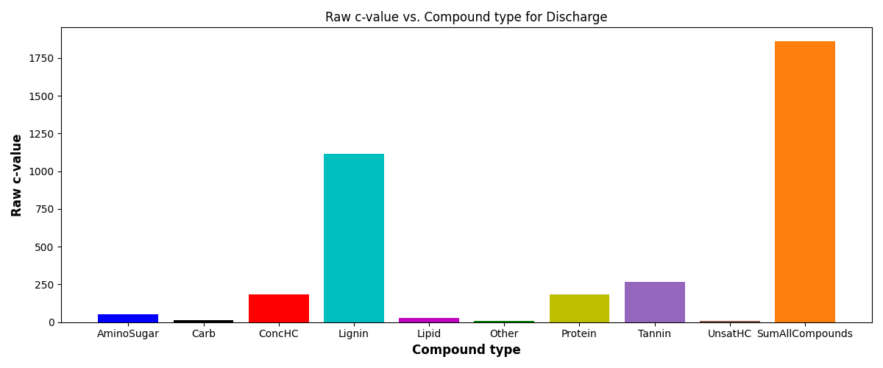
HydroSheds bar plot
S = c*(ftr)^{z}
SE = scaling exponent or z-value

Slide 5
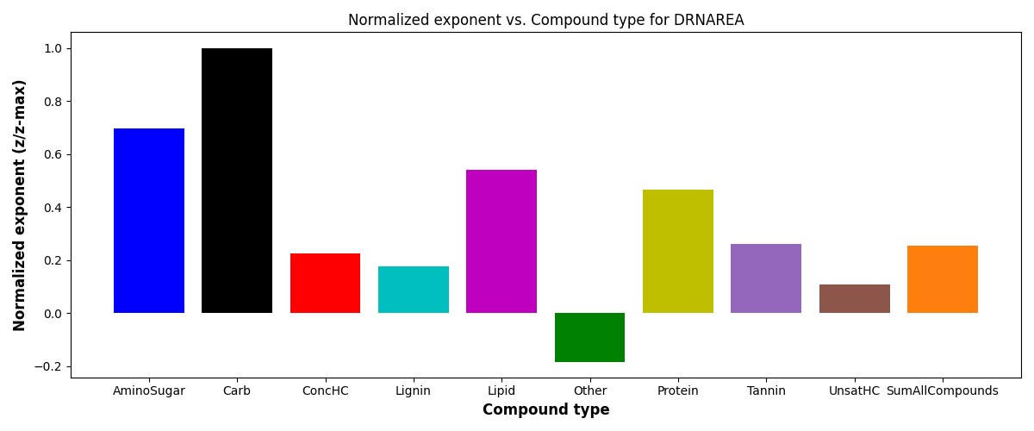

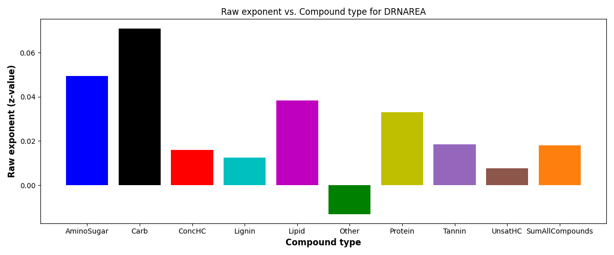

EPA-W-Watersheds bar plot
S = c*(ftr)^{z}
SE = scaling exponent or z-value

Slide 6
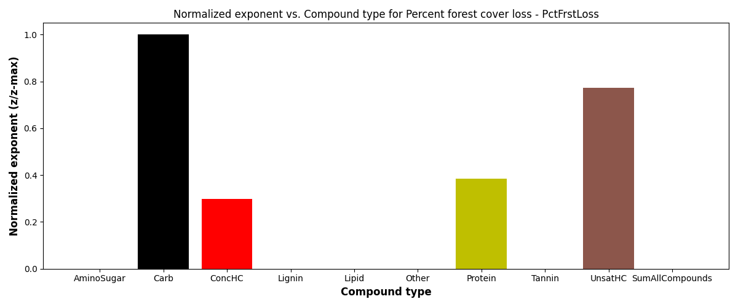
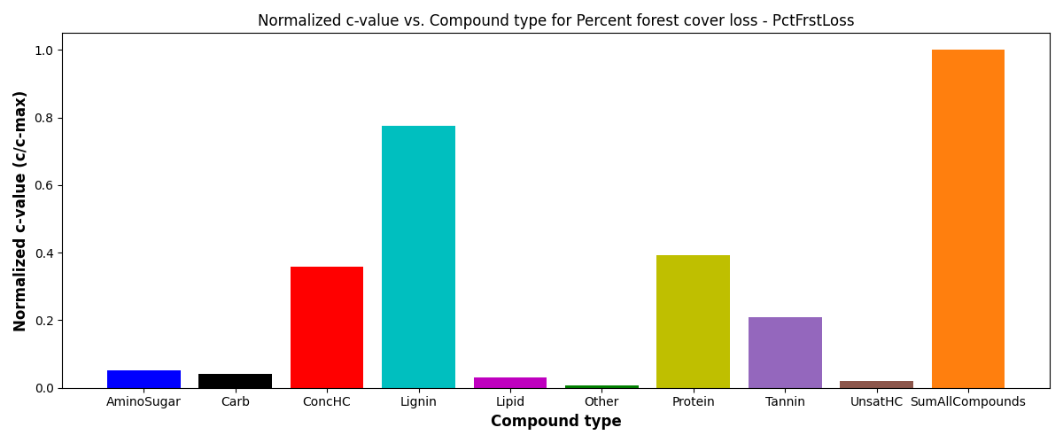

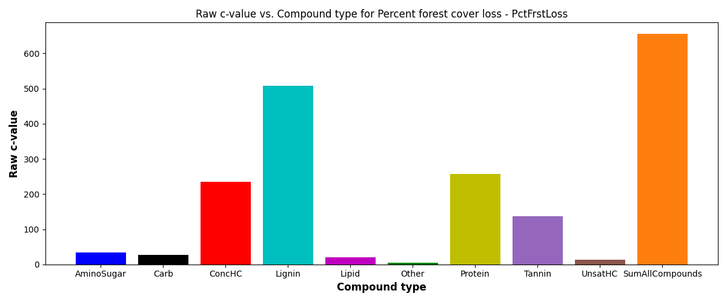
EPA-W-Catchment bar plot
S = c*(ftr)^{z}
SE = scaling exponent or z-value

Slide 7
Locations of all other Bar plots
Look for Bar_*.png plots in
WHONDRS
https://github.com/maruti-iitm/species_area_scaling/tree/main/v1/Plots_WHONDRS/Scaling_Laws/
StreamStats
https://github.com/maruti-iitm/species_area_scaling/tree/main/v1/Plots_StreamStats/Scaling_Laws
HydroSheds
https://github.com/maruti-iitm/species_area_scaling/tree/main/v1/Plots_HYDROSHEDS/Scaling_Laws
EPA-Waters-Watersheds
https://github.com/maruti-iitm/species_area_scaling/tree/main/v1/Plots_EPAWaters_ACW/Scaling_Laws
EPA-Waters-Catchment
https://github.com/maruti-iitm/species_area_scaling/tree/main/v1/Plots_EPAWaters_ACC/Scaling_Laws

